Slide 1
Bayesian Dynamic Modelling
Mike West
Duke University
ISBA Lecture on Bayesian Foundations June 25th 2012

Slide 2
Foundations : History of Dynamic Bayes in Action
Commercial forecasting, monitoring,
Socio-economics
P.J. Harrison
R.E. Kalman
~ 50 years ~
Engineering
Control systems
G.E.P. Box
H. Akaike
A. Zellner

Slide 3
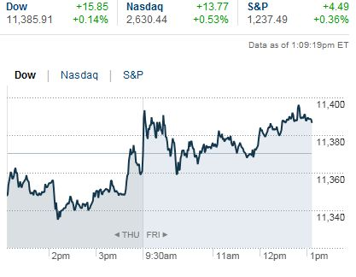
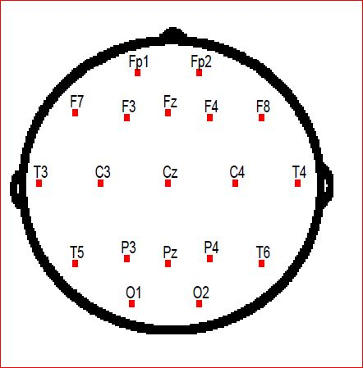
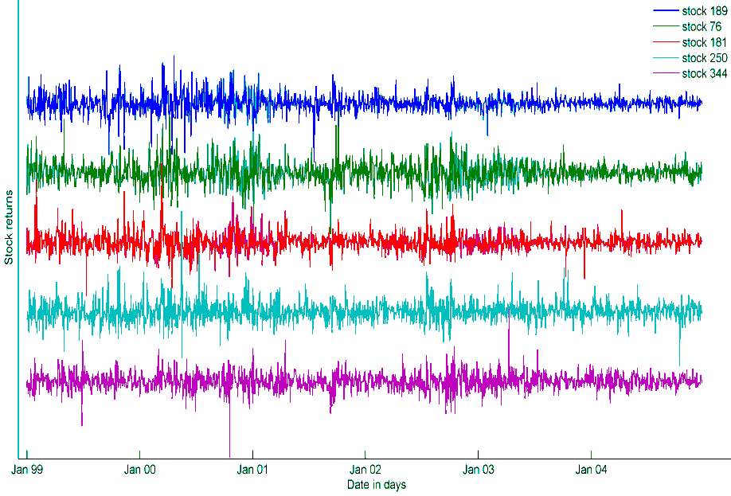
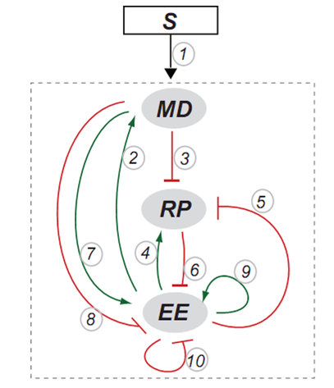
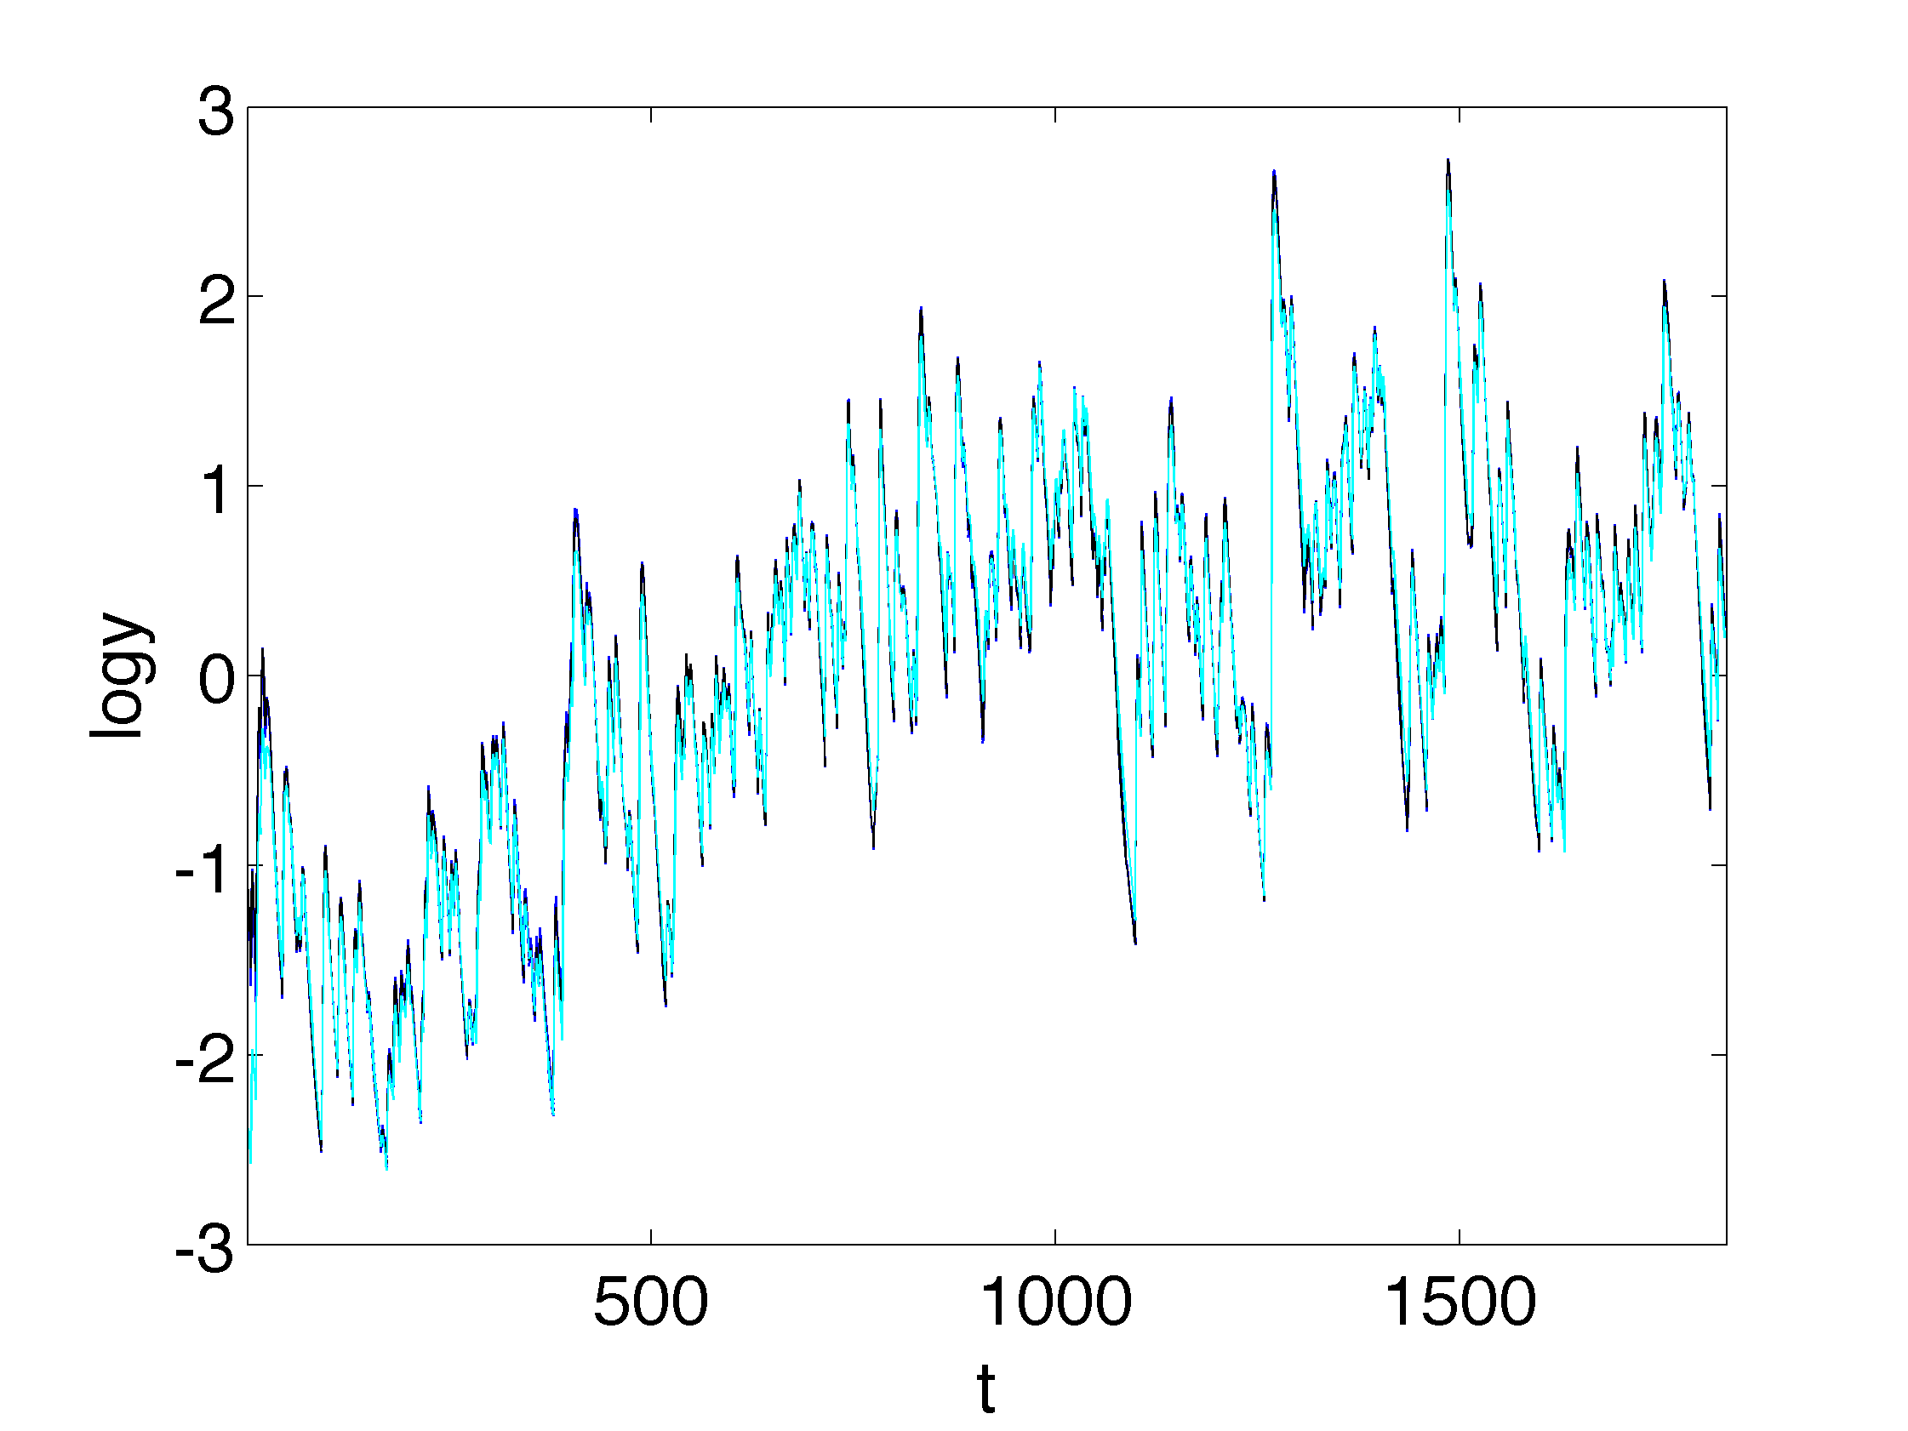
Dynamic Bayes in Action
Neuroscience,
Imaging, …
Business
Finance
Econometrics
Social systems
Finance - Portfolios
State Space
Dynamic Models
Bionetworks
Natural sciences & engineering
-
Computer modelling
Hydrology, Transportation, ….

Slide 4
Foundations : Time as a Covariate
Modelling and adapting to temporal changes
: “real” changes, hidden factors, model-mispecification :
: Attributing/partitioning variation :
Improved local model descriptions, forecasting

Slide 5
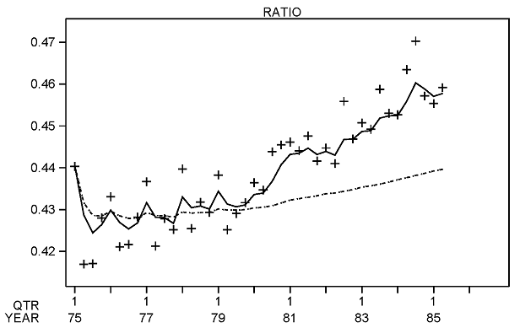
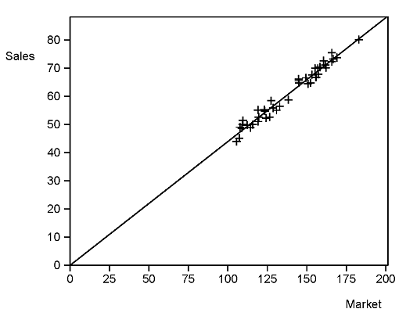
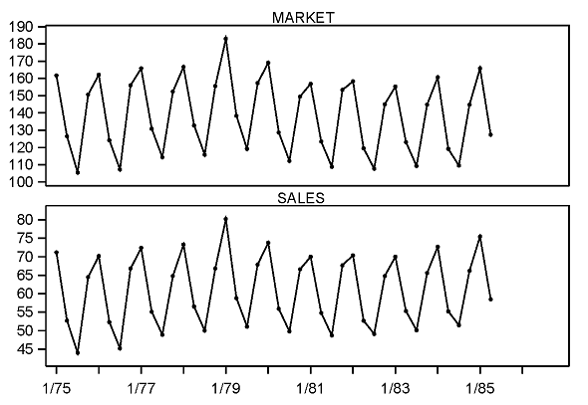
Example: Commercial Sales/Demand Tracking and Forecasting
Adaptation: - Relevant “local” inferences
- Partitions variation
- Improved short-term forecasts:
Accuracy and uncertainty

Slide 6
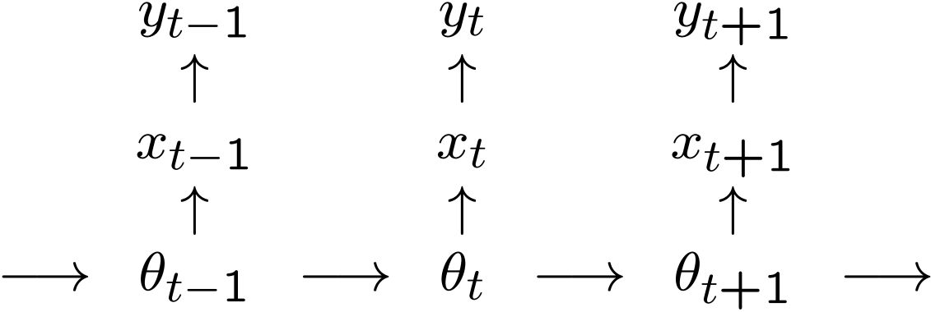
Foundations : Sequential Modelling
: model specification
: forecasting
: learning/updating
: control/intervention
Sequential
Dynamic (linear) state space models
Hidden Markov models

Slide 7
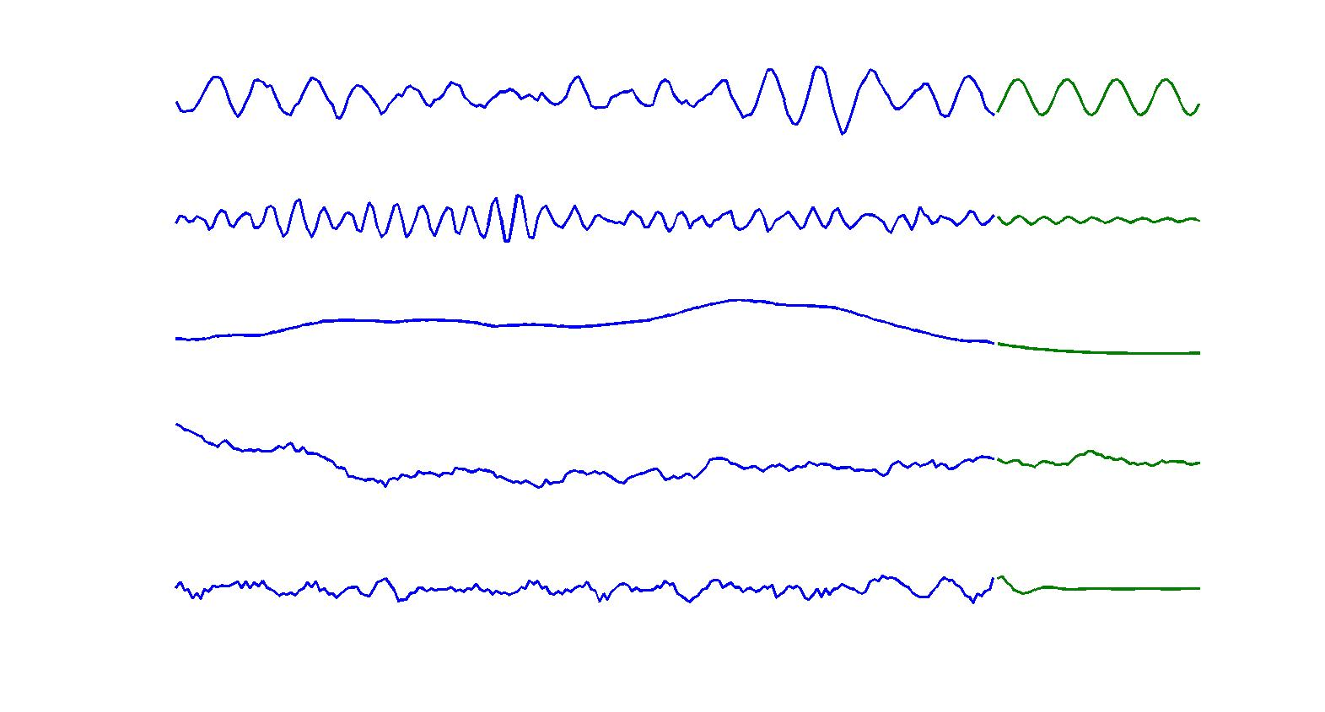
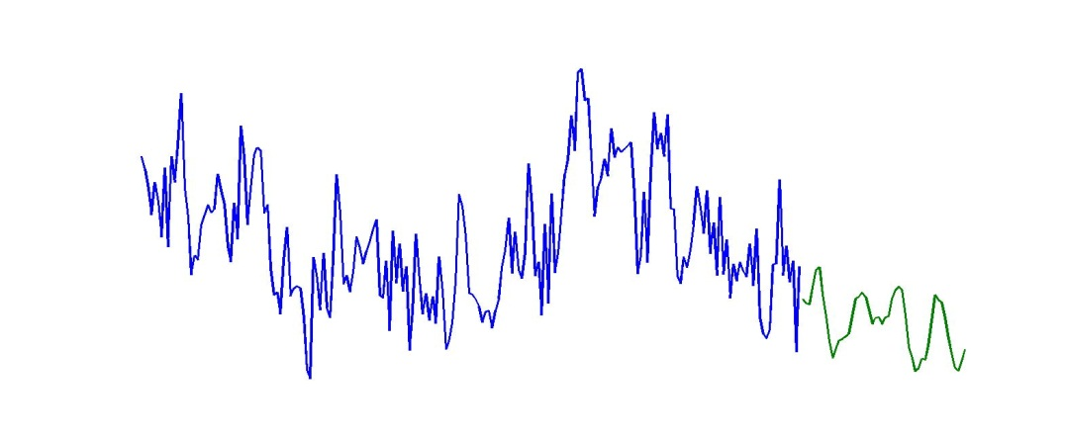
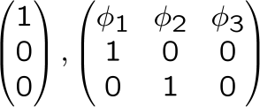
Foundations : Model Composition
e.g., commercial, socio-economics applications
c:
1 Seasonals
2 Damped seasonals
3 Local trends
4 Dynamic regressions
5 Time series: AR(p)

Slide 8
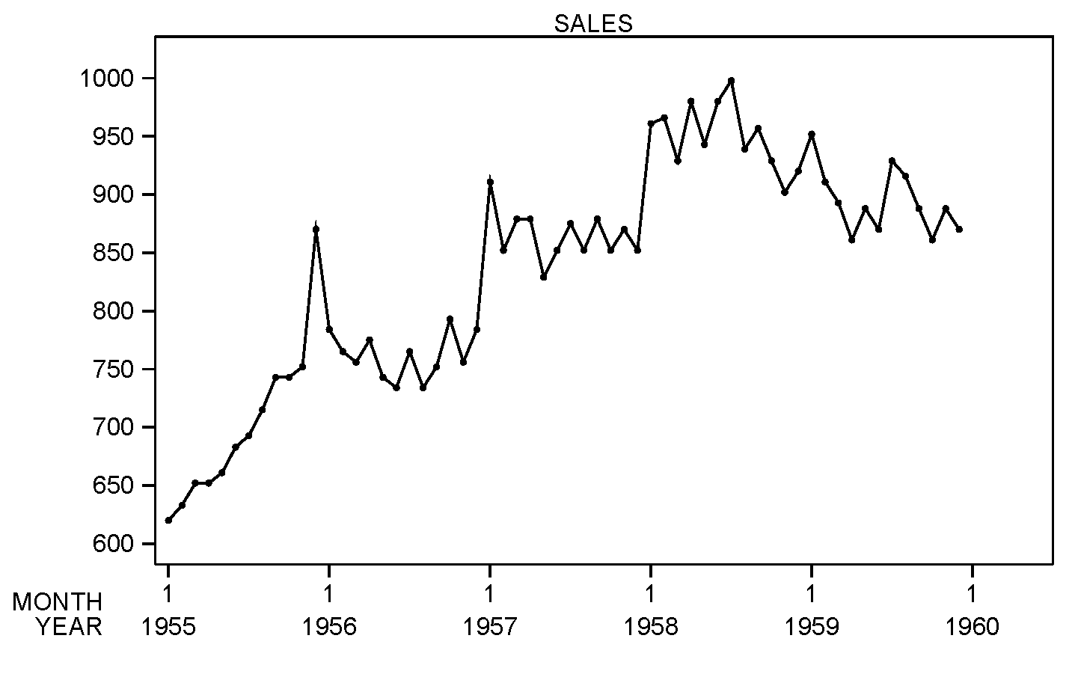
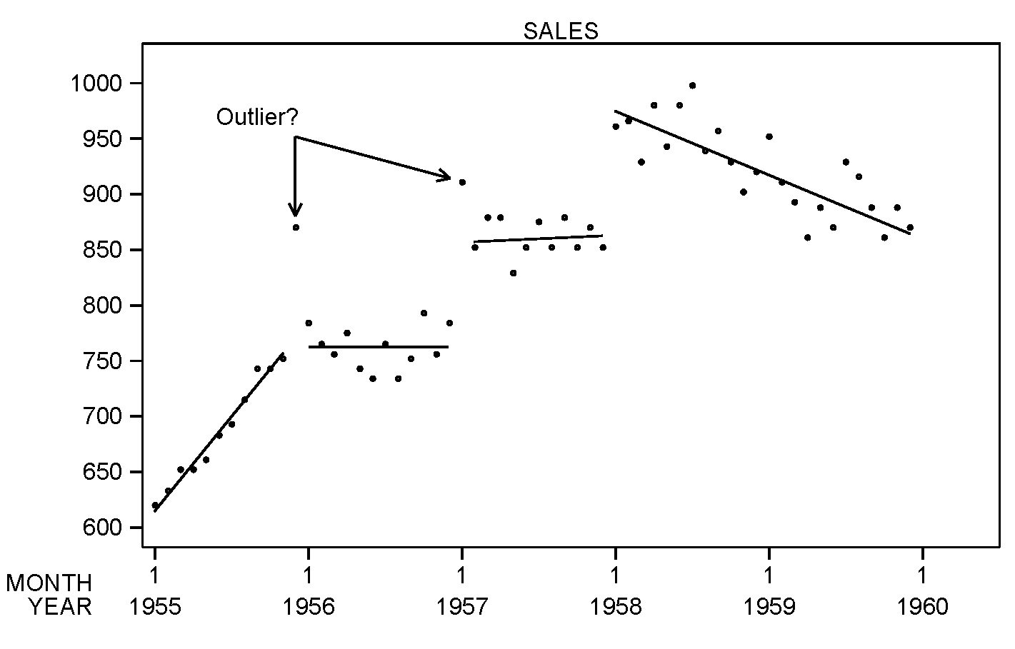
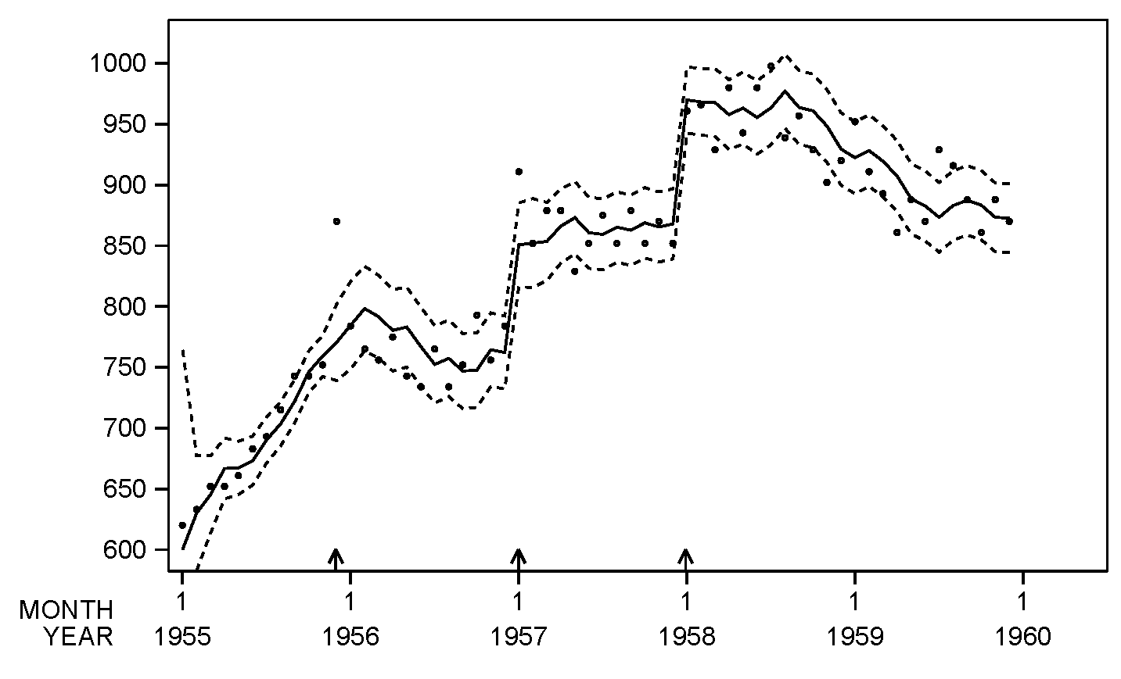
Commercial & Socio-Economic Applications: Priors, Interventions
Active sequential (real, live) modelling: Intervention
Intervention information as part of model theory
Partitioning variation: Component-wise intervention
Feed-forward and/or Feed-back
Model expansion/contraction as intervention

Slide 9
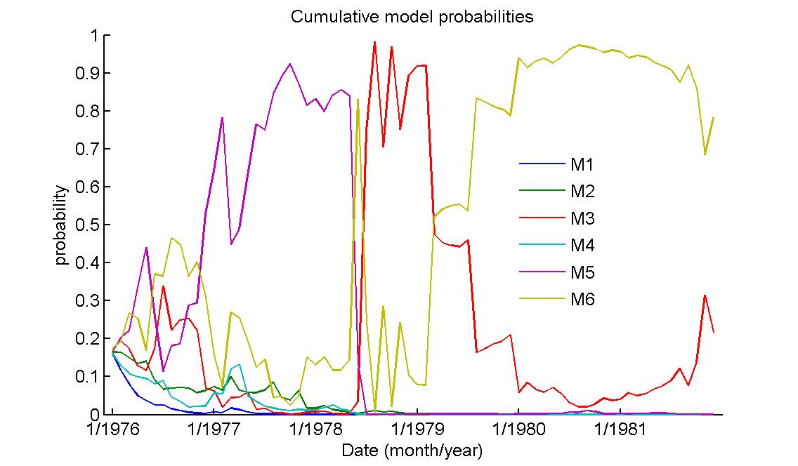
Foundations : Sequential Model Monitoring, Comparison & Mixing
1-step ahead focus: predictive density
Realised forecast error cf. forecast uncertainty
: Bayesian model averaging :
born in commercial use of
“multi-process” DLMs
- mid-1960s -
Model set:

Slide 10
Foundations: Dynamic Model Switching & Mixing
Anything can happen : Multi-process models
Gaussian mixture : outliers
Gaussian mixture : change-points, regime switching
: Computation :
“Explosion of mixtures”
Historical analytics - mid 1960s -
Modern simulation-based methods

Slide 11
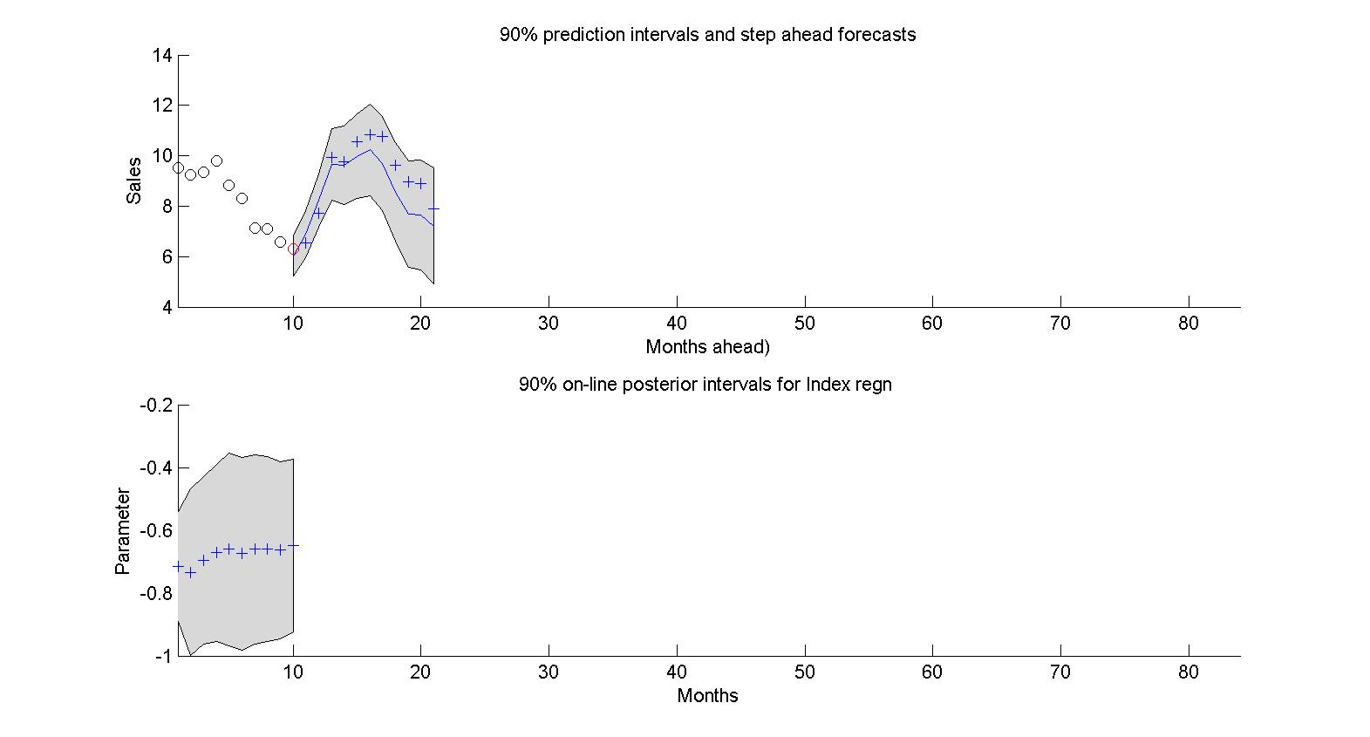
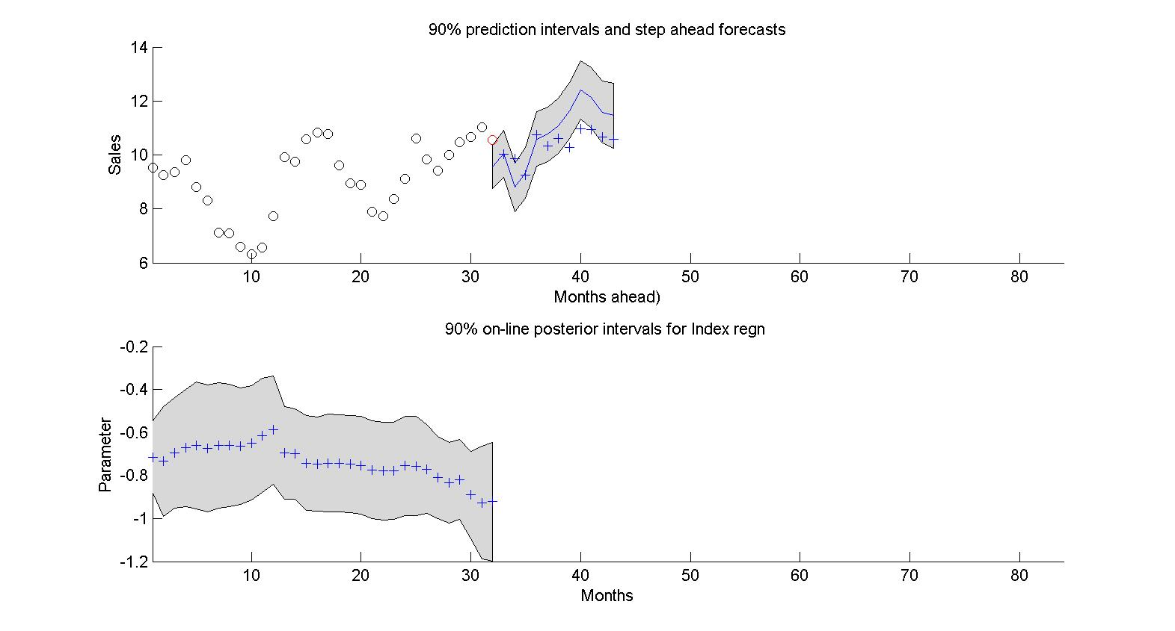
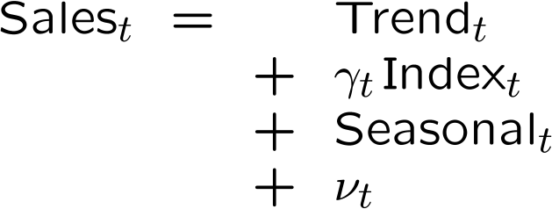
Sequential Forecasting, Learning, Adaptation
Learning - Open to constructive feed-forward intervention, and monitoring/feed-back intervention
Sequential forecasting - : What might happen?
: Model assessment, evaluation

Slide 12
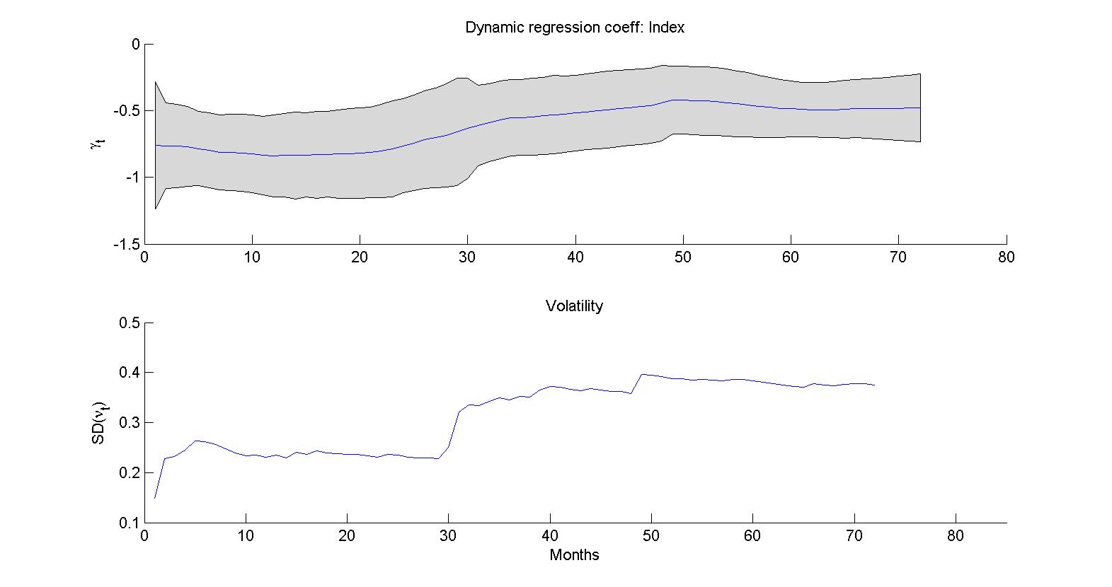
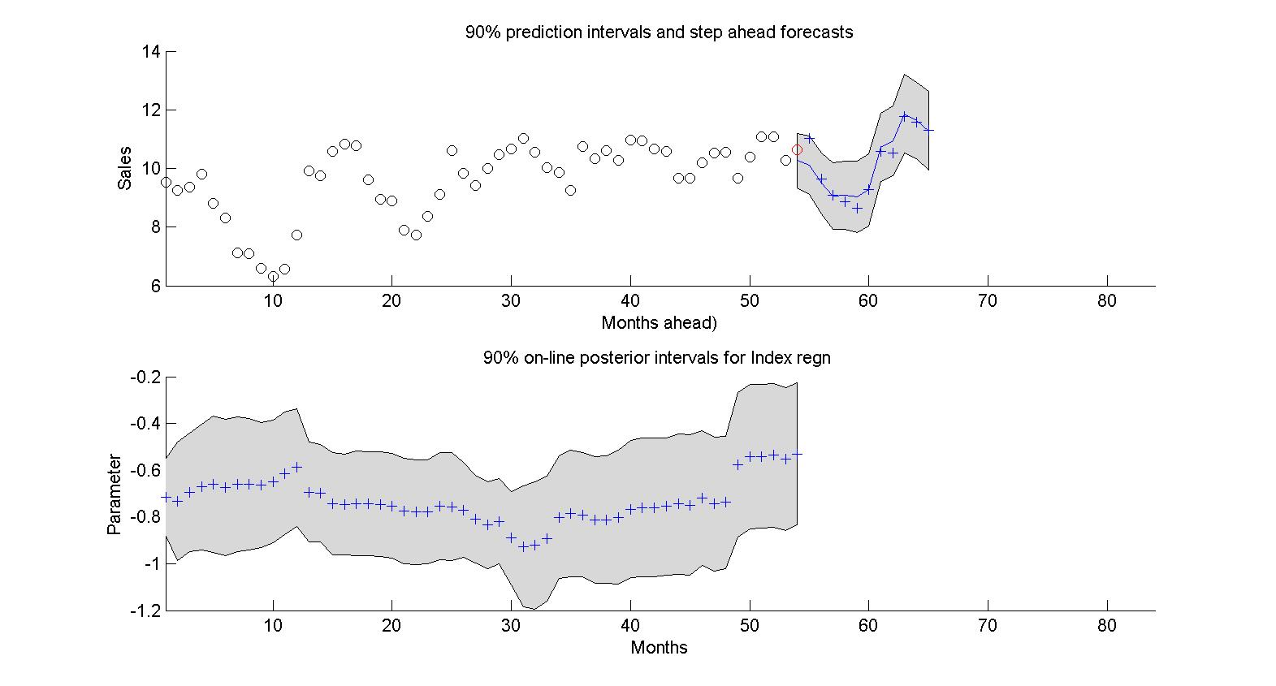
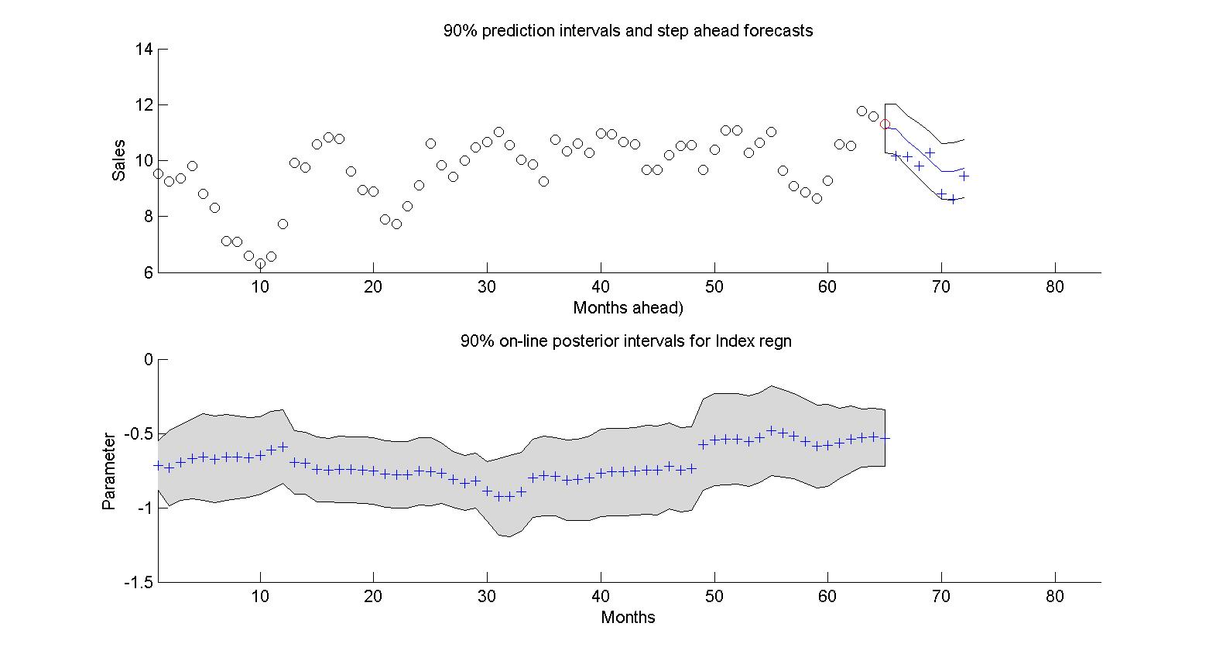
Sequential Forecasting, Learning, Adaptation
Learning - Attribution of change: Model components
Retrospection - : Time series “analysis”
: What happened?
: Model assessment, evaluation

Slide 13
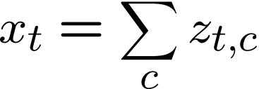
Foundations : Model Decomposition and Time Series Analysis
Constant F, G
϶ All (linear) time series models
϶ AR, ARMA models
Eigentheory of stochastic difference equations:
: Polynomial trends, seasonals, and/or:
: AR(1)
: ARMA(2,1) – quasi-cyclicals
- fixed wavelength
- time-varying amplitude, phase

Slide 14
Foundations : Model Decomposition and Time Series Analysis
General
Non-stationary models
“Locally” stationary
Time-Varying AR, ARMA models
: Time-Varying AR(1)
: Time-Varying ARMA(2,1)
- time-varying wavelength
- time-varying amplitude, phase

Slide 15
Example: Autoregessive Dynamic Linear Model
AR(d): full model or a component
Latent component structure:
Composition of several “simpler” process …
- short-term correlated
- quasi-cyclicals

Slide 16
Example: TVAR – Time-Varying Autoregessive Dynamic Linear Model
TVAR(d): full model or a component
Composition of several “simpler” process …
- short-term correlations: time-varying dependencies
- quasi-cyclicals: time-varying wavelengths (freqencies)
“Local” modelling: Time-frequency analysis & decomposition

Slide 17
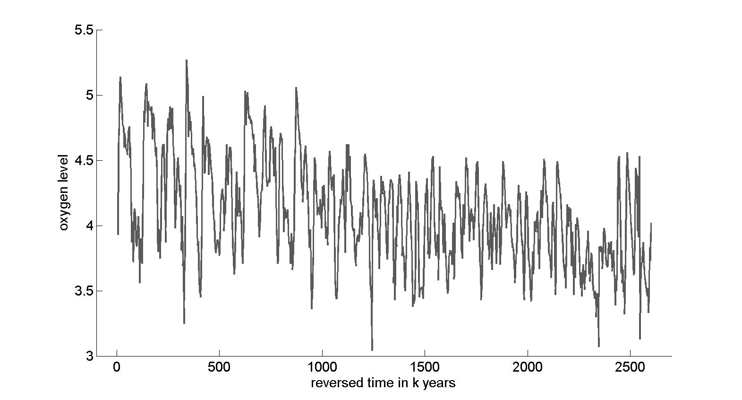
Applications in Natural Sciences and Engineering
: Exploratory discovery latent structure
: Hidden, variable quasi-periodicities
: Variation at different time scales
: Time-frequency structure
Palӕoclimatology: data
Ice cores - relative abundance of oxygen isotopes over time
Global temperature proxy
``Well known'' periodicities: earth orbital dynamics

Slide 18
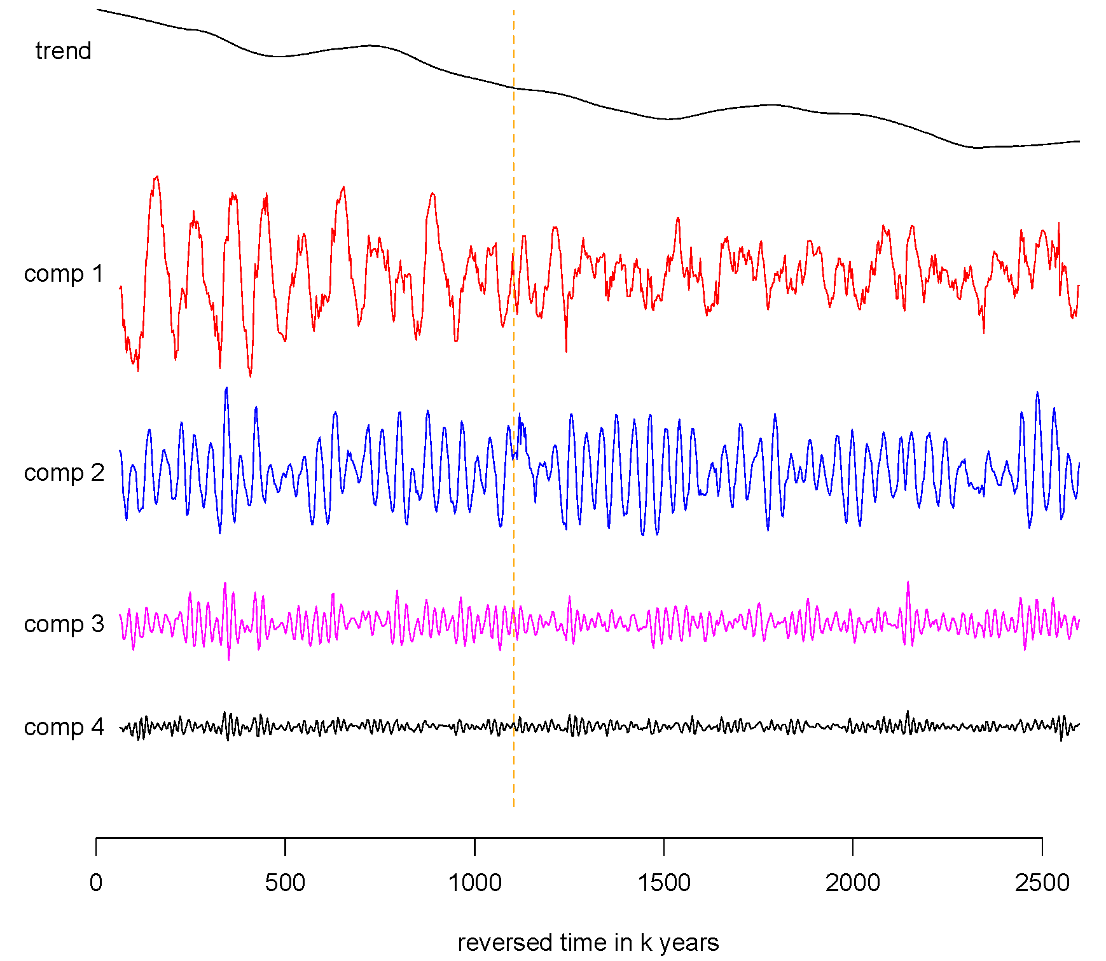
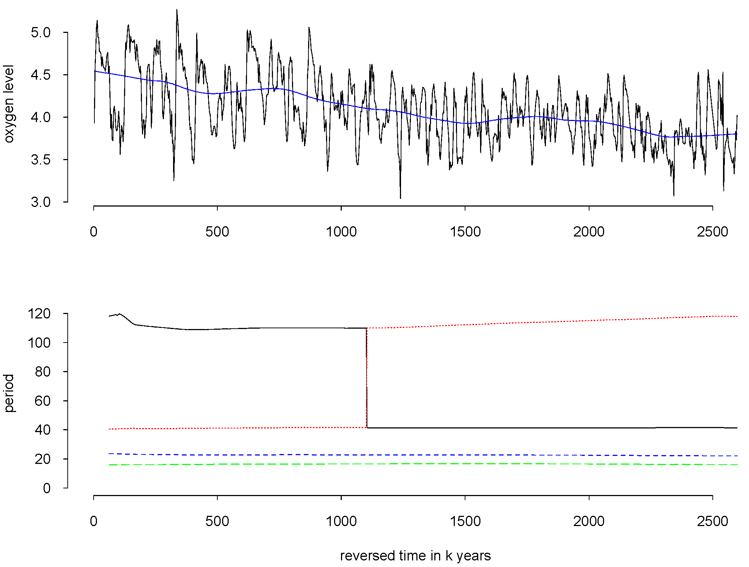
Example: Palӕoclimatology
Estimated components
Time-varying wavelengths of components
- Changes in orbital dynamic cycles
- Amplitude dominance “switch”
: structural climate change @1.1m yrs?

Slide 19
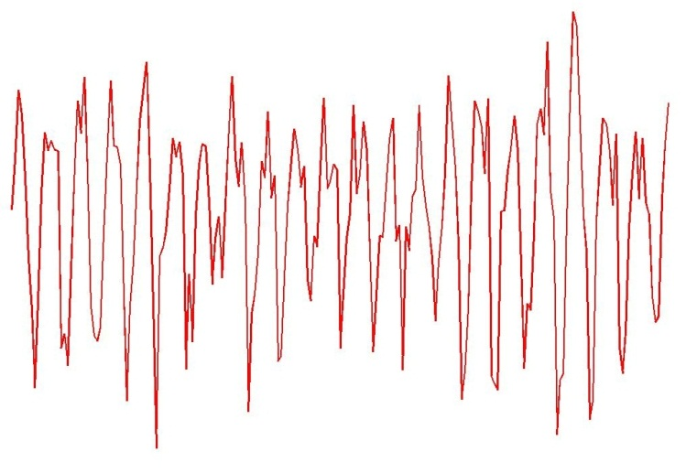
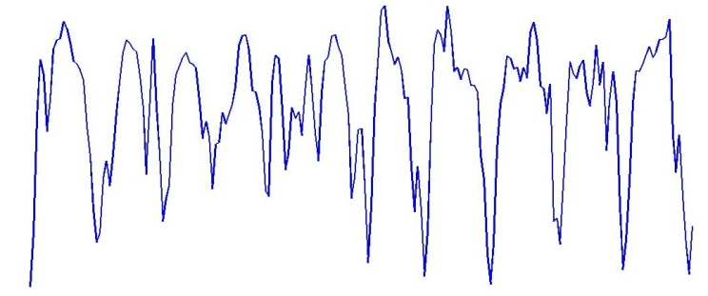
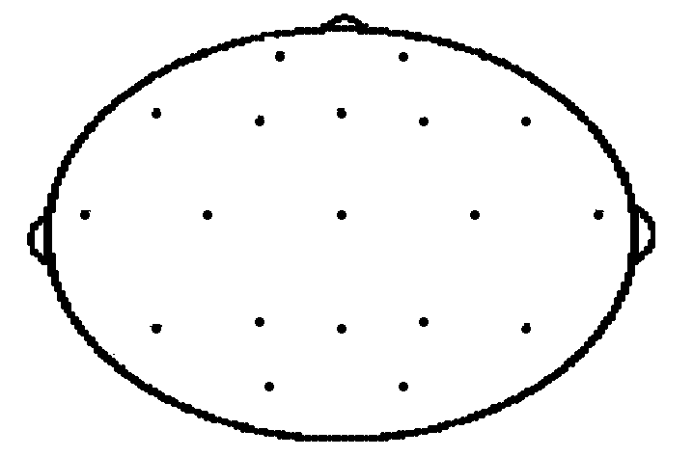
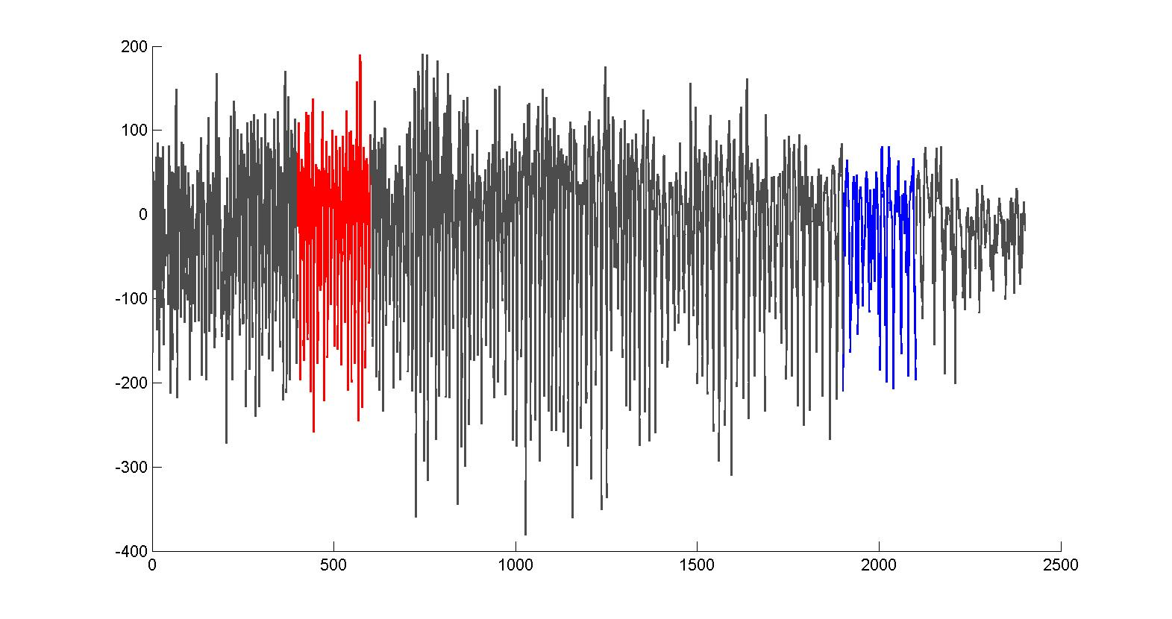
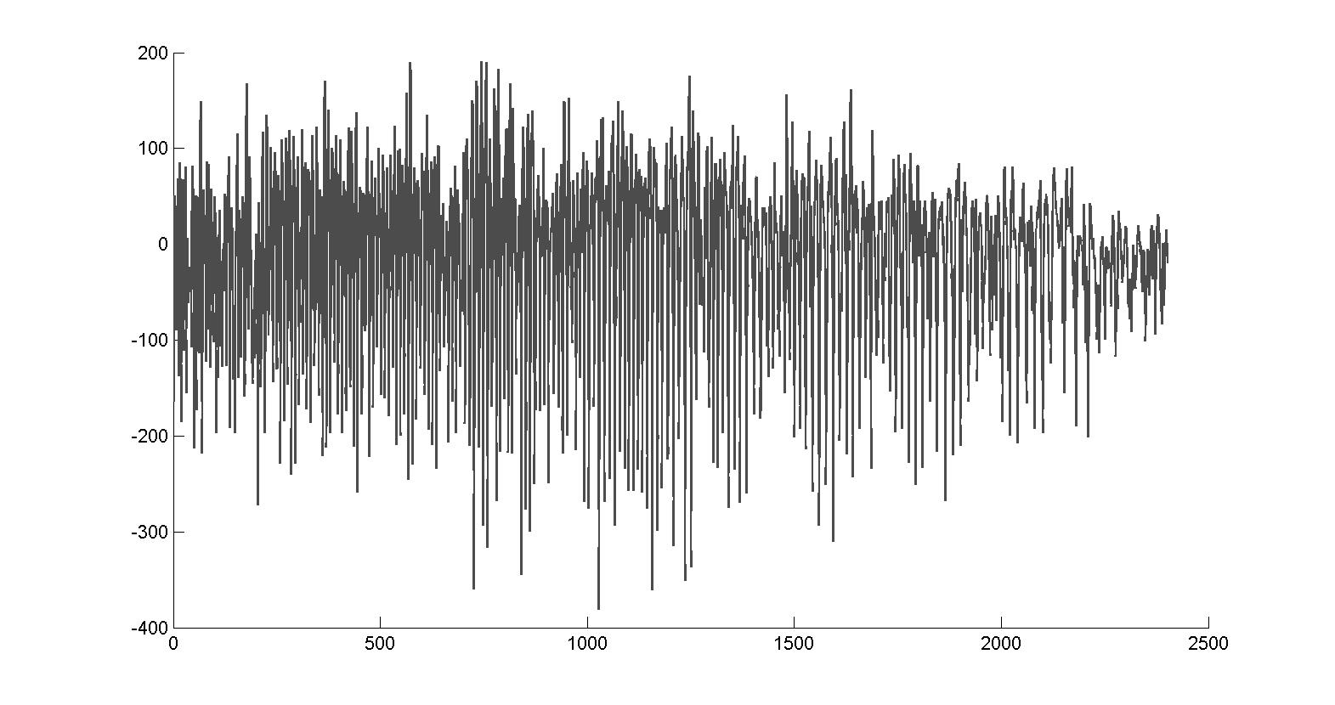
Example: EEG in Experimental Neuroscience
Why TVAR?

Slide 20
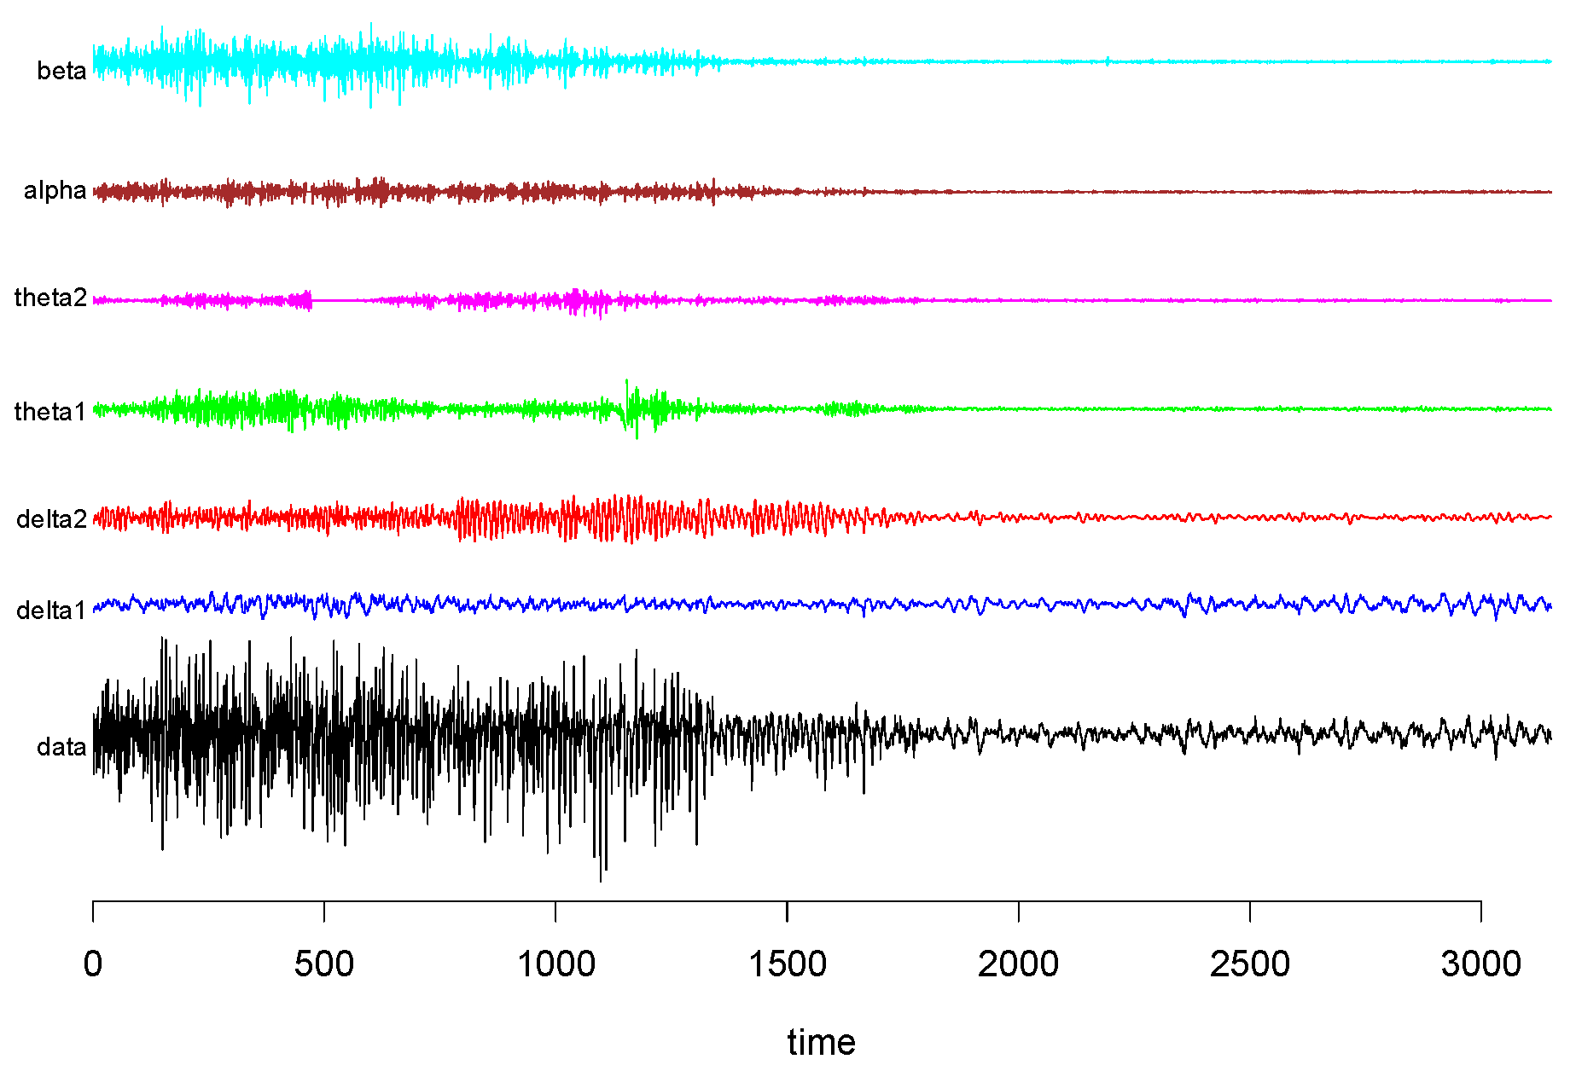
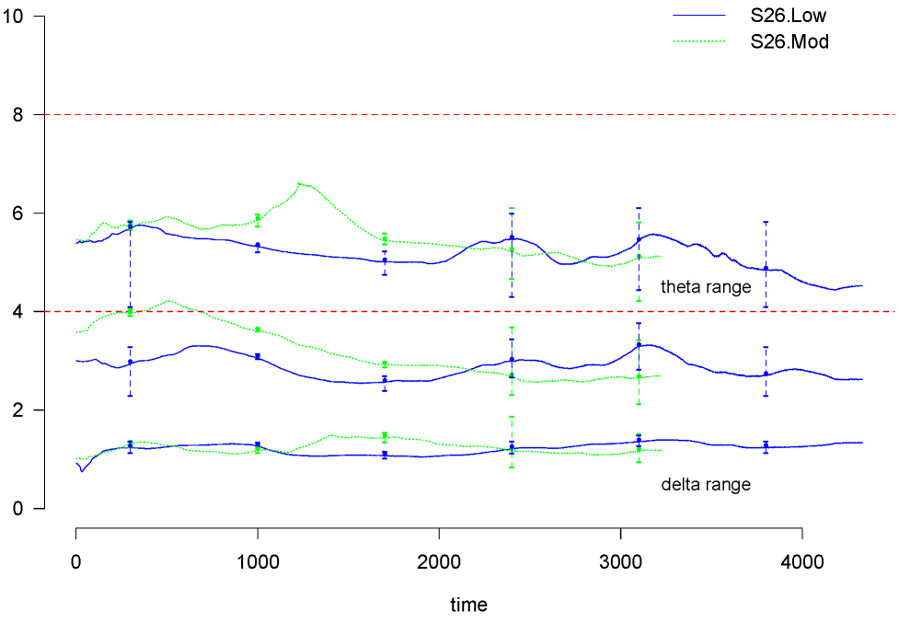
Example: EEG in Experimental Neuroscience
Some components are “brain waves”
S26.Low treatment
Treatment effects on brain seizures:
Changes in amplitudes, wavelengths brain waves
S26.Low cf S26.Mod treatments

Slide 21
Bayesian Dynamic Modelling : Multiple Time Series
Neuroscience,
Imaging, …
Business
Finance
Econometrics
Social systems
Finance - Portfolios
State Space
Dynamic Models
Bionetworks
Natural sciences & engineering
-
Computer modelling
Hydrology, Transportation, ….

Slide 22
Foundations : Time-Varying Vector Autoregressive Model
q-vector dynamic process: TV-VAR(d)
- as complete model
- or as a latent component
Multiple, latent quasi-cyclical structures
- time-varying impact on output “channels”
- dynamic network
- dynamic lagged interconnections

Slide 23
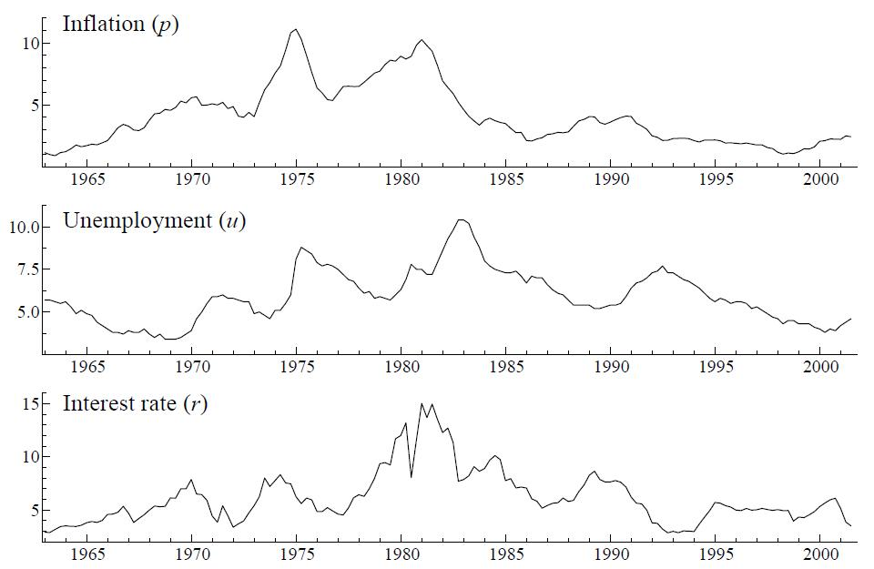
Examples of TV-VAR
Macroeconomics, finance
Causal interest, lagged effects
Dynamic models of volatility
Hydrology, Transportation, ….
Spatial correlations
Network structure, computer modelling

Slide 24
Foundations : Dynamic Volatility and Latent Factor Models
Business
Finance
Econometrics
Social systems
Finance - Portfolios
Cross-series (residual) structure:
- Time-varying dependencies
- Influences of latent stochastic factors
Econometric: macro-
Hierarchical dynamic regressions
Futures markets, exchange rates
Sequential portfolio decisions
Demographic studies, institutional assessment
Non-Gaussian/e.g. multinomial time series

Slide 25
Foundations : Partitioning/Attributing Variation
Latent factor models
- Bayesian models of “dynamic PCA”
- Dynamics: time series models for elements
Dynamic inverse Wishart processes (>25 years)
- “Random walks” for variance matrices

Slide 26
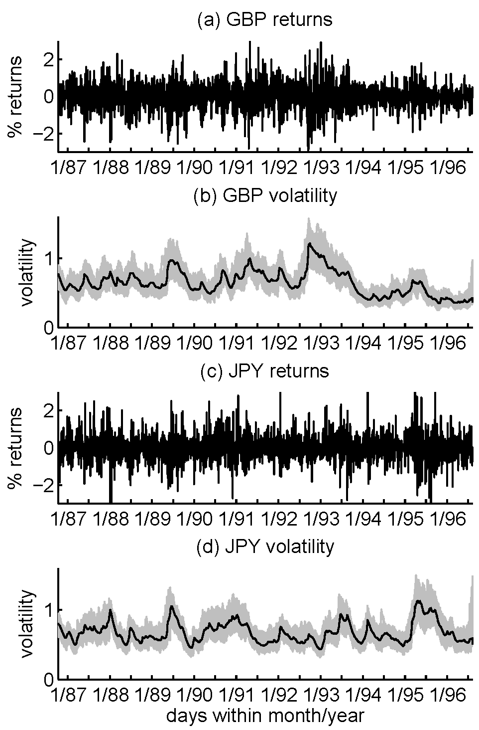
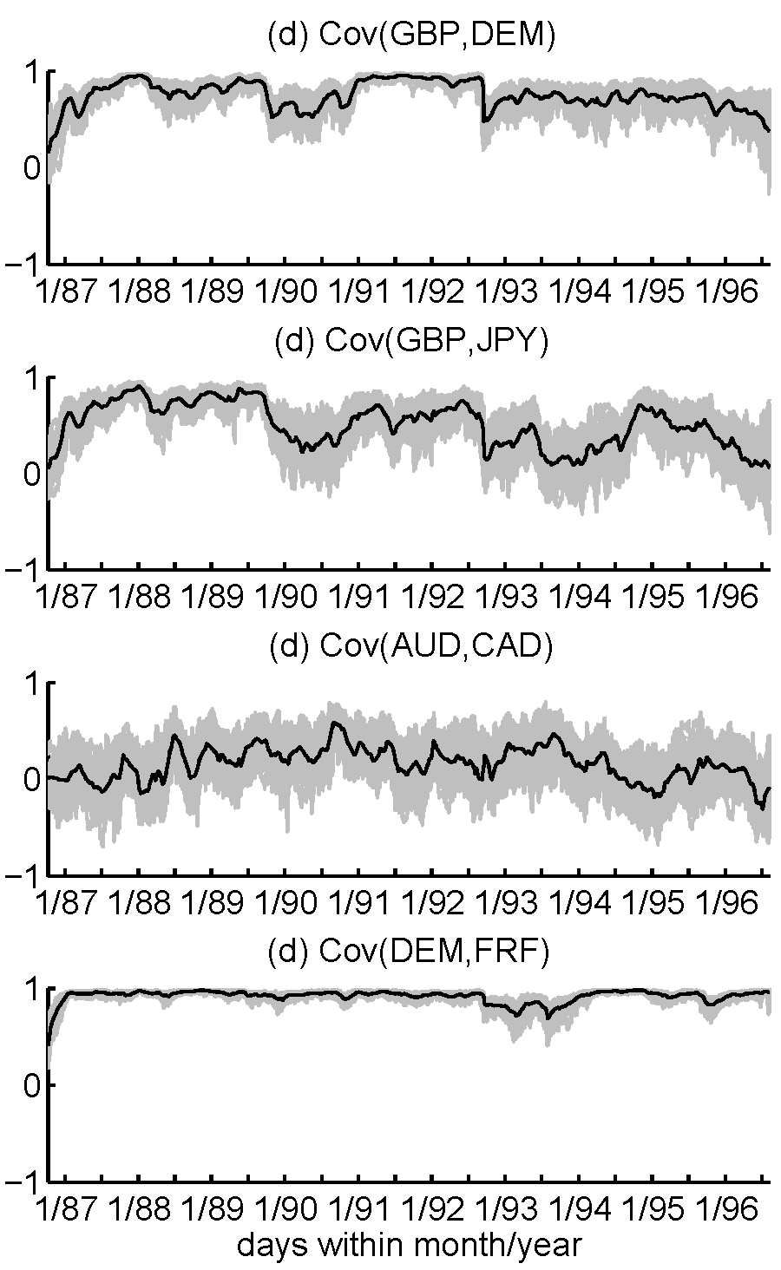
Example: Multivariate Financial Time Series - Daily FX: Volatility

Slide 27
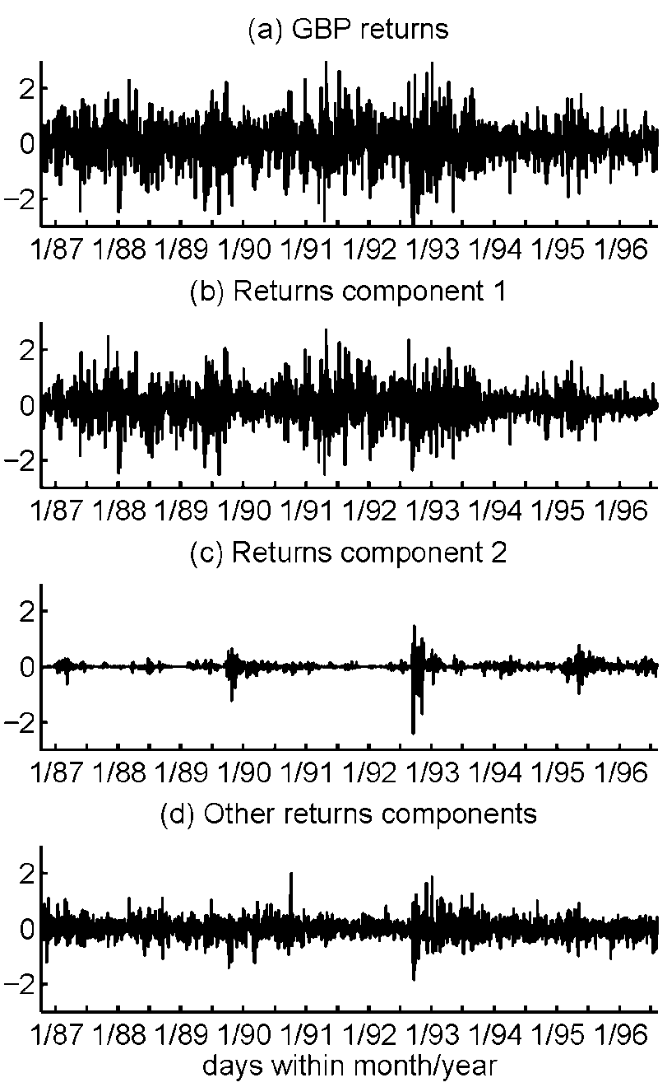
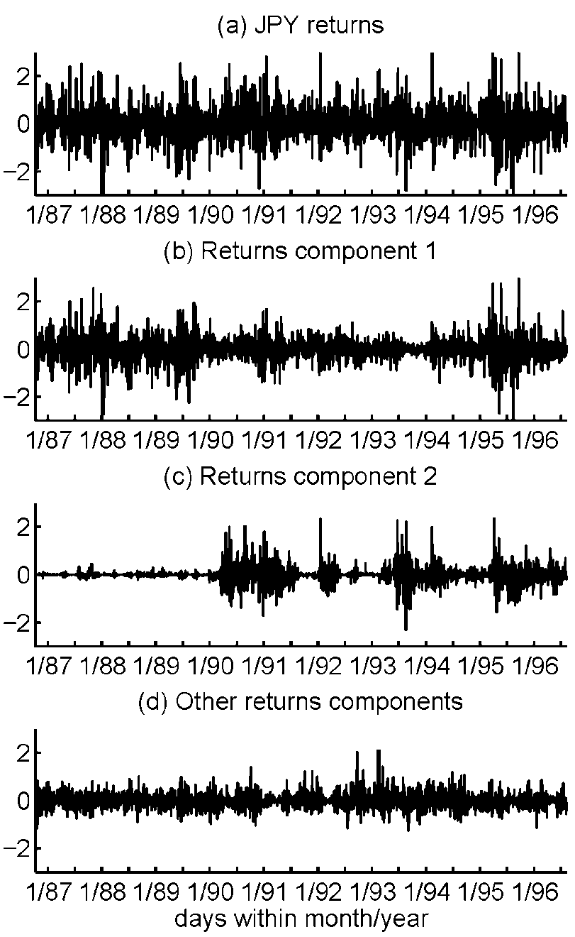
Example: Dynamic Factors in FX

Slide 28
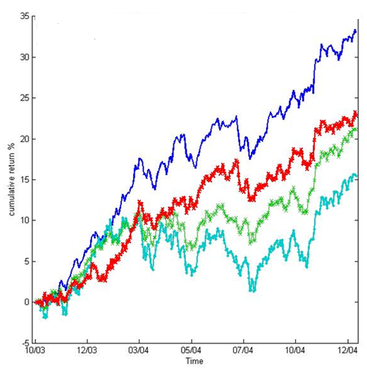
Foundations : Sequential Learning, Forecasting and Decisions
Sequential portfolio revisions:
Asset allocation
- based on step-ahead predictions
- hugely influenced by tracking/short-term prediction of volatility dynamics
- relevant partitioning/attributing variation
- volatility components/factors:
interpretation, open to intervention
¥ returns
Multiple implementations :
managing risk, making money ~ 20years

Slide 29
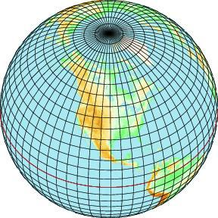
Fast Forward to 2007-2012: Some Recent and Current Foci
Dimension
Structure
Sparsity
Inputs:
Computer model
Spatial, structured covariances
Sparse/graphical
spatial model structure
Example: Atmospheric chemistry
- Hi-res satellite data - atmospheric CO
- Large scale lattice data: dim ~ 1000s
- Weekly, daily time series

Slide 30
Foundations : Sparsity in Higher-Dimensional Dynamic Models
local level/random walk
dynamic regression
TV-VAR(p)
dynamic vector latent factor
TV-VAR(s)
IID, or TV-VAR(d)
dynamic volatility model

Slide 31
Foundations : Sparsity in Higher-Dimensional Dynamic Models
Sparsity
Many zeros
TV-VAR(s)

Slide 32
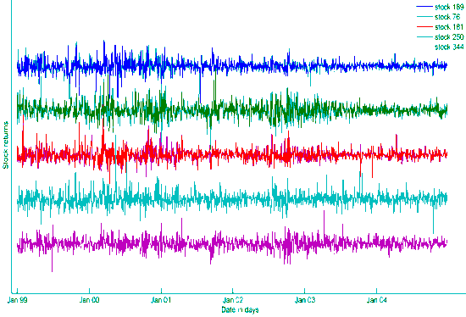
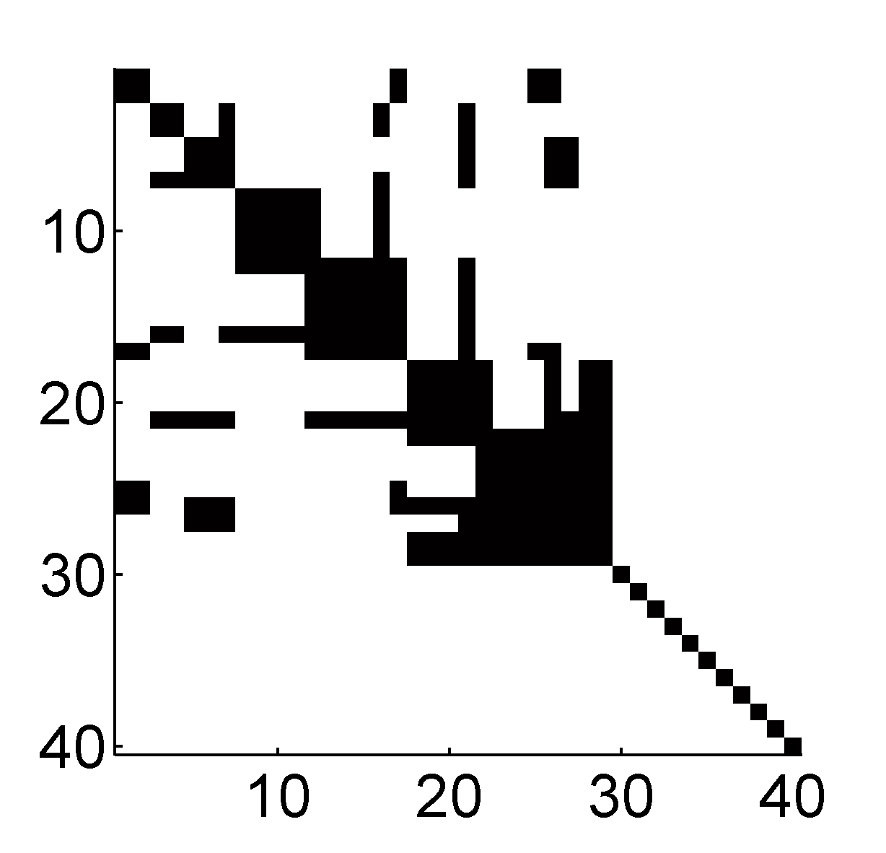
Dynamic Graphical Modelling for Volatility Matrices
Dim ~ 100s-1000s
Sparsity for structure, scale-up:
Zeros in off-diagonals of .
Dynamic hyper-inverse Wishart models
Precision matrix pattern of zeros :
chosen graph
Large scale graphical model search:
Explore graphs – parallel computation
Bayesian model mixing & averaging

Slide 33
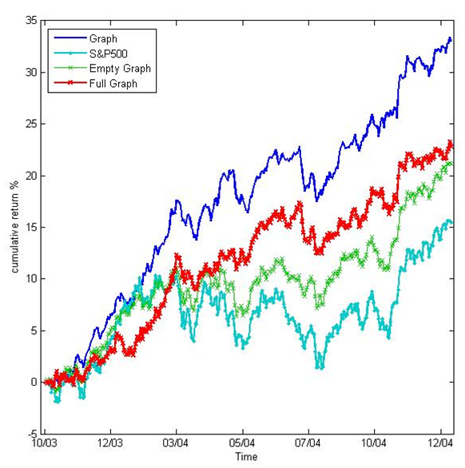
Foundations: Prediction and Decisions
S&P: 346 stocks
Sparse models -
: high posterior probability
: lower estimation uncertainties
: lower prediction uncertainties
: higher portfolio returns
: less volatile portfolios
: less risky portfolios
- better Bayesian decisions

Slide 34
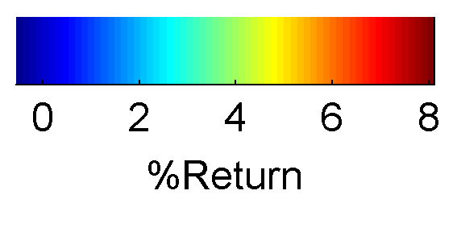
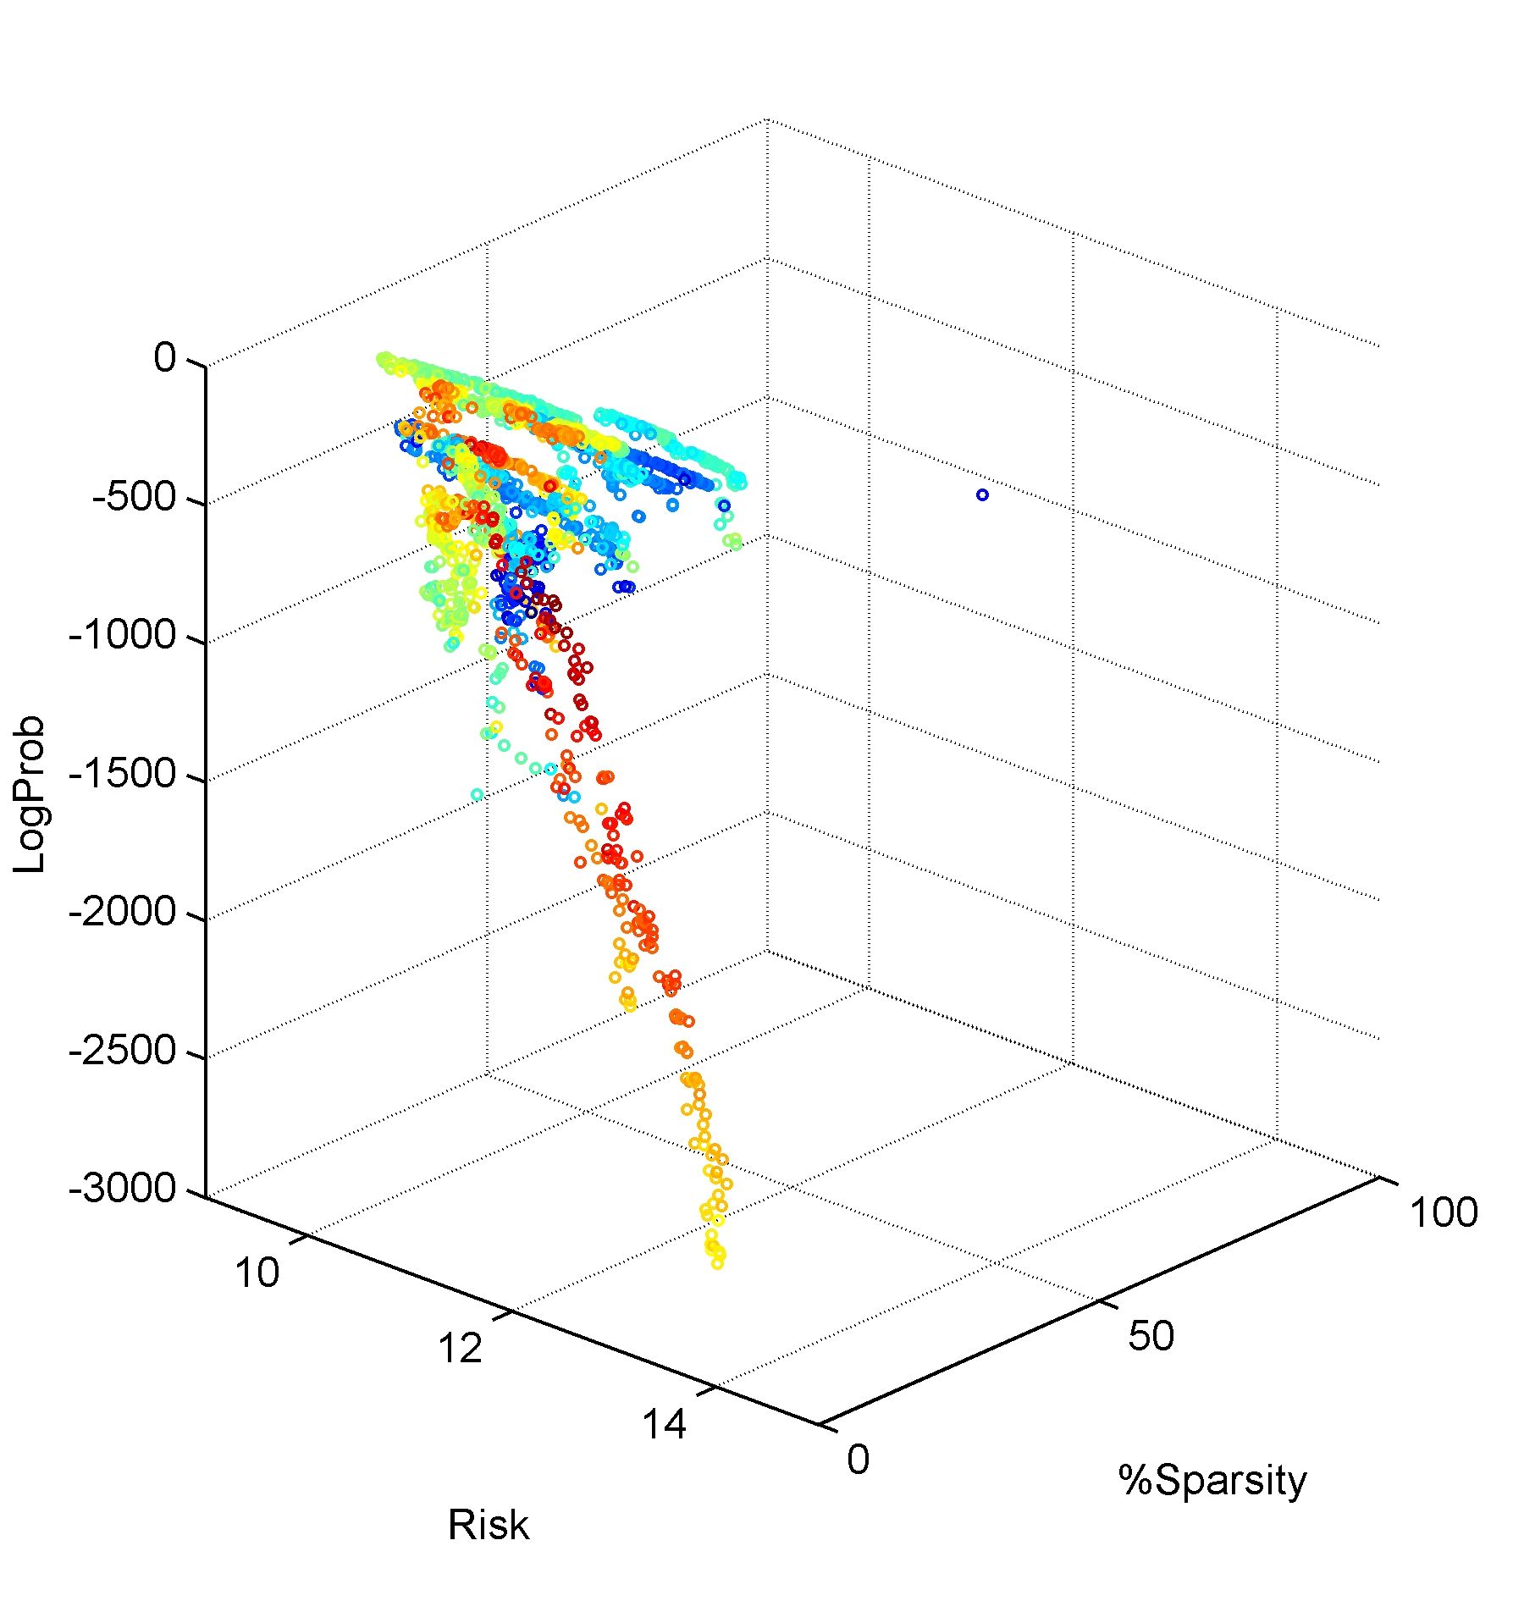
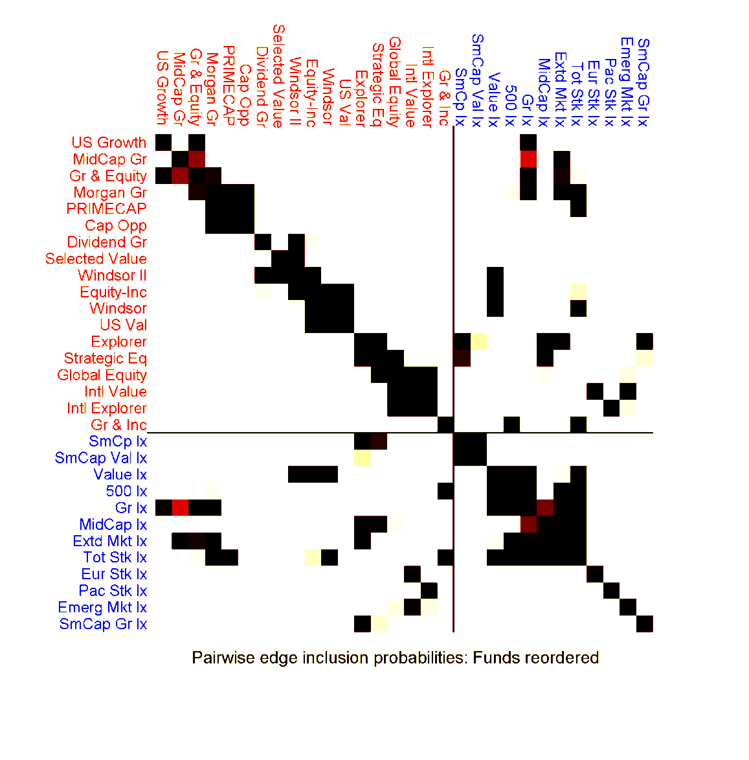
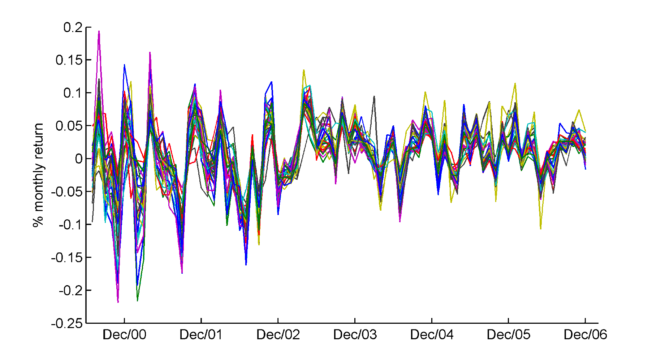
Foundations: Prediction and Decisions
30 mutual funds: in 4 metrics
Full graph

Slide 35
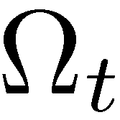
Bayesian Dynamic Modelling : Topical Issues
Time variation
in sparsity patterns?
Dynamic sparsity/parsimony
&/or
“dynamic variable selection”

Slide 36
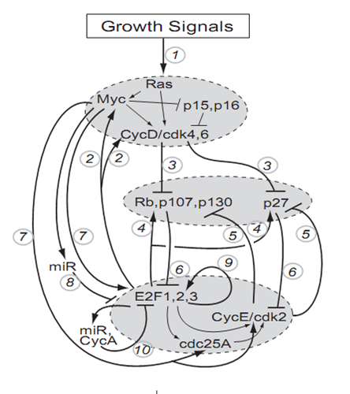
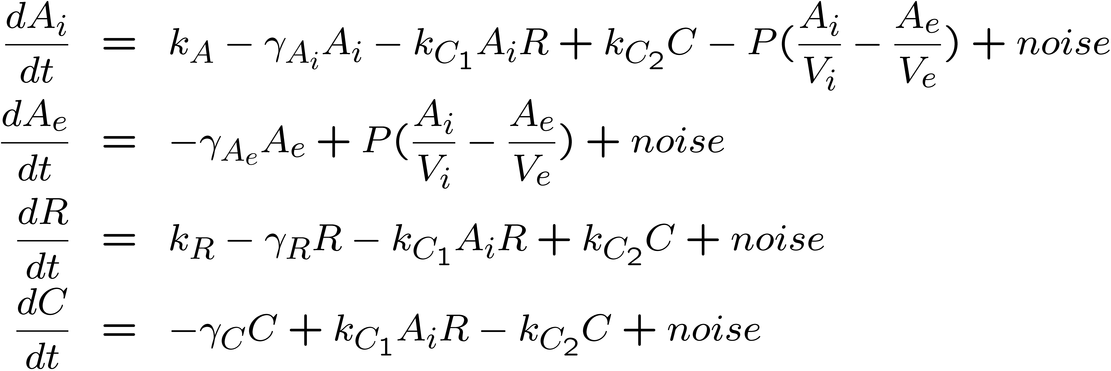
Dynamic Bionetwork Modelling : More Topical Issues
Dynamic cellular networks
Mechanistic stochastic nonlinear models
mic cellular networks
Latent states : Missing data
Dynamic imaging
Cell tracking

Slide 37
Foundations & Issues : Computation in Bayesian Dynamic Modelling
Simulation:
forecasting = synthetic futures
Major challenges
: simulation of long series of
latent states
: dimension
Major challenges
: dimension
20+ years of MCMC
: forward filtering, backward sampling for state space models
20+ years of SMC
: particle filtering, learning
: ABC

Slide 38
Bayesian Dynamic Modelling
Bayesian Dynamic Modelling, 2012
Bayesian Inference and Markov Chain Monte Carlo: In Honour of Adrian Smith
Clarendon: Oxford
Mike West
Duke University
ISBA Lecture on Bayesian Foundations ISBA World Meeting June 25th 2012, Kyoto

Slide 39
Some Dynamic Bayesians @ Kyoto ISBA 2012
Jouchi Nakajima
: Dynamic sparsity
Ryo Yoshida
: Sparsity in dynamic networks
& ±35 more ….
& >30 others …
Ioanna Manolopoulou
: Spatio-dynamics/bio-cell tracking
Fernando Bonassi
: ABC/SMC in dynamic models
Raquel Prado
: Multivariate dynamic hierarchies
Notes:
Jon Stroud : Spatio-dynamics

