Slide 1
Unit 8: Final Review
1. Final Exam Review
Sta 101 - Spring 2019
Duke University, Department of Statistical Science
Dr. Ellison
Slides posted at https://www2.stat.duke.edu/courses/Spring19/sta101.001/

Slide 2
Outline
1. Housekeeping
2. Review

Slide 3
Coming up…
--------------------------------------------------------------------------------
▶ Don’t forget to ask/answer 2 questions on Piazza before the final exam… part of your participation grade!
▶ Monday and Wednesday Lectures: Final Exam Review
▶ TA office hours officially end after 4/24!
▶ Extra Review Session 4/27 Saturday 1-3pm Old Chem 203
▶ Final Exam:
Monday 4/29 2:00pm-5:00pm
French Science 2231
Announcements

Slide 4
Final Exam
Material Covered:
  Units 1-7
  Slightly higher emphasis on Units 6 and 7
What to bring:
  Cheat sheet
    1 page (8.5’’ by 11’’)
    Front/back ok
    CAN be typed
  Calculator (no phones)
Provided:
  Z-tables, t-tables, Chi-Squared-tables
Exam
  10 MC (worth 10 points)
  10 TF (worth 20 points)
  5 fill in the blank (10 points)
  5 matching (5 points)
  5 Short answers (55 points)
1

Slide 5
Final Review Suggestions
Short answer review:
  Make sure you understand how to do the application exercises.
  Review Problem Sets (graded)
Short answer practice:
  Practice test
  Suggested practice problems in the book
  Lab Review tomorrow
1

Slide 6
Final Review Suggestions
Concept review:
  Video notes:
  Lecture slides (has material not in the videos/book):
  Readiness Assessments+Performance Assessments:
    Why are all the other options wrong?
  What to think about (among other things):
    Interpretations of analyses (WORDING IS IMPORTANT)
    Conclusions we would make (WORDING IS IMPORTANT)
    Relationships between different analyses
    Know exact definitions
    FOCUS ON THE WHY BEHIND ANALYSES
    If there’s an equation/analysis, make sure you know how to put that equation/analysis into words in the context of the problem.
    Common misconceptions (lecture notes)
    What test to use under certain conditions
1

Slide 7
Outline
1. Housekeeping
2. Review

Slide 8
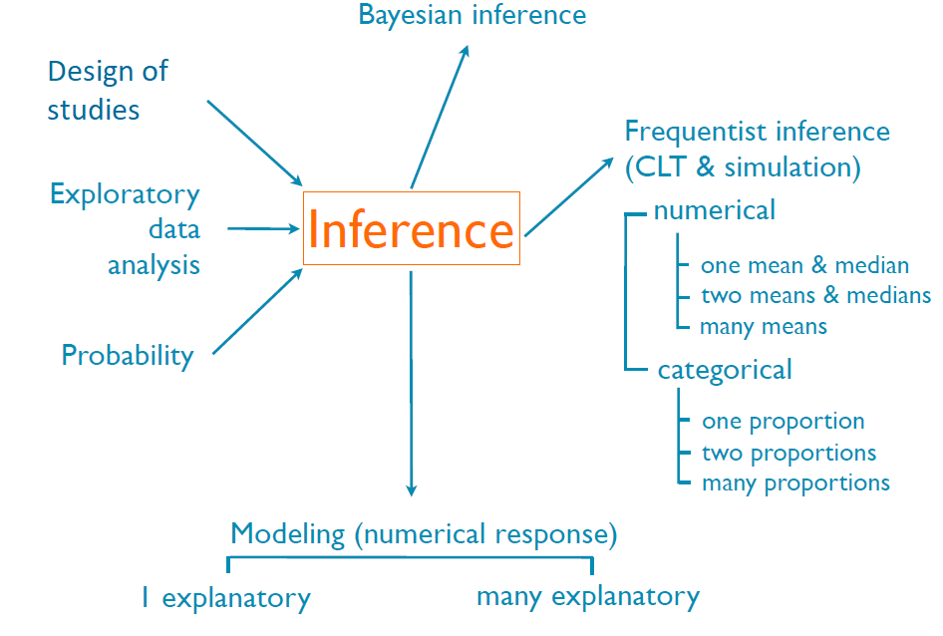
Outline

Slide 9
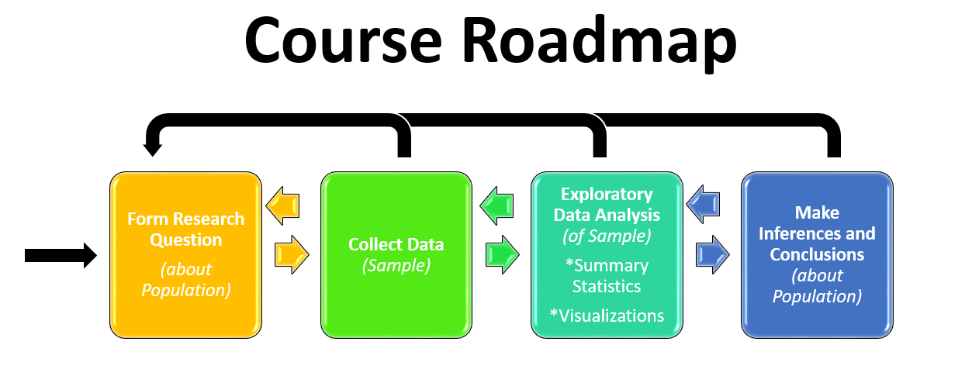
Outline
How does our data collection process change the type of conclusions we can make?
What are good ways to collect data?

Slide 10
Case Study: How many issues are there with this analysis and conclusion below?
Students at a local magnate high school want to test if drinking caffeine before the SAT causes a student to score higher on the exam. 80 students that attend the magnate school took the SAT at the testing facility one morning. They decide to assign the first 40 students that arrived at the testing facility to the “coffee group” and offer them coffee before the exam. They assigned the last 40 students to arrive at the testing facility to the “no coffee group” and did not offer them any coffee.
After scores were released, they were able to collect 36 SAT scores from the “coffee group” and 31 SAT scores from the “no coffee group.” They conducted an independent means test between the two groups using this data and found a p-value=0.03. They used this to conclude that drinking coffee before the SAT causes high school students to score higher on the SAT.
This analysis and conclusion is fine.
1 issue
≤ 3 issues
≤ 5 issues
>5 issues
2

Slide 11
Case Study: How many issues are there with this analysis and conclusion below?
Students at a local magnate high school want to test if drinking caffeine before the SAT causes a student to score higher on the exam. 80 students that attend the magnate school took the SAT at the testing facility one morning. They decide to assign the first 40 students that arrived at the testing facility to the “coffee group” and offer them coffee before the exam. They assigned the last 40 students to arrive at the testing facility to the “no coffee group” and did not offer them any coffee.
After scores were released, they were able to collect 36 SAT scores from the “coffee group” and 31 SAT scores from the “no coffee group.” They conducted an independent means test between the two groups using this data and found a p-value=0.03. They used this to conclude that drinking coffee before the SAT causes high school students to score higher on the SAT.
A lot! Let’s unpack all the issues with this inference they are making!
2

Slide 12
Is this an observational study or a random experiment?
Students at a local magnate high school want to test if drinking caffeine before the SAT causes a student to score higher on the exam. 80 students that attend the magnate school took the SAT at the testing facility one morning. They decide to assign the first 40 students that arrived at the testing facility to the “coffee group” and offer them coffee before the exam. They assigned the last 40 students to arrive at the testing facility to the “no coffee group” and did not offer them any coffee.
After scores were released, they were able to collect 36 SAT scores from the “coffee group” and 31 SAT scores from the “no coffee group.” They conducted an independent means test between the two groups using this data and found a p-value=0.03. They used this to conclude that drinking coffee before the SAT causes high school students to score higher on the SAT.
a.) observational study
b.) random experiment
2

Slide 13
Is this an observational study or a random experiment?
Students at a local magnate high school want to test if drinking caffeine before the SAT causes a student to score higher on the exam. 80 students that attend the magnate school took the SAT at the testing facility one morning. They decide to assign the first 40 students that arrived at the testing facility to the “coffee group” and offer them coffee before the exam. They assigned the last 40 students to arrive at the testing facility to the “no coffee group” and did not offer them any coffee.
After scores were released, they were able to collect 36 SAT scores from the “coffee group” and 31 SAT scores from the “no coffee group.” They conducted an independent means test between the two groups using this data and found a p-value=0.03. They used this to conclude that drinking coffee before the SAT causes high school students to score higher on the SAT.
a.) observational study
b.) random experiment
2

Slide 14
Is this an observational study or a random experiment?
Students at a local magnate high school want to test if drinking caffeine before the SAT causes a student to score higher on the exam. 80 students that attend the magnate school took the SAT at the testing facility one morning. They decide to assign the first 40 students that arrived at the testing facility to the “coffee group” and offer them coffee before the exam. They assigned the last 40 students to arrive at the testing facility to the “no coffee group” and did not offer them any coffee.
After scores were released, they were able to collect 36 SAT scores from the “coffee group” and 31 SAT scores from the “no coffee group.” They conducted an independent means test between the two groups using this data and found a p-value=0.03. They used this to conclude that drinking coffee before the SAT causes high school students to score higher on the SAT.
a.) observational study
b.) random experiment
Why?
They use assignment to groups, but the assignment is not RANDOM!
A random experiment, must have random assignment of subjects to groups.
2

Slide 15
Thus, can we make the conclusion below, then?
Students at a local magnate high school want to test if drinking caffeine before the SAT causes a student to score higher on the exam. 80 students that attend the magnate school took the SAT at the testing facility one morning. They decide to assign the first 40 students that arrived at the testing facility to the “coffee group” and offer them coffee before the exam. They assigned the last 40 students to arrive at the testing facility to the “no coffee group” and did not offer them any coffee.
After scores were released, they were able to collect 36 SAT scores from the “coffee group” and 31 SAT scores from the “no coffee group.” They conducted an independent means test between the two groups using this data and found a p-value=0.03. They used this to conclude that drinking coffee before the SAT causes high school students to score higher on the SAT.
a.) yes
b.) no
2

Slide 16
Thus, can we make the conclusion below, then?
Students at a local magnate high school want to test if drinking caffeine before the SAT causes a student to score higher on the exam. 80 students that attend the magnate school took the SAT at the testing facility one morning. They decide to assign the first 40 students that arrived at the testing facility to the “coffee group” and offer them coffee before the exam. They assigned the last 40 students to arrive at the testing facility to the “no coffee group” and did not offer them any coffee.
After scores were released, they were able to collect 36 SAT scores from the “coffee group” and 31 SAT scores from the “no coffee group.” They conducted an independent means test between the two groups using this data and found a p-value=0.03. They used this to conclude that drinking coffee before the SAT causes high school students to score higher on the SAT.
a.) yes
b.) no
One reason why:
Can’t use causal language in your conclusion, because this is not a random experiment!
Issue # 1
2

Slide 17
Thus, can we make the conclusion below, then?
Students at a local magnate high school want to test if drinking caffeine before the SAT causes a student to score higher on the exam. 80 students that attend the magnate school took the SAT at the testing facility one morning. They decide to assign the first 40 students that arrived at the testing facility to the “coffee group” and offer them coffee before the exam. They assigned the last 40 students to arrive at the testing facility to the “no coffee group” and did not offer them any coffee.
After scores were released, they were able to collect 36 SAT scores from the “coffee group” and 31 SAT scores from the “no coffee group.” They conducted an independent means test between the two groups using this data and found a p-value=0.03. They used this to conclude that drinking coffee before the SAT causes high school students to score higher on the SAT.
a.) yes
b.) no
One reason why:
Can’t use causal language in your conclusion, because this is not a random experiment!
Intuition:
Students that arrive early to the exam might be more likely score higher (personality type). Without random assignment, we can’t isolate the single effect of coffee over other potential confounding factors.
Issue # 1
2

Slide 18
Let’s change the study slightly to be a random experiment. Can we make the conclusion below now?
Students at a local magnate high school want to test if drinking caffeine before the SAT causes a student to score higher on the exam. 80 students that attend the magnate school took the SAT at the testing facility one morning. They decide to randomly assign the 40 students that arrived “coffee group” and offer them coffee before the exam. They randomly assigned the other 40 students to the “no coffee group” and did not offer them any coffee.
After scores were released, they were able to collect 36 SAT scores from the “coffee group” and 31 SAT scores from the “no coffee group.” They conducted an independent means test between the two groups using this data and found a p-value=0.03. They used this to conclude that drinking coffee before the SAT causes high school students to score higher on the SAT.
a.) yes
b.) no
2

Slide 19
Let’s change the study slightly to be a random experiment. Can we make the conclusion below now?
Students at a local magnate high school want to test if drinking caffeine before the SAT causes a student to score higher on the exam. 80 students that attend the magnate school took the SAT at the testing facility one morning. They decide to randomly assign the 40 students that arrived “coffee group” and offer them coffee before the exam. They randomly assigned the other 40 students to the “no coffee group” and did not offer them any coffee.
After scores were released, they were able to collect 36 SAT scores from the “coffee group” and 31 SAT scores from the “no coffee group.” They conducted an independent means test between the two groups using this data and found a p-value=0.03. They used this to conclude that drinking coffee before the SAT causes high school students to score higher on the SAT.
a.) yes
b.) no
2

Slide 20
Let’s change the study slightly to be a random experiment. Can we make the conclusion below now?
Students at a local magnate high school want to test if drinking caffeine before the SAT causes a student to score higher on the exam. 80 students that attend the magnate school took the SAT at the testing facility one morning. They decide to randomly assign the 40 students that arrived “coffee group” and offer them coffee before the exam. They randomly assigned the other 40 students to the “no coffee group” and did not offer them any coffee.
After scores were released, they were able to collect 36 SAT scores from the “coffee group” and 31 SAT scores from the “no coffee group.” They conducted an independent means test between the two groups using this data and found a p-value=0.03. They used this to conclude that drinking coffee before the SAT causes high school students to score higher on the SAT.
a.) yes
b.) no
Some reasons why:
Population: ALL high school students
2

Slide 21
Let’s change the study slightly to be a random experiment. Can we make the conclusion below now?
Students at a local magnate high school want to test if drinking caffeine before the SAT causes a student to score higher on the exam. 80 students that attend the magnate school took the SAT at the testing facility one morning. They decide to randomly assign the 40 students that arrived “coffee group” and offer them coffee before the exam. They randomly assigned the other 40 students to the “no coffee group” and did not offer them any coffee.
After scores were released, they were able to collect 36 SAT scores from the “coffee group” and 31 SAT scores from the “no coffee group.” They conducted an independent means test between the two groups using this data and found a p-value=0.03. They used this to conclude that drinking coffee before the SAT causes high school students to score higher on the SAT.
a.) yes
b.) no
Some reasons why:
Population: ALL high school students
Sample:
  Students at a magnate school.
Issue # 2
2

Slide 22
Let’s change the study slightly to be a random experiment. Can we make the conclusion below now?
Students at a local magnate high school want to test if drinking caffeine before the SAT causes a student to score higher on the exam. 80 students that attend the magnate school took the SAT at the testing facility one morning. They decide to randomly assign the 40 students that arrived “coffee group” and offer them coffee before the exam. They randomly assigned the other 40 students to the “no coffee group” and did not offer them any coffee.
After scores were released, they were able to collect 36 SAT scores from the “coffee group” and 31 SAT scores from the “no coffee group.” They conducted an independent means test between the two groups using this data and found a p-value=0.03. They used this to conclude that drinking coffee before the SAT causes high school students to score higher on the SAT.
a.) yes
b.) no
Some reasons why:
Population: ALL high school students
Sample:
  Students at a magnate school.
  Sampling was not random.
Issue # 3
2

Slide 23
🆕
▶ Non-response: If only a non-random fraction of the randomly sampled people choose to respond to a survey such that the sample may be no longer be representative of the population
▶ Voluntary response: Occurs when the sample consists of people who volunteer to respond because they have strong opinions on the issue since such a sample will also not be representative of the population
▶ Convenience sample: Individuals who are easily accessible are more likely to be included in the sample
5

Slide 24
Let’s change the study slightly to be a random experiment. Can we make the conclusion below now?
Students at a local magnate high school want to test if drinking caffeine before the SAT causes a student to score higher on the exam. 80 students that attend the magnate school took the SAT at the testing facility one morning. They decide to randomly assign the 40 students that arrived “coffee group” and offer them coffee before the exam. They randomly assigned the other 40 students to the “no coffee group” and did not offer them any coffee.
After scores were released, they were able to collect 36 SAT scores from the “coffee group” and 31 SAT scores from the “no coffee group.” They conducted an independent means test between the two groups using this data and found a p-value=0.03. They used this to conclude that drinking coffee before the SAT causes high school students to score higher on the SAT.
a.) yes
b.) no
Some reasons why:
Population: ALL high school students
Sample:
  Students at a magnate school.
  Sampling was not random.
  Sample data had bias:
    Convenience sampling.
Issue # 4
2

Slide 25
Let’s change the study slightly to be a random experiment. Can we make the conclusion below now?
Students at a local magnate high school want to test if drinking caffeine before the SAT causes a student to score higher on the exam. 80 students that attend the magnate school took the SAT at the testing facility one morning. They decide to randomly assign the 40 students that arrived “coffee group” and offer them coffee before the exam. They randomly assigned the other 40 students to the “no coffee group” and did not offer them any coffee.
After scores were released, they were able to collect 36 SAT scores from the “coffee group” and 31 SAT scores from the “no coffee group.” They conducted an independent means test between the two groups using this data and found a p-value=0.03. They used this to conclude that drinking coffee before the SAT causes high school students to score higher on the SAT.
a.) yes
b.) no
Some reasons why:
Population: ALL high school students
Sample:
  Students at a magnate school.
  Sampling was not random.
  Sample data had bias:
    Convenience sampling.
    Non-response bias.
Issue # 5
2

Slide 26





6. Random sampling helps generalizability, random assignment helps causality (two or more variables)
🆕
If two or more variables in research question
most
ideal experiment
Random assignment
No random assignment
observational studies
Random sampling
Causal conclusion, generalized to the whole population.
No causal conclusion, correlation statement generalized to the whole population.
Generalizability
No random sampling
Causal conclusion, only for the sample.
No causal conclusion,
No
correlation statement only _{generalizability}
for the sample.
most experiments
bad observational studies
Causation
Correlation
10

Slide 27
Let’s change the study slightly to be a random experiment. Can we make the conclusion below now?
Students at a local magnate high school want to test if drinking caffeine before the SAT causes a student to score higher on the exam. 80 students that attend the magnate school took the SAT at the testing facility one morning. They decide to randomly assign the 40 students that arrived “coffee group” and offer them coffee before the exam. They randomly assigned the other 40 students to the “no coffee group” and did not offer them any coffee.
After scores were released, they were able to collect 36 SAT scores from the “coffee group” and 31 SAT scores from the “no coffee group.” They conducted an independent means test between the two groups using this data and found a p-value=0.03. They used this to conclude that drinking coffee before the SAT causes high school students to score higher on the SAT.
a.) yes
b.) no
Some reasons why:
Population: ALL high school students
Sample:
  Students at a magnate school.
  Sampling was not random.
  Sample data had bias:
    Convenience sampling.
    Non-response bias.
Issues # 2-5
The sample is not random and not representative of the population!
2

Slide 28
Let’s change the random experiment slightly, what sampling technique was used to get the random sample?
Students at a local magnate high school want to test if drinking caffeine before the SAT causes a student to score higher on the exam. They randomly select 50 high schools (each with a diverse student body) through out the country. They decide to randomly assign half the SAT taking students from each school to the “coffee group” and offered them coffee. They randomly assigned the other half from each school to the “no coffee group” and did not offer them any coffee the morning of the exam.
They obtained SAT scores from all the students in their experiment. They conducted an independent means test between the two groups using this data and found a p-value=0.03.
Simple random sampling
Stratified sampling
Cluster sampling
Multistage sampling
2

Slide 29
Let’s change the random experiment slightly, what sampling technique was used to get the random sample?
Students at a local magnate high school want to test if drinking caffeine before the SAT causes a student to score higher on the exam. They randomly select 50 high schools (each with a diverse student body) through out the country. They decide to randomly assign half the SAT taking students from each school to the “coffee group” and offered them coffee. They randomly assigned the other half from each school to the “no coffee group” and did not offer them any coffee the morning of the exam.
They obtained SAT scores from all the students in their experiment. They conducted an independent means test between the two groups using this data and found a p-value=0.03.
Simple random sampling
Stratified sampling
Cluster sampling
Multistage sampling
2

Slide 30
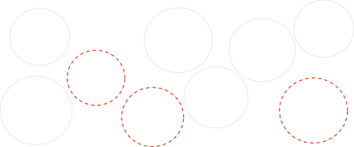
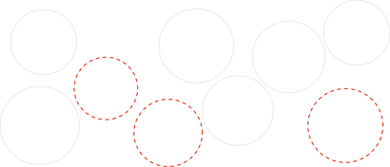
2. Ideally use a simple random sample, stratify to control for a variable, and cluster to make sampling easier
🆕
Simple random:
Drawing names from a hat
Cluster: heterogenous clusters Sample all chosen clusters
●
●●●
●●●
●
●
●
●●●
Cluster 2
Cluster 5
●
●
Cluster 9
●●●
●
●
●
● ●
● ●
●
●
Cluster 7
●
●
●
●
●
●
●
●
●
●
●●●
●
●
●
●●● ●
●
●
●
●
●
● ●
● ● ●
●●●
●
● ●
●
● ●
●●
●
●
●
● ●
●
●
●
●
Cluster 3
●●● ●●●●●
●
● ●
●
●
●
●
● ●
●
●
●●
●
●
●
●
●
●
●
●
●
●
●
●●● ●
●
●
●
●
●
●
●●
●
●●
●●
Cluster 8
●
●
●
●
●
Cluster 4
●●●
●
●
●
●
●
●
●
● ●
●
●
● ●
●●● ●●●
●
●
●●●
●
●
●●●
●●
●●●
●●●
●●●
●
●
●
●
●
●● ● ●
●
●●●●
●●
●●● ●●●●●●
●
●
●
●
●
●
●
●●●●
●
●●●
●
●
●●●
●
●●● ●●●
●●
●●●
●
● ● ●
●
●● ●
●
●●●● ●●● ●●
●
●
●
●●
●
●
●
●
●
●
●● ●
● ●●●
●
●
●
●
●●●
● ●
●●●
●●●
●●●
●●●
●●●
●
● ● ● ●
●
●
●●
●●● ●
●
●
●●●
●●● ●
●● ●●●
Cluster 6
●●●
●
●
●
●
●
●
●●●
●
●●●
●
Cluster 1
●●
●
●●●
●●●
●
●
●
●●●
Stratiﬁed: homogenous strata Stratify to control for age group
Multistage: heterogeneous clusters
Random sample in chosen clusters
Stratum 2
Stratum 4
Stratum 6
●●
●
Cluster 2
●●
● ● ●
● ●
●
●
●
●
Cluster 5
●
● ●
Cluster 9
●
●
●●●
Cluster 7
● ● ●
●
● ● ●
●
●
●
●
●
● ● ●
●●
●
Stratum 3
●
● ● ● ●
●
●
● ●
● ● ●
●●●●
● ●●
●
● ●
●
●
●●● ● ● ●
●●● ●●●
●●
●
●
Cluster 3
●
●
●
●● ●●●
●
●
●
●
●
●
● ●
●
●
● ● ●
● ● ● ●
● ●
● ●●
● ● ●
●
●
●
●
●
●
●
●
● ●
●
● ●
●
●
●
●
●
●
● ●
●
●● ●
●
●
●●● ●●●
●
● ●
●
●
Cluster 8
●
● ●
●
●
●
●
●
●
● ●
●
● ●●●
Cluster 4
Stratum 1
●
●
●
●
●
●
●●● ● ●●●
●
●
●
● ●
●
●
● ●
● ●
●
● ●
● ●
●●● ●
●
●
●
●●● ●
●
●●
●
● ●●●
●
● ●
●
●
●
● ● ●
●
●●● ●
●
● ● ●●●
●
●
● ●●● ●
● ●
● ●
● ●
● ●
●●●●
●
●
● ●● ●
●●● ●●●
●
●
●●● ●
●
●
●●●●
●
●
● ●
● ●
●
●
●●●●●●
●
● ●●●●
●●●
●
●●●
●
● ●
Cluster 6
●●
●
● ●
●
Cluster 1
●●●
● ●
●
●●●● ●
●
Stratum 5
● ●●●
3

Slide 31
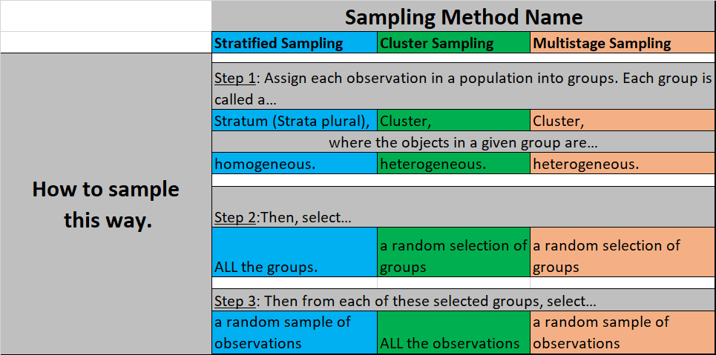
2. Ideally use a simple random sample, stratify to control for a variable,
🆕
and cluster to make sampling easier

Slide 32
Let’s make the experiment better…
The students realized that some students had already drank coffee, soda, and Redbull before arriving at the exam. What principle of experimental design could they employ to make the experiment better in light of this knowledge?
Randomize
Replicate
Control
Block
2

Slide 33
Let’s make the experiment better…
The students realized that some students had already drank coffee, soda, and Redbull before arriving at the exam. What principle of experimental design could they employ to make the experiment better in light of this knowledge?
Randomize
Replicate
Control
Block
Control: Make the treatment/control groups as similar as possible.
Have the student not ingest any caffeine before coming to the exam.
Give the students in the “coffee group” exactly 2 cups of coffee at exactly the same time.
Make sure everyone in the treatment group drinks it.
Issue # 6
2

Slide 34
Let’s make the experiment better…
The students realized that Seniors tend to outperform Juniors in the SAT. What principle of experimental design could they employ to make the experiment better in light of this knowledge?
Randomize
Replicate
Control
Block
2

Slide 35
Let’s make the experiment better…
The students realized that Seniors tend to outperform Juniors in the SAT. What principle of experimental design could they employ to make the experiment better in light of this knowledge?
Randomize
Replicate
Control
Block
Block: Minimize the effect of class year on the experiment by randomly assigning an equal amount to each group.
Randomly assign half the Seniors and half the Juniors to the treatment/coffee group.
Randomly assign half the Seniors and half the Juniors to the control/no-coffee group.
Issue # 7
2

Slide 36
Outline
What are good ways to visualize and summarize data?

Slide 37
Let’s visualize the data.
Which plot would be appropriate to visualize the data from this experiment?
Scatter plot
Mosaic plot
Segmented frequency bar plot
Frequency bar plot
Side-by-side box plots
2

Slide 38
Let’s visualize the data.
Which plot would be appropriate to visualize the data from this experiment?
Scatter plot
Mosaic plot
Segmented frequency bar plot
Frequency bar plot
Side-by-side box plots
Numerical: SAT score
Categorical: coffee/no-coffee
2

Slide 39
What’s an appropriate plot to use for each of the following types of data?
  One numerical variable – boxplot, histogram
  One categorical variable – barplot, histogram
  Two numerical variables – scatterplot
  One categorical variable and one numerical variable – side-by-side boxplots
  Two categorical variables – mosaic plot, frequency segmented barplot

Slide 40
Bayesian inference
Design of studies
Frequentist inference (CLT & simulation)
numerical
one mean & median two means & medians many means
categorical
one proportion two proportions many proportions
Clicker question
Exploratory
data analysis
Inference
Which of the following is false?
Probability
Modeling (numerical response)
1 explanatory many explanatory
Box plots are useful for highlighting outliers, but we cannot determine skew based on a box plot.
Median and IQR are more robust statistics than mean and SD, respectively, since they are not affected by outliers or extreme skewness.
When the response variable is extremely right skewed, it may be useful to apply a log transformation to obtain a more symmetric distribution, and model the logged data.
Segmented bar plots are not good enough for evaluating the relationship between two categorical variables.
4

Slide 41
Bayesian inference
Design of studies
Frequentist inference (CLT & simulation)
numerical
one mean & median two means & medians many means
categorical
one proportion two proportions many proportions
Clicker question
Exploratory
data analysis
Inference
Which of the following is false?
Probability
Modeling (numerical response)
1 explanatory many explanatory
Box plots are useful for highlighting outliers, but we cannot determine skew based on a box plot.
Median and IQR are more robust statistics than mean and SD, respectively, since they are not affected by outliers or extreme skewness.
When the response variable is extremely right skewed, it may be useful to apply a log transformation to obtain a more symmetric distribution, and model the logged data.
Segmented bar plots are not good enough for evaluating the relationship between two categorical variables.
4

Slide 42
Bayesian inference
Design of studies
Frequentist inference (CLT & simulation)
numerical
one mean & median two means & medians many means
categorical
one proportion two proportions many proportions
Clicker question
Exploratory
data analysis
Inference
Which of the following is false?
Probability
Modeling (numerical response)
1 explanatory many explanatory
Box plots are useful for highlighting outliers, but we cannot determine skew based on a box plot. → We can determine skew with a boxplot! (BUT, we can’t determine modality from a box plot)!
Median and IQR are more robust statistics than mean and SD, respectively, since they are not affected by outliers or extreme skewness. → Why is this?
When the response variable is extremely right skewed, it may be useful to apply a log transformation to obtain a more symmetric distribution, and model the logged data (Slides 7.2)
Segmented bar plots are not good enough for evaluating the relationship between two categorical variables. → (See graph)
4

Slide 43
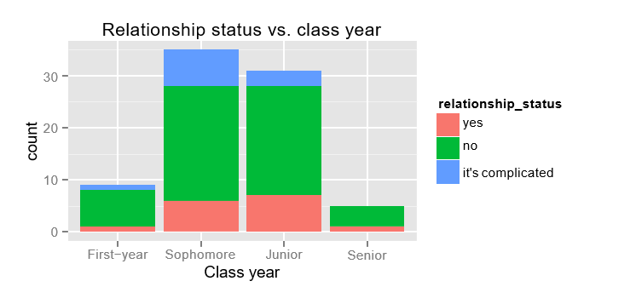
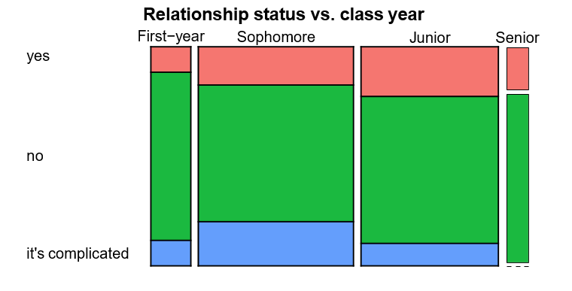
Clicker question
Which of the following is false?
Segmented Bar Plot
Box plots are useful for highlighting outliers, but we cannot determine skew based on a box plot. → What aspect of shape can we not determine from a boxplot?
Median and IQR are more robust statistics than mean and SD, respectively, since they are not affected by outliers or extreme skewness. → Why is this?
When the response variable is extremely right skewed, it may be useful to apply a log transformation to obtain a more symmetric distribution, and model the logged data (Slides 7.2)
Segmented bar plots are not good enough for evaluating the relationship between two categorical variables. → (See graph)
Mosaic Plot
4

Slide 44
Clicker question
A recent housing survey was conducted to determine the price of a typical home in Glendale, CA. Glendale is mostly middle-class, with one very expensive suburb. The mean price of a house was roughly $650,000. Which of the following statements is most likely to be true?
Most houses in Glendale cost more than $650,000.
Most houses in Glendale cost less than $650,000.
There are about as many houses in Glendale that cost more than $650,000 than less than this amount.
We need to know the standard deviation to answer this question

Slide 45
Clicker question
A recent housing survey was conducted to determine the price of a typical home in Glendale, CA. Glendale is mostly middle-class, with one very expensive suburb. The mean price of a house was roughly $650,000. Which of the following statements is most likely to be true?
Most houses in Glendale cost more than $650,000.
Most houses in Glendale cost less than $650,000.
There are about as many houses in Glendale that cost more than $650,000 than less than this amount.
We need to know the standard deviation to answer this question
Prices/income tend to be right skewed.
Median < Mean in right skewed distributions.
50% of data < Median < Mean = $650,000

Slide 46
Outline
When finding the probability of an event, how do we decide which probability equations/techniques to use?
General Probability Rules
Bayes Equation
Probability Tree
Binomial Distribution Equations
Normal Distribution Equations

Slide 47
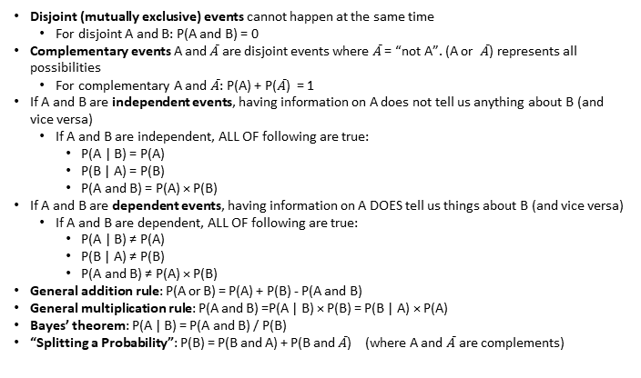
General Probability Rules
Disjoint (mutually exclusive) events cannot happen at the same time
  For disjoint A and B: P(A and B) = 0
Complementary events A and $\overline{A}$ are disjoint events where $\overline{A}$ = “not A”. (A or $\overline{A}$) represents all possibilities
  For complementary A and $\overline{A}$: P(A) + P($\overline{A}$) = 1
If A and B are independent events, having information on A does not tell us anything about B (and vice versa)
  If A and B are independent, ALL OF following are true:
    P(A | B) = P(A)
    P(B | A) = P(B)
    P(A and B) = P(A) × P(B)
If A and B are dependent events, having information on A DOES tell us things about B (and vice versa)
  If A and B are dependent, ALL OF following are true:
    P(A | B) ≠ P(A)
    P(B | A) ≠ P(B)
    P(A and B) ≠ P(A) × P(B)
General addition rule: P(A or B) = P(A) + P(B) - P(A and B)
General multiplication rule: P(A and B) =P(A | B) × P(B) = P(B | A) × P(A)
Bayes’ theorem: P(A | B) = P(A and B) / P(B)
“Splitting a Probability”: P(B) = P(B and A) + P(B and $\overline{A}$) (where A and $\overline{A}$ are complements)

Slide 48
Bayesian inference
Design of studies
Frequentist inference (CLT & simulation)
numerical
one mean & median two means & medians many means
categorical
one proportion two proportions many proportions
Clicker question
Exploratory
data analysis
Inference
Which of the following is false?
Probability
Modeling (numerical response)
1 explanatory many explanatory
If A and B are independent, then having information on A does not tell us anything about B.
If A and B are disjoint, then knowing that A occurs tells us that B cannot occur.
Disjoint (mutually exclusive) events are always dependent since if one event occurs we know the other one cannot.
If A and B are independent, then P(A and B) = P(A) + P(B).
If A and B are not disjoint, then P(A or B) = P(A) + P(B) - P(A and B).
5

Slide 49
Bayesian inference
Design of studies
Frequentist inference (CLT & simulation)
numerical
one mean & median two means & medians many means
categorical
one proportion two proportions many proportions
Clicker question
Exploratory
data analysis
Inference
Which of the following is false?
Probability
Modeling (numerical response)
1 explanatory many explanatory
If A and B are independent, then having information on A does not tell us anything about B.
If A and B are disjoint, then knowing that A occurs tells us that B cannot occur.
Disjoint (mutually exclusive) events are always dependent since if one event occurs we know the other one cannot.
If A and B are independent, then P(A and B) = P(A) + P(B).
If A and B are not disjoint, then P(A or B) = P(A) + P(B) - P(A and B).
5

Slide 50
Bayesian inference
Design of studies
Frequentist inference (CLT & simulation)
numerical
one mean & median two means & medians many means
categorical
one proportion two proportions many proportions
Clicker question
Exploratory
data analysis
Inference
Which of the following is false?
Probability
Modeling (numerical response)
1 explanatory many explanatory
If A and B are independent, then having information on A does not tell us anything about B. → Independent means: P(A)=P(A|B)
If A and B are disjoint, then knowing that A occurs tells us that B cannot occur. → Disjoint means P(A and B) = 0 and P(B|A)=0
Disjoint (mutually exclusive) events are always dependent since if one event occurs we know the other one cannot. → Disjoint means P(A and B) = 0 and and P(B|A)=0
If A and B are independent, then P(A and B) = P(A) + P(B).
If A and B are not disjoint, then P(A or B) = P(A) + P(B) - P(A and B).
P(A) × P(B).
General Addition Rule
5

Slide 51
Clicker question
What would you need to do solve this problem?
The Duke acceptance rate for last year was 0.057. What is the probability that at least two students from your high school (100 Seniors) get in this year (assume students at your school are independent)?
Calculate exactly one binomial expression.
Calculate multiple binomial expressions (and add/subtract/do other things with them).
Approximate a binomial distribution with a normal distribution (but don’t check/show any conditions before you do this.)
Approximate a binomial distribution with a normal distribution (but DO check/show conditions before you do this.)
NONE OF THE ABOVE (Use other probability equations that aren’t specific to binomial and normal distributions).

Slide 52
Clicker question
What would you need to do solve this problem?
The Duke acceptance rate for last year was 0.057. What is the probability that at least two students from your high school (100 Seniors) get in this year (assume students at your school are independent)?
Calculate exactly one binomial expression.
Calculate multiple binomial expressions (and add/subtract/do other things with them).
Approximate a binomial distribution with a normal distribution (but don’t check/show any conditions before you do this.)
Approximate a binomial distribution with a normal distribution (but DO check/show conditions before you do this.)
NONE OF THE ABOVE (Use other probability equations that aren’t specific to binomial and normal distributions).

Slide 53

Clicker question
What would you need to do solve this problem?
The Duke acceptance rate for last year was 0.057. What is the probability that at least two students from your high school (100 Seniors) get in this year (assume students at your school are independent)?
“Binomial event”
$$P\left(at least k out of n independent trials are a success\right)$$
$$P(at least 2 out of 100 students at school get into Duke)$$

Slide 54

Clicker question
What would you need to do solve this problem?
The Duke acceptance rate for last year was 0.057. What is the probability that at least two students from your high school (100 seniors) get in this year (assume students at your school are independent)?
“Binomial event”
$$P\left(at least k out of n independent trials are a success\right)$$
$$P(at least 2 out of 100 students at school get into Duke)$$
Binomial distribution is needed because:
n=100 trials (fixed)
each trial has probability 0.057
independent trials
only two possibilities (success=Duke, failure=No Duke)

Slide 55
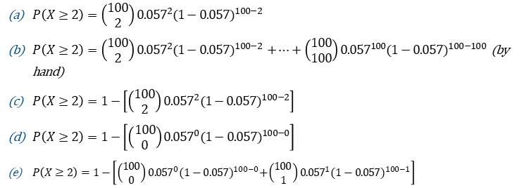
Clicker question
What would you need to do solve this problem?
The Duke acceptance rate for last year was 0.057. What is the probability that at least two students from your high school get in this year (assume students at your school are independent)?
Calculate multiple binomial expressions (and add/subtract/do other things with them).
$P\left(X≥2\right)=\left(\begin{matrix}100 \\ 2\end{matrix}\right){0.057}^{2}{(1−0.057)}^{100−2}$
$P\left(X≥2\right)=\left(\begin{matrix}100 \\ 2\end{matrix}\right){0.057}^{2}{(1−0.057)}^{100−2}$ $+…+\left(\begin{matrix}100 \\ 100\end{matrix}\right){0.057}^{100}{(1−0.057)}^{100−100}$ (by hand)
$P\left(X≥2\right)=1−\left[\left(\begin{matrix}100 \\ 2\end{matrix}\right){0.057}^{2}{(1−0.057)}^{100−2}\right]$
$P\left(X≥2\right)=1−\left[\left(\begin{matrix}100 \\ 0\end{matrix}\right){0.057}^{0}{(1−0.057)}^{100−0}\right]$
$P\left(X≥2\right)=1−\left[\left(\begin{matrix}100 \\ 0\end{matrix}\right){0.057}^{0}{(1−0.057)}^{100−0}+\left(\begin{matrix}100 \\ 1\end{matrix}\right){0.057}^{1}{(1−0.057)}^{100−1}\right]$

Slide 56
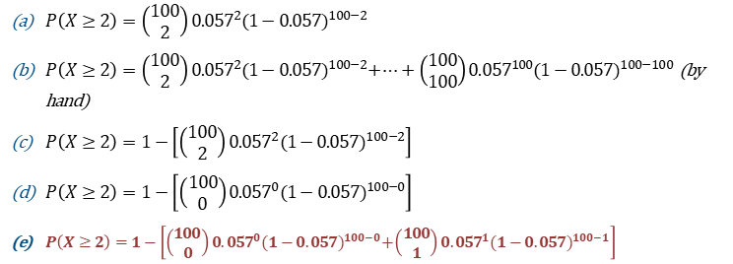
Clicker question
What would you need to do solve this problem?
The Duke acceptance rate for last year was 0.057. What is the probability that at least two students from your high school get in this year (assume students at your school are independent)?
Calculate multiple binomial expressions (and add/subtract/do other things with them).
$P\left(X≥2\right)=\left(\begin{matrix}100 \\ 2\end{matrix}\right){0.057}^{2}{(1−0.057)}^{100−2}$
$P\left(X≥2\right)=\left(\begin{matrix}100 \\ 2\end{matrix}\right){0.057}^{2}{(1−0.057)}^{100−2}+…+\left(\begin{matrix}100 \\ 100\end{matrix}\right){0.057}^{100}{(1−0.057)}^{100−100}$ (by hand)
$P\left(X≥2\right)=1−\left[\left(\begin{matrix}100 \\ 2\end{matrix}\right){0.057}^{2}{(1−0.057)}^{100−2}\right]$
$P\left(X≥2\right)=1−\left[\left(\begin{matrix}100 \\ 0\end{matrix}\right){0.057}^{0}{(1−0.057)}^{100−0}\right]$
$P\left(X≥2\right)=1−\left[\left(\begin{matrix}100 \\ 0\end{matrix}\right){0.057}^{0}{(1−0.057)}^{100−0}+\left(\begin{matrix}100 \\ 1\end{matrix}\right){0.057}^{1}{(1−0.057)}^{100−1}\right]$

Slide 57

Clicker question
What would you need to do solve this problem?
The Duke acceptance rate for last year was 0.057. What is the probability that at least three students from your high school get in this year (assume students at your school are independent)?
Calculate multiple binomial expressions (and add/subtract/do other things with them).
$$\begin{aligned}X=of students out of 100 Seniors at your HS that get into Duke\end{aligned}$$
$$X\sim Bin(n=100,p=0.57)$$

Slide 58

Clicker question
What would you need to do solve this problem?
The Duke acceptance rate for last year was 0.057. What is the probability that at least three students from your high school get in this year (assume students at your school are independent)?
Calculate multiple binomial expressions (and add/subtract/do other things with them).
$$\begin{aligned}X=of students out of 100 Seniors at your HS that get into Duke\end{aligned}$$
$$X\sim Bin(n=100,p=0.57)$$
$$P\left(at least 2 out of 100 students at school get into Duke\right)= \\ =P\left(X≥2\right)$$

Slide 59

Clicker question
What would you need to do solve this problem?
The Duke acceptance rate for last year was 0.057. What is the probability that at least three students from your high school get in this year (assume students at your school are independent)?
Calculate multiple binomial expressions (and add/subtract/do other things with them).
$$\begin{aligned}X=of students out of 100 Seniors at your HS that get into Duke\end{aligned}$$
$$X\sim Bin(n=100,p=0.57)$$
$$P\left(at least 2 out of 100 students at school get into Duke\right)= \\ =P\left(X≥2\right) \\ =P\left(X=2\right)+P\left(X=3\right)+…P\left(X=100\right)$$

Slide 60
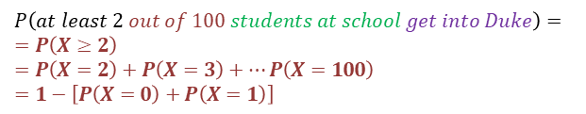

Clicker question
What would you need to do solve this problem?
The Duke acceptance rate for last year was 0.057. What is the probability that at least three students from your high school get in this year (assume students at your school are independent)?
Calculate multiple binomial expressions (and add/subtract/do other things with them).
$$\begin{aligned}X=of students out of 100 Seniors at your HS that get into Duke\end{aligned}$$
$$X\sim Bin(n=100,p=0.57)$$
$$P\left(at least 2 out of 100 students at school get into Duke\right)= \\ =P\left(X≥2\right) \\ =P\left(X=2\right)+P\left(X=3\right)+…P\left(X=100\right) \\ =1−\left[P\left(X=0\right)+P\left(X=1\right)\right]$$
Binomial Equation:
$$P\left(X=k\right)=\left(\begin{matrix}n \\ k\end{matrix}\right)p^{k}{(1−p)}^{n−k}$$

Slide 61
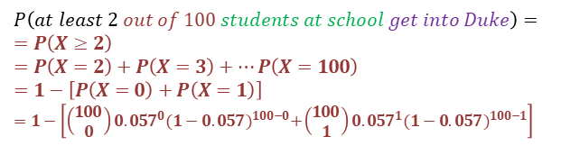
Clicker question
What would you need to do solve this problem?
The Duke acceptance rate for last year was 0.057. What is the probability that at least three students from your high school get in this year (assume students at your school are independent)?
Calculate multiple binomial expressions (and add/subtract/do other things with them).
$$\begin{aligned}X=of students out of 100 Seniors at your HS that get into Duke\end{aligned}$$
$$X\sim Bin(n=100,p=0.57)$$
$$P\left(at least 2 out of 100 students at school get into Duke\right)= \\ =P\left(X≥2\right) \\ =P\left(X=2\right)+P\left(X=3\right)+…P\left(X=100\right) \\ =1−\left[P\left(X=0\right)+P\left(X=1\right)\right] \\ =1−\left[\left(\begin{matrix}100 \\ 0\end{matrix}\right){0.057}^{0}{(1−0.057)}^{100−0}+\left(\begin{matrix}100 \\ 1\end{matrix}\right){0.057}^{1}{(1−0.057)}^{100−1}\right]$$
Binomial Equation:
$$P\left(X=k\right)=\left(\begin{matrix}n \\ k\end{matrix}\right)p^{k}{(1−p)}^{n−k}$$

Slide 62
Clicker question
What would you need to do solve this problem?
The Duke acceptance rate for last year was 0.057. What is the probability that at least two students from your high school (100 Seniors) get in this year (assume students at your school are independent)?
Why not do it this way?
Approximate a binomial distribution with a normal distribution.

Slide 63
Clicker question
What would you need to do solve this problem?
The Duke acceptance rate for last year was 0.057. What is the probability that at least two students from your high school (100 Seniors) get in this year (assume students at your school are independent)?
Why not do it this way?
Approximate a binomial distribution with a normal distribution.
SF conditions don’t hold:
np=100(0.057)<10
n(1-p)=100(1-0.057) ≥10

Slide 64

Clicker question
What would you need to do solve this problem?
The Duke acceptance rate for last year was 0.057. What is the shape of the sampling distribution of sample proportions $\hat{p}$ with sample size 100?
Uniform
Left Skewed
Right Skewed
Normal

Slide 65
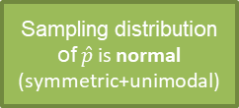

Clicker question
What would you need to do solve this problem?
The Duke acceptance rate for last year was 0.057. What is the shape of the sampling distribution of sample proportions $\hat{p}$ with sample size 100?
Uniform
Left Skewed
Right Skewed
Normal
Do SF conditions hold?
Yes
No
Sampling distribution of $\hat{p}$ is not normal
Sampling distribution of $\hat{p}$ is normal (symmetric+unimodal)

Slide 66
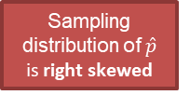
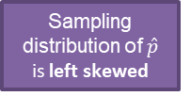
Clicker question
What would you need to do solve this problem?
The Duke acceptance rate for last year was 0.057. What is the shape of the sampling distribution of sample proportions $\hat{p}$ with sample size 100?
Uniform
Left Skewed
Right Skewed
Normal
Do SF conditions hold?
Yes
No
Sampling distribution of $\hat{p}$ is not normal
Sampling distribution of $\hat{p}$ is normal (symmetric+unimodal)
Pop. Parameter p<0.5
Pop. Parameter p>0.5
Sampling distribution of $\hat{p}$ is right skewed
Sampling distribution of $\hat{p}$ is left skewed
Natural boundaries of [0,1]

Slide 67
Clicker question
The Duke acceptance rate for last year was 0.057. Is it unusual for 3 out of a random sample of 100 Seniors to get into Duke?
Yes
No
We cannot determine.

Slide 68



Clicker question
The Duke acceptance rate for last year was 0.057. Is it unusual for 3 out of a random sample of 100 Seniors to get into Duke?
Yes
No
We cannot determine
$$X\sim Bin(n=100,p=.057)$$
But why can we use this logic to show 3 is unusual/not unusual?
$$X\sim N(μ=np,σ=\sqrt{np(1−p)})$$
$3 unusual if 3>μ+2σ$ or $3<μ−2σ$

Slide 69

Clicker question
The Duke acceptance rate for last year was 0.057. Is it unusual for 3 out of a random sample of 100 Seniors to get into Duke?
Yes
No
We cannot determine because SF conditions don’t hold!
$$X\sim Bin(n=100,p=.057)$$
Only true when
SF conditions hold
SF conditions don’t hold:
np=100(0.057)<10
n(1-p)=100(1-0.057) ≥10
$$X\sim N(μ=np,σ=\sqrt{np(1−p)})$$
Only true when
X is normal
$3 unusual if 3>μ+2σ$ or $3<μ−2σ$

Slide 70
Clicker question
What would you need to do solve this problem?
The Duke acceptance rate for last year was 0.057. What is the probability that at least 40 out of 200 randomly sampled Seniors got accepted
Yes
No
We cannot determine.

Slide 71

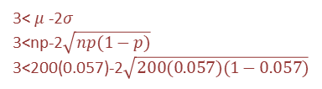
Clicker question
What would you need to do solve this problem?
The Duke acceptance rate for last year was 0.057. What is the probability that at least 40 out of 200 randomly sampled Seniors got accepted
3< $μ$-2$σ$
3<np-2$\sqrt{np(1−p)}$
3<200(0.057)-2$\sqrt{200(0.057)(1−0.057)}$
Yes
No
We cannot determine.
$$X\sim Bin(n=200,p=.057)$$
Only true when
SF conditions hold
SF conditions HOLD:
np=200(0.057) ≥ 10
n(1-p)=200(1-0.057) ≥10
$$X\sim N(μ=np,σ=\sqrt{np(1−p)})$$
Only true when
X is normal
$3 unusual if 3>μ+2σ$ or $3<μ−2σ$

Slide 72
Clicker question
What would you need to do solve this problem?
The Duke acceptance rate for last year was 0.057. What is the probability that at least 40 out of 200 randomly sampled Seniors got accepted
Calculate exactly one binomial expression.
Calculate multiple binomial expressions (and add/subtract/do other things with them).
Approximate a binomial distribution with a normal distribution (but don’t check/show any conditions before you do this.)
Approximate a binomial distribution with a normal distribution (but DO check/show conditions before you do this.)
NONE OF THE ABOVE (Use other probability equations that aren’t specific to binomial and normal distributions).

Slide 73
Clicker question
What would you need to do solve this problem?
The Duke acceptance rate for last year was 0.057. What is the probability that at least 40 out of 200 randomly sampled Seniors got accepted
Calculate exactly one binomial expression.
Calculate multiple binomial expressions (and add/subtract/do other things with them).
Approximate a binomial distribution with a normal distribution (but don’t check/show any conditions before you do this.)
Approximate a binomial distribution with a normal distribution (but DO check/show conditions before you do this.)
NONE OF THE ABOVE (Use other probability equations that aren’t specific to binomial and normal distributions).

Slide 74

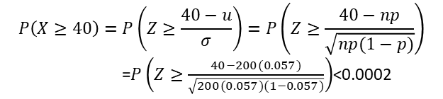
Clicker question
What would you need to do solve this problem?
The Duke acceptance rate for last year was 0.057. What is the probability that at least 40 out of 200 randomly sampled Seniors got accepted
$$X\sim Bin(n=200,p=.057)$$
SF conditions HOLD:
np=200(0.057) ≥ 10
n(1-p)=200(1-0.057) ≥10
Only true when
SF conditions hold
$$X\sim N(μ=np,σ=\sqrt{np(1−p)})$$
Only true when
X is normal
$$P\left(X≥40\right)=P\left(Z≥\frac{40−u}{σ}\right)=P\left(Z≥\frac{40−np}{\sqrt{np(1−p)}}\right)$$
=$P\left(Z≥\frac{40−200(0.057)}{\sqrt{200(0.057)(1−0.057)}}\right)$<0.0002

Slide 75
Clicker question
What would you need to do solve this problem?
The acceptance rate for College University (CU) last year was 20%. Assume the SAT scores for incoming CU freshmen was normally distributed (for Math+Verbal) with an average of 1200 and a standard deviation of 100. Assume the SAT scores for all students in the US was normally distributed (for Math+Verbal) with an average of 1060 and a standard deviation of 195. What’s the probability of getting into CU with an SAT score of at least 1500?
Bayes equation and a probability tree
Bayes equation and the normal distribution
Just use the normal distribution
Multiple binomial distribution
General probability equations

Slide 76
Clicker question
What would you need to do solve this problem?
The acceptance rate for College University (CU) last year was 20%. Assume the SAT scores for incoming CU freshmen was normally distributed (for Math+Verbal) with an average of 1200 and a standard deviation of 100. Assume the SAT scores for all students in the US was normally distributed (for Math+Verbal) with an average of 1060 and a standard deviation of 195. What’s the probability of getting into CU with an SAT score of at least 1500?
Bayes equation and a probability tree
Bayes equation and the normal distribution
Just use the normal distribution
Multiple binomial distribution
General probability equations

Slide 77
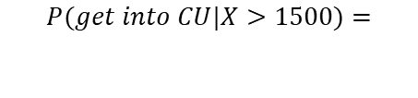
Clicker question
What would you need to do solve this problem?
The acceptance rate for College University (CU) last year was 20%. Assume the SAT scores for incoming CU freshmen was normally distributed (for Math+Verbal) with an average of 1200 and a standard deviation of 100. Assume the SAT scores for all students in the US was normally distributed (for Math+Verbal) with an average of 1060 and a standard deviation of 195. What’s the probability of getting into CU with an SAT score of at least 1500?
$$P(get into CU|X>1500)=$$

Slide 78
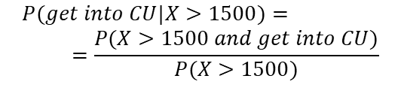
Clicker question
What would you need to do solve this problem?
The acceptance rate for College University (CU) last year was 20%. Assume the SAT scores for incoming CU freshmen was normally distributed (for Math+Verbal) with an average of 1200 and a standard deviation of 100. Assume the SAT scores for all students in the US was normally distributed (for Math+Verbal) with an average of 1060 and a standard deviation of 195. What’s the probability of getting into CU with an SAT score of at least 1500?
$$P(get into CU|X>1500)= \\ =\frac{P(X>1500 and get into CU)}{P(X>1500)}$$
Bayes Equation

Slide 79
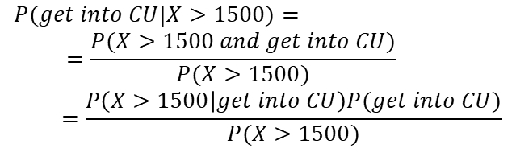
Clicker question
What would you need to do solve this problem?
The acceptance rate for College University (CU) last year was 20%. Assume the SAT scores for incoming CU freshmen was normally distributed (for Math+Verbal) with an average of 1200 and a standard deviation of 100. Assume the SAT scores for all students in the US was normally distributed (for Math+Verbal) with an average of 1060 and a standard deviation of 195. What’s the probability of getting into CU with an SAT score of at least 1500?
$$P(get into CU|X>1500)= \\ =\frac{P(X>1500 and get into CU)}{P(X>1500)} \\ =\frac{P\left(X>1500 | get into CU\right)P(get into CU)}{P(X>1500)}$$
General Mult. Rule

Slide 80
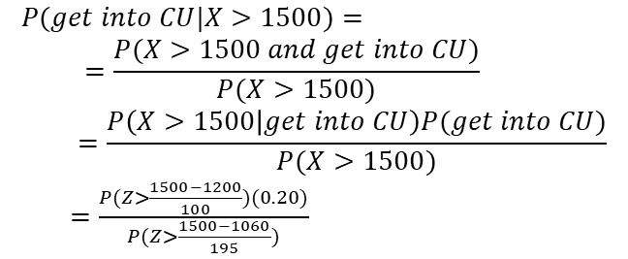
Clicker question
What would you need to do solve this problem?
The acceptance rate for College University (CU) last year was 20%. Assume the SAT scores for incoming CU freshmen was normally distributed (for Math+Verbal) with an average of 1200 and a standard deviation of 100. Assume the SAT scores for all students in the US was normally distributed (for Math+Verbal) with an average of 1060 and a standard deviation of 195. What’s the probability of getting into CU with an SAT score of at least 1500?
$$P(get into CU|X>1500)= \\ =\frac{P(X>1500 and get into CU)}{P(X>1500)} \\ =\frac{P\left(X>1500 | get into CU\right)P(get into CU)}{P(X>1500)}$$
$=\frac{P(Z>\frac{1500−1200}{100})(0.20)}{P(Z>\frac{1500−1060}{195})}$

Slide 81
Clicker question
What would you need to do solve this problem?
The acceptance rate for College University (CU) last year was 20%. 10% of students that got into CU had a perfect high school GPA and 3% of students that did not get into CU had a perfect high school GPA. What’s the probability of getting into CU with a perfect high school GPA?
Bayes equation and a probability tree
Bayes equation and the normal distribution
Just use the normal distribution
Multiple binomial distribution
General probability equations

Slide 82
Clicker question
What would you need to do solve this problem?
The acceptance rate for College University (CU) last year was 20%. 10% of students that got into CU had a perfect high school GPA and 3% of students that did not get into CU had a perfect high school GPA. What’s the probability of getting into CU with a perfect high school GPA?
Bayes equation and a probability tree
Bayes equation and the normal distribution
Just use the normal distribution
Multiple binomial distribution
General probability equations

Slide 83
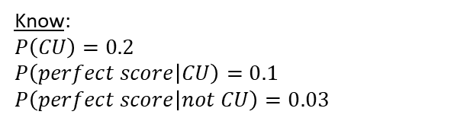

Clicker question
What would you need to do solve this problem?
The acceptance rate for College University (CU) last year was 20%. 10% of students that got into CU had a perfect high school GPA and 3% of students that did not get into CU had a perfect high school GPA. What’s the probability of getting into CU with a perfect high school GPA?
Want: $P(CU|perfect score)$
Probability Tree usually helpful when you know:
Probability of what you want, without the “data”.
“Reverse given” probability of what you want.
Probability of your “data”, given all possibilties
Know:
$$P\left(CU\right)=0.2$$
$$P\left(perfect score | CU\right)=0.1$$
$$P\left(perfect score | not CU\right)=0.03$$

Slide 84
Bayesian inference
Design of studies
Frequentist inference (CLT & simulation)
numerical
one mean & median two means & medians many means
categorical
one proportion two proportions many proportions
Clicker question
Exploratory
data analysis
Inference
Which of the following is false?
Probability
Modeling (numerical response)
1 explanatory many explanatory
Suppose you’re evaluating 4 claims. If prior to data collection you don’t have a preference for one claim over another, you should assign 0.25 as the prior probability to each claim.
Posterior probability and the p-value are the equivalent.
One advantage of Bayesian inference is that data can be integrated to the inferential scheme as they are collected.
Suppose a patient tests positive for a disease that 2% of the population are known to have. A doctor wants to conﬁrm the test result by retesting the patient. In the second test the prior probability for “having the disease” should be more than 2%.
7

Slide 85
Bayesian inference
Design of studies
Frequentist inference (CLT & simulation)
numerical
one mean & median two means & medians many means
categorical
one proportion two proportions many proportions
Clicker question
Exploratory
data analysis
Inference
Which of the following is false?
Probability
Modeling (numerical response)
1 explanatory many explanatory
Suppose you’re evaluating 4 claims. If prior to data collection you don’t have a preference for one claim over another, you should assign 0.25 as the prior probability to each claim.
Posterior probability and the p-value are the equivalent.
One advantage of Bayesian inference is that data can be integrated to the inferential scheme as they are collected.
Suppose a patient tests positive for a disease that 2% of the population are known to have. A doctor wants to conﬁrm the test result by retesting the patient. In the second test the prior probability for “having the disease” should be more than 2%.
Posterior = P(hypothesis | data), p-value ≈ P(data | hypothesis)
7

Slide 86
Frequentist Hypothesis Testing

Slide 87
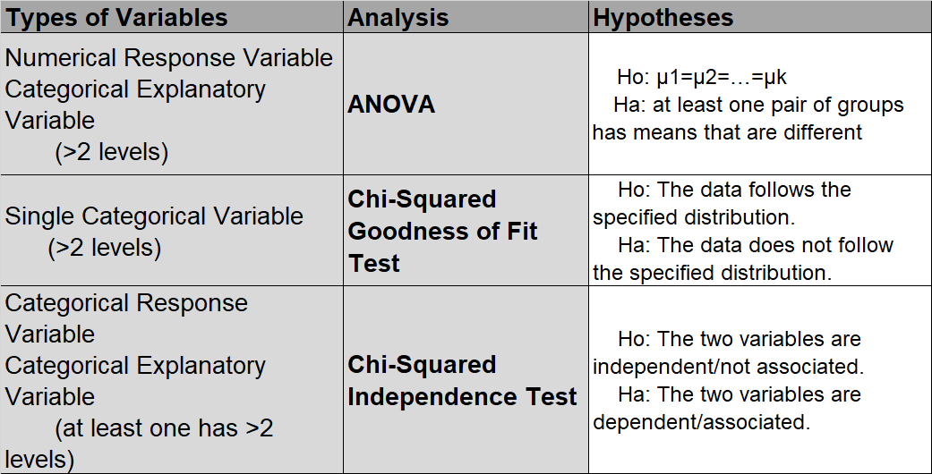
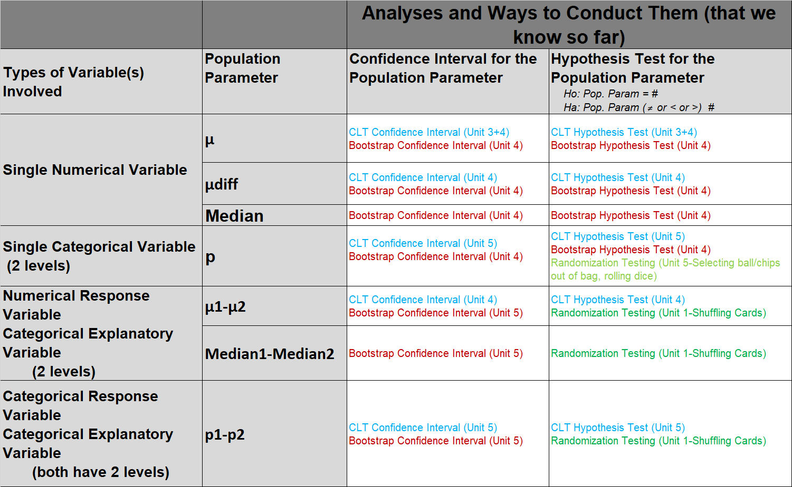
Conducting an Analysis… where to start?
How many numerical and categorical variables are involved?
If categorical variables, how many levels do they have?
What visualization would be appropriate for visualizing this data?
Is it a combo of variables that has one specified Population Parameter of Interest where
  We can create a confidence interval for the population parameter.
  We can conduct a hypothesis test for the population parameter using:
Is it a combo of variables that doesn’t have one specified Population Parameter of Interest and
  We can’t make a confidence interval.
  Has a different hypothesis test set up?
    $$Ho: Pop. Param = \#$$
    $Ha: Pop. Param (≠ or < or >) \#$?
If we are making a confidence interval or hypothesis test for this population parameter, when should we use each of the following methods to do this?
  CLT methods
  Randomization testing methods
  Bootstrap methods

Slide 88
One Population Parameter of Interest

Slide 89
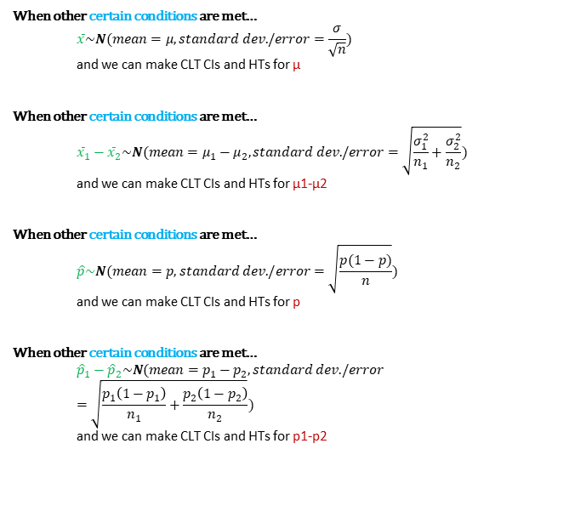
When other certain conditions are met…
  $$\overline{x}\sim N(mean=μ,standard dev./error=\frac{σ}{\sqrt{n}})$$
  and we can make CLT CIs and HTs for μ
When other certain conditions are met…
  $${\overline{x}}_{1}−{\overline{x}}_{2}\sim N(mean=μ_{1}−μ_{2},standard dev./error=\sqrt{\frac{σ_{1}^{2}}{n_{1}}+\frac{σ_{2}^{2}}{n_{2}}})$$
  and we can make CLT CIs and HTs for μ1-μ2
When other certain conditions are met…
  $$\hat{p}\sim N(mean=p,standard dev./error=\sqrt{\frac{p(1−p)}{n}})$$
  and we can make CLT CIs and HTs for p
When other certain conditions are met…
  $${\hat{p}}_{1}−{\hat{p}}_{2}\sim N(mean=p_{1}−p_{2},standard dev./error=\sqrt{\frac{p_{1}\left(1−p_{1}\right)}{n_{1}}+\frac{p_{2}\left(1−p_{2}\right)}{n_{2}}})$$
  and we can make CLT CIs and HTs for p1-p2
What are these CLT conditions?

Slide 90
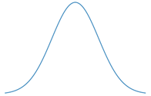
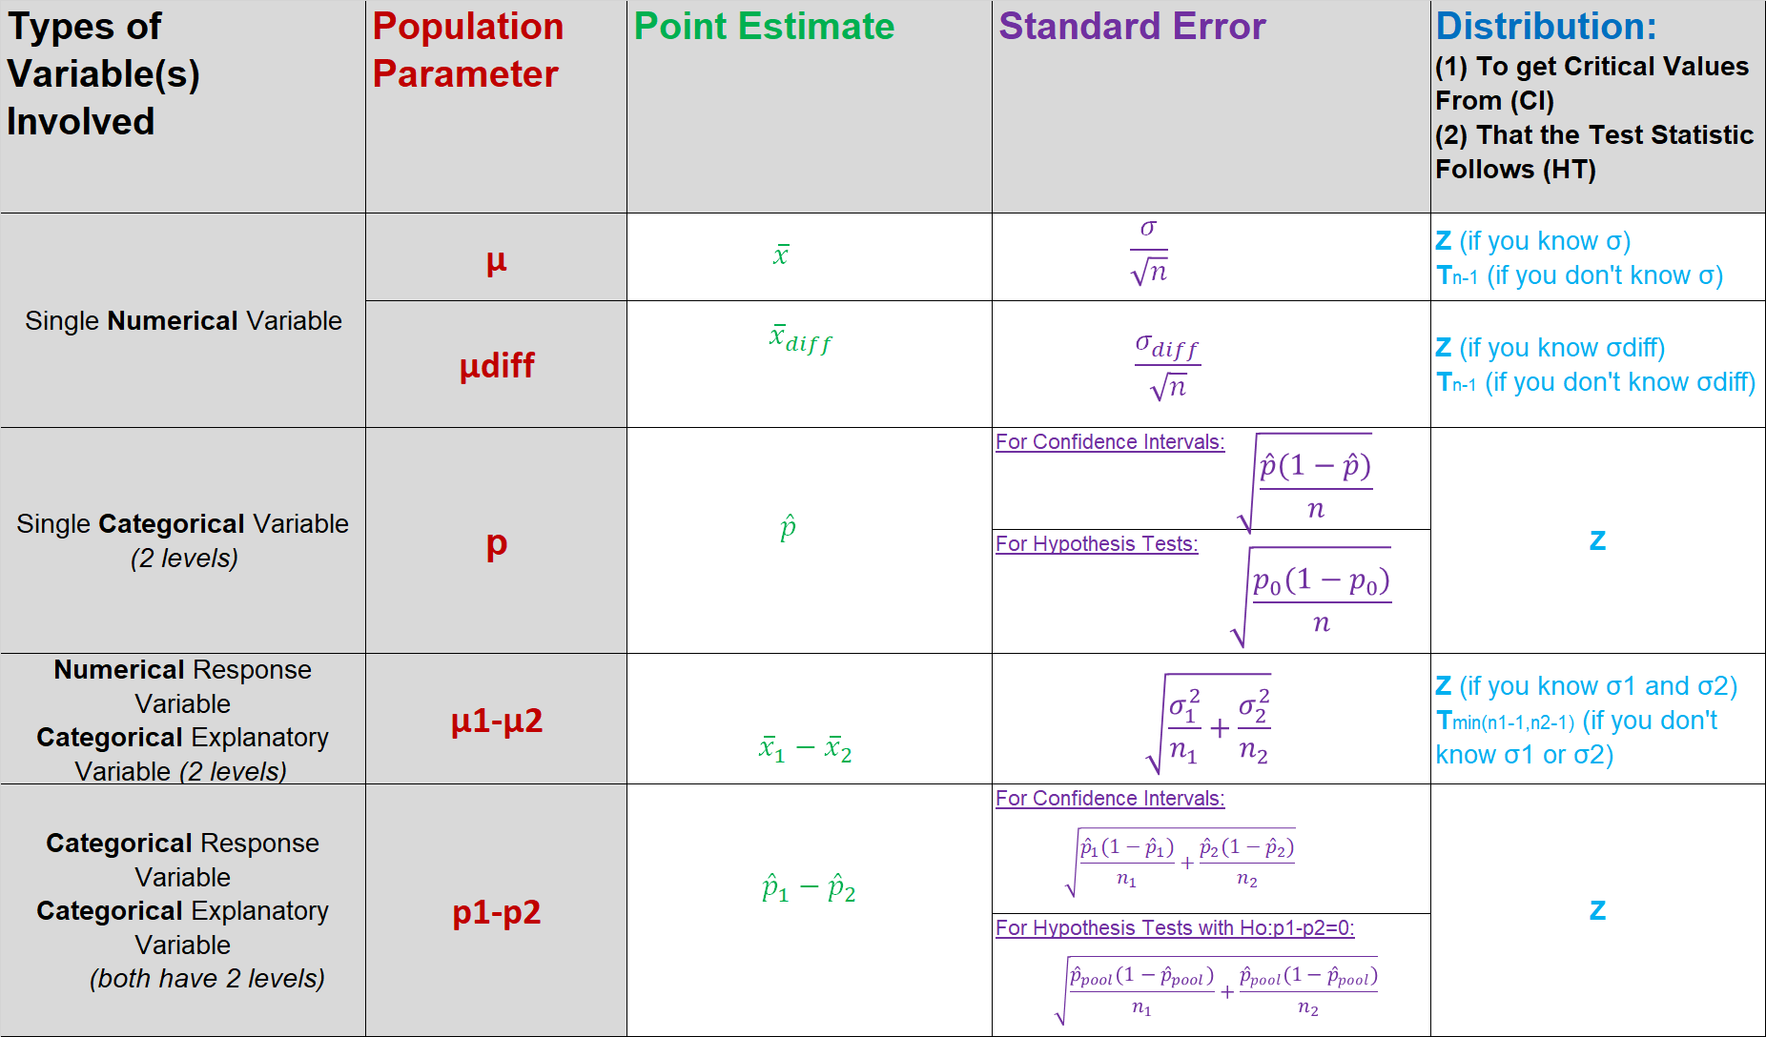

Central Limit Theorem
Confidence Interval for Population Parameter
$$(point estimate)±\left(crit. value\right)SE$$
When CLT
conditions
are met.

Slide 91

Central Limit Theorem
Hypothesis Testing for Population Parameter
$$Ho:pop. param=null value$$
$$Ha:pop. param(≠or>or<)null value$$
$$Test−Stat=\frac{\left(point estimate\right)−null value}{SE}$$
When CLT
conditions
are met.

Slide 92
Analyses with a different Hypothesis Testing Structure and don’t have Confidence Intervals

Slide 93
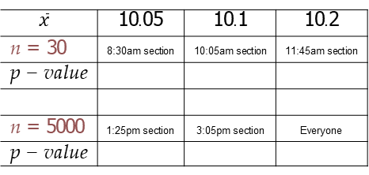
Activity:
Test the hypothesis H₀ : µ = 10 vs. H_{A} : µ > 10 for the following 6 samples. Assume σ = 2.
$$\overline{x}$$ | 10.05 | 10.1 | 10.2
n = 30 | 8:30am section | 10:05am section | 11:45am section
p − value
n = 5000 | 1:25pm section | 3:05pm section | Everyone
p − value
8

Slide 94
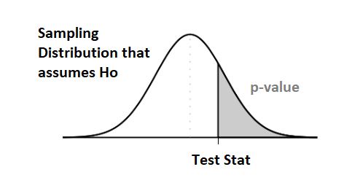
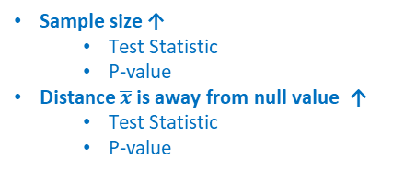
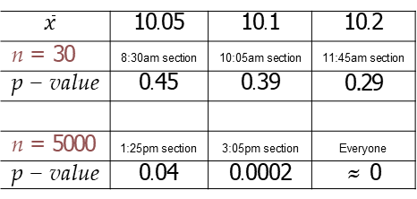
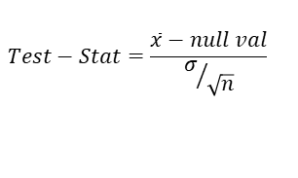
Activity:
Test the hypothesis H₀ : µ = 10 vs. H_{A} : µ > 10 for the following 6 samples. Assume σ = 2.
$$\overline{x}$$ | 10.05 | 10.1 | 10.2
n = 30 | 8:30am section | 10:05am section | 11:45am section
p − value | 0.45 | 0.39 | 0.29
n = 5000 | 1:25pm section | 3:05pm section | Everyone
p − value | 0.04 | 0.0002 | ≈ 0
Sample size ↑
  Test Statistic
  P-value
Distance $\overline{x}$ is away from null value ↑
  Test Statistic
  P-value
$$Test−Stat=\frac{\overline{x}−null val}{σ/{\sqrt{n}}}$$
8

Slide 95
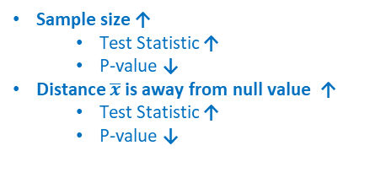
Activity:
Test the hypothesis H₀ : µ = 10 vs. H_{A} : µ > 10 for the following 6 samples. Assume σ = 2.
$$\overline{x}$$ | 10.05 | 10.1 | 10.2
n = 30 | 8:30am section | 10:05am section | 11:45am section
p − value | 0.45 | 0.39 | 0.29
n = 5000 | 1:25pm section | 3:05pm section | Everyone
p − value | 0.04 | 0.0002 | ≈ 0
Sample size ↑
  Test Statistic ↑
  P-value ↓
Distance $\overline{x}$ is away from null value ↑
  Test Statistic ↑
  P-value ↓
$$Test−Stat=\frac{\overline{x}−null val}{σ/{\sqrt{n}}}$$
8

Slide 96
Bayesian inference
Design of studies
Clicker question
Frequentist inference (CLT & simulation)
numerical
one mean & median two means & medians many means
categorical
one proportion two proportions many proportions
Exploratory
data analysis
Inference
Which of the following is the best method for evaluating the if the distribution of a categorical variable follows a hypothesized distribution?
Probability
Modeling (numerical response)
1 explanatory many explanatory
chi-square test of independence
chi-square test of goodness of ﬁt
anova
linear regression
t-test
9

Slide 97
Bayesian inference
Design of studies
Clicker question
Frequentist inference (CLT & simulation)
numerical
one mean & median two means & medians many means
categorical
one proportion two proportions many proportions
Exploratory
data analysis
Inference
Which of the following is the best method for evaluating the if the distribution of one categorical variable follows a hypothesized distribution?
Probability
Modeling (numerical response)
1 explanatory many explanatory
chi-square test of independence
chi-square test of goodness of ﬁt
anova
linear regression
t-test
9

Slide 98
Bayesian inference
Design of studies
Clicker question
Frequentist inference (CLT & simulation)
numerical
one mean & median
Exploratory
data analysis
Inference
Which of the following is the best method for evaluating the relationship between a numerical and a categorical variable with >2 levels?
many means
categorical
one proportion two proportions many proportions
Probability
Modeling (numerical response)
1 explanatory many explanatory
z-test
chi-square test of goodness of ﬁt
anova
linear regression
t-test
10

Slide 99
Bayesian inference
Design of studies
Clicker question
Frequentist inference (CLT & simulation)
numerical
one mean & median
Exploratory
data analysis
Inference
Which of the following is the best method for evaluating the relationship between a numerical and a categorical variable with >2 levels?
many means
categorical
one proportion two proportions many proportions
Probability
Modeling (numerical response)
1 explanatory many explanatory
z-test
chi-square test of goodness of ﬁt
anova
linear regression
t-test
10

Slide 100
Example - Breast Cancer & Age
It is theorized that an important risk factor for breast cancer is age at ﬁrst birth. An international study was set up to test this hypothesis. Breast-cancer cases were identiﬁed among women in selected hospitals in the United States, Greece, Yugoslavia, Brazil, Taiwan, and Japan. Controls were chosen from women of comparable age who were in the hospital at the same time as the cases but who did not have breast cancer. All women were asked about their age at ﬁrst birth.
The set of women with at least one birth was arbitrarily divided into two categories: (1) women whose age at ﬁrst birth was less than or equal to 29 years and (2) women whose age at ﬁrst birth was greater than of equal to 30 years. The following results were found among women with at least one birth: 683 of 3220 women with breast cancer (case women) and 1498 of 10,245 women without breast cancer (control women) had an age at ﬁrst birth greater than or equal to 30. How can we assess whether this difference is signiﬁcant or simply due to chance?

Slide 101
Example - Breast Cancer & Age
It is theorized that an important risk factor for breast cancer is age at ﬁrst birth. An international study was set up to test this hypothesis. Breast-cancer cases were identiﬁed among women in selected hospitals in the United States, Greece, Yugoslavia, Brazil, Taiwan, and Japan. Controls were chosen from women of comparable age who were in the hospital at the same time as the cases but who did not have breast cancer. All women were asked about their age at ﬁrst birth.
The set of women with at least one birth was arbitrarily divided into two categories: (1) women whose age at ﬁrst birth was less than or equal to 29 years and (2) women whose age at ﬁrst birth was greater than of equal to 30 years. The following results were found among women with at least one birth: 683 of 3220 women with breast cancer (case women) and 1498 of 10,245 women without breast cancer (control women) had an age at ﬁrst birth greater than or equal to 30. How can we assess whether this difference is signiﬁcant or simply due to chance?

Slide 102
Breast Cancer & Age - set-up
We are given 683 of 3220 women with breast cancer (case women) and 1498 of 10,245 women without breast cancer (control women) had an age at ﬁrst birth greater than 30.
Is there a difference in the proportions of women who had their first child over 30 for those who do and do not have breast cancer.
 | Breast Cancer (case) | No Breast Cancer (Controls) | Total
≤ 29 | 2537 | 8747 | 11284
≥ 30 | 683 | 1498 | 2181
Total | 3220 | 10245 | 100465
Age Having First Child
12

Slide 103
Breast Cancer & Age - set-up
Analysis: Compare Two Proportions HT
▶ cases: 100465 women (hospital patients) with at least one child
▶ variable(s): (1) breast cancer status - categorical, (2) age at ﬁrst birth - categorical
▶ parameter of interest: p_{case} − p_{ctrl}
– Note: p_{case} = P( age ≥ 30 |case) and p_{case} = P( age ≥ 30 |ctrl)
▶ test: compare two population proportion of independent groups
▶ hypotheses (two tailed):
  Ho: p_{case} − p_{ctrl} = 0
  Ha: p_{case} − p_{ctrl} ≠ 0
100

Slide 104
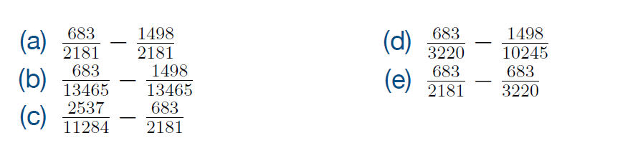
Breast Cancer & Age - point estimate
Clicker question
Which of the following is the correct point estimate for this HT?
▶ hypotheses (two tailed):
  Ho: p_{case} − p_{ctrl} = 0
  Ha: p_{case} − p_{ctrl} ≠ 0
 | BC (Case) | No BC (Controls) | Total
≤ 29 ≥ 30 | 2537 683 | 8747 1498 | 11284 2181
Total | 3220 | 10245 | 100465
Age Having First Child
14

Slide 105
Breast Cancer & Age - point estimate
Clicker question
Which of the following is the correct point estimate for this HT?
▶ hypotheses (two tailed):
  Ho: p_{case} − p_{ctrl} = 0
  Ha: p_{case} − p_{ctrl} ≠ 0
 | BC (Case) | No BC (Controls) | Total
≤ 29 ≥ 30 | 2537 683 | 8747 1498 | 11284 2181
Total | 3220 | 10245 | 100465
Age Having First Child
Success=
14

Slide 106
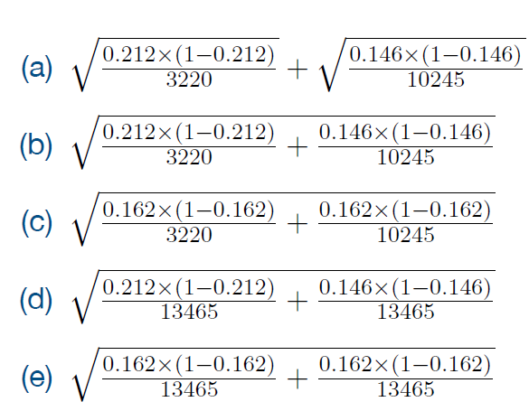
Breast Cancer & Age - standard error
Clicker question
 | BC (Case) | No BC (Controls) | Total
≤ 29 ≥ 30 | 2537 683 | 8747 1498 | 11284 2181
Total | 3220 | 10245 | 100465
pˆ | 0.212 | 0.146 | 0.162
Which of the following is the correct standard error for this HT?
15

Slide 107
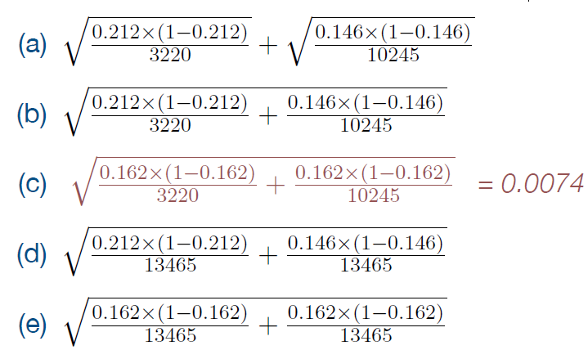
Breast Cancer & Age - standard error
Clicker question
 | BC (Case) | No BC (Controls) | Total
≤ 29 ≥ 30 | 2537 683 | 8747 1498 | 11284 2181
Total | 3220 | 10245 | 100465
pˆ | 0.212 | 0.146 | 0.162
Which of the following is the correct standard error for this HT?
Must use:
Pooled Proportion = (#successes)/(total)
*Would we calculate the standard error the same way if we were doing a confidence interval?
15

Slide 108
Breast Cancer & Age - standard error
Clicker question
 | BC (Case) | No BC (Controls) | Total
≤ 29 ≥ 30 | 2537 683 | 8747 1498 | 11284 2181
Total | 3220 | 10245 | 100465
pˆ | 0.212 | 0.146 | 0.162
Which of the following is the correct standard error for this HT?
Must use:
Pooled Proportion = (#successes)/(total)
*Would we calculate the standard error the same way if we were doing a confidence interval? NO
15

Slide 109
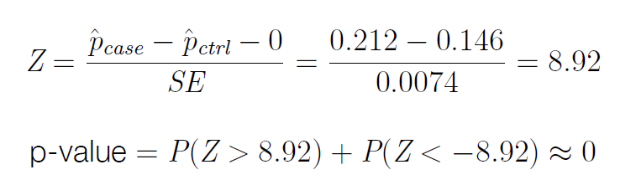
Breast Cancer & Age - test statistic & p-value
Original Question: How can we assess whether this difference is signiﬁcant or simply due to chance?
Conclusion: Reject the null hypothesis. There exists sufficient evidence to suggest that there is a statistically significant difference in the proportion of women who have their first child at age at 30 or older in those that do and do not have breast cancer.
16

Slide 110
Breast Cancer & Age - test statistic & p-value
What else can we conclude with this same result? (Hint: Think about independence).
16

Slide 111
Breast Cancer & Age - test statistic & p-value
What else can we conclude with this same result? (Hint: Think about independence).
Conclusion: Reject the null hypothesis. There exists sufficient evidence to suggest that age of first birth in women (≥30/<30) and getting breast cancer are dependent.
16

Slide 112
Breast Cancer & Age - conﬁdence interval
▶ Conﬁdence level: 98%
17

Slide 113
Breast Cancer & Age - conﬁdence interval
▶ Conﬁdence level: 98%
▶ Theoretical: Using a critical value based on the Z distr. (z⋆):
point estimate ± ME
= point estimate ± z⋆ × SE
17

Slide 114
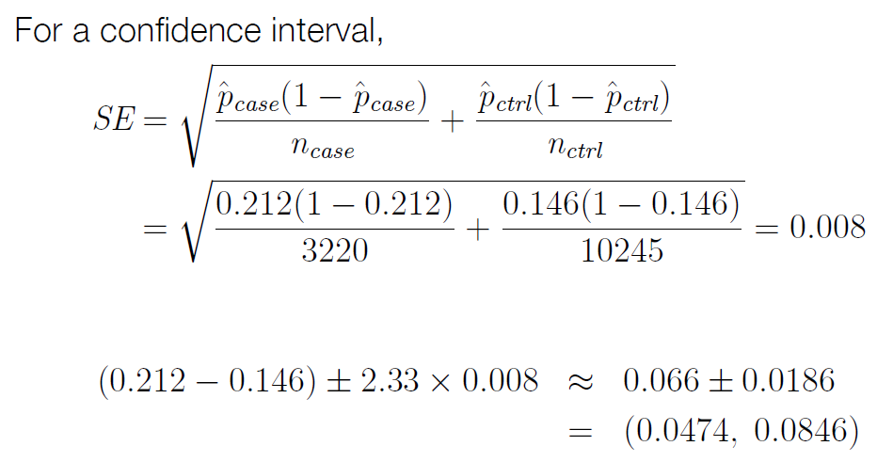
▶ Conﬁdence level: 98%
▶ Theoretical: Using a critical value based on the Z distr. (z⋆):
Breast Cancer & Age - conﬁdence interval
point estimate ± ME
= point estimate ± z⋆ × SE

Slide 115
Breast Cancer & Age - conﬁdence interval
Clicker question
The conclusions we make with the following hypothesis test at the α=0.03 significance level is equivalent to conclusions made with a confidence interval with:
▶ hypotheses:
  Ho: p_{case} − p_{ctrl} = 0
  Ha: p_{case} − p_{ctrl} > 0
Confidence level = 97%
Confidence level = 94%
Confidence level =98.5%

Slide 116
Breast Cancer & Age - conﬁdence interval
Clicker question
The conclusions we make with the following hypothesis test at the α=0.03 significance level is equivalent to conclusions made with a confidence interval with:
▶ hypotheses (two tailed):
  Ho: p_{case} − p_{ctrl} = 0
  Ha: p_{case} − p_{ctrl} > 0
For One-Sided Test, Conclusions Agree When:
Conf. Level = (1- 2α)
Confidence level = 97%
Confidence level = 94%
Confidence level =98.5%

Slide 117
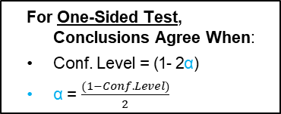
Breast Cancer & Age - conﬁdence interval
For One-Sided Test, Conclusions Agree When:
Conf. Level = (1- 2α)
α = $\frac{(1−Conf. Level)}{2}$
For Two-Sided Test, Conclusions Agree When:
Conf. level = (1- α)
α = (1 - Conf. Level)

Slide 118
Bayesian inference
Design of studies
Clicker question
Frequentist inference (CLT & simulation)
numerical
one mean & median
Exploratory
data analysis
Inference
n = 30 and pˆ = 0.6. Hypotheses: H0 : p = 0.8; H_{A} : p < 0.8. Which of the following is an appropriate method for calculating the p-value for this test?
many means
categorical
Probability
one proportion
two proportions many proportions
Modeling (numerical response)
1 explanatory many explanatory
CLT-based inference using the normal distribution
simulation-based inference
exact calculation using the binomial distribution
18

Slide 119
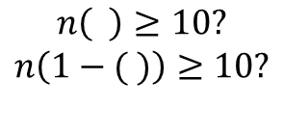
Bayesian inference
Design of studies
Clicker question
Frequentist inference (CLT & simulation)
numerical
one mean & median
Exploratory
data analysis
Inference
n = 30 and pˆ = 0.6. Hypotheses: H0 : p = 0.8; H_{A} : p < 0.8. Which of the following is an appropriate method for calculating the p-value for this test?
many means
categorical
Probability
one proportion
two proportions many proportions
Modeling (numerical response)
1 explanatory many explanatory
CLT-based inference using the normal distribution
simulation-based inference
exact calculation using the binomial distribution
$$n\left( \right)≥10?$$
$$n\left(1−( )\right)≥10?$$
18

Slide 120
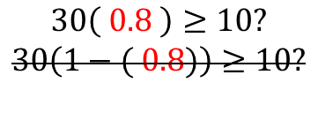
Bayesian inference
Design of studies
Clicker question
Frequentist inference (CLT & simulation)
numerical
one mean & median
Exploratory
data analysis
Inference
n = 30 and pˆ = 0.6. Hypotheses: H0 : p = 0.8; H_{A} : p < 0.8. Which of the following is an appropriate method for calculating the p-value for this test?
many means
categorical
Probability
one proportion
two proportions many proportions
Modeling (numerical response)
1 explanatory many explanatory
CLT-based inference using the normal distribution
simulation-based inference
exact calculation using the binomial distribution
$$30\left( 0.8 \right)≥10?$$
$$30\left(1−( 0.8)\right)≥10?$$
18

Slide 121
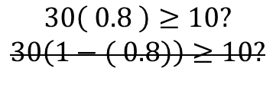
Bayesian inference
Design of studies
Clicker question
Frequentist inference (CLT & simulation)
numerical
one mean & median
Exploratory
data analysis
Inference
n = 30 and pˆ = 0.6. Hypotheses: H0 : p = 0.8; H_{A} : p < 0.8. Which of the following is an appropriate method for calculating the p-value for this test?
many means
categorical
Probability
one proportion
two proportions many proportions
Modeling (numerical response)
1 explanatory many explanatory
CLT-based inference using the normal distribution
simulation-based inference
exact calculation using the binomial distribution
$$30\left( 0.8 \right)≥10?$$
$$30\left(1−( 0.8)\right)≥10?$$
SF Conditions not met. Can’t use CLT methods.
18

Slide 122
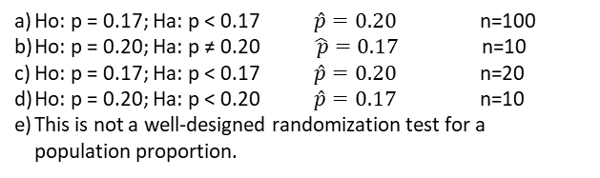
A researcher has tried to set up the following randomization test for p. What were her hypotheses, observed sample proportion, and sample size?
Clicker question
Randomization Test for p
Place 100 chips in a bag, 20 red and 80 green.
Draw 10 chips from the bag without replacement.
Note the proportion of the 10 chips that were red and plot it in the randomization distribution.
Repeat (2) and (3) many times.
In the randomization distribution find the proportion of simulations where the sample proportion was 17% or less; or 23% or more.
Ho: p = 0.17; Ha: p < 0.17 $\hat{p}=0.20$ n=100
Ho: p = 0.20; Ha: p ≠ 0.20 $\hat{ p}=0.17$ n=10
Ho: p = 0.17; Ha: p < 0.17 $\hat{p}=0.20$ n=20
Ho: p = 0.20; Ha: p < 0.20 $\hat{p}=0.17$ n=10
This is not a well-designed randomization test for a population proportion.

Slide 123
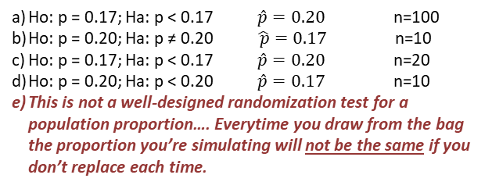
A researcher has tried to set up the following randomization test for p. What were her hypotheses, observed sample proportion, and sample size?
Clicker question
Randomization Test for p
Place 100 chips in a bag, 20 red and 80 green.
Draw 10 chips from the bag without replacement.
Note the proportion of the 10 chips that were red and plot it in the randomization distribution.
Repeat (2) and (3) many times.
In the randomization distribution find the proportion of simulations where the sample proportion was 17% or less; or 23% or more.
Ho: p = 0.17; Ha: p < 0.17 $\hat{p}=0.20$ n=100
Ho: p = 0.20; Ha: p ≠ 0.20 $\hat{ p}=0.17$ n=10
Ho: p = 0.17; Ha: p < 0.17 $\hat{p}=0.20$ n=20
Ho: p = 0.20; Ha: p < 0.20 $\hat{p}=0.17$ n=10
This is not a well-designed randomization test for a population proportion…. Everytime you draw from the bag the proportion you’re simulating will not be the same if you don’t replace each time.

Slide 124
A researcher has tried to set up the following randomization test for p. What were her hypotheses, observed sample proportion, and sample size?
Clicker question
Randomization Test for p
Place 100 chips in a bag, 20 red and 80 green.
Draw 10 chips from the bag WITH REPLACEMENT.
Note the proportion of the 10 chips that were red and plot it in the randomization distribution.
Repeat (2) and (3) many times.
In the randomization distribution find the proportion of simulations where the sample proportion was 17% or less; or 23% or more.
Ho: p = 0.17; Ha: p < 0.17 $\hat{p}=0.20$ n=100
Ho: p = 0.20; Ha: p ≠ 0.20 $\hat{ p}=0.17$ n=10
Ho: p = 0.17; Ha: p < 0.17 $\hat{p}=0.20$ n=20
Ho: p = 0.20; Ha: p < 0.20 $\hat{p}=0.17$ n=10
This is not a well-designed randomization test for a population proportion.

Slide 125
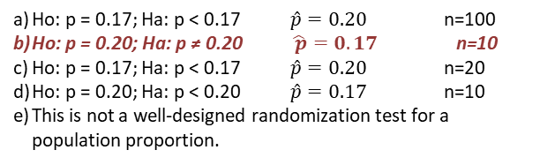
A researcher has tried to set up the following randomization test for p. What were her hypotheses, observed sample proportion, and sample size?
Clicker question
Randomization Test for p
Place 100 chips in a bag, 20 red and 80 green.
Draw 10 chips from the bag WITH REPLACEMENT.
Note the proportion of the 10 chips that were red and plot it in the randomization distribution.
Repeat (2) and (3) many times.
In the randomization distribution find the proportion of simulations where the sample proportion was 17% or less; or 23% or more.
Ho: p = 0.17; Ha: p < 0.17 $\hat{p}=0.20$ n=100
Ho: p = 0.20; Ha: p ≠ 0.20 $\hat{ p}=0.17$ n=10
Ho: p = 0.17; Ha: p < 0.17 $\hat{p}=0.20$ n=20
Ho: p = 0.20; Ha: p < 0.20 $\hat{p}=0.17$ n=10
This is not a well-designed randomization test for a population proportion.

Slide 126
A researcher has tried to set up the following randomization test for p. What were her hypotheses, observed sample proportion, and sample size?
Clicker question
Randomization Test for p
Place 100 chips in a bag, 20 red and 80 green.
Draw 10 chips from the bag WITH REPLACEMENT.
Note the proportion of the 10 chips that were red and plot it in the randomization distribution.
Repeat (2) and (3) many times.
In the randomization distribution find the proportion of simulations where the sample proportion was 17% or less; or 23% or more.
0.20=20 red chips/100 total chips
Ho: p = 0.20; Ha: p ≠ 0.20 $\hat{ p}=0.17$ n=10
$$p−value=P(\hat{ p} at least extreme as one observed|Ho:p=0.20)$$
What the randomization distribution assumes/should be centered at.

Slide 127
A researcher has tried to set up the following randomization test for p. What were her hypotheses, observed sample proportion, and sample size?
Clicker question
Randomization Test for p
Place 100 chips in a bag, 20 red and 80 green.
Draw 10 chips from the bag WITH REPLACEMENT.
Note the proportion of the 10 chips that were red and plot it in the randomization distribution.
Repeat (2) and (3) many times.
In the randomization distribution find the proportion of simulations where the sample proportion was 17% or less; or 23% or more.
0.20=20 red chips/100 total chips
Ho: p = 0.20; Ha: p ≠ 0.20 $\hat{ p}=0.17$ n=10
$$p−value=P(\hat{ p} at least extreme as one observed|Ho:p=0.20)$$
What the randomization distribution assumes/should be centered at.

Slide 128
A researcher has tried to set up the following randomization test for p. What were her hypotheses, observed sample proportion, and sample size?
Clicker question
Randomization Test for p
Place 100 chips in a bag, 20 red and 80 green.
Draw 10 chips from the bag WITH REPLACEMENT.
Note the proportion of the 10 chips that were red and plot it in the randomization distribution.
Repeat (2) and (3) many times.
In the randomization distribution find the proportion of simulations where the sample proportion was 17% or less; or 23% or more.
Looking in both directions on the randomization distribution/sampling distribution for the p-value → 2-tailed test
0.20=20 red chips/100 total chips
Ho: p = 0.20; Ha: p ≠ 0.20 n=10
Sample proportion could have been $\hat{ p}=0.23$ or $\hat{ p}=0.17$
$$p−value=P(\hat{ p} ≤0.17or \hat{ p} ≥0.23 |Ho:p=0.20)$$
What the randomization distribution assumes/should be centered at.

Slide 129
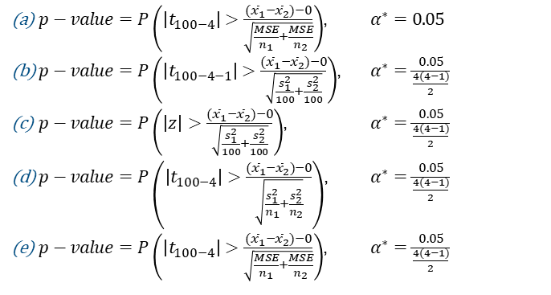
Clicker question
We just conducted an ANOVA test comparing 4 means with a total sample size of n=100. The ANOVA hypothesis was found to be statistically significant at α=0.05.
Which of the following are the appropriate p-value and significance level to use for a post-hoc pairwise comparison test?
$p−value=P\left(\left|t_{100−4}\right|>\frac{{(\overline{x}}_{1}−{\overline{x}}_{2})−0}{\sqrt{\frac{MSE}{n_{1}}+\frac{MSE}{n_{2}}}}\right)$, $α^{∗}=0.05$
$p−value=P\left(\left|t_{100−4−1}\right|>\frac{{(\overline{x}}_{1}−{\overline{x}}_{2})−0}{\sqrt{\frac{s_{1}^{2}}{100}+\frac{s_{2}^{2}}{100}}}\right)$, $α^{∗}=\frac{0.05}{\frac{4(4−1)}{2}}$
$p−value=P\left(\left|z\right|>\frac{{(\overline{x}}_{1}−{\overline{x}}_{2})−0}{\sqrt{\frac{s_{1}^{2}}{100}+\frac{s_{2}^{2}}{100}}}\right)$, $α^{∗}=\frac{0.05}{\frac{4(4−1)}{2}}$
$p−value=P\left(\left|t_{100−4}\right|>\frac{{(\overline{x}}_{1}−{\overline{x}}_{2})−0}{\sqrt{\frac{s_{1}^{2}}{n_{1}}+\frac{s_{2}^{2}}{n_{2}}}}\right)$, $α^{∗}=\frac{0.05}{\frac{4(4−1)}{2}}$
$p−value=P\left(\left|t_{100−4}\right|>\frac{{(\overline{x}}_{1}−{\overline{x}}_{2})−0}{\sqrt{\frac{MSE}{n_{1}}+\frac{MSE}{n_{2}}}}\right)$, $α^{∗}=\frac{0.05}{\frac{4(4−1)}{2}}$

Slide 130
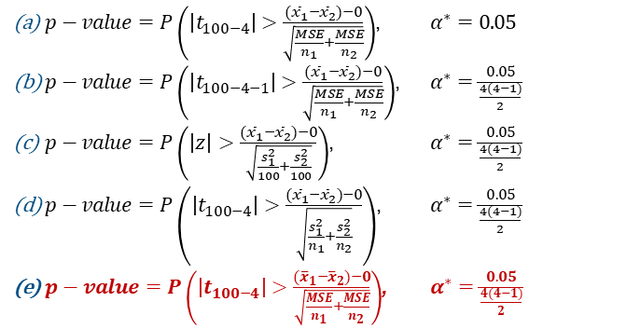
Clicker question
We just conducted an ANOVA test comparing 4 means with a total sample size of n=100. The ANOVA hypothesis was found to be statistically significant at α=0.05.
Which of the following are the appropriate p-value and significance level to use for a post-hoc pairwise comparison test?
$p−value=P\left(\left|t_{100−4}\right|>\frac{{(\overline{x}}_{1}−{\overline{x}}_{2})−0}{\sqrt{\frac{MSE}{n_{1}}+\frac{MSE}{n_{2}}}}\right)$, $α^{∗}=0.05$
$p−value=P\left(\left|t_{100−4−1}\right|>\frac{{(\overline{x}}_{1}−{\overline{x}}_{2})−0}{\sqrt{\frac{MSE}{n_{1}}+\frac{MSE}{n_{2}}}}\right)$, $α^{∗}=\frac{0.05}{\frac{4(4−1)}{2}}$
$p−value=P\left(\left|z\right|>\frac{{(\overline{x}}_{1}−{\overline{x}}_{2})−0}{\sqrt{\frac{s_{1}^{2}}{100}+\frac{s_{2}^{2}}{100}}}\right)$, $α^{∗}=\frac{0.05}{\frac{4(4−1)}{2}}$
$p−value=P\left(\left|t_{100−4}\right|>\frac{{(\overline{x}}_{1}−{\overline{x}}_{2})−0}{\sqrt{\frac{s_{1}^{2}}{n_{1}}+\frac{s_{2}^{2}}{n_{2}}}}\right)$, $α^{∗}=\frac{0.05}{\frac{4(4−1)}{2}}$
$p−value=P\left(\left|t_{100−4}\right|>\frac{{(\overline{x}}_{1}−{\overline{x}}_{2})−0}{\sqrt{\frac{MSE}{n_{1}}+\frac{MSE}{n_{2}}}}\right)$, $α^{∗}=\frac{0.05}{\frac{4(4−1)}{2}}$

Slide 131
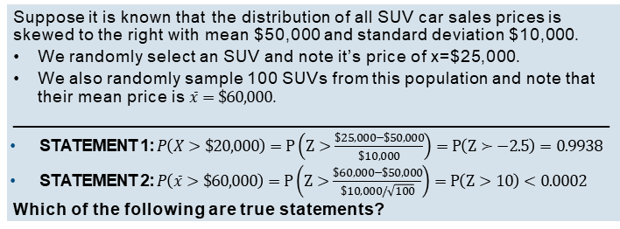
Clicker question
Suppose it is known that the distribution of all SUV car sales prices is skewed to the right with mean $50,000 and standard deviation $10,000.
We randomly select an SUV and note it’s price of x=$25,000.
We also randomly sample 100 SUVs from this population and note that their mean price is $\overline{x}=\$60,000$.
_________________________________________________________________
STATEMENT 1: $P\left(X>\$20,000\right)=P\left(Z>\frac{\$25,000−\$50,000}{\$10,000}\right)=P\left(Z≻−2.5\right)=0.9938$
STATEMENT 2: $P\left(\overline{x}>\$60,000\right)=P\left(Z>\frac{\$60,000−\$50,000}{\$10,000/\sqrt{100}}\right)=P\left(Z>10\right)<0.0002$
Which of the following are true statements?
STATEMENT 1 is TRUE and STATEMENT 2 is FALSE
STATEMENT 2 is TRUE and STATEMENT 1 is FALSE
STATEMENT 1 and 2 are BOTH TRUE
STATEMENT 1 and 2 are BOTH FALSE

Slide 132
Clicker question
Suppose it is known that the distribution of all SUV car sales prices is skewed to the right with mean $50,000 and standard deviation $10,000.
We randomly select an SUV and note it’s price of x=$25,000.
We also randomly sample 100 SUVs from this population and note that their mean price is $\overline{x}=\$60,000$.
_________________________________________________________________
STATEMENT 1: $P\left(X>\$20,000\right)=P\left(Z>\frac{\$25,000−\$50,000}{\$10,000}\right)=P\left(Z≻−2.5\right)=0.9938$
STATEMENT 2: $P\left(\overline{x}>\$60,000\right)=P\left(Z>\frac{\$60,000−\$50,000}{\$10,000/\sqrt{100}}\right)=P\left(Z>10\right)<0.0002$
Which of the following are true statements?
STATEMENT 1 is TRUE and STATEMENT 2 is FALSE
STATEMENT 2 is TRUE and STATEMENT 1 is FALSE
STATEMENT 1 and 2 are BOTH TRUE
STATEMENT 1 and 2 are BOTH FALSE

Slide 133
Clicker question
Suppose it is known that the distribution of all SUV car sales prices is skewed to the right with mean $50,000 and standard deviation $10,000.
We randomly select an SUV and note it’s price of x=$25,000.
We also randomly sample 100 SUVs from this population and note that their mean price is $\overline{x}=\$60,000$.
_________________________________________________________________
STATEMENT 1: $P\left(X>\$20,000\right)=P\left(Z>\frac{\$25,000−\$50,000}{\$10,000}\right)=P\left(Z≻−2.5\right)=0.9938$
STATEMENT 2: $P\left(\overline{x}>\$60,000\right)=P\left(Z>\frac{\$60,000−\$50,000}{\$10,000/\sqrt{100}}\right)=P\left(Z>10\right)<0.0002$
Which of the following are true statements?
Statement 1 not true:
X is not normal.
Cannot use z-score/z-tables to find probability as shown above.

Slide 134
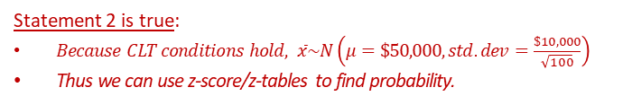
Clicker question
Suppose it is known that the distribution of all SUV car sales prices is skewed to the right with mean $50,000 and standard deviation $10,000.
We randomly select an SUV and note it’s price of x=$25,000.
We also randomly sample 100 SUVs from this population and note that their mean price is $\overline{x}=\$60,000$.
_________________________________________________________________
STATEMENT 1: $P\left(X>\$20,000\right)=P\left(Z>\frac{\$25,000−\$50,000}{\$10,000}\right)=P\left(Z≻−2.5\right)=0.9938$
STATEMENT 2: $P\left(\overline{x}>\$60,000\right)=P\left(Z>\frac{\$60,000−\$50,000}{\$10,000/\sqrt{100}}\right)=P\left(Z>10\right)<0.0002$
Which of the following are true statements?
Statement 2 is true:
$Because CLT conditions hold, \overline{x}\sim N\left(μ=\$50,000,std.dev=\frac{\$10,000}{\sqrt{100}}\right)$
Thus we can use z-score/z-tables to find probability.
CLT Conditions
Independence:
Random sampling/assignment AND
n<10% of population
Sample Size/Skew:
n>30 OR population distribution is normal

Slide 135
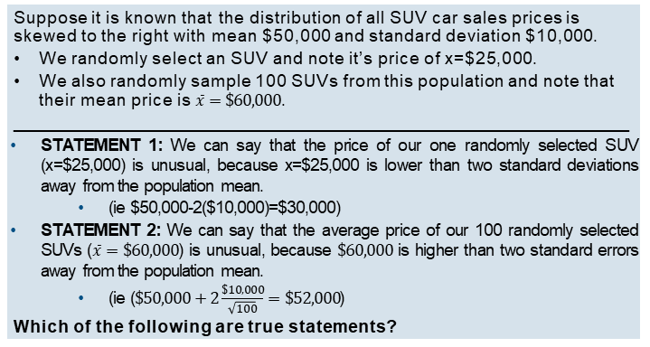
Clicker question
Suppose it is known that the distribution of all SUV car sales prices is skewed to the right with mean $50,000 and standard deviation $10,000.
We randomly select an SUV and note it’s price of x=$25,000.
We also randomly sample 100 SUVs from this population and note that their mean price is $\overline{x}=\$60,000$.
_________________________________________________________________
STATEMENT 1: We can say that the price of our one randomly selected SUV (x=$25,000) is unusual, because x=$25,000 is lower than two standard deviations away from the population mean.
  (ie $50,000-2($10,000)=$30,000)
STATEMENT 2: We can say that the average price of our 100 randomly selected SUVs ($\overline{x}=\$60,000$) is unusual, because $\$60,000$ is higher than two standard errors away from the population mean.
  (ie ($\$50,000+2\frac{\$10,000}{\sqrt{100}}=\$52,000$)
Which of the following are true statements?
STATEMENT 1 is TRUE and STATEMENT 2 is FALSE
STATEMENT 2 is TRUE and STATEMENT 1 is FALSE
STATEMENT 1 and 2 are BOTH TRUE
STATEMENT 1 and 2 are BOTH FALSE

Slide 136
Clicker question
Suppose it is known that the distribution of all SUV car sales prices is skewed to the right with mean $50,000 and standard deviation $10,000.
We randomly select an SUV and note it’s price of x=$25,000.
We also randomly sample 100 SUVs from this population and note that their mean price is $\overline{x}=\$60,000$.
_________________________________________________________________
STATEMENT 1: We can say that the price of our one randomly selected SUV (x=$25,000) is unusual, because x=$25,000 is lower than two standard deviations away from the population mean.
  (ie $50,000-2($10,000)=$30,000)
STATEMENT 2: We can say that the average price of our 100 randomly selected SUVs ($\overline{x}=\$60,000$) is unusual, because $\$60,000$ is higher than two standard errors away from the population mean.
  (ie ($\$50,000+2\frac{\$10,000}{\sqrt{100}}=\$52,000$)
Which of the following are true statements?
STATEMENT 1 is TRUE and STATEMENT 2 is FALSE
STATEMENT 2 is TRUE and STATEMENT 1 is FALSE
STATEMENT 1 and 2 are BOTH TRUE
STATEMENT 1 and 2 are BOTH FALSE

Slide 137

Clicker question
Suppose it is known that the distribution of all SUV car sales prices is skewed to the right with mean $50,000 and standard deviation $10,000.
We randomly select an SUV and note it’s price of x=$25,000.
We also randomly sample 100 SUVs from this population and note that their mean price is $\$60,000$.
_________________________________________________________________
STATEMENT 1: We can say that the price of our one randomly selected SUV (x=$25,000) is unusual, because x=$25,000 is lower than two standard deviations away from the population mean .
  (ie $50,000-2($10,000)=$30,000)
STATEMENT 2: We can say that the average price of our 100 randomly selected SUVs ($\overline{x}=\$60,000$) is unusual, because $\$60,000$ is higher than two standard errors away from the population mean .
  (ie ($\$50,000+2\frac{\$10,000}{\sqrt{100}}=\$52,000$)
Which of the following are true statements?
Rule: Unusual “observation” = “observations” that are 2 standard deviations away from the mean (or z-score >2 or <-2)

Slide 138
Clicker question
Suppose it is known that the distribution of all SUV car sales prices is skewed to the right with mean $50,000 and standard deviation $10,000.
We randomly select an SUV and note it’s price of x=$25,000.
We also randomly sample 100 SUVs from this population and note that their mean price is $\$60,000$.
_________________________________________________________________
STATEMENT 1: We can say that the price of our one randomly selected SUV (x=$25,000) is unusual, because x=$25,000 is lower than two standard deviations away from the population mean .
  (ie $50,000-2($10,000)=$30,000)
STATEMENT 2: We can say that the average price of our 100 randomly selected SUVs ($\overline{x}=\$60,000$) is unusual, because $\$60,000$ is higher than two standard errors away from the population mean .
  (ie ($\$50,000+2\frac{\$10,000}{\sqrt{100}}=\$52,000$)
Which of the following are true statements?
Rule: Unusual “observation” = “observation” that are 2 standard deviations away from the mean (or z-score >2 or <-2)
Only works when the distribution of “observations” are normal.

Slide 139

Clicker question
Suppose it is known that the distribution of SUV car sales prices is skewed to the right with mean $50,000 and standard deviation $10,000.
We randomly select an SUV and note it’s price of x=$25,000.
We also randomly sample 100 SUVs from this population and note that their mean price is $\$60,000$.
_________________________________________________________________
STATEMENT 1: We can say that the price of our one randomly selected SUV (x=$25,000) is unusual, because x=$25,000 is lower than two standard deviations away from the population mean .
  (ie $50,000-2($10,000)=$30,000)
STATEMENT 2: We can say that the average price of our 100 randomly selected SUVs ($\overline{x}=\$60,000$) is unusual, because $\$60,000$ is higher than two standard errors away from the population mean .
  (ie ($\$50,000+2\frac{\$10,000}{\sqrt{100}}=\$52,000$)
Which of the following are true statements?
Rule: Unusual “observation” = “observation” that are 2 standard deviations away from the mean (or z-score >2 or <-2)
Only works when the distribution of “observations” are normal.
Distribution of a single SUV sales price is not normal… can’t use this rule.

Slide 140

Clicker question
Suppose it is known that the distribution of all SUV car sales prices is skewed to the right with mean $50,000 and standard deviation $10,000.
We randomly select an SUV and note it’s price of x=$25,000.
We also randomly sample 100 SUVs from this population and note that their mean price is $\$60,000$.
_________________________________________________________________
STATEMENT 1: We can say that the price of our one randomly selected SUV (x=$25,000) is unusual, because x=$25,000 is lower than two standard deviations away from the population mean .
  (ie $50,000-2($10,000)=$30,000)
STATEMENT 2: We can say that the average price of our n=100 randomly selected SUVs ($\overline{x}=\$60,000$) is unusual, because $\$60,000$ is higher than two standard errors away from the population mean .
  (ie ($\$50,000+2\frac{\$10,000}{\sqrt{100}}=\$52,000$)
Which of the following are true statements?
Rule: Unusual “observation” = “observation” that are 2 standard deviations away from the mean
Only works when the distribution of “observations” are normal.
Distribution of sample SUV means (sample size 100) IS normal because CLT conditions met… CAN use this rule!

Slide 141
Power Review

Slide 142
Are you here today?
a.) yes!

Slide 143

Clicker question
For a hypothesis test, all but one of these probabilities have been given a name in this class. Which one is it?
P(reject Ho | Ho is true)
P(fail to reject Ho | Ho is true)
P(reject Ho | Ha is true)
P(fail to reject Ho | Ha is true)

Slide 144
Clicker question
For a hypothesis test, all but one of these probabilities have been given a name in this class. Which one is it?
P(reject Ho | Ho is true) = P(Type 1 Error) = α
P(fail to reject Ho | Ho is true)
P(reject Ho | Ha is true) = Power = 1- β
P(fail to reject Ho | Ha is true) = P(Type 2 Error) = β = 1 - Power

Slide 145
🔍
4. Hypothesis tests are prone to decision errors
▶ A Type 1 Error is rejecting the null hypothesis when H₀ is true.
P(Type 1 Error) = α = P(reject Ho|Ho is true)
▶ A Type 2 Error is failing to reject the null hypothesis when H_{A} is true.
P(Type 2 Error) = β = P(fail to reject Ho|Ha is true)
▶ Power is the probability of correctly rejecting H₀, and hence the complement of P(Type 2 Error).
Power = 1 – β = P(reject Ho|Ha is true)
To ↑ power/↓ β you can:
↑ n
↑ δ
↑ α

Slide 146
Regression and ANOVA Review

Slide 147

Clicker question
We are interested in how fat contributes to the amount of calories in a hotdog. Below is the ANOVA table for the multiple linear regression (where hotdog calories is the response variable). What percent of the variability in hotdog calories is explained by fat (or the SLR model)?
Regression ANOVA
 | Df | Sum Sq | Mean Sq | F value | Pr(>F)
Fat | 1 | 10946 | 10946 | 319.34 | 1.78E-09
Residuals | 11 | 377.1 | 34.3
Total | 12 | 11323.1
10946
$1−\left(\frac{377.1}{11323.1}\right)$
$1−\left(\frac{377.1}{11323.1}∙\frac{12}{11}\right)$
$\sqrt{1−\left(\frac{377.1}{11323.1}\right)}$

Slide 148

Clicker question
We are interested in how fat contributes to the amount of calories in a hotdog. Below is the ANOVA table for the multiple linear regression (where hotdog calories is the response variable. What percent of the variability in hotdog calories is explained by fat (or the SLR model)?
Regression ANOVA
 | Df | Sum Sq | Mean Sq | F value | Pr(>F)
Fat | 1 | 10946 | 10946 | 319.34 | 1.78E-09
Residuals | 11 | 377.1 | 34.3
Total | 12 | 11323.1
10946
$1−\left(\frac{377.1}{11323.1}\right)=\left(\frac{10946}{11323.1}\right)=R^{2}$
$1−\left(\frac{377.1}{11323.1}∙\frac{12}{11}\right)$
$\sqrt{1−\left(\frac{377.1}{11323.1}\right)}$

Slide 149
Clicker question
We are interested in how fat contributes to the amount of calories in a hotdog. Below is the ANOVA table for the multiple linear regression (where hotdog calories is the response variable. What is the correlation between hotdog fat and calories?
Regression ANOVA
 | Df | Sum Sq | Mean Sq | F value | Pr(>F)
Fat | 1 | 10946 | 10946 | 319.34 | 1.78E-09
Residuals | 11 | 377.1 | 34.3
Total | 12 | 11323.1
10946
$1−\left(\frac{377.1}{11323.1}\right)$
$1−\left(\frac{377.1}{11323.1}∙\frac{12}{11}\right)$
$\sqrt{1−\left(\frac{377.1}{11323.1}\right)}$

Slide 150

Clicker question
We are interested in how fat contributes to the amount of calories in a hotdog. Below is the ANOVA table for the multiple linear regression (where hotdog calories is the response variable. What is the correlation between hotdog fat and calories?
Regression ANOVA
 | Df | Sum Sq | Mean Sq | F value | Pr(>F)
Fat | 1 | 10946 | 10946 | 319.34 | 1.78E-09
Residuals | 11 | 377.1 | 34.3
Total | 12 | 11323.1
10946 = SSRegression
$1−\left(\frac{377.1}{11323.1}\right)=R^{2}$
$1−\left(\frac{377.1}{11323.1}∙\frac{12}{11}\right)=Adjusted R^{2}$
$\sqrt{1−\left(\frac{377.1}{11323.1}\right)}=\sqrt{R^{2}}$ only works for Simple Linear Regression

Slide 151



Clicker question
It is always the case that $Adjusted R^{2}≤R^{2}.$
What type of linear regression would give you $Adjusted R^{2}=R^{2}?$
Regression ANOVA
 | Df | Sum Sq | Mean Sq | F value | Pr(>F)
Fat | 1 | 10946 | 10946 | 319.34 | 1.78E-09
Residuals | 11 | 377.1 | 34.3
Total | 12 | 11323.1
$$1−\left(\frac{377.1}{11323.1}∙\frac{12}{11}\right)=Adjusted R^{2}$$
$$1−\left(\frac{377.1}{11323.1} \right)=R^{2}$$

Slide 152


Clicker question
It is always the case that $Adjusted R^{2}≤R^{2}.$
What type of linear regression would give you $Adjusted R^{2}=R^{2}?$
Regression ANOVA
 | Df | Sum Sq | Mean Sq | F value | Pr(>F)
… | … | … | … | … | …
Residuals | n-k-1 | SSresid | MSresid
Total | n-1 | SST
$$1−\left(\frac{SSresid}{SST}∙\frac{n−1}{n−k−1}\right)=Adjusted R^{2}$$
$$1−\left(\frac{SSresid}{SST} \right)=R^{2}$$

Slide 153

Clicker question
It is always the case that $Adjusted R^{2}≤R^{2}.$
What type of linear regression would give you $Adjusted R^{2}=R^{2}?$
Regression ANOVA
 | Df | Sum Sq | Mean Sq | F value | Pr(>F)
… | … | … | … | … | …
Residuals | n-k-1 | SSresid | MSresid
Total | n-1 | SST
$$1−\left(\frac{SSresid}{SST}∙\frac{n−1}{n−k−1}\right)=Adjusted R^{2}$$
$$1−\left(\frac{SSresid}{SST} \right)=R^{2}$$
When k=0 (there are k=0 predictors in the equation… just an intercept.)

Slide 154

Clicker question
Which of the following is false?
The SST and $df_{T}$ are the same for ANOVA (which compares >2 means) and ANOVA for regression.
The $df_{error}$ is the same for ANOVA (which compares >2 means) and ANOVA for regression.
$\sqrt{\frac{SST}{df_{T}}}=s_{y},$ where y is the response variable.
$SS_{residuals} (or SS_{E})$ is equal to the sum of the squares of the residuals of the model.
SSG for ANOVA (which compares >2 means), represents the total variability of y between groups.

Slide 155
Clicker question
Which of the following is false?
The SST and $df_{T}$ are the same for ANOVA (which compares >2 means) and ANOVA for regression.
The $df_{error}$ is the same for ANOVA (which compares >2 means) and ANOVA for regression.
$\sqrt{\frac{SST}{df_{T}}}=s_{y},$ where y is the response variable.
$SS_{residuals} (or SS_{E})$ is equal to the sum of the squares of the residuals of the model.
SSG for ANOVA (which compares >2 means), represents the total variability of y between groups.

Slide 156

🔍 👫
ANOVA for Comparing >2 Means
Error
k: # of groups; n: # of obs.

Slide 157

ANOVA for Linear Regression
Error
k: # of slopes being estimate; n: # of obs.

Slide 158

Clicker question
Which of the following is false?
$MSG=\frac{SSG}{df_{G}}$ for ANOVA (which compares >2 means), can be thought of as the average variability between groups.
$MSE=\frac{SSE}{df_{E}}$ for ANOVA (which compares >2 means), can be thought of as the average variability within groups.
A high F statistic for ANOVA (which compares >2 means), shows there is sufficient evidence to suggest the means are all different.
For a simple linear regression, $1−\frac{SS_{Regression}}{SST}$ represents the percent of response variable variability that is NOT explained by the explanatory variable.
In an ANOVA (which compares >2 means and the groups = levels of a categorical explanatory variable) $1−\frac{SS_{Group}}{SST}$ represents the percent of response variable variability that is NOT explained by the explanatory variable.

Slide 159
Clicker question
Which of the following is false?
$MSG=\frac{SSG}{df_{G}}$ for ANOVA (which compares >2 means), can be thought of as the average variability between groups.
$MSE=\frac{SSE}{df_{E}}$ for ANOVA (which compares >2 means), can be thought of as the average variability within groups.
A high F statistic for ANOVA (which compares >2 means), shows there is sufficient evidence to suggest the means are all different.
For a simple linear regression, $1−\frac{SS_{Regression}}{SST}$ represents the percent of response variable variability that is NOT explained by the explanatory variable.
In an ANOVA (which compares >2 means and the groups = levels of a categorical explanatory variable) $1−\frac{SS_{Group}}{SST}$ represents the percent of response variable variability that is NOT explained by the explanatory variable.

Slide 160
Clicker question
Which of the following is true?
A low R means that the two variables have no strong relationship or association.
A high R means that a simple linear regression with variables will be a good fit (one variable as response, the other explanatory).
The correlation between housing prices (in $US) and time will be different if you convert the currency to New Zealand dollars.
An influence point is more likely to decrease R and change the regression slope, than a leverage point.

Slide 161
Clicker question
Which of the following is true?
A low R means that the two variables have no strong relationship or association. →They could have a strong nonlinear relationship. R only measures strength of linear relationships.
A high R means that a simple linear regression with variables will be a good fit (one variable as response, the other explanatory). →A high R doesn’t mean the regression conditions will hold. You could still have a nonlinear relationship or non-constant variance for instance.
The correlation between housing prices (in $US) and time will be different if you convert the currency to New Zealand dollars. →R is unitless… not affected by unit conversions.
An influence point is more likely to decrease R and change the regression slope, than a leverage point. →An influence point will fall further away from the regression line, causing the R to decrease, and the slope of the line to change.

Slide 162

Clicker question
Would the result from the first step of backwards elimination agree if you used the p-value method vs. adjusted R^2 method?
Full Model: Hotdog Calories ~ Fat +SatFat
Model that Removed Fat: Adjusted R^2 =0.9637
Model that Removed SatFat: Adjusted R^2 = 0.8837
Yes
No

Slide 163
Clicker question
Would the result from the first step of backwards elimination agree if you used the p-value method vs. adjusted R^2 method?
Full Model: Hotdog Calories ~ Fat +SatFat
Model that Removed Fat: Adjusted R^2 =0.9637
Model that Removed SatFat: Adjusted R^2 = 0.8837
Yes
No – Full model best using Adjusted R^2,
Model with just Fat best using p-value method.

Slide 164

We are interested in predicting the annual income of a person that works 80 hours a week. What are THREE REASONS we SHOULD NOT fit a simple linear regression model and make this prediction with the data that we have (shown below)?

Slide 165
We are interested in predicting the annual income of a person that works 80 hours a week. What are THREE REASONS we SHOULD NOT fit a simple linear regression model and make this prediction with the data that we have (shown below)?
Condition Violation: The relationship is nonlinear.
Condition Violation: The variance of the residuals (when fitting a linear model) would increase as hours worked increases…. so non-homoscedastic residuals.
Extrapolation: 80 hrs/week working is outside the range of data (highest our data goes is 65hrs/week). So our prediction would be an unreliable extrapolation.

Slide 166




Clicker question
We are interested in predicting the annual income of a person that works 45 hours a week with the same data set. The plots below are the the residuals vs. fitted values plots for two separate simple linear regression models. Which model would produce a smaller prediction interval?
Model 1
Model 2
$$\log_{e}\left(income\right)=b_{0}+b_{1}(hrswork)$$
$$\log_{10}\left(income\right)=b_{0}+b_{1}(hrswork)$$
Model 1
Model 2

Slide 167

Clicker question
We are interested in predicting the annual income of a person that works 45 hours a week with the same data set. The plots below are the the residuals vs. fitted values plots for two separate simple linear regression models. Which model would produce a smaller prediction interval?
Model 1
Model 2
$$\log_{e}\left(income\right)=b_{0}+b_{1}(hrswork)$$
$$\log_{10}\left(income\right)=b_{0}+b_{1}(hrswork)$$
Model 1 has smaller residual standard deviation, so will have a smaller prediction interval.
Model 1
Model 2

