Slide 1
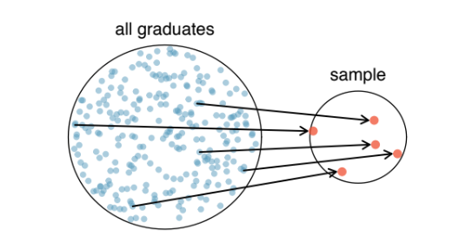
Unit 1: Introduction to data
1. Data Collection + Observational studies & experiments
Sta 101 – Spring 19
Duke University, Department of Statistical Science
Dr. Ellison
Slides posted at https://www2.stat.duke.edu/courses/Spring19/sta101.001/

Slide 2
In-Class Lecture Notes Key
🔍 Extra Focus
∡ Concept from Different Angle
🆕 Completely New Concept
⚙ Inner Workings/Why does this work?
👫 Relationships Between Concepts
🔮 Building Intuition
✋ Hands-On Exercises
🙃 Common Misconceptions
🖳 Coding
🎰 Game

Slide 3
Outline
Main ideas
    Course Goal: 🆕 Use a sample (data) to make inferences about the population
    Data Collection Principles
      Random Sampling:
        🆕 Ideally use a simple random sample, stratify to control for a variable, and cluster to make sampling easier
        🆕 Sampling schemes can suﬀer from a variety of biases
      Random Assignment: Randomly assign observations to each independent variable group.
        🆕 Four principles of experimental design: randomize, control, block, replicate
    Types of Studies: 🆕 Experiments use random assignment to treatment groups observational studies do not
    Types of Inferences we can Make and How:
      🆕 Random sampling helps generalizability,
      🆕 Random assignment helps causality (two or more variables)
2. Summary

Slide 4
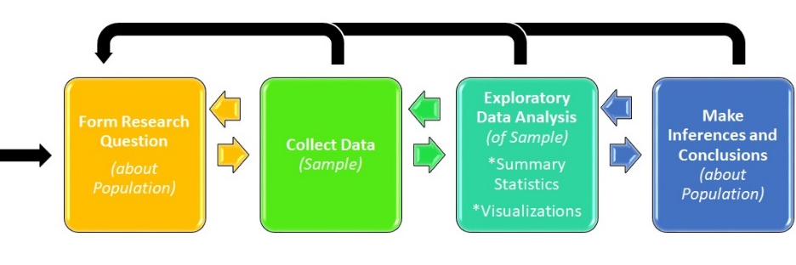
1. Use a sample to make inferences about the population
🆕
▶ Ultimate goal: make inferences about populations
1

Slide 5
🆕
1. Use a sample to make inferences about the population
▶ Ultimate goal: make inferences about populations
▶ Caveat: populations are difﬁcult or impossible to access
1

Slide 6
1. Use a sample to make inferences about the population
🆕
▶ Ultimate goal: make inferences about populations
▶ Caveat: populations are difﬁcult or impossible to access
▶ Solution: use a sample from that population, and use statistics from that sample to make inferences about the unknown population parameters
1

Slide 7
1. Use a sample to make inferences about the population
🆕
▶ Ultimate goal: make inferences about populations
▶ Caveat: populations are difﬁcult or impossible to access
▶ Solution: use a sample from that population, and use statistics from that sample to make inferences about the unknown population parameters
▶ The better (more representative) sample we have, the more reliable our estimates and more accurate our inferences will be
1

Slide 8
🆕
1. Use a sample to make inferences about the population
▶ Ultimate goal: make inferences about populations
▶ Caveat: populations are difﬁcult or impossible to access
▶ Solution: use a sample from that population, and use statistics from that sample to make inferences about the unknown population parameters
▶ The better (more representative) sample we have, the more reliable our estimates and more accurate our inferences will be
Suppose we want to know how many offspring female lemurs have, on average. It’s not feasible to obtain offspring data from on all female lemurs, so we use data from the Duke Lemur Center. We use the sample mean from these data as an estimate for the unknown population mean. Can you see any limitations to using data from the Duke Lemur Center to make inferences about all lemurs?
1

Slide 9

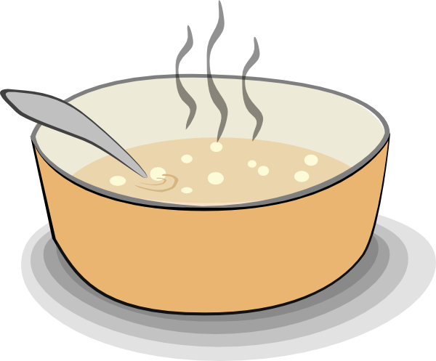
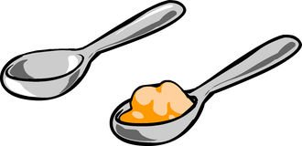
Sampling is natural
🆕
Is the soup salty?
Get a spoonful.
Taste it. Is it salty?
Use this spoonful to determine if the whole soup is salty.
2

Slide 10
Sampling is natural
🆕
▶ When you taste a spoonful of soup and decide the spoonful you tasted isn’t salty enough, that’s exploratory analysis
▶ If you generalize and conclude that your entire soup needs salt, that’s an inference
▶ For your inference to be valid, the spoonful you tasted (the sample) needs to be representative of the entire pot (the population)
2

Slide 11
Outline
🆕
Main ideas
    Course Goal: 🆕 Use a sample (data) to make inferences about the population
    Data Collection Principles
      Random Sampling:
        🆕 Ideally use a simple random sample, stratify to control for a variable, and cluster to make sampling easier
        🆕 Sampling schemes can suﬀer from a variety of biases
      Random Assignment: Randomly assign observations to each independent variable group.
        🆕 Four principles of experimental design: randomize, control, block, replicate
    Types of Studies: 🆕 Experiments use random assignment to treatment groups, observational studies do not
    Types of Inferences we can Make and How:
      🆕 Random sampling helps generalizability,
      🆕 Random assignment helps causality (two or more variables)
2. Summary

Slide 12
2. Ideally use a simple random sample, stratify to control for a variable,
and cluster to make sampling easier
🆕
Simple random:
Drawing names from a hat
●
●●●
●●●
●
●
●
●●●
●●●
●
●
●
● ●
● ●
●
●
●
●
●
●
●
●
●●●
●
●
●●● ●
●
●●●
●
● ●
●
●
●
●
●
●
●
●
●
●
●
●
●
●
●
●
●
●
●
●
●
●
●
●
● ●
●●●
●
●
●
●
●
●
●
●
●
●
●
●
●
●
●
●
●
●
●●● ●
●●●
●
●●●
●
●
●
●
●●●
● ●●●
●
●
●
●●●
●
●
●
●
●
●●●
●
●●●
●●●
●
●
●
●
●●●
3

Slide 13
🆕
2. Ideally use a simple random sample, stratify to control for a variable,
and cluster to make sampling easier
Assess: We want to know how many hours the average adult American spends watching TV. We have log data from TV set-top-boxes. However, adults age groups 18-29, 30-45, and 55+ often have different TV viewing habits and 18-29 adults don’t often have TV set-top-boxes.
What is the population of interest in this example?
What are some potential issues that might be encountered in conducting a simple random sample of this population?
3

Slide 14
2. Ideally use a simple random sample, stratify to control for a variable,
and cluster to make sampling easier
🆕
Simple random:
Drawing names from a hat
●
●●●
●●●
●
●
●
●●●
●●●
●
●
●
● ●
● ●
●
●
●
●
●
●
●
●
●●●
●
●
●●● ●
●
●●●
●
● ●
●
●
●
●
●
●
●
●
●
●
●
●
●
●
●
●
●
●
●
●
●
●
●
●
● ●
●●●
●
●
●
●
●
●
●
●
●
●
●
●
●
●
●
●
●
●
●●● ●
●●●
●
●●●
●
●
●
●
●●●
● ●●●
●
●
●
●●●
●
●
●
●
●
●●●
●
●●●
●●●
●
●
●
●
●●●
Stratiﬁed: homogenous strata Stratify to control for age group
Stratum 2
Stratum 4
Stratum 6
●●
●
●
●
●●●
●
●
●
● ● ●
●●
●
Stratum 3
●
● ● ● ●
● ●
●
●
●
●●●●
● ●●
●●● ●●●
●●
●
●
●
●●● ● ● ●
●● ●●●
●
●
●
●
●
● ●
● ● ● ●
● ●
● ●●
●
●●● ●
●
●
●
●
● ●
● ● ●
●
●
●
●
● ●
●
●
●
Stratum 1
●
●
●
●
●
●
●
●
● ●
●
● ●
● ●
● ●
● ●
● ●
●
●
●●
●
● ●●●
●
● ●
●
●
● ●●● ●
● ●
●
●●● ●
● ●●●
●
● ● ●●●
●
●●● ●
●
●
●
●●●●
●
●
●
Stratum 5
3

Slide 15
2. Ideally use a simple random sample, stratify to control for a variable,
and cluster to make sampling easier
Assess: There exist 57 distinct colonies of chimpanzees spread across a large country. Researcher wish to assess the average gestation period of female chimpanzees in the country. Each of these colonies are spread out across the country and are difficult to find, but the chimpanzees in each colony are all interspersed with young, old, sick, and healthy chimpanzees.
What is the population of interest in this example?
What are some potential issues that might be encountered in conducting a simple random sample of this population?
3

Slide 16
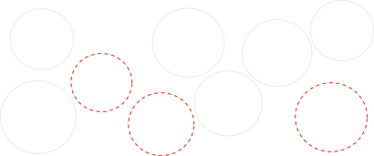
2. Ideally use a simple random sample, stratify to control for a variable,
🆕
and cluster to make sampling easier
Simple random:
Drawing names from a hat
Cluster: heterogenous clusters Sample all chosen clusters
●
●●●
●●●
●
●
●
●●●
Cluster 2
Cluster 5
●
●
Cluster 9
●●●
●
●
●
● ●
● ●
●
●
Cluster 7
●
●
●
●
●
●
●
●
●
●
●●●
●
●
●
●●● ●
●
●
●
●
●
● ●
● ● ●
●●●
●
● ●
●
● ●
●●
●
●
●
● ●
●
●
●
●
Cluster 3
●●● ●●●●●
●
● ●
●
●
●
●
● ●
●
●
●●
●
●
●
●
●
●
●
●
●
●
●
●●● ●
●
●
●
●
●
●
●●
●
●●
●●
Cluster 8
●
●
●
●
●
Cluster 4
●●●
●
●
●
●
●
●
●
● ●
●
●
● ●
●●● ●●●
●
●
●●●
●
●
●●●
●●
●●●
●●●
●●●
●
●
●
●
●
●● ● ●
●
●●●●
●●
●●● ●●●●●●
●
●
●
●
●
●
●
●●●●
●
●●●
●
●
●●●
●
●●● ●●●
●●
●●●
●
● ● ●
●
●● ●
●
●●●● ●●● ●●
●
●
●
●●
●
●
●
●
●
●
●● ●
● ●●●
●
●
●
●
●●●
● ●
●●●
●●●
●●●
●●●
●●●
●
● ● ● ●
●
●
●●
●●● ●
●
●
●●●
●●● ●
Cluster 6
●●●
●
●● ●●●
●●●
●
●
●
●
●
●●●
●●●
●
●●●
●
Cluster 1
●●
●
●●●
●
●
●
Stratiﬁed: homogenous strata Stratify to control for age group
Stratum 2
Stratum 4
Stratum 6
●●
●
●
●
●●●
●
●
●
● ● ●
●●
●
Stratum 3
●
● ● ● ●
● ●
●
●
●
●●●●
● ●●
●●● ●●●
●●
●
●
●
●●● ● ● ●
●● ●●●
●
●
●
●
●
● ●
● ● ● ●
● ●
● ●●
●
●●● ●
●
●
●
●
● ●
● ● ●
●
●
●
●
● ●
●
●
●
Stratum 1
●
●
●
●
●
●
●
●
● ●
●
● ●
● ●
● ●
● ●
● ●
●
●
●●
●
● ●●●
●
● ●
●
●
● ●●● ●
● ●
●
●●● ●
● ●●●
●
● ● ●●●
●
●●● ●
●
●
●
●●●●
●
●
●
Stratum 5
3

Slide 17
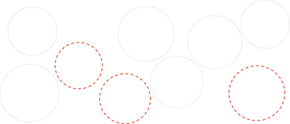
2. Ideally use a simple random sample, stratify to control for a variable,
🆕
and cluster to make sampling easier
Simple random:
Drawing names from a hat
Cluster: heterogenous clusters Sample all chosen clusters
●
●●●
●●●
●
●
●
●●●
Cluster 2
Cluster 5
●
●
Cluster 9
●●●
●
●
●
● ●
● ●
●
●
Cluster 7
●
●
●
●
●
●
●
●
●
●
●●●
●
●
●
●●● ●
●
●
●
●
●
● ●
● ● ●
●●●
●
● ●
●
● ●
●●
●
●
●
● ●
●
●
●
●
Cluster 3
●●● ●●●●●
●
● ●
●
●
●
●
● ●
●
●
●●
●
●
●
●
●
●
●
●
●
●
●
●●● ●
●
●
●
●
●
●
●●
●
●●
●●
Cluster 8
●
●
●
●
●
Cluster 4
●●●
●
●
●
●
●
●
●
● ●
●
●
● ●
●●● ●●●
●
●
●●●
●
●
●●●
●●
●●●
●●●
●●●
●
●
●
●
●
●● ● ●
●
●●●●
●●
●●● ●●●●●●
●
●
●
●
●
●
●
●●●●
●
●●●
●
●
●●●
●
●●● ●●●
●●
●●●
●
● ● ●
●
●● ●
●
●●●● ●●● ●●
●
●
●
●●
●
●
●
●
●
●
●● ●
● ●●●
●
●
●
●
●●●
● ●
●●●
●●●
●●●
●●●
●●●
●
● ● ● ●
●
●
●●
●●● ●
●
●
●●●
●●● ●
●● ●●●
Cluster 6
●●●
●
●
●
●
●
●
●●●
●
●●●
●
Cluster 1
●●
●
●●●
●●●
●
●
●
●●●
Stratiﬁed: homogenous strata Stratify to control for age group
Multistage: heterogeneous clusters
Random sample in chosen clusters
Stratum 2
Stratum 4
Stratum 6
●●
●
Cluster 2
●●
● ● ●
● ●
●
●
●
●
Cluster 5
●
● ●
Cluster 9
●
●
●●●
Cluster 7
● ● ●
●
● ● ●
●
●
●
●
●
● ● ●
●●
●
Stratum 3
●
● ● ● ●
●
●
● ●
● ● ●
●●●●
● ●●
●
● ●
●
●
●●● ● ● ●
●●● ●●●
●●
●
●
Cluster 3
●
●
●
●● ●●●
●
●
●
●
●
●
● ●
●
●
● ● ●
● ● ● ●
● ●
● ●●
● ● ●
●
●
●
●
●
●
●
●
● ●
●
● ●
●
●
●
●
●
●
● ●
●
●● ●
●
●
●●● ●●●
●
● ●
●
●
Cluster 8
●
● ●
●
●
●
●
●
●
● ●
●
● ●●●
Cluster 4
Stratum 1
●
●
●
●
●
●
●●● ● ●●●
●
●
●
● ●
●
●
● ●
● ●
●
● ●
● ●
●●● ●
●
●
●
●●● ●
●
●●
●
● ●●●
●
● ●
●
●
●
● ● ●
●
●●● ●
●
● ● ●●●
●
●
● ●●● ●
● ●
● ●
● ●
● ●
●●●●
●
●
● ●● ●
●●● ●●●
●
●
●●● ●
●
●
●●●●
●
●
● ●
● ●
●
●
●●●●●●
●
● ●●●●
●●●
●
●●●
●
● ●
Cluster 6
●●
●
● ●
●
Cluster 1
●●●
● ●
●
●●●● ●
●
Stratum 5
● ●●●
3

Slide 18
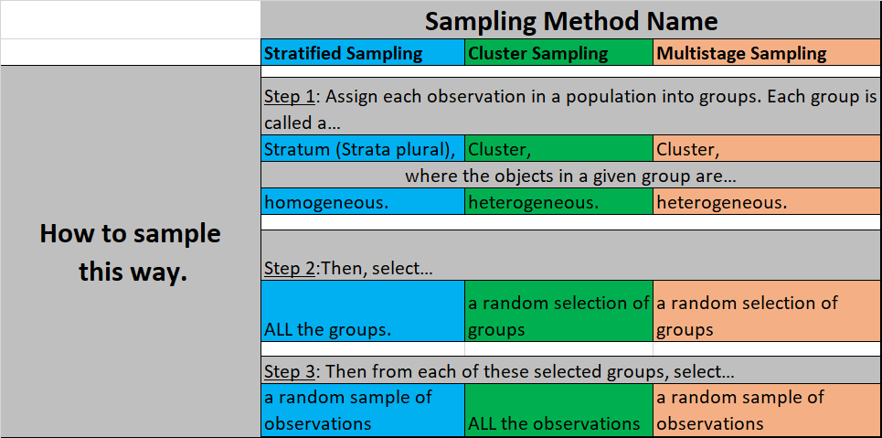
2. Ideally use a simple random sample, stratify to control for a variable,
🆕
and cluster to make sampling easier

Slide 19
Clicker question
🆕
A city council has requested a household survey be conducted in a suburban area of their city. The area is broken into many distinct and unique neighborhoods, some including large homes and some with only apartments. Which approach would likely be the least effective?
Simple random sampling
Stratiﬁed sampling, where each stratum is a neighborhood
Cluster sampling, where each cluster is a neighborhood
4

Slide 20
Clicker question
🆕
A city council has requested a household survey be conducted in a suburban area of their city. The area is broken into many distinct and unique neighborhoods, some including large homes and some with only apartments. Which approach would likely be the least effective?
Simple random sampling
Stratiﬁed sampling, where each stratum is a neighborhood
Cluster sampling, where each cluster is a neighborhood
4

Slide 21
Clicker question
A city council has requested a household survey be conducted in a suburban area of their city. The area is broken into many distinct and unique neighborhoods, some including large homes and some with only apartments. Which approach would likely be the least effective?
Simple random sampling
Stratiﬁed sampling, where each stratum is a neighborhood
Cluster sampling, where each cluster is a neighborhood
Groups = neighborhoods
Neighborhoods are unique => homogeneous within
Clusters (in cluster sampling) need to be heterogeneous.
4

Slide 22
Outline
Random sampling HELPS generalize sample results to the population, what types of sampling make it HARDER to generalize to the population?

Slide 23
Outline
Main ideas
    Course Goal: 🆕 Use a sample (data) to make inferences about the population
    Data Collection Principles
      Random Sampling:
        🆕 Ideally use a simple random sample, stratify to control for a variable, and cluster to make sampling easier
        🆕 Sampling schemes can suﬀer from a variety of biases
      Random Assignment: Randomly assign observations to each independent variable group.
        🆕 Four principles of experimental design: randomize, control, block, replicate
    Types of Studies: 🆕 Experiments use random assignment to treatment groups, observational studies do not
    Types of Inferences we can Make and How:
      🆕 Random sampling helps generalizability,
      🆕 Random assignment helps causality (two or more variables)
2. Summary

Slide 24
3. Sampling schemes can suﬀer from a variety of biases
🆕
Assess: Out of a list of 30 political issues (ex: abortion, healthcare) what issue do Americans most desire to hear discussed in the 2016 presidential debate?
Some sample ideas… how could these samples be NOT REPRESENTATIVE of the population?
Poll everyone in this STA101 class?
Randomly select 300 addresses, send them a poll, and request that they return it?
Open up a national online poll?
1

Slide 25
3. Sampling schemes can suﬀer from a variety of biases
🆕
▶ Non-response: If only a non-random fraction of the randomly sampled people choose to respond to a survey, the sample may no longer be representative of the population
5

Slide 26
3. Sampling schemes can suﬀer from a variety of biases
🆕
Assess: Out of a list of 30 political issues (ex: abortion, healthcare) what issue do Americans most desire to hear discussed in the 2016 presidential debate?
Some sample ideas… what type of biases do these sampling methods suffer from?
Poll everyone in this STA101 class.
Randomly select 300 addresses, send them a poll, and request that they return it
Open up a national online poll.
1

Slide 27
3. Sampling schemes can suﬀer from a variety of biases
🆕
Assess: Out of a list of 30 political issues (ex: abortion, healthcare) what issue do Americans most desire to hear discussed in the 2016 presidential debate?
Some sample ideas… what type of biases do these sampling methods suffer from?
Poll everyone in this STA101 class.
Randomly select 300 addresses, send them a poll, and request that they return it. (Non-response bias)
Open up a national online poll.
1

Slide 28
3. Sampling schemes can suﬀer from a variety of biases
🆕
▶ Non-response: If only a non-random fraction of the randomly sampled people choose to respond to a survey, the sample may no longer be representative of the population
▶ Voluntary response: Occurs when the sample consists of people who volunteer to respond because they have strong opinions on the issue since such a sample will also not be representative of the population
5

Slide 29
3. Sampling schemes can suﬀer from a variety of biases
🆕
Assess: Out of a list of 30 political issues (ex: abortion, healthcare) what issue do Americans most desire to hear discussed in the 2016 presidential debate?
Some sample ideas… what type of biases do these sampling methods suffer from?
Poll everyone in this STA101 class.
Randomly select 300 addresses, send them a poll, and request that they return it. (Non-response bias)
Open up a national online poll.
1

Slide 30
3. Sampling schemes can suﬀer from a variety of biases
🆕
Assess: Out of a list of 30 political issues (ex: abortion, healthcare) what issue do Americans most desire to hear discussed in the 2016 presidential debate?
Some sample ideas… what type of biases do these sampling methods suffer from?
Poll everyone in this STA101 class
Randomly select 300 addresses, send them a poll, and request that they return it (Non-response bias)
Open up a national online poll (Voluntary response bias)
1

Slide 31
3. Sampling schemes can suﬀer from a variety of biases
🆕
▶ Non-response: If only a non-random fraction of the randomly sampled people choose to respond to a survey such that the sample may be no longer be representative of the population
▶ Voluntary response: Occurs when the sample consists of people who volunteer to respond because they have strong opinions on the issue since such a sample will also not be representative of the population
▶ Convenience sample: Individuals who are easily accessible are more likely to be included in the sample
5

Slide 32
3. Sampling schemes can suﬀer from a variety of biases
🆕
Assess: Out of a list of 30 political issues (ex: abortion, healthcare) what issue do Americans most desire to hear discussed in the 2016 presidential debate?
Some sample ideas… what type of biases do these sampling methods suffer from?
Poll everyone in this STA101 class
Randomly select 300 addresses, send them a poll, and request that they return it (Non-response bias)
Open up a national online poll (Voluntary response bias)
1

Slide 33
3. Sampling schemes can suﬀer from a variety of biases
🆕
Assess: Out of a list of 30 political issues (ex: abortion, healthcare) what issue do Americans most desire to hear discussed in the 2016 presidential debate?
Some sample ideas… what type of biases do these sampling methods suffer from?
Poll everyone in this STA101 class? (convenience sample bias)
Randomly select 300 addresses, send them a poll, and request that they return it? (Non-response bias)
Open up a national online poll? (voluntary response bias)
1

Slide 34
🆕
Clicker question
A school district is considering whether it will no longer allow high school students to park at school after two recent accidents where students were severely injured. As a ﬁrst step, they survey parents by mail, asking them whether or not the parents would object to this policy change. Of 6,000 surveys that go out, 1,200 are returned. Of these 1,200 surveys that were completed, 960 agreed with the policy change and 240 disagreed. Which of the following statements are true?
Some of the mailings may have never reached the parents.
Overall, the school district has strong support from parents to move forward with the policy approval.
It is possible that majority of the parents of high school students disagree with the policy change.
The survey results are unlikely to be biased because all parents were mailed a survey.
(a) Only I
(b) I and II
(c) I and III (d) III and IV (e) Only IV
6

Slide 35
🆕
Clicker question
A school district is considering whether it will no longer allow high school students to park at school after two recent accidents where students were severely injured. As a ﬁrst step, they survey parents by mail, asking them whether or not the parents would object to this policy change. Of 6,000 surveys that go out, 1,200 are returned. Of these 1,200 surveys that were completed, 960 agreed with the policy change and 240 disagreed. Which of the following statements are true?
Some of the mailings may have never reached the parents.
Overall, the school district has strong support from parents to move forward with the policy approval.
It is possible that majority of the parents of high school students disagree with the policy change.
The survey results are unlikely to be biased because all parents were mailed a survey.
(a) Only I
(b) I and II
(c) I and III (d) III and IV (e) Only IV
6

Slide 36
🆕
Clicker question
A school district is considering whether it will no longer allow high school students to park at school after two recent accidents where students were severely injured. As a ﬁrst step, they survey parents by mail, asking them whether or not the parents would object to this policy change. Of 6,000 surveys that go out, 1,200 are returned. Of these 1,200 surveys that were completed, 960 agreed with the policy change and 240 disagreed. Which of the following statements are true?
Some of the mailings may have never reached the parents. (Convenience sample)
Overall, the school district has strong support from parents to move forward with the policy approval.
It is possible that majority of the parents of high school students disagree with the policy change. (Non-response bias)
The survey results are unlikely to be biased because all parents were mailed a survey.
(a) Only I
(b) I and II
(c) I and III (d) III and IV (e) Only IV
6

Slide 37
Outline
Main ideas
    Course Goal: 🆕 Use a sample (data) to make inferences about the population
    Data Collection Principles
      Random Sampling:
        🆕 Ideally use a simple random sample, stratify to control for a variable, and cluster to make sampling easier
        🆕 Sampling schemes can suﬀer from a variety of biases
      Random Assignment: Randomly assign observations to each independent variable group.
        🆕 Four principles of experimental design: randomize, control, block, replicate
    Types of Studies: 🆕 Experiments use random assignment to treatment groups, observational studies do not
    Types of Inferences we can Make and How:
      🆕 Random sampling helps generalizability,
      🆕 Random assignment helps causality (two or more variables)
2. Summary

Slide 38
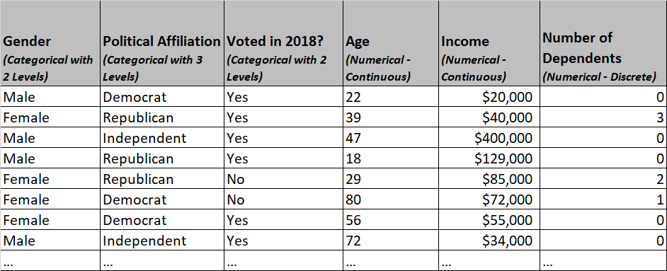
Inferences about Relationships between two or more Variables:
“Is there an association between age and political affiliation?”
Vs.
“Does age affect/cause political affiliation?” or “Does being older cause you vote Republican?”
Sample Data

Slide 39
Outline
Main ideas
    Course Goal: 🆕 Use a sample (data) to make inferences about the population
    Data Collection Principles
      Random Sampling:
        🆕 Ideally use a simple random sample, stratify to control for a variable, and cluster to make sampling easier
        🆕 Sampling schemes can suﬀer from a variety of biases
      Random Assignment: Randomly assign observations to each independent variable group.
        🆕 Four principles of experimental design: randomize, control, block, replicate
    Types of Studies: 🆕 Experiments use random assignment to treatment groups, observational studies do not
    Types of Inferences we can Make and How:
      🆕 Random sampling helps generalizability,
      🆕 Random assignment helps causality (two or more variables)
2. Summary

Slide 40
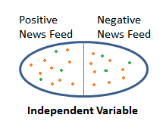
Outline
Why does random assignment allow for us to conclude the independent variable causes/influences the dependent variable?
Causes
Dependent Variable

Slide 41
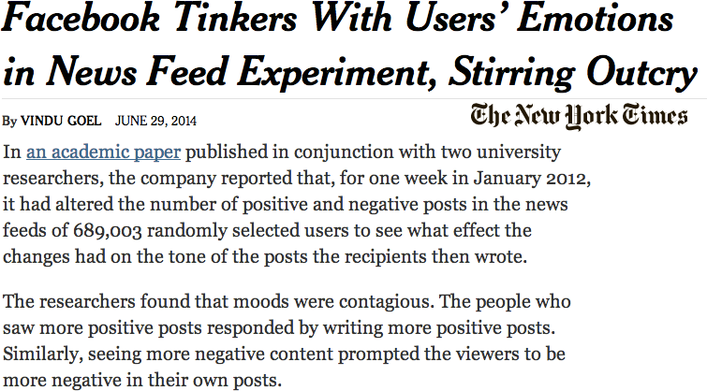
What type of study is this? What is the scope of inference (causality / generalizability)?
Were the users allowed to assign themselves to the positive or negative newsfeed groups or were they randomly assigned?
http://www.nytimes.com/2014/06/30/technology/
facebook-tinkers-with-users-emotions-in-news-feed-experiment-stirring-outcry.html

Slide 42
What type of study is this? What is the scope of inference (causality / generalizability)?
🆕
Were the users allowed to assign themselves to the positive or negative newsfeed groups or were they randomly assigned?
→Study is an Experiment, not an observational study!
http://www.nytimes.com/2014/06/30/technology/
facebook-tinkers-with-users-emotions-in-news-feed-experiment-stirring-outcry.html

Slide 43
What type of study is this? What is the scope of inference (causality / generalizability)?
🆕
What is the scope of inference:
If it’s a Random Experiment:
  “Does newsfeed positivity affect/cause posting positivity?”
If it’s an Observational Study:
  “Is there an association between newsfeed positivity and posting positivity?”
http://www.nytimes.com/2014/06/30/technology/
facebook-tinkers-with-users-emotions-in-news-feed-experiment-stirring-outcry.html

Slide 44
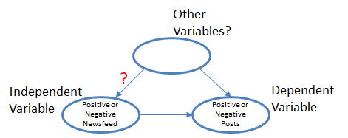
What type of study is this? What is the scope of inference (causality / generalizability)?
🆕
Experiment: Facebook Study

Slide 45
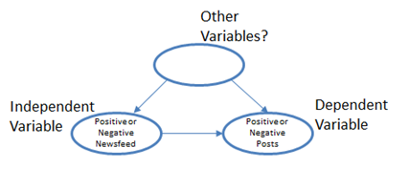
What type of study is this? What is the scope of inference (causality / generalizability)?
Experiment: Facebook Study
Negative things going on in your area

Slide 46

What type of study is this? What is the scope of inference (causality / generalizability)?
Experiment: Facebook Study
Causes
Posting Positivity/
Negativity
Dependent Variable

Slide 47
4. Experiments use random assignment to treatment groups,
observational studies do not
A study that surveyed a random sample of otherwise healthy adults found that people are more likely to get muscle cramps when they’re stressed. The study also noted that people drink more coffee and sleep less when they’re stressed. What type of study is this?
What is the conclusion of the study?
Can this study be used to conclude a causal relationship between increased stress and muscle cramps?
8

Slide 48
🆕
4. Experiments use random assignment to treatment groups,
observational studies do not
A study that surveyed a random sample of otherwise healthy adults found that people are more likely to get muscle cramps when they’re stressed. The study also noted that people drink more coffee and sleep less when they’re stressed. What type of study is this?
Observational
Independent Variable
Dependent Variable
What is the conclusion of the study?
Can this study be used to conclude a causal relationship between increased stress and muscle cramps?
8

Slide 49
🆕
4. Experiments use random assignment to treatment groups,
observational studies do not
A study that surveyed a random sample of otherwise healthy adults found that people are more likely to get muscle cramps when they’re stressed. The study also noted that people drink more coffee and sleep less when they’re stressed. What type of study is this?
Observational
What is the conclusion of the study?
There is an association between increased stress & muscle cramps.
Can this study be used to conclude a causal relationship between increased stress and muscle cramps?
8

Slide 50
🆕
4. Experiments use random assignment to treatment groups,
observational studies do not
Can this study be used to conclude a causal relationship between increased stress and muscle cramps?
Muscle cramps might also be due to increased caffeine consumption or sleeping less – these are potential confounding variables.
extraneous variables that affect both the independent and
the dependent variable and that make it seem like there's a relationship between them.
High Stress
Low Stress
Causes?
Muscle Cramps
Independent Variable
Dependent Variable
8

Slide 51
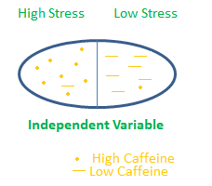
🆕
4. Experiments use random assignment to treatment groups,
observational studies do not
Can this study be used to conclude a causal relationship between increased stress and muscle cramps?
Muscle cramps might also be due to increased caffeine consumption or sleeping less – these are potential confounding variables.
Causes?
Muscle Cramps
Dependent Variable
8

Slide 52

Outline
What are the four principles of an experimental design?

Slide 53
Outline
Main ideas
    Course Goal: 🆕 Use a sample (data) to make inferences about the population
    Data Collection Principles
      Random Sampling:
        🆕 Ideally use a simple random sample, stratify to control for a variable, and cluster to make sampling easier
        🆕 Sampling schemes can suﬀer from a variety of biases
      Random Assignment: Randomly assign observations to each independent variable group.
        🆕 Four principles of experimental design: randomize, control, block, replicate
    Types of Studies: 🆕 Experiments use random assignment to treatment groups, observational studies do not
    Types of Inferences we can Make and How:
      🆕 Random sampling helps generalizability,
      🆕 Random assignment helps causality (two or more variables)
2. Summary

Slide 54
5. Four principles of experimental design: randomize, control, block, replicate
🆕
▶ We would like to design an experiment to investigate if increased stress causes muscle cramps, randomly assign subjects to either:
Treatment: increased stress
Control: no or baseline stress
9

Slide 55
5. Four principles of experimental design: randomize, control, block, replicate
🆕
▶ We would like to design an experiment to investigate if increased stress causes muscle cramps, randomly assign subjects to either:
Treatment: increased stress
Control: no or baseline stress
▶ It is suspected that the effect of stress might be different on younger and older people: block for age.
Why is this important? Can you think of other variables to block for?
9

Slide 56
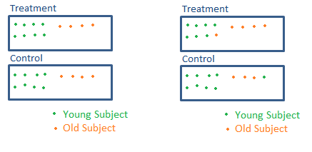
5. Four principles of experimental design: randomize, control, block, replicate
🆕
▶ We would like to design an experiment to investigate if increased stress causes muscle cramps, randomly assign subjects to either:
Treatment: increased stress
Control: no or baseline stress
▶ It is suspected that the effect of stress might be different on younger and older people: block for age.
Why is this important? Can you think of other variables to block for?
DON’T Want
Want
9

Slide 57
Outline
Main ideas
    Course Goal: 🆕 Use a sample (data) to make inferences about the population
    Data Collection Principles
      Random Sampling:
        🆕 Ideally use a simple random sample, stratify to control for a variable, and cluster to make sampling easier
        🆕 Sampling schemes can suﬀer from a variety of biases
      Random Assignment: Randomly assign observations to each independent variable group.
        🆕 Four principles of experimental design: randomize, control, block, replicate
    Types of Studies: 🆕 Experiments use random assignment to treatment groups, observational studies do not
    Types of Inferences we can Make and How:
      🆕 Random sampling helps generalizability,
      🆕 Random assignment helps causality (two or more variables)
2. Summary

Slide 58





6. Random sampling helps generalizability, random assignment helps causality (two or more variables)
🆕
If two or more variables in research question
most
ideal experiment
Random assignment
No random assignment
observational studies
Random sampling
Causal conclusion, generalized to the whole population.
No causal conclusion, correlation statement generalized to the whole population.
Generalizability
No random sampling
Causal conclusion, only for the sample.
No causal conclusion,
No
correlation statement only _{generalizability}
for the sample.
most experiments
bad observational studies
Causation
Correlation
10

Slide 59
Outline
Main ideas
    Course Goal: 🆕 Use a sample (data) to make inferences about the population
    Data Collection Principles
      Random Sampling:
        🆕 Ideally use a simple random sample, stratify to control for a variable, and cluster to make sampling easier
        🆕 Sampling schemes can suﬀer from a variety of biases
      Random Assignment: Randomly assign observations to each independent variable group.
        🆕 Four principles of experimental design: randomize, control, block, replicate
    Types of Studies: 🆕 Experiments use random assignment to treatment groups, observational studies do not
    Types of Inferences we can Make and How:
      🆕 Random sampling helps generalizability,
      🆕 Random assignment helps causality (two or more variables)
2. Summary

Slide 60
TO-DO:
Get clickers if you haven’t already and bring to class on Monday.
Download or purchase book.
Complete the Pre-test and Getting to Know you Survey.
Watch Unit 1 videos
Thursday:
Go to lab and work on Lab Assignment 0.
Next Monday:
Begin registering clickers (roll-call).
Take our unit 1 Readiness Assessment (not graded.)
Lesson 1.2 and Application Exercises.
11

