Slide 1
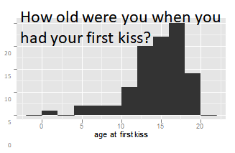
Unit 1: Introduction to data
2. Exploratory data analysis
Sta 101 – Spring 2019
Duke University, Department of Statistical Science
Dr. Ellison
Slides posted at https://www2.stat.duke.edu/courses/Spring19/sta101.001/index.html

Slide 2
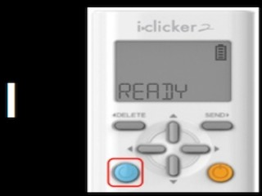
Register your Clicker!
To do now:
Turn on your clicker (orange button)
Wait about 6 seconds.
IF your clicker says “READY,”:
Look for when your name appears on the slides. (If you don’t see your name and you are officially enrolled in the course let me know!)
When you see your name, type the 4 letters you see under it (you have 15 seconds).
If your name box turned another color, your clicker should now be registered to the class!
IF your clicker does not say “READY”:
Hold down on the orange button until the clicker screen changes.
Quickly press AA.
Wait ~6 seconds.
Your screen should now say “READY”. (If not, ask a TA for help!)
We will be registering clickers 1/14, 1/16, 1/23… clicker grading begins on 1/28!

Slide 3
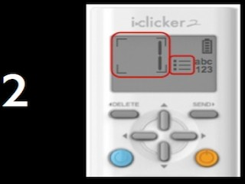
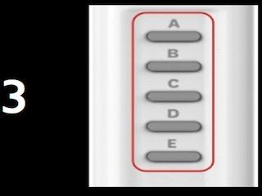
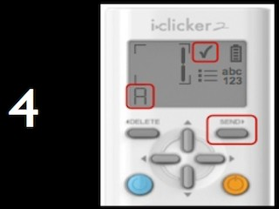
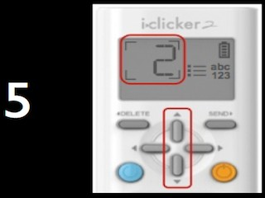
Readiness assessment
▶ Individual: 15 minutes, using clickers
▶ Team: 10 minutes, using scratch off sheets (1 per team)
1

Slide 4
Summary of main ideas
To Do:
Getting to Know you Survey + Pretest due tomorrow 1/15
Start working on Problem Set 1 (Due Friday 1/26)
16

Slide 5
Outline
Readiness assessment
Housekeeping
Main ideas
Analysis work flow:
🆕 👫 Always start your exploration with a visualization
Single Numerical Variable
🔍 🔮 ⚙ When describing numerical distributions discuss shape, center, spread, and unusual observations
🔍 Robust statistics are not easily aﬀected by outliers and extreme skew
🔍 🆕 Use box plots to display quartiles, median, and outliers
Application exercises
Summary

Slide 6
Outline
Readiness assessment
Housekeeping
Main ideas
Analysis work flow:
🆕 👫 Always start your exploration with a visualization
Single Numerical Variable
🔍 🔮 ⚙ When describing numerical distributions discuss shape, center, spread, and unusual observations
🔍 Robust statistics are not easily aﬀected by outliers and extreme skew
🔍 🆕 Use box plots to display quartiles, median, and outliers
Application exercises
Summary

Slide 7
Outline
Readiness assessment
Housekeeping
Main ideas
Analysis work flow:
🆕 👫 Always start your exploration with a visualization
Single Numerical Variable
🔍 🔮 ⚙ When describing numerical distributions discuss shape, center, spread, and unusual observations
🔍 Robust statistics are not easily aﬀected by outliers and extreme skew
🔍 🆕 Use box plots to display quartiles, median, and outliers
Application exercises
Summary

Slide 8
Outline
Readiness assessment
Housekeeping
Main ideas
Analysis work flow:
🆕 👫 Always start your exploration with a visualization
Single Numerical Variable
🔍 🔮 ⚙ When describing numerical distributions discuss shape, center, spread, and unusual observations
🔍 Robust statistics are not easily aﬀected by outliers and extreme skew
🔍 🆕 Use box plots to display quartiles, median, and outliers
Application exercises
Summary

Slide 9
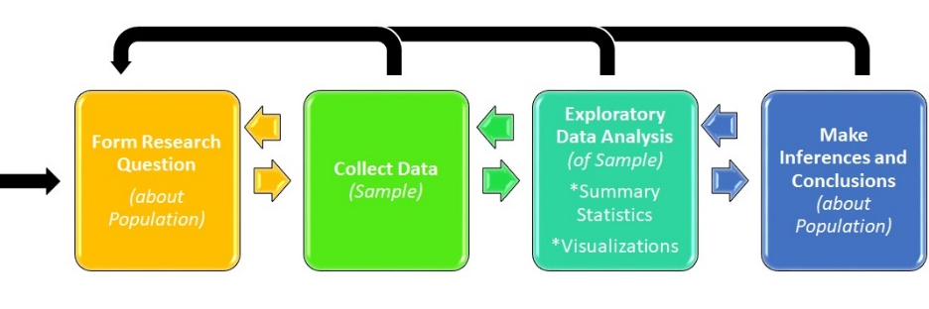
Outline
Should we calculate a summary statistic or make a data visualization first?

Slide 10
From a past Sta 101 survey...
🔮
👫
🆕
Do you see anything out of the ordinary?
How old were you when you had your first kiss?
20
15
10
5
0
0
5
10
age at first kiss
15
20
3

Slide 11
From a past Sta 101 survey...
🔮
👫
🆕
Do you see anything out of the ordinary?
How old were you when you had your first kiss?
20
15
10
5
0
0
5
10
age at first kiss
15
20
Some people reported very low ages, which might suggest the survey question wasn’t clear: romantic kiss or any kiss?
3

Slide 12
Outline
We should start our exploratory data analysis with a visualization first!

Slide 13

Outline
Lab Hint: When asked to describe a visualization of a single numerical variable, there are four things we should always discuss. What
are they?

Slide 14
Outline
Readiness assessment
Housekeeping
Main ideas
Analysis work flow:
🆕 👫 Always start your exploration with a visualization
Single Numerical Variable
🔍 🔮 ⚙ When describing numerical distributions discuss shape, center, spread, and unusual observations
🔍 Robust statistics are not easily aﬀected by outliers and extreme skew
🔍 🆕 Use box plots to display quartiles, median, and outliers
Application exercises
Summary

Slide 15
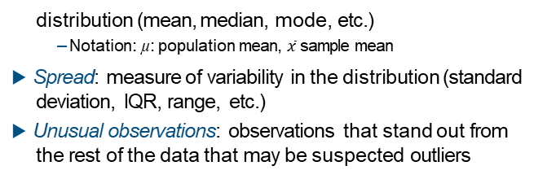
Describing distributions of numerical variables
🔍
▶ Shape: skewness, modality
▶ Center: an estimate of a typical observation in the
distribution (mean, median, mode, etc.)
– Notation: µ: population mean, $\overline{x}$ sample mean
▶ Spread: measure of variability in the distribution (standard deviation, IQR, range, etc.)
▶ Unusual observations: observations that stand out from the rest of the data that may be suspected outliers
7

Slide 16

Outline
What are some things to think about when guessing the distribution of any variable?

Slide 17
Clicker question
🔮
Which of these is most likely to have a roughly symmetric distribution?
salaries of a random sample of people from North Carolina
weights of adult females
scores on an well-designed exam
last digits of phone numbers
8

Slide 18
Clicker question
🔮
Which of these is most likely to have a roughly symmetric distribution?
salaries of a random sample of people from North Carolina
weights of adult females
scores on an well-designed exam
last digits of phone numbers
8

Slide 19
Outline
Think about natural boundaries!

Slide 20
Application exercise: 1.1 Distributions of numerical variables
See the course website for instructions.
15

Slide 21
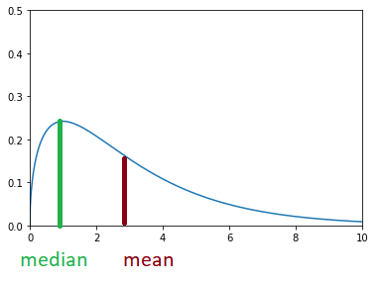
Outline
How do mean, median, and skewness relate?

Slide 22

👫
🔍
Mean vs. median
Clicker question
How do the mean and median of the following two datasets compare?
Dataset 1: 30, 50, 70, 90
Dataset 2: 30, 50, 70, 1000
${\overline{x}}_{1}={\overline{x}}_{2}$, median₁ = median₂
${\overline{x}}_{1}<{\overline{x}}_{2}$, median₁ = median₂
${\overline{x}}_{1}<{\overline{x}}_{2}$, median₁ < median₂
${\overline{x}}_{1}>{\overline{x}}_{2}$, median₁ < median₂
${\overline{x}}_{1}>{\overline{x}}_{2}$, median₁ = median₂
9

Slide 23

👫
🔍
Mean vs. median
Clicker question
How do the mean and median of the following two datasets compare?
Dataset 1: 30, 50, 70, 90
Dataset 2: 30, 50, 70, 1000
${\overline{x}}_{1}={\overline{x}}_{2}$, median₁ = median₂
${\overline{x}}_{1}<{\overline{x}}_{2}$, median₁ = median₂
${\overline{x}}_{1}<{\overline{x}}_{2}$, median₁ < median₂
${\overline{x}}_{1}>{\overline{x}}_{2}$, median₁ < median₂
${\overline{x}}_{1}>{\overline{x}}_{2}$, median₁ = median₂
9

Slide 24
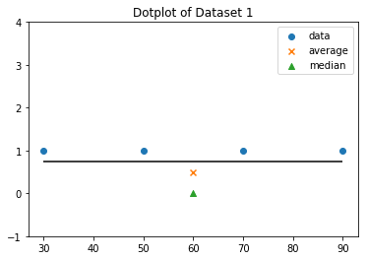
👫
🔍
Mean vs. median
Clicker question
How do the mean and median of the following two datasets compare?
Dataset 1: 30, 50, 70, 90
Dataset 2: 30, 50, 70, 1000
${\overline{x}}_{1}={\overline{x}}_{2}$, median₁ = median₂
${\overline{x}}_{1}<{\overline{x}}_{2}$, median₁ = median₂
${\overline{x}}_{1}<{\overline{x}}_{2}$, median₁ < median₂
${\overline{x}}_{1}>{\overline{x}}_{2}$, median₁ < median₂
${\overline{x}}_{1}>{\overline{x}}_{2}$, median₁ = median₂
Symmetric
Mean=median=60
9

Slide 25
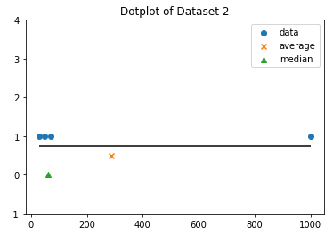
👫
🔍
Mean vs. median
Clicker question
How do the mean and median of the following two datasets compare?
Dataset 1: 30, 50, 70, 90
Dataset 2: 30, 50, 70, 1000
${\overline{x}}_{1}={\overline{x}}_{2}$, median₁ = median₂
${\overline{x}}_{1}<{\overline{x}}_{2}$, median₁ = median₂
${\overline{x}}_{1}<{\overline{x}}_{2}$, median₁ < median₂
${\overline{x}}_{1}>{\overline{x}}_{2}$, median₁ < median₂
${\overline{x}}_{1}>{\overline{x}}_{2}$, median₁ = median₂
Symmetric
Mean=median=60
Right-Skewed
Mean>median=60
9

Slide 26
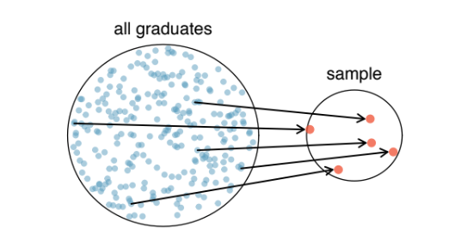
Outline
Why are the ways we calculate population standard deviation and sample standard deviation different?
σ
s

Slide 27
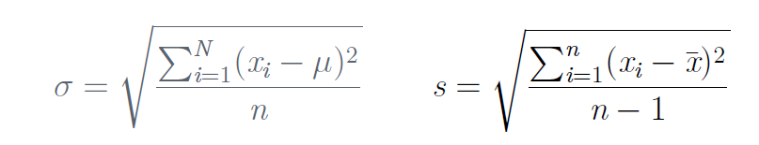
▶ Most commonly used measure of variability is the
🔍
Standard deviation and variance
standard deviation, which roughly measures the average deviation from the mean
– Notation: σ: population standard deviation, s: sample standard deviation
▶ Calculating the standard deviation, for a population (rarely, if ever) and for a sample:
▶ Square of the standard deviation is called the variance.

Slide 28
▶ Most commonly used measure of variability is the
🔍
Standard deviation and variance
standard deviation, which roughly measures the average deviation from the mean
– Notation: σ: population standard deviation, s: sample standard deviation
▶ Calculating the standard deviation, for a population (rarely, if ever) and for a sample:
▶ Square of the standard deviation is called the variance.

Slide 29
Why divide by n − 1 instead of n when calculating the sample
🔍
⚙
More on SD
standard deviation?
11

Slide 30
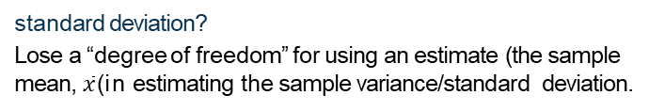
Why divide by n − 1 instead of n when calculating the sample
🔍
⚙
More on SD
standard deviation?
Lose a “degree of freedom” for using an estimate (the sample mean, $\overline{x}$ ) i n estimating the sample variance/standard deviation.
11

Slide 31
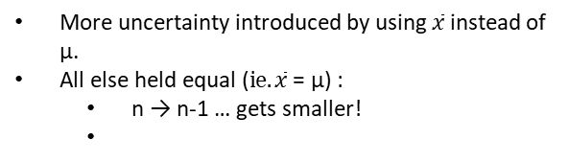
Why divide by n − 1 instead of n when calculating the sample
🔍
⚙
More on SD
standard deviation?
Lose a “degree of freedom” for using an estimate (the sample mean, $\overline{x}$ ) i n estimating the sample variance/standard deviation.
More uncertainty introduced by using $\overline{x}$ instead of μ.
All else held equal ($ie. \overline{x}$ = μ) :
n → n-1 … gets smaller!
→
…gets larger…. incorporates more variation/uncertainty.
11

Slide 32
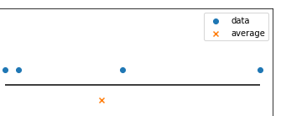
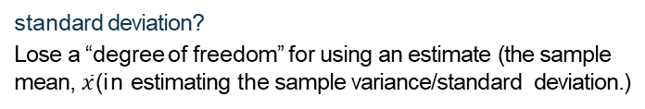
Why divide by n − 1 instead of n when calculating the sample
🔍
⚙
More on SD
standard deviation?
Lose a “degree of freedom” for using an estimate (the sample mean, $\overline{x}$ ) i n estimating the sample variance/standard deviation.)
Why do we use the squared deviation in the calculation of variance?
11

Slide 33
Why divide by n − 1 instead of n when calculating the sample
🔍
⚙
More on SD
standard deviation?
Lose a “degree of freedom” for using an estimate (the sample mean, $\overline{x}$ ) i n estimating the sample variance/standard deviation.)
Why do we use the squared deviation in the calculation of variance?
▶ To get rid of negatives so that observations equally distant from the mean are weighed equally.
▶ To weigh larger deviations more heavily.
11

Slide 34
Outline
Center:
When should we use mean vs. median?
Spread:
When should we use standard deviation vs. IQR vs. range?

Slide 35
Outline
Readiness assessment
Housekeeping
Main ideas
Analysis work flow:
🆕 👫 Always start your exploration with a visualization
Single Numerical Variable
🔍 🔮 ⚙ When describing numerical distributions discuss shape, center, spread, and unusual observations
🔍 Robust statistics are not easily aﬀected by outliers and extreme skew
🔍 🆕 Use box plots to display quartiles, median, and outliers
Application exercises
Summary

Slide 36
Range and IQR
🔍
Clicker question
True / False: The range is always at least as large as the IQR for a given dataset.
Yes
No
12

Slide 37
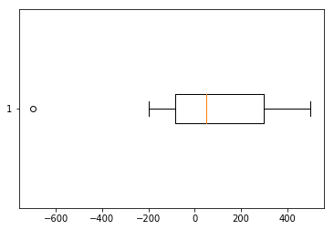
Range and IQR
🔍
Clicker question
True / False: The range is always at least as large as the IQR for a given dataset.
Yes
No
Range = max - min, IQR = Q3 - Q1
12

Slide 38
Range and IQR
🔍
Clicker question
True / False: The range is always at least as large as the IQR for a given dataset.
Yes
No
Range = max - min, IQR = Q3 - Q1
Is the range or the IQR more robust to outliers?
12

Slide 39
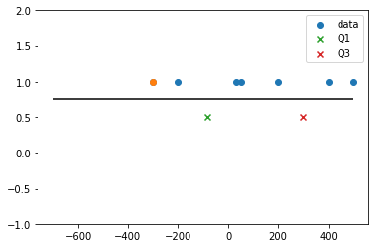
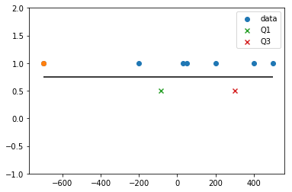
Range and IQR
🔍
IQR
IQR
range
range
Is the range or the IQR more robust to outliers?
IQR
12

Slide 40
Robust statistics
🔍
▶ Mean and standard deviation are easily affected by extreme observations since the value of each data point contributes to their calculation.
▶ Median and IQR are more robust to outliers.
▶ Therefore we choose median & IQR (over mean&SD) when describing skewed distributions.
▶ We choose mean & SD when describing symmetric distributions, as they are more useful in using mathematical theory to make inferences.
13

Slide 41
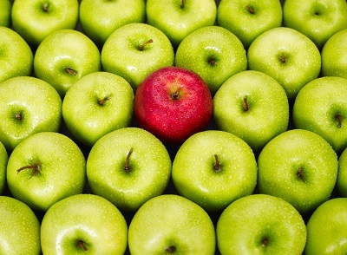
Outline
How do we determine if a data point is an outlier in a numerical distribution?
How do we
construct a
boxplot?
https://www.kdnuggets.com/2017/01/3-methods-deal-outliers.html

Slide 42
Outline
Readiness assessment
Housekeeping
Main ideas
Analysis work flow:
🆕 👫 Always start your exploration with a visualization
Single Numerical Variable
🔍 🔮 ⚙ When describing numerical distributions discuss shape, center, spread, and unusual observations
🔍 Robust statistics are not easily aﬀected by outliers and extreme skew
🔍 🆕 Use box plots to display quartiles, median, and outliers
Application exercises
Summary

Slide 43
Box plot
A box plot visualizes the median, the quartiles, and suspected outliers. An outlier is deﬁned as an observation more than 1.5×IQR away from the quartiles (Q1 and Q3).
Q₃ (third quartile)
median
Q (first quartile)
1
14

Slide 44
Box plot
A box plot visualizes the median, the quartiles, and suspected outliers. An outlier is deﬁned as an observation more than 1.5×IQR away from the quartiles (Q1 and Q3).
Q₃ (third quartile)
median
IQR
Q (first quartile)
1
14

Slide 45
Box plot
A box plot visualizes the median, the quartiles, and suspected outliers. An outlier is deﬁned as an observation more than 1.5×IQR away from the quartiles (Q1 and Q3).
max whisker reach
=Q3+1.5(IQR)
(upper fence)
1.5(IQR)
Q₃ (third quartile)
median
IQR
min whisker reach
Q (first quartile)
1
(lower fence)
1.5(IQR)
=Q1-1.5(IQR)
14

Slide 46
Box plot
A box plot visualizes the median, the quartiles, and suspected outliers. An outlier is deﬁned as an observation more than 1.5×IQR away from the quartiles (Q1 and Q3).
outliers
max whisker reach
=Q3+1.5(IQR)
(upper fence)
1.5(IQR)
Q₃ (third quartile)
median
IQR
min whisker reach
Q (first quartile)
1
(lower fence)
1.5(IQR)
=Q1-1.5(IQR)
14

Slide 47
Box plot
A box plot visualizes the median, the quartiles, and suspected outliers. An outlier is deﬁned as an observation more than 1.5×IQR away from the quartiles (Q1 and Q3).
outliers
max whisker reach
(upper fence)
upper whisker
=largest observation ≤ upper fence
min whisker reach
lower whisker
(lower fence)
=smallest observation ≥ lower fence
14

Slide 48
Box plot
A box plot visualizes the median, the quartiles, and suspected outliers. An outlier is deﬁned as an observation more than 1.5×IQR away from the quartiles (Q1 and Q3).
1
14

Slide 49
Outline
Readiness assessment
Housekeeping
Main ideas
Analysis work flow:
🆕 👫 Always start your exploration with a visualization
Single Numerical Variable
🔍 🔮 ⚙ When describing numerical distributions discuss shape, center, spread, and unusual observations
🔍 Robust statistics are not easily aﬀected by outliers and extreme skew
🔍 🆕 Use box plots to display quartiles, median, and outliers
Application exercises
Summary

