Slide 1

Unit 1: Introduction to data
4. Introduction to statistical inference
Sta 101 - Spring 2019
Duke University, Department of Statistical Science
Dr. Ellison
Slides posted at https://www2.stat.duke.edu/courses/Spring19/sta101.001/

Slide 2
Outline
Housekeeping
🔮 ✋ Case study: Is yawning contagious?
  Competing claims
  Testing via simulation
  Checking for independence
🔮 ✋ Case study: Tapping on caﬀeine
Application exercise

Slide 3
Announcements
Coming up…
▶ Lab Assignment 1 is due Thursday just before your lab section time.
▶ Problem Set 1 is due Friday night (11:55pm)
▶ Performance Assessment 1 is due Sunday night (11:55pm)
▶ Readiness Assessment 2 is next Monday, so start reviewing resources for Unit 2, don’t wait till Sunday!
▶ We will start grading for clickers on Monday!
1

Slide 4
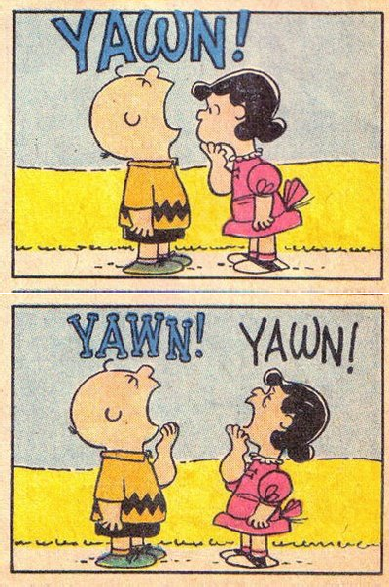
Outline
Research Question: Is yawning contagious?

Slide 5
Outline
1. Housekeeping
Case study: Is yawning contagious?
  Competing claims
  Testing via simulation
  Checking for independence
Case study: Tapping on caﬀeine
Application exercise

Slide 6
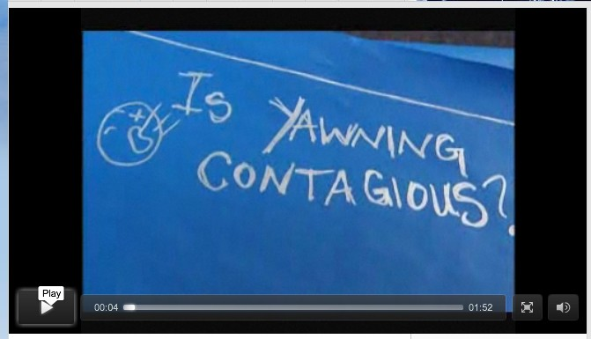
🔮 ✋
Is yawning contagious?
An experiment conducted by the MythBusters tested if a person can be subconsciously inﬂuenced into yawning if another person near them yawns.
https://www.youtube.com/watch?v=bCCCxV3nNgs&feature=youtu.be
3

Slide 7
Outline
What are the variables in this research question?
Which is the independent and which is the dependent variable?
Are these variables categorical or numerical?
What sample statistics can we calculate?
Study Type
Is this an experiment or an observational study?

Slide 8
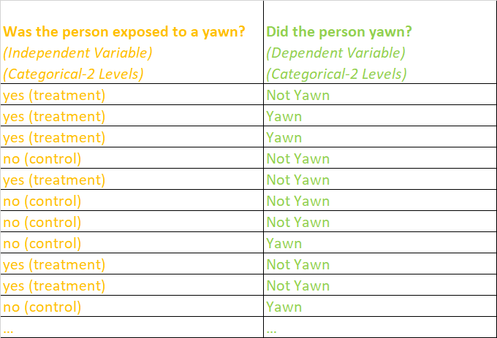
Outline
Original Sample Data Collected
Tabulating Data

Slide 9
50 people were randomly assigned to two groups:
▶ treatment: see someone yawn, n = 34
🔮 ✋
Experiment summary
▶ control: don’t see someone yawn, n = 16
 | Treatment | Control | Total
Yawn Not Yawn | 10 24 | 4 12 | 14 36
Total | 34 | 16 | 50
% Yawners
4

Slide 10
50 people were randomly assigned to two groups:
▶ treatment: see someone yawn, n = 34
🔮 ✋
Experiment summary
▶ control: don’t see someone yawn, n = 16
 | Treatment | Control | Total
Yawn Not Yawn | 10 24 | 4 12 | 14 36
Total | 34 | 16 | 50
% Yawners | ¹⁰ = 0.29 34 | ⁴ = 0.25 16
4

Slide 11
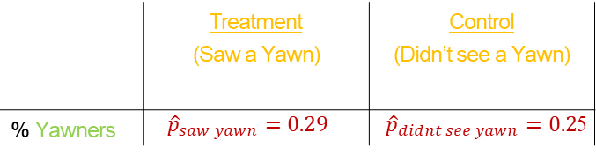
🔮 ✋
Experiment summary
 | Treatment (Saw a Yawn) | Control (Didn’t see a Yawn)
% Yawners | $${\hat{p}}_{saw yawn}=0.29$$ | ${\hat{p}}_{didnt see yawn}=0.2$5
4% Difference!
4

Slide 12
Outline
Interpreting 4% Difference:
Is a difference of 4% or more big enough to suggest yawning is contagious?
OR
Could it be the case that yawning is NOT contagious and a 4% or more difference was just due to random chance?

Slide 13
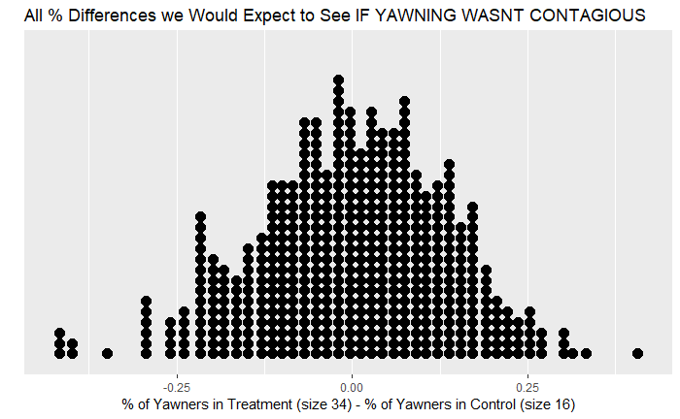
Outline
What do we expect this to be centered at?

Slide 14
Outline
What do we expect this to be centered at?

Slide 15
Outline
Interpreting 4% Difference:
Is a difference of 4% or more big enough to suggest yawning is contagious?
OR
Could it be the case that yawning is NOT contagious and a 4% or more difference was just due to random chance?
What if we had this information?

Slide 16
Outline
Interpreting 4% Difference:
Is a difference of 4% or more big enough to suggest yawning is contagious?
OR
Could it be the case that yawning is NOT contagious and a 4% or more difference was just due to random chance?
What if we had this information?
4%

Slide 17
Outline
Interpreting 4% Difference:
Is a difference of 4% or more big enough to suggest yawning is contagious?
OR
Could it be the case that yawning is NOT contagious and a 4% or more difference was just due to random chance?
What if we had this information?
4%

Slide 18
Outline
Interpreting 4% Difference:
There is NOT enough evidence to suggest that yawning is contagious and a 4% or more difference could just be due to random chance.
What if we had this information?
4%

Slide 19
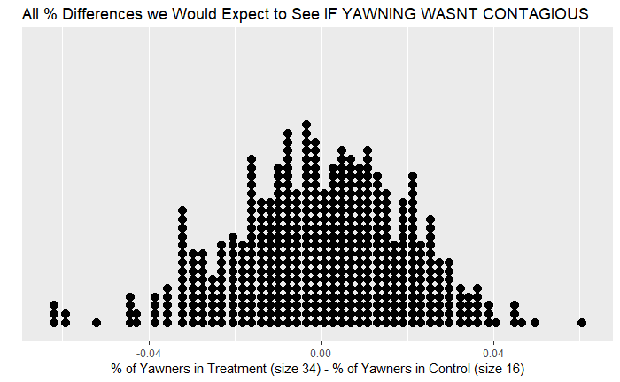
Outline
Interpreting 4% Difference:
Is a difference of 4% or more big enough to suggest yawning is contagious?
OR
Could it be the case that yawning is NOT contagious and a 4% or more difference was just due to random chance?
What if we had this information?

Slide 20
Outline
Interpreting 4% Difference:
Is a difference of 4% or more big enough to suggest yawning is contagious?
OR
Could it be the case that yawning is NOT contagious and a 4% or more difference was just due to random chance?
What if we had this information?
4%

Slide 21
Outline
Interpreting 4% Difference:
Is a difference of 4% or more big enough to suggest yawning is contagious?
OR
Could it be the case that yawning is NOT contagious and a 4% or more difference was just due to random chance?
What if we had this information?
4%

Slide 22
Outline
Interpreting 4% Difference:
A difference of 4% or more is big enough to suggest yawning is contagious.
What if we had this information?
4%

Slide 23
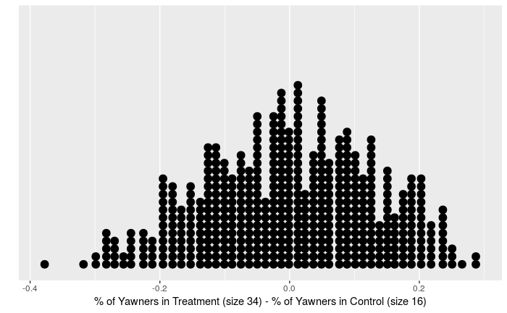
Outline
Main Goal in Randomization Testing
What would be great to have
(but we don’t)
Randomization Distribution
Simulate
this

Slide 24
Outline
Main Goal in Randomization Testing (for two categorical variables):
Step 0: Set up two competing claims/hypotheses.

Slide 25
Outline
Main Goal in Randomization Testing (for two categorical variables):
Randomization Distribution
Step 0: Set up two competing claims/hypotheses.
Step 1: Generate a simulated histogram or dot plot that shows us the expected differences in sample proportions we might see IF the variables are independent in the population (Ie: the population proportions are equal!)
This distribution is called a Randomization Distribution.

Slide 26
Outline
Main Goal in Randomization Testing (for two categorical variables):
Randomization Distribution
Step 0: Set up two competing claims/hypotheses.
Step 1: Generate a simulated histogram or dot plot that shows us the expected differences in sample proportions we might see IF the variables are independent in the population (Ie: the population proportions are equal!)
This distribution is called a Randomization Distribution.
Step 2: Use Randomization Distribution and our actual observed differences in sample proportions to make an inference about the relationship between two variables in the population.
4%

Slide 27

Outline
Let’s perform randomization testing for yawning experiment!
Yawn

Slide 28
Outline
Randomization Testing
Step 0: How do we set up null and alternative hypotheses?
Ho: _________
Ha: _________

Slide 29
Outline
Housekeeping
Case study: Is yawning contagious?
  Competing claims
  Testing via simulation
  Checking for independence
Case study: Tapping on caﬀeine
Application exercise

Slide 30
🔮 ✋
Two competing claims
 | Ho: Null Hypothesis
Interpretations | "There is nothing going on."
 | Seeing someone yawn and yawning are independent.
 | In the population there is no difference in the proportions of yawners who did and did not see a yawn.
 | The observed difference in the proportion of yawners in the treatment and control is simply due to chance.
6

Slide 31
🔮 ✋
Two competing claims
 | Ho: Null Hypothesis | Ha: Alternative Hypothesis
Interpretations | "There is nothing going on." | "There is something going on."
 | Seeing someone yawn and yawning are independent. | Seeing someone yawn and yawning are dependent.
 | In the population there is no difference in the proportions of yawners who did and did not see a yawn. | In the population the proportion of yawners who did see a yawn is greater than those who didn’t.
 | The observed difference in the proportion of yawners in the treatment and control is simply due to chance. | The observed difference in the proportion of yawners in the treatment and control is not due to chance.
6

Slide 32
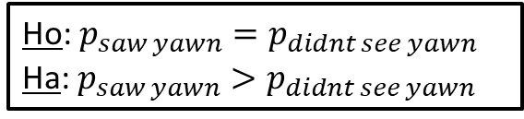
Outline
Randomization Testing
Step 0: Set up null and alternative hypotheses.
Ho: $p_{saw yawn}=p_{didnt see yawn}$
Ha: $p_{saw yawn}>p_{didnt see yawn}$

Slide 33
🔮 ✋
👫
Hypothesis testing is natural
Step 1: Formulate hypotheses/claims.
H₀: Your partner isn’t cheating.
H_{A}: Your partner is cheating.
7

Slide 34
🔮 ✋
👫
Hypothesis testing is natural
Step 1: Formulate hypotheses/claims.
H₀: Your partner isn’t cheating.
H_{A}: Your partner is cheating.
Step 2:
Collect the evidence
Evidence:
Partner isn’t saying your name on the phone.
Partner isn’t saying “I love you” on the phone.
Every other word is “uh huh… yeah ok” on the phone.
…
7

Slide 35
🔮 ✋
👫
Hypothesis testing is natural
Step 1: Formulate hypotheses/claims.
H₀: Your partner isn’t cheating.
H_{A}: Your partner is cheating.
Step 2:
Collect the evidence
Step 3:
Judge the evidence: “Could these
data plausibly have happened by chance
if the null hypothesis were true?”
Evidence:
Partner isn’t saying your name on the phone.
Partner isn’t saying “I love you” on the phone.
Every other word is “uh huh… yeah ok” on the phone.
…
Judge the Evidence
Shady!
7

Slide 36
🔮 ✋
👫
Hypothesis testing is natural
Step 1: Formulate hypotheses/claims.
H₀: Your partner isn’t cheating.
H_{A}: Your partner is cheating.
Step 2:
Collect the evidence
Step 3:
Judge the evidence: “Could these
data plausibly have happened by chance
if the null hypothesis were true?”
Step 4:
Make a decision: “How unlikely is unlikely?”
Evidence:
Partner isn’t saying your name on the phone.
Partner isn’t saying “I love you” on the phone.
Every other word is “uh huh… yeah ok” on the phone.
…
Judge the Evidence
Shady!
7

Slide 37

Outline
Step 1: How do we generate the randomization distribution that allows us to judge the evidence for our two competing claims?
Randomization Distribution
Yawn

Slide 38
Outline
Housekeeping
Case study: Is yawning contagious?
  Competing claims
  Testing via simulation
  Checking for independence
Case study: Tapping on caﬀeine
Application exercise

Slide 39
Simulation setup
🔮 ✋
Generating the Randomization Distribution (two categorical variables).
Write the dependent variable values from the sample data on index cards.
Do the following many times:
  Shuffle the index cards 7 times.
  Deal the index cards into two groups:
    “Treatment Group” (# of cards = Treatment Group Size)
    “Control Group” (# of cards = Control Group Size)
  Note the difference in proportions between the treatment and control groups and plot the difference in a dot plot.
Randomization Distribution
8

Slide 40
Simulation setup
🔮 ✋
Generating the Randomization Distribution (two categorical variables).
Write the dependent variable values from the sample data on index cards
(50 cards = yawning experiment sample size
=total number of actors)
14 Say yawn, 36 say not yawn
Do the following many times:
  Shuffle the index cards 7 times.
  Deal the index cards into two groups:
    “Treatment Group” (# of cards = Treatment Group Size)
    “Control Group” (# of cards = Control Group Size)
  Note the difference in proportions between the treatment and control groups and plot the difference in a dot plot.
Randomization Distribution
8

Slide 41
Simulation setup
🔮 ✋
Generating the Randomization Distribution (two categorical variables).
Write the dependent variable values from the sample data on index cards
(50 cards = yawning experiment sample size
=total number of actors)
14 Say yawn, 36 say not yawn
Do the following many times:
  Shuffle the index cards 7 times.
  Deal the index cards into two groups:
    “Treatment Group” (# of cards = 34)
    “Control Group” (# of cards = 16)
  Note the difference in proportions (of yawn cards) between the treatment and control groups and plot the difference in a dot plot.
Randomization Distribution
8

Slide 42
Outline
What do we expect this randomization distribution to be centered at?
Randomization Distribution

Slide 43

Outline
What do we expect this randomization distribution to be centered at?
Randomization Distribution
0

Slide 44
🔮 ✋
See R simulation
Simulate the Yawning Experiment under the assumption of independence 500 times.

Slide 45
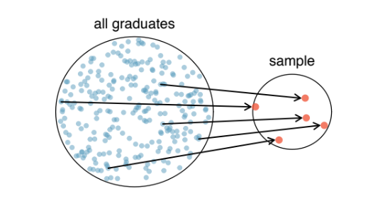
Outline
Step 2: Once we have our randomization distribution, how do we use this and our observed difference to make an inference about the relationship between two variables in the population?
Randomization Distribution
4%

Slide 46
Outline
Housekeeping
Case study: Is yawning contagious?
  Competing claims
  Testing via simulation
  Checking for independence
Case study: Tapping on caﬀeine
Application exercise

Slide 47
Clicker question
🔮 ✋
Do the simulation results suggest that yawning is contagious,
i.e. does seeing someone yawn and yawning appear to be dependent?
(Hint: In the actual data the difference was 0.04, does this appear to be an unusual observation for the chance model?)
(a) Yes (b) No
Randomization Distribution
10

Slide 48
Outline
Inference:
Randomization Distribution
500 total dots =
500 simulated % differences we would expect to see IF SEEING A YAWN AND YAWNING WERE INDEPENDENT.
199/500 ≈39.8% of simulated differences are 4% or above.
4%

Slide 49
Outline
Inference:
P-value
Randomization Distribution
500 total dots =
500 simulated % differences we would expect to see IF SEEING A YAWN AND YAWNING WERE INDEPENDENT.
199/500 ≈0.398 of simulated differences are 4% or above.
4%
P-value is High → There is NOT enough evidence to suggest seeing someone yawn makes you more likely to yawn (yawning is contagious)(yawning and seeing someone yawn are dependent).

Slide 50
Outline
Housekeeping
Case study: Is yawning contagious?
  Competing claims
  Testing via simulation
  Checking for independence
Case study: Tapping on caﬀeine
Application exercise

Slide 51

Outline
Research Question: Does caffeine intake increase tapping rate?

Slide 52
Tapping on caﬀeine
🔮 ✋
▶ In a double-blind experiment a sample of 20 male college students were randomly assigned to two groups of 10 students each.
▶ Each student drank the equivalent of about two cups of coffee, which included about 200 mg of caffeine for the students in one group, but was decaffeinated coffee for the second group.
▶ After a two hour period, each student was tested to measure ﬁnger tapping rate (taps per minute).

Slide 53
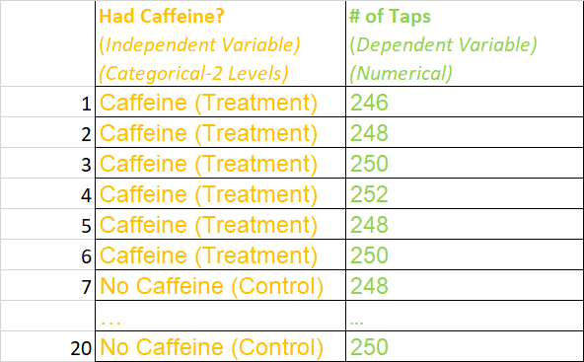
🔮 ✋
Data
Original Sample Data Collected
Visualizing Data

Slide 54
Clicker question
🔮 ✋
🔍
What type of plot would be useful to visualize the distributions of tapping rate in the caffeine and no caffeine groups.
Bar plot
Mosaic plot
Pie chart
Side-by-side box plots
Single box plot
13

Slide 55
Clicker question
🔮 ✋
🔍
What type of plot would be useful to visualize the distributions of tapping rate in the caffeine and no caffeine groups.
categorical variable
numerical variable
Bar plot
Mosaic plot
Pie chart
Side-by-side box plots
Single box plot
13

Slide 56
Exploratory data analysis
🔮 ✋
Compare the distributions of tapping rates in the caffeine and no caffeine groups.
 | Caffeine | No Caffeine | Difference
mean | 248.3 | 244.8 | 3.5
SD | 2.21 | 2.39 | -0.18
median | 248 | 245 | 3
IQR | 3.5 | 4.25 | -0.75
242 244 246 248 250 252
Tap Rate
Caffeine
NoCaffeine

Slide 57
Outline
Randomization Testing
Step 0: Set up null and alternative hypotheses.
Ho: _________
Ha: _________

Slide 58
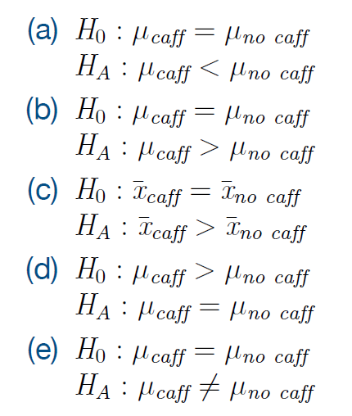
We are interested in ﬁnding out if caffeine increases tapping rate. Which of the following are the correct set of hypotheses?
🔮 ✋
🔍
Clicker question

Slide 59
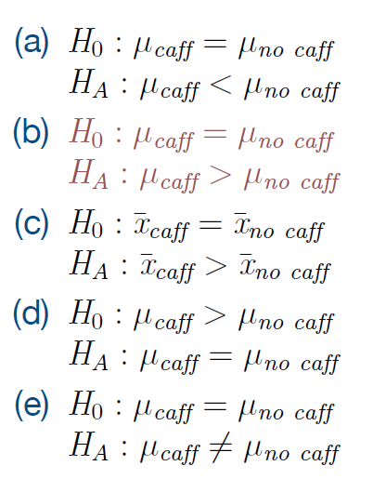
We are interested in ﬁnding out if caffeine increases tapping rate. Which of the following are the correct set of hypotheses?
🔮 ✋
🔍
Clicker question

Slide 60
We are interested in ﬁnding out if caffeine increases tapping rate. Which of the following are the correct set of hypotheses?
🔮 ✋
🔍
Clicker question
…for a much larger population than 20 college males.

Slide 61
Outline
Randomization Testing
Step 1: Generate randomization distribution.

Slide 62
Simulation setup
🔮 ✋
Generating the Randomization Distribution (one cat. variable/one num. variable)
Write the dependent variable values from the sample on index cards.
Do the following many times:
  Shuffle the index cards 7 times.
  Deal the index cards into two groups:
    “Treatment Group” (# of cards = Treatment Group Size)
    “Control Group” (# of cards = Control Group Size)
  Note the difference in means (or medians) between the treatment and control groups and plot the difference in a dot plot.
Randomization Distribution
8

Slide 63
Simulation setup
🔮 ✋
Generating the Randomization Distribution (one cat. variable/one num. variable)
Write the dependent variable values from the sample on index cards.
Do the following many times:
  Shuffle the index cards 7 times.
  Deal the index cards into two groups:
    “Treatment Group” (# of cards = 10)
    “Control Group” (# of cards = 10)
  Note the difference in means (or medians) between the treatment and control groups and plot the difference in a dot plot.
(20 cards =total number of students in sample)
Card 1=“246”, Card 2=“248”…
Randomization Distribution
8

Slide 64
Outline
What do we expect this randomization distribution to be centered at?
Randomization Distribution

Slide 65
Outline
What do we expect this randomization distribution to be centered at?
Randomization Distribution
0

Slide 66
Outline
Randomization Testing
Step 2: Use the randomization distribution and observed sample difference to calculate the p-value to determine if there is enough evidence to suggest the alternative hypothesis.

Slide 67

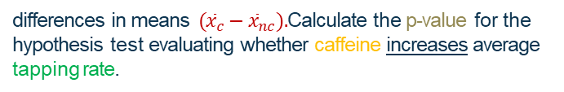
Below is a randomization distribution of 100 simulated
🔮 ✋
Making a decision
differences in means $({\overline{x}}_{c}−{\overline{x}}_{nc}).$Calculate the p-value for the hypothesis test evaluating whether caffeine increases average tapping rate.
 | Caffeine | No Caffeine | Difference
mean | 248.3 | 244.8 | 3.5
Randomization Distribution
(assumes null hypothesis is true)
●
● ●
● ● ●
● ● ● ●
● ● ● ● ● ● ●
● ● ● ● ● ● ● ● ● ● ● ● ●
● ● ● ● ● ● ● ● ● ● ● ● ● ●
● ● ● ● ● ● ● ● ● ● ● ● ● ● ● ● ● ● ● ● ●
● ● ● ● ● ● ● ● ● ● ● ● ● ● ● ● ● ● ● ● ●
●
●
●
●
● ● ● ● ● ●
●
●
●
●
−4
−2
0
2
4
$$({\overline{x}}_{c}−{\overline{x}}_{nc})$$
Size 10 Size 10
17

Slide 68
🔮 ✋
Making a decision
Below is a randomization distribution of 100 simulated
differences in means $({\overline{x}}_{c}−{\overline{x}}_{nc}).$Calculate the p-value for the hypothesis test evaluating whether caffeine increases average tapping rate.
 | Caffeine | No Caffeine | Difference
mean | 248.3 | 244.8 | 3.5
Randomization Distribution
(assumes null hypothesis is true)
●
● ●
● ● ●
● ● ● ●
● ● ● ● ● ● ●
● ● ● ● ● ● ● ● ● ● ● ● ●
● ● ● ● ● ● ● ● ● ● ● ● ● ●
● ● ● ● ● ● ● ● ● ● ● ● ● ● ● ● ● ● ● ● ●
● ● ● ● ● ● ● ● ● ● ● ● ● ● ● ● ● ● ● ● ●
●
●
●
●
● ● ● ● ● ●
●
●
●
●
−4
1/100 = 0.01 p-value
3.5
−2
0
2
4
$$({\overline{x}}_{c}−{\overline{x}}_{nc})$$
Size 10 Size 10
17

Slide 69
🔮 ✋
Making a decision
Below is a randomization distribution of 100 simulated
differences in means $({\overline{x}}_{c}−{\overline{x}}_{nc}).$Calculate the p-value for the hypothesis test evaluating whether caffeine increases average tapping rate.
 | Caffeine | No Caffeine | Difference
mean | 248.3 | 244.8 | 3.5
Randomization Distribution
(assumes null hypothesis is true)
●
● ●
● ● ●
● ● ● ●
● ● ● ● ● ● ●
● ● ● ● ● ● ● ● ● ● ● ● ●
● ● ● ● ● ● ● ● ● ● ● ● ● ●
● ● ● ● ● ● ● ● ● ● ● ● ● ● ● ● ● ● ● ● ●
● ● ● ● ● ● ● ● ● ● ● ● ● ● ● ● ● ● ● ● ●
●
●
●
●
● ● ● ● ● ●
●
●
●
●
−2
0
2
3.5
4
P-value is Low → There IS enough evidence to suggest caffeine increases average tapping rate.
17

Slide 70
Testing for the median
🔮 ✋
Describe how could we use the same approach to test whether the median tapping rate is higher for the caffeine group?
18

Slide 71
Testing for the median
🔮 ✋
Describe how could we use the same approach to test whether the median tapping rate is higher for the caffeine group?
Use the same simulation scheme but record the difference between the medians instead of the means, and calculate the p-value as the proportion of simulations where the simulated difference in medians is at least 3.
18

Slide 72
Below is a randomization distribution of 100 simulated
🔮 ✋
Testing for the median (cont.)
differences in medians (med_{c} − med_{nc}). Do the data provide convincing evidence that caffeine increases median tapping rate?
 | Caffeine | No Caffeine | Difference
median | 248 | 245 | 3
●
●
●
●
●
●
●
●
●
●
●
●
●
●
●
●
●
●
●
●
●
●
●
●
●
●
●
●
●
●
●
●
●
●
●
●
●
●
●
●
●
●
●
●
●
●
●
●
●
●
●
●
●
●
●
●
●
●
●
●
●
●
●
●
●
●
●
●
●
●
●
●
●
●
●
●
●
●
●
●
●
●
●
●
●
●
●
●
●
●
● ●
● ●
●
●
● ●
● ●
−4
−2
0
2
4
19

Slide 73
Outline
Housekeeping
Case study: Is yawning contagious?
  Competing claims
  Testing via simulation
  Checking for independence
Case study: Tapping on caﬀeine
Application exercise

Slide 74
Application exercise: 1.4 Randomization testing
See the course website for instructions.
20

