Slide 1


Unit 2: Probability and distributions
1. Probability and conditional probability
Sta 101 – Spring 2019
Duke University, Department of Statistical Science
Dr. Ellison
Slides posted at https://www2.stat.duke.edu/courses/Spring19/sta101.001/

Slide 2
Outline
Housekeeping
Readiness assessment
Main ideas
Differences between Probability Properties
🔍 Disjoint and independent do not mean the same thing
Relationships between Probability Properties
🔍 👫 Application of the addition rule depends on disjointness of events
🔍 👫 Bayes' theorem works for all types of events
4. Summary

Slide 3
Announcements
Coming up…
▶ Lab Assignment 2 is due Thursday just before your lab section time.
▶ Start working on Problem Set 2.
1

Slide 4
Outline
Housekeeping
Readiness assessment
Main ideas
Differences between Probability Properties
🔍 Disjoint and independent do not mean the same thing
Relationships between Probability Properties
🔍 👫 Application of the addition rule depends on disjointness of events
🔍 👫 Bayes' theorem works for all types of events
4. Summary

Slide 5


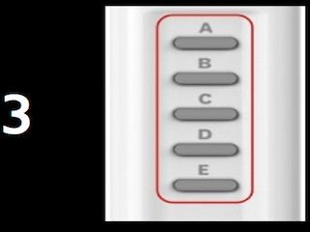
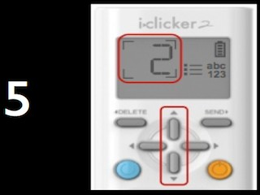
Readiness assessment
Clicker Help in Readiness Assessment
Syncing to the Quiz
Reviewing/Changing your Answer
You should see this screen once I press the RA clicker start button (I’ll tell you when). If not, press the blue refresh button!
The most recent letter you chose should show up here. If you want to change your answer, just press the letter you want. My iclicker box stores your most recent letter you pressed for that number.
Submitting your Answer
Moving to Other Questions
Press the up button to go to higher numbers. Press the down button to go lower numbers.
Select the letter you want to pick for the number shown here.
1

Slide 6
Important Reminder
for Scratch Cards and Application Exercises
Accurately taking group attendance on the scratch cards and application exercises is part of your participation grade!
Correct Name Format
Incorrect Name Format
Group Name: “Stats IS FUN”
Present Group Members:
Amy Lastname
Barry Lastname
Absent Group Members:
Missing Mary
Absent Albert
“Stats IS FUN”
Amy Lastname
Barry Lastname
Missing Mary
Absent Albert

Slide 7
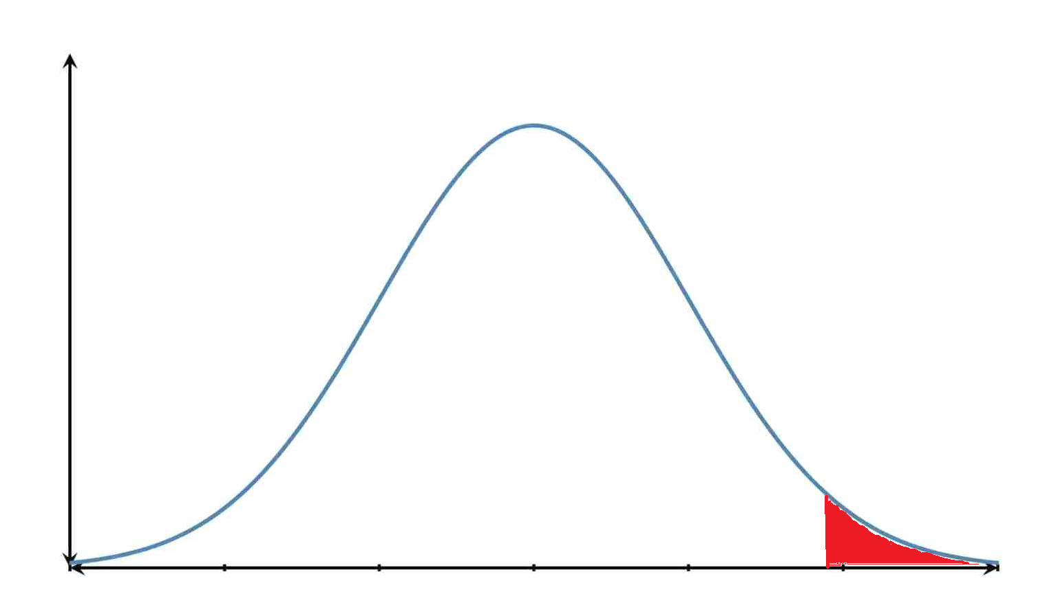
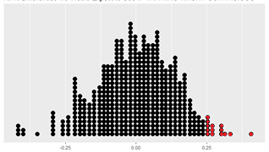

Outline
Making an Inference
Randomization Distribution (Unit 1)
Sampling Distribution (Special kind of normal distribution) (Units 3-7)
Vs.
-0.25 0 0.25
-0.25 0 0.25
$${\hat{p}}_{saw yawn}−{\hat{p}}_{didnt see yawn}$$
$${\hat{p}}_{saw yawn}−{\hat{p}}_{didnt see yawn}$$

Slide 8
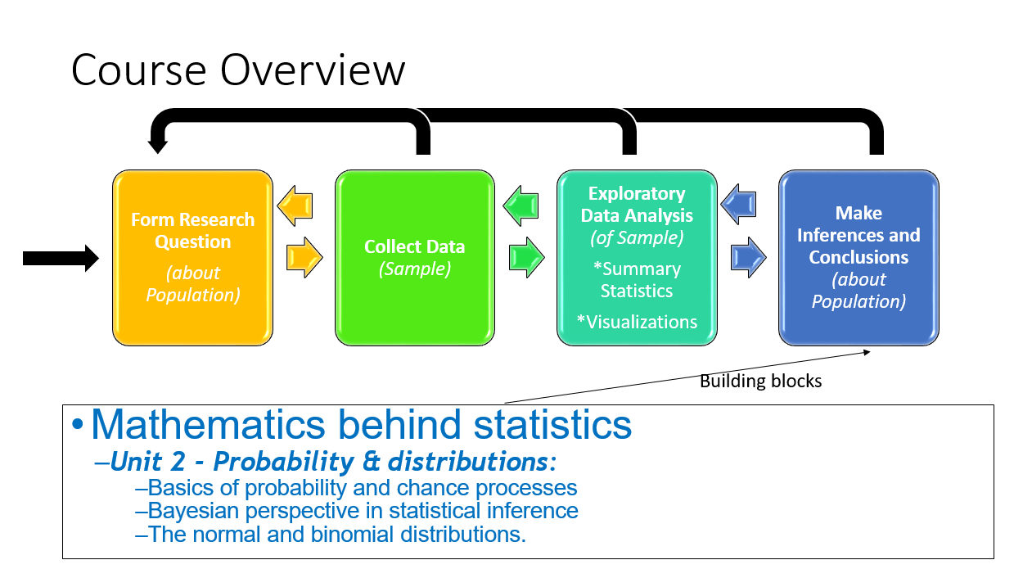
Outline

Slide 9
Outline
Do mutually exclusive/disjoint events, independent events, or dependent events mean same thing?
Independent Events
Mutually Exclusive/ Disjoint Events
Dependent Events

Slide 10
Outline
Housekeeping
Readiness assessment
Main ideas
Differences between Probability Properties
🔍 Disjoint and independent do not mean the same thing
Relationships between Probability Properties
🔍 👫 Application of the addition rule depends on disjointness of events
🔍 👫 Bayes' theorem works for all types of events
4. Summary

Slide 11
1. Disjoint and independent do not mean the same thing
🔍
▶ Disjoint (mutually exclusive) events cannot happen at the
same time
A voter cannot register as a Democrat and a Republican at the same time
But they might be a Republican and a Moderate at the same time – non-disjoint events
For disjoint A and B: P(A and B) = 0
A
B
3

Slide 12
1. Disjoint and independent do not mean the same thing
🔍
▶ Disjoint (mutually exclusive) events cannot happen at the
same time
A voter cannot register as a Democrat and a Republican at the same time
But they might be a Republican and a Moderate at the same time – non-disjoint events
For disjoint A and B: P(A and B) = 0
▶ If A and B are independent events, having information on
A does not tell us anything about B (and vice versa)
A and B are independent
ALL of these equations hold:
P(A | B) = P(A)
P(B | A) = P(B)
P(A and B) = P(A) × P(B)
3

Slide 13
1. Disjoint and independent do not mean the same thing
🔍
▶ Disjoint (mutually exclusive) events cannot happen at the
same time
A voter cannot register as a Democrat and a Republican at the same time
But they might be a Republican and a Moderate at the same time – non-disjoint events
For disjoint A and B: P(A and B) = 0
▶ If A and B are dependent events, having information on
A DOES tell us anything about B (and vice versa)
A and B are dependent
NONE of these equations hold:
P(A | B) = P(A)
P(B | A) = P(B)
P(A and B) = P(A) × P(B)
3

Slide 14
How are Mutually Exclusive/Disjoint Events and the General Addition Rule related?
Mutually Exclusive/Disjoint Events
General Addition Rule
math

Slide 15
Outline
Housekeeping
Readiness assessment
Main ideas
Differences between Probability Properties
🔍 Disjoint and independent do not mean the same thing
Relationships between Probability Properties
🔍 👫 Application of the addition rule depends on disjointness of events
🔍 👫 Bayes' theorem works for all types of events
4. Summary

Slide 16

2. Application of the addition rule depends on disjointness of events
🔍
👫
▶ General addition rule: P(A or B) = P(A) + P(B) - P(A and B)
▶ A or B = either A or B or both
4

Slide 17
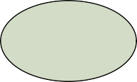
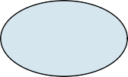
2. Application of the addition rule depends on disjointness of events
🔍
👫
▶ General addition rule: P(A or B) = P(A) + P(B) - P(A and B)
▶ A or B = either A or B or both
disjoint events:
P(A or B)
= P(A) + P(B) - P(A and B)
= 0.4 + 0.3 - 0 = 0.7
A
B
0.4
0.3
4

Slide 18
2. Application of the addition rule depends on disjointness of events
🔍
👫
▶ General addition rule: P(A or B) = P(A) + P(B) - P(A and B)
▶ A or B = either A or B or both
disjoint events:
P(A or B)
= P(A) + P(B) - P(A and B)
= 0.4 + 0.3 - 0 = 0.7
A
B
0.4
0.3
4

Slide 19
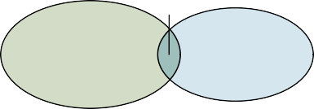
2. Application of the addition rule depends on disjointness of events
🔍
👫
▶ General addition rule: P(A or B) = P(A) + P(B) - P(A and B)
▶ A or B = either A or B or both
disjoint events:
P(A or B)
= P(A) + P(B) - P(A and B)
= 0.4 + 0.3 - 0 = 0.7
non-disjoint events:
P(A or B)
= P(A) + P(B) - P(A and B)
= 0.4 + 0.3 - 0.02 = 0.68
0.02
A
B
0.4
0.3
0.38
0.28
A
B
4

Slide 20
Outline
Housekeeping
Readiness assessment
Main ideas
Differences between Probability Properties
🔍 Disjoint and independent do not mean the same thing
Relationships between Probability Properties
🔍 👫 Application of the addition rule depends on disjointness of events
🔍 👫 Bayes' theorem works for all types of events
4. Summary

Slide 21
How are Bayes Equation and the General Multiplication Rule related?
General Multiplication Rule
Bayes Equation
math

Slide 22
🔍
👫
3. Bayes' theorem works for all types of events
▶ Bayes’ theorem/equation: P(A | B) =
P(A and B)
P(B)
5

Slide 23
3. Bayes' theorem works for all types of events
🔍
👫
▶ Bayes’ theorem/equation: P(A | B) =
P(A and B)
P(B)
▶ ... can be rewritten as: P(A and B) = P(A | B) × P(B)
5

Slide 24
3. Bayes' theorem works for all types of events
🔍
👫
▶ Bayes’ theorem/equation: P(A | B) =
P(A and B)
P(B)
▶ ... can be rewritten as: P(A and B) = P(A | B) × P(B)
▶ Bayes’ theorem/equation: P(B | A) =
P(A and B)
P(A)
▶ ... can be rewritten as: P(A and B) = P(B | A) × P(A)
5

Slide 25
🔍
👫
3. Bayes' theorem works for all types of events
▶ Bayes’ theorem/equation: P(A | B) =
P(A and B)
P(B)
▶ ... can be rewritten as: P(A and B) = P(A | B) × P(B)
disjoint events:
▶ We know P(A | B) = ?, since if B happened A could not have happened
*assume P(B)≠0
5

Slide 26
🔍
👫
3. Bayes' theorem works for all types of events
▶ Bayes’ theorem/equation: P(A | B) =
P(A and B)
P(B)
▶ ... can be rewritten as: P(A and B) = P(A | B) × P(B)
disjoint events:
▶ We know P(A | B) = 0, since if B happened A could not have happened
*assume P(B)≠0
5

Slide 27
🔍
👫
3. Bayes' theorem works for all types of events
▶ Bayes’ theorem/equation: P(A | B) =
P(A and B)
P(B)
▶ ... can be rewritten as: P(A and B) = P(A | B) × P(B)
disjoint events:
▶ We know P(A | B) = 0, since if B happened A could not have happened
▶ P(A and B)
= P(A | B) × P(B)
*assume P(B)≠0
5

Slide 28
🔍
👫
3. Bayes' theorem works for all types of events
▶ Bayes’ theorem/equation: P(A | B) =
P(A and B)
P(B)
▶ ... can be rewritten as: P(A and B) = P(A | B) × P(B)
disjoint events:
▶ We know P(A | B) = 0, since if B happened A could not have happened
▶ P(A and B)
= P(A | B) × P(B)
= 0 × P(B) = 0
*assume P(B)≠0
5

Slide 29
🔍
👫
3. Bayes' theorem works for all types of events
▶ Bayes’ theorem/equation: P(A | B) =
P(A and B)
P(B)
▶ ... can be rewritten as: P(A and B) = P(A | B) × P(B)
disjoint events:
independent events:
▶ We know P(A | B) = 0,
▶ We know P(A | B) = ? ,
since if B happened A could not have happened
▶ P(A and B)
since knowing B doesn’t tell us anything about A
= P(A | B) × P(B)
= 0 × P(B) = 0
*assume P(B)≠0
5

Slide 30
🔍
👫
3. Bayes' theorem works for all types of events
▶ Bayes’ theorem/equation: P(A | B) =
P(A and B)
P(B)
▶ ... can be rewritten as: P(A and B) = P(A | B) × P(B)
disjoint events:
independent events:
▶ We know P(A | B) = 0,
▶ We know P(A | B) = P(A),
since if B happened A could not have happened
▶ P(A and B)
since knowing B doesn’t tell us anything about A
= P(A | B) × P(B)
= 0 × P(B) = 0
*assume P(B)≠0
5

Slide 31
🔍
👫
3. Bayes' theorem works for all types of events
▶ Bayes’ theorem/equation: P(A | B) =
P(A and B)
P(B)
▶ ... can be rewritten as: P(A and B) = P(A | B) × P(B)
disjoint events:
independent events:
▶ We know P(A | B) = 0,
▶ We know P(A | B) = P(A),
since if B happened A could not have happened
▶ P(A and B)
since knowing B doesn’t tell us anything about A
▶ P(A and B)
= P(A | B) × P(B)
= P(A | B) × P(B)
= 0 × P(B) = 0
*assume P(B)≠0
5

Slide 32
🔍
👫
3. Bayes' theorem works for all types of events
▶ Bayes’ theorem/equation: P(A | B) =
P(A and B)
P(B)
▶ ... can be rewritten as: P(A and B) = P(A | B) × P(B)
disjoint events:
independent events:
▶ We know P(A | B) = 0,
▶ We know P(A | B) = P(A),
since if B happened A could not have happened
▶ P(A and B)
since knowing B doesn’t tell us anything about A
▶ P(A and B)
= P(A | B) × P(B)
= P(A | B) × P(B)
= 0 × P(B) = 0
= P(A) × P(B)
*assume P(B)≠0
5

Slide 33
🔍
👫
3. Bayes' theorem works for all types of events
▶ Bayes’ theorem/equation: P(A | B) =
P(A and B)
P(B)
▶ ... can be rewritten as: P(A and B) = P(A | B) × P(B)
disjoint events:
independent events:
▶ We know P(A | B) = 0,
▶ We know P(A | B) = P(A),
since if B happened A could not have happened
▶ P(A and B)
since knowing B doesn’t tell us anything about A
▶ P(A and B)
= P(A | B) × P(B)
= P(A | B) × P(B)
= 0 × P(B) = 0
= P(A) × P(B)
*assume P(B)≠0
5

Slide 34
How do complementary, mutually exclusive/disjoint, and dependent events relate?
Mutually Exclusive/Disjoint Events
Bayes Equation
Complementary Events
Dependent Events

Slide 35
How do complementary and mutually exclusive/disjoint events relate?
Sample Space
A

Slide 36
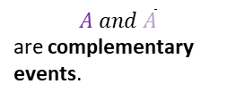


How do complementary and mutually exclusive/disjoint events relate?
Sample Space
$$A and \overline{A}$$
are complementary events.
A
$P(A and \overline{A}$)=?
$$\overline{A}$$

Slide 37

How do complementary and mutually exclusive/disjoint events relate?
Sample Space
$$A and \overline{A}$$
are complementary events.
A
$P(A and \overline{A}$)=0
$$\overline{A}$$

Slide 38
How do complementary and mutually exclusive/disjoint events relate?
Mutually Exclusive/Disjoint Events
then
If
Complementary Events

Slide 39
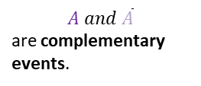





Sample Space
$$A and \overline{A}$$
are complementary events.
A
$P(A and \overline{A}$)=0
$$\overline{A}$$
Useful equation
$P\left(A\right)+P(\overline{A}$)=1
Where does it come from?
$P(A or \overline{A}$)=1
0
$P(A or \overline{A}$)=$P\left(A\right)+P(\overline{A}$)-$P(A and \overline{A}$)

Slide 40
How do complementary, mutually exclusive/disjoint, and dependent events relate?
Mutually Exclusive/Disjoint Events
then
Bayes Equation
If
Complementary Events
Dependent Events

Slide 41

How do mutually exclusive/disjoint and dependent events relate?
Mutually Exclusive/Disjoint Events
Bayes Equation
Dependent Events
And both events have probabilities ≠ 0
$$P\left(A | B\right)=\frac{P(A and B)}{P(B)}$$

Slide 42

How do mutually exclusive/disjoint and dependent events relate?
Mutually Exclusive/Disjoint Events
Bayes Equation
Dependent Events
And both events have probabilities ≠ 0
$P\left(A | B\right)=\frac{P(A and B)}{P(B)}$=$\frac{0}{P(B)}=0$

Slide 43


How do mutually exclusive/disjoint and dependent events relate?
Mutually Exclusive/Disjoint Events
Bayes Equation
Dependent Events
And both events have probabilities ≠ 0
$$P\left(A | B\right)=0$$
$$P(A)≠0$$

Slide 44

How do mutually exclusive/disjoint and dependent events relate?
Mutually Exclusive/Disjoint Events
Bayes Equation
Dependent Events
And both events have probabilities ≠ 0
$$P(A)≠P\left(A | B\right)$$

Slide 45
How do complementary, mutually exclusive/disjoint, and dependent events relate?
If
And both events have probabilities ≠ 0
Mutually Exclusive/ Disjoint Events
then
Bayes Equation
then
If
Complementary Events
Dependent Events

Slide 46
Application exercise: 2.1 Probability and conditional probability
See the course website for instructions.
6

Slide 47
Summary of main ideas
Disjoint and independent do not mean the same thing
Application of the addition rule depends on disjointness of events
Bayes’ theorem works for all types of events
7

