Slide 1

Unit 2: Probability and distributions
2. Bayes’ theorem and Bayesian inference
Sta 101 – Spring 2019
Duke University, Department of Statistical Science
Dr. Ellison
Slides posted at https://www2.stat.duke.edu/courses/Spring19/sta101.001/

Slide 2
Outline
Housekeeping
Main ideas
    🔍 ⚙ Tips for Bayesian Inference: Probability trees are useful for conditional probability calculations
    🎰 ✋ Bayesian Inference Game: Bayesian inference: start with a prior, collect data, calculate posterior, make a decision or iterate
    🔍 👫 Bayesian vs. Frequentist Inference: Posterior probability and p-value do not mean the same thing
Summary

Slide 3
Announcements
Coming up…
▶ Lab Assignment 2 is due Thursday just before your lab section time.
▶ Problem Set 2 due next Wednesday 2/6 11:55
▶ Readiness Assessment 3 next Wednesday 2/6 in class!
1

Slide 4
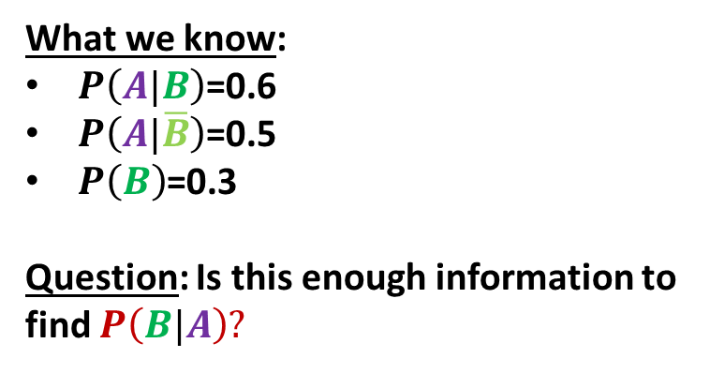
What we know:
$P\left(A|B\right)$=0.6
$P\left(A|\overline{B}\right)$=0.5
$P\left(B\right)$=0.3
Question: Is this enough information to find $P\left(B|A\right)?$

Slide 5
What we know:
$P\left(A|B\right)$=0.6
$P\left(A|\overline{B}\right)$=0.5
$P\left(B\right)$=0.3
Question: Is this enough information to find $P\left(B|A\right)?$
“observation”

Slide 6
Outline
Housekeeping
Main ideas
    🔍 ⚙ Tips for Bayesian Inference: Probability trees are useful for conditional probability calculations
    🎰 ✋ Bayesian Inference Game: Bayesian inference: start with a prior, collect data, calculate posterior, make a decision or iterate
    🔍 👫 Bayesian vs. Frequentist Inference: Posterior probability and p-value do not mean the same thing
Summary

Slide 7
▶ Probability trees are useful for organizing information in conditional probability calculations
1. Probability trees are useful for conditional probability calculations
🔍 ⚙
▶ They’re especially useful in cases where you know P(A | B), along with some other information, and you’re asked for P(B | A)
2

Slide 8
What we know:
$P\left(A|B\right)$=0.6
$P\left(A|\overline{B}\right)$=0.5
$P\left(B\right)$=0.3
Question: Is this enough information to find $P\left(B|A\right)?$
Yes! We have enough information to fill out a Bayesian Probability Tree to get the answer!

Slide 9
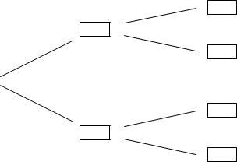

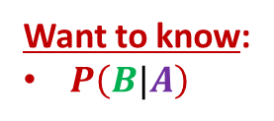

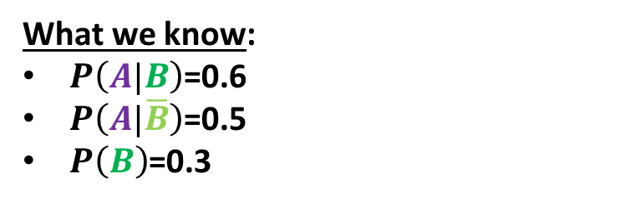



What we know:
$P\left(A|B\right)$=0.6
$P\left(A|\overline{B}\right)$=0.5
$P\left(B\right)$=0.3
Want to know:
$P\left(B|A\right)$
Priors
$$A$$
$$B$$
$$\overline{A}$$
$$A$$
$$\overline{B}$$
$$\overline{A}$$

Slide 10

What we know:
$P\left(A|B\right)$=0.6
$P\left(A|\overline{B}\right)$=0.5
$P\left(B\right)$=0.3
Want to know:
$P\left(B|A\right)$
Priors
$$A$$
$$P\left(A|B\right)$$
$$P\left(B\right)$$
$$B$$
$$\overline{A}$$
$$A$$
$$\overline{B}$$
$$P\left(A|\overline{B}\right)$$
$$\overline{A}$$
$$P\left(\overline{B}\right)$$
$$P\left(\overline{A}|\overline{B}\right)$$

Slide 11

What we know:
$P\left(A|B\right)$=0.6
$P\left(A|\overline{B}\right)$=0.5
$P\left(B\right)$=0.3
Want to know:
$P\left(B|A\right)$
Priors
$$A$$
$$P\left(A|B\right)$$
$$P\left(B\right)$$
complements
$$B$$
$$\overline{A}$$
$$P\left(\overline{A}|B\right)$$
complements
$$A$$
$$\overline{B}$$
$$P\left(A|\overline{B}\right)$$
$$P\left(\overline{B}\right)$$
complements
$$\overline{A}$$
$$P\left(\overline{A}|\overline{B}\right)$$

Slide 12
What we know:
$P\left(A|B\right)$=0.6
$P\left(A|\overline{B}\right)$=0.5
$P\left(B\right)$=0.3
Want to know:
$P\left(B|A\right)$
Priors
$$A$$
$$P\left(A|B\right)$$
$$P\left(B\right)$$
$$B$$
$$\overline{A}$$
$$P\left(\overline{A}|B\right)$$
$$A$$
$$\overline{B}$$
$$P\left(A|\overline{B}\right)$$
$$P\left(\overline{B}\right)$$
$$\overline{A}$$
$$P\left(\overline{A}|\overline{B}\right)$$

Slide 13
Outline
1. Housekeeping
Main ideas
    Probability trees are useful for conditional probability calculations
    Bayesian inference: start with a prior, collect data, calculate posterior, make a decision or iterate
    Posterior probability and p-value do not mean the same thing
3. Summary

Slide 14
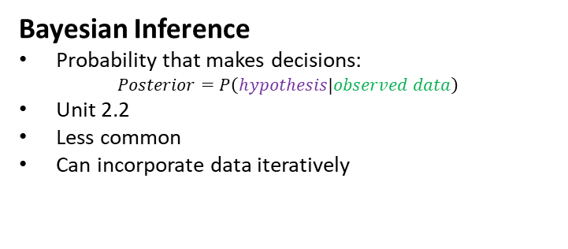

🔍
👫
Frequentist Inference
Probability that makes decisions:
$$p−value=P\left(\begin{matrix}data more \left(or as\right)extreme \\ than observed\end{matrix}|null hypothesis is true\right)$$
All units except for 2.2
More common
Incorporate data all at once
Bayesian Inference
Probability that makes decisions:
$$Posterior=P\left(hypothesis|observed data\right)$$
Unit 2.2
Less common
Can incorporate data iteratively

Slide 15


🔍
👫
Frequentist Inference
Probability that makes decisions:
$$p−value=P\left(\begin{matrix}data more \left(or as\right)extreme \\ than observed\end{matrix}|null hypothesis is true\right)$$
All units except for 2.2
More common
Incorporate data all at once
Possible Outcomes
Fail to Reject Null Hypothesis
Reject Null Hypothesis
Bayesian Inference
Probability that makes decisions:
$$Posterior=P\left(hypothesis|observed data\right)$$
Unit 2.2
Less common/newer
Can incorporate data iteratively
Possible Outcomes
Range of Probabilities for a Hypothesis Being True

Slide 16
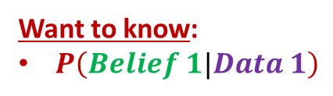
2. Bayesian inference: start with a prior, collect data, calculate
posterior, make a decision or iterate
🔍
▶ In Bayesian inference, probabilities are at times interpreted as degrees of belief.
Want to know:
$P\left(Belief 1|Data 1\right)$
3

Slide 17





2. Bayesian inference: start with a prior, collect data, calculate
posterior, make a decision or iterate
🔍
Step 1: You start with a set of prior beliefs (or prior probabilities).
Priors
$$P\left(Belief 1\right)$$
Want to know:
$P\left(Belief 1|Data 1\right)$
$$Belief 1$$
$$Belief 2$$
$$P\left(Belief 2\right)$$
3

Slide 18








2. Bayesian inference: start with a prior, collect data, calculate
posterior, make a decision or iterate
🔍
Step 1: You start with a set of prior beliefs (or prior probabilities).
Step 2: You observe some data.
Step 3: Based on that data, you update your beliefs.
Priors
$$P\left(Data 1|Belief 1\right)$$
$$P\left(Belief 1\right)$$
$$Data 1$$
Want to know:
$P\left(Belief 1|Data 1\right)$
$$P\left(Data 2|Belief 1\right)$$
$$Belief 1$$
$$Data 2$$
$$P\left(Data 1|Belief 2\right)$$
$$Belief 2$$
$$P\left(Belief 2\right)$$
$$Data 1$$
$$P\left(Data 2|Belief 2\right)$$
$$Data 2$$
3

Slide 19

2. Bayesian inference: start with a prior, collect data, calculate
posterior, make a decision or iterate
🔍
Step 1: You start with a set of prior beliefs (or prior probabilities).
Step 2: You observe some data.
Step 3: Based on that data, you update your beliefs.
Step 4: These new beliefs are called posterior beliefs (or posterior probabilities), because they are post-data.
Priors
$$P\left(Data 1|Belief 1\right)$$
$$P\left(Belief 1\right)$$
$$Data 1$$
Want to know:
$P\left(Belief 1|Data 1\right)$
$$P\left(Data 2|Belief 1\right)$$
$$Belief 1$$
$$Data 2$$
$$P\left(Data 1|Belief 2\right)$$
$$Belief 2$$
$$P\left(Belief 2\right)$$
$$Data 1$$
$$P\left(Data 2|Belief 2\right)$$
$$Data 2$$
3

Slide 20

2. Bayesian inference: start with a prior, collect data, calculate
posterior, make a decision or iterate
🔍
Want to know:
Posterior Belief = $P\left(Belief 1|Data 1\right)$
3

Slide 21
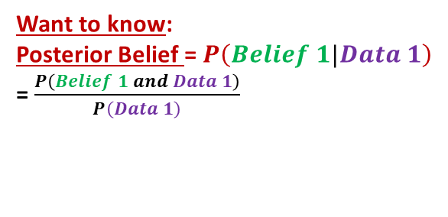
2. Bayesian inference: start with a prior, collect data, calculate
posterior, make a decision or iterate
🔍
Want to know:
Posterior Belief = $P\left(Belief 1|Data 1\right)$
= $\frac{P\left(Belief 1 and Data 1\right)}{P\left(Data 1\right)}$
3

Slide 22
2. Bayesian inference: start with a prior, collect data, calculate
posterior, make a decision or iterate
🔍
Want to know:
Posterior Belief = $P\left(Belief 1|Data 1\right)$
= $\frac{P\left(Belief 1 and Data 1\right)}{P\left(Data 1\right)}$
Bayes Equation
3

Slide 23
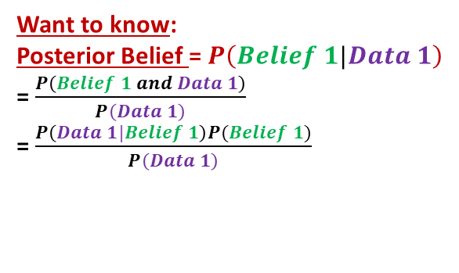
2. Bayesian inference: start with a prior, collect data, calculate
posterior, make a decision or iterate
🔍
Want to know:
Posterior Belief = $P\left(Belief 1|Data 1\right)$
= $\frac{P\left(Belief 1 and Data 1\right)}{P\left(Data 1\right)}$
= $\frac{P\left(Data 1|Belief 1\right)P(Belief 1)}{P\left(Data 1\right)}$
3

Slide 24
2. Bayesian inference: start with a prior, collect data, calculate
posterior, make a decision or iterate
🔍
Want to know:
Posterior Belief = $P\left(Belief 1|Data 1\right)$
= $\frac{P\left(Belief 1 and Data 1\right)}{P\left(Data 1\right)}$
= $\frac{P\left(Data 1|Belief 1\right)P(Belief 1)}{P\left(Data 1\right)}$
General Multiplication Rule
3

Slide 25
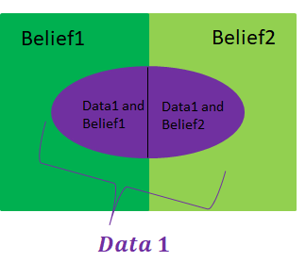
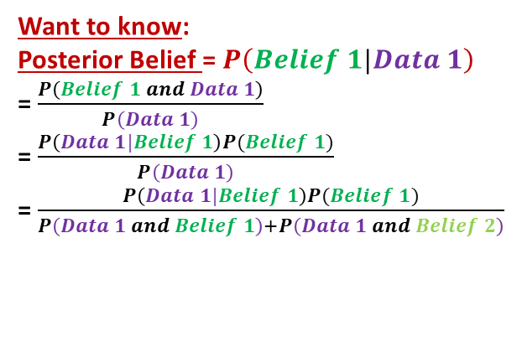
2. Bayesian inference: start with a prior, collect data, calculate
posterior, make a decision or iterate
🔍
Want to know:
Posterior Belief = $P\left(Belief 1|Data 1\right)$
= $\frac{P\left(Belief 1 and Data 1\right)}{P\left(Data 1\right)}$
= $\frac{P\left(Data 1|Belief 1\right)P(Belief 1)}{P\left(Data 1\right)}$
= $\frac{P\left(Data 1|Belief 1\right)P(Belief 1)}{P\left(Data 1 and Belief 1\right)+P\left(Data 1 and Belief 2\right)}$
*We assume that belief 1 and 2 cannot happen at the same time.
3

Slide 26
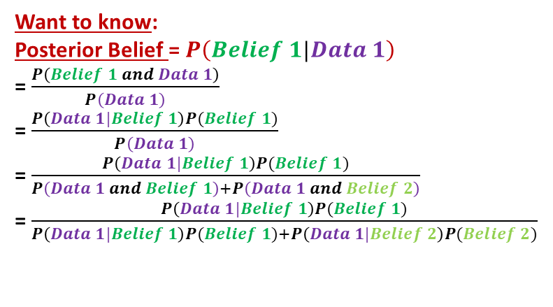
2. Bayesian inference: start with a prior, collect data, calculate
posterior, make a decision or iterate
🔍
Want to know:
Posterior Belief = $P\left(Belief 1|Data 1\right)$
= $\frac{P\left(Belief 1 and Data 1\right)}{P\left(Data 1\right)}$
= $\frac{P\left(Data 1|Belief 1\right)P(Belief 1)}{P\left(Data 1\right)}$
= $\frac{P\left(Data 1|Belief 1\right)P(Belief 1)}{P\left(Data 1 and Belief 1\right)+P\left(Data 1 and Belief 2\right)}$
= $\frac{P\left(Data 1|Belief 1\right)P(Belief 1)}{P\left(Data 1|Belief 1\right)P(Belief 1)+P\left(Data 1|Belief 2\right)P(Belief 2)}$
General Multiplication Rule
3

Slide 27
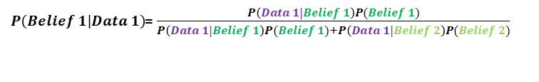
2. Bayesian inference: start with a prior, collect data, calculate
posterior, make a decision or iterate
🔍
Final Equation we use with a Bayesian Probability Tree
Posterior Probability/Belief:
$P\left(Belief 1|Data 1\right)$= $\frac{P\left(Data 1|Belief 1\right)P(Belief 1)}{P\left(Data 1|Belief 1\right)P(Belief 1)+P\left(Data 1|Belief 2\right)P(Belief 2)}$
3

Slide 28
2. Bayesian inference: start with a prior, collect data, calculate
posterior, make a decision or iterate
🔍
▶ In Bayesian inference, probabilities are at times interpreted as degrees of belief.
Step 1: You start with a set of prior beliefs (or prior probabilities).
Step 2: You observe some data.
Step 3: Based on that data, you update your beliefs.
Step 4: These new beliefs are called posterior beliefs (or posterior probabilities), because they are post-data.
▶ You can iterate this process.
Step 5: Set NEW prior beliefs = old posterior beliefs
3

Slide 29

2. Bayesian inference: start with a prior, collect data, calculate
posterior, make a decision or iterate
🔍
Iteration 1
Observed Data 1
Found Posterior: $P\left(Belief 1|Data 1\right)$
Old Priors
$$P\left(Data 1|Belief 1\right)$$
$$P\left(Belief 1\right)$$
$$Data 1$$
$$P\left(Data 2|Belief 1\right)$$
$$Belief 1$$
$$Data 2$$
$$P\left(Data 1|Belief 2\right)$$
$$Belief 2$$
$$P\left(Belief 2\right)$$
$$Data 1$$
$$P\left(Data 2|Belief 2\right)$$
$$Data 2$$
3

Slide 30


2. Bayesian inference: start with a prior, collect data, calculate
posterior, make a decision or iterate
🔍
Iteration 1
Observed Data 1
Old Posterior: $P\left(Belief 1|Data 1\right)$
Iteration 2
NOW we observed Data 2
FIND NEW Posterior: $P\left(Belief 1|Data 2\right)$
New Priors
$$P\left(Data 1|Belief 1\right)$$
$$P\left(Belief 1\right)$$
$$Data 1$$
$$P\left(Data 2|Belief 1\right)$$
$$Belief 1$$
$$Data 2$$
$$P\left(Data 1|Belief 2\right)$$
$$Belief 2$$
$$P\left(Belief 2\right)$$
$$Data 1$$
$$P\left(Data 2|Belief 2\right)$$
$$Data 2$$
3

Slide 31
2. Bayesian inference: start with a prior, collect data, calculate
posterior, make a decision or iterate
🔍
Iteration 1
Observed Data 1
Old Posterior: $P\left(Belief 1|Data 1\right)$
Iteration 2
NOW we observed Data 2
FIND NEW Posterior: $P\left(Belief 1|Data 2\right)$
New Priors
$$P\left(Data 1|Belief 1\right)$$
$$Data 1$$
$$P\left(Data 2|Belief 1\right)$$
$$Belief 1$$
$$Data 2$$
$$P\left(Data 1|Belief 2\right)$$
$$Belief 2$$
$$Data 1$$
$$P\left(Data 2|Belief 2\right)$$
$$Data 2$$
3

Slide 32



2. Bayesian inference: start with a prior, collect data, calculate
posterior, make a decision or iterate
🔍
Iteration 1
Observed Data 1
Old Posterior: $P\left(Belief 1|Data 1\right)$
Iteration 2
NOW we observed Data 2
FIND NEW Posterior: $P\left(Belief 1|Data 2\right)$
New Priors
$$P\left(Data 1|Belief 1\right)$$
Old posterior
$$Data 1$$
$$P\left(Belief 1|Data 1\right)$$
$$P\left(Data 2|Belief 1\right)$$
$$Belief 1$$
$$Data 2$$
$$P\left(Data 1|Belief 2\right)$$
$$Belief 2$$
$$Data 1$$
1-(Old posterior)
$$P\left(Data 2|Belief 2\right)$$
$$1−P\left(Belief 1|Data 1\right)$$
$$Data 2$$
3

Slide 33
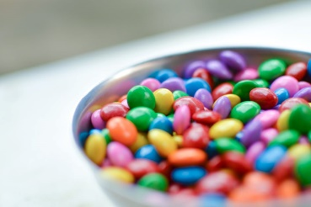
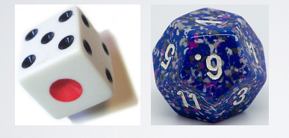
Win candy today!

Slide 34
🎰
✋
Dice game
We’ll play a game to demonstrate this approach:
▶ Two dice: 6-sided and 12-sided
– I keep one die on the left and one die on the right
4

Slide 35
Dice game
🎰
✋
We’ll play a game to demonstrate this approach:
▶ Two dice: 6-sided and 12-sided
– I keep one die on the left and one die on the right
▶ The “good die” is the 12-sided die.
4

Slide 36
Dice game
🎰
✋
We’ll play a game to demonstrate this approach:
▶ Two dice: 6-sided and 12-sided
– I keep one die on the left and one die on the right
▶ The “good die” is the 12-sided die.
▶ Ultimate goal: come to a class consensus about whether the die on the left or the die on the right is the “good die”
4

Slide 37
🎰
✋
Dice game
We’ll play a game to demonstrate this approach:
▶ Two dice: 6-sided and 12-sided
– I keep one die on the left and one die on the right
▶ The “good die” is the 12-sided die.
▶ Ultimate goal: come to a class consensus about whether the die on the left or the die on the right is the “good die”
▶ We will start with priors, collect data, and calculate posteriors, and make a decision or iterate until we’re ready to make a decision
4

Slide 38
Collecting Information on the Dice Location

Slide 39
🎰
✋
Prior probabilities
▶ The two competing claims are
H₁: Good die is on left
H₂: Good die is on right
5

Slide 40
🎰
✋
Prior probabilities
▶ The two competing claims are
H₁: Good die is on left
H₂: Good die is on right
▶ Winning in a Given Roll: The die you selected rolls a number ≥4
▶ At each roll I tell you whether you won or not (win = ≥ 4)
P(win | 6-sided die) =
P(win | 12-sided die) =
Question: If we knew which die was in which hand, which die would we always want to pick?
5

Slide 41
🎰
✋
Prior probabilities
▶ The two competing claims are
H₁: Good die is on left
H₂: Good die is on right
▶ Winning in a Given Roll: The die you selected rolls a number ≥4
▶ At each roll I tell you whether you won or not (win = ≥ 4)
P(win | 6-sided die) = 3/6 = 0.5 → “Bad Die”
P(win | 12-sided die) = 9/12 = 0.75 → “Good Die”
5

Slide 42
Instructions for Volunteer Students who Collect Data

Slide 43
🎰
✋
Rules of the game
Instructions for Student Volunteer
▶ You won’t know which die I’m holding in which hand, left
(L) or right (R).
In a Round for a Student Volunteer
  ▶ You pick die (L or R), I roll it, and I tell you if you win or not, where winning is getting a number ≥ 4.
    If you win, you get a piece of candy.
    If you lose, I get to keep the candy.
  ▶ We’ll play this multiple times with different contestants.
  ▶ I will not swap the sides the dice are on at any point.
  ▶ You get to pick how long you want play, but there are costs associated with playing longer.

Slide 44
Winning/Losing the Game

Slide 45
🎰
✋
Hypotheses and decisions
▶ Winning/Losing the GAME
Final Class Decision | Truth
 | L good, R bad | L bad, R good
Pick L | You get candy! | You lose all the candy :(
Pick R | You lose all the candy :( | You get candy!
Sampling isn’t free!
At each trial you risk losing pieces of candy if you lose (the die comes up < 4).
Too many trials means you won’t have much candy left. And if we spend too much class time and we may not get through all the material.

Slide 46
🎰
✋
Data and decision making
 | Choice (L or R) | Result (win or loss)
Roll 1
Roll 2
Roll 3
Roll 4
Roll 5
Roll 6
Roll 7
...
What is your decision? How did you make this decision?

Slide 47
🎰
✋
Calculate the posterior probability for the hypothesis chosen in the ﬁrst roll, and discuss how this might inﬂuence your decision for the next roll.
10

Slide 48
Outline
1. Housekeeping
Main ideas
    Probability trees are useful for conditional probability calculations
    Bayesian inference: start with a prior, collect data, calculate posterior, make a decision or iterate
    Posterior probability and p-value do not mean the same thing
3. Summary

Slide 49
▶ p-value : P(observed or more extreme outcome | null
👫
3. Posterior probability and p-value do not mean the same thing
🔍
hypothesis is true)
– This is more like P(data | hyp) than P(hyp | data).
▶ posterior : P(hypothesis | data)
▶ Bayesian approach avoids the counter-intuitive Frequentist p-value for decision making, and more advanced Bayesian techniques offer ﬂexibility not present in Frequentist models
▶ Watch out!
Bayes: A good prior helps, a bad prior hurts, but the prior matters less the more data you have.
p-value: It is really easy to mess up p-values: Goodman, 2008
11

Slide 50
Application exercise: 2.2 Bayesian inference for drug testing
See the course website for instructions.
12

Slide 51
Summary of main ideas
Probability trees are useful for conditional probability calculations
Bayesian inference: start with a prior, collect data, calculate posterior, make a decision or iterate
Posterior probability and p-value do not mean the same thing
13

