Slide 1

Unit 2: Probability and distributions
3. Normal and binomial distributions
Sta 101 – Spring 2019
Duke University, Department of Statistical Science
Dr. Ellison
Slides posted at https://www2.stat.duke.edu/courses/Spring19/sta101.001/

Slide 2
Outline
Housekeeping
Main ideas
General Probability Distribution Properties: 🔍 👫 Two types of probability distributions: discrete and continuous
Normal Distribution Properties:
🔍 Normal distribution is unimodal, symmetric, and follows the 68-95-99.7 rule
🔮 ⚙️ 🔍 👫 Z scores serve as a ruler for any distribution
Binomial Distribution Properties:
⚙️ 🔍 🖳 Binomial distribution is used for calculating the probability of exact number of successes for a given number of trials
🔍 Expected value and standard deviation of the binomial can be calculated using its parameters n and p
Relationship between Binomial and Normal Distribution:
👫 ✋ 🔮 🖳 Shape of the binomial distribution approaches normal when the S-F rule is met

Slide 3
Announcements
Coming up…
▶ Lab Assignment 3 is due Thursday just before your lab section time.
▶ Problem Set 2 due Wednesday 2/6 11:55 pm
▶ Performance Assessment 2 due Sunday 2/10 11:55 pm (opens Wednesday)
▶ Readiness Assessment 3 next Wednesday 2/6 in class!
1

Slide 4
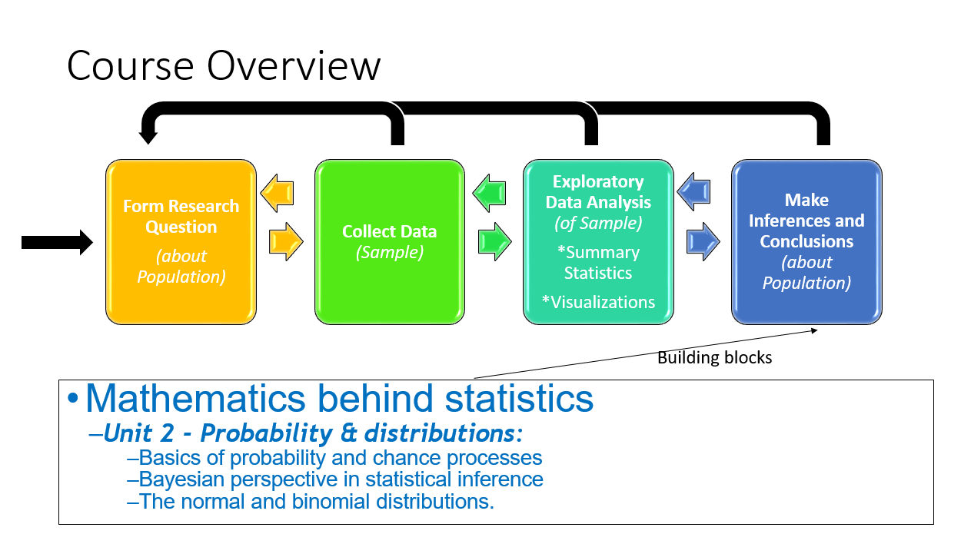
Outline

Slide 5
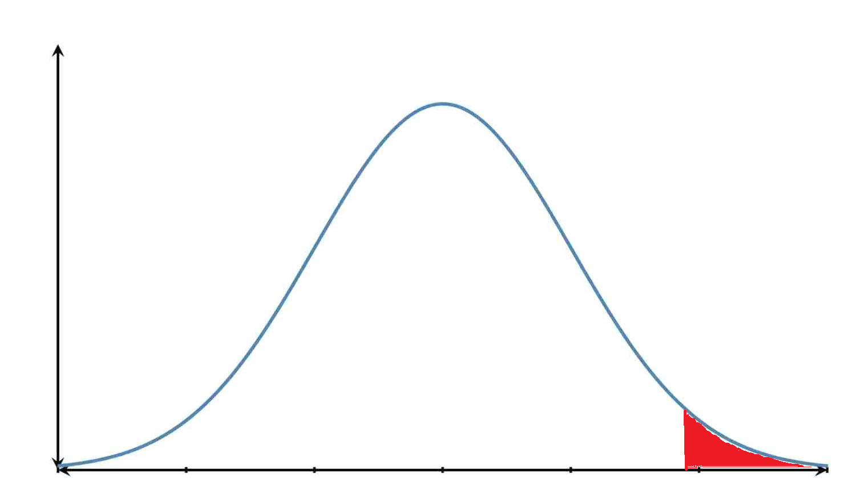
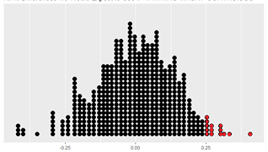

Outline
Making an Inference
Randomization Distribution (Unit 1)
Sampling Distribution (Special kind of normal distribution) (Units 3-7)
Vs.
-0.25 0 0.25
-0.25 0 0.25
$${\hat{p}}_{saw yawn}−{\hat{p}}_{didnt see yawn}$$
$${\hat{p}}_{saw yawn}−{\hat{p}}_{didnt see yawn}$$

Slide 6
Outline
Housekeeping
Main ideas
General Probability Distribution Properties: 🔍 👫 Two types of probability distributions: discrete and continuous
Normal Distribution Properties:
🔍 Normal distribution is unimodal, symmetric, and follows the 68-95-99.7 rule
🔮 ⚙️ 🔍 👫 Z scores serve as a ruler for any distribution
Binomial Distribution Properties:
⚙️ 🔍 🖳 Binomial distribution is used for calculating the probability of exact number of successes for a given number of trials
🔍 Expected value and standard deviation of the binomial can be calculated using its parameters n and p
Relationship between Binomial and Normal Distribution:
👫 ✋ 🔮 🖳 Shape of the binomial distribution approaches normal when the S-F rule is met

Slide 7
Outline
Discrete Probability Distributions
vs.
Continuous Probability Distributions

Slide 8
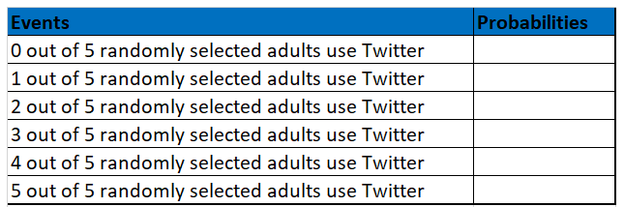
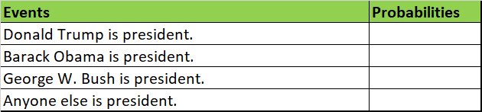
Outline
How can we describe the probabilities for a set of events that are discrete?

Slide 9
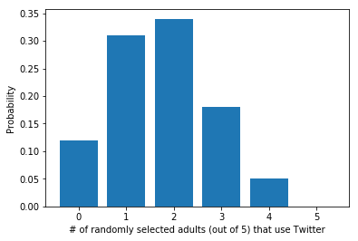
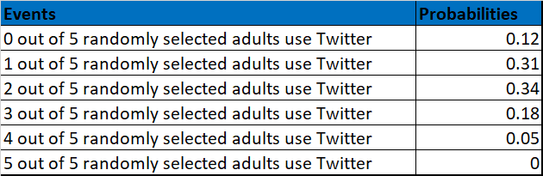

Outline
How can we describe the probabilities for a set of events that are discrete?
Equation
E$P\left(\begin{aligned}k out of n RS adults \\ use Twitter\end{aligned}\right)=\left(\begin{matrix}n \\ k\end{matrix}\right)p^{k}{(1−p)}^{n−k}$
Table
Histogram
Distribution Shorthand, if a random variable follows probabilities that follow a well-known distribution.
Ex: $X\sim Bin(n=5,p=0.34)$ means X follows a Binomial Distribution with n=5 trials and probability of a trial success is p=0.34

Slide 10
1. Two types of probability distributions: discrete and continuous
🔍 👫
▶ A discrete probability distribution lists all possible events
and the probabilities with which they occur
The events listed must be disjoint
Each probability must be between 0 and 1
The probabilities must total 1
Example: Binomial distribution
2

Slide 11
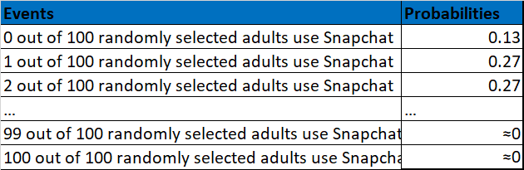
1. Two types of probability distributions: discrete and continuous
🔍 👫
▶ A discrete probability distribution lists all possible events
and the probabilities with which they occur
The events listed must be disjoint
Each probability must be between 0 and 1
The probabilities must total 1
Example: Binomial distribution
Question: Using the table below, what is the probability that at least 1 out of 100 randomly selected adults use Snapchat?
2

Slide 12
1. Two types of probability distributions: discrete and continuous
🔍 👫
▶ A discrete probability distribution lists all possible events
and the probabilities with which they occur
The events listed must be disjoint
Each probability must be between 0 and 1
The probabilities must total 1
Example: Binomial distribution
Question: Using the table below, what is the probability that at least 1 out of 100 randomly selected adults use Snapchat?
Know:
Sum of all
probabilities is 1
Want: Sum of these probabilities
2

Slide 13
1. Two types of probability distributions: discrete and continuous
🔍 👫
▶ A discrete probability distribution lists all possible events
and the probabilities with which they occur
The events listed must be disjoint
Each probability must be between 0 and 1
The probabilities must total 1
Example: Binomial distribution
Question: Using the table below, what is the probability that at least 1 out of 100 randomly selected adults use Snapchat?
Answer:
$P\left(\begin{matrix}at least 1 out 100 randomly \\ selected adults use Snapchat\end{matrix}\right)=1−P\left(\begin{matrix}0 out 100 randomly \\ selected adults use Snapchat\end{matrix}\right)=1−0.13=0.8$7
2

Slide 14
Outline
How do we describe the probabilities for a set of events that are continuous?
Ex:
Event: Adult Female is 5’8”
Event: Adult Female is 5’2”
Event: Adult Female is 5’8.5”
Event: Adult Female is 5’8.59289039”
Events = Heights of Adult Females

Slide 15
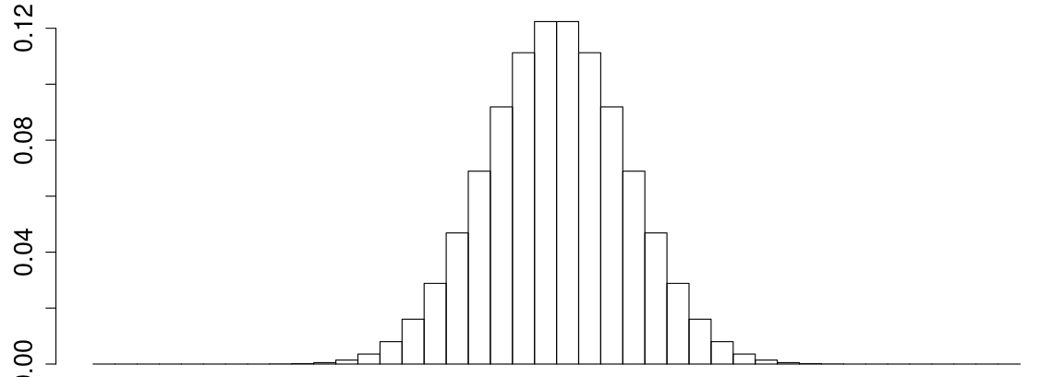
Outline
5’0’’-5’1” 5’4”-5’5” 5’8”-5’9””
Events = Heights of Adult Females

Slide 16
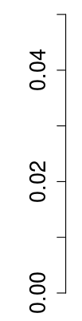
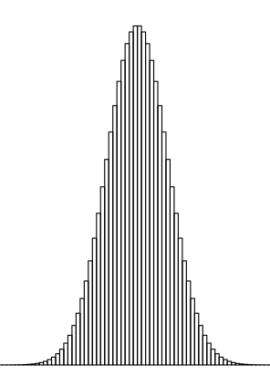
Outline
5’0’’-5’0.5” 5’4”-5’4.5” 5’8”-5’8.5””
Events = Heights of Adult Females

Slide 17
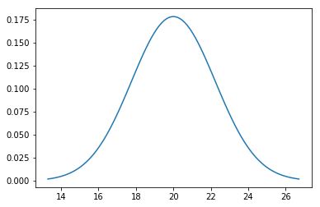
Outline
How do we describe the probabilities for a set of events that are continuous?
5’0’’ 5’4” 5’8”
Events = Heights of Adult Females

Slide 18

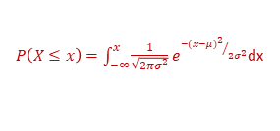
Outline
How do we describe the probabilities for a set of events that are continuous?
Probability Density Function
Distribution Shorthand, if a random variable follows probabilities that follow a well-known distribution.
Ex: $X\sim N(µ=5^{′}4",σ=3.5")$ means X follows a Normal Distribution with mean $µ=5^{′}4"$and $σ=3.5"$.
5’0’’ 5’4” 5’8”
Equation
Events = Heights of Adult Females
Ex:
$P\left(X≤x\right)=\int_{−∞}^{x}{\frac{1}{\sqrt{2πσ^{2}}}e^{{−{(x−μ)}^{2}}/{2σ^{2}}}}$dx

Slide 19
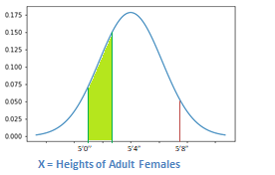
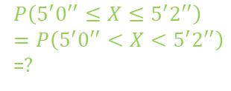

1. Two types of probability distributions: discrete and continuous
🔍 👫
▶ A continuous probability distribution differs from a discrete
probability distribution in several ways:
The probability that a continuous random variable will equal to any speciﬁc value is zero.
As such, they cannot be expressed in tabular form.
Instead, we use an equation or a formula to describe its distribution via a probability density function (pdf).
We can calculate the probability for ranges of values the random variable takes (area under the curve).
Area/probability under the WHOLE pdf curve = 1.
Example: Normal distribution
$$P\left(X=5^{′}8^{′′}\right)=?$$
$$P\left(5^{′}0^{′′}≤X≤5^{′}2^{′′}\right)$$
$$=P\left(5^{′}0^{′′}<X<5^{′}2^{′′}\right)$$
=$?$
2

Slide 20
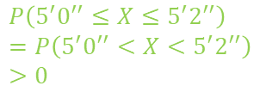

1. Two types of probability distributions: discrete and continuous
🔍 👫
▶ A continuous probability distribution differs from a discrete
probability distribution in several ways:
The probability that a continuous random variable will equal to any speciﬁc value is zero.
As such, they cannot be expressed in tabular form.
Instead, we use an equation or a formula to describe its distribution via a probability density function (pdf).
We can calculate the probability for ranges of values the random variable takes (area under the curve).
Area/probability under the WHOLE pdf curve = 1.
Example: Normal distribution
$$P\left(X=5^{′}8^{′′}\right)=0$$
$$P\left(5^{′}0^{′′}≤X≤5^{′}2^{′′}\right)$$
$$=P\left(5^{′}0^{′′}<X<5^{′}2^{′′}\right)$$
$$>0$$
2

Slide 21
Outline
Housekeeping
Main ideas
General Probability Distribution Properties: 🔍 👫 Two types of probability distributions: discrete and continuous
Normal Distribution Properties:
🔍 Normal distribution is unimodal, symmetric, and follows the 68-95-99.7 rule
🔮 ⚙️ 🔍 👫 Z scores serve as a ruler for any distribution
Binomial Distribution Properties:
⚙️ 🔍 🖳 Binomial distribution is used for calculating the probability of exact number of successes for a given number of trials
🔍 Expected value and standard deviation of the binomial can be calculated using its parameters n and p
Relationship between Binomial and Normal Distribution:
👫 ✋ 🔮 🖳 Shape of the binomial distribution approaches normal when the S-F rule is met

Slide 22
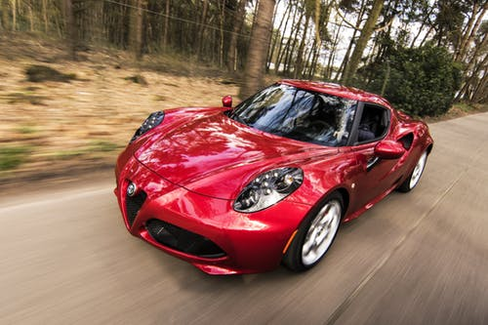
Outline
What is a useful property that normal distributions have (that most others don’t)?

Slide 23
Clicker question
🔍
Speeds of cars on a highway are normally distributed with mean 65 miles / hour. The minimum speed recorded is 48 miles / hour and the maximum speed recorded is 83 miles / hour. Which of the following is most likely to be the standard deviation of the distribution?
-5
5
10
15
30
3

Slide 24
Speeds of cars on a highway are normally distributed with mean 65 miles / hour. The minimum speed recorded is 48 miles / hour and the maximum speed recorded is 83 miles / hour. Which of the following is most likely to be the standard deviation of the distribution?
🔍
Clicker question
(a) -5 → SD cannot be negative (b) 5 → 65 ± (3 × 5) = (50, 80)
(c) 10 → 65 ± (3 × 10) = (35, 95) (d) 15 → 65 ± (3 × 15) = (20, 110)
(e) 30 → 65 ± (3 × 30) = (−25, 155)
3

Slide 25
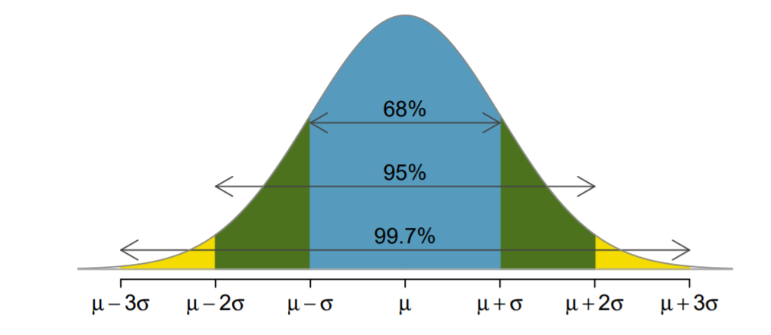
🔍
Normal Distribution Follows the 68-95-99.7 rule
What percent of the observations are greater than µ+2σ?
What percent of the observations are greater than µ+2.5σ?
3

Slide 26
🔍
Normal Distribution Follows the 68-95-99.7 rule
What percent of the observations are greater than µ+2σ? (about 2.5%)
What percent of the observations are greater than µ+2.5σ? (need to use z-tables to figure out)
3

Slide 27
Outline
Housekeeping
Main ideas
General Probability Distribution Properties: 🔍 👫 Two types of probability distributions: discrete and continuous
Normal Distribution Properties:
🔍 Normal distribution is unimodal, symmetric, and follows the 68-95-99.7 rule
🔮 ⚙️ 🔍 👫 Z scores serve as a ruler for any distribution
Binomial Distribution Properties:
⚙️ 🔍 🖳 Binomial distribution is used for calculating the probability of exact number of successes for a given number of trials
🔍 Expected value and standard deviation of the binomial can be calculated using its parameters n and p
Relationship between Binomial and Normal Distribution:
👫 ✋ 🔮 🖳 Shape of the binomial distribution approaches normal when the S-F rule is met

Slide 28

Outline
How can we determine if an observation is unusual?

Slide 29
3. Z scores serve as a ruler for any distribution
🔮 🔍
How can we determine if it would be unusual for an adult woman in North Carolina to be 96” (8 ft) tall?
How can we determine if it would be unusual for an adult alien woman to be 103 metreloots tall, assuming the distribution of heights of adult alien women is approximately normal?
4

Slide 30
3. Z scores serve as a ruler for any distribution
🔮 🔍
A Z score creates a common scale so you can assess data without worrying about the speciﬁc units in which it was measured.
_{Z =} obs − mean
SD
4

Slide 31
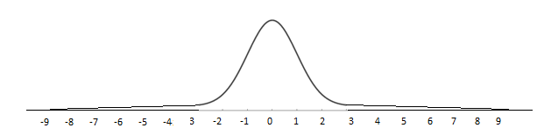

3. Z scores serve as a ruler for any distribution
🔮 🔍
A Z score creates a common scale so you can assess data without worrying about the speciﬁc units in which it was measured.
_{Z =} obs − mean
SD
How can we determine if it would be unusual for an adult woman in North Carolina to be 96” (8 ft) tall?
$$z−score=\frac{96−μ_{NC woman}}{σ_{NC woman}}$$
z-scores
4

Slide 32

3. Z scores serve as a ruler for any distribution
🔮 🔍
A Z score creates a common scale so you can assess data without worrying about the speciﬁc units in which it was measured.
_{Z =} obs − mean
SD
How can we determine if it would be unusual for an adult woman in North Carolina to be 96” (8 ft) tall?
How can we determine if it would be unusual for an adult alien woman to be 103 metreloots tall, assuming the distribution of heights of adult alien women is approximately normal?
… but we still don’t know if these women’s heights are unusual… yet!
$$z−score=\frac{103−μ_{ALIEN woman}}{σ_{ALIEN woman}}$$
$$z−score=\frac{96−μ_{NC woman}}{σ_{NC woman}}$$
z-scores
4

Slide 33
🔍 ⚙
3. Z scores serve as a ruler for any distribution
_{Z =} obs − mean
SD
All Distributions
▶ Z score: number of standard deviations the observation falls above or below the mean (for any distribution)
5

Slide 34
🔍 ⚙
3. Z scores serve as a ruler for any distribution
_{Z =} obs − mean
Mean of the population the observation comes from
SD
Standard deviation of the population the
observation comes from
All Distributions
▶ Z score: number of standard deviations the observation falls above or below the mean (for any distribution)
5

Slide 35
🔍 ⚙
3. Z scores serve as a ruler for any distribution
_{Z =} obs − mean
Mean of the population the observation comes from
SD
Standard deviation of the population the
observation comes from
All Distributions
▶ Z score: number of standard deviations the observation falls above or below the mean (for any distribution)
▶ Z score deﬁned for distributions of any shape, but only when the distribution is normal can we use Z scores to calculate percentiles and assess if an observation is unusual.
5

Slide 36
🔍 ⚙
3. Z scores serve as a ruler for any distribution
_{Z =} obs − mean
Mean of the population the observation comes from
SD
Standard deviation of the population the
observation comes from
All Distributions
▶ Z score: number of standard deviations the observation falls above or below the mean (for any distribution)
▶ Z score deﬁned for distributions of any shape, but only when the distribution is normal can we use Z scores to calculate percentiles and assess if an observation is unusual.
▶ Z distribution (also called the standardiZed normal distribution, is a special case of the normal distribution where µ = 0 and σ = 1. Distribution of z-scores of obs from normal distributions. Z ∼ N(µ = 0, σ = 1)
Normal Distributions
5

Slide 37
🔍 ⚙
3. Z scores serve as a ruler for any distribution
_{Z =} obs − mean
Mean of the population the observation comes from
SD
Standard deviation of the population the
observation comes from
All Distributions
▶ Z score: number of standard deviations the observation falls above or below the mean (for any distribution)
▶ Z score deﬁned for distributions of any shape, but only when the distribution is normal can we use Z scores to calculate percentiles and assess if an observation is unusual
▶ Z distribution (also called the standardiZed normal distribution, is a special case of the normal distribution where µ = 0 and σ = 1. Distribution of z-scores of obs from normal distributions. Z ∼ N(µ = 0, σ = 1)
Normal Distributions
▶ Observations from normal distributions with |Z| > 2 are usually considered unusual
5

Slide 38

3. Z scores serve as a ruler for any distribution
🔮 🔍
A Z score creates a common scale so you can assess data without worrying about the speciﬁc units in which it was measured.
It is unusual for an adult woman in North Carolina to be 96” (8 ft) tall (we know that adult heights are approx. normal)
It is not unusual for an adult alien woman(?) to be 103 metreloots tall, assuming the distribution of heights of adult alien women is approximately normal.
Standard Normal Distribution
$$Z\sim N(0,1)$$
probability
$$z−score=\frac{103−μ_{ALIEN woman}}{σ_{ALIEN woman}}$$
$$z−score=\frac{96−μ_{NC woman}}{σ_{NC woman}}$$
z-scores
4

Slide 39
Question: What is the probability that the z-score of an observation from a normal distribution is between -1 and 1?

Slide 40
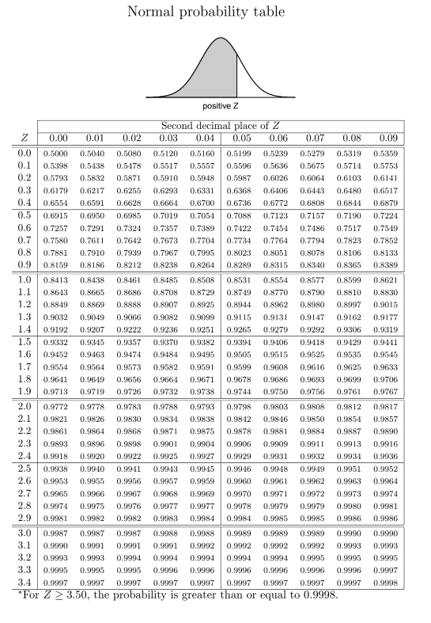

Question: What is the probability that the z-score of an observation from a normal distribution is between -1 and 1?
Answer: $P\left(−1≤Z≤1\right)=0.68$
We CAN use the z-tables to find this probability, because the observation comes from a normal distribution.

Slide 41
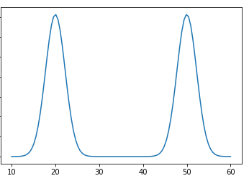
Question: What is the probability that the z-score of an observation from the distribution below is between -1 and 1?

Slide 42

Question: What is the probability that the z-score of an observation from the distribution below is between -1 and 1?
Answer: $P\left(−1≤Z≤1\right)=?$
We’re not given enough information! We CAN’T use the z-table because the observation doesn’t come from a normal distribution.

Slide 43
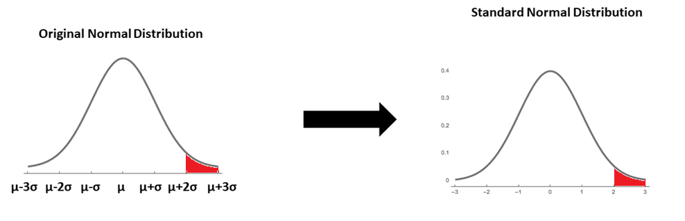


$P(X≥$ $μ+2σ)=P(Z≥2)$
$$z=\frac{x−μ}{σ}$$
$$=\frac{(μ+2σ)−μ}{σ}$$
$=2$
x
z

Slide 44
Clicker question
👫 🔍
Scores on a standardized test are normally distributed with a mean of 100 and a standard deviation of 20. If these scores are converted to standard normal Z scores, which of the following statements will be correct?
The mean will equal 0, but the median cannot be determined.
The mean of the standardized Z-scores will equal 100.
The mean of the standardized Z-scores will equal 5.
Both the mean and median score will equal 0.
A score of 70 is considered unusually low on this test.
6

Slide 45

Clicker question
👫 🔍
Scores on a standardized test are normally distributed with a mean of 100 and a standard deviation of 20. If these scores are converted to standard normal Z scores, which of the following statements will be correct?
The mean will equal 0, but the median cannot be determined.
The mean of the standardized Z-scores will equal 100.
The mean of the standardized Z-scores will equal 5.
Both the mean and median score will equal 0.
A score of 70 is considered unusually low on this test.
$$z−score=\frac{70−100}{20}=−1.5≻−2$$
Not unusual
6

Slide 46
Outline
Housekeeping
Main ideas
General Probability Distribution Properties: 🔍 👫 Two types of probability distributions: discrete and continuous
Normal Distribution Properties:
🔍 Normal distribution is unimodal, symmetric, and follows the 68-95-99.7 rule
🔮 ⚙️ 🔍 👫 Z scores serve as a ruler for any distribution
Binomial Distribution Properties:
⚙️ 🔍 🖳 Binomial distribution is used for calculating the probability of exact number of successes for a given number of trials
🔍 Expected value and standard deviation of the binomial can be calculated using its parameters n and p
Relationship between Binomial and Normal Distribution:
👫 ✋ 🔮 🖳 Shape of the binomial distribution approaches normal when the S-F rule is met

Slide 47
Outline
How do we know if a random variable follows a binomial distribution? How do we use a binomial distribution to calculate probabilities?
Broadband User
Not Broadband user

Slide 48
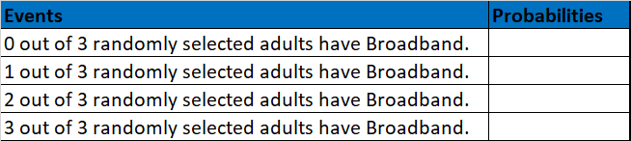
Outline
Do we have enough information to fill out this probability table?

Slide 49
Outline
Do we have enough information to fill out this probability table?
Binomial Distribution Conditions Met:
n=3 fixed trials
Each trial is independent.
Each trial can have one of two outcomes (success=having Broadband, failure=not having Broadband)
______________
No!

Slide 50
Outline
Suppose we know now that the probability of any one randomly selected adult having Broadband is p=0.7.
Do we have enough information to fill out this probability table?

Slide 51
Outline
Suppose we know now that the probability of any one randomly selected adult having Broadband is p=0.7.
Do we have enough information to fill out this probability table?
Yes! We can use the Binomial Distribution to find these probabilities.
Binomial Distribution Conditions Met:
n=3 fixed trials
Each trial is independent.
Each trial can have one of two outcomes (success=having Broadband, failure=not having Broadband)
Probability of a given trial being a “success” (having Broadband) is the same (p=0.7).

Slide 52


Binomial distribution (cont.)
🔍 🖳
The Binomial distribution describes the probability of having exactly k successes in n independent trials with probability of success p.
$$P\left(k success in n trials\right)=\left(\begin{matrix}n \\ k\end{matrix}\right)p^{k}{(1−p)}^{n−k}$$
$$\left(\begin{matrix}n \\ k\end{matrix}\right)=\frac{n!}{k!\left(n−k\right)!}$$
10

Slide 53

Binomial distribution (cont.)
🔍 🖳
The Binomial distribution describes the probability of having exactly k successes in n independent trials with probability of success p.
$$P\left(k success in n trials\right)=\left(\begin{matrix}n \\ k\end{matrix}\right)p^{k}{(1−p)}^{n−k}$$
$$\left(\begin{matrix}n \\ k\end{matrix}\right)=\frac{n!}{k!\left(n−k\right)!}$$
$$0!=1$$
$$1!=1$$
$$2!=2×1$$
$$…$$
$$5!=5×4×3×2×1$$
10

Slide 54

Binomial distribution (cont.)
🔍 🖳
The Binomial distribution describes the probability of having exactly k successes in n independent trials with probability of success p.
$$P\left(k success in n trials\right)=\left(\begin{matrix}n \\ k\end{matrix}\right)p^{k}{(1−p)}^{n−k}$$
Note: You can also use R for the calculation of number of scenarios:
$$\left(\begin{matrix}n \\ k\end{matrix}\right)=\frac{n!}{k!\left(n−k\right)!}$$
> choose(5,3)
[1] 10
Note: And to compute probabilities
> dbinom(1, size = 3, prob = 0.7)
10
[1] 0.189

Slide 55




Outline
Suppose we know now that the probability of any one randomly selected adult having Broadband is p=0.7.
$$\left(\begin{matrix}3 \\ 0\end{matrix}\right){0.7}^{0}{(1−0.7)}^{3−0}$$
$$\left(\begin{matrix}3 \\ 1\end{matrix}\right){0.7}^{1}{(1−0.7)}^{3−1}$$
$$\left(\begin{matrix}3 \\ 2\end{matrix}\right){0.7}^{2}{(1−0.7)}^{3−2}$$
$$\left(\begin{matrix}3 \\ 3\end{matrix}\right){0.7}^{3}{(1−0.7)}^{3−3}$$

Slide 56

Outline
Where does the Binomial Distribution probability equation come from?
$$P\left(k success in n trials\right)=\left(\begin{matrix}n \\ k\end{matrix}\right)p^{k}{(1−p)}^{n−k}$$

Slide 57
Considering many scenarios
🔍 ⚙
Suppose we randomly select three individuals from the US, what is the probability that exactly 1 has high-speed broadband connection at home?
Let’s call these people Anthony (A), Barry (B), Cam (C). Each one of the three scenarios below will satisfy the condition of “exactly 1 of them says Yes”:
8

Slide 58
Considering many scenarios
🔍 ⚙
Suppose we randomly select three individuals from the US, what is the probability that exactly 1 has high-speed broadband connection at home?
Let’s call these people Anthony (A), Barry (B), Cam (C). Each one of the three scenarios below will satisfy the condition of “exactly 1 of them says Yes”:
0.70 0.30
0.30
Scenario 1:
× × ≈ 0.063
(A) yes (B) no (C) no
8

Slide 59
Considering many scenarios
🔍 ⚙
Suppose we randomly select three individuals from the US, what is the probability that exactly 1 has high-speed broadband connection at home?
Let’s call these people Anthony (A), Barry (B), Cam (C). Each one of the three scenarios below will satisfy the condition of “exactly 1 of them says Yes”:
0.70
(A) yes
0.30
(B) no
0.30
(C) no
0.30
(C) no
Scenario 1:
×
×
×
≈ 0.063
≈ 0.063
0.30 0.70
Scenario 2:
×
(A) no (B) yes
8

Slide 60
Considering many scenarios
🔍 ⚙
Suppose we randomly select three individuals from the US, what is the probability that exactly 1 has high-speed broadband connection at home?
Let’s call these people Anthony (A), Barry (B), Cam (C). Each one of the three scenarios below will satisfy the condition of “exactly 1 of them says Yes”:
0.70
(A) yes
0.30
(A) no
0.30
(A) no
0.30
(B) no
0.70
(B) yes
0.30
(B) no
0.30
(C) no
0.30
(C) no
0.70
(C) yes
Scenario 1:
×
×
×
×
×
×
≈ 0.063
≈ 0.063
≈ 0.063
Scenario 2:
Scenario 3:
8

Slide 61
Suppose we randomly select three individuals from the US, what is the probability that exactly 1 has high-speed broadband connection at home?
🔍 ⚙
Considering many scenarios
Let’s call these people Anthony (A), Barry (B), Cam (C). Each one of the three scenarios below will satisfy the condition of “exactly 1 of them says Yes”:
0.70
(A) yes
0.30
(A) no
0.30
(A) no
0.30
(B) no
0.70
(B) yes
0.30
(B) no
0.30
(C) no
0.30
(C) no
0.70
(C) yes
Scenario 1:
×
×
×
×
≈ 0.063
≈ 0.063
Scenario 2:
Scenario 3:
×
×
≈ 0.063
The probability of exactly one 1 of 3 people saying Yes is the sum of all of these probabilities.
0.063 + 0.063 + 0.063 = 3 × 0.063 = 0.189
8

Slide 62
Binomial distribution
🔍 ⚙
The question from the prior slide asked for the probability of given number of successes, k, in a given number of trials, n, (k = 1 success in n = 3 trials), and we calculated this probability as
# of scenarios × P(single scenario)
9

Slide 63
Binomial distribution
🔍 ⚙
The question from the prior slide asked for the probability of given number of successes, k, in a given number of trials, n, (k = 1 success in n = 3 trials), and we calculated this probability as
# of scenarios × P(single scenario)
▶ P(single scenario) = p^{k} (1 − p)^{(n−k)}
probability of success to the power of number of successes, probability of failure to the power of number of failures
9

Slide 64
Binomial distribution
🔍 ⚙
The question from the prior slide asked for the probability of given number of successes, k, in a given number of trials, n, (k = 1 success in n = 3 trials), and we calculated this probability as
# of scenarios × P(single scenario)
▶ P(single scenario) = p^{k} (1 − p)^{(n−k)}
probability of success to the power of number of successes, probability of failure to the power of number of failures
▶ number of scenarios: =
n n!
( )
k k!(n−k)!
9

Slide 65

Binomial distribution
🔍 ⚙
The question from the prior slide asked for the probability of given number of successes, k, in a given number of trials, n, (k = 1 success in n = 3 trials), and we calculated this probability as
$$P\left(k success in n trials\right)=\left(\#of scenarios\right)P(single scenario)$$
$$P\left(k success in n trials\right)=\left(\begin{matrix}n \\ k\end{matrix}\right)p^{k}{(1−p)}^{n−k}$$
9

Slide 66
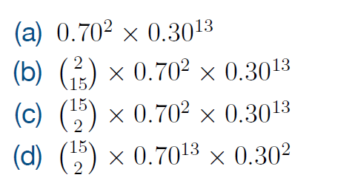
According to the results of the Pew poll 70% of Americans have high-speed broadband connection at home, what is the probability that exactly 2 out of 15 randomly sampled Americans have such connection at home?
🔍 🔮
Clicker question
13

Slide 67
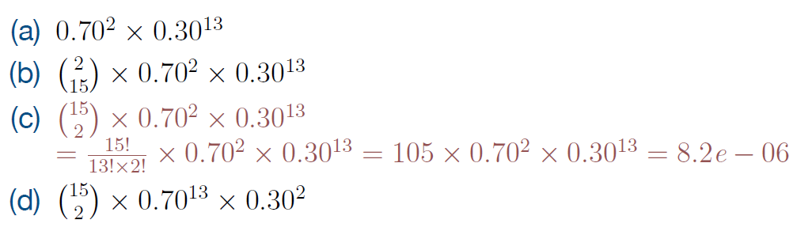

According to the results of the Pew poll 70% of Americans have high-speed broadband connection at home, what is the probability that exactly 2 out of 15 randomly sampled Americans have such connection at home?
🔍 🔮
Clicker question
$$P\left(k success in n trials\right)=\left(\begin{matrix}n \\ k\end{matrix}\right)p^{k}{(1−p)}^{n−k}$$
13

Slide 68
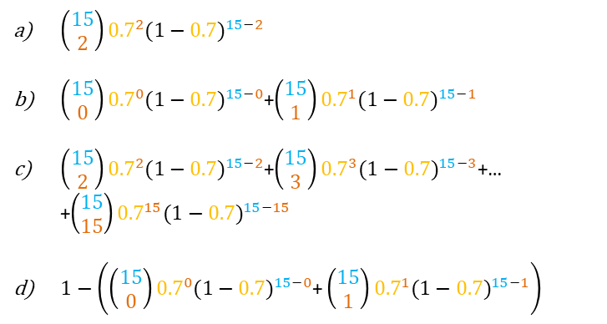
According to the results of the Pew poll 70% of Americans have high-speed broadband connection at home, what is the probability that at least 2 out of 15 randomly sampled Americans have such connection at home?
🔍 🔮
Clicker question
$\left(\begin{matrix}15 \\ 2\end{matrix}\right){0.7}^{2}{(1−0.7)}^{15−2}$
$\left(\begin{matrix}15 \\ 0\end{matrix}\right){0.7}^{0}{(1−0.7)}^{15−0}$+$\left(\begin{matrix}15 \\ 1\end{matrix}\right){0.7}^{1}{(1−0.7)}^{15−1}$
$\left(\begin{matrix}15 \\ 2\end{matrix}\right){0.7}^{2}{(1−0.7)}^{15−2}$+$\left(\begin{matrix}15 \\ 3\end{matrix}\right){0.7}^{3}{(1−0.7)}^{15−3}$+… +$\left(\begin{matrix}15 \\ 15\end{matrix}\right){0.7}^{15}{(1−0.7)}^{15−15}$
$1−\left(\left(\begin{matrix}15 \\ 0\end{matrix}\right){0.7}^{0}{(1−0.7)}^{15−0}\text{+}\left(\begin{matrix}15 \\ 1\end{matrix}\right){0.7}^{1}{(1−0.7)}^{15−1}\right)$
13

Slide 69
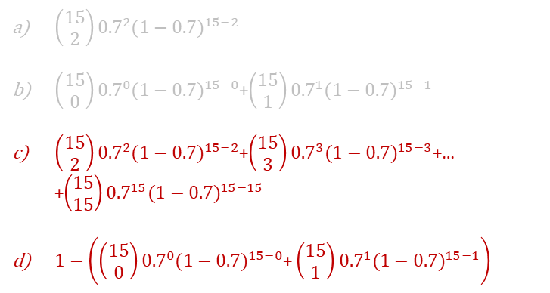
According to the results of the Pew poll 70% of Americans have high-speed broadband connection at home, what is the probability that at least 2 out of 15 randomly sampled Americans have such connection at home?
🔍 🔮
Clicker question
$\left(\begin{matrix}15 \\ 2\end{matrix}\right){0.7}^{2}{(1−0.7)}^{15−2}$
$\left(\begin{matrix}15 \\ 0\end{matrix}\right){0.7}^{0}{(1−0.7)}^{15−0}$+$\left(\begin{matrix}15 \\ 1\end{matrix}\right){0.7}^{1}{(1−0.7)}^{15−1}$
$\left(\begin{matrix}15 \\ 2\end{matrix}\right){0.7}^{2}{(1−0.7)}^{15−2}$+$\left(\begin{matrix}15 \\ 3\end{matrix}\right){0.7}^{3}{(1−0.7)}^{15−3}$+… +$\left(\begin{matrix}15 \\ 15\end{matrix}\right){0.7}^{15}{(1−0.7)}^{15−15}$
$1−\left(\left(\begin{matrix}15 \\ 0\end{matrix}\right){0.7}^{0}{(1−0.7)}^{15−0}\text{+}\left(\begin{matrix}15 \\ 1\end{matrix}\right){0.7}^{1}{(1−0.7)}^{15−1}\right)$
This way takes less time!
13

Slide 70
Outline
Housekeeping
Main ideas
General Probability Distribution Properties: 🔍 👫 Two types of probability distributions: discrete and continuous
Normal Distribution Properties:
🔍 Normal distribution is unimodal, symmetric, and follows the 68-95-99.7 rule
🔮 ⚙️ 🔍 👫 Z scores serve as a ruler for any distribution
Binomial Distribution Properties:
⚙️ 🔍 🖳 Binomial distribution is used for calculating the probability of exact number of successes for a given number of trials
🔍 Expected value and standard deviation of the binomial can be calculated using its parameters n and p
Relationship between Binomial and Normal Distribution:
👫 ✋ 🔮 🖳 Shape of the binomial distribution approaches normal when the S-F rule is met

Slide 71
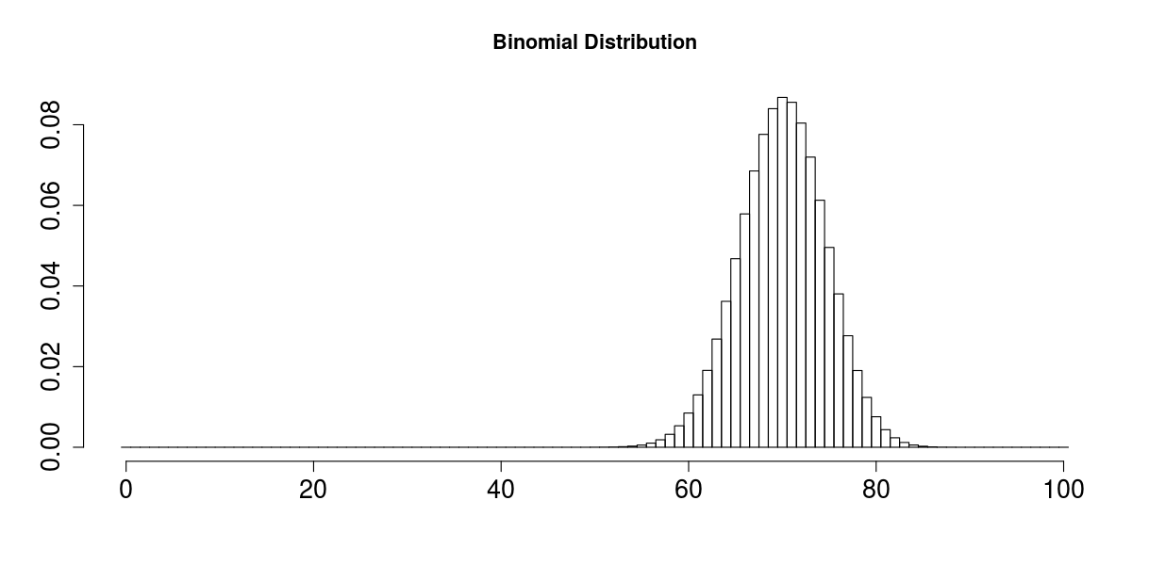
Outline
What is the mean and standard deviation of a binomial distribution?

Slide 72
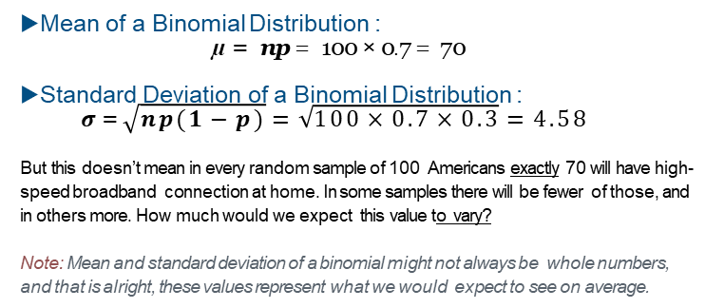
According to the results of the Pew poll suggestion that 70% of Americans have high-speed broadband connection at home, among a random sample of 100 Americans, how many would you expect to have such connection at home?
🔍
Expected value and standard deviation of binomial
▶Mean of a Binomial Distribution :
$$\text{µ }\text{= }\text{np} \text{= }\text{100 }\text{× }\text{0}\text{.}\text{7 }\text{=} \text{70}$$
▶Standard Deviation of a Binomial Distribution :
$$σ \text{=}\sqrt{np(1−p)}=\sqrt{100×0.7×0.3}=4.58$$
But this doesn’t mean in every random sample of 100 Americans exactly 70 will have high-speed broadband connection at home. In some samples there will be fewer of those, and in others more. How much would we expect this value to vary?
Note: Mean and standard deviation of a binomial might not always be whole numbers, and that is alright, these values represent what we would expect to see on average.
14

Slide 73
Outline
Housekeeping
Main ideas
General Probability Distribution Properties: 🔍 👫 Two types of probability distributions: discrete and continuous
Normal Distribution Properties:
🔍 Normal distribution is unimodal, symmetric, and follows the 68-95-99.7 rule
🔮 ⚙️ 🔍 👫 Z scores serve as a ruler for any distribution
Binomial Distribution Properties:
⚙️ 🔍 🖳 Binomial distribution is used for calculating the probability of exact number of successes for a given number of trials
🔍 Expected value and standard deviation of the binomial can be calculated using its parameters n and p
Relationship between Binomial and Normal Distribution:
👫 ✋ 🔮 🖳 Shape of the binomial distribution approaches normal when the S-F rule is met

Slide 74
Outline
When can we approximate the binomial distribution with a normal distribution?
Why would we want to do this?

Slide 75
✋ 🔮
Shape of the binomial distribution
https://gallery.shinyapps.io/dist_calc/
15

Slide 76
Shape of the binomial distribution
✋ 🔮
https://gallery.shinyapps.io/dist_calc/
You can use the normal distribution to approximate binomial probabilities when the sample size is large enough.
15

Slide 77
https://gallery.shinyapps.io/dist_calc/
✋ 🔮 🔍
Shape of the binomial distribution
You can use the normal distribution to approximate binomial probabilities when the sample size is large enough.
S-F rule: The sample size is considered large enough if the expected number of successes and failures are both at least 10
np ≥ 10 and n(1 − p) ≥ 10
expected number
of successes
expected number
of failures
15

Slide 78
👫 🔍
What is the probability that among a random sample of 1,000 Americans at least three-fourths have high-speed broadband connection at home? (Remember probability of a randomly selected American having Broadband is p=0.70).
16

Slide 79
What is the probability that among a random sample of 1,000 Americans at least three-fourths have high-speed broadband connection at home? (Remember probability of a randomly selected American having Broadband is p=0.70).
👫 🔍
X = # of Americans in a random sample (of 1000) that have Broadband
Long and tedious way…
X~Binom(n = ?, p = ?)
16

Slide 80
👫 🔍
What is the probability that among a random sample of 1,000 Americans at least three-fourths have high-speed broadband connection at home? (Remember probability of a randomly selected American having Broadband is p=0.70).
X = # of Americans in a random sample (of 1000) that have Broadband
Long and tedious way…
X~Bin(n = 1000, p = 0.7)
16

Slide 81
👫 🔍
What is the probability that among a random sample of 1,000 Americans at least three-fourths have high-speed broadband connection at home? (Remember probability of a randomly selected American having Broadband is p=0.70).
X = # of Americans in a random sample (of 1000) that have Broadband
Long and tedious way…
P(X ≥ 750) = P(X = 750)+P(X = 751)+P(X = 752)+· · ·+P(X = 1000)
X~Bin(n = 1000, p = 0.7)
$=\left(\begin{matrix}1000 \\ 750\end{matrix}\right){0.7}^{750}{(1−0.7)}^{1000−750}+\left(\begin{matrix}1000 \\ 751\end{matrix}\right){0.7}^{751}{(1−0.7)}^{1000−751}$+…$\left(\begin{matrix}1000 \\ 1000\end{matrix}\right){0.7}^{1000}{(1−0.7)}^{1000−1000}$
16

Slide 82
👫 🔍 🖳
What is the probability that among a random sample of 1,000 Americans at least three-fourths have high-speed broadband connection at home? (Remember probability of a randomly selected American having Broadband is p=0.70).
Better ways…
1. Using R:
> sum(dbinom(750:1000, size = 1000, prob = 0.7))
[1] 0.00026
16

Slide 83


👫 🔍 🖳
What is the probability that among a random sample of 1,000 Americans at least three-fourths have high-speed broadband connection at home? (Remember probability of a randomly selected American having Broadband is p=0.70).
Better ways…
1. Using R:
> sum(dbinom(750:1000, size = 1000, prob = 0.7))
[1] 0.00026
2. Using the normal approximation to the binomial:
Since we have:
at least 10 expected successes (1000 × 0.7 = 700 ≥ 10) and
at least 10 expected failures (1000 × 0.3 = 300 ≥ 10),
$$P\left(x≥750\right)=P\left(Z≥\frac{750−\left(1000×0.7\right)}{\sqrt{1000×0.7×0.3}}\right)=0.9997$$
16

Slide 84
Summary of main ideas
Two types of probability distributions: discrete and continuous
Normal distribution is unimodal, symmetric, and follows the 68-95-99.7 rule
Z scores serve as a ruler for any distribution
Binomial distribution is used for calculating the probability of exact number of successes for a given number of trials
Expected value and standard deviation of the binomial can be calculated using its parameters n and p
Shape of the binomial distribution approaches normal when the S-F rule is met
17

