Slide 1

Unit 3: Foundations for inference
1. Variability in estimates and CLT
Sta 101 – Spring 2019
Duke University, Department of Statistical Science
http://www.goduke.com/
Dr. Ellison
Slides posted at https://www2.stat.duke.edu/courses/Spring19/sta101.001/

Slide 2
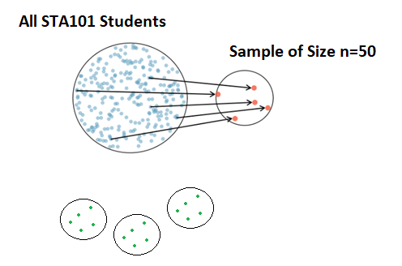
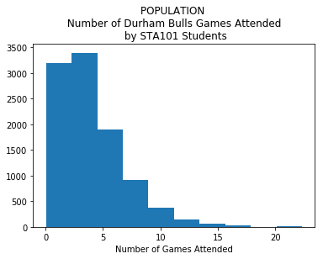
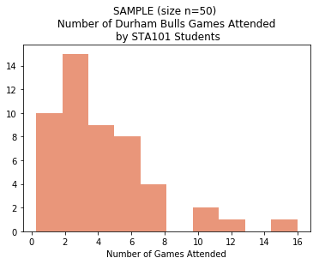
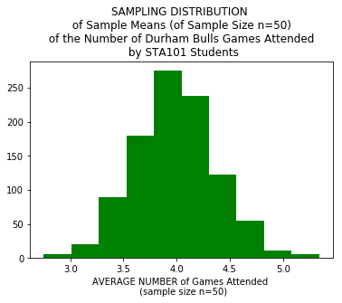

Population Distribution
Sample Distribution
$$\overline{x}$$
$$\overline{x}$$
$$\overline{x}$$
Population Mean: µ
Population Standard Deviation: σ
Sample Mean: $\overline{x}$
Sample Standard Deviation: s
Sampling Mean: µ
Sampling Standard Deviation ↔(Standard Error) : σ/$\sqrt{n}$
Sampling Distribution

Slide 3
Outline
Housekeeping
Main ideas
    Problem: We need a probability distribution of values that a sample statistic can take on to assess how “extreme” (or likely) a sample statistic is (given an assumption about the population).
    One Solution: If you can, use a theoretical probability distribution of the sample statistic, using the Central Limit Theorem.
      Observation: ✋ 🔮 🖳 Sample statistics vary from sample to sample
      Important Theorem: CLT describes the shape, center, and spread of sampling distributions
      Necessary Conditions: CLT only applies when independence and sample size/skew conditions are met
Summary
Exercises [time permitting]

Slide 4
Announcements
Coming up…
▶ Lab Assignment 3 is due Thursday just before your lab section time.
▶ Problem Set 2 due Friday 2/8 11:55 pm
▶ Performance Assessment 2 due Sunday 2/10 11:55 pm (opens today)
▶ Midterm 1 Review Wednesday 2/13
▶ Midterm 1 (Unit 1-Unit 3.2) Monday 2/18
1

Slide 5
Outline
Housekeeping
Main ideas
    Problem: We need a probability distribution of values that a sample statistic can take on to assess how “extreme” (or likely) a sample statistic is (given an assumption about the population).
    One Solution: If you can, use a theoretical probability distribution of the sample statistic, using the Central Limit Theorem.
      Observation: ✋ 🔮 🖳 Sample statistics vary from sample to sample.
      Important Theorem: CLT describes the shape, center, and spread of sampling distributions
      Necessary Conditions: CLT only applies when independence and sample size/skew conditions are met
Summary
Exercises [time permitting]

Slide 6
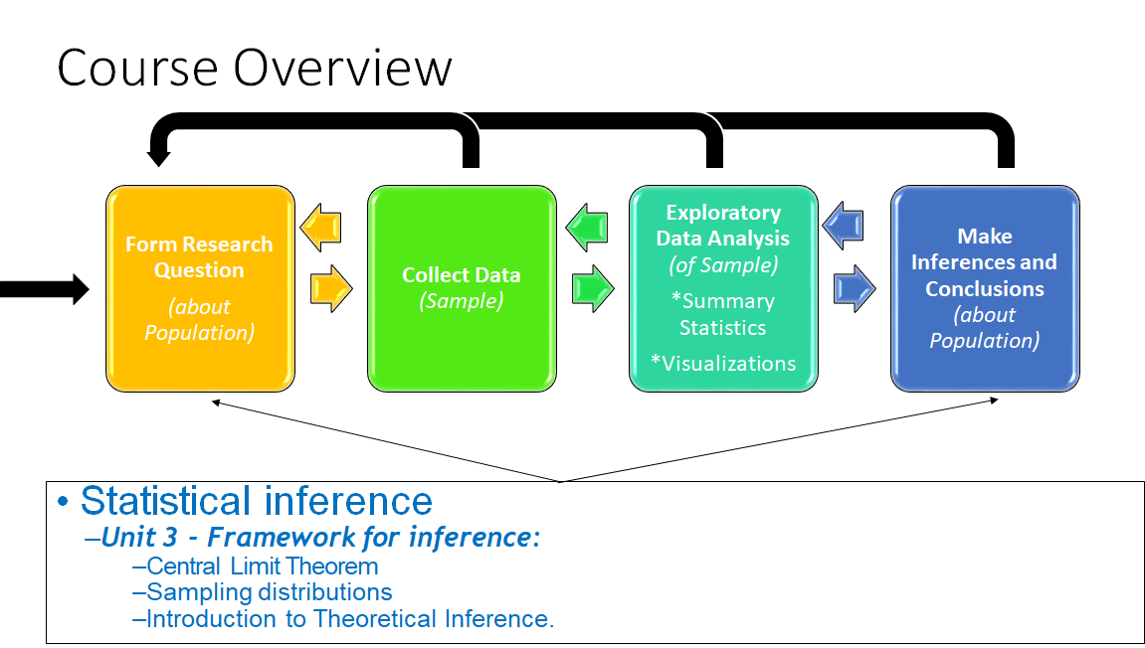
Outline

Slide 7
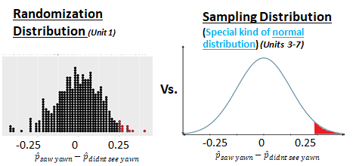
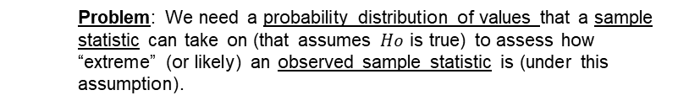
Outline
Making an Inference
    Problem: We need a probability distribution of values that a sample statistic can take on (that assumes $Ho$ is true) to assess how “extreme” (or likely) an observed sample statistic is (under this assumption).

Slide 8
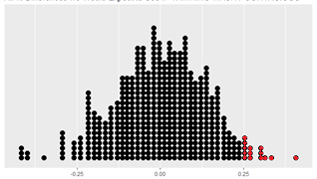

Outline
Making an Inference
    One Solution: Generate a randomization distribution.
Randomization Distribution (Unit 1)
-0.25 0 0.25
$${\hat{p}}_{saw yawn}−{\hat{p}}_{didnt see yawn}$$

Slide 9
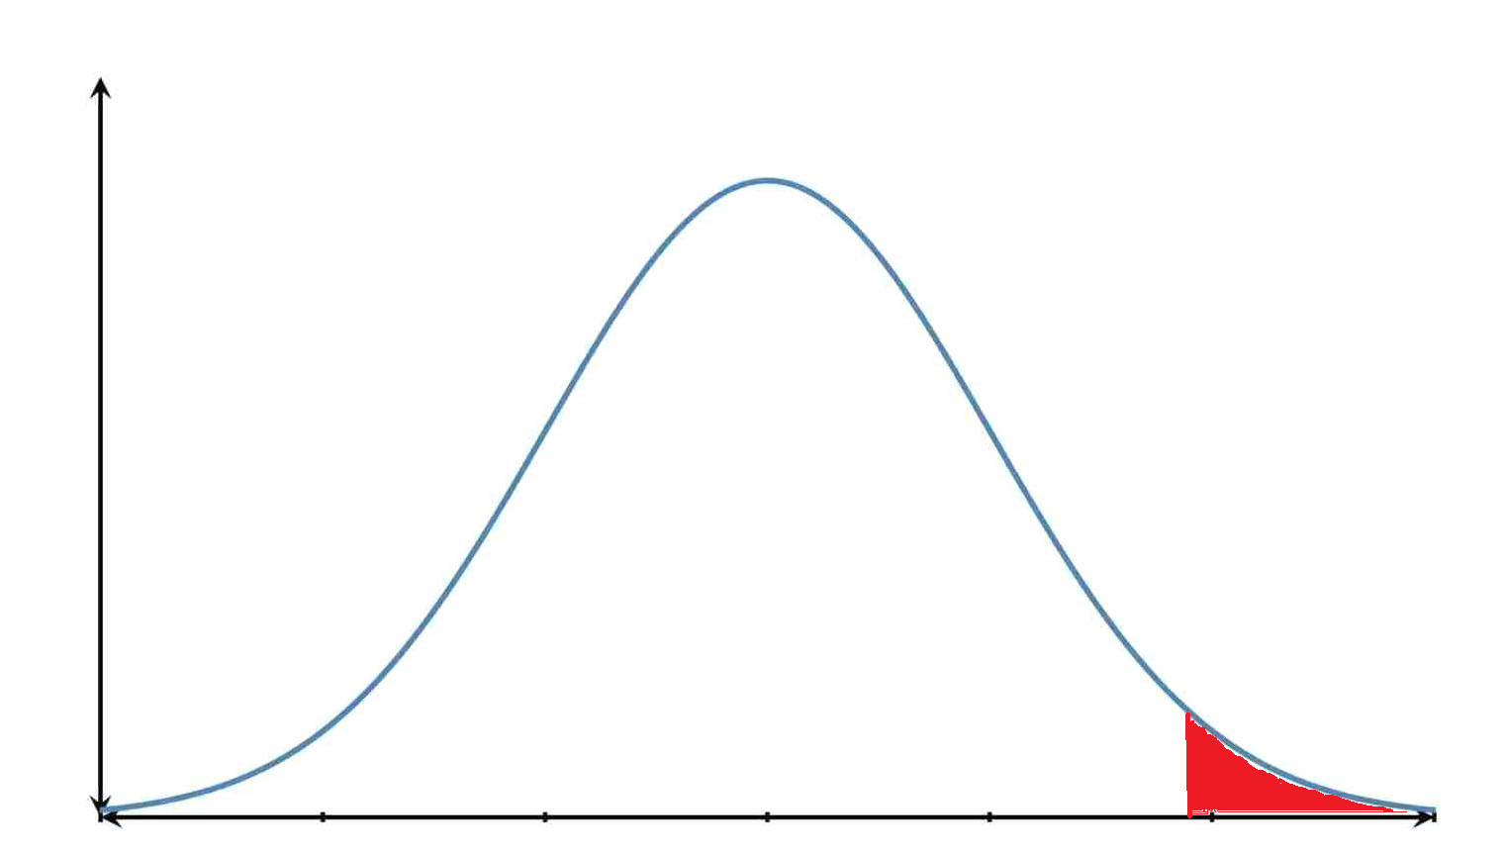

Outline
Making an Inference
    Another Solution: If you can (see conditions), use a theoretical probability distribution (probabilities come from an equation) of the sample statistics, using the Central Limit Theorem.
Sampling Distribution (Units 3-7)
-0.25 0 0.25
$${\hat{p}}_{saw yawn}−{\hat{p}}_{didnt see yawn}$$

Slide 10
Goal: We are often interested in population parameters.
Population Distribution
Population Mean: µ

Slide 11
Goal: We are often interested in population parameters.
Issue: Complete populations are difﬁcult (or impossible) to collect data on.
Population Distribution
Population Mean: µ

Slide 12

Goal: We are often interested in population parameters.
Issue: Complete populations are difﬁcult (or impossible) to collect data on.
Solution: We use sample statistics as point estimates for the unknown population parameters of interest.
Population Distribution
Sample Distribution
Population Mean: µ
Sample Mean: $\overline{x}$

Slide 13
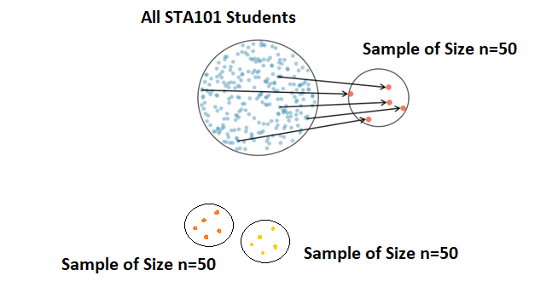



Goal: We use sample statistics as point estimates for the unknown population parameters of interest.
Issues:
Sample statistic rarely = population parameter
Sample statistics vary from sample to sample.
Population Mean: µ
Sample Mean: $\overline{x}$
Sample Mean: $\overline{x}$
Sample Mean: $\overline{x}$

Slide 14
Goal: We use sample statistics as point estimates for the unknown population parameters of interest.
Issues:
Sample statistic rarely = population parameter
Sample statistics vary from sample to sample.
Solution: Quantifying how sample statistics vary provides a way to estimate the margin of error associated with our point estimate. A sampling distribution describes how these sample statistics vary.
Population Mean: µ
Sample Mean: $\overline{x}$
Sample Mean: $\overline{x}$
Sample Mean: $\overline{x}$

Slide 15
Outline
Housekeeping
Main ideas
    Problem: We need a probability distribution of values that a sample statistic can take on to assess how “extreme” (or likely) a sample statistic is (given an assumption about the population).
    One Solution: If you can, use a theoretical probability distribution of the sample statistic, using the Central Limit Theorem.
      Observation: ✋ 🔮 🖳 Sample statistics vary from sample to sample.
      Important Theorem: CLT describes the shape, center, and spread of sampling distributions
      Necessary Conditions: CLT only applies when independence and sample size/skew conditions are met
Summary
Exercises [time permitting]

Slide 16


Outline
🔍Explore: How sample statistics vary from sample to sample.
Population Mean: µ
Sample Mean: $\overline{x}$
Sample Mean: $\overline{x}$
Sample Mean: $\overline{x}$

Slide 17
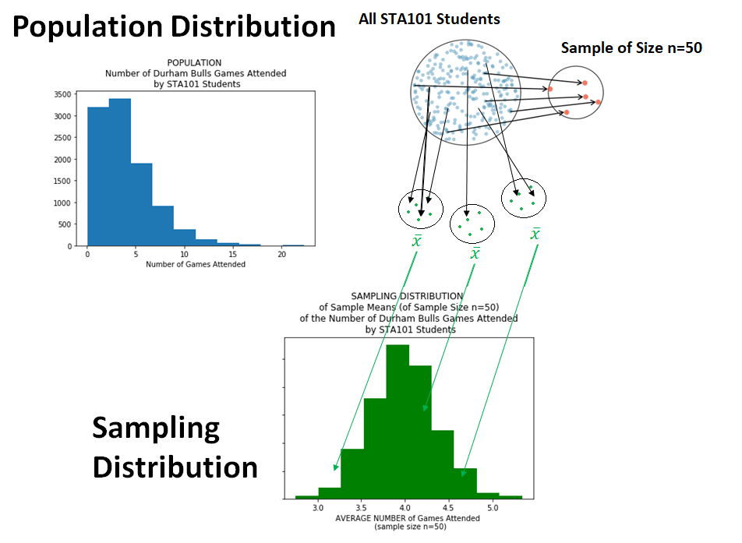
🔮 How does the variability of observations from a population compare to the variability of sample statistics (generated from this population?

Slide 18
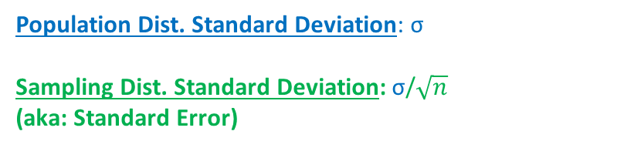
🔮 How does the variability of observations from a population compare to the variability of sample statistics (generated from this population?
Population Dist. Standard Deviation: σ
Sampling Dist. Standard Deviation: σ/$\sqrt{n}$
(aka: Standard Error)

Slide 19


🔮
Variability of Observations in a Population
Would it be highly unlikely to randomly sample a US citizen of age 64 or older?
Would it be highly unlikely to randomly sample a US citizen of age 17 or younger?

Slide 20
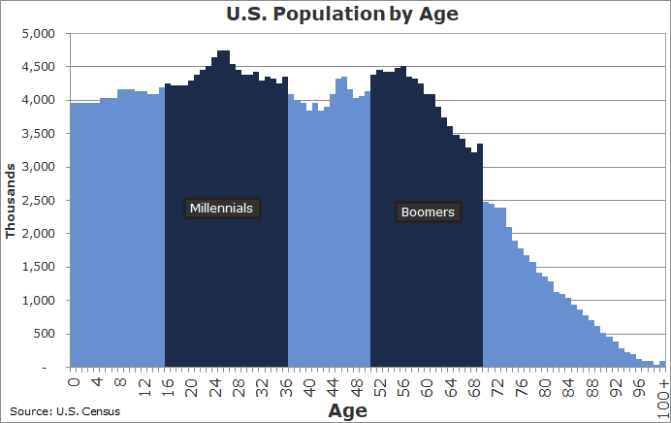
🔮
Variability of Observations in a Population
Would it be highly unlikely to randomly select a US citizen of age 64 or older? – No!
Would it be highly unlikely to randomly select a US citizen of age 17 or younger? – No!

Slide 21
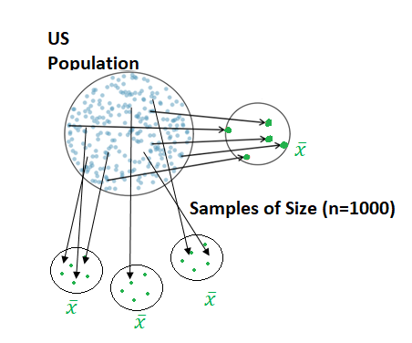
🔮
Variability of Sample Statistics
Suppose we randomly sample 1,000 adults from each state in the US.

Slide 22
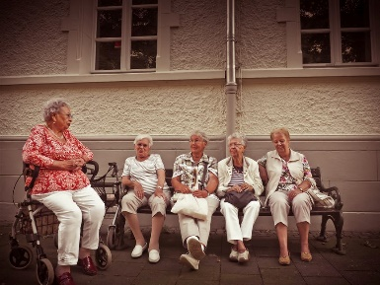
🔮
Variability of Sample Statistics
Suppose we randomly sample 1,000 adults from each state in the US.
Would it be highly unlikely to have a state with a sample mean that was 64 or higher?
Would you expect the sample means of their ages from the different states to be:
the same?
just as variable as the observations from the population?
LESS variable as the observations from the population?

Slide 23
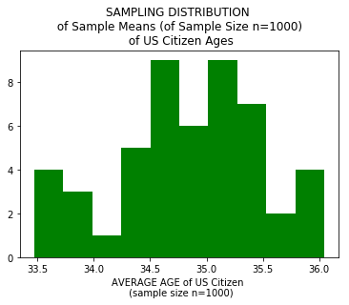
🔮
Variability of Sample Statistics
Suppose we randomly sample 1,000 adults from each state in the US.
Would it be highly unlikely to have a state with a sample mean that was 64 or higher? – YES!
Would you expect the sample means of their ages from the different states to be:
all the same?–NO!
just as variable as the observations from the population?–NO!
LESS variable as the observations from the population? – YES!

Slide 24
🔮 Variability of observations from a population
GREATER THAN
Variability of sample statistics.
Population Distribution
Sampling Distribution

Slide 25
Outline
✋ Let‘s make a SAMPLING DISTRIBUTION.

Slide 26

We would like to estimate the average number of drinks it takes students to get drunk.
✋ 🔮 🖳
Sampling distribution
▶ We will assume that our population is comprised of 146 students.
▶ Assume also that we don’t have the resources to collect data from all 146, so we will take a sample of size n = 10.
If we randomly select observations from this data set, which values are most likely to be selected, which are least likely?
Population Distribution
0 5 10 15 20 25
(assume we don’t have this in the analysis).
0
2
4 6
number of drinks to get drunk
8
10

Slide 27
✋ 🔮 🖳
RANDOMLY SAMPLE n=10 STUDENTS AND CALCULATE THE SAMPLE MEAN.
4

Slide 28
✋ 🔮 🖳
▶ Sample, with replacement, 10 student IDs:
> sample(1:146, size = 10, replace = TRUE)
[1] | 59 | 121 | 88 | 46 | 58 | 72 | 82 | 81 | 5 | 10
4

Slide 29
✋ 🔮 🖳
▶ Sample, with replacement, 10 student IDs:
> sample(1:146, size = 10, replace = TRUE)
[1] | 59 | 121 | 88 | 46 | 58 | 72 | 82 | 81 | 5 | 10
A sampling distribution has random samples sampled with replacement.
Can still use it even if your random sample is sampled without replacement.
4

Slide 30
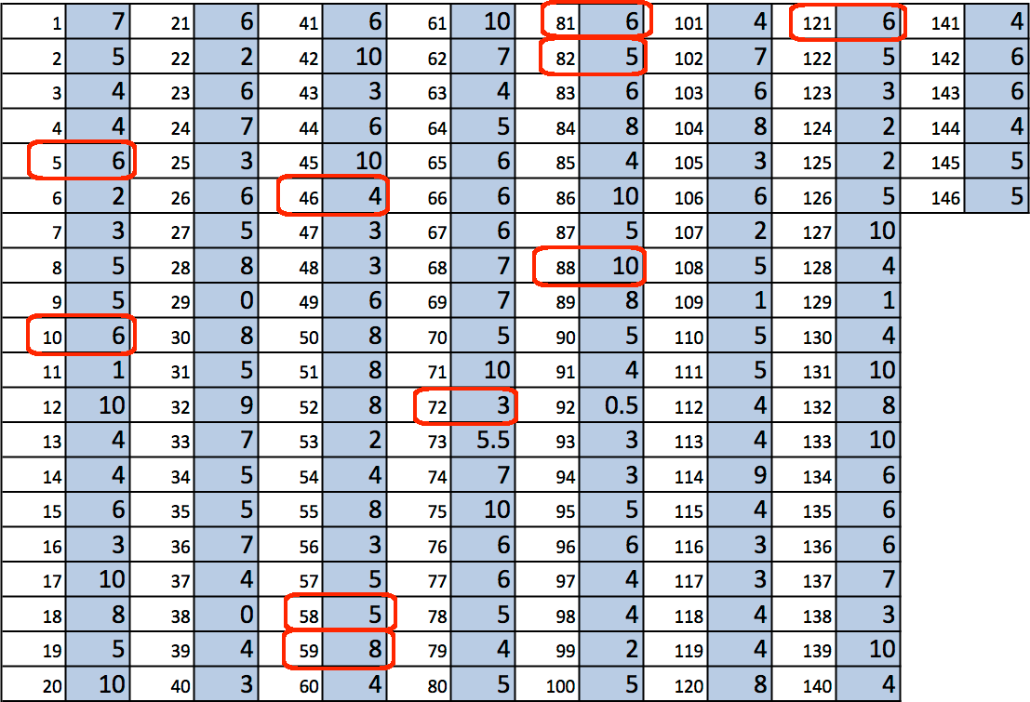
✋ 🔮 🖳
▶ Sample, with replacement, 10 student IDs:
> sample(1:146, size = 10, replace = TRUE)
[1] | 59 | 121 | 88 | 46 | 58 | 72 | 82 | 81 | 5 | 10
▶ Find the students with these IDs:
4

Slide 31
✋ 🔮 🖳
▶ Sample, with replacement, 10 student IDs:
> sample(1:146, size = 10, replace = TRUE)
[1] | 59 | 121 | 88 | 46 | 58 | 72 | 82 | 81 | 5 | 10
▶ Find the students with these IDs:
▶ Calculate the sample mean:
(8 + 6 + 10 + 4 + 5 + 3 + 5 + 6 + 6 + 6)/10 = 5.9
4

Slide 32
✋ 🔮 🖳
RANDOMLY SAMPLE n=10 STUDENTS AGAIN AND CALCULATE THE NEW SAMPLE MEAN.
4

Slide 33
✋ 🔮 🖳
▶ Sample, with replacement, 10 student IDs:
> sample(1:146, size = 10, replace = TRUE)
[1] | 120 | 90 | 145 | 118 | 122 | 62 | 42 | 58 | 83 | 93
▶ Find the students with these IDs:
1 | 7 | 21 | 6 | 41 | 6 | 61 | 10 | 81 | 6 | 101 | 4 | 121 | 6 | 141 | 4
2 | 5 | 22 | 2 | 42 | 10 | 62 | 7 | 82 | 5 | 102 | 7 | 122 | 5 | 142 | 6
3 | 4 | 23 | 6 | 43 | 3 | 63 | 4 | 83 | 6 | 103 | 6 | 123 | 3 | 143 | 6
4 | 4 | 24 | 7 | 44 | 6 | 64 | 5 | 84 | 8 | 104 | 8 | 124 | 2 | 144 | 4
5 | 6 | 25 | 3 | 45 | 10 | 65 | 6 | 85 | 4 | 105 | 3 | 125 | 2 | 145 | 5
6 | 2 | 26 | 6 | 46 | 4 | 66 | 6 | 86 | 10 | 106 | 6 | 126 | 5 | 146 | 5
7 | 3 | 27 | 5 | 47 | 3 | 67 | 6 | 87 | 5 | 107 | 2 | 127 | 10
8 | 5 | 28 | 8 | 48 | 3 | 68 | 7 | 88 | 10 | 108 | 5 | 128 | 4
9 | 5 | 29 | 0 | 49 | 6 | 69 | 7 | 89 | 8 | 109 | 1 | 129 | 1
10 | 6 | 30 | 8 | 50 | 8 | 70 | 5 | 90 | 5 | 110 | 5 | 130 | 4
11 | 1 | 31 | 5 | 51 | 8 | 71 | 10 | 91 | 4 | 111 | 5 | 131 | 10
12 | 10 | 32 | 9 | 52 | 8 | 72 | 3 | 92 | 0.5 | 112 | 4 | 132 | 8
13 | 4 | 33 | 7 | 53 | 2 | 73 | 5.5 | 93 | 3 | 113 | 4 | 133 | 10
14 | 4 | 34 | 5 | 54 | 4 | 74 | 7 | 94 | 3 | 114 | 9 | 134 | 6
15 | 6 | 35 | 5 | 55 | 8 | 75 | 10 | 95 | 5 | 115 | 4 | 135 | 6
16 | 3 | 36 | 7 | 56 | 3 | 76 | 6 | 96 | 6 | 116 | 3 | 136 | 6
17 | 10 | 37 | 4 | 57 | 5 | 77 | 6 | 97 | 4 | 117 | 3 | 137 | 7
18 | 8 | 38 | 0 | 58 | 5 | 78 | 5 | 98 | 4 | 118 | 4 | 138 | 3
19 | 5 | 39 | 4 | 59 | 8 | 79 | 4 | 99 | 2 | 119 | 4 | 139 | 10
20 | 10 | 40 | 3 | 60 | 4 | 80 | 5 | 100 | 5 | 120 | 8 | 140 | 4
▶ Calculate the sample mean:
(10+5+7+6+5+3+4+4+5+5)/10 = 5.4
4

Slide 34
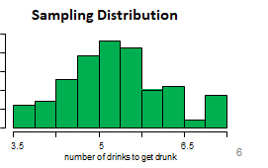
✋ 🔮 🖳
Do this many many more times….
Plot all of your sample means in a histogram.
Averages of
4

Slide 35
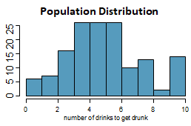
Sampling distribution
✋ 🔮 🖳
What you just constructed is called a sampling distribution (approximately)
… not the sample distribution (this is the distribution of observations in a single sample from the population.)
What is the shape and center of this distribution. Based on this distribution what do you think is the true population average?
Averages of

Slide 36
🔮 The sampling distribution mean is the population mean.
Averages of

Slide 37
🔮 How does the variability (spread), shape, and mean of sampling distribution change as n (sample size) increases?

Slide 38
Average number of Duke games attended
🔮
Next let’s look at the population data for the number of Duke basketball games attended:
(assume that we don’t have this in a typical analysis)
Population Distribution
100 150
50
0
0
10 20 30
40 50 60 70
number of games attended

Slide 39
Average number of Duke games attended
🔮
Next let’s look at the population data for the number of Duke basketball games attended:
(assume that we don’t have this in a typical analysis)
Population Distribution
100 150
50
0
0
10 20 30
40 50 60 70
number of games attended
Center: mean between 0 and 10?
Shape: right skewed
Spread: range=70

Slide 40
Average number of Duke games attended (cont.)
🔮
Sampling distribution, of sample means from the population with samples of size n = 10.
What does each observation in this distribution represent?
1500
Is the variability of the sampling distribution smaller or larger than the variability of the population distribution?
0 500
5 10 15
sample means from samples of n = 10
20
8

Slide 41

🔮
Average number of Duke games attended (cont.)
Sampling distribution, of sample means from the population with samples of size n = 10.
What does each observation in this distribution represent?
1500
Sample mean, $\overline{x}$, of samples of size n = 10.
0 500
Is the variability of the sampling distribution smaller or larger than the variability of the population distribution?
5 10 15
sample means from samples of n = 10
20
8

Slide 42
🔮
Average number of Duke games attended (cont.)
Sampling distribution, of sample means from the population with samples of size n = 10.
What does each observation in this distribution represent?
1500
Sample mean, $\overline{x}$, of samples of size n = 10.
0 500
Is the variability of the sampling distribution smaller or larger than the variability of the population distribution?
5 10 15
sample means from samples of n = 10
20
Center: mean between 6-7?
Shape: right skewed (less so)
Spread: range=20
Smaller, sample means will vary less than individual observations.
8

Slide 43
🔮
Average number of Duke games attended (cont.)
Sampling distribution, of sample means from the population with samples of size n = 30.
How did the shape, center, and spread of the sampling distribution change going from
n = 10 to n = 30?
500 1000
0
2
4 6 8 10
sample means from samples of n = 30
12
9

Slide 44
🔮
Average number of Duke games attended (cont.)
Sampling distribution, of sample means from the population with samples of size n = 30.
How did the shape, center, and spread of the sampling distribution change going from
n = 10 to n = 30?
500 1000
Shape is more symmetric, center is about the same, spread is smaller.
0
2
4 6 8 10
sample means from samples of n = 30
12
Center: mean around 6?
Shape: right skewed (even less so)
Spread: range=10
9

Slide 45
Average number of Duke games attended (cont.)
🔮
Sampling distribution, n = 70:
2000
1000
0
4
5 6 7
sample means from samples of n = 70
8
Center: mean around 6
Shape: mostly unimodal and symmetric now
Spread: range=5
10

Slide 46
🔮 Sampling distribution variability (spread) decreases as n (sample size) increases.
🔮 Sampling distribution shape becomes more symmetric and unimodal as n (sample size) increases.
🔮 Sampling distribution mean stays roughly the same n (sample size) increases.

Slide 47
Outline
Housekeeping
Main ideas
    Problem: We need a probability distribution of values that a sample statistic can take on to assess how “extreme” (or likely) a sample statistic is (given an assumption about the population).
    One Solution: If you can, use a theoretical probability distribution of the sample statistic, using the Central Limit Theorem.
      Observation: ✋ 🔮 🖳 Sample statistics vary from sample to sample.
      Important Theorem: CLT describes the shape, center, and spread of sampling distributions
      Necessary Conditions: CLT only applies when independence and sample size/skew conditions are met
Summary
Exercises [time permitting]

Slide 48
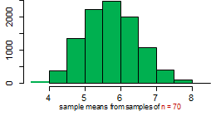
🔮 Putting it all together:
What happens to the center, spread, and shape of the sampling distribution when n (sample size) becomes “large”?
Can we prove this?

Slide 49
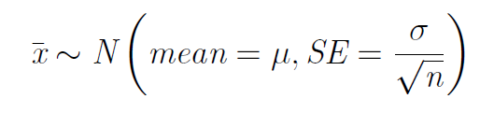
🔍
2. CLT describes the shape, center, and spread of sampling
distributions
Central Limit Theorem
Under the right conditions, the distribution of the sample means (sampling dist) is well approximated by a normal distribution:
A cheat: If σ is unknown, use s.
12

Slide 50

🔍 👫
2. CLT describes the shape, center, and spread of sampling
distributions
Central Limit Theorem
Under the right conditions, the distribution of the sample means (sampling dist) is well approximated by a normal distribution:
A cheat: If σ is unknown, use s.
▶ So it wasn’t a coincidence that the sampling distributions we saw earlier were symmetric.
▶ We won’t go into the proving why , but note that
as n increases SE ___________.
▶ As the sample size increases we would expect samples to yield more consistent sample means, hence the variability among the sample means would be lower.
12

Slide 51
🔍 👫
2. CLT describes the shape, center, and spread of sampling
distributions
Central Limit Theorem
Under the right conditions, the distribution of the sample means (sampling dist) is well approximated by a normal distribution:
A cheat: If σ is unknown, use s.
▶ So it wasn’t a coincidence that the sampling distributions we saw earlier were symmetric.
▶ We won’t go into the proving why , but note that
as n increases SE decreases.
▶ As the sample size increases we would expect samples to yield more consistent sample means, hence the variability among the sample means would be lower.
12

Slide 52
Outline
Housekeeping
Main ideas
    Problem: We need a probability distribution of values that a sample statistic can take on to assess how “extreme” (or likely) a sample statistic is (given an assumption about the population).
    One Solution: If you can, use a theoretical probability distribution of the sample statistic, using the Central Limit Theorem.
      Observation: ✋ 🔮 🖳 Sample statistics vary from sample to sample.
      Important Theorem: CLT describes the shape, center, and spread of sampling distributions
      Necessary Conditions: CLT only applies when independence and sample size/skew conditions are met
Summary
Exercises [time permitting]

Slide 53
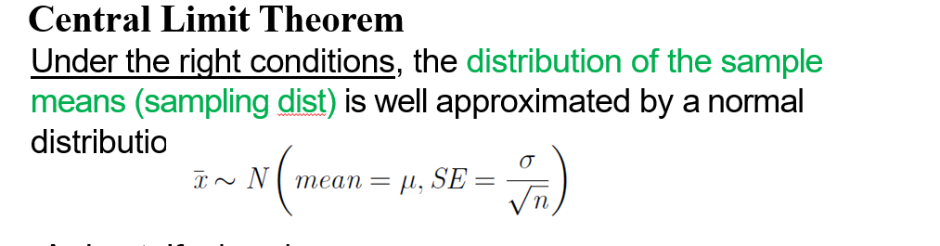
Outline
What are these conditions?

Slide 54
3. CLT only applies when independence and sample size/skew
conditions are met
🔍
Independence: Sampled observations must be independent.
This is difﬁcult to verify, but is more likely if
  random sampling/assignment is used, and,
  if sampling without replacement, n < 10% of the population.
Sample size/skew: Either
  the population distribution is normal OR
  Sample size n > 30 and the population dist. is not extremely skewed, OR
  Sample size n >> 30 (approx. gets better as n increases).
13

Slide 55
Checking Skewness Conditions for Central Limit Theorem:
How can we guess what the shape of the population distribution is (without seeing it)?
Population Distribution

Slide 56
Checking Skewness Conditions for Central Limit Theorem:
How can we guess what the shape of the population distribution is (without seeing it)?
Population Distribution
Sample Distribution
Shapes are roughly the same.

Slide 57
3. CLT only applies when independence and sample size/skew
conditions are met
🔍
Independence: Sampled observations must be independent.
This is difﬁcult to verify, but is more likely if
  random sampling/assignment is used, and,
  if sampling without replacement, n < 10% of the population.
Sample size/skew: Either
  the population distribution is normal OR
  n > 30 and the population dist. is not extremely skewed, OR
  n >> 30 (approx. gets better as n increases).
This is also difﬁcult to verify for the population, but we can check it using the sample data, and assume that the sample distribution shape mirrors the population distribution shape.
13

Slide 58
3. CLT only applies when independence and sample size/skew
conditions are met
Amongst other things, the central limit theorem is useful for
▶ constructing conﬁdence intervals and
▶ conducting hypothesis tests.
14

Slide 59
Clicker question
🔍 👫
Which of the below visualizations is not appropriate for checking the shape of the sample distribution of a numerical variable, and hence the population distribution?
histogram
boxplot
normal probability plot
mosaic plot
15

Slide 60
Clicker question
🔍 👫
Which of the below visualizations is not appropriate for checking the shape of the sample distribution of a numerical variable, and hence the population distribution?
histogram
boxplot
normal probability plot
mosaic plot
15

Slide 61
Summary of main ideas
Sample statistics vary from sample to sample
CLT describes the shape, center, and spread of sampling distributions
CLT only applies when independence and sample size/skew conditions are met
16

Slide 62
Outline
Housekeeping
Main ideas
    Sample statistics vary from sample to sample
    CLT describes the shape, center, and spread of sampling distributions
    CLT only applies when independence and sample size/skew conditions are met
Summary
Exercises [time permitting]

Slide 63
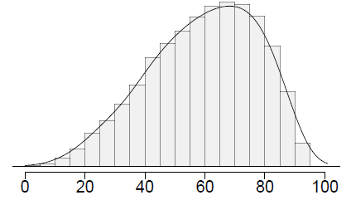
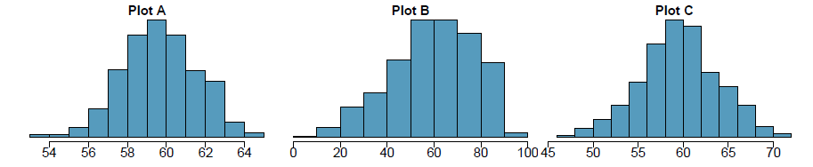
Clicker question
Four plots: Determine which plot (A, B, or C) is which.
At top: distribution for a population (µ = 60, σ = 18),
a single random sample of 500 observations from this population,
a distribution of 500 sample means from random samples with size 18,
a distribution of 500 sample means from random samples with size 81.
Four plots: Determine which plot (A, B, or C) is which.
At top: distribution for a population (µ = 60, σ = 18),
a single random sample of 500 observations from this population,
a distribution of 500 sample means from random samples with size 18,
a distribution of 500 sample means from random samples with size 81.
(a) (2) - B; (3) - A; (4) - C
(b) (2) - A; (3) - B; (4) - C
(c) (2) - C; (3) - A; (4) - D
(d) (2) - B; (3) - C; (4) - A
17

Slide 64
Clicker question
Four plots: Determine which plot (A, B, or C) is which.
At top: distribution for a population (µ = 60, σ = 18),
a single random sample of 500 observations from this population,
a distribution of 500 sample means from random samples with size 18,
a distribution of 500 sample means from random samples with size 81.
(a) (2) - B; (3) - A; (4) - C
(b) (2) - A; (3) - B; (4) - C
(c) (2) - C; (3) - A; (4) - D
(d) (2) - B; (3) - C; (4) - A
17

Slide 65
A housing survey was conducted to determine the price of a typical home in Topanga, CA. The mean price of a house was roughly $1.3 million with a standard deviation of $300,000. There were no houses listed below $600,000 but a few houses above $3 million.
Would you expect most houses in Topanga to cost more or less than
$1.3 million? Hint: What is most likely the shape of this distribution?
18

Slide 66
A housing survey was conducted to determine the price of a typical home in Topanga, CA. The mean price of a house was roughly $1.3 million with a standard deviation of $300,000. There were no houses listed below $600,000 but a few houses above $3 million.
Would you expect most houses in Topanga to cost more or less than
$1.3 million? Hint: What is most likely the shape of this distribution?
Since the distribution is probably right skewed, the median would be less than the mean, and a majority of observations would be lower than the mean.
18

Slide 67
A housing survey was conducted to determine the price of a typical home in Topanga, CA. The mean price of a house was roughly $1.3 million with a standard deviation of $300,000. There were no houses listed below $600,000 but a few houses above $3 million.
Clicker question
Can we estimate the probability that a randomly chosen house in Topanga costs more than $1.4 million using the normal distribution?
yes
no
19

Slide 68
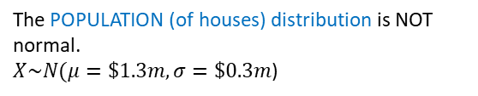
A housing survey was conducted to determine the price of a typical home in Topanga, CA. The mean price of a house was roughly $1.3 million with a standard deviation of $300,000. There were no houses listed below $600,000 but a few houses above $3 million.
Clicker question
Can we estimate the probability that a randomly chosen house in Topanga costs more than $1.4 million using the normal distribution?
yes
no
The POPULATION (of houses) distribution is NOT normal.
$X\sim N(μ=\$1.3m,σ=\$0.3m$)
19

Slide 69
A housing survey was conducted to determine the price of a typical home in Topanga, CA. The mean price of a house was roughly $1.3 million with a standard deviation of $300,000. There were no houses listed below $600,000 but a few houses above $3 million.
Clicker question
Can we estimate the probability that the mean of 60 randomly chosen houses in Topanga is more than $1.4 million?
yes
no
20

Slide 70
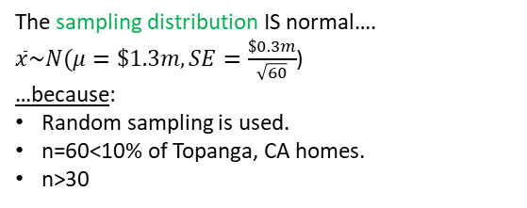
A housing survey was conducted to determine the price of a typical home in Topanga, CA. The mean price of a house was roughly $1.3 million with a standard deviation of $300,000. There were no houses listed below $600,000 but a few houses above $3 million.
Clicker question
Can we estimate the probability that the mean of 60 randomly chosen houses in Topanga is more than $1.4 million?
yes
no
The sampling distribution IS normal….
$\overline{x}\sim N(μ=\$1.3m,SE=\frac{\$0.3m}{\sqrt{60}}$)
…because:
Random sampling is used.
n=60<10% of Topanga, CA homes.
n>30
20

Slide 71
A housing survey was conducted to determine the price of a typical home in Topanga, CA. The mean price of a house was roughly $1.3 million with a standard deviation of $300,000. There were no houses listed below $600,000 but a few houses above $3 million.
What is the probability that the mean of 60 randomly chosen houses in Topanga is more than $1.4 million?
21

Slide 72

A housing survey was conducted to determine the price of a typical home in Topanga, CA. The mean price of a house was roughly $1.3 million with a standard deviation of $300,000. There were no houses listed below $600,000 but a few houses above $3 million.
What is the probability that the mean of 60 randomly chosen houses in Topanga is more than $1.4 million?
21

Slide 73

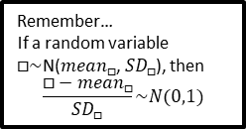
A housing survey was conducted to determine the price of a typical home in Topanga, CA. The mean price of a house was roughly $1.3 million with a standard deviation of $300,000. There were no houses listed below $600,000 but a few houses above $3 million.
What is the probability that the mean of 60 randomly chosen houses in Topanga is more than $1.4 million?
Remember…
If a random variable $□\sim$N(${mean}_{□}$, ${SD}_{□}$), then
$$\frac{□−{mean}_{□}}{{SD}_{□}}\sim N(0,1)$$
21

Slide 74
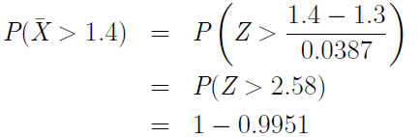
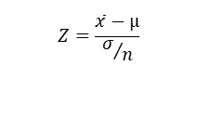
A housing survey was conducted to determine the price of a typical home in Topanga, CA. The mean price of a house was roughly $1.3 million with a standard deviation of $300,000. There were no houses listed below $600,000 but a few houses above $3 million.
What is the probability that the mean of 60 randomly chosen houses in Topanga is more than $1.4 million?
Remember…
If a random variable $□\sim$N(${mean}_{□}$, ${SD}_{□}$), then
$$\frac{□−{mean}_{□}}{{SD}_{□}}\sim N(0,1)$$
Z-table
= 1 - P(Z ≤ 2.58)
$$Z=\frac{\overline{x}−µ}{σ/n}$$
21

