Slide 1

Unit 3: Foundations for inference
2. Conﬁdence Intervals
Sta 101 – Spring 2019
Duke University, Department of Statistical Science
Dr. Ellison
Slides posted at https://www2.stat.duke.edu/courses/Spring19/sta101.001/

Slide 2
Outline
Housekeeping
Main ideas
    Making a Confidence Interval: 🔍 🆕 Use conﬁdence intervals to estimate population parameters
    Conditions for using the CLT to make a Conf. Interval: 🔍 Statistical inference methods based on the CLT depend on the same conditions as the CLT
    What sample size do we need?🔍 🙃 👫 Calculate the sample size a priori to achieve desired margin of error
Summary

Slide 3
Announcements
Coming up…
▶ Lab Assignment 4 is due Thursday just before your lab section time.
▶ Sample Midterm 1+Key Posted on Sakai Resources!
▶ Midterm 1 Review Wednesday 2/13
▶ Midterm 1 (Unit 1-Unit 3.2) Monday 2/18
1

Slide 4
Outline
Housekeeping
Main ideas
    Making a Confidence Interval: 🔍 🆕 Use conﬁdence intervals to estimate population parameters
    Conditions for using the CLT to make a Conf. Interval: 🔍 Statistical inference methods based on the CLT depend on the same conditions as the CLT
    Common misconceptions about confidence intervals 🙃
    What sample size do we need?🔍 👫 Calculate the sample size a priori to achieve desired margin of error
Summary

Slide 5
Outline
What is the general structure of a confidence interval (for any population parameter)?

Slide 6

2. Use conﬁdence intervals to estimate population parameters
🔍
General Confidence Interval Set-Up
point estimate ± margin of error
Margin of Error
Margin of Error
(
)
$$point estimate$$
3

Slide 7
point estimate ± margin of error
2. Use conﬁdence intervals to estimate population parameters
🔍
General Confidence Interval Set-Up
point estimate ± (critical value)(standard error)
3

Slide 8
point estimate ± margin of error
2. Use conﬁdence intervals to estimate population parameters
🔍
General Confidence Interval Set-Up
point estimate ± (critical value)(standard error)
The sample statistic
(see upcoming slides for info)
Standard deviation of:
the distribution sample statistics
(aka: the sampling distribution)
3

Slide 9
Outline
What is the confidence interval for a population mean?

Slide 10
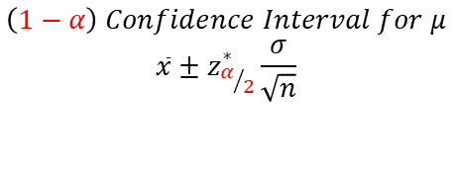
2. Use conﬁdence intervals to estimate population parameters
🔍
$$\left(1−α\right) Confidence Interval for μ$$
$$\overline{x}±z_{α/2}^{∗}\frac{σ}{\sqrt{n}}$$
*right conditions must be met to use this equation
3

Slide 11
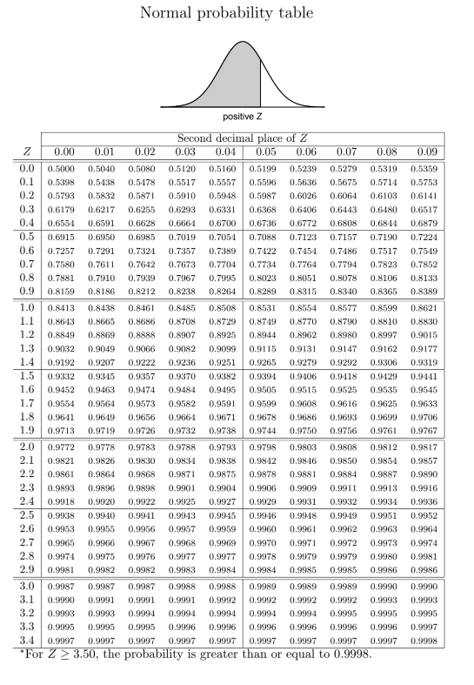
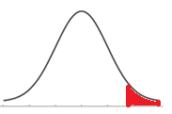
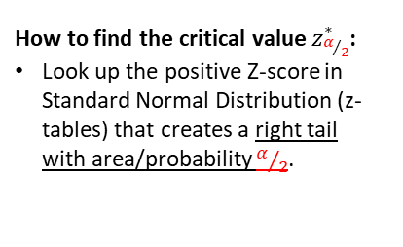
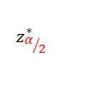
2. Use conﬁdence intervals to estimate population parameters
🔍
$$\left(1−α\right) Confidence Interval for μ$$
$$\overline{x}±z_{α/2}^{∗}\frac{σ}{\sqrt{n}}$$
*right conditions must be met to use this equation
How to find the critical value $z_{α/2}^{∗}$:
Look up the positive Z-score in Standard Normal Distribution (z-tables) that creates a right tail with area/probability $α/2$.
Z-Distribution
aka: Standard Normal Distribution
Aka: N(0,1)
0
$$z_{α/2}^{∗}$$
3

Slide 12
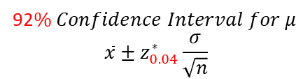


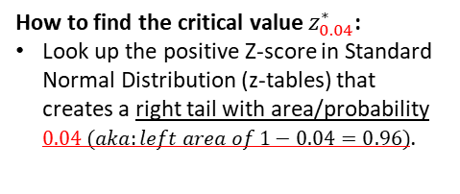
2. Use conﬁdence intervals to estimate population parameters
🔍
92$\% Confidence Interval for μ$
$$\overline{x}±z_{0.04}^{∗}\frac{σ}{\sqrt{n}}$$
*right conditions must be met to use this equation
How to find the critical value $z_{0.04}^{∗}$:
Look up the positive Z-score in Standard Normal Distribution (z-tables) that creates a right tail with area/probability $0.04 (aka:left area of 1−0.04=0.96)$.
only gives areas to left of z-scores
Z-Distribution
aka: Standard Normal Distribution
Aka: N(0,1)
$$0.9600$$
$$1−0.0400$$
0
$$z_{0.04}^{∗}$$
3

Slide 13

2. Use conﬁdence intervals to estimate population parameters
🔍
92$\% Confidence Interval for μ$
$$\overline{x}±z_{0.04}^{∗}\frac{σ}{\sqrt{n}}$$
*right conditions must be met to use this equation
How to find the critical value $z_{0.04}^{∗}$:
Look up the positive Z-score in Standard Normal Distribution (z-tables) that creates a right tail with area/probability $0.04 (aka:left area of 1−0.04=0.96)$.
only gives areas to left of z-scores
Z-Distribution
aka: Standard Normal Distribution
Aka: N(0,1)
$$0.9600$$
$$1−0.0400$$
0
$z_{0.04}^{∗}$=1.76
3

Slide 14
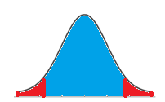

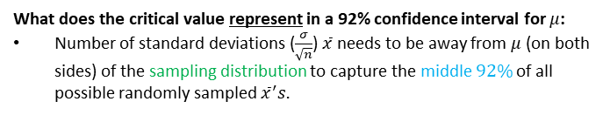


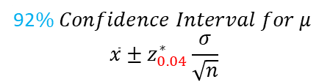
2. Use conﬁdence intervals to estimate population parameters
🔍
92$\% Confidence Interval for μ$
$$\overline{x}±z_{0.04}^{∗}\frac{σ}{\sqrt{n}}$$
*right conditions must be met to use this equation
What does the critical value represent in a 92% confidence interval for $μ$:
Number of standard deviations ($\frac{σ}{\sqrt{n}}$) $\overline{x}$ needs to be away from $μ$ (on both sides) of the sampling distribution to capture the middle $92\%$of all possible randomly sampled ${\overline{x}}^{′}s.$
Sampling Distribution
92%
4%
4%
$$μ−z_{0.04}^{∗}\frac{σ}{\sqrt{n}}$$
$$μ$$
$$μ+z_{0.04}^{∗}\frac{σ}{\sqrt{n}}$$
$$\overline{x}$$
3

Slide 15
Outline
What is the margin of error for a population mean?

Slide 16
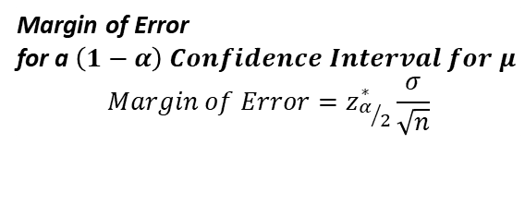
Outline
What is the margin of error for a population mean?
*right conditions must be met to use this equation
Margin of Error
for a $\left(1−α\right) Confidence Interval for μ$
$$Margin of Error=z_{α/2}^{∗}\frac{σ}{\sqrt{n}}$$

Slide 17
3. Critical value depends on the conﬁdence level
🔍
Clicker question
What is the critical value (Z⋆) for a conﬁdence interval at the 91% conﬁdence level?
(a) Z⋆ = 1.34 (b) Z⋆ = 1.65 (c) Z⋆ = 1.70 (d) Z⋆ = 1.96 (e) Z⋆ = 2.33
4

Slide 18
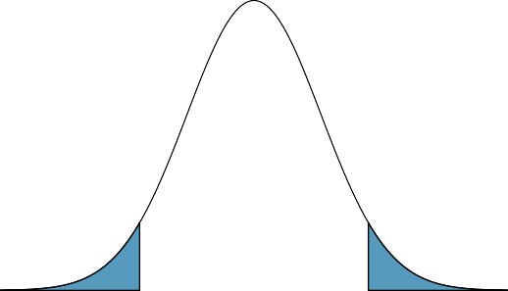
3. Critical value depends on the conﬁdence level
🔍
Clicker question
What is the critical value (Z⋆) for a conﬁdence interval at the 91% conﬁdence level?
Z-distribution
(a) Z⋆ = 1.34 (b) Z⋆ = 1.65 (c) Z⋆ = 1.70 (d) Z⋆ = 1.96 (e) Z⋆ = 2.33
0.91
0.045
0.045
−□
0
□
4

Slide 19
3. Critical value depends on the conﬁdence level
🔍
Clicker question
What is the critical value (Z⋆) for a conﬁdence interval at the 91% conﬁdence level?
Z-distribution
(a) Z⋆ = 1.34 (b) Z⋆ = 1.65 (c) Z⋆ = 1.70 (d) Z⋆ = 1.96 (e) Z⋆ = 2.33
0.91
0.045
0.045
−□
0
□
4

Slide 20
3. Critical value depends on the conﬁdence level
🔍
Clicker question
What is the critical value (Z⋆) for a conﬁdence interval at the 91% conﬁdence level?
Z-distribution
(a) Z⋆ = 1.34 (b) Z⋆ = 1.65 (c) Z⋆ = 1.70 (d) Z⋆ = 1.96 (e) Z⋆ = 2.33
0.91
0.045
0.045
−1.7
0
1.7
4

Slide 21

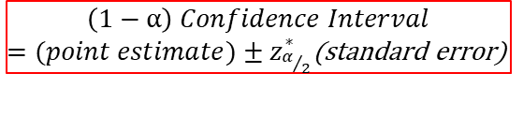

🔍
$$\left(1−α\right) Confidence Interval$$
$=(point estimate)±z_{α/2}^{∗}$(standard error)
*if using the z-distribution
Standard Normal Distribution
Z~N(0,1)
1-α
α/2
α/2
$${−z}_{α/2}^{∗}$$
0
$$z_{α/2}^{∗}$$

Slide 22
Outline
Housekeeping
Main ideas
    Making a Confidence Interval: 🔍 🆕 Use conﬁdence intervals to estimate population parameters
    Conditions for using the CLT to make a Conf. Interval: 🔍 Statistical inference methods based on the CLT depend on the same conditions as the CLT
    Common misconceptions about confidence intervals 🙃
    What sample size do we need?🔍 👫 Calculate the sample size a priori to achieve desired margin of error
Summary

Slide 23
Outline
Case 1: If we know σ, when can we create a confidence interval (or margin of error) for μ (using CLT methods)?

Slide 24
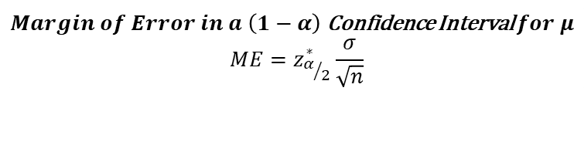
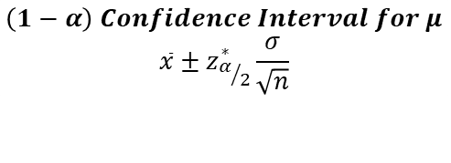
Outline
Case 1: If we know σ, when can we create a confidence interval (or margin of error) for μ (using CLT methods)?
Aka: use these equations
$$\left(1−α\right) Confidence Interval for μ$$
$$\overline{x}±z_{α/2}^{∗}\frac{σ}{\sqrt{n}}$$
$Margin of Error in a \left(1−α\right)$ Confidence Interval $for μ$
$$ME=z_{α/2}^{∗}\frac{σ}{\sqrt{n}}$$

Slide 25
🔍 🆕
2. Use conﬁdence intervals to estimate population parameters
Case 1: We know population standard deviation σ.
Central Limit Theorem Conditions
  Independence: Sampled observations must be independent.
    This is difﬁcult to verify, but is more likely if
      random sampling/assignment is used, and,
      if sampling without replacement, n < 10% of the population.
  Sample size/skew:
    Either the population distribution is normal OR
    n > 30 and the population distribution is not extremely skewed (the more skewed the distribution, the higher n necessary for the CLT to apply).
3

Slide 26
Outline
Case 2: If we don’t know σ, when can we create a confidence interval (or margin of error) for μ (using CLT methods)?

Slide 27
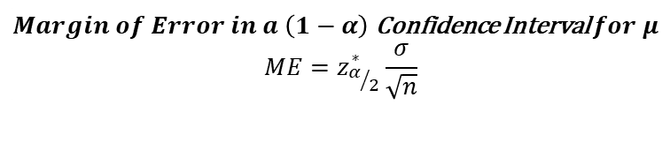
Outline
Case 2: If we don’t know σ, when can we create a confidence interval (or margin of error) for μ (using CLT methods)?
Aka: use these equations
$$\left(1−α\right) Confidence Interval for μ$$
$$\overline{x}±z_{α/2}^{∗}\frac{σ}{\sqrt{n}}$$
s
$Margin of Error in a \left(1−α\right)$ Confidence Interval $for μ$
$$ME=z_{α/2}^{∗}\frac{σ}{\sqrt{n}}$$
s

Slide 28
🔍 🆕
2. Use conﬁdence intervals to estimate population parameters
Case 2: We don’t know population standard deviation σ.
Condition:
s needs to be a good enough approximation for σ
AND
Central Limit Theorem Conditions
  Independence: Sampled observations must be independent.
    This is difﬁcult to verify, but is more likely if
      random sampling/assignment is used, and,
      if sampling without replacement, n < 10% of the population.
  Sample size/skew:
    Either the population distribution is normal OR
    n > 30 and the population distribution is not extremely skewed (the more skewed the distribution, the higher n necessary for the CLT to apply).
n > 30
3

Slide 29
🔍 🆕
2. Use conﬁdence intervals to estimate population parameters
Case 2: We don’t know population standard deviation σ.
Condition:
s needs to be a good enough approximation for σ
AND
Central Limit Theorem Conditions
  Independence: Sampled observations must be independent.
    This is difﬁcult to verify, but is more likely if
      random sampling/assignment is used, and,
      if sampling without replacement, n < 10% of the population.
  Sample size/skew:
    Either the population distribution is normal OR
    n > 30 and the population distribution is not extremely skewed (the more skewed the distribution, the higher n necessary for the CLT to apply).
n > 30
Combining both sets of conditions is equivalent to saying…
3

Slide 30
🔍 🆕
2. Use conﬁdence intervals to estimate population parameters
Case 2: You don’t know population standard deviation σ.
Condition:
s needs to be a good enough approximation for σ
Central Limit Theorem Conditions
  Independence: Sampled observations must be independent.
    This is difﬁcult to verify, but is more likely if
      random sampling/assignment is used, and,
      if sampling without replacement, n < 10% of the population.
  Sample size/skew:
    Either the population distribution is normal OR
    n > 30 and the population distribution is not extremely skewed (the more skewed the distribution, the higher n necessary for the CLT to apply).
3

Slide 31
Outline
Housekeeping
Main ideas
    Making a Confidence Interval: 🔍 🆕 Use conﬁdence intervals to estimate population parameters
    Conditions for using the CLT to make a Conf. Interval: 🔍 Statistical inference methods based on the CLT depend on the same conditions as the CLT
    Common misconceptions about confidence intervals 🙃
    What sample size do we need?🔍 👫 Calculate the sample size a priori to achieve desired margin of error
Summary

Slide 32
Outline
XX% Confidence Interval Interpretation:
“We are XX% confident that the true *insert population parameter* is between and *insert confidence interval upper bound*.

Slide 33
Outline
XX% Confidence Interval Interpretation:
“We are XX% confident that the true *insert population parameter* is between *insert confidence interval lower bound* and *insert confidence interval upper bound*.
What does this mean?

Slide 34
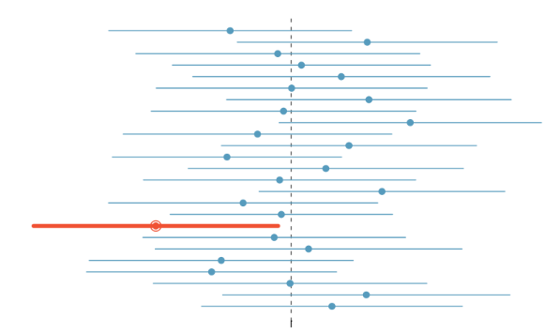
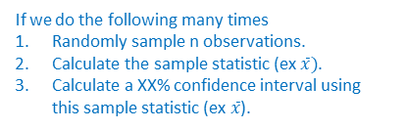
Outline
XX% Confidence Interval Interpretation:
“We are XX% confident that the true *insert population parameter* is between *insert confidence interval lower bound* and *insert confidence interval upper bound*.
What does this mean?
If we do the following many times
Randomly sample n observations.
Calculate the sample statistic (ex $\overline{x})$.
Calculate a XX% confidence interval using this sample statistic (ex $\overline{x}$).
μ
Then XX% of these confidence intervals will contain the true population parameter (ex μ).

Slide 35
Common misconceptions about conﬁdence intervals
🔍 🙃
1. The conﬁdence level of a conﬁdence interval is the probability that the true population parameter is in the conﬁdence interval you construct for a single sample.
The conﬁdence level is equal to the proportion of random samples that result in conﬁdence intervals that contain the true pop. parameter.
μ
5

Slide 36
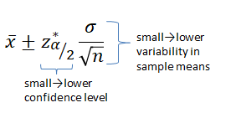
Common misconceptions about conﬁdence intervals
🔍 🙃 👫
The conﬁdence level of a conﬁdence interval is the probability that the true population parameter is in the conﬁdence interval you construct for a single sample.
The conﬁdence level is equal to the proportion of random samples that result in conﬁdence intervals that contain the true pop. parameter.
A narrower conﬁdence interval is always better.
This is incorrect since the width is a function of both the conﬁdence level and the standard error.
5

Slide 37
Common misconceptions about conﬁdence intervals
🔍 🙃 👫
The conﬁdence level of a conﬁdence interval is the probability that the true population parameter is in the conﬁdence interval you construct for a single sample.
The conﬁdence level is equal to the proportion of random samples that result in conﬁdence intervals that contain the true pop. parameter.
A narrower conﬁdence interval is always better.
This is incorrect since the width is a function of both the conﬁdence level and the standard error.
A wider interval means less conﬁdence.
This is incorrect since it is possible to make very precise statements with very little conﬁdence.
5

Slide 38
Outline
Housekeeping
Main ideas
    Making a Confidence Interval: 🔍 🆕 Use conﬁdence intervals to estimate population parameters
    Conditions for using the CLT to make a Conf. Interval: 🔍 Statistical inference methods based on the CLT depend on the same conditions as the CLT
    Common misconceptions about confidence intervals 🙃
    What sample size do we need?🔍 👫 Calculate the sample size a priori to achieve desired margin of error
Summary

Slide 39
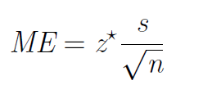

4. Calculate the sample size a priori to achieve desired margin of error
🔍 👫
Know
$$ME≤\#$$
Want
So if we know the desired ME, and conﬁdence level (and hence
z⋆), and the sample standard deviation, we can solve for n.
6

Slide 40
Application exercise: 3.1 Conﬁdence interval for a single mean
See course website for details.
7

Slide 41
Summary of main ideas
Statistical inference methods based on the CLT depend on the same conditions as the CLT
Use conﬁdence intervals to estimate population parameters
Critical value depends on the conﬁdence level
Calculate the sample size a priori to achieve desired margin of error
8

