Slide 1

Unit 3: Foundations for inference
3. Hypothesis tests
Sta 101 – Spring 2019
Duke University, Department of Statistical Science
Dr. Ellison
Slides posted at https://www2.stat.duke.edu/courses/Spring19/sta101.001/

Slide 2
Outline
Housekeeping
Main ideas
    Another Application of the CLT: 🔍 ⚙ 🙃 Use hypothesis tests to make decisions about population parameters
    Relationship Between Two CLT Applications: 🔍 👫 ⚙ Hypothesis tests and conﬁdence intervals at equivalent signiﬁcance/conﬁdence levels should agree
    Interpretation of Hypothesis Testing:
      🔍 👫 ⚙ Results that are statistically signiﬁcant are not necessarily practically signiﬁcant
      🔍 Hypothesis tests are prone to decision errors
Summary

Slide 3
Announcements
Coming up…
▶ Lab Assignment 5 is due Thursday just before your lab section time.
▶ Problem Set 3 is due Friday 2/22 11:55pm
▶ Performance Assessment 3 is due Sunday 2/24 11:55pm (opens today 1-2 hours after class)
▶ Readiness Assessment 4 is due Monday 2/25
▶ Peer Evaluations is due Thursday 2/28 11:55pm (part of your participation grade)
1

Slide 4
Outline
Housekeeping
Main ideas
    Another Application of the CLT: 🔍 ⚙ 🙃 Use hypothesis tests to make decisions about population parameters
    Relationship Between Two CLT Applications: 🔍 👫 ⚙ Hypothesis tests and conﬁdence intervals at equivalent signiﬁcance/conﬁdence levels should agree
    Interpretation of Hypothesis Testing:
      🔍 👫 ⚙ Results that are statistically signiﬁcant are not necessarily practically signiﬁcant
      🔍 Hypothesis tests are prone to decision errors
Summary

Slide 5
Outline
👫 Have we done frequentist hypothesis testing yet?

Slide 6
Outline
👫 Have we done frequentist hypothesis testing yet?
Yes! Randomization testing is a type of frequentist hypothesis testing!

Slide 7
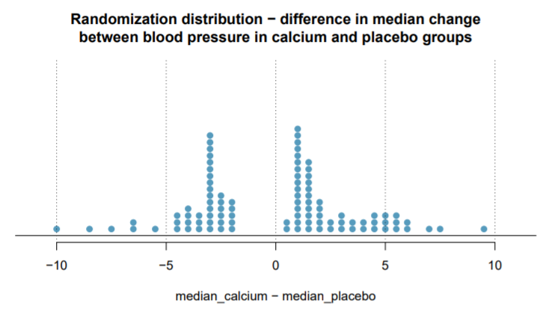

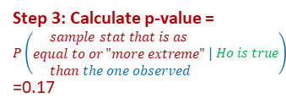

Step 1: Hypotheses
Step 3: Calculate p-value =
$$P\left(\begin{matrix}sample stat that is as \\ equal to or "more extreme" \\ than the one observed\end{matrix} | Ho is true\right)$$
=0.17
$$Ho:{Median}_{calc}={Median}_{placebo}$$
$$Ha:{Median}_{calc}≠{Median}_{placebo}$$
Step 2: Calculate Point Estimate/Sample Statistic
Step 4: Make conclusion
p-value ≥ 0.05 → Fail to reject null hypothesis. There is not sufficient evidence to suggest the alternative hypothesis.
$${\hat{median}}_{calc}−{\hat{median}}_{placebo}=5$$

Slide 8
Outline
👫 What is a big difference between Randomization Hypothesis Testing and CLT-based Hypothesis Testing?

Slide 9
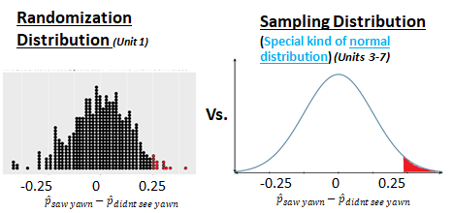
Outline
👫 What is a big difference between Randomization Hypothesis Testing and CLT-based Hypothesis Testing?
To calculate the p-value:
Randomization Hypothesis Testing uses a randomization distribution
CLT-based hypothesis testing uses the sampling distribution

Slide 10
Outline
🔍 What is the general framework for frequentist hypothesis testing (using CLT-based methods)?

Slide 11
1. Use hypothesis tests to make decisions about population
parameters
🔍 ⚙
Hypothesis testing framework:
Set the hypotheses.
Check assumptions and conditions.
Calculate a test statistic and a p-value.
Make a decision, and interpret it in context of the research question.

Slide 12
Outline
🔍 How do we conduct frequentist hypothesis testing (using CLT-based methods) for a population mean?

Slide 13
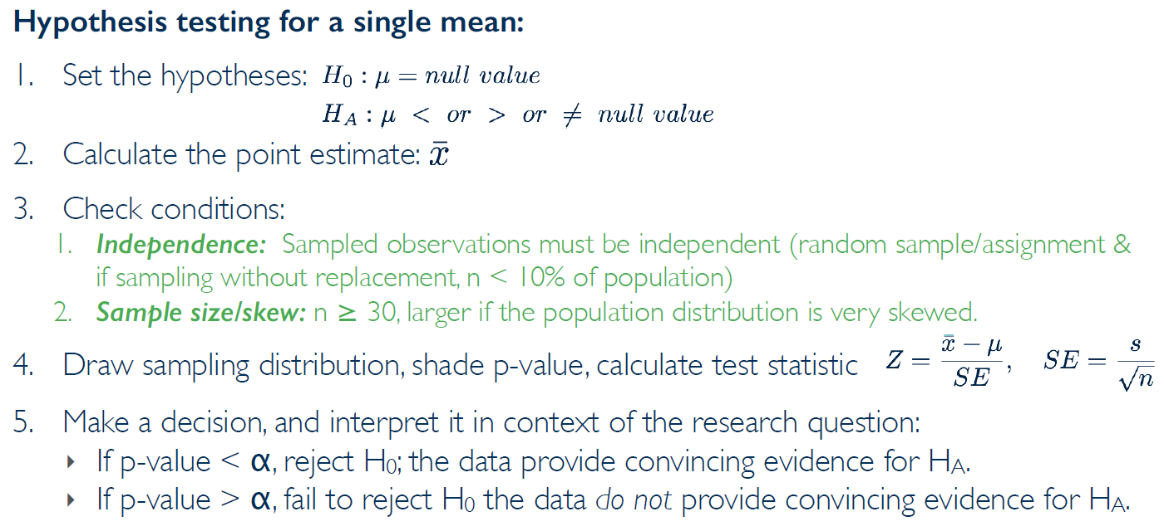
🔍 ⚙
Hypothesis testing for a population mean
From the videos… only gives one case… let’s break down both conditions cases!
3

Slide 14

🔍 ⚙
Hypothesis testing for a population mean
CLT
Conditions
Case 1: When σ IS known.
OR the population distribution is approximately normal
$$\frac{σ}{\sqrt{n}}$$
3

Slide 15

🔍 ⚙
Hypothesis testing for a population mean
Case 2: When σ is NOT known.
Stricter than CLT conditions. Why?
s
$$\frac{σ}{\sqrt{n}}$$
3

Slide 16
🔍 ⚙
Hypothesis testing for a population mean
Case 2: When σ is NOT known.
Stricter than CLT conditions. Why?
n>30 for s to be a good enough approx. for σ
s
$$\frac{σ}{\sqrt{n}}$$
3

Slide 17
Outline
⚙ 👫 How do we use a sampling distribution to calculate the p-value for a population mean?

Slide 18
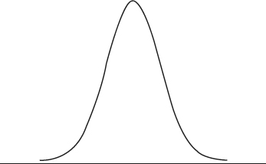




🔍 ⚙
Hypothesis testing for a population mean
$$Ho: μ=null value$$
$$Ha: μ>or<or ≠null value$$
WANT p-value =
$$P\left(\begin{matrix}\overline{x} that is equal \\ to or "more extreme" \\ than the one observed\end{matrix} | Ho is true\right)$$
Sampling Distribution $\overline{x}\sim N(μ=?, SE=\frac{s}{\sqrt{n}})$
All possible values of $\overline{x}$
3

Slide 19
🔍 ⚙
Hypothesis testing for a population mean
$$Ho: μ=null value$$
$$Ha: μ>or<or ≠null value$$
WANT p-value =
$$P\left(\begin{matrix}\overline{x} that is equal \\ to or "more extreme" \\ than the one observed\end{matrix} | Ho is true\right)$$
Sampling Distribution $\overline{x}\sim N(μ=?, SE=\frac{s}{\sqrt{n}})$
μ=?
3

Slide 20
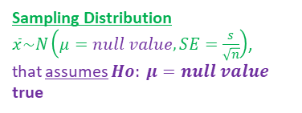

🔍 ⚙
Hypothesis testing for a population mean
$$Ho: μ=null value$$
$$Ha: μ>or<or ≠null value$$
WANT p-value =
$$P\left(\begin{matrix}\overline{x} that is equal \\ to or "more extreme" \\ than the one observed\end{matrix} | Ho is true\right)$$
Sampling Distribution
$\overline{x}\sim N\left(μ=null value, SE=\frac{s}{\sqrt{n}}\right)$,
that assumes $Ho: μ=null value$ true
μ=null value
3

Slide 21
Outline
⚙ What does “more extreme” mean in the p-value definition?

Slide 22
Outline
⚙ What does “more extreme” mean in the p-value definition?
Depends on the alternative hypothesis. What types of sample statistics will make us suspect the alternative?

Slide 23
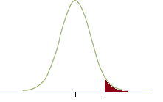

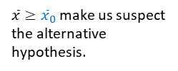


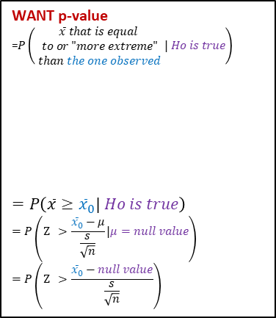
🔍 ⚙
Hypothesis testing for a population mean
Hypotheses
$$Ho: μ=null value$$
$$Ha: μ>null value$$
WANT p-value
=$P\left(\begin{matrix}\overline{x} that is equal \\ to or "more extreme" \\ than the one observed\end{matrix} | Ho is true\right)$
$$=P\left(\overline{x}≥{\overline{x}}_{0}| Ho is true\right)$$
$$=P\left(\text{Z}\text{ > }\frac{{\overline{x}}_{0}−μ}{\frac{s}{\sqrt{n}}}\text{|}μ=null value\right)$$
$$=P\left(\text{Z}\text{ > }\frac{{\overline{x}}_{0}−null value}{\frac{s}{\sqrt{n}}}\right)$$
Sampling Distribution
$\overline{x}\sim N\left(μ=?, SE=\frac{s}{\sqrt{n}}\right)$,
that assumes $Ho: μ=null value$ true
$\overline{x}≥{\overline{x}}_{0}$make us suspect the alternative hypothesis.
p-value
Use z-tables
μ=null value
$${\overline{x}}_{0}$$
3

Slide 24
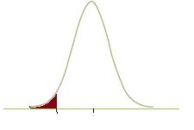




🔍 ⚙
Hypothesis testing for a population mean
Hypotheses
$$Ho: μ=null value$$
$$Ha: μ<null value$$
WANT p-value
=$P\left(\begin{matrix}\overline{x} that is equal \\ to or "more extreme" \\ than the one observed\end{matrix} | Ho is true\right)$
$$=P\left(\overline{x}≤{\overline{x}}_{0}| Ho is true\right)$$
$$=P\left(\text{Z}\text{ < }\frac{{\overline{x}}_{0}−μ}{\frac{s}{\sqrt{n}}}\text{|}μ=null value\right)$$
$$=P\left(\text{Z}\text{ < }\frac{{\overline{x}}_{0}−null value}{\frac{s}{\sqrt{n}}}\right)$$
Sampling Distribution
$\overline{x}\sim N\left(μ=?, SE=\frac{s}{\sqrt{n}}\right)$,
that assumes $Ho: μ=null value$ true
$\overline{x}≤{\overline{x}}_{0}$make us suspect the alternative hypothesis.
p-value
Use z-tables
$${\overline{x}}_{0}$$
μ=null value
3

Slide 25
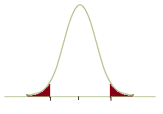




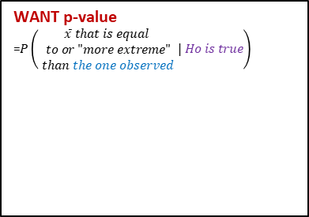
🔍 ⚙
Hypothesis testing for a population mean
Hypotheses
$$Ho: μ=null value$$
$$Ha: μ≠null value$$
WANT p-value
=$P\left(\begin{matrix}\overline{x} that is equal \\ to or "more extreme" \\ than the one observed\end{matrix} | Ho is true\right)$
Sampling Distribution
$\overline{x}\sim N\left(μ=?, SE=\frac{s}{\sqrt{n}}\right)$,
that assumes $Ho: μ=null value$ true
$\overline{x}≥μ+\left|{\overline{x}}_{0}−μ\right|$ or
$\overline{x}≥μ−\left|{\overline{x}}_{0}−μ\right|$ make us suspect the alternative hypothesis.
p-value
$$μ−\left|{\overline{x}}_{0}−μ\right|$$
μ=null value
$$μ+\left|{\overline{x}}_{0}−μ\right|$$
3

Slide 26
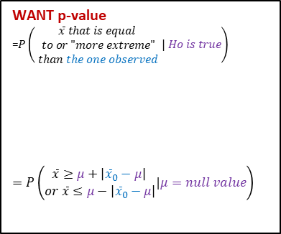
🔍 ⚙
Hypothesis testing for a population mean
Hypotheses
$$Ho: μ=null value$$
$$Ha: μ≠null value$$
WANT p-value
=$P\left(\begin{matrix}\overline{x} that is equal \\ to or "more extreme" \\ than the one observed\end{matrix} | Ho is true\right)$
$$=P\left(\begin{matrix}\overline{x}≥μ+\left|{\overline{x}}_{0}−μ\right| \\ or \overline{x}≤μ−\left|{\overline{x}}_{0}−μ\right|\end{matrix}|μ=null value\right)$$
Sampling Distribution
$\overline{x}\sim N\left(μ=?, SE=\frac{s}{\sqrt{n}}\right)$,
that assumes $Ho: μ=null value$ true
$\overline{x}≥μ+\left|{\overline{x}}_{0}−μ\right|$ or
$\overline{x}≥μ−\left|{\overline{x}}_{0}−μ\right|$ make us suspect the alternative hypothesis.
p-value
$$μ−\left|{\overline{x}}_{0}−μ\right|$$
μ=null value
$$μ+\left|{\overline{x}}_{0}−μ\right|$$
3

Slide 27
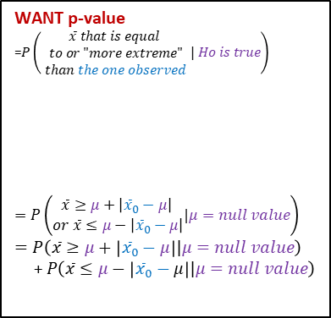
🔍 ⚙
Hypothesis testing for a population mean
Hypotheses
$$Ho: μ=null value$$
$$Ha: μ≠null value$$
WANT p-value
=$P\left(\begin{matrix}\overline{x} that is equal \\ to or "more extreme" \\ than the one observed\end{matrix} | Ho is true\right)$
$$=P\left(\begin{matrix}\overline{x}≥μ+\left|{\overline{x}}_{0}−μ\right| \\ or \overline{x}≤μ−\left|{\overline{x}}_{0}−μ\right|\end{matrix}|μ=null value\right)$$
$$=P\left(\overline{x}≥μ+\left|{\overline{x}}_{0}−μ\right||μ=null value\right)$$
+$P\left(\overline{x}≤μ−\left|{\overline{x}}_{0}−μ\right||μ=null value\right)$
Sampling Distribution
$\overline{x}\sim N\left(μ=?, SE=\frac{s}{\sqrt{n}}\right)$,
that assumes $Ho: μ=null value$ true
$\overline{x}≥μ+\left|{\overline{x}}_{0}−μ\right|$ or
$\overline{x}≥μ−\left|{\overline{x}}_{0}−μ\right|$ make us suspect the alternative hypothesis.
p-value
$$μ−\left|{\overline{x}}_{0}−μ\right|$$
μ=null value
$$μ+\left|{\overline{x}}_{0}−μ\right|$$
3

Slide 28
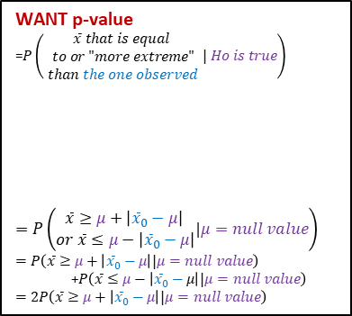
🔍 ⚙
Hypothesis testing for a population mean
Hypotheses
$$Ho: μ=null value$$
$$Ha: μ≠null value$$
WANT p-value
=$P\left(\begin{matrix}\overline{x} that is equal \\ to or "more extreme" \\ than the one observed\end{matrix} | Ho is true\right)$
$$=P\left(\begin{matrix}\overline{x}≥μ+\left|{\overline{x}}_{0}−μ\right| \\ or \overline{x}≤μ−\left|{\overline{x}}_{0}−μ\right|\end{matrix}|μ=null value\right)$$
$$=P\left(\overline{x}≥μ+\left|{\overline{x}}_{0}−μ\right||μ=null value\right)$$
+$P\left(\overline{x}≤μ−\left|{\overline{x}}_{0}−μ\right||μ=null value\right)$
$$=2P\left(\overline{x}≥μ+\left|{\overline{x}}_{0}−μ\right||μ=null value\right)$$
Sampling Distribution
$\overline{x}\sim N\left(μ=?, SE=\frac{s}{\sqrt{n}}\right)$,
that assumes $Ho: μ=null value$ true
$\overline{x}≥μ+\left|{\overline{x}}_{0}−μ\right|$ or
$\overline{x}≥μ−\left|{\overline{x}}_{0}−μ\right|$ make us suspect the alternative hypothesis.
p-value
$$μ−\left|{\overline{x}}_{0}−μ\right|$$
μ=null value
$$μ+\left|{\overline{x}}_{0}−μ\right|$$
3

Slide 29
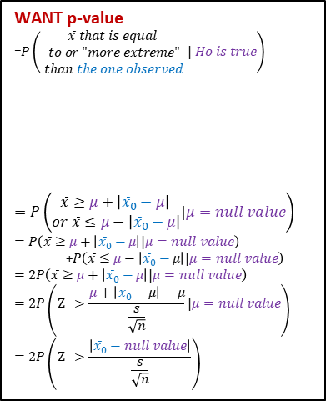
🔍 ⚙
Hypothesis testing for a population mean
Hypotheses
$$Ho: μ=null value$$
$$Ha: μ≠null value$$
WANT p-value
=$P\left(\begin{matrix}\overline{x} that is equal \\ to or "more extreme" \\ than the one observed\end{matrix} | Ho is true\right)$
$$=P\left(\begin{matrix}\overline{x}≥μ+\left|{\overline{x}}_{0}−μ\right| \\ or \overline{x}≤μ−\left|{\overline{x}}_{0}−μ\right|\end{matrix}|μ=null value\right)$$
$$=P\left(\overline{x}≥μ+\left|{\overline{x}}_{0}−μ\right||μ=null value\right)$$
+$P\left(\overline{x}≤μ−\left|{\overline{x}}_{0}−μ\right||μ=null value\right)$
$$=2P\left(\overline{x}≥μ+\left|{\overline{x}}_{0}−μ\right||μ=null value\right)=2P\left(\text{Z}\text{ > }\frac{μ+\left|{\overline{x}}_{0}−μ\right|−μ}{\frac{s}{\sqrt{n}}}\text{|}μ=null value\right)$$
$$=2P\left(\text{Z}\text{ > }\frac{\left|{\overline{x}}_{0}−null value\right|}{\frac{s}{\sqrt{n}}}\right)$$
Sampling Distribution
$\overline{x}\sim N\left(μ=?, SE=\frac{s}{\sqrt{n}}\right)$,
that assumes $Ho: μ=null value$ true
$\overline{x}≥μ+\left|{\overline{x}}_{0}−μ\right|$ or
$\overline{x}≥μ−\left|{\overline{x}}_{0}−μ\right|$ make us suspect the alternative hypothesis.
p-value
$$μ−\left|{\overline{x}}_{0}−μ\right|$$
μ=null value
$$μ+\left|{\overline{x}}_{0}−μ\right|$$
3

Slide 30
Outline
⚙ 👫 How does the test-statistic help us find the p-value?

Slide 31
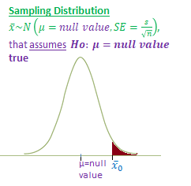
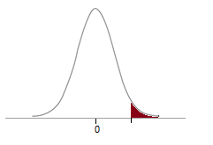
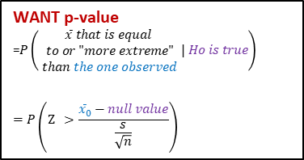

🔍 ⚙
Hypothesis testing for a population mean
Hypotheses
$$Ho: μ=null value$$
$$Ha: μ>null value$$
WANT p-value
=$P\left(\begin{matrix}\overline{x} that is equal \\ to or "more extreme" \\ than the one observed\end{matrix} | Ho is true\right)$
$$=P\left(\text{Z}\text{ > }\frac{{\overline{x}}_{0}−null value}{\frac{s}{\sqrt{n}}}\right)$$
Use z-tables
Test Statistic
Standard Normal Distribution
$Z\sim N\left(0,1\right)$
p-value
0
3

Slide 32
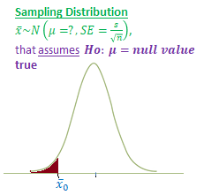
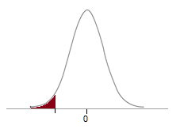

🔍 ⚙
Hypothesis testing for a population mean
Hypotheses
$$Ho: μ=null value$$
$$Ha: μ<null value$$
WANT p-value
=$P\left(\begin{matrix}\overline{x} that is equal \\ to or "more extreme" \\ than the one observed\end{matrix} | Ho is true\right)$
$$=P\left(\text{Z}\text{ < }\frac{{\overline{x}}_{0}−null value}{\frac{s}{\sqrt{n}}}\right)$$
Use z-tables
Test Statistic
Standard Normal Distribution
$Z\sim N\left(0,1\right)$
p-value
0
3

Slide 33
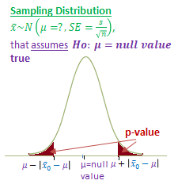
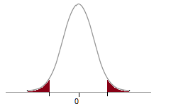

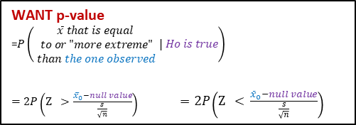


🔍 ⚙
Hypothesis testing for a population mean
Hypotheses
$$Ho: μ=null value$$
$$Ha: μ≠null value$$
WANT p-value
=$P\left(\begin{matrix}\overline{x} that is equal \\ to or "more extreme" \\ than the one observed\end{matrix} | Ho is true\right)$
$=2P\left(\text{Z}\text{ > }\frac{{\overline{x}}_{0}−null value}{\frac{s}{\sqrt{n}}}\right)$ $=2P\left(\text{Z}\text{ < }\frac{{\overline{x}}_{0}−null value}{\frac{s}{\sqrt{n}}}\right)$
Use z-tables
If ${\overline{x}}_{0}>null value$
If ${\overline{x}}_{0}<null value$
Standard Normal Distribution
$Z\sim N\left(0,1\right)$
p-value
-|Test Statistic|
|Test Statistic|
0
3

Slide 34
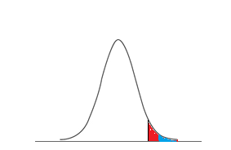
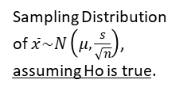
🔍 ⚙
Hypothesis testing for a population mean
From the videos…
Sampling Distribution of $\overline{x}\sim N\left(μ, \frac{s}{\sqrt{n}}\right)$, assuming Ho is true.
p-value
α
μ=null value
$$\overline{x}o$$
3

Slide 35
Application exercise: 3.2 Hypothesis testing for a single mean
See course website for details.

Slide 36
Outline
🙃 How do we interpret the p-value?

Slide 37
Clicker question
🙃
Which of the following is the correct interpretation of the p-value from App Ex 3.2?
The probability that average GPA of Duke students has changed since 2001.
The probability that average GPA of Duke students has not changed since 2001.
The probability that average GPA of Duke students has not changed since 2001, if in fact a random sample of 63 Duke students this year have an average GPA of 3.58 or higher.
The probability that a random sample of 63 Duke students have an average GPA of 3.58 or higher, if in fact the average GPA has not changed since 2001.
The probability that a random sample of 63 Duke students have an average GPA of 3.58 or higher or 3.16 or lower, if in fact the average GPA has not changed since 2001.

Slide 38
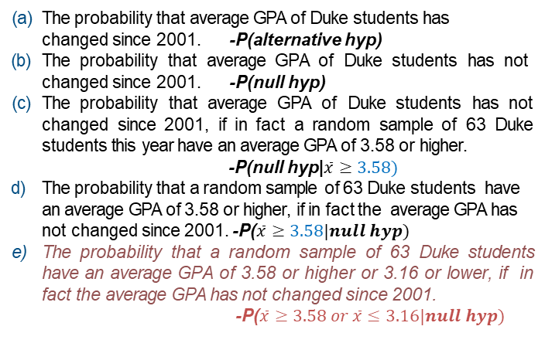
Clicker question
🙃
Which of the following is the correct interpretation of the p-value from App Ex 3.2?
The probability that average GPA of Duke students has changed since 2001. -P(alternative hyp)
The probability that average GPA of Duke students has not changed since 2001. -P(null hyp)
The probability that average GPA of Duke students has not changed since 2001, if in fact a random sample of 63 Duke students this year have an average GPA of 3.58 or higher.
-P(null hyp|$\overline{x}≥3.58)$
The probability that a random sample of 63 Duke students have an average GPA of 3.58 or higher, if in fact the average GPA has not changed since 2001. -P($\overline{x}≥3.58|null hyp)$
The probability that a random sample of 63 Duke students have an average GPA of 3.58 or higher or 3.16 or lower, if in fact the average GPA has not changed since 2001.
-P($\overline{x}≥3.58 or \overline{x}≤3.16|null hyp)$

Slide 39
Common misconceptions about hypothesis testing
🙃
1. P-value is the probability that the null hypothesis is true
A p-value is the probability of getting a sample that results in a test statistic/sample statistic as or more extreme than what you actually observed (and in favor of the null hypothesis) if in fact the null hypothesis is correct. It is a conditional probability, conditioned on the null hypothesis being correct.
6

Slide 40
Common misconceptions about hypothesis testing
🙃
P-value is the probability that the null hypothesis is true
A p-value is the probability of getting a sample that results in a test statistic/sample statistic as or more extreme than what you actually observed (and in favor of the null hypothesis) if in fact the null hypothesis is correct. It is a conditional probability, conditioned on the null hypothesis being correct.
A high p-value conﬁrms the null hypothesis.
A high p-value means the data do not provide convincing evidence for the alternative hypothesis and hence that the null hypothesis can’t be rejected.
6

Slide 41
Common misconceptions about hypothesis testing
🙃
P-value is the probability that the null hypothesis is true
A p-value is the probability of getting a sample that results in a test statistic/sample statistic as or more extreme than what you actually observed (and in favor of the null hypothesis) if in fact the null hypothesis is correct. It is a conditional probability, conditioned on the null hypothesis being correct.
A high p-value conﬁrms the null hypothesis.
A high p-value means the data do not provide convincing evidence for the alternative hypothesis and hence that the null hypothesis can’t be rejected.
3. A low p-value conﬁrms the alternative hypothesis.
A low p-value means the data provide convincing evidence for the alternative hypothesis, but not necessarily that it is conﬁrmed.
6

Slide 42
Outline
Housekeeping
Main ideas
    Another Application of the CLT: 🔍 ⚙ 🙃 Use hypothesis tests to make decisions about population parameters
    Relationship Between Two CLT Applications: 🔍 👫 ⚙ Hypothesis tests and conﬁdence intervals at equivalent signiﬁcance/conﬁdence levels should agree
    Interpretation of Hypothesis Testing:
      🔍 👫 ⚙ Results that are statistically signiﬁcant are not necessarily practically signiﬁcant
      🔍 Hypothesis tests are prone to decision errors
Summary

Slide 43
Outline
⚙ How do we conduct hypothesis testing with a confidence interval (instead of a p-value)?

Slide 44
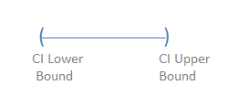
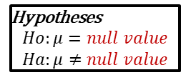
🔍 👫
2. Hypothesis tests and conﬁdence intervals at equivalent signiﬁcance/conﬁdence levels should agree
Hypotheses
$$Ho:μ=null value$$
$$Ha:μ≠null value$$
Fail to Reject Ho when:
Null value is ______ the confidence interval
Reject Ho when:
Null value is ______ the confidence interval
Range of “plausible” values for μ
Range of “plausible” values for μ
7

Slide 45
🔍 👫
2. Hypothesis tests and conﬁdence intervals at equivalent signiﬁcance/conﬁdence levels should agree
Hypotheses
$$Ho:μ=null value$$
$$Ha:μ≠null value$$
Fail to Reject Ho when:
Null value is inside the confidence interval
Reject Ho when:
Null value is outside the confidence interval
Null value
Range of “plausible” values for μ
Null value
Null value
Range of “plausible” values for μ
7

Slide 46

🔍 👫
2. Hypothesis tests and conﬁdence intervals at equivalent signiﬁcance/conﬁdence levels should agree
Hypotheses
$$Ho:μ=null value$$
$$Ha:μ>null value$$
Fail to Reject Ho when:
Null value is ______ the confidence interval
Reject Ho when:
Null value is ______ the confidence interval
Range of “plausible” values for μ
Range of “plausible” values for μ
7

Slide 47
🔍 👫
2. Hypothesis tests and conﬁdence intervals at equivalent signiﬁcance/conﬁdence levels should agree
Hypotheses
$$Ho:μ=null value$$
$$Ha:μ>null value$$
Fail to Reject Ho when:
Null value is inside the confidence interval
Reject Ho when:
Null value is less than the confidence interval
Null value
Range of “plausible” values for μ
Null value
Range of “plausible” values for μ
7

Slide 48

🔍 👫
2. Hypothesis tests and conﬁdence intervals at equivalent signiﬁcance/conﬁdence levels should agree
Hypotheses
$$Ho:μ=null value$$
$$Ha:μ<null value$$
Fail to Reject Ho when:
Null value is ______ the confidence interval
Reject Ho when:
Null value is ______ the confidence interval
Range of “plausible” values for μ
Range of “plausible” values for μ
7

Slide 49
🔍 👫
2. Hypothesis tests and conﬁdence intervals at equivalent signiﬁcance/conﬁdence levels should agree
Hypotheses
$$Ho:μ=null value$$
$$Ha:μ<null value$$
Fail to Reject Ho when:
Null value is inside the confidence interval
Reject Ho when:
Null value is greater than the confidence interval
Null value
Range of “plausible” values for μ
Null value
Range of “plausible” values for μ
7

Slide 50
Outline
⚙ When do the conclusions of the following agree?
Hypothesis testing with a confidence interval
Hypothesis testing with a p-value

Slide 51
🔍 👫 ⚙
2. Hypothesis tests and conﬁdence intervals at equivalent signiﬁcance/conﬁdence levels should agree
For Two-Sided Test, Conclusions Agree When:
Conf. level = (1- α)
α = (1 - Conf. Level)
7

Slide 52
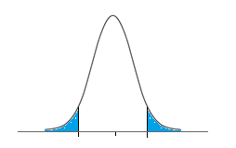
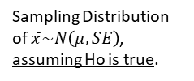

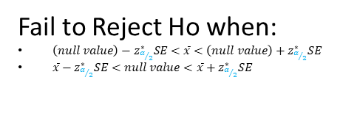


TWO sided Hypothesis Test with α significance level
🔍 👫 ⚙
2. Hypothesis tests and conﬁdence intervals at equivalent signiﬁcance/conﬁdence levels should agree
Fail to Reject Ho when:
$\left(null value\right)−z_{α/2}^{∗}SE<\overline{x}<\left(null value\right)+z_{α/2}^{∗}SE$
$\overline{x}−z_{α/2}^{∗}SE<null value<\overline{x}+z_{α/2}^{∗}SE$
Sampling Distribution of $\overline{x}\sim N\left(μ, SE\right)$, assuming Ho is true.
For Two-Sided Test, Conclusions Agree When:
Conf. level = (1- α)
α = (1 - Conf. Level)
1-α
α/2
α/2
$$\left(null value\right)−z_{α/2}^{∗}SE$$
μ=null value
$$\left(null value\right)+z_{α/2}^{∗}SE$$
$\overline{x}$ values
7

Slide 53
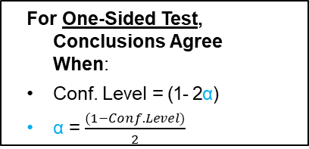
🔍 👫 ⚙
2. Hypothesis tests and conﬁdence intervals at equivalent signiﬁcance/conﬁdence levels should agree
For One-Sided Test, Conclusions Agree When:
Conf. Level = (1- 2α)
α = $\frac{(1−Conf. Level)}{2}$
7

Slide 54
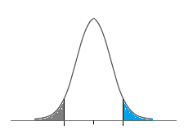
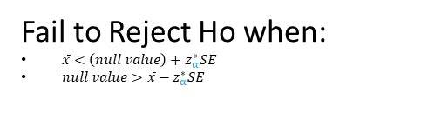
🔍 👫 ⚙
2. Hypothesis tests and conﬁdence intervals at equivalent signiﬁcance/conﬁdence levels should agree
ONE sided Hypothesis Test
with α significance level
Fail to Reject Ho when:
$\overline{x}<\left(null value\right)+z_{α}^{∗}SE$
$null value>\overline{x}−z_{α}^{∗}SE$
Sampling Distribution of $\overline{x}\sim N\left(μ, SE\right)$, assuming Ho is true.
For One-Sided Test, Conclusions Agree When:
Conf. Level = (1- 2α)
α = $\frac{(1−Conf. Level)}{2}$
1-2α
α
α
μ=null value
$$\left(null value\right)+z_{α}^{∗}SE$$
$\overline{x}$ values
7

Slide 55
Clicker question
🔍 👫
What is the conﬁdence level for a conﬁdence interval that is equivalent to a two-sided hypothesis test at the 1% signiﬁcance level? Hint: Draw a picture and mark the conﬁdence level in the center.
(a) 0.80
(b) 0.90
(c) 0.95
(d) 0.98
(e) 0.99
8

Slide 56
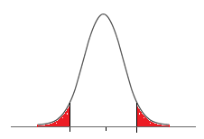
Clicker question
🔍 👫
What is the conﬁdence level for a conﬁdence interval that is equivalent to a two-sided hypothesis test at the 1% signiﬁcance level? Hint: Draw a picture and mark the conﬁdence level in the center.
(a) 0.80
(b) 0.90
(c) 0.95
(d) 0.98
(e) 0.99
.99
.005
.005
8

Slide 57
Clicker question
🔍 👫
What is the conﬁdence level for a conﬁdence interval that is equivalent to a one-sided hypothesis test at the 1% signiﬁcance level? Hint: Draw a picture and mark the conﬁdence level in the center.
(a) 0.80
(b) 0.90
(c) 0.95
(d) 0.98
(e) 0.99
9

Slide 58
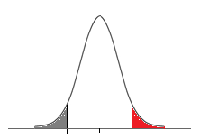
Clicker question
🔍 👫
What is the conﬁdence level for a conﬁdence interval that is equivalent to a one-sided hypothesis test at the 1% signiﬁcance level? Hint: Draw a picture and mark the conﬁdence level in the center.
(a) 0.80
(b) 0.90
(c) 0.95
(d) 0.98
(e) 0.99
.98
.01
9

Slide 59
A 95% conﬁdence interval for the average normal body temperature of humans is found to be (98.1 F, 98.4 F). Which of the following is true?
🔍 👫
Clicker question
The hypothesis H₀ : µ = 98.2 would be rejected at α = 0.05 in favor of H_{A} : µ ≠98.2.
The hypothesis H₀ : µ = 98.2 would be rejected at
α = 0.025 in favor of H_{A} : µ > 98.2.
The hypothesis H₀ : µ = 98 would be rejected in favor of H_{A} : µ ≠ 98 using a 90% conﬁdence interval.
The hypothesis H₀ : µ = 98.2 would be rejected would be rejected in favor of H_{A} : µ ≠ 98.2 using a 99% conﬁdence interval.
10

Slide 60
A 95% conﬁdence interval for the average normal body temperature of humans is found to be (98.1 F, 98.4 F). Which of the following is true?
🔍 👫
Clicker question
The hypothesis H₀ : µ = 98.2 would be rejected at α = 0.05 in favor of H_{A} : µ ≠98.2.
The hypothesis H₀ : µ = 98.2 would be rejected at
α = 0.025 in favor of H_{A} : µ > 98.2.
The hypothesis H₀ : µ = 98 would be rejected in favor of H_{A} : µ ≠ 98 using a 90% conﬁdence interval.
The hypothesis H₀ : µ = 98.2 would be rejected would be rejected in favor of H_{A} : µ ≠ 98.2 using a 99% conﬁdence interval.
10

Slide 61
A 95% conﬁdence interval for the average normal body temperature of humans is found to be (98.1 F, 98.4 F). Which of the following is true?
🔍 👫
Clicker question
The hypothesis H₀ : µ = 98.2 would be rejected at α = 0.05 in favor of H_{A} : µ ≠98.2.
Hypothesis Tests:
H₀ : µ = 98.2
H_{A} : µ ≠ 98.2
95% Confidence Interval:
Step 1: Evaluate null value in confidence interval.
  98.2 IS in (98.1 F, 98.4 F)
Step 2: Conclusion for a two-tailed test:
  Conclusion:
  Conclusion made at
10

Slide 62
A 95% conﬁdence interval for the average normal body temperature of humans is found to be (98.1 F, 98.4 F). Which of the following is true?
🔍 👫
Clicker question
The hypothesis H₀ : µ = 98.2 would be rejected at α = 0.05 in favor of H_{A} : µ ≠98.2.
Hypothesis Tests:
H₀ : µ = 98.2
H_{A} : µ ≠ 98.2
95% Confidence Interval:
Step 1: Evaluate null value in confidence interval.
  98.2 IS in (98.1 F, 98.4 F)
Step 2: Conclusion for a two-tailed test:
  Conclusion: Fail to reject null hypothesis
  Conclusion made at α = 0.05
10

Slide 63
A 95% conﬁdence interval for the average normal body temperature of humans is found to be (98.1 F, 98.4 F). Which of the following is true?
🔍 👫
Clicker question
The hypothesis H₀ : µ = 98.2 would be rejected at
α = 0.025 in favor of H_{A} : µ > 98.2.
Hypothesis Tests:
H₀ : µ =98.2
H_{A} : µ > 98.2
95% Confidence Interval:
Step 1: Evaluate null value in confidence interval.
  98.2 IS in (98.1 F, 98.4 F)
Step 2: Conclusion for a ONE-TAILED test:
  Conclusion:
  Conclusion made at
10

Slide 64
A 95% conﬁdence interval for the average normal body temperature of humans is found to be (98.1 F, 98.4 F). Which of the following is true?
🔍 👫
Clicker question
The hypothesis H₀ : µ = 98.2 would be rejected at
α = 0.025 in favor of H_{A} : µ > 98.2.
Hypothesis Tests:
H₀ : µ =98.2
H_{A} : µ > 98.2
95% Confidence Interval:
Step 1: Evaluate null value in confidence interval.
  98.2 IS in (98.1 F, 98.4 F)
Step 2: Conclusion for a ONE-TAILED test:
  Conclusion: Fail to reject null hypothesis
  Conclusion made at α = 0.025
10

Slide 65
A 95% conﬁdence interval for the average normal body temperature of humans is found to be (98.1 F, 98.4 F). Which of the following is true?
🔍 👫
Clicker question
The hypothesis H₀ : µ = 98 would be rejected in favor of H_{A} : µ ≠ 98 using a 90% conﬁdence interval.
Hypothesis Tests:
H₀ : µ =98
H_{A} : µ ≠ 98
90% Confidence Interval:
Step 1: Evaluate null value in confidence interval.
  98 IS NOT in (98.1 F, 98.4 F) – 95% CI
  98 _______ 90% CI
Step 2: Conclusion for a TWO-TAILED test:
  Conclusion: ________ null hypothesis with 90% CI
10

Slide 66
A 95% conﬁdence interval for the average normal body temperature of humans is found to be (98.1 F, 98.4 F). Which of the following is true?
🔍 👫
Clicker question
The hypothesis H₀ : µ = 98 would be rejected in favor of H_{A} : µ ≠ 98 using a 90% conﬁdence interval.
Hypothesis Tests:
H₀ : µ =98
H_{A} : µ ≠ 98
90% Confidence Interval:
Step 1: Evaluate null value in confidence interval.
  98 IS NOT in (98.1 F, 98.4 F) – 95% CI
  98 is not in a 90% CI either (90% is more narrow than 95% CI)
Step 2: Conclusion for a TWO-TAILED test:
  Conclusion: Reject null hypothesis with 90% CI
10

Slide 67
A 95% conﬁdence interval for the average normal body temperature of humans is found to be (98.1 F, 98.4 F). Which of the following is true?
🔍 👫
Clicker question
The hypothesis H₀ : µ = 98.2 would be rejected would be rejected in favor of H_{A} : µ ≠ 98.2 using a 99% conﬁdence interval.
Hypothesis Tests:
H₀ : µ =98.2
H_{A} : µ ≠ 98.2
99% Confidence Interval:
Step 1: Evaluate null value in confidence interval.
  98.2 IS in (98.1 F, 98.4 F)
  98 _________99% CI
Step 2: Conclusion for a TWO-TAILED test:
  Conclusion: ________null hypothesis
10

Slide 68
A 95% conﬁdence interval for the average normal body temperature of humans is found to be (98.1 F, 98.4 F). Which of the following is true?
🔍 👫
Clicker question
The hypothesis H₀ : µ = 98.2 would be rejected would be rejected in favor of H_{A} : µ ≠ 98.2 using a 99% conﬁdence interval.
Hypothesis Tests:
H₀ : µ =98.2
H_{A} : µ ≠ 98.2
99% Confidence Interval:
Step 1: Evaluate null value in confidence interval.
  98.2 IS in (98.1 F, 98.4 F)
  98 is also in 99% CI (99% is more wide than 95% CI)
Step 2: Conclusion for a TWO-TAILED test:
  Conclusion: Fail to reject null hypothesis with a 99% CI
10

Slide 69
Outline
Housekeeping
Main ideas
    Another Application of the CLT: 🔍 ⚙ 🙃 Use hypothesis tests to make decisions about population parameters
    Relationship Between Two CLT Applications: 🔍 👫 ⚙ Hypothesis tests and conﬁdence intervals at equivalent signiﬁcance/conﬁdence levels should agree
    Interpretation of Hypothesis Testing:
      🔍 👫 ⚙ Results that are statistically signiﬁcant are not necessarily practically signiﬁcant
      🔍 Hypothesis tests are prone to decision errors
Summary

Slide 70
Outline
🔮 What are some issues if our sample size is too small?
What are some issues if our sample size is too large?

Slide 71
3. Results that are statistically signiﬁcant are not necessarily practically
signiﬁcant
🔍 ⚙ 👫
Clicker question
All else held equal, will p-value be lower if n = 100 or
n = 10, 000?
(a) n = 100
(b) n = 10, 000
11

Slide 72
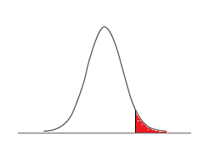
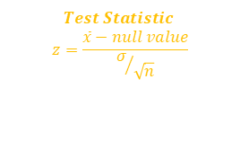
3. Results that are statistically signiﬁcant are not necessarily practically
signiﬁcant
🔍 ⚙ 👫
Clicker question
All else held equal, will p-value be lower if n = 100 or
n = 10, 000?
(a) n = 100
(b) n = 10, 000
Standard Normal Distribution N(0,1)
p-value
$$Test Statistic$$
$$z=\frac{\overline{x}−null value}{σ/{\sqrt{n}}}$$
11

Slide 73
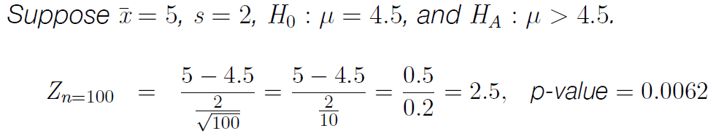
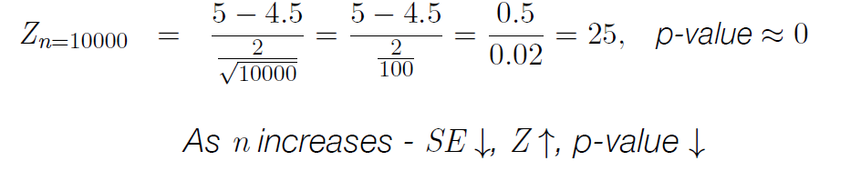
3. Results that are statistically signiﬁcant are not necessarily practically
signiﬁcant
🔍 ⚙ 👫
Clicker question
All else held equal, will p-value be lower if n = 100 or
n = 10, 000?
(a) n = 100
(b) n = 10, 000
Test Statistic
11

Slide 74
Outline
Housekeeping
Main ideas
    Another Application of the CLT: 🔍 ⚙ 🙃 Use hypothesis tests to make decisions about population parameters
    Relationship Between Two CLT Applications: 🔍 👫 ⚙ Hypothesis tests and conﬁdence intervals at equivalent signiﬁcance/conﬁdence levels should agree
    Interpretation of Hypothesis Testing:
      🔍 👫 ⚙ Results that are statistically signiﬁcant are not necessarily practically signiﬁcant
      🔍 Hypothesis tests are prone to decision errors
Summary

Slide 75
Outline
🔍 What are two ways we can make an error in hypothesis testing?

Slide 76
🔍
4. Hypothesis tests are prone to decision errors
Decision
 | fail to reject H₀ reject H₀
H₀ true H_{A} true
Truth
12

Slide 77
🔍
4. Hypothesis tests are prone to decision errors
Decision
 | fail to reject H₀ reject H₀
H₀ true H_{A} true | ✓
Truth
12

Slide 78
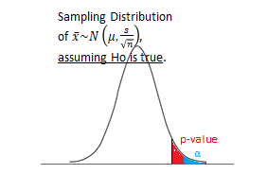
Decision
🔍
4. Hypothesis tests are prone to decision errors
 | fail to reject H₀ reject H₀
H₀ true H_{A} true | Type 1 Error, α
Truth
▶ A Type 1 Error is rejecting the null hypothesis when H₀ is true: α
P(Type 1 Error) = α
12

Slide 79
Decision
🔍
4. Hypothesis tests are prone to decision errors
 | fail to reject H₀ reject H₀
H₀ true H_{A} true | Type 1 Error, α Type 2 Error, β
Truth
▶ A Type 1 Error is rejecting the null hypothesis when H₀ is true.
P(Type 1 Error) = α
▶ A Type 2 Error is failing to reject the null hypothesis when
H_{A} is true.
P(Type 2 Error) = β
12

Slide 80
Decision
🔍
4. Hypothesis tests are prone to decision errors
 | fail to reject H₀ reject H₀
H₀ true H_{A} true | Type 1 Error, α Type 2 Error, β Power, 1 − β
Truth
▶ A Type 1 Error is rejecting the null hypothesis when H₀ is true.
P(Type 1 Error) = α
▶ A Type 2 Error is failing to reject the null hypothesis when
H_{A} is true.
P(Type 2 Error) = β
▶ Power is the probability of correctly rejecting H₀, and hence the complement of the probability of a Type 2 Error
Power = 1 - β
12

Slide 81
Decision
🔍 👫
4. Hypothesis tests are prone to decision errors
 | fail to reject H₀ reject H₀
H₀ true H_{A} true | Type 1 Error, α Type 2 Error, β Power, 1 − β
Truth
Ex: What does a Type 1 and Type 2 error mean given the hypotheses below. Why type of error is worse?
Ho: Defendant is innocent.
Ha: Defendant is guilty.
12

Slide 82
Summary of main ideas
Use hypothesis tests to make decisions about population parameters
Hypothesis tests and conﬁdence intervals at equivalent signiﬁcance/conﬁdence levels should agree
Results that are statistically signiﬁcant are not necessarily practically signiﬁcant
Hypothesis tests are prone to decision errors
13

