Slide 1

Unit 4: Inference for numerical data
1. Inference using the t-distribution
Sta 101 - Spring 2019
Duke University, Department of Statistical Science
Dr. Ellison
Slides posted at https://www2.stat.duke.edu/courses/Spring19/sta101.001/

Slide 2
Outline
1. Housekeeping
Main ideas
  Problem: Extra uncertainty is introduced into CLT hypothesis testing and confidence intervals when we plug in s for σ.
    Old Solution (from Unit 3): When we don’t know σ, only proceed with CLT hypothesis testing (or confidence interval) if n>30. But we still have some unaccounted for uncertainty of approximating σ with s.
    Better Solution (Use from Now on):
      🔍 👫 ⚙ Use T-distribution instead of Z-distribution when you plug in s for σ
  Other Hypothesis Tests and Confidence Intervals you Can Make:
      🔍 When comparing means of two groups, details depend on paired or independent
      🔍 All other details of the inferential framework is the same...

Slide 3
Announcements
Coming up…
▶ Lab Assignment 6 is due Thursday just before your lab section time.
▶ Peer Evaluations is due Thursday 2/28 11:55pm (part of your participation grade)
▶ Read over project statement before Thursday 2/28
▶ Data Exploration Project is due Thursday 3/7
1

Slide 4
Outline
1. Housekeeping
Main ideas
  Problem: Extra uncertainty is introduced into CLT hypothesis testing and confidence intervals when we plug in s for σ.
    Old Solution (from Unit 3): When we don’t know σ, only proceed with CLT hypothesis testing (or confidence interval) if n>30. But we still have some unaccounted for uncertainty of approximating σ with s.
    Better Solution (Use from Now on):
      🔍 👫 ⚙ Use T-distribution instead of Z-distribution when you plug in s for σ
  Other Hypothesis Tests and Confidence Intervals you Can Make:
      🔍 When comparing means of two groups, details depend on paired or independent
      🔍 All other details of the inferential framework is the same...

Slide 5
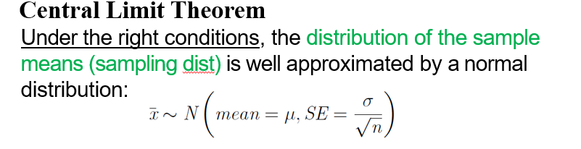
Outline

Slide 6
Outline

Slide 7

Outline
  Problem: Extra uncertainty is introduced into CLT hypothesis testing and confidence intervals when we plug in s for σ.
  .
Ex: $\overline{x}±z^{∗}\frac{σ}{\sqrt{n}}$
s

Slide 8

Outline
  Problem: Extra uncertainty is introduced into CLT hypothesis testing and confidence intervals when we plug in s for σ.
  Old Solution (from Unit 3):
  When we don’t know σ, only proceed with CLT hypothesis testing (or confidence interval) if n>30 (even if the population was normal).
s
Ex: $\overline{x}±z^{∗}\frac{σ}{\sqrt{n}}$

Slide 9

Outline
“Old Rules” from Unit 3…
When can we make a CLT confidence interval or hypothesis test?

Slide 10
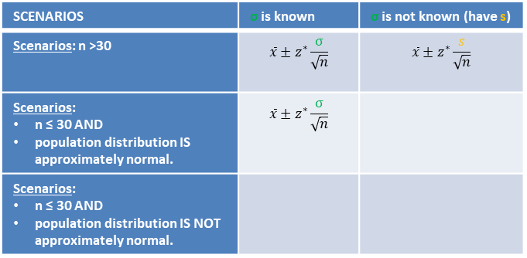
Outline
What we know from Unit 3
Making a Confidence Interval for μ with CLT
Independence
✓Random sampling/assignment is used.
✓ Sample size n < 10% of population
✓ One of the available Sample Size/Skewness “Scenarios” is met
SCENARIOS | σ is known | σ is not known (have s)
Scenarios: n >30 | $$\overline{x}±z^{∗}\frac{σ}{\sqrt{n}}$$ | $$\overline{x}±z^{∗}\frac{s}{\sqrt{n}}$$
Scenarios: n ≤ 30 AND population distribution IS approximately normal. | $$\overline{x}±z^{∗}\frac{σ}{\sqrt{n}}$$
Scenarios: n ≤ 30 AND population distribution IS NOT approximately normal.
2

Slide 11
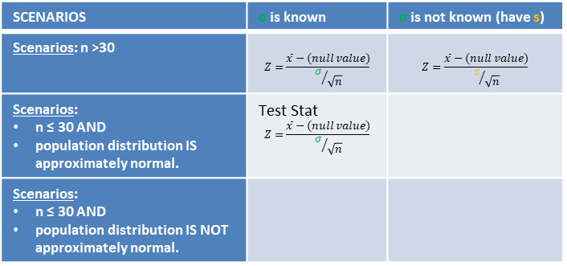
Outline
What we know from Unit 3
Hypothesis Testing for μ with CLT
Independence
✓Random sampling/assignment is used.
✓ Sample size n < 10% of population
✓ One of the available Sample Size/Skewness “Scenarios” is met
SCENARIOS | σ is known | σ is not known (have s)
Scenarios: n >30 | $$Z=\frac{\overline{x}−(null value)}{σ/{\sqrt{n}}}$$ | $$Z=\frac{\overline{x}−(null value)}{s/{\sqrt{n}}}$$
Scenarios: n ≤ 30 AND population distribution IS approximately normal. | Test Stat $$Z=\frac{\overline{x}−(null value)}{σ/{\sqrt{n}}}$$
Scenarios: n ≤ 30 AND population distribution IS NOT approximately normal.
Test Stat
Test Stat
2

Slide 12
Outline
1. Housekeeping
Main ideas
  Problem: Extra uncertainty is introduced into CLT hypothesis testing and confidence intervals when we plug in s for σ.
    Old Solution (from Unit 3): When we don’t know σ, only proceed with CLT hypothesis testing (or confidence interval) if n>30. But we still have some unaccounted for uncertainty of approximating σ with s.
    Better Solution (Use from Now on):
      🔍 👫 ⚙ Use T-distribution instead of Z-distribution when you plug in s for σ
  Other Hypothesis Tests and Confidence Intervals you Can Make:
      🔍 When comparing means of two groups, details depend on paired or independent
      🔍 All other details of the inferential framework is the same...

Slide 13

Outline
  Problem: Extra uncertainty is introduced into CLT hypothesis testing and confidence intervals when we plug in s for σ.
  Old Solution (from Unit 3):
  When we don’t know σ, only proceed with CLT hypothesis testing (or confidence interval) if n>30.
  Issues:
  We want to make confidence intervals and hypothesis tests for n ≤ 30.
  We still have some unaccounted for uncertainty of approximating σ with s.
s
Ex: $\overline{x}±z^{∗}\frac{σ}{\sqrt{n}}$

Slide 14

Outline
Unit 4 onward…
Using the T-distribution can gives us more flexibility.

Slide 15
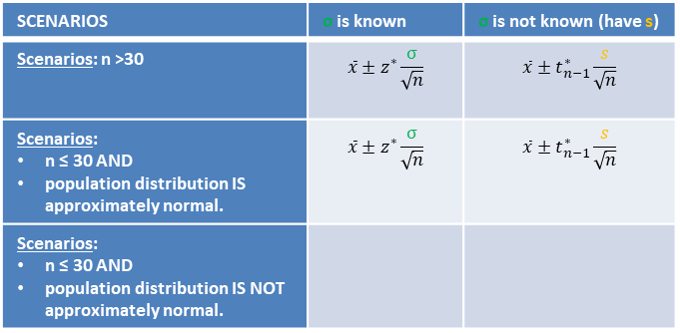
Outline
Unit 4
Making a Confidence Interval for μ with CLT
Independence
✓Random sampling/assignment is used.
✓ Sample size n < 10% of population
✓ One of the available Sample Size/Skewness “Scenarios” is met
SCENARIOS | σ is known | σ is not known (have s)
Scenarios: n >30 | $$\overline{x}±z^{∗}\frac{σ}{\sqrt{n}}$$ | $$\overline{x}±t_{n−1}^{∗}\frac{s}{\sqrt{n}}$$
Scenarios: n ≤ 30 AND population distribution IS approximately normal. | $$\overline{x}±z^{∗}\frac{σ}{\sqrt{n}}$$ | $$\overline{x}±t_{n−1}^{∗}\frac{s}{\sqrt{n}}$$
Scenarios: n ≤ 30 AND population distribution IS NOT approximately normal.
*or not extremely skewed
2

Slide 16
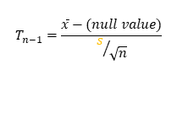
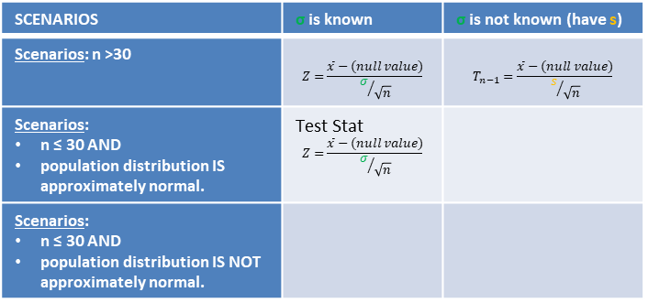
Outline
Unit 4
Hypothesis Testing for μ with CLT
Independence
✓Random sampling/assignment is used.
✓ Sample size n < 10% of population
✓ One of the available Sample Size/Skewness “Scenarios” is met
SCENARIOS | σ is known | σ is not known (have s)
Scenarios: n >30 | $$Z=\frac{\overline{x}−(null value)}{σ/{\sqrt{n}}}$$ | $$T_{n−1}=\frac{\overline{x}−(null value)}{s/{\sqrt{n}}}$$
Scenarios: n ≤ 30 AND population distribution IS approximately normal. | Test Stat $$Z=\frac{\overline{x}−(null value)}{σ/{\sqrt{n}}}$$
Scenarios: n ≤ 30 AND population distribution IS NOT approximately normal.
Test Stat
Test Stat
Test Stat
$$T_{n−1}=\frac{\overline{x}−(null value)}{s/{\sqrt{n}}}$$
*or not extremely skewed
2

Slide 17
Outline
  Problem: Extra uncertainty is introduced into CLT hypothesis testing and confidence intervals when we plug in s for σ.
  Old Solution (from Unit 3):
  When we don’t know σ, only proceed with CLT hypothesis testing (or confidence interval) if n>30.
  Issues:
  We want to make confidence intervals and hypothesis tests for n ≤ 30.
  We still have some unaccounted for uncertainty of approximating σ with s.
s
Ex: $\overline{x}±z^{∗}\frac{σ}{\sqrt{n}}$

Slide 18

Outline
Unit 4 onward…
Using the T-distribution can incorporate the uncertainty of using s when we don’t
know σ.

Slide 19
Outline
Unit 4
Making a Confidence Interval for μ with CLT
Independence
✓Random sampling/assignment is used.
✓ Sample size n < 10% of population
✓ One of the available Sample Size/Skewness “Scenarios” is met
SCENARIOS | σ is known | σ is not known (have s)
Scenarios: n >30 | $$\overline{x}±z^{∗}\frac{σ}{\sqrt{n}}$$ | $$\overline{x}±t_{n−1}^{∗}\frac{s}{\sqrt{n}}$$
Scenarios: n ≤ 30 AND population distribution IS approximately normal. | $$\overline{x}±z^{∗}\frac{σ}{\sqrt{n}}$$ | $$\overline{x}±t_{n−1}^{∗}\frac{s}{\sqrt{n}}$$
Scenarios: n ≤ 30 AND population distribution IS NOT approximately normal.
*or not extremely skewed
2

Slide 20
Outline
Unit 4
Hypothesis Testing for μ with CLT
Independence
✓Random sampling/assignment is used.
✓ Sample size n < 10% of population
✓ One of the available Sample Size/Skewness “Scenarios” is met
SCENARIOS | σ is known | σ is not known (have s)
Scenarios: n >30 | $$Z=\frac{\overline{x}−(null value)}{σ/{\sqrt{n}}}$$ | $$T_{n−1}=\frac{\overline{x}−(null value)}{s/{\sqrt{n}}}$$
Scenarios: n ≤ 30 AND population distribution IS approximately normal. | Test Stat $$Z=\frac{\overline{x}−(null value)}{σ/{\sqrt{n}}}$$
Scenarios: n ≤ 30 AND population distribution IS NOT approximately normal.
Test Stat
Test Stat
Test Stat
$$T_{n−1}=\frac{\overline{x}−(null value)}{s/{\sqrt{n}}}$$
*or not extremely skewed
2

Slide 21
Outline
Properties of the T-distribution:
  How is it similar/different to the normal distribution?

Slide 22
🔍 👫
2. T corrects for uncertainty introduced by plugging in s for σ
T-distribution is more “conservative” distribution than the normal distribution.
t-distribution also has a bell shape, but:
  Peak is lower than the normal model’s
  Tails are thicker than the normal model’s
    Observations are more likely to fall beyond two SDs from the mean than under the normal distribution.
normal t
−4
−2
0
2
4
2

Slide 23
🔍 👫
2. T corrects for uncertainty introduced by plugging in s for σ
T-distribution is more “conservative” distribution than the normal distribution.
t-distribution also has a bell shape, but:
  Peak is lower than the normal model’s
  Tails are thicker than the normal model’s
    Observations are more likely to fall beyond two SDs from the mean than under the normal distribution.
  Always centered at zero, like the standard normal (z) distribution
standard normal
t
−4
−2
0
2
4
2

Slide 24
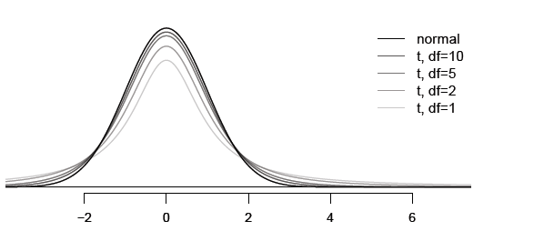
Outline
Properties of the T-distribution:
What is the “parameter” that determine the tail thickness/peak height of t-distribution?

Slide 25
🔍 👫
t-distribution
▶ Has a single parameter, degrees of freedom (df ), that is
tied to sample size. Determines tail thickness, peak height.
What happens to shape of the t-distribution as df increases?
Z Standard normal
3

Slide 26
🔍 👫
t-distribution
▶ Has a single parameter, degrees of freedom (df ), that is
tied to sample size. Determines tail thickness, peak height.
What happens to shape of the t-distribution as df increases?
Z Standard normal
df↑
thickness of tails↓
peak ↑
approaches standard
normal dist
3

Slide 27
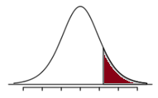
Outline
How do we use the t-distribution for hypothesis testing for one population mean?
T-distribution
with df=n-1
p-value

Slide 28
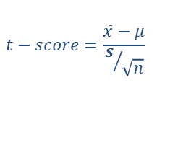
Outline
How do we use the t-distribution for hypothesis testing for one population mean?
T-distribution
with df=n-1
p-value
$$t−score=\frac{\overline{x}−μ}{s/{\sqrt{n}}}$$
Test Statistic

Slide 29
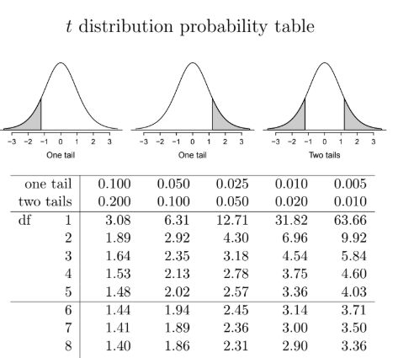
Outline
How do we use the t-distribution for hypothesis testing for one population mean?
T-distribution
with df=n-1
$$t−score=\frac{\overline{x}−μ}{s/{\sqrt{n}}}$$
Test Statistic

Slide 30
Outline
How do we use the t-distribution for hypothesis testing for one population mean?
p-value
T-distribution
with df=n-1
$$t−score=\frac{\overline{x}−μ}{s/{\sqrt{n}}}$$
Test Statistic

Slide 31
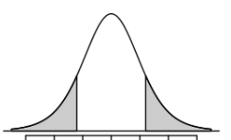
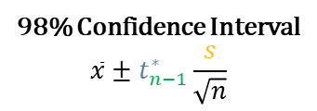
Outline
How do we use the t-distribution for confidence intervals for one population mean?
T-distribution
with df=n-1
98% Confidence Interval
$$\overline{x}±t_{n−1}^{∗}\frac{s}{\sqrt{n}}$$

Slide 32



Outline
How do we use the t-distribution for confidence intervals for one population mean?
T-distribution
with df=n-1
.98
.01
.01
$${−t}_{n−1}^{∗}$$
$$0$$
$$t_{n−1}^{∗}$$
98% Confidence Interval
$$\overline{x}±t_{n−1}^{∗}\frac{s}{\sqrt{n}}$$

Slide 33
Outline
How do we use the t-distribution for confidence intervals for one population mean?
T-distribution
with df=n-1
.98
.01
.01
$${−t}_{n−1}^{∗}$$
$$0$$
$$t_{n−1}^{∗}$$
98% Confidence Interval
$$\overline{x}±t_{n−1}^{∗}\frac{s}{\sqrt{n}}$$

Slide 34
Outline
How do we use the t-distribution for confidence intervals for one population mean?
T-distribution
with df=n-1
.98
.01
.01
$${−t}_{n−1}^{∗}$$
$$0$$
$$t_{n−1}^{∗}$$
98% Confidence Interval
$$\overline{x}±t_{n−1}^{∗}\frac{s}{\sqrt{n}}$$

Slide 35
Outline
Unit 4 onward…
How/why does the T-distribution incorporate the uncertainty of using s when we don’t know σ?

Slide 36
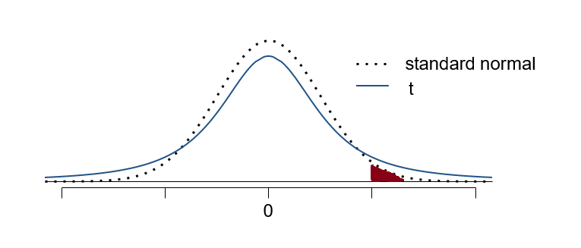
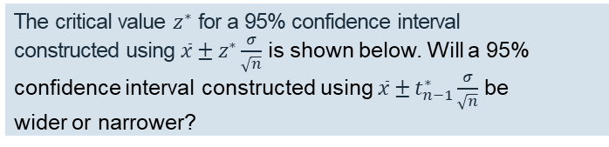

Clicker question
The critical value $z^{∗}$ for a 95% confidence interval constructed using $\overline{x}±z^{∗}\frac{σ}{\sqrt{n}}$ is shown below. Will a 95% confidence interval constructed using $\overline{x}±t_{n−1}^{∗}\frac{σ}{\sqrt{n}}$ be wider or narrower?
a.) wider
b.) narrower
n-1
0.025
$$z^{∗}$$

Slide 37
Clicker question
The critical value $z^{∗}$ for a 95% confidence interval constructed using $\overline{x}±z^{∗}\frac{σ}{\sqrt{n}}$ is shown below. Will a 95% confidence interval constructed using $\overline{x}±t_{n−1}^{∗}\frac{σ}{\sqrt{n}}$ be wider or narrower?
a.) wider
b.) narrower
n-1
0.025
$$z^{∗}$$

Slide 38
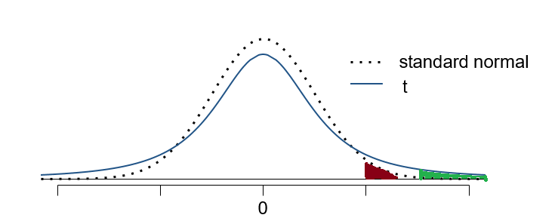


Clicker question
The critical value $z^{∗}$ for a 95% confidence interval constructed using $\overline{x}±z^{∗}\frac{σ}{\sqrt{n}}$ is shown below. Will a 95% confidence interval constructed using $\overline{x}±t_{n−1}^{∗}\frac{σ}{\sqrt{n}}$ be wider or narrower?
a.) wider
b.) narrower
n-1
0.025
0.025
$$z^{∗}$$
$$t_{n−1}^{∗}$$

Slide 39
Outline
For large confidence levels, the T-distribution’s thicker tails lead to…
→ wider confidence intervals
→ more uncertainty about pop. param.

Slide 40
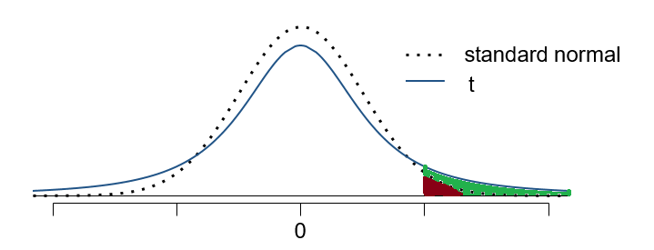
Outline
Hypothesis Testing
t-score =
z-score
Test Statistic

Slide 41
Outline
Hypothesis Testing
P-value with z-distribution
P-value with t-distribution
t-score =
z-score
Test Statistic

Slide 42
Outline
For large z-scores/t-scores, the T-distribution’s thicker tails lead to…
→ higher p-values
→ harder to reject the null hypothesis.

Slide 43
Outline
1. Housekeeping
Main ideas
  Problem: Extra uncertainty is introduced into CLT hypothesis testing and confidence intervals when we plug in s for σ.
    Old Solution (from Unit 3): When we don’t know σ, only proceed with CLT hypothesis testing (or confidence interval) if n>30. But we still have some unaccounted for uncertainty of approximating σ with s.
    Better Solution (Use from Now on):
      🔍 👫 ⚙ Use T-distribution instead of Z-distribution when you plug in s for σ
  Other Hypothesis Tests and Confidence Intervals you Can Make:
      🔍 When comparing means of two groups, details depend on paired or independent
      🔍 All other details of the inferential framework is the same...

Slide 44

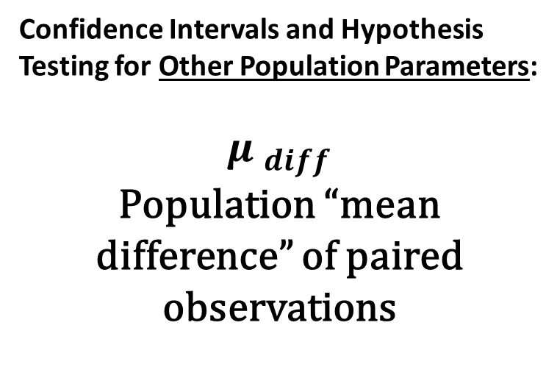
Outline
Confidence Intervals and Hypothesis Testing for Other Population Parameters:
$${μ }_{diff}$$
Population “mean difference” of paired observations

Slide 45
Example 1: Zinc in water
🔍
Trace metals in drinking water affect the ﬂavor and an unusually high concentration can pose a health hazard. Ten pairs of data were taken measuring zinc concentration in bottom water and surface water at 10 randomly sampled locations.
Location | bottom | surface
1 | 0.43 | 0.415
2 | 0.266 | 0.238
3 | 0.567 | 0.39
4 | 0.531 | 0.41
5 | 0.707 | 0.605
6 | 0.716 | 0.609
7 | 0.651 | 0.632
8 | 0.589 | 0.523
9 | 0.469 | 0.411
10 | 0.723 | 0.612
4

Slide 46
Example 1: Zinc in water
🔍
Trace metals in drinking water affect the ﬂavor and an unusually high concentration can pose a health hazard. Ten pairs of data were taken measuring zinc concentration in bottom water and surface water at 10 randomly sampled locations.
Location | bottom | surface
1 | 0.43 | 0.415
2 | 0.266 | 0.238
3 | 0.567 | 0.39
4 | 0.531 | 0.41
5 | 0.707 | 0.605
6 | 0.716 | 0.609
7 | 0.651 | 0.632
8 | 0.589 | 0.523
9 | 0.469 | 0.411
10 | 0.723 | 0.612
Water samples collected at the same location, on the surface and in the bottom, cannot be assumed to be independent of each other, hence we need to use a paired analysis.
Source: https://onlinecourses.science.psu.edu/stat500/node/51
4

Slide 47
Example 1: Zinc in water
🔍
Trace metals in drinking water affect the ﬂavor and an unusually high concentration can pose a health hazard. Ten pairs of data were taken measuring zinc concentration in bottom water and surface water at 10 randomly sampled locations.
Identifying a Paired Means Test
Each observation in one population has a corresponding observation in the other population. The problem usually talks about this correspondence/pairing.
Pairing = Location | bottom | surface
1 | 0.43 | 0.415
2 | 0.266 | 0.238
3 | 0.567 | 0.39
4 | 0.531 | 0.41
5 | 0.707 | 0.605
6 | 0.716 | 0.609
7 | 0.651 | 0.632
8 | 0.589 | 0.523
9 | 0.469 | 0.411
10 | 0.723 | 0.612
Source: https://onlinecourses.science.psu.edu/stat500/node/51
4

Slide 48
Example 1: Zinc in water
🔍
Trace metals in drinking water affect the ﬂavor and an unusually high concentration can pose a health hazard. Ten pairs of data were taken measuring zinc concentration in bottom water and surface water at 10 randomly sampled locations.
Identifying a Paired Means Test
Each observation in one population has a corresponding observation in the other population. The problem will talk about this correspondence/pairing.
The sample sizes of two groups HAVE to be the same.
Location | bottom | surface
1 | 0.43 | 0.415
2 | 0.266 | 0.238
3 | 0.567 | 0.39
4 | 0.531 | 0.41
5 | 0.707 | 0.605
6 | 0.716 | 0.609
7 | 0.651 | 0.632
8 | 0.589 | 0.523
9 | 0.469 | 0.411
10 | 0.723 | 0.612
Source: https://onlinecourses.science.psu.edu/stat500/node/51
4

Slide 49
Example 1: Zinc in water
🔍
Trace metals in drinking water affect the ﬂavor and an unusually high concentration can pose a health hazard. Ten pairs of data were taken measuring zinc concentration in bottom water and surface water at 10 randomly sampled locations.
Identifying a Paired Means Test
Each observation in one population has a corresponding observation in the other population. The problem will talk about this correspondence/pairing.
The sample sizes of two groups HAVE to be the same.
Common paired-means test examples:
  Before/after data
  Couples/twins
Location | bottom | surface
1 | 0.43 | 0.415
2 | 0.266 | 0.238
3 | 0.567 | 0.39
4 | 0.531 | 0.41
5 | 0.707 | 0.605
6 | 0.716 | 0.609
7 | 0.651 | 0.632
8 | 0.589 | 0.523
9 | 0.469 | 0.411
10 | 0.723 | 0.612
Source: https://onlinecourses.science.psu.edu/stat500/node/51
4

Slide 50
Analyzing paired data
🔍
Suppose we want to compare the average zinc concentration levels in the bottom and surface:
▶ Two sets of observations with a special correspondence (not independent): paired
▶ Synthesize down to differences in outcomes of each pair of observations, subtract using a consistent order
Location | bottom | surface | difference
1 | 0.43 | 0.415 | 0.015
2 | 0.266 | 0.238 | 0.028
3 | 0.567 | 0.39 | 0.177
4 | 0.531 | 0.41 | 0.121
5 | 0.707 | 0.605 | 0.102
6 | 0.716 | 0.609 | 0.107
7 | 0.651 | 0.632 | 0.019
8 | 0.589 | 0.523 | 0.066
9 | 0.469 | 0.411 | 0.058
10 | 0.723 | 0.612 | 0.111
4
3
2
1
0
0.00 0.05 0.10 0.15 0.20
difference in zinc concentrations (bottom − surface)
7

Slide 51
Parameter and point estimate for paired data
🔍
For comparing average zinc concentration levels in the bottom and surface when the data are paired:
8

Slide 52
🔍
Parameter and point estimate for paired data
For comparing average zinc concentration levels in the bottom and surface when the data are paired:
▶ Parameter of interest: Average difference between the bottom and surface zinc measurements of all drinking water.
µdiff
8

Slide 53
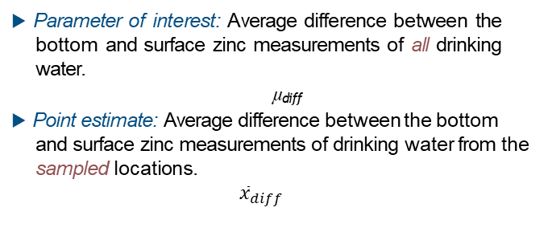
For comparing average zinc concentration levels in the bottom and surface when the data are paired:
🔍
Parameter and point estimate for paired data
▶ Parameter of interest: Average difference between the bottom and surface zinc measurements of all drinking water.
µdiff
▶ Point estimate: Average difference between the bottom and surface zinc measurements of drinking water from the sampled locations.
$${\overline{x}}_{diff}$$
8

Slide 54
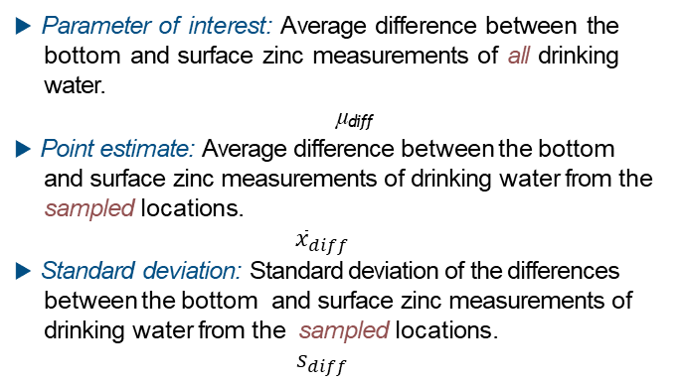
For comparing average zinc concentration levels in the bottom and surface when the data are paired:
🔍
Parameter and point estimate for paired data
▶ Parameter of interest: Average difference between the bottom and surface zinc measurements of all drinking water.
µdiff
▶ Point estimate: Average difference between the bottom and surface zinc measurements of drinking water from the sampled locations.
$${\overline{x}}_{diff}$$
▶ Standard deviation: Standard deviation of the differences between the bottom and surface zinc measurements of drinking water from the sampled locations.
$$s_{diff}$$
8

Slide 55

▶ Dependent (paired) groups (e.g. pre/post weights of subjects in a weight loss study, twin studies, etc.)
🔍
Standard errors

Slide 56
3. All other details of the inferential framework is the same...
🔍 👫
_{HT : test statistic =} point estimate − null
SE
CI : point estimate ± critical value × SE

Slide 57
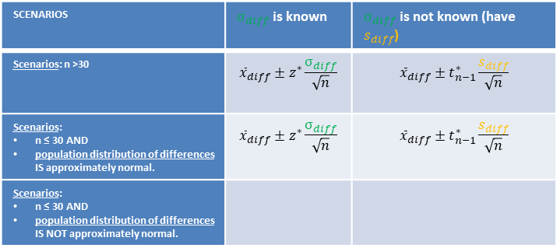
Outline
Unit 4
Making a Confidence Interval for µdiff with CLT
Independence
✓Random sampling/assignment is used to collect the pairs of data
✓ Sample size n < 10% of population of pairs.
✓ One of the available Sample Size/Skewness “Scenarios” is met
SCENARIOS | $σ_{diff}$ is known | $σ_{diff}$ is not known (have $s_{diff}$)
Scenarios: n >30 | $${\overline{x}}_{diff}±z^{∗}\frac{σ_{diff}}{\sqrt{n}}$$ | $${\overline{x}}_{diff}±t_{n−1}^{∗}\frac{s_{diff}}{\sqrt{n}}$$
Scenarios: n ≤ 30 AND population distribution of differences IS approximately normal. | $${\overline{x}}_{diff}±z^{∗}\frac{σ_{diff}}{\sqrt{n}}$$ | $${\overline{x}}_{diff}±t_{n−1}^{∗}\frac{s_{diff}}{\sqrt{n}}$$
Scenarios: n ≤ 30 AND population distribution of differences IS NOT approximately normal.
n=# of pairs
n=# of pairs
*or not extremely skewed
n=# of pairs

Slide 58
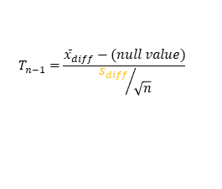
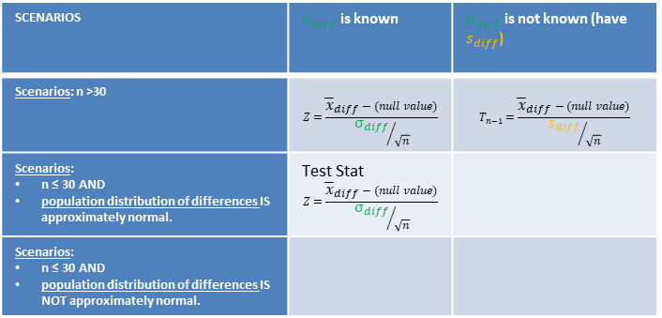
Outline
Unit 4
Hypothesis Testing for µdiff with CLT
Independence
✓Random sampling/assignment is used to collect the pairs of data
✓ Sample size n < 10% of population of pairs.
✓ One of the available Sample Size/Skewness “Scenarios” is met
SCENARIOS | $σ_{diff}$ is known | $σ_{diff}$ is not known (have $s_{diff}$)
Scenarios: n >30 | $$Z=\frac{{\overline{x}}_{diff}−(null value)}{{σ_{diff}}/{\sqrt{n}}}$$ | $$T_{n−1}=\frac{{\overline{x}}_{diff}−(null value)}{{s_{diff}}/{\sqrt{n}}}$$
Scenarios: n ≤ 30 AND population distribution of differences IS approximately normal. | Test Stat $$Z=\frac{{\overline{x}}_{diff}−(null value)}{{σ_{diff}}/{\sqrt{n}}}$$
Scenarios: n ≤ 30 AND population distribution of differences IS NOT approximately normal.
Test Stat
Test Stat
n=# of pairs
Test Stat
n=# of pairs
$$T_{n−1}=\frac{{\overline{x}}_{diff}−(null value)}{{s_{diff}}/{\sqrt{n}}}$$
*or not extremely skewed
n=# of pairs

Slide 59

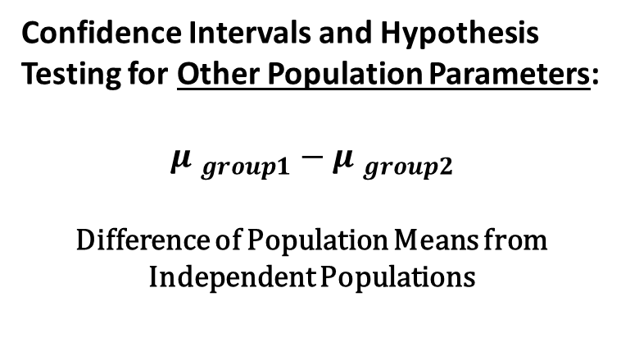
Outline
Confidence Intervals and Hypothesis Testing for Other Population Parameters:
$${μ }_{group1}−{μ }_{group2}$$
Difference of Population Means from Independent Populations

Slide 60

Parameter and point estimate for independent data
🔍
For comparing average salaries in two independent groups
https://www.wsj.com/articles/parsing-the-gender-pay-gap-1542917969
9

Slide 61

Example 2: Gender gap in salaries
🔍
Since 2005, the American Community Survey¹ polls ∼3.5 million households yearly. The following summarizes distribution of salaries of males and females from a random sample of individuals who responded to the 2012 ACS:
 | ¯x | s | n
male | 55,890 | 68,767.88 | 470
female | 29,240 | 32,025.98 | 373
 | ¯x | s | n
male | 55,890 | 68,767.88 | 470
female | 29,240 | 32,025.98 | 373
female
male
0e+00 1e+05 2e+05 3e+05 4e+05
¹Aside: Surge of media attention in spring 2012 when the House of Representatives voted to eliminate the survey. Daniel Webster, Republican congressman from Florida: “in the end this is not a scientiﬁc survey. It’s a random survey.”
5

Slide 62
Example 2: Gender gap in salaries
🔍
Since 2005, the American Community Survey¹ polls ∼3.5 million households yearly. The following summarizes distribution of salaries of males and females from a random sample of individuals who responded to the 2012 ACS:
 | ¯x | s | n
male | 55,890 | 68,767.88 | 470
female | 29,240 | 32,025.98 | 373
Identifying an Independent Means Test
Observations in one population have no explicit or obvious pairing with another observation in the other population.
Pairing | Male | female
 | $30K
 |  | $50K
… | … | …
?
?
?
5

Slide 63
Example 2: Gender gap in salaries
🔍
Since 2005, the American Community Survey¹ polls ∼3.5 million households yearly. The following summarizes distribution of salaries of males and females from a random sample of individuals who responded to the 2012 ACS:
 | ¯x | s | n
male | 55,890 | 68,767.88 | 470
female | 29,240 | 32,025.98 | 373
Identifying an Independent Means Test
Observations in one population have no explicit or obvious pairing with another observation in the other population.
If the sample sizes are different → NOT a paired means test!
Pairing | Male | female
 | $30K
 |  | $50K
… | … | …
?
?
?
5

Slide 64
🔍
Parameter and point estimate for independent data
For comparing average salaries in two independent groups
▶ Parameter of interest: Average difference between the average salaries of all males and females in the US.
µ_{m} − µ_{f}
9

Slide 65

For comparing average salaries in two independent groups
🔍
Parameter and point estimate for independent data
▶ Parameter of interest: Average difference between the average salaries of all males and females in the US.
µ_{m} − µ_{f}
▶ Point estimate: Average difference between the average salaries of sampled males and females in the US.
$${\overline{(x}}_{1}−{\overline{x}}_{2)}$$
9

Slide 66

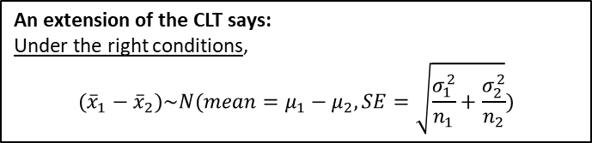
🔍
Standard errors
▶ Independent groups (e.g. grades of students across two
sections)
An extension of the CLT says:
Under the right conditions,
$$({\overline{x}}_{1}−{\overline{x}}_{2})\sim N(mean=μ_{1}−μ_{2}, SE=\sqrt{\frac{σ_{1}^{2}}{n_{1}}+\frac{σ_{2}^{2}}{n_{2}}})$$
▶ For the same data, SE_{paired} < SE_{independent}, so be careful about calling data paired
10

Slide 67
3. All other details of the inferential framework is the same...
🔍 👫
_{HT : test statistic =} point estimate − null
SE
CI : point estimate ± critical value × SE
11

Slide 68
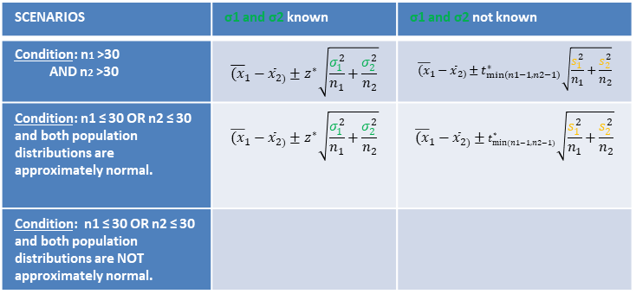
2. T corrects for uncertainty introduced by plugging in s for σ
🔍 👫
Making a Confidence Interval for µ1 -µ2 with CLT
Independence between Groups
✓both populations are independent.
Independence within Groups
✓Random sampling/assignment is used for both samples
✓ Sample size n1 < 10% of population 1 and sample size n2 < 10% of population 2.
✓ One of the available Sample Size/Skewness “Scenarios” is met
SCENARIOS | σ1 and σ2 known | σ1 and σ2 not known
Condition: n1 >30 AND n2 >30 | $${\overline{(x}}_{1}−{\overline{x}}_{2)}±z^{∗}\sqrt{\frac{σ_{1}^{2}}{n_{1}}+\frac{σ_{2}^{2}}{n_{2}}}$$ | $${\overline{(x}}_{1}−{\overline{x}}_{2)}±t_{min⁡(n1−1,n2−1)}^{∗}\sqrt{\frac{s_{1}^{2}}{n_{1}}+\frac{s_{2}^{2}}{n_{2}}}$$
Condition: n1 ≤ 30 OR n2 ≤ 30 and both population distributions are approximately normal. | $${\overline{(x}}_{1}−{\overline{x}}_{2)}±z^{∗}\sqrt{\frac{σ_{1}^{2}}{n_{1}}+\frac{σ_{2}^{2}}{n_{2}}}$$ | $${\overline{(x}}_{1}−{\overline{x}}_{2)}±t_{min⁡(n1−1,n2−1)}^{∗}\sqrt{\frac{s_{1}^{2}}{n_{1}}+\frac{s_{2}^{2}}{n_{2}}}$$
Condition: n1 ≤ 30 OR n2 ≤ 30 and both population distributions are NOT approximately normal.
*Or not extremely skewed (if using t-distribution)
2

Slide 69
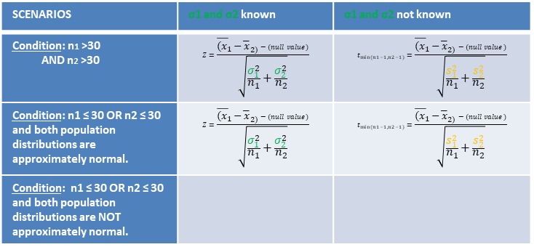
2. T corrects for uncertainty introduced by plugging in s for σ
🔍 👫
Making a Hypothesis Test for µ1 -µ2 with CLT
Independence between Groups
✓both populations are independent.
Independence within Groups
✓Random sampling/assignment is used for both samples
✓ Sample size n1 < 10% of population 1 and sample size n2 < 10% of population 2.
✓ One of the available Sample Size/Skewness “Scenarios” is met
SCENARIOS | σ1 and σ2 known | σ1 and σ2 not known
Condition: n1 >30 AND n2 >30 | $$Z=\frac{{\overline{(x}}_{1}−{\overline{x}}_{2)}−(null value)}{\sqrt{\frac{σ_{1}^{2}}{n_{1}}+\frac{σ_{2}^{2}}{n_{2}}}}$$ | $$t_{min⁡(n1−1,n2−1)}=\frac{{\overline{(x}}_{1}−{\overline{x}}_{2)}−(null value)}{\sqrt{\frac{s_{1}^{2}}{n_{1}}+\frac{s_{2}^{2}}{n_{2}}}}$$
Condition: n1 ≤ 30 OR n2 ≤ 30 and both population distributions are approximately normal. | $$Z=\frac{{\overline{(x}}_{1}−{\overline{x}}_{2)}−(null value)}{\sqrt{\frac{σ_{1}^{2}}{n_{1}}+\frac{σ_{2}^{2}}{n_{2}}}}$$ | $$t_{min⁡(n1−1,n2−1)}=\frac{{\overline{(x}}_{1}−{\overline{x}}_{2)}−(null value)}{\sqrt{\frac{s_{1}^{2}}{n_{1}}+\frac{s_{2}^{2}}{n_{2}}}}$$
Condition: n1 ≤ 30 OR n2 ≤ 30 and both population distributions are NOT approximately normal.
Test Stat
Test Stat
Test Stat
Test Stat
*Or not extremely skewed
2

Slide 70
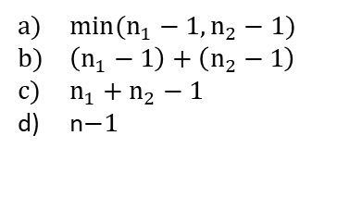
Clicker question
Suppose an independent means test has a sample size of n1 in the first group and n2 in the second group. What degrees of freedom would you use in the t-distribution if you were constructing a confidence interval or calculating a p-value, using a t-distribution?
$min⁡(n_{1}−1,n_{2}−1)$
$\left(n_{1}−1\right)+\left(n_{2}−1\right)$
$n_{1}+n_{2}−1$
n$−1$

Slide 71
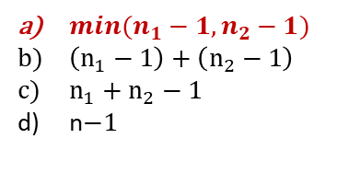
Clicker question
Suppose an independent means test has a sample size of n1 in the first group and n2 in the second group. What degrees of freedom would you use in the t-distribution if you were constructing a confidence interval or calculating a p-value, using a t-distribution?
$min⁡(n_{1}−1,n_{2}−1)$
$\left(n_{1}−1\right)+\left(n_{2}−1\right)$
$n_{1}+n_{2}−1$
n$−1$

Slide 72
Outline
1. Housekeeping
Main ideas
  Problem: Extra uncertainty is introduced into CLT hypothesis testing and confidence intervals when we plug in s for σ.
    Old Solution (from Unit 3): When we don’t know σ, only proceed with CLT hypothesis testing (or confidence interval) if n>30. But we still have some unaccounted for uncertainty of approximating σ with s.
    Better Solution (Use from Now on):
      🔍 👫 ⚙ Use T-distribution instead of Z-distribution when you plug in s for σ
  Other Hypothesis Tests and Confidence Intervals you Can Make:
      🔍 When comparing means of two groups, details depend on paired or independent
      🔍 All other details of the inferential framework is the same...

Slide 73
3. All other details of the inferential framework is the same...
🔍 👫
_{HT : test statistic =} point estimate − null
SE
11

Slide 74
3. All other details of the inferential framework is the same...
🔍 👫
_{HT : test statistic =} point estimate − null
SE
CI : point estimate ± critical value × SE
11

