Slide 1
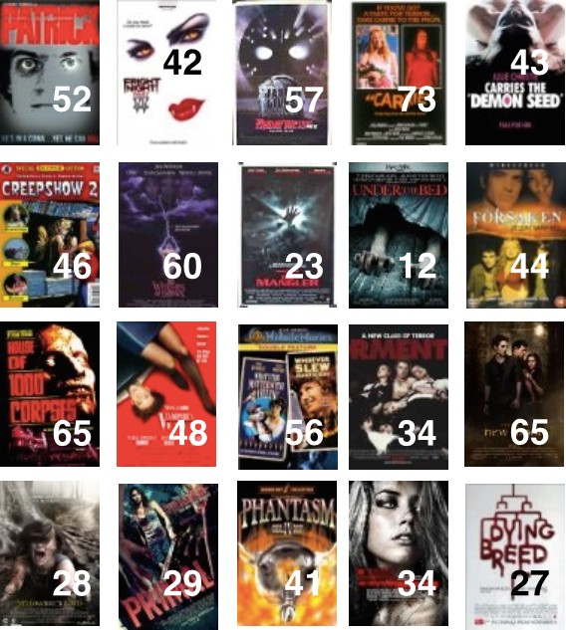

Unit 4: Inference for numerical data
2. Bootstrapping
Sta 101 – Spring 2019
Duke University, Department of Statistical Science
Dr. Ellison
Slides posted at https://www2.stat.duke.edu/courses/Spring19/sta101.001/

Slide 2
Outline
Housekeeping
Main ideas
Problem: We can’t make CLT confidence intervals or hypothesis tests for MEDIANS.
Solution: Use Bootstrapping (a simulation method).
🔍 ✋ Bootstrapping = sampling with replacement from the observed sample
🔍 Bootstrap percentile intervals: middle XX% of the bootstrap distribution
🔍 Bootstrap SE intervals: point estimate ± ME
🆕 Bootstrap testing for a single numerical variable requires shifting the bootstrap distribution to be centered at the null value

Slide 3
Announcements
Coming up…
▶ Lab Assignment 6 is due Thursday just before your lab section time.
▶ Peer Evaluations is due Thursday 2/28 11:55pm (part of your participation grade)
▶ Read over project statement before Thursday 2/28
(see Sakai Resources)
▶ Project Stage 1 is due Thursday 3/7
1

Slide 4
Outline
Housekeeping
Main ideas
Problem: We can’t make CLT confidence intervals or hypothesis tests for MEDIANS.
Solution: Use Bootstrapping (a simulation method).
🔍 ✋ Bootstrapping = sampling with replacement from the observed sample
🔍 Bootstrap percentile intervals: middle XX% of the bootstrap distribution
🔍 Bootstrap SE intervals: point estimate ± ME
🆕 Bootstrap testing for a single numerical variable requires shifting the bootstrap distribution to be centered at the null value

Slide 5
Rotten horrors
✋
is a movie aggregator, where the audience is also able to review and score the movies. We want to estimate the median audience score of horror movies on RottenTomatoes.com. We start with a random sample of 20 horror movies.

Slide 6
✋
Data
title audience_score
1 | Patrick | 52
2 | Demon Seed | 43
3 | Tormented | 34
4 | Under the Bed | 12
5 | Phantasm IV: Oblivion | 41
6 | Fright Night Part 2 | 42
7 | House of 1000 Corpses | 65
8 | Creepshow 2 | 46
9 | The Forsaken | 44
10 | All the Boys Love Mandy Lane | 34
11 Jason | Lives: Friday the 13th Part VI | 57
12 | Vampire's Kiss | 48
13 | The Witches of Eastwick | 60
14 | Yellowbrickroad | 28
15 | Dying Breed | 27
16 | Carrie | 73
17 | Whoever Slew Auntie Roo? | 56
18 | The Mangler | 23
19 | Primal | 29
20 | The Twilight Saga: New Moon | 65

Slide 7
First look
🔍
👫
The histogram below shows the distribution of the audience scores of these movies (ranging from 0 to 100). The median score in the sample is 43.5. Can we apply CLT based methods we have learned so far to construct a conﬁdence interval for the median RottenTomatoes score of horror movies. Why or why not?
6
4
2
0
10
20
30 40 50 60
audience scores
70
80

Slide 8
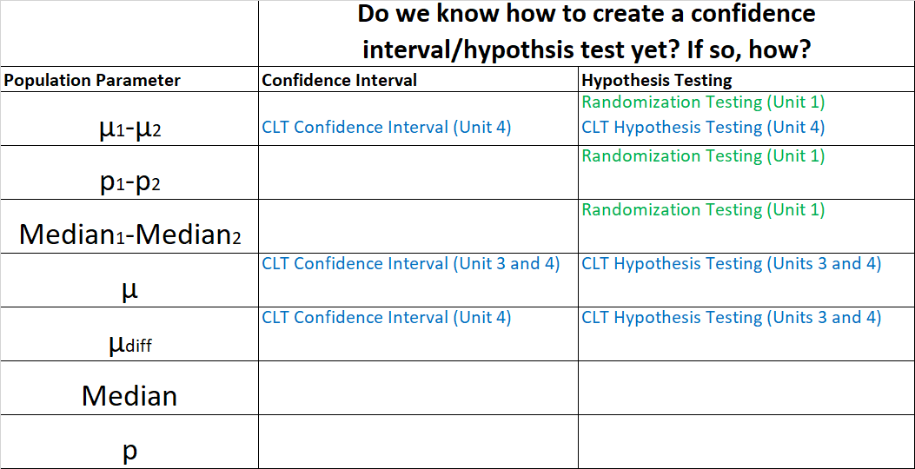
Outline
Recap… what we can do so far…

Slide 9
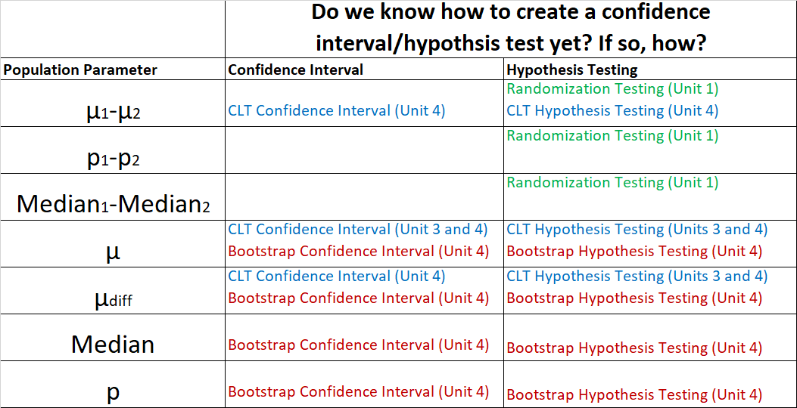
Outline
What we can do after today…

Slide 10
Outline
🔍
What are some reasons to use bootstrapping methods to create a confidence interval or conduct a hypothesis test instead of CLT-based methods?
The population parameter of interest is _________.
The conditions for CLT-based methods are ______ strict. In bootstrapping methods you don’t need:
___________________________________
___________________________________
Therefore you can create a confidence interval or conduct a hypothesis test on population parameters like _____, ______, _______ under less strict conditions.

Slide 11
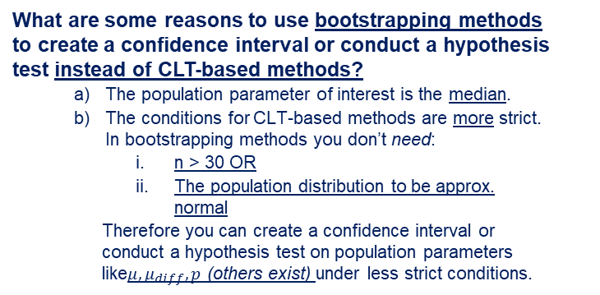
Outline
🔍
What are some reasons to use bootstrapping methods to create a confidence interval or conduct a hypothesis test instead of CLT-based methods?
The population parameter of interest is the median.
The conditions for CLT-based methods are more strict. In bootstrapping methods you don’t need:
n > 30 OR
The population distribution to be approx. normal
Therefore you can create a confidence interval or conduct a hypothesis test on population parameters like$μ, μ_{diff},p$ (others exist) under less strict conditions.

Slide 12
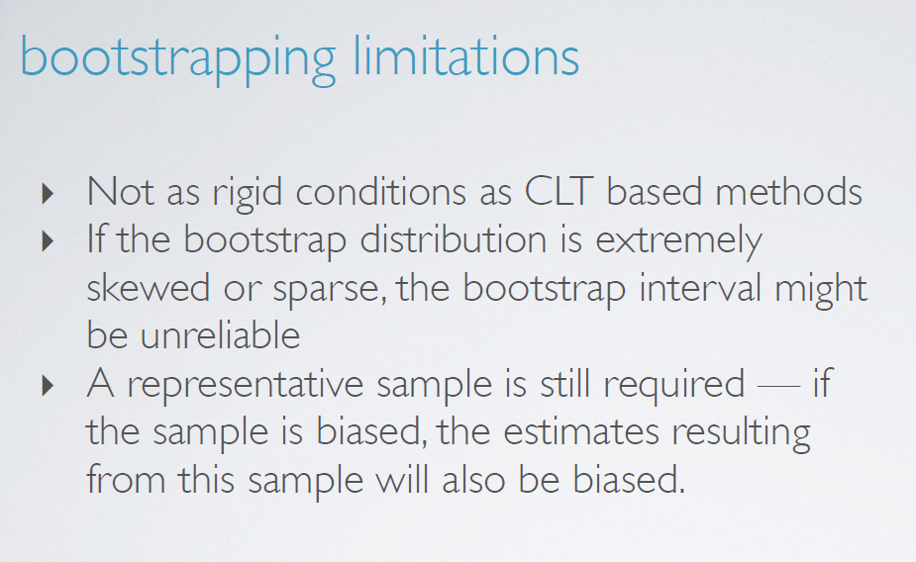
Outline
🔍
From videos…
Some CLT conditions still do apply however: Sample should be random.

Slide 13
Bootstrapping
🔍
▶ An alternative approach to constructing conﬁdence intervals is bootstrapping.
5

Slide 14
Bootstrapping
🔍
▶ An alternative approach to constructing conﬁdence intervals is bootstrapping.
▶ This term comes from the phrase “pulling oneself up by one’s bootstraps”, which is a metaphor for accomplishing an impossible task without any outside help.
5

Slide 15

Bootstrapping
🔍
▶ An alternative approach to constructing conﬁdence intervals is bootstrapping.
▶ This term comes from the phrase “pulling oneself up by one’s bootstraps”, which is a metaphor for accomplishing an impossible task without any outside help.
▶ In this case the impossible task is estimating a population parameter, and we’ll accomplish it using data from only the given sample.
5

Slide 16
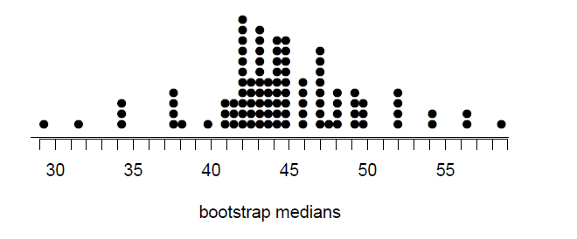
Outline
🔍
How do we make a confidence interval using bootstrapping?
Step 1: Create a bootstrap distribution.

Slide 17
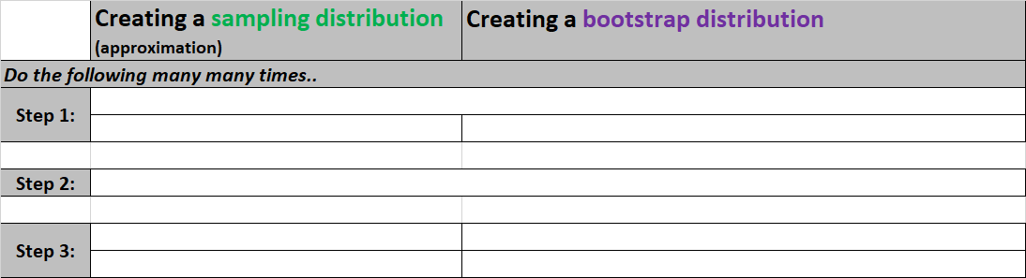
Bootstrapping
🔍
Step 1: Create the bootstrap distribution
For comparison
6

Slide 18
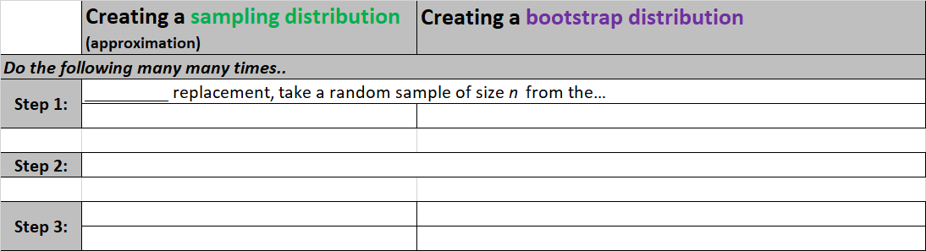
Bootstrapping
🔍
Step 1: Create the bootstrap distribution
For comparison
6

Slide 19
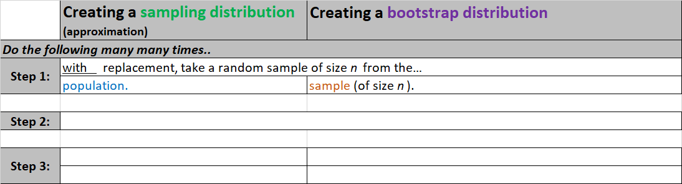
Bootstrapping
🔍
Step 1: Create the bootstrap distribution
For comparison
6

Slide 20
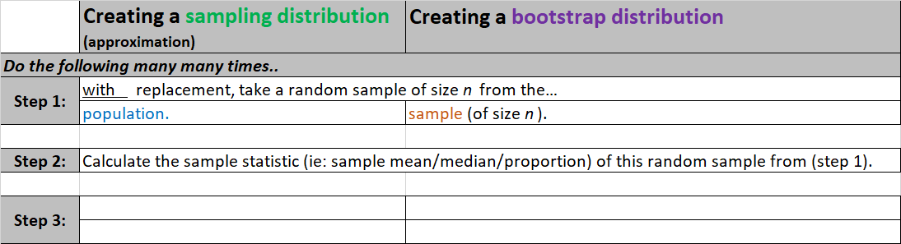
Bootstrapping
🔍
Step 1: Create the bootstrap distribution
For comparison
6

Slide 21
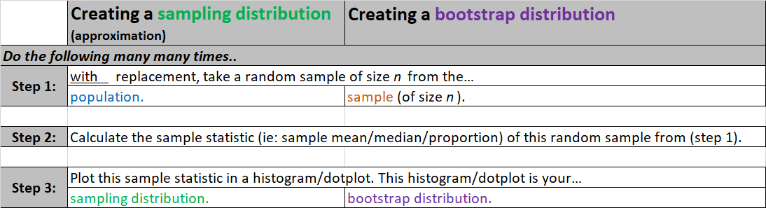
Bootstrapping
🔍
Step 1: Create the bootstrap distribution
For comparison
6

Slide 22
Bootstrapping
🔍
Step 1: Create the bootstrap distribution
aka:bootstrap sample
aka:bootstrap statistic
For comparison
6

Slide 23
Outline
🔍
How do we make a confidence interval using bootstrapping?
Step 1: Create a bootstrap distribution.
Step 2: Use the bootstrap distribution to create your confidence interval.

Slide 24
Bootstrapping
Step 2: Use the bootstrap distribution to create a confidence interval.
Percentile Method
XX% bootstrap confidence interval =
the cutoff values for the middle
XX% of the bootstrap distribution
6

Slide 25
Bootstrapping
Step 2: Use the bootstrap distribution to create a confidence interval.
Percentile Method
XX% bootstrap confidence interval =
the cutoff values for the middle
XX% of the bootstrap distribution
Standard Error Method
XX% bootstrap confidence interval =
point estimate ± t⋆SE_{boot}
6

Slide 26

Bootstrapping
Step 2: Use the bootstrap distribution to create a confidence interval.
Percentile Method
XX% bootstrap confidence interval =
the cutoff values for the middle
XX% of the bootstrap distribution
Standard Error Method
XX% bootstrap confidence interval =
point estimate ± t⋆SE_{boot}
Standard deviation of all the bootstrap statistics you calculated
When the point estimate is: $median, μ, μ_{diff},p$
degrees of freedom = n-1 (n = size of the original sample = each bootstrap sample)
area under t-distribution curve =(1-XX/100)% TWO TAILS.
6

Slide 27
Outline
🔍
Let’s make a bootstrap confidence interval for the population median audience score!
Step 1: Create a bootstrap distribution.

Slide 28
🔍
Bootstrap sample 1
(1) Take a bootstrap sample:
7

Slide 29
Bootstrap sample 1
🔍 ✋
(1) Take a bootstrap sample:
title audience_score
1 | Vampire's Kiss | 48
2 | Phantasm IV: Oblivion | 41
3 | House of 1000 Corpses | 65
4 | Dying Breed | 27
5 | Whoever Slew Auntie Roo? | 56
6 | The Forsaken | 44
7 | The Twilight Saga: New Moon | 65
8 | The Twilight Saga: New Moon | 65
9 | Whoever Slew Auntie Roo? | 56
10 | The Twilight Saga: New Moon | 65
11 | The Mangler | 23
12 | Dying Breed | 27
13 | Creepshow 2 | 46
14 | House of 1000 Corpses | 65
15 | Whoever Slew Auntie Roo? | 56
16 | Tormented | 34
17 Jason | Lives: Friday the 13th Part VI | 57
18 | Vampire's Kiss | 48
19 | Primal | 29
20 | The Witches of Eastwick | 60
(2) Calculate the median of the bootstrap sample:
7

Slide 30
Bootstrap sample 1
🔍 ✋
(1) Take a bootstrap sample:
title audience_score
1 | Vampire's Kiss | 48
2 | Phantasm IV: Oblivion | 41
3 | House of 1000 Corpses | 65
4 | Dying Breed | 27
5 | Whoever Slew Auntie Roo? | 56
6 | The Forsaken | 44
7 | The Twilight Saga: New Moon | 65
8 | The Twilight Saga: New Moon | 65
9 | Whoever Slew Auntie Roo? | 56
10 | The Twilight Saga: New Moon | 65
11 | The Mangler | 23
12 | Dying Breed | 27
13 | Creepshow 2 | 46
14 | House of 1000 Corpses | 65
15 | Whoever Slew Auntie Roo? | 56
16 | Tormented | 34
17 Jason | Lives: Friday the 13th Part VI | 57
18 | Vampire's Kiss | 48
19 | Primal | 29
20 | The Witches of Eastwick | 60
(2) Calculate the median of the bootstrap sample:
23, 27, 27, 29, 34, 41, 44, 46, 48, 48, 56, 56, 56, 57, 60, 65, 65, 65, 65, 65
median = (48 + 56) / 2 = 52
7

Slide 31
Bootstrap sample 1
🔍 ✋
(1) Take a bootstrap sample:
title audience_score
1 | Vampire's Kiss | 48
2 | Phantasm IV: Oblivion | 41
3 | House of 1000 Corpses | 65
4 | Dying Breed | 27
5 | Whoever Slew Auntie Roo? | 56
6 | The Forsaken | 44
7 | The Twilight Saga: New Moon | 65
8 | The Twilight Saga: New Moon | 65
9 | Whoever Slew Auntie Roo? | 56
10 | The Twilight Saga: New Moon | 65
11 | The Mangler | 23
12 | Dying Breed | 27
13 | Creepshow 2 | 46
14 | House of 1000 Corpses | 65
15 | Whoever Slew Auntie Roo? | 56
16 | Tormented | 34
17 Jason | Lives: Friday the 13th Part VI | 57
18 | Vampire's Kiss | 48
19 | Primal | 29
20 | The Witches of Eastwick | 60
Calculate the median of the bootstrap sample:
23, 27, 27, 29, 34, 41, 44, 46, 48, 48, 56, 56, 56, 57, 60, 65, 65, 65, 65, 65
median = (48 + 56) / 2 = 52
Plot this value
7

Slide 32
Bootstrap sample 1
🔍 ✋
(1) Take a bootstrap sample:
title audience_score
1 | Vampire's Kiss | 48
2 | Phantasm IV: Oblivion | 41
3 | House of 1000 Corpses | 65
4 | Dying Breed | 27
5 | Whoever Slew Auntie Roo? | 56
6 | The Forsaken | 44
7 | The Twilight Saga: New Moon | 65
8 | The Twilight Saga: New Moon | 65
9 | Whoever Slew Auntie Roo? | 56
10 | The Twilight Saga: New Moon | 65
11 | The Mangler | 23
12 | Dying Breed | 27
13 | Creepshow 2 | 46
14 | House of 1000 Corpses | 65
15 | Whoever Slew Auntie Roo? | 56
16 | Tormented | 34
17 Jason | Lives: Friday the 13th Part VI | 57
18 | Vampire's Kiss | 48
19 | Primal | 29
20 | The Witches of Eastwick | 60
Calculate the median of the bootstrap sample:
23, 27, 27, 29, 34, 41, 44, 46, 48, 48, 56, 56, 56, 57, 60, 65, 65, 65, 65, 65
median = (48 + 56) / 2 = 52
Plot this value
A bootstrap statistic (median)
7

Slide 33
🔍 ✋
Bootstrap sample 2
(1) Take another bootstrap sample:
8

Slide 34
🔍 ✋
Bootstrap sample 2
(1) Take another bootstrap sample:
title audience_score
1 |  | Fright Night Part 2 | 42
2 |  | Carrie | 73
3 |  | The Forsaken | 44
4 |  | The Mangler | 23
5 |  | Primal | 29
6 |  | Patrick | 52
7 Jason Lives: |  | Friday the 13th Part VI | 57
8 | The Mangler |  | 23
9 | Vampire's Kiss |  | 48
10 | All the Boys Love Mandy Lane |  | 34
11 | The Twilight Saga: New Moon |  | 65
12 | All the Boys Love Mandy Lane |  | 34
13 | Yellowbrickroad |  | 28
14 | Vampire's Kiss |  | 48
15 | Tormented |  | 34
16 | The Mangler |  | 23
17 | Phantasm IV: Oblivion |  | 41
18 | Patrick |  | 52
19 | House of 1000 Corpses |  | 65
20 | The Twilight Saga: New Moon |  | 65
8

Slide 35
Bootstrap sample 2
🔍 ✋
(1) Take another bootstrap sample:
title audience_score
1 |  | Fright Night Part 2 | 42
2 |  | Carrie | 73
3 |  | The Forsaken | 44
4 |  | The Mangler | 23
5 |  | Primal | 29
6 |  | Patrick | 52
7 Jason Lives: |  | Friday the 13th Part VI | 57
8 | The Mangler |  | 23
9 | Vampire's Kiss |  | 48
10 | All the Boys Love Mandy Lane |  | 34
11 | The Twilight Saga: New Moon |  | 65
12 | All the Boys Love Mandy Lane |  | 34
13 | Yellowbrickroad |  | 28
14 | Vampire's Kiss |  | 48
15 | Tormented |  | 34
16 | The Mangler |  | 23
17 | Phantasm IV: Oblivion |  | 41
18 | Patrick |  | 52
19 | House of 1000 Corpses |  | 65
20 | The Twilight Saga: New Moon |  | 65
(2) Calculate the median of the bootstrap sample:
8

Slide 36
Bootstrap sample 2
🔍 ✋
(1) Take another bootstrap sample:
title audience_score
1 |  | Fright Night Part 2 | 42
2 |  | Carrie | 73
3 |  | The Forsaken | 44
4 |  | The Mangler | 23
5 |  | Primal | 29
6 |  | Patrick | 52
7 Jason Lives: |  | Friday the 13th Part VI | 57
8 | The Mangler |  | 23
9 | Vampire's Kiss |  | 48
10 | All the Boys Love Mandy Lane |  | 34
11 | The Twilight Saga: New Moon |  | 65
12 | All the Boys Love Mandy Lane |  | 34
13 | Yellowbrickroad |  | 28
14 | Vampire's Kiss |  | 48
15 | Tormented |  | 34
16 | The Mangler |  | 23
17 | Phantasm IV: Oblivion |  | 41
18 | Patrick |  | 52
19 | House of 1000 Corpses |  | 65
20 | The Twilight Saga: New Moon |  | 65
(2) Calculate the median of the bootstrap sample:
23, 23, 23, 28, 29, 34, 34, 34, 41, 42, 44, 48, 48, 52, 52, 57, 65, 65, 65, 73
median = (42 + 44) / 2 = 43
8

Slide 37
Bootstrap sample 2
🔍 ✋
(1) Take another bootstrap sample:
title audience_score
1 |  | Fright Night Part 2 | 42
2 |  | Carrie | 73
3 |  | The Forsaken | 44
4 |  | The Mangler | 23
5 |  | Primal | 29
6 |  | Patrick | 52
7 Jason Lives: |  | Friday the 13th Part VI | 57
8 | The Mangler |  | 23
9 | Vampire's Kiss |  | 48
10 | All the Boys Love Mandy Lane |  | 34
11 | The Twilight Saga: New Moon |  | 65
12 | All the Boys Love Mandy Lane |  | 34
13 | Yellowbrickroad |  | 28
14 | Vampire's Kiss |  | 48
15 | Tormented |  | 34
16 | The Mangler |  | 23
17 | Phantasm IV: Oblivion |  | 41
18 | Patrick |  | 52
19 | House of 1000 Corpses |  | 65
20 | The Twilight Saga: New Moon |  | 65
Calculate the median of the bootstrap sample:
23, 23, 23, 28, 29, 34, 34, 34, 41, 42, 44, 48, 48, 52, 52, 57, 65, 65, 65, 73
median = (42 + 44) / 2 = 43
Plot this value
…Another bootstrap statistic (median)
8

Slide 38
🔍 ✋
Bootstrap sample 3
(1) Take another bootstrap sample:
9

Slide 39
🔍 ✋
Bootstrap sample 3
(1) Take another bootstrap sample:
title audience_score
1 | Tormented | 34
2 | The Witches of Eastwick | 60
3 | The Witches of Eastwick | 60
4 | The Witches of Eastwick | 60
5 | The Mangler | 23
6 | The Witches of Eastwick | 60
7 | Patrick | 52
8 | Phantasm IV: Oblivion | 41
9 | Yellowbrickroad | 28
10 Jason | Lives: Friday the 13th Part VI | 57
11 | Yellowbrickroad | 28
12 Jason | Lives: Friday the 13th Part VI | 57
13 | Fright Night Part 2 | 42
14 | Primal | 29
15 | Fright Night Part 2 | 42
16 | Whoever Slew Auntie Roo? | 56
17 | Fright Night Part 2 | 42
18 | Fright Night Part 2 | 42
19 | Under the Bed | 12
20 | Phantasm IV: Oblivion | 41
9

Slide 40
Bootstrap sample 3
🔍 ✋
(1) Take another bootstrap sample:
title audience_score
1 | Tormented | 34
2 | The Witches of Eastwick | 60
3 | The Witches of Eastwick | 60
4 | The Witches of Eastwick | 60
5 | The Mangler | 23
6 | The Witches of Eastwick | 60
7 | Patrick | 52
8 | Phantasm IV: Oblivion | 41
9 | Yellowbrickroad | 28
10 Jason | Lives: Friday the 13th Part VI | 57
11 | Yellowbrickroad | 28
12 Jason | Lives: Friday the 13th Part VI | 57
13 | Fright Night Part 2 | 42
14 | Primal | 29
15 | Fright Night Part 2 | 42
16 | Whoever Slew Auntie Roo? | 56
17 | Fright Night Part 2 | 42
18 | Fright Night Part 2 | 42
19 | Under the Bed | 12
20 | Phantasm IV: Oblivion | 41
(2) Calculate the median of the bootstrap sample:
9

Slide 41
Bootstrap sample 3
🔍 ✋
(1) Take another bootstrap sample:
title audience_score
1 | Tormented | 34
2 | The Witches of Eastwick | 60
3 | The Witches of Eastwick | 60
4 | The Witches of Eastwick | 60
5 | The Mangler | 23
6 | The Witches of Eastwick | 60
7 | Patrick | 52
8 | Phantasm IV: Oblivion | 41
9 | Yellowbrickroad | 28
10 Jason | Lives: Friday the 13th Part VI | 57
11 | Yellowbrickroad | 28
12 Jason | Lives: Friday the 13th Part VI | 57
13 | Fright Night Part 2 | 42
14 | Primal | 29
15 | Fright Night Part 2 | 42
16 | Whoever Slew Auntie Roo? | 56
17 | Fright Night Part 2 | 42
18 | Fright Night Part 2 | 42
19 | Under the Bed | 12
20 | Phantasm IV: Oblivion | 41
(2) Calculate the median of the bootstrap sample:
12, 23, 28, 28, 29, 34, 41, 41, 42, 42, 42, 42, 52, 56, 57, 57, 60, 60, 60, 60
median = (42 + 42) / 2 = 42
9

Slide 42
Bootstrap sample 3
(1) Take another bootstrap sample:
title audience_score
1 | Tormented | 34
2 | The Witches of Eastwick | 60
3 | The Witches of Eastwick | 60
4 | The Witches of Eastwick | 60
5 | The Mangler | 23
6 | The Witches of Eastwick | 60
7 | Patrick | 52
8 | Phantasm IV: Oblivion | 41
9 | Yellowbrickroad | 28
10 Jason | Lives: Friday the 13th Part VI | 57
11 | Yellowbrickroad | 28
12 Jason | Lives: Friday the 13th Part VI | 57
13 | Fright Night Part 2 | 42
14 | Primal | 29
15 | Fright Night Part 2 | 42
16 | Whoever Slew Auntie Roo? | 56
17 | Fright Night Part 2 | 42
18 | Fright Night Part 2 | 42
19 | Under the Bed | 12
20 | Phantasm IV: Oblivion | 41
Calculate the median of the bootstrap sample:
12, 23, 28, 28, 29, 34, 41, 41, 42, 42, 42, 42, 52, 56, 57, 57, 60, 60, 60, 60
median = (42 + 42) / 2 = 42
Plot this value
…and another bootstrap statistic (median)
9

Slide 43
🔍 ✋
Many more bootstrap samples
... repeat
Bootstrap Distribution
10

Slide 44
Clicker question
🔍 ✋
The dot plot below is the bootstrap distribution of medians constructed using 100 simulations. What does each dot on the dot plot represent?
Bootstrap Distribution
Score of a horror movie in the original sample
Score of a horror movie in the population
Median from one bootstrap sample from the original sample
(d) Median from one sample from the population
11

Slide 45
Clicker question
🔍 ✋
The dot plot below is the bootstrap distribution of medians constructed using 100 simulations. What does each dot on the dot plot represent?
Bootstrap Distribution
Score of a horror movie in the original sample (sample dist)
Score of a horror movie in the population (population dist)
Median from one bootstrap sample from the original sample (boostrap dist)
(d) Median from one sample from the population (sampling dist)
11

Slide 46
Outline
Housekeeping
Main ideas
Problem: We can’t make CLT confidence intervals or hypothesis tests for MEDIANS.
Solution: Use Bootstrapping (a simulation method).
🔍 ✋ Bootstrapping = sampling with replacement from the observed sample
🔍 Bootstrap percentile intervals: middle XX% of the bootstrap distribution
🔍 Bootstrap SE intervals: point estimate ± ME
🆕 Bootstrap testing for a single numerical variable requires shifting the bootstrap distribution to be centered at the null value

Slide 47
Outline
🔍
Let’s make a bootstrap confidence interval for the population median audience score!
Step 1: Create a bootstrap distribution.
Step 2: Use the bootstrap distribution to create a confidence interval. Let’s use the percentile method!

Slide 48
Clicker question
🔍 ✋
The dot plot below shows the distribution of 100 bootstrap medians. Estimate the 90% bootstrap conﬁdence interval for the median RT score of horror movies using the percentile method.
Bootstrap Distribution
(a) (29, 58.5)
(b) (34, 57)
(c) (37.5, 52)
(d) (40, 49.5)
12

Slide 49
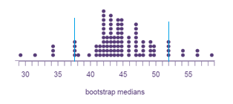
Clicker question
The dot plot below shows the distribution of 100 bootstrap medians. Estimate the 90% bootstrap conﬁdence interval for the median RT score of horror movies using the percentile method.
90% confidence Interval should “hug” the middle 90% of points.
Bootstrap Distribution
(a) (29, 58.5)
(b) (34, 57)
(c) (37.5, 52)
(d) (40, 49.5)
12

Slide 50
Outline
Housekeeping
Main ideas
Problem: We can’t make CLT confidence intervals or hypothesis tests for MEDIANS.
Solution: Use Bootstrapping (a simulation method).
🔍 ✋ Bootstrapping = sampling with replacement from the observed sample
🔍 Bootstrap percentile intervals: middle XX% of the bootstrap distribution
🔍 Bootstrap SE intervals: point estimate ± ME
🆕 Bootstrap testing for a single numerical variable requires shifting the bootstrap distribution to be centered at the null value

Slide 51
Outline
🔍
Let’s make a bootstrap confidence interval for the population median audience score!
Step 1: Create a bootstrap distribution.
Step 2: Use the bootstrap distribution to create a confidence interval. Let’s use the standard error method!

Slide 52

Bootstrap interval, standard error
🔍 ✋
The dot plot below shows the distribution of 100 bootstrap medians. The median of the original sample is 43.5 and the bootstrap standard error is 4.88. Estimate the 90% bootstrap conﬁdence interval for the median RT score of horror movies using the standard error method (remember n = 20).
Bootstrap Distribution
$$(sample median)±t_{n−1}^{∗}{SE}_{bootstrap}$$
13

Slide 53

The dot plot below shows the distribution of 100 bootstrap medians. The median of the original sample is 43.5 and the bootstrap standard error is 4.88. Estimate the 90% bootstrap conﬁdence interval for the median RT score of horror movies using the standard error method (remember n=20).
🔍 ✋
Bootstrap interval, standard error
Bootstrap Distribution
?
$$(sample median)±t_{n−1}^{∗}{SE}_{bootstrap}$$
43.5 ± (1.73 × 4.88) = (35.1, 51.9)
13

Slide 54
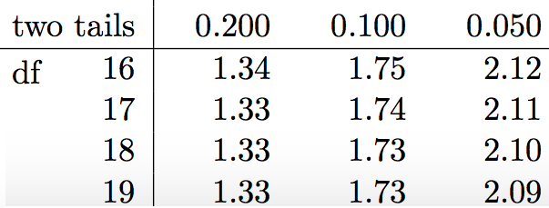
The dot plot below shows the distribution of 100 bootstrap medians. The median of the original sample is 43.5 and the bootstrap standard error is 4.88. Estimate the 90% bootstrap conﬁdence interval for the median RT score of horror movies using the standard error method (remember n=20).
🔍 ✋
Bootstrap interval, standard error
Bootstrap Distribution
$$(sample median)±t_{n−1}^{∗}{SE}_{bootstrap}$$
43.5 ± (1.73 × 4.88) = (35.1, 51.9)
degrees of freedom = 20-1 (n is the size of the original sample)
area under t-distribution curve =(1-.90)=0.10 TWO TAILS.
13

Slide 55
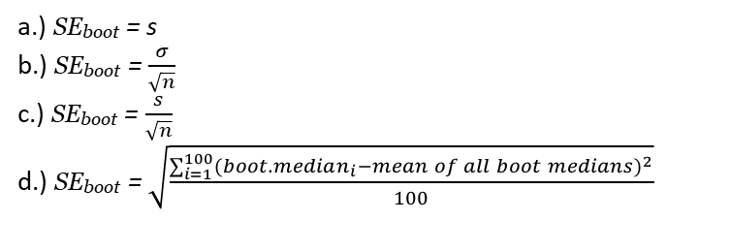
Bootstrapping
Clicker question
How would we calculate the bootstrap standard error (SE_{boot} ) in the bootstrap distribution below?
a.) SE_{boot} = s
b.) SE_{boot} = $\frac{σ}{\sqrt{n}}$
c.) SE_{boot} = $\frac{s}{\sqrt{n}}$
d.) SE_{boot} = $\sqrt{\frac{\sum_{i=1}^{100}{{({boot. median}_{i}−mean of all boot medians)}^{2}}}{100}}$
Bootstrap Distribution
6

Slide 56
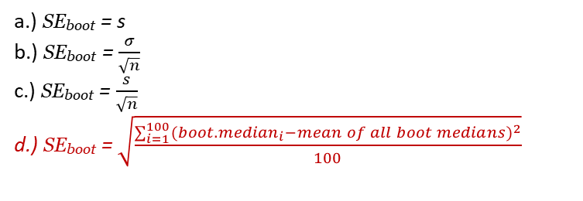
Bootstrapping
Clicker question
How would we calculate the bootstrap standard error (SE_{boot} ) in the bootstrap distribution below?
a.) SE_{boot} = s
b.) SE_{boot} = $\frac{σ}{\sqrt{n}}$
c.) SE_{boot} = $\frac{s}{\sqrt{n}}$
d.) SE_{boot} = $\sqrt{\frac{\sum_{i=1}^{100}{{({boot. median}_{i}−mean of all boot medians)}^{2}}}{100}}$
Bootstrap Distribution
6

Slide 57
Bootstrap vs. sampling distributions
Application exercise: 4.2 Bootstrap intervals
See the course webpage for details.
14

Slide 58
Outline
Housekeeping
Main ideas
Problem: We can’t make CLT confidence intervals or hypothesis tests for MEDIANS.
Solution: Use Bootstrapping (a simulation method).
🔍 ✋ Bootstrapping = sampling with replacement from the observed sample
🔍 Bootstrap percentile intervals: middle XX% of the bootstrap distribution
🔍 Bootstrap SE intervals: point estimate ± ME
🆕 Bootstrap testing for a single numerical variable requires shifting the bootstrap distribution to be centered at the null value

Slide 59
Outline
🆕
Let’s conduct a bootstrap hypothesis test for the population median audience score!

Slide 60
🆕
Do these data provide convincing evidence that the median audience score of horror movies is greater than 40?
Remember that the median of the original sample was 43.5.
Original Bootstrap Distribution
Center: median=45)
Hypotheses:
H₀ : pop. median = 40
H_{A} : pop. median > 40
16

Slide 61
🆕
Do these data provide convincing evidence that the median audience score of horror movies is greater than 40?
Remember that the median of the original sample was 43.5.
Original Bootstrap Distribution
Centered at: 43.5
Center: median=45)
Hypotheses:
H₀ : pop. median = 40
H_{A} : pop. median > 40
16

Slide 62
🆕
Do these data provide convincing evidence that the median audience score of horror movies is greater than 40?
Remember that the median of the original sample was 43.5.
Original Bootstrap Distribution
Centered at: 43.5
Center: median=45)
Hypotheses:
H₀ : pop. median = 40
H_{A} : pop. median > 40
To assess the p-value we want our sampling distribution to:
Assume Ho: median = 40
Be centered at: 40
16

Slide 63
Bootstrap testing for a mean
🆕
▶ This is very similar to bootstrapping, i.e. we randomly sample with replacement from the sample, but this time we shift the bootstrap distribution to be centered at the null value.
15

Slide 64
Bootstrap testing for a mean
🆕
▶ This is very similar to bootstrapping, i.e. we randomly sample with replacement from the sample, but this time we shift the bootstrap distribution to be centered at the null value.
▶ The p-value is then deﬁned as the proportion of simulations that yield a sample statistic at least as extreme as the one observed in the bootstrap distribution that has been shifted to center at the null (aka: the bootstrap distribution that assumes the null value is true).
15

Slide 65
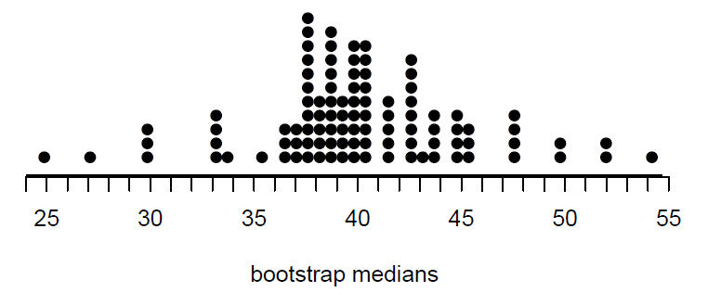
🆕
Do these data provide convincing evidence that the median audience score of horror movies is greater than 40?
Remember that the median of the original sample was 43.5.
Original Bootstrap Distribution
Center: median=45)
Hypotheses:
H₀ : pop. median = 40
H_{A} : pop. median > 40
Shift all points to the left by 3.5
Original Bootstrap Distribution Shifted to be Centered at Null Value (40)
16

Slide 66
🆕
Do these data provide convincing evidence that the median audience score of horror movies is greater than 40?
Remember that the median of the original sample was 43.5.
Hypotheses:
H₀ : pop. median = 40
H_{A} : pop. median > 40
Original Bootstrap Distribution Shifted to be Centered at Null Value (40)
16

Slide 67

🆕
Do these data provide convincing evidence that the median audience score of horror movies is greater than 40?
Remember that the median of the original sample was 43.5.
Hypotheses:
H₀ : pop. median = 40
H_{A} : pop. median > 40
Original Bootstrap Distribution Shifted to be Centered at Null Value (40)
43.5
p-value: proportion of simulations where the simulated bootstrap sample median is at least as extreme as the one observed (43.5). →20/100 = 0.20
100=Total number of bootstrap statistics in the bootstrap dist
16

Slide 68
1. Bootstrapping = sampling with replacement from the observed sample
Summary of main ideas
Bootstrap percentile intervals: middle XX% of the bootstrap distribution
Bootstrap SE intervals: point estimate ± ME
Bootstrap testing for a single numerical variable requires shifting the bootstrap distribution to be centered at the null value
17

