Slide 1

Unit 4: Inference for numerical data
4. ANOVA
Sta 101 - Spring 2019
Duke University, Department of Statistical Science
Dr. Ellison
Slides posted at https://www2.stat.duke.edu/courses/Spring19/sta101.001/

Slide 2
Outline
Housekeeping
Main ideas
Independent Means Hypothesis Testing: Test for an Association Between a Numerical Variable and a Categorical Variable with Two Levels
Problem: What if we want to test for an Association Between a Numerical Variable and a Categorical Variable with MORE THAN TWO Levels?
Solution: Use ANOVA!
    🆕 ⚙ 🔮 Why do we need ANOVA? Comparing many means requires care
    🔍 ANOVA Step 1: ANOVA tests for some diﬀerence in means of many diﬀerent groups
    🔍 ⚙ 👫 How/Why does ANOVA Step 1 Work? ANOVA compares between group variation to within group variation
    🔍 ⚙ ANOVA Step 2: To identify which means are diﬀerent, use t-tests and the Bonferroni correction
Summary

Slide 3
Announcements
Coming up…
▶ Project Stage 1 is due Thursday just before your lab section time.
▶ Problem Set 4 is due Friday 3/8 11:55pm
▶ Performance Assessment 4 is due Sunday 3/17 11:55pm (opens Wednesday)
▶ Readiness Assessment 5 is Monday 3/18
▶ New TA for 10:05 section Melanie Lai Wai
▶ New TA for 3:05 section Tess Chandler

Slide 4
Outline
Housekeeping
Main ideas
Independent Means Hypothesis Testing: Test for an Association Between a Numerical Variable and a Categorical Variable with Two Levels
Problem: What if we want to test for an Association Between a Numerical Variable and a Categorical Variable with MORE THAN TWO Levels?
Solution: Use ANOVA!
    🆕 ⚙ 🔮 Why do we need ANOVA? Comparing many means requires care
    🔍 ANOVA Step 1: ANOVA tests for some diﬀerence in means of many diﬀerent groups
    🔍 ⚙ 👫 How/Why does ANOVA Step 1 Work? ANOVA compares between group variation to within group variation
    🔍 ⚙ ANOVA Step 2: To identify which means are diﬀerent, use t-tests and the Bonferroni correction
Summary

Slide 5
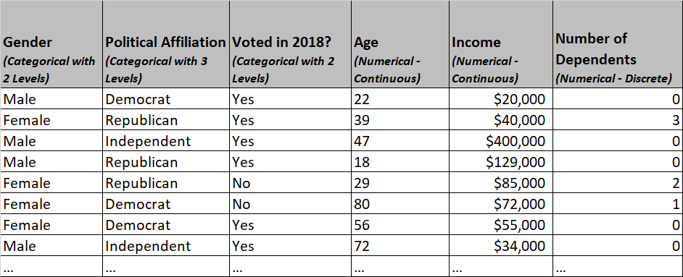
Would we use the same analysis for the following research questions?
“Is there an association between income and gender?”
“Is there an association between income and political affiliation?”
Sample Data

Slide 6

“Is there an association between income and gender?”
Numerical response variable
Categorical explanatory variable with 2 levels
https://www.wsj.com/articles/parsing-the-gender-pay-gap-1542917969

Slide 7

“Is there an association between income and gender?”
Numerical response variable
Categorical explanatory variable with 2 levels
Independent Means Hypothesis Test
*provided necessary conditions are met
$$Ho: μ_{male}−μ_{female}=0$$
$$Ha: μ_{male}−μ_{female}≠0$$
α=0.05
https://www.wsj.com/articles/parsing-the-gender-pay-gap-1542917969

Slide 8
“Is there an association between income and gender?”
Numerical response variable
Categorical explanatory variable with 2 levels
Independent Means Hypothesis Test
*provided necessary conditions are met
$$Ho: μ_{male}−μ_{female}=0$$
$$Ha: μ_{male}−μ_{female}≠0$$
No association
Association
α=0.05
https://www.wsj.com/articles/parsing-the-gender-pay-gap-1542917969

Slide 9
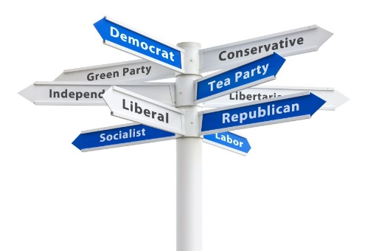
“Is there an association between income and political affiliation?”
Numerical response variable
Categorical explanatory variable with >2 levels

Slide 10
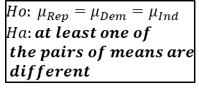
“Is there an association between income and political affiliation?”
Numerical response variable
Categorical explanatory variable with >2 levels
ANOVA
*provided necessary conditions are met
α=0.05
$$Ho: μ_{Rep}=μ_{Dem}=μ_{Ind}$$
$$Ha:at least one of$$
$$the pairs of means are$$
$$different$$

Slide 11
“Is there an association between income and political affiliation?”
Numerical response variable
Categorical explanatory variable with >2 levels
ANOVA
*provided necessary conditions are met
α=0.05
$$Ho: μ_{Rep}=μ_{Dem}=μ_{Ind}$$
$$Ha:at least one of$$
$$the pairs of means are$$
$$different$$
No association
Association

Slide 12



“Is there an association between income and political affiliation?”
Numerical response variable
Categorical explanatory variable with >2 levels
Why should we not just do the following?
$$Ho: μ_{Dem}−μ_{Rep}=0$$
$$Ha: μ_{Dem}−μ_{Rep}≠0$$
α=0.05
$$Ho: μ_{Dem}−μ_{Ind}=0$$
$$Ha: μ_{Dem}−μ_{Ind}≠0$$
α=0.05
$$Ho: μ_{Ind}−μ_{Rep}=0$$
$$Ha: μ_{Ind}−μ_{Rep}≠0$$
α=0.05

Slide 13
“Is there an association between income and political affiliation?”
Numerical response variable
Categorical explanatory variable with >2 levels
See next slides!
$$Ho: μ_{Dem}−μ_{Rep}=0$$
$$Ha: μ_{Dem}−μ_{Rep}≠0$$
α=0.05
$$Ho: μ_{Dem}−μ_{Ind}=0$$
$$Ha: μ_{Dem}−μ_{Ind}≠0$$
α=0.05
$$Ho: μ_{Ind}−μ_{Rep}=0$$
$$Ha: μ_{Ind}−μ_{Rep}≠0$$
α=0.05

Slide 14
Outline
Housekeeping
Main ideas
Independent Means Hypothesis Testing: Test for an Association Between a Numerical Variable and a Categorical Variable with Two Levels
Problem: What if we want to test for an Association Between a Numerical Variable and a Categorical Variable with MORE THAN TWO Levels?
Solution: Use ANOVA!
    🆕 ⚙ 🔮 Why do we need ANOVA? Comparing many means requires care
    🔍 ANOVA Step 1: ANOVA tests for some diﬀerence in means of many diﬀerent groups
    🔍 ⚙ 👫 How/Why does ANOVA Step 1 Work? ANOVA compares between group variation to within group variation
    🔍 ⚙ ANOVA Step 2: To identify which means are diﬀerent, use t-tests and the Bonferroni correction
Summary

Slide 15
Outline
🔮 Why do we need ANOVA?
  Comparing more than two means requires care!

Slide 16
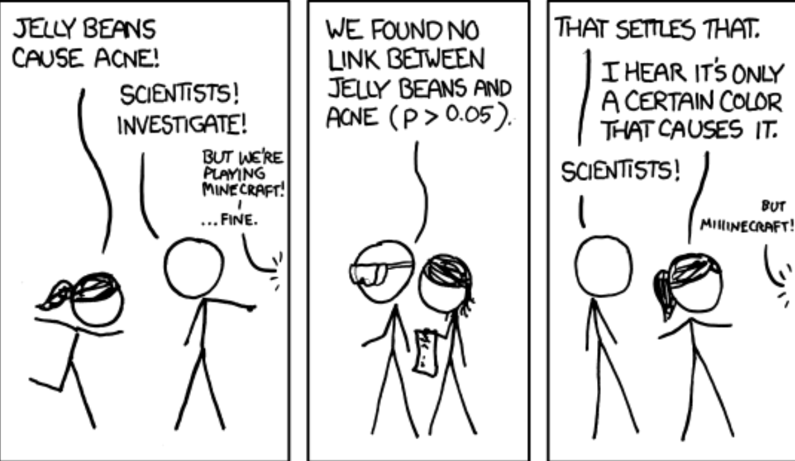
🆕 ⚙ 🔮
NEWS FLASH!
Jelly beans rumored to cause acne!!!
http://imgs.xkcd.com/comics/significant.png

Slide 17

NEWS FLASH!
Jelly beans rumored to cause acne!!!
🆕 ⚙ 🔮
How would you check this rumor? Imagine that doctors can assign an “acne score” to patients on a 0-100 scale.
▶ What would your research question be?
▶ How would you conduct your study?
▶ What statistical test would you use?

Slide 18
NEWS FLASH!
Jelly beans rumored to cause acne!!!
🆕 ⚙ 🔮
How would you check this rumor? Imagine that doctors can assign an “acne score” to patients on a 0-100 scale.
▶ What would your research question be?
▶ How would you conduct your study?
▶ What statistical test would you use?
Research Question: Does eating jelly beans cause acne?

Slide 19
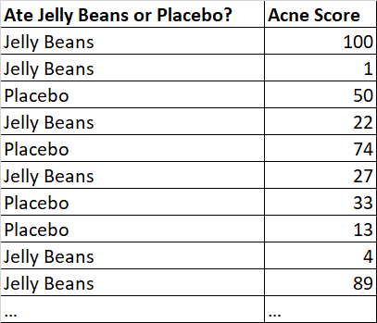
NEWS FLASH!
Jelly beans rumored to cause acne!!!
🆕 ⚙ 🔮
How would you check this rumor? Imagine that doctors can assign an “acne score” to patients on a 0-100 scale.
▶ What would your research question be?
▶ How would you conduct your study?
▶ What statistical test would you use?
Research Question: Does eating jelly beans cause acne?
Random Experiment

Slide 20
NEWS FLASH!
Jelly beans rumored to cause acne!!!
🆕 ⚙ 🔮
How would you check this rumor? Imagine that doctors can assign an “acne score” to patients on a 0-100 scale.
▶ What would your research question be?
▶ How would you conduct your study?
▶ What statistical test would you use?
Research Question: Does eating jelly beans cause acne?
Random Experiment
Use an Independent Means
Hypothesis Test:
H0 : µjelly beans − µplacebo = 0
HA : µjelly beans − µplacebo > 0

Slide 21
NEWS FLASH!
Now they’re saying that it’s only a certain color of jelly bean that causes acne!!!
🆕 ⚙ 🔮
How would you check this rumor? Imagine that doctors can assign an “acne score” to patients on a 0-100 scale.
▶ What would your research question be?
▶ How would you conduct your study?
http://imgs.xkcd.com/comics/significant.png

Slide 22
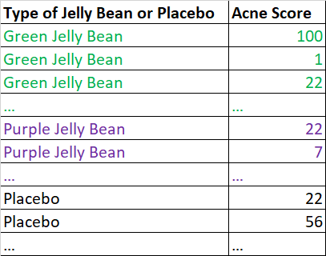
NEWS FLASH!
Now they’re saying that it’s only a certain color of jelly bean that causes acne!!!
🆕 ⚙ 🔮
How would you check this rumor? Imagine that doctors can assign an “acne score” to patients on a 0-100 scale.
▶ What would your research question be?
▶ How would you conduct your study?
Research Question: Does eating a certain color of jelly bean cause you to get acne?
Random Experiment

Slide 23
Suppose α = 0.05. What is the probability of making a Type 1 error (aka: rejecting a null hypothesis like
🆕 ⚙ 🔮
Clicker question
H0 : µpurple jelly bean − µplacebo = 0
when it is actually true)?
(a) | 1%
(b) | 5%
(c) | 36%
(d) | 64%
(e) | 95%

Slide 24
Suppose α = 0.05. What is the probability of making a Type 1 error (aka: rejecting a null hypothesis like
Clicker question
H0 : µpurple jelly bean − µplacebo = 0
when it is actually true)?
(a) | 1%
(b) | 5%
(c) | 36%
(d) | 64%
(e) | 95%

Slide 25
Suppose we want to test 20 different colors of jelly beans versus a placebo with hypotheses like
🆕 ⚙ 🔮 👫
Clicker question
^{H}0 ^{: µ}purple jelly bean ^{− µ}placebo ^{= 0 H}0 ^{: µ}brown jelly bean ^{− µ}placebo ^{= 0 H}0 ^{: µ}peach jelly bean ^{− µ}placebo ⁼ ⁰
...
and we use α = 0.05 for each of these tests. What is the probability of making at least one Type 1 error in these 20 independent tests?
1%
5%
(c) 36%
(d) 64%
(e) 95%

Slide 26
Suppose we want to test 20 different colors of jelly beans versus a placebo with hypotheses like
🆕 ⚙ 🔮 👫
Clicker question
^{H}0 ^{: µ}purple jelly bean ^{− µ}placebo ^{= 0 H}0 ^{: µ}brown jelly bean ^{− µ}placebo ^{= 0 H}0 ^{: µ}peach jelly bean ^{− µ}placebo ⁼ ⁰
...
and we use α = 0.05 for each of these tests. What is the probability of making at least one Type 1 error in these 20 independent tests?
1%
5%
(c) 36%
(d) 64%
Hint: What type of distribution should we consider using if we are asked to find the probability that k (or at least/at most k) out of n independent trials have a certain outcome when we know the probability of any given trial having this outcome is p?
(e) 95%

Slide 27

Suppose we want to test 20 different colors of jelly beans versus a placebo with hypotheses like
🆕 ⚙ 🔮 👫
Clicker question
^{H}0 ^{: µ}purple jelly bean ^{− µ}placebo ^{= 0 H}0 ^{: µ}brown jelly bean ^{− µ}placebo ^{= 0 H}0 ^{: µ}peach jelly bean ^{− µ}placebo ⁼ ⁰
...
and we use α = 0.05 for each of these tests. What is the probability of making at least one Type 1 error in these 20 independent tests?
1%
5%
(c) 36%
(d) 64% → =1-$\left(\begin{matrix}20 \\ 0\end{matrix}\right){0.05}^{0}{(1−0.05)}^{20−0}$
X=# of tests out of 20 that make a type 1 error
X~Bin(n=20,p=0.05)
P(X≥1)= 1-P(X=0)
(e) 95%

Slide 28
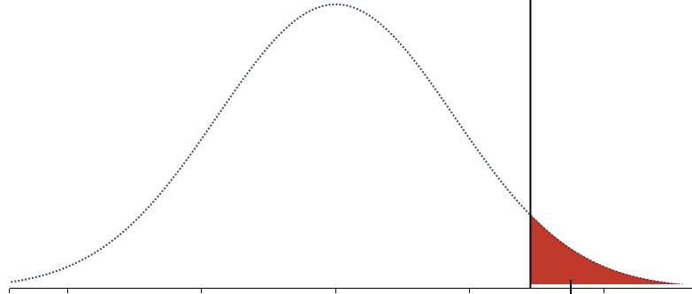
Outline
🔮 Running multiple independent means hypothesis tests to answer just one research question will result in a higher probability of making at least one Type 1 Error.

Slide 29
Outline
Housekeeping
Main ideas
Independent Means Hypothesis Testing: Test for an Association Between a Numerical Variable and a Categorical Variable with Two Levels
Problem: What if we want to test for an Association Between a Numerical Variable and a Categorical Variable with MORE THAN TWO Levels?
Solution: Use ANOVA!
    🆕 ⚙ 🔮 Why do we need ANOVA? Comparing many means requires care
    🔍 ANOVA Step 1: ANOVA tests for some diﬀerence in means of many diﬀerent groups
    🔍 ⚙ 👫 How/Why does ANOVA Step 1 Work? ANOVA compares between group variation to within group variation
    🔍 ⚙ ANOVA Step 2: To identify which means are diﬀerent, use t-tests and the Bonferroni correction
Summary

Slide 30
Outline
Step 0 of ANOVA: Check conditions.
Step 1 of ANOVA:
Assess the following hypotheses.
H0 : µplacebo = µpurple = µbrown = . . . = µpeach = µorange.
Ha : __________________________________________________

Slide 31
🔍
ANOVA tests for some diﬀerence in means of many diﬀerent groups
Null hypothesis:
H0 : µplacebo = µpurple = µbrown = . . . = µpeach = µorange.
Clicker question
Which of the following is a correct statement of the alternative hypothesis?
For any two groups, including the placebo group, no two group means are the same.
For any two groups, not including the placebo group, no two group means are the same.
Amongst the jelly bean groups, there are at least two groups that have different group means from each other.
Amongst all groups, there are at least two groups that have different group means from each other.

Slide 32
🔍
ANOVA tests for some diﬀerence in means of many diﬀerent groups
Null hypothesis:
H0 : µplacebo = µpurple = µbrown = . . . = µpeach = µorange.
Clicker question
Which of the following is a correct statement of the alternative hypothesis?
For any two groups, including the placebo group, no two group means are the same.
For any two groups, not including the placebo group, no two group means are the same.
Amongst the jelly bean groups, there are at least two groups that have different group means from each other.
Amongst all groups, there are at least two groups that have diﬀerent group means from each other.

Slide 33
Outline
Step 0 of ANOVA: Check conditions.
Step 1 of ANOVA:
Assess the following hypotheses.
H0 : µplacebo = µpurple = µbrown = . . . = µpeach = µorange.
Ha : Amongst all groups, there are at least two groups that have diﬀerent group means from each other.

Slide 34
Outline
Housekeeping
Main ideas
Independent Means Hypothesis Testing: Test for an Association Between a Numerical Variable and a Categorical Variable with Two Levels
Problem: What if we want to test for an Association Between a Numerical Variable and a Categorical Variable with MORE THAN TWO Levels?
Solution: Use ANOVA!
    🆕 ⚙ 🔮 Why do we need ANOVA? Comparing many means requires care
    🔍 ANOVA Step 1: ANOVA tests for some diﬀerence in means of many diﬀerent groups
    🔍 ⚙ 👫 How/Why does ANOVA Step 1 Work? ANOVA compares between group variation to within group variation
    🔍 ⚙ ANOVA Step 2: To identify which means are diﬀerent, use t-tests and the Bonferroni correction
Summary

Slide 35
Outline
Step 0 of ANOVA: Check conditions.
Step 1 of ANOVA:
Assess the following hypotheses.
H0 : µplacebo = µpurple = µbrown = . . . = µpeach = µorange.
Ha : Amongst all groups, there are at least two groups that have diﬀerent group means from each other.
How do we make a conclusion about these hypotheses with ANOVA?

Slide 36
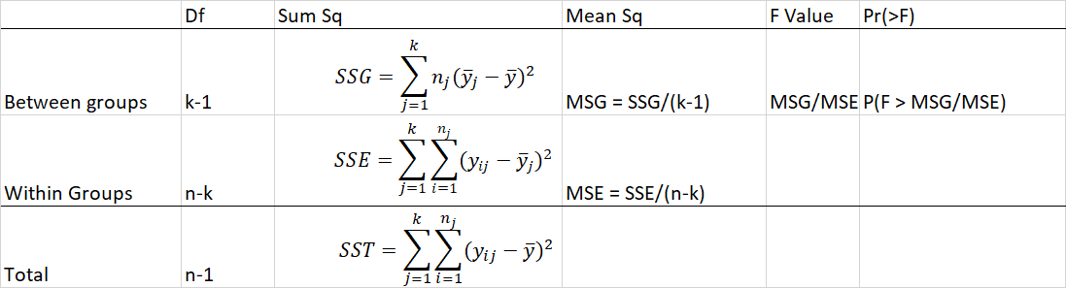
🔍 👫
Step 1a: Fill out the ANOVA table.
k: # of groups; n: # of obs.

Slide 37
🔍 👫
Step 1a: Fill out the ANOVA table.
p-value
Test Statistic
k: # of groups; n: # of obs.

Slide 38
🔍 👫
Step 1a: Fill out the ANOVA table.
p-value
Test Statistic
k: # of groups; n: # of obs.
Rstudio
p-value=pf(test statistic, k-1, n-k, lower.tail=FALSE)
Order matters!

Slide 39
🔍 👫
Step 1a: Fill out the ANOVA table.
p-value
Test Statistic
+
+
k: # of groups; n: # of obs.
Other useful information…

Slide 40
🔍 👫
Step 1a: Fill out the ANOVA table.
p-value
Test Statistic
+
+
=
=
k: # of groups; n: # of obs.
Other useful information…

Slide 41
🔍 👫
Step 1a: Fill out the ANOVA table.
p-value
Test Statistic
k: # of groups; n: # of obs.
Step 1b: Evaluate the p-value to make a conclusion.
p-value<α: Reject Ho. There is sufficient evidence to suggest Ha.
p-value≥α: Fail to reject Ho. There is not sufficient evidence to suggest Ha.

Slide 42
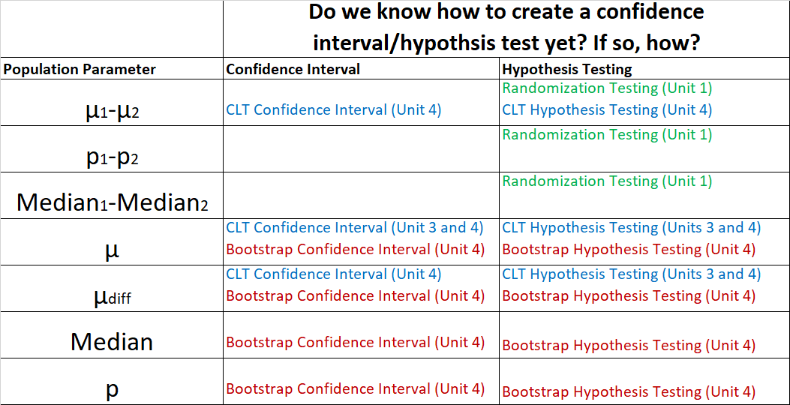
Outline
🔍 ANOVA seems like it follows a different hypothesis testing structure than what we’ve done so far. Let’s see why ANOVA works and how it’s different!

Slide 43
Outline
🔍 👫 Let’s compare Step 1 of ANOVA and an Independent Means Test.
Hypotheses Different

Slide 44

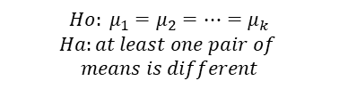


ANOVA compares between group variation to within group variation
Similarities/Differences with the independent means test:
ANOVA (step 1) Hypotheses:
Independent Means Hypotheses:
$$Ho: μ_{1}=μ_{2}=…=μ_{k}$$
$$Ha:at least one pair of$$
$$means is different$$
$$Ho: μ_{1}=μ_{2}$$
$$Ha: μ_{1}>μ_{2}$$
$$Ho: μ_{1}=μ_{2}$$
$$Ha: μ_{1}<μ_{2}$$
$$Ho: μ_{1}=μ_{2}$$
$$Ha: μ_{1}≠μ_{2}$$

Slide 45
Outline
🔍 👫 Let’s compare Step 1 of ANOVA and an Independent Means Test.
Test Statistics Come from Different Distributions

Slide 46






ANOVA compares between group variation to within group variation
Test statistic from ANOVA Step 1 always follows the F-distribution:
$$p−value=P\left(F≥MSG/MSE\right)$$
Test statistic for independent means hypothesis test follows the Z-distribution or T-distribution:
$$p−value=P\left(Z≥\frac{{\overline{x}}_{1}−{\overline{x}}_{2}−0}{\sqrt{\frac{σ_{1}^{2}}{n_{1}}+\frac{σ_{2}^{2}}{n_{2}}}}\right)$$
$$p−value=P\left(T≥\frac{{\overline{x}}_{1}−{\overline{x}}_{2}−0}{\sqrt{\frac{s_{1}^{2}}{n_{1}}+\frac{s_{2}^{2}}{n_{2}}}}\right)$$
$$p−value=P\left(Z≤\frac{{\overline{x}}_{1}−{\overline{x}}_{2}−0}{\sqrt{\frac{σ_{1}^{2}}{n_{1}}+\frac{σ_{2}^{2}}{n_{2}}}}\right)$$
$$p−value=P\left(T≤\frac{{\overline{x}}_{1}−{\overline{x}}_{2}−0}{\sqrt{\frac{s_{1}^{2}}{n_{1}}+\frac{s_{2}^{2}}{n_{2}}}}\right)$$
$$p−value=2∙P\left(Z≥\left|\frac{{\overline{x}}_{1}−{\overline{x}}_{2}−0}{\sqrt{\frac{σ_{1}^{2}}{n_{1}}+\frac{σ_{2}^{2}}{n_{2}}}}\right|\right)$$
$$p−value=2∙P\left(T≥\left|\frac{{\overline{x}}_{1}−{\overline{x}}_{2}−0}{\sqrt{\frac{s_{1}^{2}}{n_{1}}+\frac{s_{2}^{2}}{n_{2}}}}\right|\right)$$

Slide 47
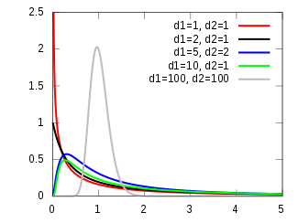
🔍 🖳
ANOVA compares between group variation to within group variation
F-distribution
F-distribution is always positive.
Has two parameters:
  “Degrees of freedom 1”
  “Degrees of freedom 2”
ORDER MATTERS!
https://en.wikipedia.org/wiki/F-distribution
R-Studio
pf(f-stat, df1, df2, lower.tail=FALSE) ≠ pf(f-stat, df2, df1, lower.tail=FALSE)

Slide 48
Outline
🔍 👫 Let’s compare Step 1 of ANOVA and an Independent Means Test.
Shape of p-value of only one type for ANOVA Step 1.

Slide 49
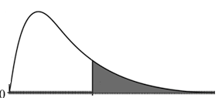
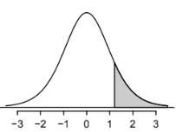
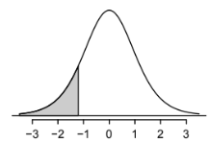
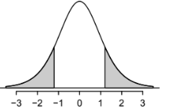


ANOVA compares between group variation to within group variation
P-value from ANOVA Step 1 always is a RIGHT TAIL in the F-distribution!
$$p−value$$
$$p−value=P\left(F≥MSG/MSE\right)$$
$$MSG/MSE$$
P-value for a independent means hypothesis test can be a right/left/two-sided tail in the Z-distribution or T-distribution:
$$p−value=P\left(Z≥\frac{{\overline{x}}_{1}−{\overline{x}}_{2}−0}{\sqrt{\frac{σ_{1}^{2}}{n_{1}}+\frac{σ_{2}^{2}}{n_{2}}}}\right)$$
$$p−value=P\left(T≥\frac{{\overline{x}}_{1}−{\overline{x}}_{2}−0}{\sqrt{\frac{s_{1}^{2}}{n_{1}}+\frac{s_{2}^{2}}{n_{2}}}}\right)$$
$$p−value=P\left(Z≤\frac{{\overline{x}}_{1}−{\overline{x}}_{2}−0}{\sqrt{\frac{σ_{1}^{2}}{n_{1}}+\frac{σ_{2}^{2}}{n_{2}}}}\right)$$
$$p−value=P\left(T≤\frac{{\overline{x}}_{1}−{\overline{x}}_{2}−0}{\sqrt{\frac{s_{1}^{2}}{n_{1}}+\frac{s_{2}^{2}}{n_{2}}}}\right)$$
$$p−value=2∙P\left(Z≥\left|\frac{{\overline{x}}_{1}−{\overline{x}}_{2}−0}{\sqrt{\frac{σ_{1}^{2}}{n_{1}}+\frac{σ_{2}^{2}}{n_{2}}}}\right|\right)$$
$$p−value=2∙P\left(T≥\left|\frac{{\overline{x}}_{1}−{\overline{x}}_{2}−0}{\sqrt{\frac{s_{1}^{2}}{n_{1}}+\frac{s_{2}^{2}}{n_{2}}}}\right|\right)$$

Slide 50
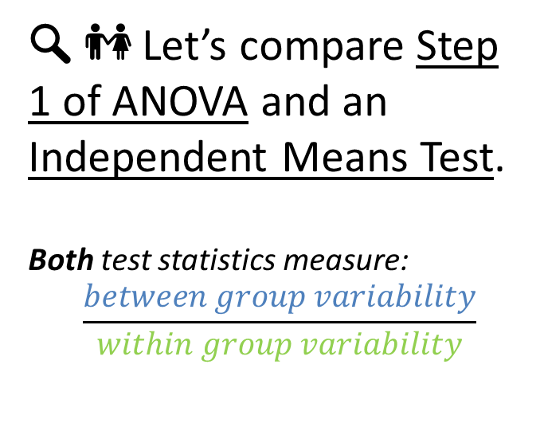
Outline
🔍 👫 Let’s compare Step 1 of ANOVA and an Independent Means Test.
Both test statistics measure:
$$\frac{between group variability}{within group variability}$$

Slide 51
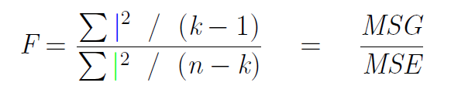

For historical reasons, we use a modiﬁcation of this ratio called the F-statistic:
🔍 👫
k: # of groups; n: # of obs.

Slide 52
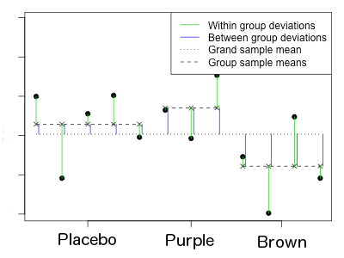
ANOVA compares between group variation to within group variation
🔍
Test Statistic=MSG/MSE=
( )∙(n-k/k-1)
Acne Score

Slide 53
For historical reasons, we use a modiﬁcation of this ratio called the F-statistic:
🔍 👫
k: # of groups; n: # of obs.
Variability between groups
Variability within groups
Total variability in the response variable.

Slide 54


ANOVA compares between group variation to within group variation
Similarities with the independent means/samples test:
F-statistic in ANOVA:
T-statistic in INDEPENDENT MEANS TEST (with null value=0 and right tailed):
Measure of:
$$\frac{Between Group Variability}{Within Group Variability}$$
$$p−value=P\left(F≥MSG/MSE\right)$$
Between group variability measure
$$p−value=P\left(T≥\frac{{\overline{x}}_{1}−{\overline{x}}_{2}−0}{\sqrt{\frac{s_{1}^{2}}{n_{1}}+\frac{s_{2}^{2}}{n_{2}}}}\right)$$
Within group variability measure

Slide 55
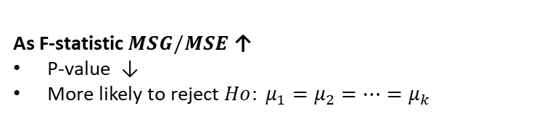


ANOVA compares between group variation to within group variation
As F-statistic $MSG/MSE$ ↑
P-value ↓
More likely to reject $Ho: μ_{1}=μ_{2}=…=μ_{k}$
$$p−value$$
$$MSG/MSE$$
$$p−value=P\left(F≥MSG/MSE\right)$$

Slide 56
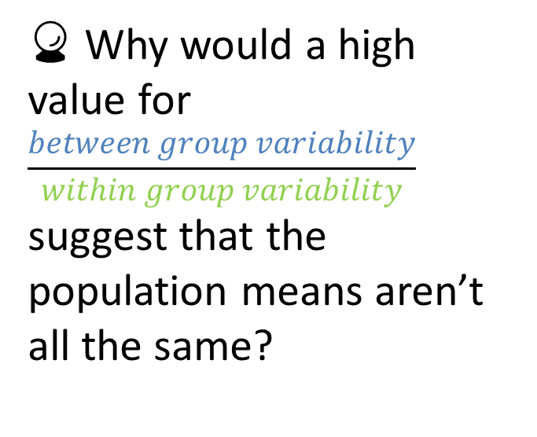
Outline
🔮 Why would a high value for
$$\frac{between group variability}{within group variability}$$
suggest that the population means aren’t all the same?

Slide 57
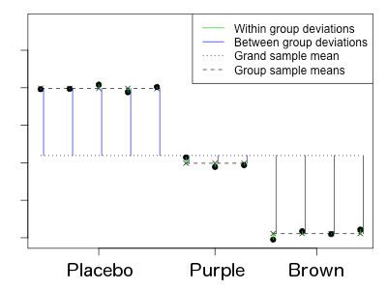
Relatively large BETWEEN group variation: there may be a diﬀerence
🔍
Test Statistic=MSG/MSE=
( )∙(n-k/k-1)
Acne Score
Fraction is ______, more likely to ______ in ANOVA.

Slide 58
Relatively large BETWEEN group variation: there may be a diﬀerence
🔍
Test Statistic=MSG/MSE=
( )∙(n-k/k-1)
Acne Score
Fraction is ______, more likely to ______ in ANOVA.

Slide 59
Relatively large BETWEEN group variation: there may be a diﬀerence
🔍
Test Statistic=MSG/MSE=
( )∙(n-k/k-1)
Acne Score
Fraction is large, more likely to reject Ho in ANOVA.

Slide 60
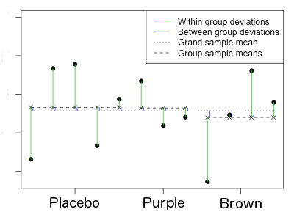
Relatively large WITHIN group variation: little apparent diﬀerence
🔍
Test Statistic=MSG/MSE=
( )∙(n-k/k-1)
Acne Score
Fraction is ______, more likely to ______ in ANOVA.

Slide 61
Relatively large WITHIN group variation: little apparent diﬀerence
🔍
Test Statistic=MSG/MSE=
( )∙(n-k/k-1)
Acne Score
Fraction is ______, more likely to ______ in ANOVA.

Slide 62
Relatively large WITHIN group variation: little apparent diﬀerence
🔍
Test Statistic=MSG/MSE=
( )∙(n-k/k-1)
Acne Score
Fraction is small, more likely to fail to reject Ho in ANOVA.

Slide 63
Outline
Housekeeping
Main ideas
Independent Means Hypothesis Testing: Test for an Association Between a Numerical Variable and a Categorical Variable with Two Levels
Problem: What if we want to test for an Association Between a Numerical Variable and a Categorical Variable with MORE THAN TWO Levels?
Solution: Use ANOVA!
    🆕 ⚙ 🔮 Why do we need ANOVA? Comparing many means requires care
    🔍 ANOVA Step 1: ANOVA tests for some diﬀerence in means of many diﬀerent groups
    🔍 ⚙ 👫 How/Why does ANOVA Step 1 Work? ANOVA compares between group variation to within group variation
    🔍 ⚙ ANOVA Step 2: To identify which means are diﬀerent, use t-tests and the Bonferroni correction
Summary

Slide 64
Outline
Step 0 of ANOVA: Check conditions.
Step 1 of ANOVA:
Assess the following hypotheses.
H0 : µplacebo = µpurple = µbrown = . . . = µpeach = µorange.
Ha : Amongst all groups, there are at least two groups that have diﬀerent group means from each other.
Step 2 of ANOVA:

Slide 65
Outline
Step 0 of ANOVA: Check conditions.
Step 1 of ANOVA:
Assess the following hypotheses.
H0 : µplacebo = µpurple = µbrown = . . . = µpeach = µorange.
Ha : Amongst all groups, there are at least two groups that have diﬀerent group means from each other.
Step 2 of ANOVA:
If we rejected Ho in Step 1…. find out which pairs have different group means from each other.

Slide 66
Outline
Step 0 of ANOVA: Check conditions.
Step 1 of ANOVA:
Assess the following hypotheses.
H0 : µplacebo = µpurple = µbrown = . . . = µpeach = µorange.
Ha : Amongst all groups, there are at least two groups that have diﬀerent group means from each other.
Step 2 of ANOVA:
Post-hoc multiple pairwise comparison tests.
Conduct a 2-Tailed Independent Means Test for Each Possible Mean Pair… BUT CHANGE THE FOLLOWING 3 THINGS IN EACH TEST!
NEXT SLIDE
H0 : µplacebo = µpurple
Ha : µplacebo ≠ µpurple
H0 : µplacebo = µpeach
Ha : µplacebo ≠ µpeach
H0 : µpurple = µbrown
Ha : µpurple ≠ µbrown
…
H0 : µplacebo = µbrown
Ha : µplacebo ≠ µbrown
H0 : µplacebo = µorange
Ha : µplacebo ≠ µorange
H0 : µpurple = µpeach
Ha : µpurple ≠ µpeach

Slide 67
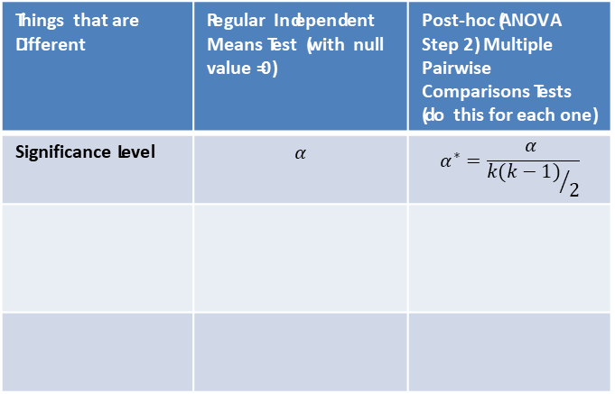
To identify which means are diﬀerent, use t-tests and the Bonferroni
correction
🔍 👫
Things that are Different | Regular Independent Means Test (with null value =0) | Post-hoc (ANOVA Step 2) Multiple Pairwise Comparisons Tests (do this for each one)
Significance Level | $$α$$ | $$α^{∗}=\frac{α }{{k(k−1)}/2}$$

Slide 68
To identify which means are diﬀerent, use t-tests and the Bonferroni
correction
🔍 👫
Things that are Different | Regular Independent Means Test (with null value =0) | Post-hoc (ANOVA Step 2) Multiple Pairwise Comparisons Tests (do this for each one)
Significance Level | $$α$$ | $$α^{∗}=\frac{α }{{k(k−1)}/2}$$
Bonferroni Correction
From Step 1 of ANOVA
Total number of pairings of means
k=# of groups

Slide 69
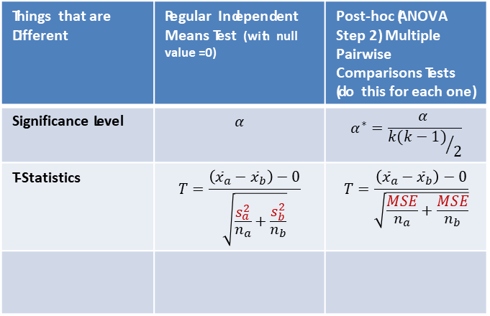
To identify which means are diﬀerent, use t-tests and the Bonferroni
correction
🔍 👫
Things that are Different | Regular Independent Means Test (with null value =0) | Post-hoc (ANOVA Step 2) Multiple Pairwise Comparisons Tests (do this for each one)
Significance Level | $$α$$ | $$α^{∗}=\frac{α }{{k(k−1)}/2}$$
T-Statistics | $$T=\frac{\left({\overline{x}}_{a}−{\overline{x}}_{b}\right)−0}{\sqrt{\frac{s_{a}^{2}}{n_{a}}+\frac{s_{b}^{2}}{n_{b}}}}$$ | $$T=\frac{\left({\overline{x}}_{a}−{\overline{x}}_{b}\right)−0}{\sqrt{\frac{MSE}{n_{a}}+\frac{MSE}{n_{b}}}}$$

Slide 70
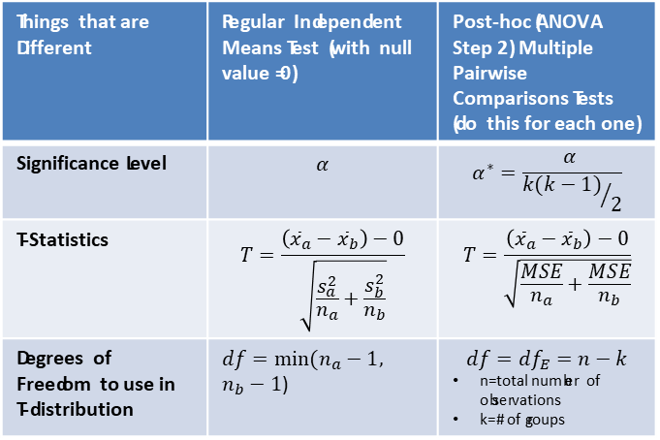
To identify which means are diﬀerent, use t-tests and the Bonferroni
correction
🔍 👫
Things that are Different | Regular Independent Means Test (with null value =0) | Post-hoc (ANOVA Step 2) Multiple Pairwise Comparisons Tests (do this for each one)
Significance Level | $$α$$ | $$α^{∗}=\frac{α }{{k(k−1)}/2}$$
T-Statistics | $$T=\frac{\left({\overline{x}}_{a}−{\overline{x}}_{b}\right)−0}{\sqrt{\frac{s_{a}^{2}}{n_{a}}+\frac{s_{b}^{2}}{n_{b}}}}$$ | $$T=\frac{\left({\overline{x}}_{a}−{\overline{x}}_{b}\right)−0}{\sqrt{\frac{MSE}{n_{a}}+\frac{MSE}{n_{b}}}}$$
Degrees of Freedom to use in T-distribution | $df=min⁡(n_{a}−1,$ $n_{b}−1$) | $$df={df}_{E}=n−k$$ n=total number of observations k=# of groups

Slide 71

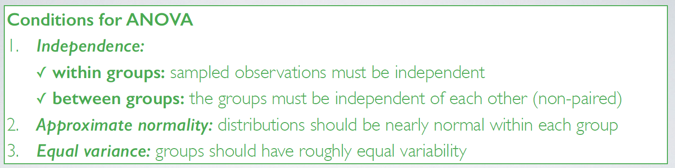
Outline

Slide 72
Application exercise: 4.4 ANOVA
See the course webpage for details.

