Slide 1

Unit 5: Inference for categorical data
1. Inference for a single proportion
Sta 101 – Spring 2019
Duke University, Department of Statistical Science
Dr. Ellison
Slides posted at https://www2.stat.duke.edu/courses/Spring19/sta101.001/index.html

Slide 2
Outline
Housekeeping
Main ideas
Hypothesis Testing and Confidence Intervals with a Single Categorical Variable
Theoretical Hypothesis Testing and Confidence Intervals: 🔍 The CLT also describes the distribution of pˆ
Interpretations: 🆕 ⚙ CI vs. HT determines observed vs. expected counts / proportions
CLT Conditions: 🔍 Only use CLT based methods if the sample size is large enough for a nearly normal sampling distribution
Applications
✋ Single population proportion, large sample
✋ 🆕 🖳 Single population proportion, small sample
Recap
Summary

Slide 3

Organizing Analyses We Know
Tip: Break it down by types of variables involved in the research question.
https://www.facebook.com/konmarimethod/

Slide 4
Organizing Analyses We Know
Tip: Break it down by types of variables involved in the research question.
Any numerical variables? How many?
Any categorical variables? How many?

Slide 5
Organizing Analyses We Know
Tip: Break it down by types of variables involved in the research question.
Any numerical variables? How many?
Any categorical variables? How many?
How many levels does each categorical variable have?

Slide 6
Organizing Analyses We Know
Tip: Break it down by types of variables involved in the research question.
Any numerical variables? How many?
Any categorical variables? How many?
How many levels does each categorical variable have?
If two variables, which variable(s) are explanatory and which variable is response?

Slide 7
Organizing
What analyses do we know so far?
https://www.facebook.com/konmarimethod/

Slide 8
Organizing
What analyses do we know so far?
Is there more than one way to conduct them?

Slide 9
Organizing
What analyses do we know so far?
Is there more than one way to conduct them?
If so, when should we use each way (ie. what conditions must be met)?

Slide 10
Organizing
Types of analyses that HAVE one specified Population Parameter of Interest and

Slide 11
Organizing
Types of analyses that HAVE one specified Population Parameter of Interest and
We can create a confidence interval for the population parameter.

Slide 12
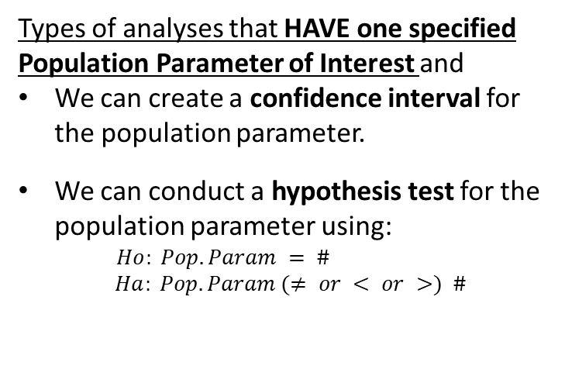
Organizing
Types of analyses that HAVE one specified Population Parameter of Interest and
We can create a confidence interval for the population parameter.
We can conduct a hypothesis test for the population parameter using:
$$Ho: Pop. Param = \# \\ Ha: Pop. Param (≠ or < or >) \#$$

Slide 13
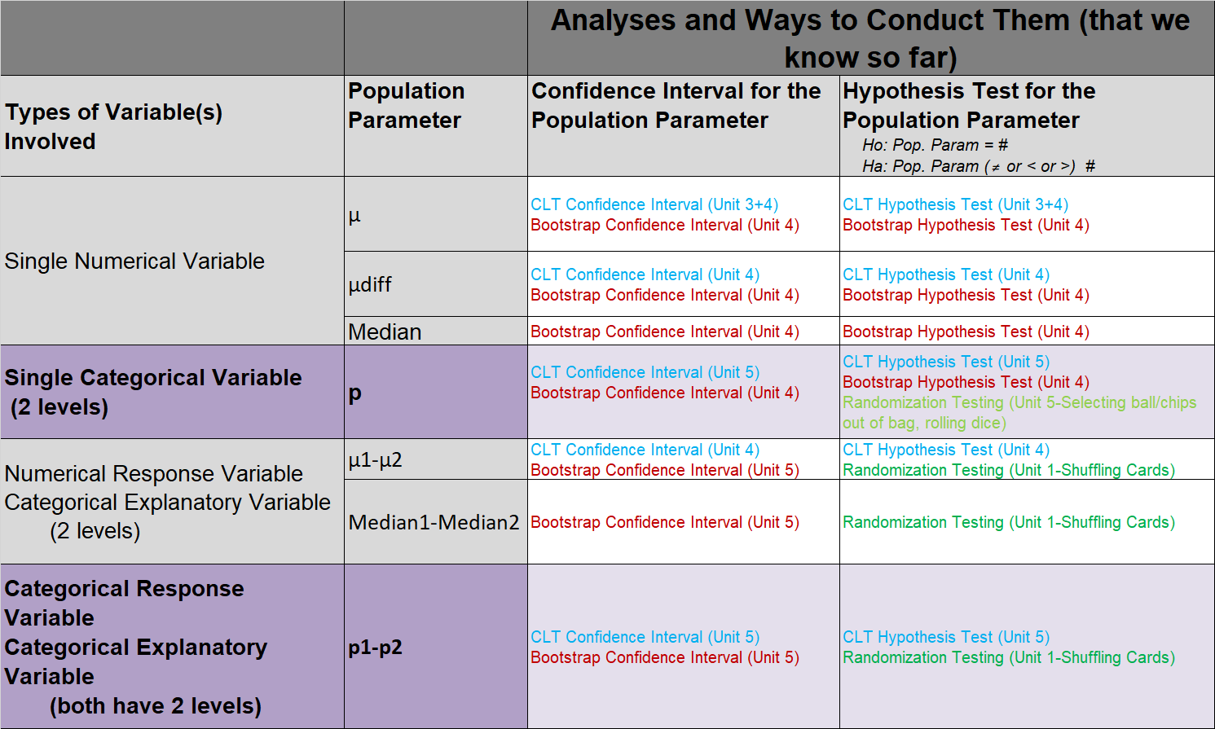
Organizing (read over later)
What’s new in Unit 5?

Slide 14

Organizing
Types of analyses that DON’T HAVE one specified Population Parameter of Interest and
No confidence interval framework
Hypothesis tests set up are different
https://www.facebook.com/konmarimethod/

Slide 15
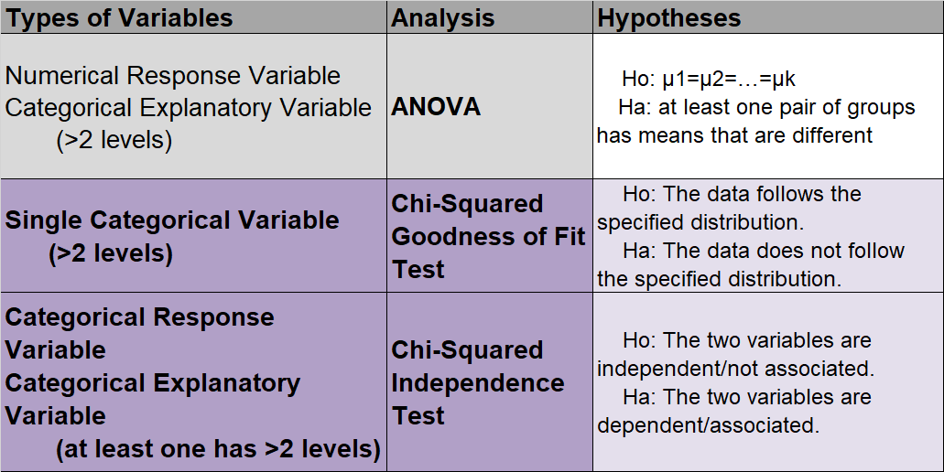
Organizing (read over later)
What’s new in Unit 5?

Slide 16

Focus today:
Categorical Variable (2 levels)
Single Population Proportion, p
p = proportion of one of the levels

Slide 17
Focus today:
Categorical Variable (2 levels)
Single Population Proportion, p
p = proportion of one of the levels
Construct confidence intervals and hypothesis tests using Central Limit Theorem methods.

Slide 18
Focus today:
Categorical Variable (2 levels)
Single Population Proportion, p
p = proportion of one of the levels
Construct confidence intervals and hypothesis tests using Central Limit Theorem methods.
Conduct a hypothesis test for p with randomization testing.
Create a confidence interval for p with bootstrapping.

Slide 19
Focus today:
Categorical Variable (2 levels)
Single Population Proportion, p
p = proportion of one of the levels
When to use each method
Construct confidence intervals and hypothesis tests using Central Limit Theorem methods.
Conduct a hypothesis test for p with randomization testing.
Create a confidence interval for p with bootstrapping.

Slide 20
Outline
Housekeeping
Main ideas
Hypothesis Testing and Confidence Intervals with a Single Categorical Variable
Theoretical Hypothesis Testing and Confidence Intervals: 🔍 The CLT also describes the distribution of pˆ
Interpretations: 🆕 ⚙ CI vs. HT determines observed vs. expected counts / proportions
CLT Conditions: 🔍 Only use CLT based methods if the sample size is large enough for a nearly normal sampling distribution
Applications
✋ Single population proportion, large sample
✋ 🆕 🖳 Single population proportion, small sample
Recap
Summary

Slide 21
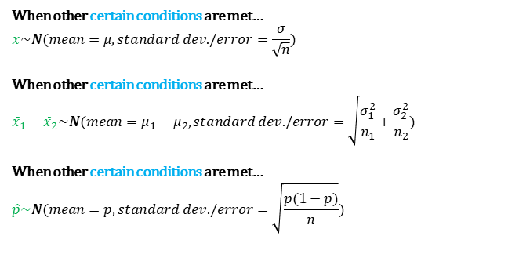
Organizing CLT Results for Different Sample Statistics
When other certain conditions are met…
$$\overline{x}\sim N(mean=μ,standard dev./error=\frac{σ}{\sqrt{n}})$$
When other certain conditions are met…
$${\overline{x}}_{1}−{\overline{x}}_{2}\sim N(mean=μ_{1}−μ_{2},standard dev./error=\sqrt{\frac{σ_{1}^{2}}{n_{1}}+\frac{σ_{2}^{2}}{n_{2}}})$$
When other certain conditions are met…
$$\hat{p}\sim N(mean=p,standard dev./error=\sqrt{\frac{p(1−p)}{n}})$$
https://www.facebook.com/konmarimethod/

Slide 22
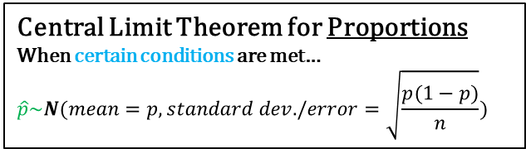
🔍
Distribution of pˆ
Central Limit Theorem for Proportions
When certain conditions are met…
$$\hat{p}\sim N(mean=p,standard dev./error=\sqrt{\frac{p(1−p)}{n}})$$
Conditions:
▶ Independence:
Random sample/assignment AND
n<10% of population
▶ Shape/Skew:
“Success/Failure Conditions:”
np ≥ 10 AND
n(1-p) ≥ 10

Slide 23
🔍
Distribution of pˆ
Why is are the following called the success/failure conditions?
np ≥ 10
n(1-p) ≥ 10

Slide 24
🔍
Distribution of pˆ
Why is are the following called the success/failure conditions?
p=proportion of “successes”
1-p=proportion of “failures”
np ≥ 10
n(1-p) ≥ 10

Slide 25
🔍
Distribution of pˆ
Why is are the following called the success/failure conditions?
p=proportion of “successes”
1-p=proportion of “failures”
Number of successes
np ≥ 10
n(1-p) ≥ 10
Number of
failures

Slide 26
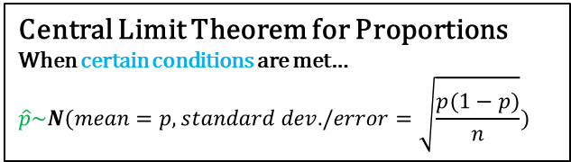
🔍
Distribution of pˆ
Central Limit Theorem for Proportions
When certain conditions are met…
$$\hat{p}\sim N(mean=p,standard dev./error=\sqrt{\frac{p(1−p)}{n}})$$
Conditions:
▶ Independence:
Random sample/assignment AND
n<10% of population
▶ Shape/Skew:
“Success/Failure Conditions:”
np ≥ 10 (ie: at least 10 successes) AND
n(1-p) ≥ 10 (ie: at least 10 failures)

Slide 27
Suppose p = 0.05. What shape does the distribution of pˆ have in random samples of n = 100.
🔍
Clicker question
unimodal and symmetric (nearly normal)
bimodal and symmetric
right skewed
left skewed

Slide 28

Suppose p = 0.05. What shape does the distribution of pˆ have in random samples of n = 100.
🔍
Clicker question
unimodal and symmetric (nearly normal) p and n don’t satisfy SF Conditions.
bimodal and symmetric
right skewed
left skewed
$$np=5<10$$
$$n(1−p)=95≥10$$

Slide 29
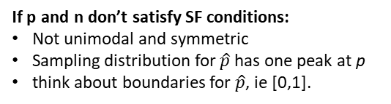
Suppose p = 0.05. What shape does the distribution of pˆ have in random samples of n = 100.
🔍
Clicker question
unimodal and symmetric (nearly normal) p and n don’t satisfy SF Conditions.
bimodal and symmetric
right skewed
left skewed
$$np=5<10$$
$$n(1−p)=95≥10$$
If p and n don’t satisfy SF conditions:
Not unimodal and symmetric
Sampling distribution for $\hat{p}$ has one peak at p
think about boundaries for $\hat{p}$, ie [0,1].

Slide 30
Suppose p = 0.5. What shape does the distribution of pˆ have in random samples of n = 100.
🔍
Clicker question
unimodal and symmetric (nearly normal)
bimodal and symmetric
right skewed
left skewed

Slide 31

Suppose p = 0.5. What shape does the distribution of pˆ have in random samples of n = 100.
🔍
Clicker question
unimodal and symmetric (nearly normal) p and n satisfy SF Conditions.
bimodal and symmetric
right skewed
left skewed
$$np=50≥10$$
$$n(1−p)=50≥10$$

Slide 32
Outline
Housekeeping
Main ideas
Hypothesis Testing and Confidence Intervals with a Single Categorical Variable
Theoretical Hypothesis Testing and Confidence Intervals: 🔍 The CLT also describes the distribution of pˆ
Interpretations: 🆕 ⚙ CI vs. HT determines observed vs. expected counts / proportions
CLT Conditions: 🔍 Only use CLT based methods if the sample size is large enough for a nearly normal sampling distribution
Applications
✋ Single population proportion, large sample
✋ 🆕 🖳 Single population proportion, small sample
Recap
Summary

Slide 33
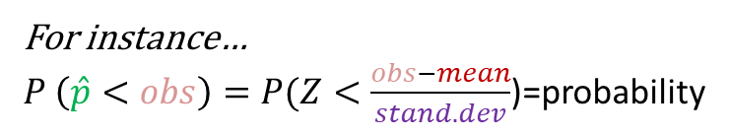
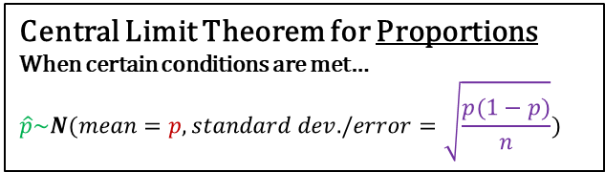
🔍
CI vs. HT determines observed vs. expected counts / proportions
Central Limit Theorem for Proportions
When certain conditions are met…
$$\hat{p}\sim N(mean=p,standard dev./error=\sqrt{\frac{p(1−p)}{n}})$$
Use z-tables
For instance…
$P \left(\hat{p}<obs\right)=P(Z<\frac{obs−mean}{stand. dev}$)=probability

Slide 34
🔍
CI vs. HT determines observed vs. expected counts / proportions
Central Limit Theorem for Proportions
When certain conditions are met…
$$\hat{p}\sim N(mean=p,standard dev./error=\sqrt{\frac{p(1−p)}{n}})$$
Use z-tables
For instance…
$P \left(\hat{p}<obs\right)=P(Z<\frac{obs−mean}{stand. dev}$)=probability

Slide 35
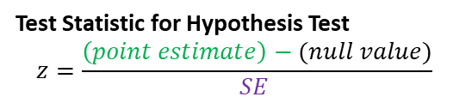
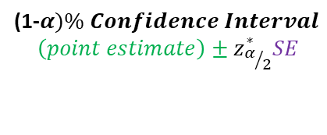
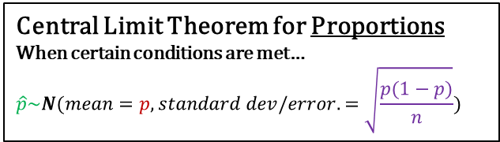
🔍
CI vs. HT determines observed vs. expected counts / proportions
Central Limit Theorem for Proportions
When certain conditions are met…
$$\hat{p}\sim N(mean=p,standard dev/error.=\sqrt{\frac{p(1−p)}{n}})$$
(1-$α)\% Confidence Interval$
$$\left(point estimate\right)±z_{α/2}^{∗}SE$$
Test Statistic for Hypothesis Test
$$z=\frac{\left(point estimate\right)−(null value)}{SE }$$

Slide 36
🔍
CI vs. HT determines observed vs. expected counts / proportions
Central Limit Theorem for Proportions
When certain conditions are met…
$$\hat{p}\sim N(mean=p,standard dev/error.=\sqrt{\frac{p(1−p)}{n}})$$
(1-$α)\% Confidence Interval$
$$\left(point estimate\right)±z_{α/2}^{∗}SE$$
Test Statistic for Hypothesis Test
$$z=\frac{\left(point estimate\right)−(null value)}{SE }$$

Slide 37
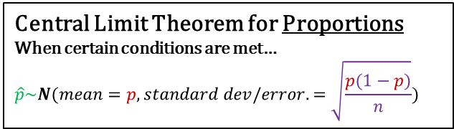
🔍
CI vs. HT determines observed vs. expected counts / proportions
Central Limit Theorem for Proportions
When certain conditions are met…
$$\hat{p}\sim N(mean=p,standard dev/error.=\sqrt{\frac{p(1−p)}{n}})$$
Problem: However, in Confidence intervals and Hypothesis Testing, we don’t know what p is….
(1-$α)\% Confidence Interval$
$$\left(point estimate\right)±z_{α/2}^{∗}SE$$
Test Statistic for Hypothesis Test
$$z=\frac{\left(point estimate\right)−(null value)}{SE }$$

Slide 38
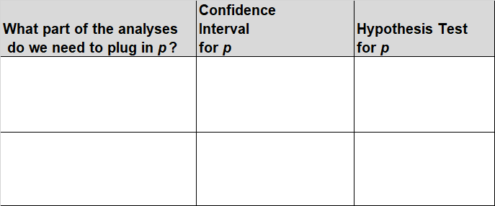
🔍
CI vs. HT determines observed vs. expected counts / proportions
Problem: In Confidence intervals and Hypothesis Testing, we don’t know what p is but we need to plug it in in two parts of the analyses.

Slide 39
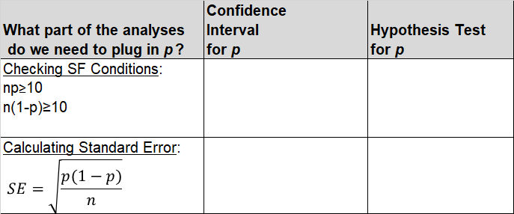
🔍
CI vs. HT determines observed vs. expected counts / proportions
Problem: In Confidence intervals and Hypothesis Testing, we don’t know what p is but we need to plug it in in two parts of the analyses.

Slide 40
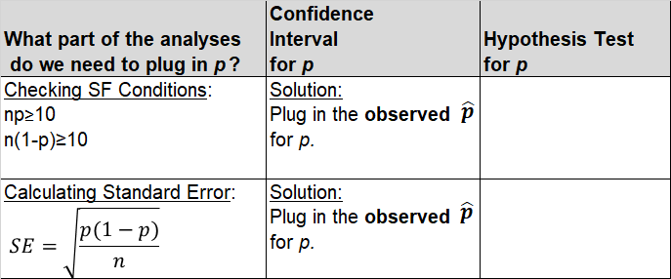
🔍
CI vs. HT determines observed vs. expected counts / proportions
Problem: In Confidence intervals and Hypothesis Testing, we don’t know what p is but we need to plug it in in two parts of the analyses.

Slide 41
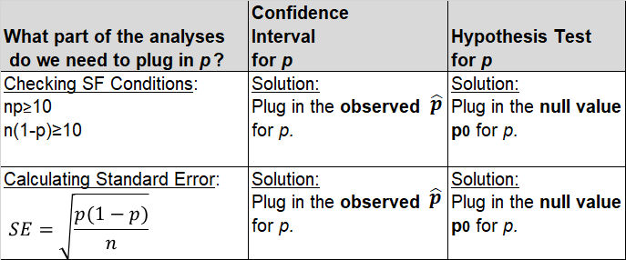
🔍
CI vs. HT determines observed vs. expected counts / proportions
Problem: In Confidence intervals and Hypothesis Testing, we don’t know what p is but we need to plug it in in two parts of the analyses.

Slide 42
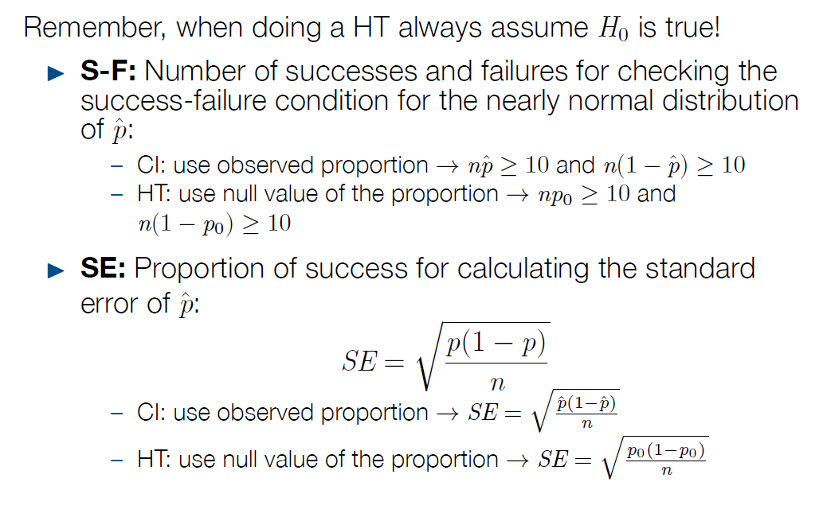
🔍
CI vs. HT determines observed vs. expected counts / proportions
Answer:

Slide 43
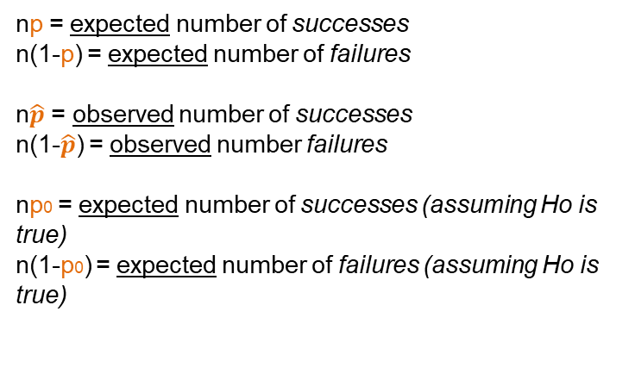
🆕
CI vs. HT determines observed vs. expected counts / proportions
👫
Interpreting…
np = expected number of successes
n(1-p) = expected number of failures
n$\hat{p}$ = observed number of successes
n(1-$\hat{p}$) = observed number failures
np0 = expected number of successes (assuming Ho is true)
n(1-p0) = expected number of failures (assuming Ho is true)

Slide 44
Outline
Housekeeping
Main ideas
Hypothesis Testing and Confidence Intervals with a Single Categorical Variable
Theoretical Hypothesis Testing and Confidence Intervals: 🔍 The CLT also describes the distribution of pˆ
Interpretations: 🆕 ⚙ CI vs. HT determines observed vs. expected counts / proportions
CLT Conditions: 🔍 Only use CLT based methods if the sample size is large enough for a nearly normal sampling distribution
Applications
✋ Single population proportion, large sample
✋ 🆕 🖳 Single population proportion, small sample
Recap
Summary

Slide 45
Single Population Proportion, p
When to use each method
Construct confidence intervals and hypothesis tests using Central Limit Theorem methods.
Conduct a hypothesis test for p with randomization testing.
Create a confidence interval for p with bootstrapping.

Slide 46


Simulation vs. theoretical inference
🔍
Conditions:
▶ Independence:
Random sample/assignment
10% rule
▶ Shape/Skew:
“Success/Failure Conditions:” At least 10 successes and failures (ie: n$\hat{p}$ ≥ 10, n(1-$\hat{p}$) ≥ 10)
Confidence Interval
Condition met:
Condition NOT met:
(1-$α)\% Confidence$
$$Interval$$
With CLT Methods
$$\hat{p}±z_{α/2}^{∗}\sqrt{\frac{\hat{p}(1−\hat{p})}{n}}$$
Make a bootstrap confidence interval.

Slide 47

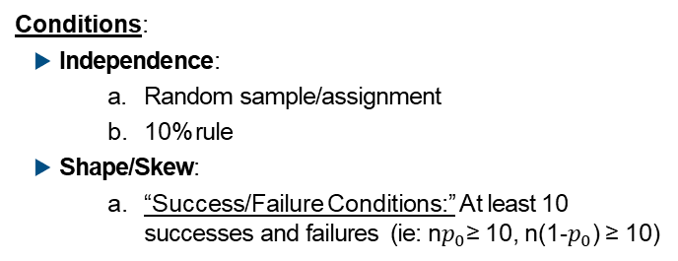
Simulation vs. theoretical inference
🔍
Conditions:
▶ Independence:
Random sample/assignment
10% rule
▶ Shape/Skew:
“Success/Failure Conditions:” At least 10 successes and failures (ie: n$p_{0}$≥ 10, n(1-$p_{0}$) ≥ 10)
Hypothesis Test
Condition met:
Condition NOT met:
CLT Methods
Test Statistic
$$z=\frac{\hat{p}−p_{0}}{\sqrt{\frac{p_{0}(1−p_{0})}{n}}}$$
Conduct hypothesis test for p with randomization testing – balls/chips in a bag, dice, etc.

Slide 48
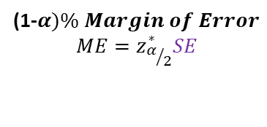
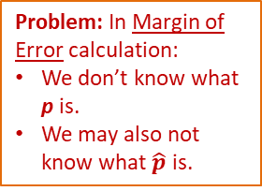
🔍
Central Limit Theorem for Proportions
When certain conditions are met…
$$\hat{p}\sim N(mean=p,standard dev/error.=\sqrt{\frac{p(1−p)}{n}})$$
Problem: In Margin of Error calculation:
We don’t know what p is.
We may also not know what $\hat{p}$ is.
(1-$α)\% Margin of Error$
$$ME=z_{α/2}^{∗}SE$$

Slide 49
Recap on CLT based methods
▶ Calculating the necessary sample size for a CI with a given margin of error:
Option 1: If there is a previous study, use pˆ from that study

Slide 50
Recap on CLT based methods
▶ Calculating the necessary sample size for a CI with a given margin of error:
Option 1: If there is a previous study, use pˆ from that study
Option 2: If not, use pˆ = 0.5:
if you don’t know any better, 50-50 is a good guess
pˆ = 0.5 gives the most conservative estimate of the standard error, which gives the highest possible sample size

Slide 51
Outline
Housekeeping
Main ideas
Hypothesis Testing and Confidence Intervals with a Single Categorical Variable
Theoretical Hypothesis Testing and Confidence Intervals: 🔍 The CLT also describes the distribution of pˆ
Interpretations: 🆕 ⚙ CI vs. HT determines observed vs. expected counts / proportions
CLT Conditions: 🔍 Only use CLT based methods if the sample size is large enough for a nearly normal sampling distribution
Applications
✋ Single population proportion, large sample
✋ 🆕 🖳 Single population proportion, small sample
Recap
Summary

Slide 52

Application exercise: App Ex 5.1
See course website for details.

Slide 53
Outline
Housekeeping
Main ideas
Hypothesis Testing and Confidence Intervals with a Single Categorical Variable
Theoretical Hypothesis Testing and Confidence Intervals: 🔍 The CLT also describes the distribution of pˆ
Interpretations: 🆕 ⚙ CI vs. HT determines observed vs. expected counts / proportions
CLT Conditions: 🔍 Only use CLT based methods if the sample size is large enough for a nearly normal sampling distribution
Applications
✋ Single population proportion, large sample
✋ 🆕 🖳 Single population proportion, small sample
Recap
Summary

Slide 54

Outline
✋Let’s conduct a hypothesis test on p (the proportion of Duke students that are vegetarian/vegan) with randomization testing.

Slide 55
✋
🆕
Clicker question
Are you vegetarian or vegan?
Yes, I am vegetarian or vegan
No, I am neither vegetarian nor vegan

Slide 56
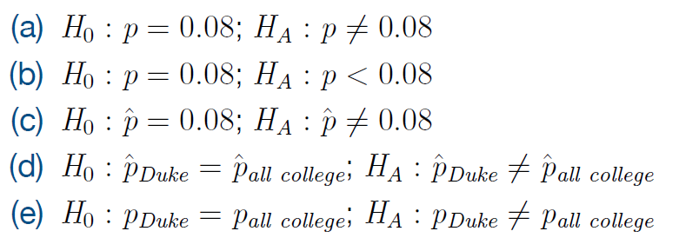
✋
🆕
Clicker question
A variety of studies suggest that 8% of college students are vegetarian or vegan. Assuming that this class is a representative sample of Duke students, which of the following are the correct set of hypotheses for testing if the proportion of Duke students who are vegetarian is different than the proportion of vegetarian college students at large.

Slide 57
✋
🆕
Clicker question
A variety of studies suggest that 8% of college students are vegetarian or vegan. Assuming that this class is a representative sample of Duke students, which of the following are the correct set of hypotheses for testing if the proportion of Duke students who are vegetarian is different than the proportion of vegetarian college students at large.
“A variety of studies…” usually suggests we can assume that we “know” the pop. parameter it’s referring to (0.08).

Slide 58
Simulate by hand
✋
🆕
Goal in Randomization Testing:
Set up hypotheses.
Ho: p=0.08 (=8/100)
Ha: p≠0.08
Example 1:

Slide 59
Simulate by hand
✋
🆕
Goal in Randomization Testing:
Set up hypotheses.
Create a Randomization Distribution: an approximation for the sampling distribution that assumes Ho is true (or is centered at the null value)
Ho: p=0.08 (=8/100)
Ha: p≠0.08
Example 1:
▶ 100 chips in a bag: 8 green (veg), 92 white (non veg).
▶ Sample randomly n times from the bag, with replacement (n = observed sample size=144)
▶ Calculate pˆ, the proportion of greens (successes) in the random sample of size n=144, record this value.
▶ Repeat many times.

Slide 60
Simulate by hand
✋
🆕
Goal in Randomization Testing:
Set up hypotheses.
Create a Randomization Distribution:an approximation for the sampling distribution that assumes Ho is true (or is centered at the null value)
Calculate p-value with this randomization distribution: P-value=% of simulated points in the randomization distribution that are at least as extreme as the sample statistic observed.
Ho: p=0.08 (=8/100)
Ha: p≠0.08
Example 1:
▶ 100 chips in a bag: 8 green (veg), 92 white (non veg).
▶ Sample randomly n times from the bag, with replacement (n = observed sample size=144)
▶ Calculate pˆ, the proportion of greens (successes) in the random sample of size n=144, record this value.
▶ Repeat many times.
▶ Calculate the proportion of simulations where pˆ is at least as different from 0.08 (null value) as the observed sample proportion.

Slide 61
✋
🆕
Clicker question
What would we expect this randomization distribution to be centered at?
0
0.08
the proportion of vegans/vegetarians in this class
Some number higher than 0.08.

Slide 62
✋
🆕
Clicker question
What would we expect this randomization distribution to be centered at?
0
0.08 – The null value.
the proportion of vegans/vegetarians in this class
Some number higher than 0.08.

Slide 63
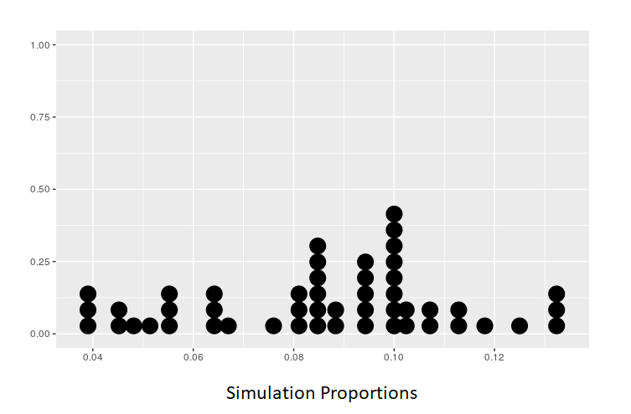
Simulate by hand
✋
🆕
Ho: p=0.08
Ha: p≠0.08
50 simulated sample
proportions
Example:
P-value=

Slide 64
HT in R
✋
🆕
🖳
n_veg = # of veg’s in class
n_nonveg = # of nonveg’s in class
sta101 = data.frame(veg = c(rep("yes", n_veg), rep("no", n_nonveg))) inference(y = veg, data = sta101, success = "yes",
statistic = "proportion", type = "ht",
null = 0.08, alternative = "twosided", method = "simulation")

Slide 65
Outline
✋Let’s create a bootstrap confidence interval for p (the proportion of Duke students that are vegetarian/vegan).

Slide 66
Bootstrap interval for a single proportion
✋
🆕
How would the simulation scheme change for a bootstrap interval for the proportion of Duke students who are vegetarians?

Slide 67
Bootstrap interval for a single proportion
✋
🆕
How would the simulation scheme change for a bootstrap confidence interval for the proportion of Duke students who are vegetarians?
Step 1: Create a Bootstrap Distribution
▶ 100 chips in a bag: 8 green (veg), 92 white (non veg).
▶ Sample randomly n times from the bag original sample, with replacement (n = observed sample size)
▶ Calculate pˆ, the proportion of vegetarians (successes) in the random sample of size n, record this value.
▶ Repeat many times.

Slide 68
Bootstrap interval for a single proportion
✋
🆕
How would the simulation scheme change for a bootstrap confidence interval for the proportion of Duke students who are vegetarians?
Step 1: Create a Bootstrap Distribution
▶ 100 chips in a bag: 8 green (veg), 92 white (non veg).
▶ Sample randomly n times from the bag original sample, with replacement (n = observed sample size)
▶ Calculate pˆ, the proportion of vegetarians (successes) in the random sample of size n, record this value.
▶ Repeat many times.
Step 2: Using the Bootstrap distribution, find a confidence interval using the Percentile Method or the SE Method

Slide 69
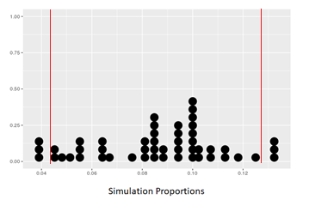
✋
🆕
Simulate by hand
▶ Find a confidence interval using the Percentile Method or the SE Method
Bootstrap Distribution
50 bootstrap
proportions
Percentile Method: Middle 44=(0.88)*(50) points
88% Confidence Interval:
(4.2%,12.4%)
bootstrap proportions

Slide 70
CI in R
✋
🆕
🖳
inference(y = veg, data = sta101, success = "yes", statistic = "proportion", type = "ci", method = "simulation", boot_method = "se")

Slide 71
1. The CLT also describes the distribution of pˆ
Summary of main ideas
CI vs. HT determines observed vs. expected counts / proportions
Only use CLT based methods if the sample size is large enough for a nearly normal sampling distribution

