Slide 1

Unit 5: Inference for categorical data
2. Inference for comparing two proportions
Sta 101 – Spring 2019
Duke University, Department of Statistical Science
https://bloody-disgusting.com/editorials/3422854/slashing-back-revive-slasher-genre/
Dr. Ellison
Slides posted at https://www2.stat.duke.edu/courses/Spring19/sta101.001/

Slide 2
Outline
Housekeeping
Main ideas: a Categorical Independent Variable (two levels) and a Categorical Dependent Variable (two levels)
  Theoretical Hypothesis Testing and Confidence Intervals: 🔍 CLT also describes the distribution of pˆ₁ − pˆ₂
  Different Protocol for CI vs. HT: 🔍 🔮 For HT where H₀ : p₁ = p₂, pool!
  CLT Conditions: 🔍 When S-F fails, simulate!
🔍 ✋ 👫 🖳 Applications
Summary

Slide 3
Announcements
Coming up…
▶ Lab Assignment 7 is due Thursday just before your lab section time.
▶ Readiness Assessment 5 Wednesday 3/27
▶ Problem Set 5 due Wednesday 3/27
1

Slide 4
Outline
Housekeeping
Main ideas: a Categorical Independent Variable (two levels) and a Categorical Dependent Variable (two levels)
  Theoretical Hypothesis Testing and Confidence Intervals: 🔍 CLT also describes the distribution of pˆ₁ − pˆ₂
  Different Protocol for CI vs. HT: 🔍 🔮 For HT where H₀ : p₁ = p₂, pool!
  CLT Conditions: 🔍 When S-F fails, simulate!
🔍 ✋ 👫 🖳 Applications
Summary

Slide 5

Focus today:
Categorical Response Variable (2 levels) and Categorical Explanatory Variable (2 levels)

Slide 6
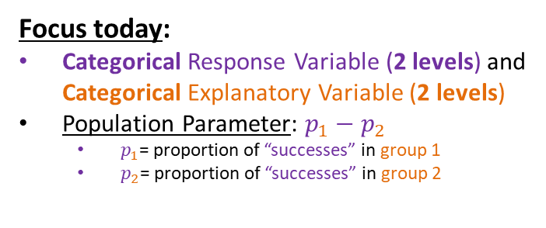
Focus today:
Categorical Response Variable (2 levels) and Categorical Explanatory Variable (2 levels)
Population Parameter: $p_{1}−p_{2}$
  $p_{1}$= proportion of “successes” in group 1
  $p_{2}$= proportion of “successes” in group 2

Slide 7
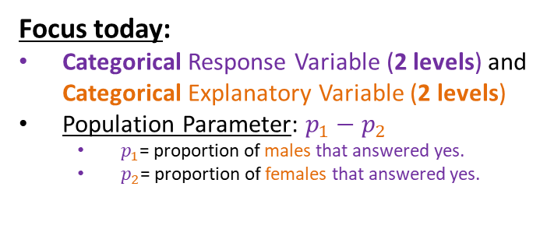
Focus today:
Categorical Response Variable (2 levels) and Categorical Explanatory Variable (2 levels)
Population Parameter: $p_{1}−p_{2}$
  $p_{1}$= proportion of males that answered yes.
  $p_{2}$= proportion of females that answered yes.
For example…

Slide 8
Focus today:
Categorical Response Variable (2 levels) and Categorical Explanatory Variable (2 levels)
Population Parameter: $p_{1}−p_{2}$
  $p_{1}$= proportion of “successes” in group 1
  $p_{2}$= proportion of “successes” in group 2
Construct confidence intervals and hypothesis tests using Central Limit Theorem methods.
Conduct a hypothesis test for p with randomization testing.
Create a confidence interval for p with bootstrapping.

Slide 9
Focus today:
Categorical Response Variable (2 levels) and Categorical Explanatory Variable (2 levels)
Population Parameter: $p_{1}−p_{2}$
  $p_{1}$= proportion of “successes” in group 1
  $p_{2}$= proportion of “successes” in group 2
When to use each method
Construct confidence intervals and hypothesis tests using Central Limit Theorem methods.
Conduct a hypothesis test for p with randomization testing.
Create a confidence interval for p with bootstrapping.

Slide 10
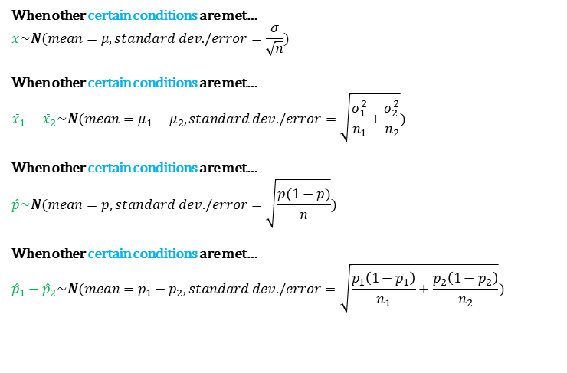
Organizing CLT Results for Different Sample Statistics
When other certain conditions are met…
$$\overline{x}\sim N(mean=μ,standard dev./error=\frac{σ}{\sqrt{n}})$$
When other certain conditions are met…
$${\overline{x}}_{1}−{\overline{x}}_{2}\sim N(mean=μ_{1}−μ_{2},standard dev./error=\sqrt{\frac{σ_{1}^{2}}{n_{1}}+\frac{σ_{2}^{2}}{n_{2}}})$$
When other certain conditions are met…
$$\hat{p}\sim N(mean=p,standard dev./error=\sqrt{\frac{p(1−p)}{n}})$$
When other certain conditions are met…
$${\hat{p}}_{1}−{\hat{p}}_{2}\sim N(mean=p_{1}−p_{2},standard dev./error=\sqrt{\frac{p_{1}\left(1−p_{1}\right)}{n_{1}}+\frac{p_{2}\left(1−p_{2}\right)}{n_{2}}})$$

Slide 11
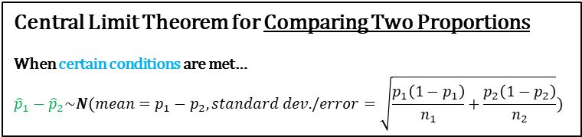
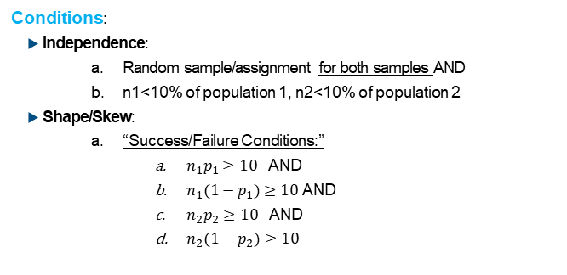
🔍
Distribution of pˆ
Central Limit Theorem for Comparing Two Proportions
When certain conditions are met…
$${\hat{p}}_{1}−{\hat{p}}_{2}\sim N(mean=p_{1}−p_{2},standard dev./error=\sqrt{\frac{p_{1}\left(1−p_{1}\right)}{n_{1}}+\frac{p_{2}\left(1−p_{2}\right)}{n_{2}}})$$
Conditions:
▶ Independence:
  Random sample/assignment for both samples AND
  n1<10% of population 1, n2<10% of population 2
▶ Shape/Skew:
  “Success/Failure Conditions:”
    $n_{1}p_{1}≥10$ AND
    $n_{1}(1−p_{1})≥10$ AND
    $n_{2}p_{2}≥10$ AND
    $n_{2}(1−p_{2})≥10$

Slide 12
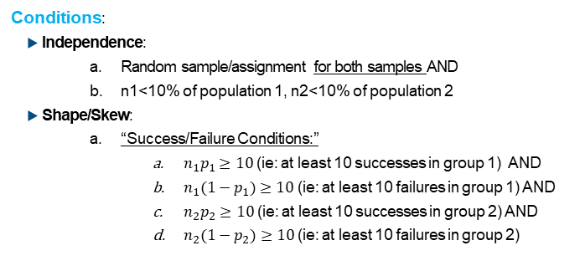
🔍
Distribution of pˆ
Central Limit Theorem for Comparing Two Proportions
When certain conditions are met…
$${\hat{p}}_{1}−{\hat{p}}_{2}\sim N(mean=p_{1}−p_{2},standard dev./error=\sqrt{\frac{p_{1}\left(1−p_{1}\right)}{n_{1}}+\frac{p_{2}\left(1−p_{2}\right)}{n_{2}}})$$
Conditions:
▶ Independence:
  Random sample/assignment for both samples AND
  n1<10% of population 1, n2<10% of population 2
▶ Shape/Skew:
  “Success/Failure Conditions:”
    $n_{1}p_{1}≥10$ (ie: at least 10 successes in group 1) AND
    $n_{1}(1−p_{1})≥10$ (ie: at least 10 failures in group 1) AND
    $n_{2}p_{2}≥10$ (ie: at least 10 successes in group 2) AND
    $n_{2}(1−p_{2})≥10$ (ie: at least 10 failures in group 2)

Slide 13
Outline
Housekeeping
Main ideas: a Categorical Independent Variable (two levels) and a Categorical Dependent Variable (two levels)
  Theoretical Hypothesis Testing and Confidence Intervals: 🔍 CLT also describes the distribution of pˆ₁ − pˆ₂
  Different Protocol for CI vs. HT: 🔍 🔮 For HT where H₀ : p₁ = p₂, pool!
  CLT Conditions: 🔍 When S-F fails, simulate!
🔍 ✋ 👫 🖳 Applications
Summary

Slide 14
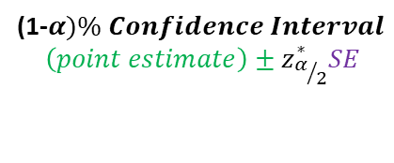
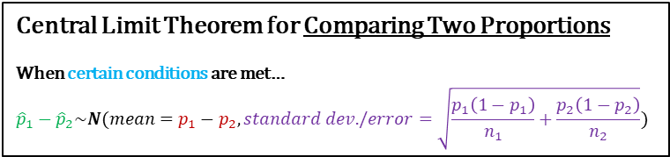
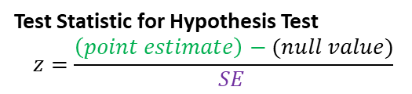
🔍
Distribution of pˆ
Central Limit Theorem for Comparing Two Proportions
When certain conditions are met…
$${\hat{p}}_{1}−{\hat{p}}_{2}\sim N(mean=p_{1}−p_{2},standard dev./error=\sqrt{\frac{p_{1}\left(1−p_{1}\right)}{n_{1}}+\frac{p_{2}\left(1−p_{2}\right)}{n_{2}}})$$
(1-$α)\% Confidence Interval$
$$\left(point estimate\right)±z_{α/2}^{∗}SE$$
Test Statistic for Hypothesis Test
$$z=\frac{\left(point estimate\right)−(null value)}{SE }$$

Slide 15
🔍
Distribution of pˆ
Central Limit Theorem for Comparing Two Proportions
When certain conditions are met…
$${\hat{p}}_{1}−{\hat{p}}_{2}\sim N(mean=p_{1}−p_{2},standard dev./error=\sqrt{\frac{p_{1}\left(1−p_{1}\right)}{n_{1}}+\frac{p_{2}\left(1−p_{2}\right)}{n_{2}}})$$
(1-$α)\% Confidence Interval$
$$\left(point estimate\right)±z_{α/2}^{∗}SE$$
Test Statistic for Hypothesis Test
$$z=\frac{\left(point estimate\right)−(null value)}{SE }$$

Slide 16
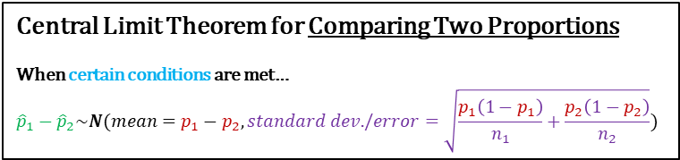
🔍
Distribution of pˆ
Central Limit Theorem for Comparing Two Proportions
When certain conditions are met…
$${\hat{p}}_{1}−{\hat{p}}_{2}\sim N(mean=p_{1}−p_{2},standard dev./error=\sqrt{\frac{p_{1}\left(1−p_{1}\right)}{n_{1}}+\frac{p_{2}\left(1−p_{2}\right)}{n_{2}}})$$
Problem: However, in Confidence intervals and Hypothesis Testing, we don’t know what p1 and p2 are….
(1-$α)\% Confidence Interval$
$$\left(point estimate\right)±z_{α/2}^{∗}SE$$
Test Statistic for Hypothesis Test
$$z=\frac{\left(point estimate\right)−(null value)}{SE }$$

Slide 17
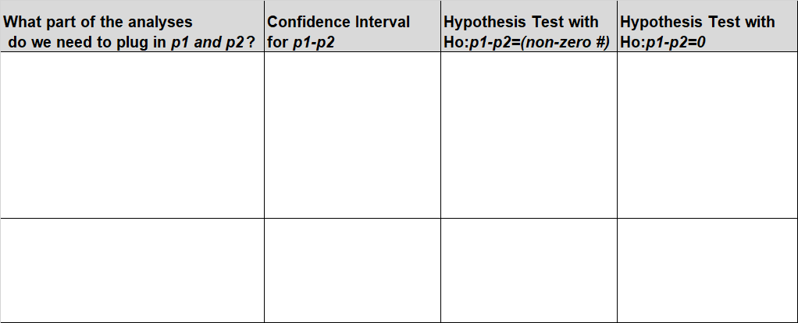
🔍
For HT where H₀ : p₁ = p₂, pool!
3

Slide 18
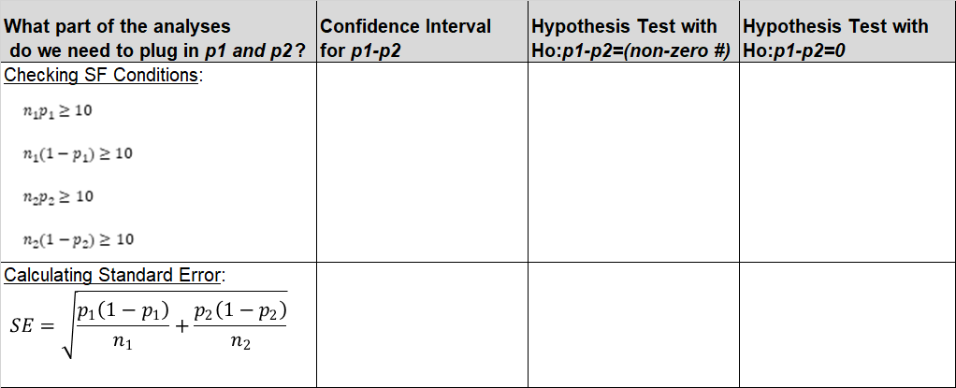
🔍
For HT where H₀ : p₁ = p₂, pool!
3

Slide 19
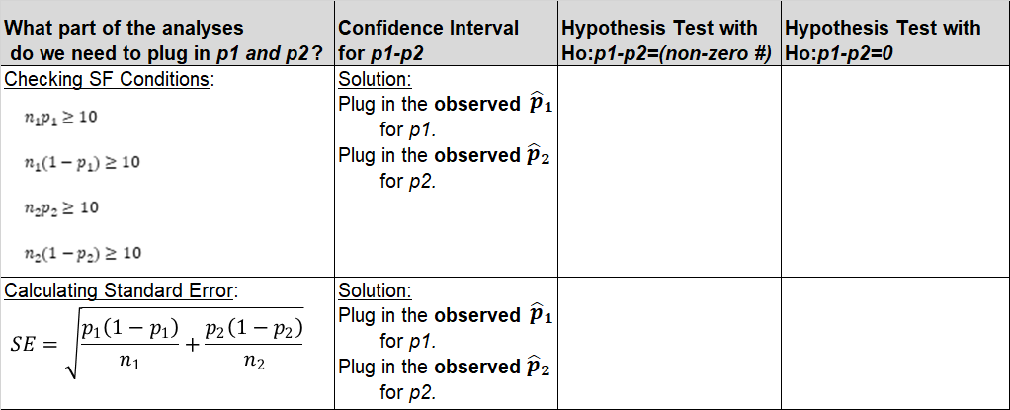
🔍
For HT where H₀ : p₁ = p₂, pool!
3

Slide 20
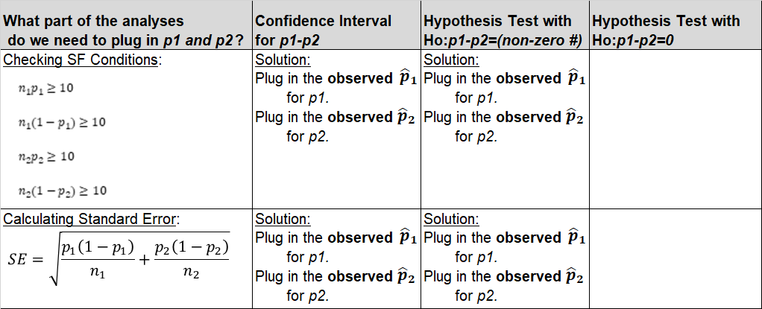
🔍
For HT where H₀ : p₁ = p₂, pool!
3

Slide 21
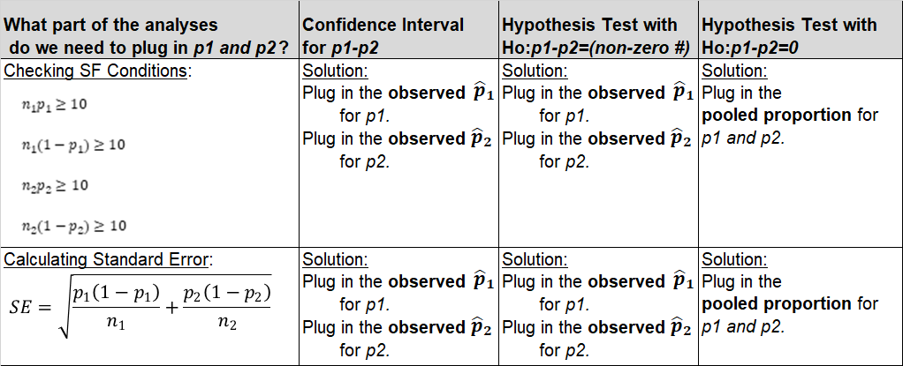
🔍
For HT where H₀ : p₁ = p₂, pool!
3

Slide 22
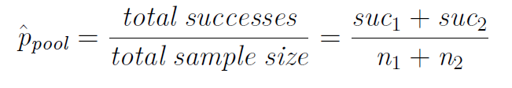
🔍
For HT where H₀ : p₁ = p₂, pool!
Expected proportion of success for both groups when
H₀ : p₁ = p₂ is deﬁned as the pooled proportion:
3

Slide 23
Suppose in group 1, 30 out of 50 observations are successes and in group 2, 20 out of 60 observations are successes. What is the pooled proportion?
🔍
Clicker question
(a)
(b)
(c)
(d)
(e)
30
50
20
60
30 ₊ 20
50 60
30+20
50+60
30 ₊20
50 60
2
4

Slide 24
Suppose in group 1, 30 out of 50 observations are successes and in group 2, 20 out of 60 observations are successes. What is the pooled proportion?
🔍
Clicker question
(a)
(b)
(c)
(d)
(e)
30
50
20
60
30 ₊ 20
50 60
30+20
50+60
30 ₊20
50 60
2
4

Slide 25
Outline
Housekeeping
Main ideas: a Categorical Independent Variable (two levels) and a Categorical Dependent Variable (two levels)
  Theoretical Hypothesis Testing and Confidence Intervals: 🔍 CLT also describes the distribution of pˆ₁ − pˆ₂
  Different Protocol for CI vs. HT: 🔍 🔮 For HT where H₀ : p₁ = p₂, pool!
  CLT Conditions: 🔍 When S-F fails, simulate!
🔍 ✋ 👫 🖳 Applications
Summary

Slide 26
Focus today:
Categorical Response Variable (2 levels) and Categorical Explanatory Variable (2 levels)
Population Parameter: $p_{1}−p_{2}$
  $p_{1}$= proportion of “successes” in group 1
  $p_{2}$= proportion of “successes” in group 2
When to use each method
Construct confidence intervals and hypothesis tests using Central Limit Theorem methods.
Conduct a hypothesis test for p with randomization testing.
Create a confidence interval for p with bootstrapping.

Slide 27
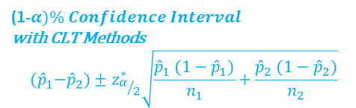

Simulation vs. theoretical inference
🔍
Conditions:
▶ Independence:
  Random sample/assignment for both samples
  10% rule for both samples
▶ Shape/Skew:
    “Success/Failure Conditions:”
      $n_{1}{\hat{p}}_{1}≥10$,
      $n_{2}{\hat{p}}_{2}≥10$
      $n_{2}(1−{\hat{p}}_{2})≥10$
Confidence Interval for p1-p2
Condition met:
Condition NOT met:
(1-$α)\% Confidence Interval$
with CLT Methods
$${(\hat{p}}_{1}−{\hat{p}}_{2})±z_{α/2}^{∗}\sqrt{\frac{{\hat{p}}_{1} (1−{\hat{p}}_{1})}{n_{1}}+\frac{{\hat{p}}_{2} (1−{\hat{p}}_{2})}{n_{2}}}$$
(1-α)% Confidence Interval with Bootstrapping

Slide 28
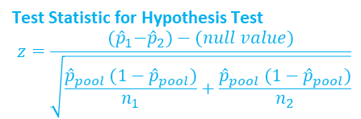
Simulation vs. theoretical inference
🔍
Conditions:
▶ Independence:
  Random sample/assignment for both samples
  10% rule for both samples
▶ Shape/Skew:
    “Success/Failure Conditions:”
      $n_{1}{\hat{p}}_{1}≥10$,
      $n_{2}{\hat{p}}_{2}≥10$
      $n_{2}(1−{\hat{p}}_{2})≥10$
Hypothesis Test for p1-p2
Condition met:
Condition NOT met:
Test Statistic for Hypothesis Test
$$z=\frac{{(\hat{p}}_{1}−{\hat{p}}_{2})−(null value)}{\sqrt{\frac{{\hat{p}}_{pool} (1−{\hat{p}}_{pool})}{n_{1}}+\frac{{\hat{p}}_{pool} (1−{\hat{p}}_{pool})}{n_{2}}}}$$
Randomization Testing

Slide 29
Outline
Housekeeping
Main ideas: a Categorical Independent Variable (two levels) and a Categorical Dependent Variable (two levels)
  Theoretical Hypothesis Testing and Confidence Intervals: 🔍 CLT also describes the distribution of pˆ₁ − pˆ₂
  Different Protocol for CI vs. HT: 🔍 🔮 For HT where H₀ : p₁ = p₂, pool!
  CLT Conditions: 🔍 When S-F fails, simulate!
🔍 ✋ 👫 🖳 Applications
Summary

Slide 30
On the perils of living dangerously in the slasher horror ﬁlm
🔍 ✋ 👫
Abstract: The slasher horror ﬁlm has been deplored based on claims that it depicts eroticized violence against predominately female characters as punishment for sexual activities. To test this assertion, a quantitative content analysis was conducted to examine the extent to which gender differences are evident in the association between character survival and engagement in sexual activities.
Information pertaining to gender, engagement in sexual activities, and survival was coded for ﬁlm characters from a simple random sample of 50 English-language, North American slasher ﬁlms released between 1960 and 2009.
Welsh, Andrew. “On the perils of living dangerously in the slasher horror ﬁlm: Gender differences in the association between sexual activity and survival.” Sex Roles 62.11-12 (2010): 762-773.

Slide 31
On the perils of living dangerously in the slasher horror ﬁlm
🔍 ✋ 👫
Abstract: The slasher horror ﬁlm has been deplored based on claims that it depicts eroticized violence against predominately female characters as punishment for sexual activities. To test this assertion, a quantitative content analysis was conducted to examine the extent to which gender differences are evident in the association between character survival and engagement in sexual activities.
Information pertaining to gender, engagement in sexual activities, and survival was coded for ﬁlm characters from a simple random sample of 50 English-language, North American slasher ﬁlms released between 1960 and 2009.
Welsh, Andrew. “On the perils of living dangerously in the slasher horror ﬁlm: Gender differences in the association between sexual activity and survival.” Sex Roles 62.11-12 (2010): 762-773.

Slide 32
On the perils of living dangerously in the slasher horror ﬁlm
🔍 ✋ 👫
Let’s ask two research questions about relationships, controlling for gender.
“If you are a male, is there an relationship between having sex in a slasher film and surviving?”
“If you are a female, is there an relationship between having sex in a slasher film and surviving?”

Slide 33
On the perils of living dangerously in the slasher horror ﬁlm
🔍 ✋ 👫
Let’s ask two research questions about relationships, controlling for gender.
Filter for males
“If you are a male, is there an relationship between having sex in a slasher film and surviving?”
“If you are a female, is there an relationship between having sex in a slasher film and surviving?”
Categorical Explanatory Variable,
2 levels
Categorical
Response Variable,
2 levels

Slide 34
On the perils of living dangerously in the slasher horror ﬁlm
🔍 ✋ 👫
Let’s ask two research questions about relationships, controlling for gender.
Filter for males
“If you are a male, is there an relationship between having sex in a slasher film and surviving?”
“If you are a female, is there an relationship between having sex in a slasher film and surviving?”
Categorical Explanatory Variable,
2 levels
Categorical
Response Variable,
2 levels
Comparing Two Proportions Test

Slide 35
On the perils of living dangerously in the slasher horror ﬁlm
🔍 ✋ 👫
Setting up hypotheses
for males
https://bloody-disgusting.com/editorials/3422854/slashing-back-revive-slasher-genre/

Slide 36
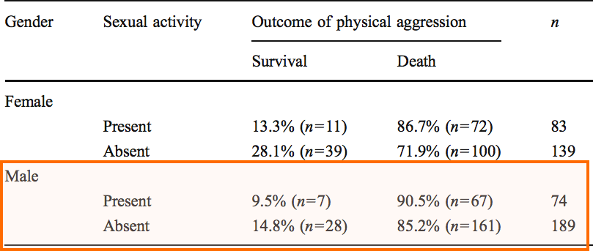
Is survival for male characters in slasher ﬁlms associated with sexual activity?
🔍 ✋ 👫
Males...
7

Slide 37


Is survival for male characters in slasher ﬁlms associated with sexual activity?
🔍 ✋ 👫
Males...
$$Ho: p_{present}−p_{absent}=0$$
$$Ha: p_{present}−p_{absent}≠0$$
$p_{present}$ proportion of males that had sex that survived
$p_{absent}$ proportion of males that had no sex that survived
7

Slide 38
On the perils of living dangerously in the slasher horror ﬁlm
🔍 ✋ 👫
Should we use CLT methods or randomization testing to conduct this hypothesis test (for males)?
https://bloody-disgusting.com/editorials/3422854/slashing-back-revive-slasher-genre/

Slide 39
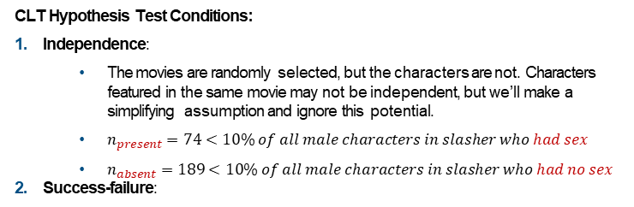
Is survival for male characters in slasher ﬁlms associated with sexual activity?
🔍 ✋ 👫
Males...
$$Ho: p_{present}−p_{absent}=0$$
$$Ha: p_{present}−p_{absent}≠0$$
$p_{present}$ proportion of males that had sex that survived
$p_{absent}$ proportion of males that had no sex that survived
CLT Hypothesis Test Conditions:
Independence:
  The movies are randomly selected, but the characters are not. Characters featured in the same movie may not be independent, but we’ll make a simplifying assumption and ignore this potential.
  $n_{present}=74<10\% of all male characters in slasher who had sex$
  $n_{absent}=189<10\% of all male characters in slasher who had no sex$
Success-failure:
Next slide
7

Slide 40
Assuming that the null hypothesis (H₀ : p_{sex present} = p_{sex absent}) is true, which of the following is the pooled proportion of characters who survived?
🔍 ✋ 👫
Clicker question
(a) ⁷ = 0.095
(b)
(c)
(d)
(e)
74
²⁸ = 0.148
189
⁷ = 0.027
74+189
⁷⁺²⁸ = 0.133
74+189
67+161 _{= 0.867}
74+189

Slide 41
Assuming that the null hypothesis (H₀ : p_{sex present} = p_{sex absent}) is true, which of the following is the pooled proportion of characters who survived?
🔍 ✋ 👫
Clicker question
(a) ⁷ = 0.095
(b)
(c)
(d)
(e)
74
²⁸ = 0.148
189
⁷ = 0.027
74+189
⁷⁺²⁸ = 0.133
Total Successes (survivals)
Total Sample Size
74+189
67+161 _{= 0.867}
74+189

Slide 42
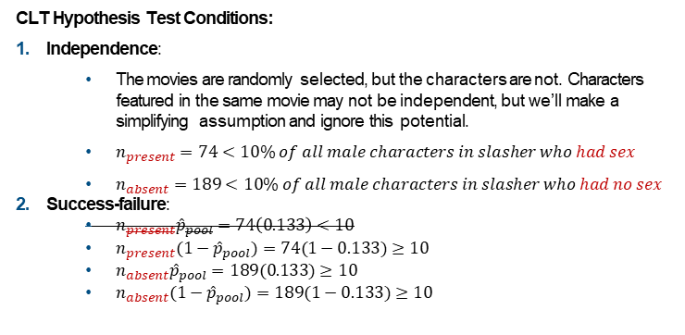
Is survival for male characters in slasher ﬁlms associated with sexual activity?
🔍 ✋ 👫
Males...
CLT Hypothesis Test Conditions:
Independence:
  The movies are randomly selected, but the characters are not. Characters featured in the same movie may not be independent, but we’ll make a simplifying assumption and ignore this potential.
  $n_{present}=74<10\% of all male characters in slasher who had sex$
  $n_{absent}=189<10\% of all male characters in slasher who had no sex$
Success-failure:
  $n_{present}{\hat{p}}_{pool}=74\left(0.133\right)<10$
  $n_{present}{(1−\hat{p}}_{pool})=74(1−0.133)≥10$
  $n_{absent}{\hat{p}}_{pool}=189(0.133)≥10$
  $n_{absent}{(1−\hat{p}}_{pool})=189(1−0.133)≥10$
SF conditions not met, use a Randomization Test!
7

Slide 43
On the perils of living dangerously in the slasher horror ﬁlm
🔍 ✋ 👫
Interpreting number of successes and failures (with male pooled survival proportion).
https://bloody-disgusting.com/editorials/3422854/slashing-back-revive-slasher-genre/

Slide 44
Clicker question
🔍 ✋ 👫
Assuming that the null hypothesis (H₀ : p_{sex present} = p_{sex absent}) is true, how many males characters involved in sexual activity are expected to survive?
(a) 0.133 × (28 + 7) = 4.655
(b) 0.133 × 74 = 9.842
(c) 0.133 × (74 + 189) = 34.979
(d) 7
(e) 7 + 28 = 35

Slide 45
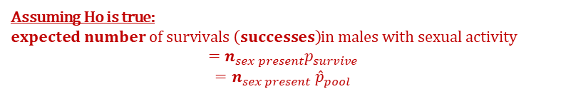
Clicker question
🔍 ✋ 👫
Assuming that the null hypothesis (H₀ : p_{sex present} = p_{sex absent}) is true, how many males characters involved in sexual activity are expected to survive?
(a) 0.133 × (28 + 7) = 4.655
(b) 0.133 × 74 = 9.842
(c) 0.133 × (74 + 189) = 34.979
(d) 7
(e) 7 + 28 = 35
Assuming Ho is true:
$expected number of survivals \left(successes\right)$in males with sexual activity
$$={n_{sex present}p}_{survive}$$
$${{=n}_{sex present}\hat{p}}_{pool}$$

Slide 46
On the perils of living dangerously in the slasher horror ﬁlm
🔍 ✋ 👫
Creating a Randomization Distribution for the difference in male survival rates (sex vs. not sex).
https://bloody-disgusting.com/editorials/3422854/slashing-back-revive-slasher-genre/

Slide 47
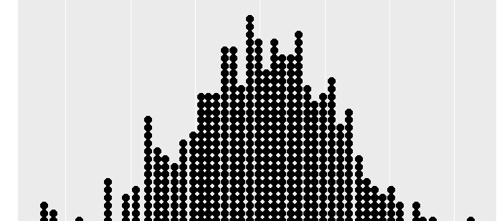
Simulation setup
🔮 ✋
Generating the Randomization Distribution (two categorical variables).
Write the response variable values from the sample data on index cards
(263 cards =total number of male characters)
35 say “survived”, 228 say “not survived”
Do the following many times:
  Shuffle the index cards 7 times.
  Deal the index cards into two groups:
    “Sex Group” (# of cards = 74)
    “No Sex Group” (# of cards = 189)
  Note the difference in proportions of “survived” cards between the sex group and no sex group and plot this difference in a dot plot.
Randomization Distribution
8

Slide 48
On the perils of living dangerously in the slasher horror ﬁlm
🔍 ✋ 👫
Calculating the p-value (for male hypothesis test).
https://bloody-disgusting.com/editorials/3422854/slashing-back-revive-slasher-genre/

Slide 49
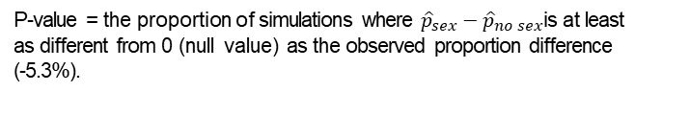

Simulation scheme
🔍 ✋ 👫
P-value = the proportion of simulations where ${\hat{p}}_{sex}−{\hat{p}}_{no sex}$is at least as different from 0 (null value) as the observed proportion difference (-5.3%).
Randomization Distribution
0
$${\hat{p}}_{sex}−{\hat{p}}_{no sex}$$
10

Slide 50
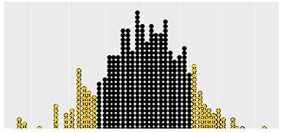
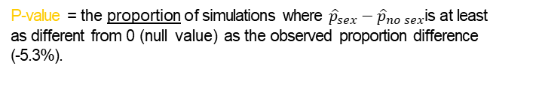
Simulation scheme
🔍 ✋ 👫
P-value = the proportion of simulations where ${\hat{p}}_{sex}−{\hat{p}}_{no sex}$is at least as different from 0 (null value) as the observed proportion difference (-5.3%).
Randomization Distribution
-5.3%
0
5.3%
$${\hat{p}}_{sex}−{\hat{p}}_{no sex}$$
10

Slide 51
Simulate in R
🔍 ✋ 👫
🖳
# read and subset data for males
slasher <- read.csv("https://stat.duke.edu/~mc301/data/slasher.csv") slasher_m <- slasher >
filter(gender == "male")
# load inference function load(url("https://stat.duke.edu/~mc301/R/fun/inference.RData"))
# run the hypothesis test
inference(y = outcome, x = sexual_activity, data = slasher_m, success = "survival", statistic = "proportion", type = "ht", null = 0, alternative = "twosided", method = "simulation", seed = 66613)
11

Slide 52
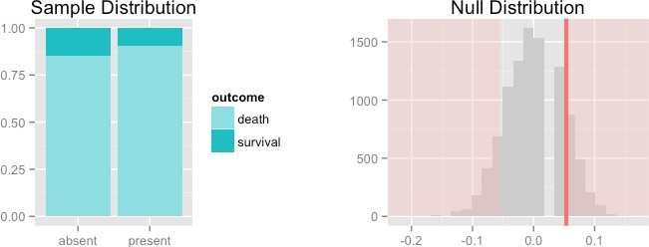
Simulate in R
🔍 ✋ 👫
🖳
# read and subset data for males
slasher <- read.csv("https://stat.duke.edu/~mc301/data/slasher.csv") slasher_m <- slasher >
filter(gender == "male")
# load inference function load(url("https://stat.duke.edu/~mc301/R/fun/inference.RData"))
# run the hypothesis test
inference(y = outcome, x = sexual_activity, data = slasher_m, success = "survival", statistic = "proportion", type = "ht", null = 0, alternative = "twosided", method = "simulation", seed = 66613)
Response variable: categorical (2 levels), Explanatory variable: categorical (2 levels) n_absent = 189, p_hat_absent = 0.1481
n_absent = 74, p_hat_absent = 0.0946
H0: p_pres = p_absent HA: p_pres != p_absent p_value = 0.3465
11

Slide 53
“If
“If you are a female, is there an relationship between having sex in a slasher film and surviving?”
Application exercise: App Ex 5.2
See course website for details.
https://bloody-disgusting.com/editorials/3422854/slashing-back-revive-slasher-genre/
12

Slide 54
Summary of main ideas
CLT also describes the distribution of pˆ₁ − pˆ₂
For HT where H₀ : p₁ = p₂, pool!
When S-F fails, simulate!
13

