Slide 1

Unit 5: Inference for categorical data
3. Chi-square testing
Sta 101 - Spring 2019
Duke University, Department of Statistical Science
Dr. Ellison
Slides posted at https://www2.stat.duke.edu/courses/Spring19/sta101.001/

Slide 2
Outline
Housekeeping
Main ideas: Analyses that involve categorical variable(s) with >2 levels
  Which analysis to use: Categorical data: 2 levels → Z, >2 levels → χ² square
  χ² Distribution Properties: The χ² statistic is always positive and right skewed
  Conditions for χ² Analyses: At least 5 expected successes for χ² testing
Application exercises
Summary

Slide 3
Announcements
Coming up…
▶ Problem Set 5 due Wednesday 3/27
▶ Midterm 2 Review Wednesday 3/27
▶ Midterm 2 Review Thursday 3/28
▶ Performance Assessment 5 due Sunday 3/31
▶ Midterm 2 Monday 4/1

Slide 4
Outline
Housekeeping
Main ideas: Analyses that involve categorical variable(s) with >2 levels
  Which analysis to use: Categorical data: 2 levels → Z, >2 levels → χ² square
  χ² Distribution Properties: The χ² statistic is always positive and right skewed
  Conditions for χ² Analyses: At least 5 expected successes for χ² testing
Application exercises
Summary

Slide 5

Last week… (5.1 and 5.2)
Categorical Variable(s) involved have only 2 levels

Slide 6
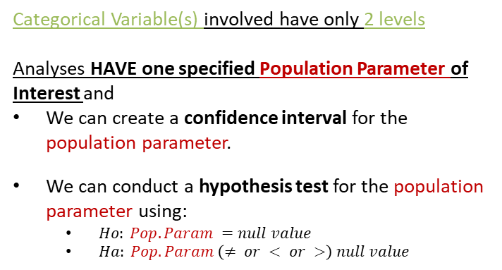
Last week… (5.1 and 5.2)
Categorical Variable(s) involved have only 2 levels
Analyses HAVE one specified Population Parameter of Interest and
We can create a confidence interval for the population parameter.
We can conduct a hypothesis test for the population parameter using:
  $Ho: Pop. Param =null value$
  $Ha: Pop. Param \left(≠ or < or >\right) null value$

Slide 7
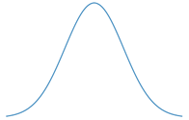
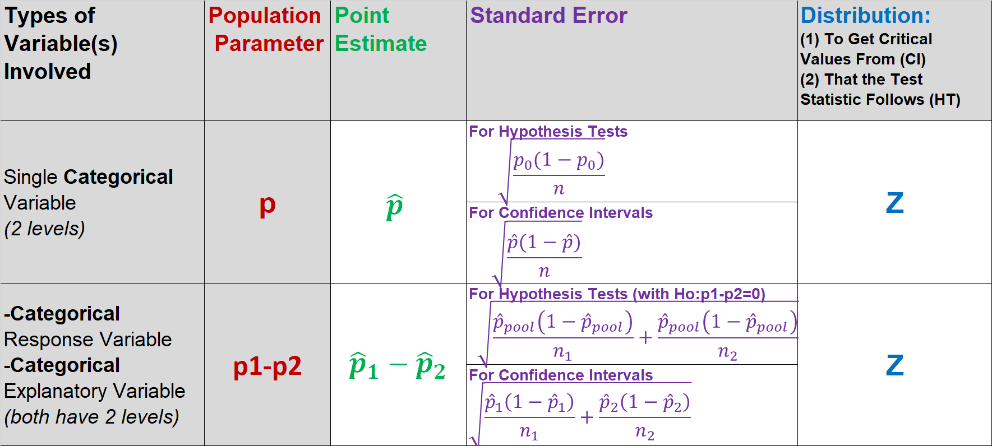

Outline
Central Limit Theorem
Confidence Interval for Population Parameter
$$(point estimate)±\left(crit. value\right)SE$$

Slide 8


Outline
Central Limit Theorem
Hypothesis Testing for Population Parameter
$$Ho:pop. param=null value$$
$$Ha:pop. param(≠or>or<)null value$$
$$Test−Stat=\frac{\left(point estimate\right)−null value}{SE}$$

Slide 9

Today… (5.3)
At least one of the Categorical Variable(s) involved has >2 levels

Slide 10
Today… (5.3)
At least one of the Categorical Variable(s) involved has >2 levels
Analyses that DON’T HAVE one specified Population Parameter of Interest and
No confidence interval framework
Hypothesis tests set up are different

Slide 11
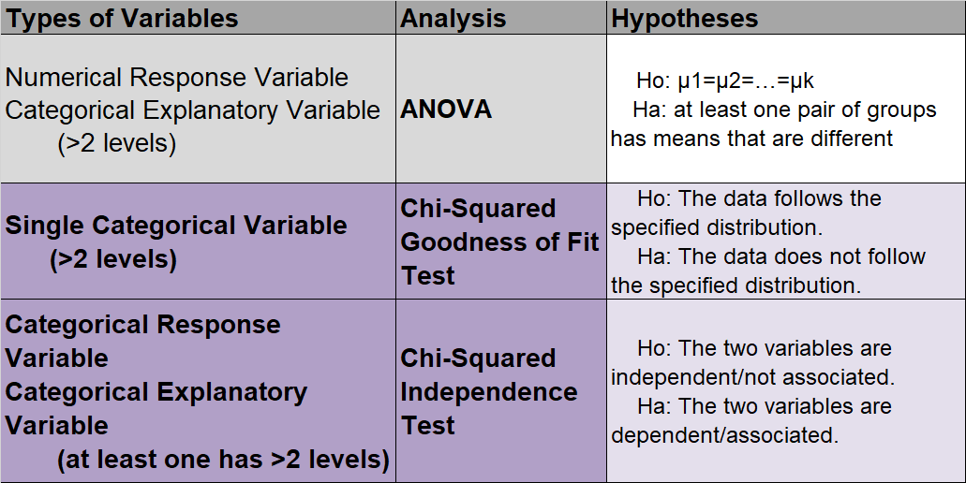
Outline

Slide 12

Determining which test to use.

Slide 13
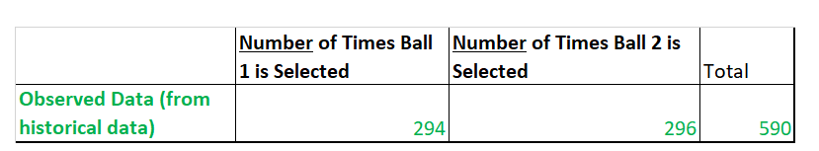
Clicker question
In a children’s game that teaches kids about probability, the child can randomly select from a set of 2 green balls in the basket (labeled 1 and 2). We have historical data from the toy that indicates how often each of the balls were picked. We want to ﬁnd out if each number is equally likely to be drawn by the child. Which test is most appropriate?
Z test for a single proportion
Z test for comparing two proportions
χ² test of goodness of ﬁt
χ² test of independence

Slide 14
Clicker question
In a children’s game that teaches kids about probability, the child can randomly select from a set of 2 green balls in the basket (labeled 1 and 2). We have historical data from the toy that indicates how often each of the balls were picked. We want to ﬁnd out if each number is equally likely to be drawn by the child. Which test is most appropriate?
Z test for a single proportion
Z test for comparing two proportions
χ² test of goodness of ﬁt
χ² test of independence

Slide 15
Clicker question
In a children’s game that teaches kids about probability, the child can randomly select from a set of 2 green balls in the basket (labeled 1 and 2). We have historical data from the toy that indicates how often each of the balls were picked. We want to ﬁnd out if each number is equally likely to be drawn by the child. Which test is most appropriate?
Z test for a single proportion
Z test for comparing two proportions
χ² test of goodness of ﬁt
χ² test of independence
One categorical variable
with 2 levels (ball 1 picked, ball 2 picked)

Slide 16
Clicker question
In a children’s game that teaches kids about probability, the child can randomly select from a set of 2 green balls in the basket (labeled 1 and 2). We have historical data from the toy that indicates how often each of the balls were picked. We want to ﬁnd out if each number is equally likely to be drawn by the child. Which test is most appropriate?
Ho: p = 1/2
Ha: p ≠ 1/2
p=probability of ball 1 being drawn

Slide 17
Clicker question
In a children’s game that teaches kids about probability, the child can randomly select from a set of 2 green balls in the basket (labeled 1 and 2). We have historical data from the toy that indicates how often each of the balls were picked. We want to ﬁnd out if each number is equally likely to be drawn by the child. Which test is most appropriate?
Ho: p = 1/2
Ha: p ≠ 1/2
p=probability of ball 1 being drawn
Inference on p automatically conducts
inference on (1-p)=probability of ball 2 being drawn

Slide 18

Determining which test to use.
https://www.fool.com/retirement/2017/09/13/how-does-the-powerball-annuity-work.aspx

Slide 19

Clicker question
In the basic Powerball game players select 5 numbers from a set of 59 white balls. We have historical data from lottery outcomes such that we are able to calculate how many times each of the 59 white balls were picked. We want to ﬁnd out if each number is equally likely to be drawn. Which test is most appropriate?
Z test for a single proportion
Z test for comparing two proportions
χ² test of goodness of ﬁt
χ² test of independence
https://www.fool.com/retirement/2017/09/13/how-does-the-powerball-annuity-work.aspx

Slide 20
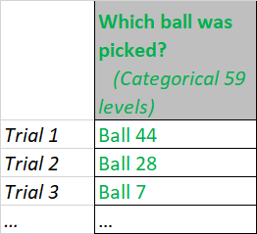
Clicker question
In the basic Powerball game players select 5 numbers from a set of 59 white balls. We have historical data from lottery outcomes such that we are able to calculate how many times each of the 59 white balls were picked. We want to ﬁnd out if each number is equally likely to be drawn. Which test is most appropriate?
Z test for a single proportion
Z test for comparing two proportions
χ² test of goodness of ﬁt
χ² test of independence
One categorical variable
with >2 levels (ball 1 picked, ball 2 picked,… ball 59 picked)

Slide 21
Clicker question
In the basic Powerball game players select 5 numbers from a set of 59 white balls. We have historical data from lottery outcomes such that we are able to calculate how many times each of the 59 white balls were picked. We want to ﬁnd out if each number is equally likely to be drawn. Which test is most appropriate?
Z test for a single proportion
Z test for comparing two proportions
χ² test of goodness of ﬁt
χ² test of independence
One Categorical Variable of Interest (>2 levels): Powerball outcomes 59 levels.
Want to compare it to a “specified distribution”

Slide 22
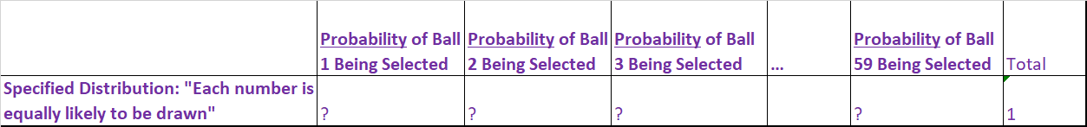
Clicker question
In the basic Powerball game players select 5 numbers from a set of 59 white balls. We have historical data from lottery outcomes such that we are able to calculate how many times each of the 59 white balls were picked. We want to ﬁnd out if each number is equally likely to be drawn. Which test is most appropriate?
χ² test of goodness of ﬁt
Ho: The data follows the specified distribution
Ha: The data does not follow the specified distribution

Slide 23

Clicker question
In the basic Powerball game players select 5 numbers from a set of 59 white balls. We have historical data from lottery outcomes such that we are able to calculate how many times each of the 59 white balls were picked. We want to ﬁnd out if each number is equally likely to be drawn. Which test is most appropriate?
χ² test of goodness of ﬁt
Ho: The data follows the specified distribution
Ha: The data does not follow the specified distribution

Slide 24
Clicker question
If the data follows the specified distribution of interest (ie: each number is equally likely to be drawn), then what would be the expected number of times ball 3 would have been selected?
8
10
1/59
8/59

Slide 25
Clicker question
If the data follows the specified distribution of interest (ie: each number is equally likely to be drawn), then what would be the expected number of times ball 3 would have been selected?
8
10= np3 =590 (1/59)
1/59
8/59

Slide 26
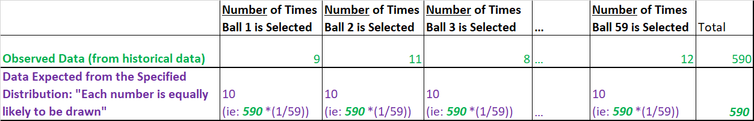
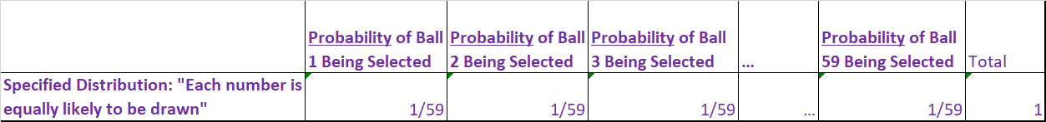
χ² test of goodness of ﬁt
Ho: The data does resemble a specified distribution
Ha: The data does not resemble a specified distribution

Slide 27
χ² test of goodness of ﬁt
Ho: The data does resemble a specified distribution
Ha: The data does not resemble a specified distribution

Slide 28
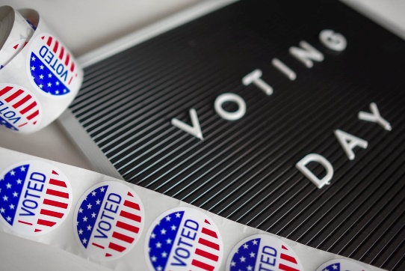
Determining which test to use.

Slide 29
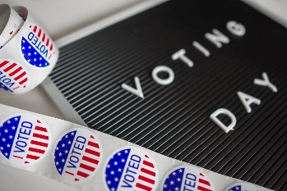
Clicker question
A Gallup poll asked whether or not respondents identify as Tea Party Republican (yes / no) and whether or not they are motivated to vote in the upcoming midterm election (yes / no). We want to ﬁnd out whether being a Tea Party Republican is associated with motivation to vote. Which test is most appropriate?
Z test for a single proportion
Z test for comparing two proportions
χ² test of goodness of ﬁt
χ² test of independence

Slide 30
Clicker question
A Gallup poll asked whether or not respondents identify as Tea Party Republican (yes / no) and whether or not they are motivated to vote in the upcoming midterm election (yes / no). We want to ﬁnd out whether being a Tea Party Republican is associated with motivation to vote. Which test is most appropriate?
Z test for a single proportion
Z test for comparing two proportions
χ² test of goodness of ﬁt
χ² test of independence
Categorical variable with 2 levels
Categorical variable with 2 levels

Slide 31
Clicker question
A Gallup poll asked whether or not respondents identify as Tea Party Republican (yes / no) and whether or not they are motivated to vote in the upcoming midterm election (yes / no). We want to ﬁnd out whether being a Tea Party Republican is associated with motivation to vote. Which test is most appropriate?
H₀ : p_{TPR} = p_{Other},
H_{a} : p_{TPR} ≠ p_{Other},
p_{TPR} = probability/proportion of all TPR members motivated to vote
p_{Other} = probability/proportion of all non-TPR members motivated to vote

Slide 32
Clicker question
A Gallup poll asked whether or not respondents identify as Tea Party Republican (yes / no) and whether or not they are motivated to vote in the upcoming midterm election (yes / no). We want to ﬁnd out whether being a Tea Party Republican is associated with motivation to vote. Which test is most appropriate?
H₀ : p_{TPR} = p_{Other},
H_{a} : p_{TPR} ≠ p_{Other},
Equivalent to saying
H₀ : P(motivated to vote|TPR) = P(motivated to vote|other) ,
H_{a} : P(motivated to vote|TPR) ≠ P(motivated to vote|other)

Slide 33
Clicker question
A Gallup poll asked whether or not respondents identify as Tea Party Republican (yes / no) and whether or not they are motivated to vote in the upcoming midterm election (yes / no). We want to ﬁnd out whether being a Tea Party Republican is associated with motivation to vote. Which test is most appropriate?
H₀ : p_{TPR} = p_{Other},
H_{a} : p_{TPR} ≠ p_{Other},
Equivalent to saying
H₀ : P(motivated to vote|TPR) = P(motivated to vote|other) ,
H_{a} : P(motivated to vote|TPR) ≠ P(motivated to vote|other)
Equivalent to saying
H₀ : Tea Party affiliation is not associated (or independent) with being motivated to vote
H_{a} : Tea Party affiliation is associated (or dependent) with being motivated to vote

Slide 34
Determining which test to use.

Slide 35
Suppose the Gallup poll instead asked about
Clicker question
▶ party afﬁliation (Tea Party Republican, Other Republican, and Non-Republican), and
▶ motivation to vote (extremely unmotivated, very unmotivated, unmotivated, motivated, very motivated, extremely motivated)
We want to ﬁnd out whether party afﬁliation is associated with motivation to vote. Which test is most appropriate?
Z test for a single proportion
Z test for comparing two proportions
χ² test of goodness of ﬁt
χ² test of independence

Slide 36
Suppose the Gallup poll instead asked about
Clicker question
▶ party afﬁliation (Tea Party Republican, Other Republican, and Non-Republican), and
▶ motivation to vote (extremely unmotivated, very unmotivated, unmotivated, motivated, very motivated, extremely motivated)
We want to ﬁnd out whether party afﬁliation is associated with motivation to vote. Which test is most appropriate?
Z test for a single proportion
Z test for comparing two proportions
χ² test of goodness of ﬁt
χ² test of independence
Categorical variable with >2 levels
Categorical variable with >2 levels
H₀ : Party afﬁliation and motivation to vote are independent/not associated
H_{a} : Party afﬁliation and motivation to vote are dependent/associated

Slide 37
Outline
Housekeeping
Main ideas: Analyses that involve categorical variable(s) with >2 levels
  Which analysis to use: Categorical data: 2 levels → Z, >2 levels → χ² square
  χ² Distribution Properties: The χ² statistic is always positive and right skewed
  Conditions for χ² Analyses: At least 5 expected successes for χ² testing
Application exercises
Summary

Slide 38
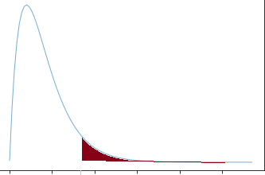
What is the test statistic for:
Chi-Squared Goodness of Fit Test?
Chi-Squared Independence Test?

Slide 39
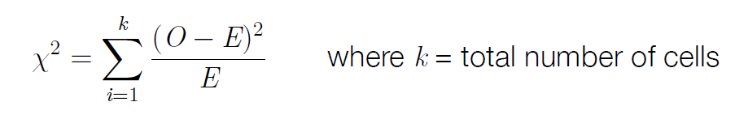
What is the test statistic for:
Chi-Squared Goodness of Fit Test?
Chi-Squared Independence Test?
It’s the same calculation!
2

Slide 40
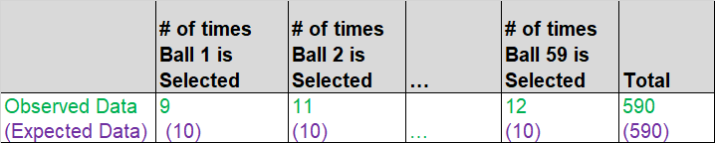
χ² statistic: When dealing with counts and investigating how far the observed counts are from the expected counts, we use a new test statistic called the chi-square (χ²) statistic:
The χ² statistic
Observed # in cell i
Expected # in cell i
Ex: Chi-Squared GOF, 59 cells

Slide 41
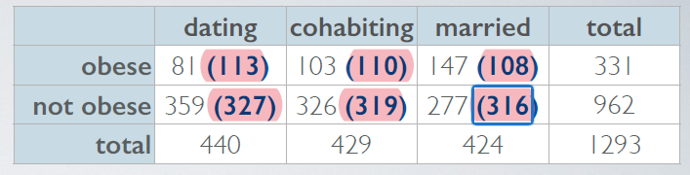
χ² statistic: When dealing with counts and investigating how far the observed counts are from the expected counts, we use a new test statistic called the chi-square (χ²) statistic:
The χ² statistic
Observed # in cell i
Expected # in cell i
Ex: Chi-Squared Independence Test, 6 cells

Slide 42
χ² statistic: When dealing with counts and investigating how far the observed counts are from the expected counts, we use a new test statistic called the chi-square (χ²) statistic:
The χ² statistic
Important points:
▶ Use counts (not proportions) in the calculation of the text statistic, even though we’re truly interested in the proportions for inference
▶ Expected counts are calculated assuming the null hypothesis is true

Slide 43
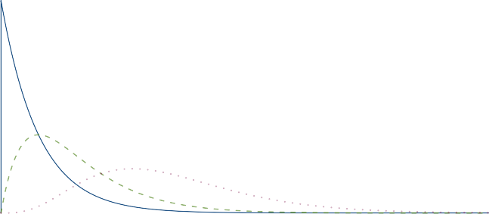
What are the degrees of freedom for the test statistic for a:
Chi-Squared Goodness of Fit Test?
Chi-Squared Independence Test?
Degrees of Freedom
2
4
9
0
5
10
15
20
25

Slide 44
The χ² distribution
The χ² distribution has just one parameter, degrees of freedom (df), which inﬂuences the shape, center, and spread of the distribution.
Degrees of Freedom
2
4
9
0
5
10
15
20
25

Slide 45
The χ² distribution
The χ² distribution has just one parameter, degrees of freedom (df), which inﬂuences the shape, center, and spread of the distribution.
▶ For χ² GOF test: df = k − 1
▶ For χ² independence test: df = (R − 1) × (C − 1)
Degrees of Freedom
2
4
9
0
5
10
15
20
25

Slide 46
The χ² distribution
The χ² distribution has just one parameter, degrees of freedom (df), which inﬂuences the shape, center, and spread of the distribution.
▶ For χ² GOF test: df = k − 1
▶ For χ² independence test: df = (R − 1) × (C − 1)
# of levels of the one categorical variable
# of levels of categorical variable 1 (or Rows in the counts table)
# of levels of categorical variable 2 (or Columns in the counts table)
Degrees of Freedom
2
4
9
0
5
10
15
20
25

Slide 47
Finding areas under the chi-square curve
p-value = P(χ² ≥χ²-statistic)
=tail area under the chi-square distribution (as usual)

Slide 48
Finding areas under the chi-square curve
p-value = P(χ² ≥χ²-statistic)
=tail area under the chi-square distribution (as usual)
▶ Using the applet: https://gallery.shinyapps.io/dist_calc/

Slide 49
▶ Using the applet: https://gallery.shinyapps.io/dist_calc/
Finding areas under the chi-square curve
p-value = P(χ² ≥χ²-statistic)
=tail area under the chi-square distribution (as usual)
▶ Using R: pchisq()

Slide 50
▶ Using the applet: https://gallery.shinyapps.io/dist_calc/
Finding areas under the chi-square curve
p-value = P(χ² ≥χ²-statistic)
=tail area under the chi-square distribution (as usual)
▶ Using R: pchisq()
▶ Using the table: works a lot like the t table, but only provides upper tail values.
0
5
10
15
20
25
Upper | tail | 0.3 | 0.2 | 0.1 | 0.05 | 0.02 | 0.01 | 0.005 | 0.001
df | 1 2 3 4 5 | 1.07 2.41 3.66 4.88 6.06 | 1.64 3.22 4.64 5.99 7.29 | 2.71 4.61 6.25 7.78 9.24 | 3.84 5.99 7.81 9.49 11.07 | 5.41 7.82 9.84 11.67 13.39 | 6.63 9.21 11.34 13.28 15.09 | 7.88 10.60 12.84 14.86 16.75 | 10.83 13.82 16.27 18.47 20.52
6 · · · |  | 7.23 | 8.56 | 10.64 | 12.59 | 15.03 | 16.81 | 18.55 | 22.46

Slide 51
Outline
Housekeeping
Main ideas: Analyses that involve categorical variable(s) with >2 levels
  Which analysis to use: Categorical data: 2 levels → Z, >2 levels → χ² square
  χ² Distribution Properties: The χ² statistic is always positive and right skewed
  Conditions for χ² Analyses: At least 5 expected successes for χ² testing
Application exercises
Summary

Slide 52

What are the conditions for:
Chi-Squared Goodness of Fit Test?
Chi-Squared Independence Test?

Slide 53
Conditions for χ² testing
Conditions for χ² IndependenceTest
Independence:
  For each population: random sampling/assignment
  n1<10% of population 1, n2<10% of population 2,
  Each case contributes to only one cell in the table.
Sample size / distribution:
  Each expected cell must have at least 5 expected cases.

Slide 54
Conditions for χ² testing
Conditions for χ² IndependenceTest
Independence:
  For each population: random sampling/assignment
  n1<10% of population 1, n2<10% of population 2,
  Each case contributes to only one cell in the table.
Sample size / distribution:
  Each expected cell must have at least 5 expected cases.

Slide 55
Conditions for χ² testing
Conditions for χ² IndependenceTest
Independence:
  For each population: random sampling/assignment
  n<10% of population
  Each case contributes to only one cell in the table.
Sample size / distribution:
  Each cell must have at least 5 expected cases.

Slide 56

Determining which test to use.

Slide 57

Suppose a poll asked the following questions:
Clicker question
▶ How would you identify your socio-economic status: low, middle, high?
▶ What type of pet did you have growing up, select all that apply: cat, dog, ﬁsh, bird, rodent, none of the above?
What test is most appropriate for evaluating the relationship between these two variables?
Z test for a single proportion
Z test for comparing two proportions
χ² test of goodness of ﬁt
χ² test of independence
none of the above
10

Slide 58
Suppose a poll asked the following questions:
Clicker question
▶ How would you identify your socio-economic status: low, middle, high?
▶ What type of pet did you have growing up, select all that apply: cat, dog, ﬁsh, bird, rodent, none of the above?
What test is most appropriate for evaluating the relationship between these two variables?
Z test for a single proportion
Z test for comparing two proportions
χ² test of goodness of ﬁt
χ² test of independence
none of the above
  Condition Violated: Each case MUST contribute to only one cell in the table.

Slide 59
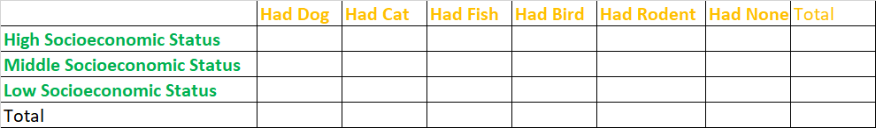
Suppose a poll asked the following questions:
Clicker question
▶ How would you identify your socio-economic status: low, middle, high?
▶ What type of pet did you have growing up, select all that apply: cat, dog, ﬁsh, bird, rodent, none of the above?
What test is most appropriate for evaluating the relationship between these two variables?
1
1
  Ex: I had dogs and cats growing up. My case contributed twice.-> CONDITIONS FOR χ² TEST OF INDEPENDENCE VIOLATED

Slide 60
Application exercise: 5.3 Chi-square tests
See course website for details.

Slide 61
Summary of main ideas
Categorical data: 2 levels → Z, >2 levels → χ² square
The χ² statistic is always positive and right skewed
At least 5 expected successes for χ² testing

