Slide 1

Unit 6: Introduction to linear regression
2. Outliers and inference for regression
Sta 101 - Spring 2019
Duke University, Department of Statistical Science
Dr. Ellison
Slides posted at https://www2.stat.duke.edu/courses/Spring19/sta101.001/

Slide 2
Outline
Housekeeping
Main ideas
  Assessing the Fit: Simple Linear Regression Model
    USING the Model:
      Predictions: Predicted values also have uncertainty around them
    UNDERSTANDING Relationships in the Model:
      Overall Fit of Model: R² assesses model ﬁt -- higher the better
      Individual Coefficients: Inference for regression uses the t-distribution
      Conditions/Diagnostic Checking
      Outliers: Type of outlier determines how it should be handled
Summary

Slide 3
Coming up…
Announcements
▶ Peer Evaluation 2 due Tuesday 4/9 11:55 pm
▶ Problem Set 6 due Wednesday 4/10
▶ Readiness Assessment 7 Wednesday 4/10
▶ Lab Assignment 10 due Friday 4/12 11:55pm (extension)
▶ Performance Assessment 6 due Sunday 4/14 11:55pm (opens today)
▶ Don’t forget the Project Stage 2 due in ~1.5 weeks

Slide 4
Outline
Housekeeping
Main ideas
  Assessing the Fit: Simple Linear Regression Model
    USING the Model:
      Predictions: Predicted values also have uncertainty around them
    UNDERSTANDING Relationships in the Model:
      Overall Fit of Model: R² assesses model ﬁt -- higher the better
      Individual Coefficients: Inference for regression uses the t-distribution
      Conditions/Diagnostic Checking
      Outliers: Type of outlier determines how it should be handled
Summary

Slide 5


Outline
Regression Models:
Using vs. Understanding

Slide 6
Outline
Regression Models:
Using: Make Predictions

Slide 7
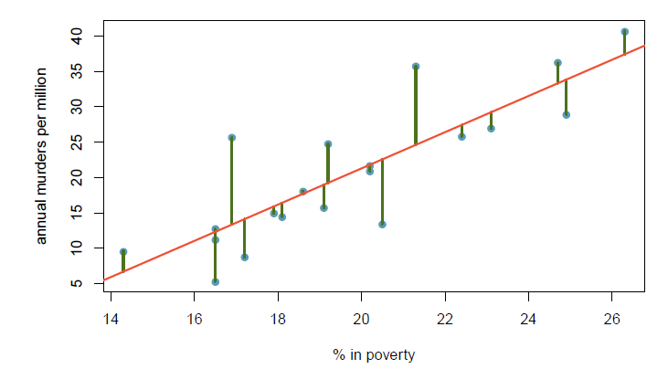
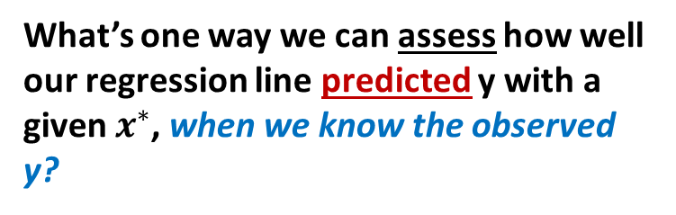
Outline
What’s one way we can assess how well our regression line predicted y with a given $x^{∗}$, when we know the observed y?

Slide 8

Outline
What’s one way we can assess how well our regression line predicted y with a given $x^{∗}$, when we know the observed y?
Residual of $x^{∗}$:$e=y−\hat{y}$

Slide 9
Uncertainty of predictions
▶ Regression models are useful for making predictions for new observations not include in the original dataset.

Slide 10
▶ Regression models are useful for making predictions for new observations not include in the original dataset.
Uncertainty of predictions
▶ If the model is good, the predictions should be close to the true value of the response variable for this observation, however it may not be exact, i.e. ˆy might be different than y.

Slide 11
▶ Regression models are useful for making predictions for new observations not include in the original dataset.
Uncertainty of predictions
▶ If the model is good, the predictions should be close to the true value of the response variable for this observation, however it may not be exact, i.e. ˆy might be different than y.
▶ With any prediction we can (and should) also report a measure of uncertainty of the prediction.

Slide 12
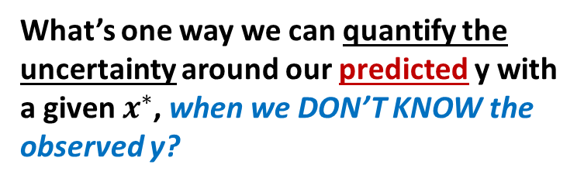
Outline
What’s one way we can quantify the uncertainty around our predicted y with a given $x^{∗}$, when we DON’T KNOW the observed y?

Slide 13
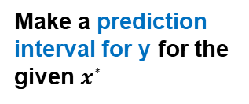
Outline
What’s one way we can quantify the uncertainty around our predicted y with a given $x^{∗}$, when we DON’T KNOW the observed y?
Make a prediction interval for y for the given $x^{∗}$

Slide 14
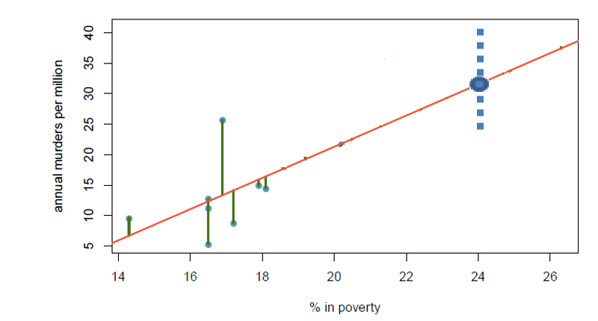
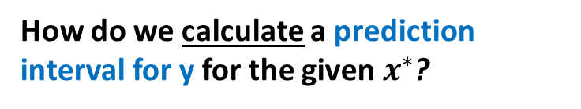
Outline
How do we calculate a prediction interval for y for the given $x^{∗}$?
(
(

Slide 15

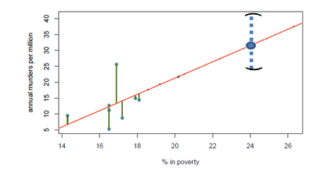

Prediction intervals for speciﬁc predicted values
A prediction interval for y for a given x⋆ is
$x^{∗}$ is a new observation that you plug into the regression equation (don’t usually know the corresponding observed y)
$$x^{∗}$$

Slide 16


Prediction intervals for speciﬁc predicted values
A prediction interval for y for a given x⋆ is
$x^{∗}$ is a new observation that you plug into the regression equation (don’t usually know the corresponding observed y)
$\hat{y}$ is the predicted response you get by plugging in $x^{∗}$ into the regression equation
$$\hat{y}$$
$$x^{∗}$$

Slide 17
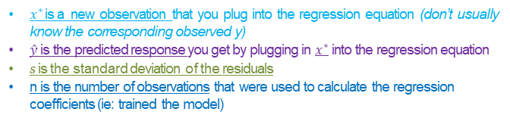
Prediction intervals for speciﬁc predicted values
A prediction interval for y for a given x⋆ is
$x^{∗}$ is a new observation that you plug into the regression equation (don’t usually know the corresponding observed y)
$\hat{y}$ is the predicted response you get by plugging in $x^{∗}$ into the regression equation
s is the standard deviation of the residuals
n is the number of observations that were used to calculate the regression coefficients (ie: trained the model)
$$\hat{y}$$
$$x^{∗}$$

Slide 18
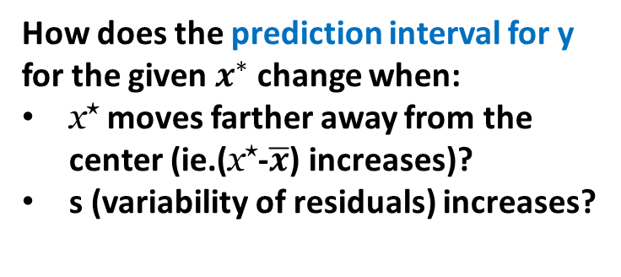
Outline
How does the prediction interval for y for the given $x^{∗}$ change when:
x⋆ moves farther away from the center (ie.(x⋆-$\overline{x}$) increases)?
s (variability of residuals) increases?

Slide 19
Prediction intervals for speciﬁc predicted values
A prediction interval for y for a given x⋆ is
s =
the variability of residuals
▶ Relationship: The width of the prediction interval for ˆy increases as
x⋆ moves away from the center
s (the variability of residuals), i.e. the scatter, increases

Slide 20
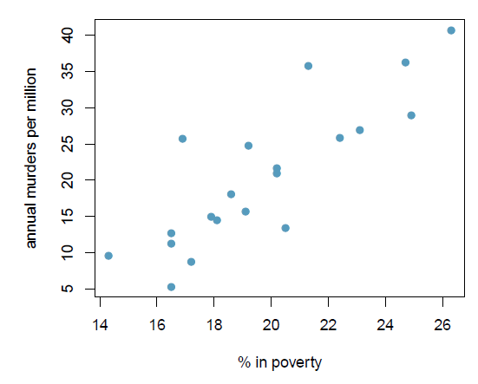



Remember from Deck 6.1….
Suppose you want to predict annual murder count (per million) for a series of districts that were not included in the dataset.
For which of the following districts would you be most comfortable with your prediction?
A district where % in poverty =
(c) 20%
$$x^{∗}$$
$$\overline{x}$$
*Larger distance x* is from $\overline{x}$
… prediction interval larger… more uncertainty.

Slide 21

Outline
How do we interpret a prediction interval for y for the given $x^{∗}$?
(
(

Slide 22
Prediction intervals for speciﬁc predicted values
A prediction interval for y for a given x⋆ is
▶ Interpretation: "We are XX% conﬁdent that y for given x⋆ is within this interval."

Slide 23
Outline
What does “XX% confident” mean when it is used in a prediction interval? (Ie: what does the “prediction level” mean?)
(
(

Slide 24

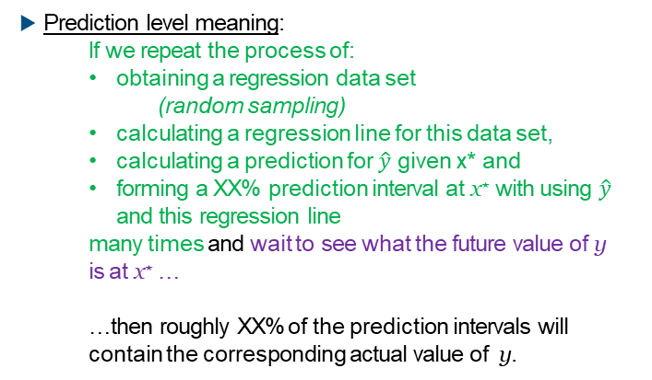
Prediction intervals for speciﬁc predicted values
▶ Prediction level meaning:
  If we repeat the process of:
  obtaining a regression data set
    (random sampling)
  calculating a regression line for this data set,
  calculating a prediction for $\hat{y}$ given x* and
  forming a XX% prediction interval at x⋆ with using $\hat{y}$ and this regression line
  many times and wait to see what the future value of y is at x⋆ …
  …then roughly XX% of the prediction intervals will contain the corresponding actual value of y.
$$\left(x_{1},y_{1}\right),…\left(x_{n},y_{n}\right)$$

Slide 25
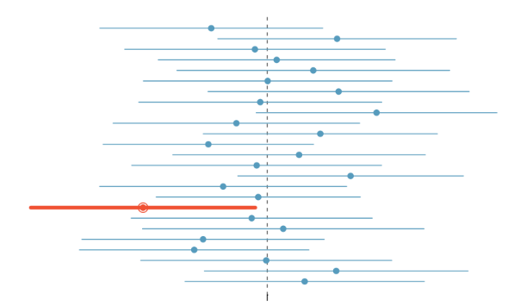
Prediction intervals for speciﬁc predicted values
▶ Prediction level meaning:
First, make many prediction XX% intervals for y given x*(each prediction interval uses a new regression line… which was calculated from n new random sampled (x,y) data)
  then roughly XX% of the prediction intervals will contain the corresponding actual value of y.
y
Then, randomly select a value with x=x* from the population, note the corresponding y.

Slide 26
Calculating the prediction interval
By hand:
Don’t worry about it...

Slide 27
Calculating the prediction interval
By hand:
Don’t worry about it...
In R:
# load data
murder <- read.csv("https://stat.duke.edu/~mc301/data/murder.csv") # fit model
m_mur_pov <- lm(annual_murders_per_mil ~ perc_pov, data = murder)
# create new data
newdata <- data.frame(perc_pov = 20)
# predict
predict(m_mur_pov, newdata, interval = "prediction", level = 0.95)

Slide 28
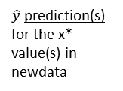
Calculating the prediction interval
By hand:
Don’t worry about it...
In R:
# load data
murder <- read.csv("https://stat.duke.edu/~mc301/data/murder.csv") # fit model
m_mur_pov <- lm(annual_murders_per_mil ~ perc_pov, data = murder)
# create new data
newdata <- data.frame(perc_pov = 20)
# predict
predict(m_mur_pov, newdata, interval = "prediction", level = 0.95)
fit lwr upr 1 21.28663 9.418327 33.15493
$\hat{y}$ prediction(s) for the x* value(s) in newdata
Prediction interval(s) for y given the x* value(s) in newdata

Slide 29
Calculating the prediction interval
By hand:
Don’t worry about it...
In R:
# load data
murder <- read.csv("https://stat.duke.edu/~mc301/data/murder.csv") # fit model
m_mur_pov <- lm(annual_murders_per_mil ~ perc_pov, data = murder)
# create new data
newdata <- data.frame(perc_pov = 20)
# predict
predict(m_mur_pov, newdata, interval = "prediction", level = 0.95)
fit lwr upr 1 21.28663 9.418327 33.15493
“We are 95% conﬁdent that the annual murders per million for a county with 20% poverty rate is between 9.52 and 33.15."

Slide 30
Outline
Housekeeping
Main ideas
  Assessing the Fit: Simple Linear Regression Model
    USING the Model:
      Predictions: Predicted values also have uncertainty around them
    UNDERSTANDING Relationships in the Model:
      Overall Fit of Model: R² assesses model ﬁt -- higher the better
      Individual Coefficients: Inference for regression uses the t-distribution
      Conditions/Diagnostic Checking
      Outliers: Type of outlier determines how it should be handled
Summary

Slide 31
Outline
Regression Models:
Using vs. Understanding

Slide 32
Outline
Regression Models:
Understanding: Relationships between Variables

Slide 33

Outline
How do we assess the overall fit of the whole model?
$$\hat{y}=b_{0}+b_{1}x$$

Slide 34
Outline
How do we assess the overall fit of the whole model?
$$\hat{y}=b_{0}+b_{1}x$$
R²

Slide 35
(1) R² assesses model ﬁt -- higher the better
▶ Interpreting R²: "percentage of variability in y explained by the model"
Higher R→ Better overall model fit!

Slide 36

(1) R² assesses model ﬁt -- higher the better
▶ Interpreting R²: "percentage of variability in y explained by the model"
▶ Calculating R² for a simple linear regression model (ie. 1 expl. var)
Higher R→ Better overall model fit!
$$R^{2}={(correlation coeff)}^{2}={(R)}^{2}$$
murder >
summarise(r_sq = cor(annual_murders_per_mil, perc_pov)^2)
r_sq 1 0.7052275

Slide 37

(1) R² assesses model ﬁt -- higher the better
▶ Interpreting R²: "percentage of variability in y explained by the model"
▶ Calculating R² for a simple linear regression model (ie. 1 expl. var)
▶ Calculating R² for any linear regression model (ie. could have >1 expl. var – Unit 7)
Higher R→ Better overall model fit!
$$R^{2}={(correlation coeff)}^{2}={(R)}^{2}$$
$$R^{2}=\frac{{SS}_{reg}}{{SS}_{tot}}=\frac{{{SS}_{tot}−SS}_{residuals}}{{SS}_{tot}}=1−\frac{{SS}_{residuals}}{{SS}_{tot}}$$

Slide 38
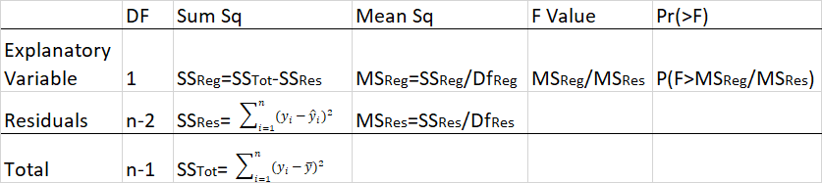

(1) R² assesses model ﬁt -- higher the better
ANOVA Output for Simple Linear Regression
$$R^{2}=\frac{{SS}_{reg}}{{SS}_{tot}}=\frac{{{SS}_{tot}−SS}_{residuals}}{{SS}_{tot}}=1−\frac{{SS}_{residuals}}{{SS}_{tot}}$$

Slide 39
(1) R² assesses model ﬁt -- higher the better
ANOVA Output for Simple Linear Regression
5

Slide 40
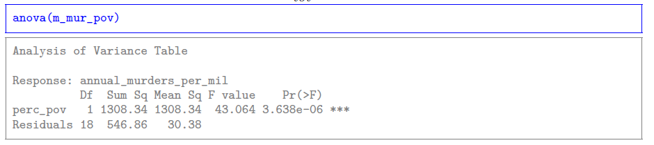
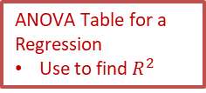
(1) R² assesses model ﬁt -- higher the better
ANOVA Output for Simple Linear Regression
m_mur_pov <- lm(annual_murders_per_mil ~ perc_pov, data = murder)
ANOVA Table for a Regression
Use to find $R^{2}$

Slide 41
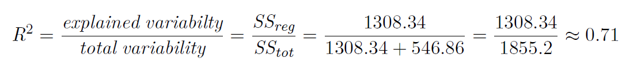
(1) R² assesses model ﬁt -- higher the better
ANOVA Output for Simple Linear Regression
ANOVA Table for a Regression
Use to find $R^{2}$
5
5

Slide 42

(1) R² assesses model ﬁt -- higher the better
ANOVA Output for Simple Linear Regression
ANOVA Table for a Regression
Use to find $R^{2}$
Total 1855.2
${SS}_{tot}$= ${SS}_{reg}+{SS}_{residuals}$
5
5

Slide 43

(1) R² assesses model ﬁt -- higher the better
ANOVA Output for Simple Linear Regression
ANOVA Table for a Regression
Use to find $R^{2}$
${SS}_{reg}$= Sum of the Sum Squared values for all the predictors in the ANOVA table.
5
5

Slide 44
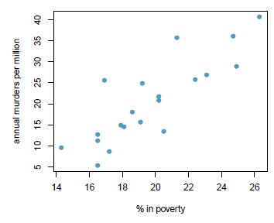
Clicker question
R² for the regression model for predicting annual murders per million based on percentage living in poverty is roughly 71%. Which of the following is the correct interpretation of this value?
71% of the variability in percentage living in poverty is explained by the model.
84% of the variability in the murder rates is explained by the model, i.e. percentage living in poverty.
71% of the variability in the murder rates is explained by the model, i.e. percentage living in poverty.
71% of the time percentage living in poverty predicts murder rates accurately.

Slide 45
Clicker question
R² for the regression model for predicting annual murders per million based on percentage living in poverty is roughly 71%. Which of the following is the correct interpretation of this value?
71% of the variability in percentage living in poverty is explained by the model.
84% of the variability in the murder rates is explained by the model, i.e. percentage living in poverty.
71% of the variability in the murder rates is explained by the model, i.e. percentage living in poverty.
71% of the time percentage living in poverty predicts murder rates accurately.

Slide 46
Outline
Housekeeping
Main ideas
  Assessing the Fit: Simple Linear Regression Model
    USING the Model:
      Predictions: Predicted values also have uncertainty around them
    UNDERSTANDING Relationships in the Model:
      Overall Fit of Model: R² assesses model ﬁt -- higher the better
      Individual Coefficients: Inference for regression uses the t-distribution
      Conditions/Diagnostic Checking
      Outliers: Type of outlier determines how it should be handled
Summary

Slide 47
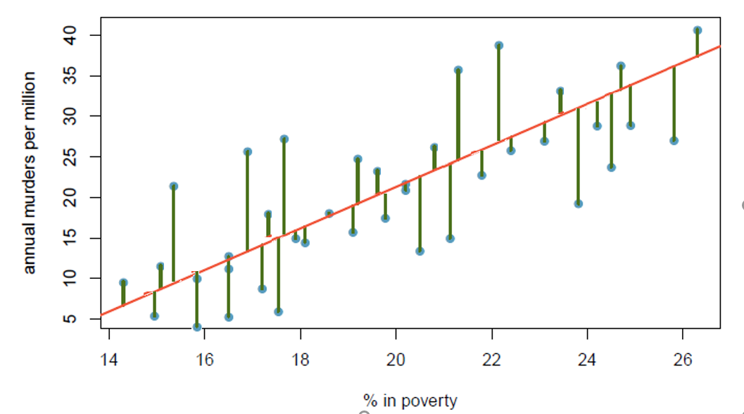


Outline
How do we test the significance of a intercept or coefficient in the population model?
$$\hat{y}=β_{0}+β_{1}x$$
$$\hat{y}=b_{0}+b_{1}x$$

Slide 48
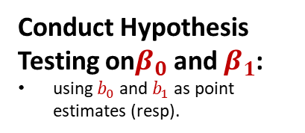
Outline
How do we test the significance of a intercept or coefficient in the population model?
$$\hat{y}=β_{0}+β_{1}x$$
Conduct Hypothesis Testing on$β_{0}$ and $β_{1}$:
using $b_{0}$ and $b_{1}$ as point estimates (resp).
$$\hat{y}=b_{0}+b_{1}x$$

Slide 49
Inference for regression uses the t-distribution
Coefficient Hypothesis Testing for Simple Linear Regression
▶ Hypothesis testing for a slope:
  H₀ : β₁ = 0;
  H_{A} : β₁ ≠ 0

Slide 50
Inference for regression uses the t-distribution
Coefficient Hypothesis Testing for Simple Linear Regression
▶ Hypothesis testing for a slope:
  H₀ : β₁ = 0;
  H_{A} : β₁ ≠ 0
▶ Test Statistic
b −0
T =
1
n−2
SE_{b1}

Slide 51
Inference for regression uses the t-distribution
Coefficient Hypothesis Testing for Simple Linear Regression
▶ Hypothesis testing for a slope:
  H₀ : β₁ = 0;
  H_{A} : β₁ ≠ 0
In general, use df= n – k – 1, where k = # of slopes/predictors you’re estimating in the regression equation.
▶ Test Statistic
b −0
T =
1
n−2
SE_{b1}

Slide 52
Inference for regression uses the t-distribution
Coefficient Hypothesis Testing for Simple Linear Regression
▶ Hypothesis testing for a slope:
  H₀ : β₁ = 0;
  H_{A} : β₁ ≠ 0
In general, use df= n – k – 1, where k = # of slopes/predictors you’re estimating in the regression equation.
▶ Test Statistic
b −0
T =
1
n−2
SE_{b1}
▶ p-value = P(observing a slope at least as different from 0 as the one observed given there is no linear relationship between x and y)

Slide 53
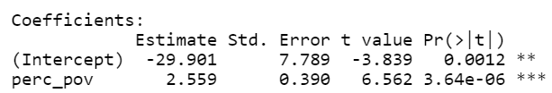
Inference for regression uses the t-distribution
Coefficient Hypothesis Testing for Simple Linear Regression
▶ Hypothesis testing for a slope:
  H₀ : β₁ = 0;
  H_{A} : β₁ ≠ 0
In general, use df= n – k – 1, where k = # of slopes/predictors you’re estimating in the regression equation.
▶ Test Statistic
T =
b −0
n−2
1
SE_{b1}
▶ p-value = P(observing a slope at least as different from 0 as the one observed given there is no linear relationship between x and y)
murder <- read.csv("https://stat.duke.edu/~mc301/data/murder.csv") m_mur_pov <- lm(annual_murders_per_mil ~ perc_pov, data = murder)
summary(m_mur_pov, newdata)

Slide 54
Inference for regression uses the t-distribution
Coefficient Hypothesis Testing for Simple Linear Regression
▶ Hypothesis testing for a slope:
  H₀ : β₁ = 0;
  H_{A} : β₁ ≠ 0
How to interpret:
Ho: Explanatory variable is not a significant predictor of the response variable.
Ha: Explanatory variable is a significant predictor of the response variable.
OR
Ho: There is no linear relationship between the explanatory variable and response variable.
Ha: There is a linear relationship between the explanatory variable and response variable.
OR
Ho: The slope of the relationship between the explanatory and response variable is 0.
Ha: The slope of the relationship between the explanatory and response variable is not 0.

Slide 55

Inference for regression uses the t-distribution
Coefficient Confidence Intervals for Simple Linear Regression
▶ Confidence Interval for a slope:
In general, use df= n – k – 1, where k = # of slopes/predictors you’re estimating in the regression equation.
$$b_{1}±t_{n−2}^{∗}{SE}_{b_{1}}$$

Slide 56

Inference for regression uses the t-distribution
Coefficient Confidence Intervals for Simple Linear Regression
▶ Confidence Interval for a Slope:
In general, use df= n – k – 1, where k = # of slopes/predictors you’re estimating in the regression equation.
$$b_{1}±t_{n−2}^{∗}{SE}_{b_{1}}$$
murder <- read.csv("https://stat.duke.edu/~mc301/data/murder.csv")
m_mur_pov <- lm(annual_murders_per_mil ~ perc_pov, data = murder)
confint(m_mur_pov, level = 0.95)
2.5 97.5
(Intercept) -46.265631 -13.536694
perc_pov 1.740003 3.378776

Slide 57
Inference for regression uses the t-distribution
Coefficient Confidence Intervals for Simple Linear Regression
▶ Confidence Interval for a Slope:
In general, use df= n – k – 1, where k = # of slopes/predictors you’re estimating in the regression equation.
$$b_{1}±t_{n−2}^{∗}{SE}_{b_{1}}$$
murder <- read.csv("https://stat.duke.edu/~mc301/data/murder.csv")
m_mur_pov <- lm(annual_murders_per_mil ~ perc_pov, data = murder)
confint(m_mur_pov, level = 0.95)
2.5 97.5
(Intercept) -46.265631 -13.536694
perc_pov 1.740003 3.378776
▶ Interpreting Confidence Interval for this Slope:
“We are 95% confident that for each additional % increase in poverty rate, we would expect the annual murder per million to increase, on average, by 1.74 to 3.38.”

Slide 58
Inference for regression uses the t-distribution
Coefficient Confidence Intervals for Simple Linear Regression
▶ Confidence Interval for a Slope:
In general, use df= n – k – 1, where k = # of slopes/predictors you’re estimating in the regression equation.
$$b_{1}±t_{n−2}^{∗}{SE}_{b_{1}}$$
murder <- read.csv("https://stat.duke.edu/~mc301/data/murder.csv")
m_mur_pov <- lm(annual_murders_per_mil ~ perc_pov, data = murder)
confint(m_mur_pov, level = 0.95)
2.5 97.5
(Intercept) -46.265631 -13.536694
perc_pov 1.740003 3.378776
Use non-causal language!
▶ Interpreting Confidence Interval for this Slope:
“We are 95% confident that for each additional % increase in poverty rate, we would expect the annual murder per million to increase, on average, by 1.74 to 3.38.”

Slide 59
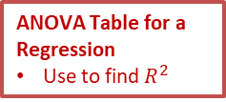
Important Tables Recap for Linear Regression (with one predictor)
murder <- read.csv("https://stat.duke.edu/~mc301/data/murder.csv") m_mur_pov <- lm(annual_murders_per_mil ~ perc_pov, data = murder)
summary(m_mur_pov, newdata)
Table with Coefficient Test Statistics and p-values
Use to test:
  Ho: β0=0; Ho: β0≠0
  Ho: β1=0; Ho: β1≠0
ANOVA Table for a Regression
Use to find $R^{2}$

Slide 60
Important Tables Recap for Linear Regression (with one predictor)
confint(m_mur_pov, level = 0.95)
2.5 97.5
(Intercept) -46.265631 -13.536694
perc_pov 1.740003 3.378776
Table with Confidence Intervals for β0 and β1

Slide 61
Outline
Housekeeping
Main ideas
  Assessing the Fit: Simple Linear Regression Model
    USING the Model:
      Predictions: Predicted values also have uncertainty around them
    UNDERSTANDING Relationships in the Model:
      Overall Fit of Model: R² assesses model ﬁt -- higher the better
      Individual Coefficients: Inference for regression uses the t-distribution
      Conditions/Diagnostic Checking
      Outliers: Type of outlier determines how it should be handled
Summary

Slide 62
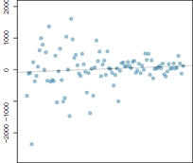
Outline
What conditions/diagnostics should we also check to see if our linear regression model is appropriate for the data?

Slide 63
Conditions for regression
Important regardless of doing inference
▶ Linearity → randomly scattered residuals around 0 in the residuals plot – important regardless of doing inference (or check the scatter plot for linear relationship)

Slide 64
Important regardless of doing inference
Conditions for regression
▶ Linearity → randomly scattered residuals around 0 in the residuals plot – important regardless of doing inference (or check the scatter plot for linear relationship)
Important for inference
▶ Nearly normally distributed residuals → histogram or normal probability plot of residuals

Slide 65
Important regardless of doing inference
Conditions for regression
▶ Linearity → randomly scattered residuals around 0 in the residuals plot – important regardless of doing inference
(or check the scatter plot for linear relationship)
Important for inference
▶ Nearly normally distributed residuals → histogram or normal probability plot of residuals
▶ Constant variability of residuals (homoscedasticity) → no fan shape in the residuals plot (can also check in a scatter plot)

Slide 66
Important regardless of doing inference
Conditions for regression
▶ Linearity → randomly scattered residuals around 0 in the residuals plot – important regardless of doing inference (or check the scatter plot for linear relationship)
Important for inference
▶ Nearly normally distributed residuals → histogram or normal probability plot of residuals
▶ Constant variability of residuals (homoscedasticity) → no fan shape in the residuals plot
▶ Independence of residuals (and hence observations) → depends on data collection method, often violated for time-series data

Slide 67
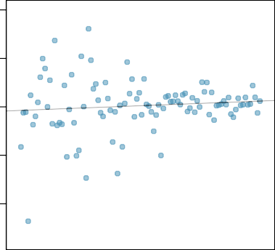
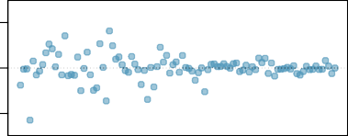
Checking conditions
Scatter Plot
2000
Clicker question
What condition is this linear model obviously and deﬁnitely violating?
1000
0
−2000 −1000
Linear relationship
Non-normal residuals
Constant variability
Independence of observations
−2000 0 2000
Residuals Plot

Slide 68
Checking conditions
Scatter Plot
2000
Clicker question
What condition is this linear model obviously and deﬁnitely violating?
1000
0
−2000 −1000
Linear relationship
Non-normal residuals
Constant variability
Independence of observations
−2000 0 2000
Residuals Plot

Slide 69
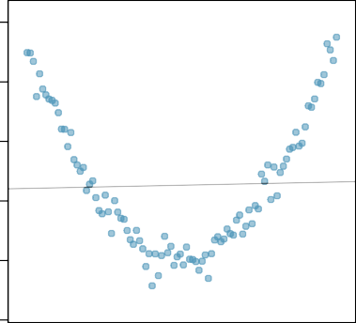
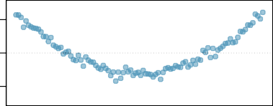
Checking conditions
Scatter Plot
1000 1500 2000
Clicker question
What condition is this linear model obviously and deﬁnitely violating?
500
Linear relationship
Non-normal residuals
Constant variability
Independence of observations
0
−1000 0 1000 −500
Residuals Plot

Slide 70
Checking conditions
Scatter Plot
1000 1500 2000
Clicker question
What condition is this linear model obviously and deﬁnitely violating?
500
Linear relationship
Non-normal residuals
Constant variability
Independence of observations
0
−1000 0 1000 −500
Residuals Plot

Slide 71
Outline
Housekeeping
Main ideas
  Assessing the Fit: Simple Linear Regression Model
    USING the Model:
      Predictions: Predicted values also have uncertainty around them
    UNDERSTANDING Relationships in the Model:
      Overall Fit of Model: R² assesses model ﬁt -- higher the better
      Individual Coefficients: Inference for regression uses the t-distribution
      Conditions/Diagnostic Checking
      Outliers: Type of outlier determines how it should be handled
Summary

Slide 72
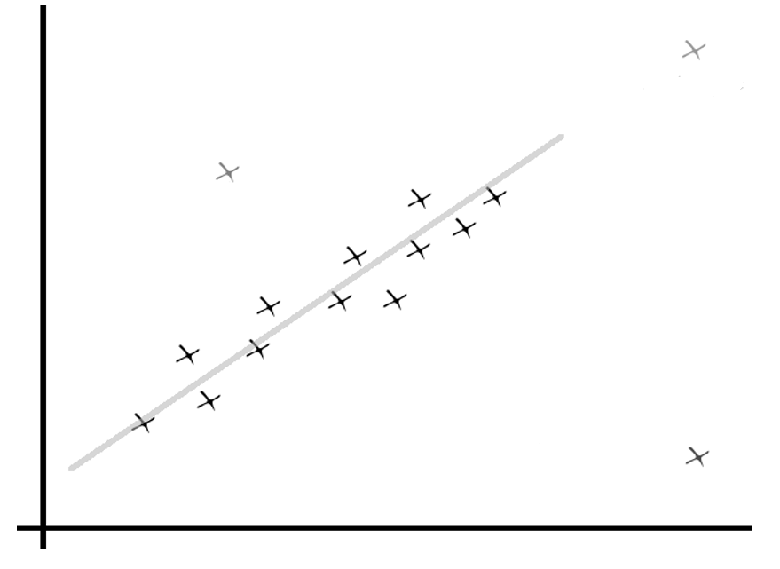
Outline
How can we classify outliers by affect they might have on the regression model?

Slide 73
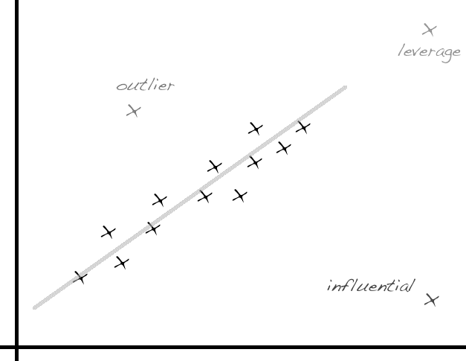
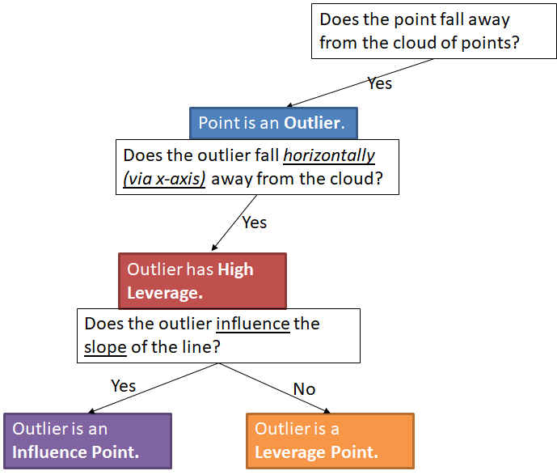

Slide 74
▶ If clusters (groups of points) are apparent in the data, it might be worthwhile to model the groups separately.

Slide 75

Application exercise: 6.2 Linear regression
See course website for details

Slide 76
Summary of main ideas
Predicted values also have uncertainty around them
R² assesses model ﬁt – higher the better
Inference for regression uses the t-distribution
Conditions for regression
Type of outlier determines how it should be handled

