Slide 1

Unit 7: Multiple linear regression
1. Introduction to multiple linear regression
Sta 101 – Spring 2019
Duke University, Department of Statistical Science
Dr. Ellison
Slides posted at https://www2.stat.duke.edu/courses/Spring19/sta101.001/

Slide 2
Outline
Housekeeping
Main ideas: Multiple Linear Regression (MLR)
Interpreting Slopes/Coefficients: In MLR everything is conditional on all other variables in the model
Setting up the MLR Equation: Categorical predictors and slopes for (almost) each level
Inference for MLR: model as a whole + individual slopes
Selecting Predictors for MLR:
Adjusted R² applies a penalty for additional variables
Avoid collinearity in MLR
Model selection criterion depends on goal: signiﬁcance vs. prediction
Additional Conditions for MLR: Conditions for MLR are (almost) the same as conditions for SLR
Summary

Slide 3
Coming up…
Announcements
▶ Project Stage 2 Materials due 4/17 11:55pm (html file, RMD file, slides)
▶ Project Stage 2 Presentations 4/18
▶ Don’t forget to ask/answer 2 questions on Piazza before the final exam… part of your participation grade! Memes don’t count ☺

Slide 4
Outline
Housekeeping
Main ideas: Multiple Linear Regression (MLR)
Interpreting Slopes/Coefficients: In MLR everything is conditional on all other variables in the model
Setting up the MLR Equation: Categorical predictors and slopes for (almost) each level
Inference for MLR: model as a whole + individual slopes
Selecting Predictors for MLR:
Adjusted R² applies a penalty for additional variables
Avoid collinearity in MLR
Model selection criterion depends on goal: signiﬁcance vs. prediction
Additional Conditions for MLR: Conditions for MLR are (almost) the same as conditions for SLR
Summary

Slide 5

Outline
When do we need a multiple linear regression model?
$$\hat{y}=b_{0}+b_{1}x_{1}+b_{2}x_{2}+…$$

Slide 6
Outline
When do we need a multiple linear regression model?
$$\hat{y}=b_{0}+b_{1}x_{1}+b_{2}x_{2}+…$$
*more than 1 slope or predictor is needed.

Slide 7

Outline
When do we need a multiple linear regression model?
More than one explanatory variable
Ex: Number of Dependents and Party Affiliation
$$\hat{income}=b_{0}+b_{1}\left(num.dependents\right)+b_{2}\left(party:dem\right)$$
$+b_{3}(party:ind)$

Slide 8
Outline
When do we need a multiple linear regression model?
More than one explanatory variable
Ex: Number of Dependents and Party Affiliation
One categorical explanatory variable with >2 levels
Ex: Party Affiliation (Dem./Ind./Rep.)
$$\hat{income}=b_{0}+b_{1}\left(num.dependents\right)+b_{2}\left(party:dem\right)$$
$+b_{3}(party:ind)$
$$\hat{income}=b_{0}+b_{1}\left(party:dem\right)+b_{2}(party:ind)$$

Slide 9
Outline
When do we need a multiple linear regression model?
$$\hat{y}=b_{0}+b_{1}x_{1}+b_{2}x_{2}+…$$
*more than 1 slope or predictor is needed.
*# of explanatory variables not always equal to the # of slopes/predictors in the linear regression equation

Slide 10
Outline
Housekeeping
Main ideas: Multiple Linear Regression (MLR)
Interpreting Slopes/Coefficients: In MLR everything is conditional on all other variables in the model
Setting up the MLR Equation: Categorical predictors and slopes for (almost) each level
Inference for MLR: model as a whole + individual slopes
Selecting Predictors for MLR:
Adjusted R² applies a penalty for additional variables
Avoid collinearity in MLR
Model selection criterion depends on goal: signiﬁcance vs. prediction
Additional Conditions for MLR: Conditions for MLR are (almost) the same as conditions for SLR
Summary

Slide 11


Outline
What is different about interpreting a slope in a simple linear regression vs. multiple linear regression?
*assume x1 is numerical
$$\hat{y}=b_{0}+b_{1}x_{1}$$
$$\hat{y}=b_{0}+b_{1}x_{1}+b_{2}x_{2}+…$$

Slide 12
Outline
What is different about interpreting a slope in a simple linear regression vs. multiple linear regression?
*assume x1 is numerical
$$\hat{y}=b_{0}+b_{1}x_{1}$$
“For one unit increase in x1, we would expect, y to increase/decrease, on average, by |b1|.”
$$\hat{y}=b_{0}+b_{1}x_{1}+b_{2}x_{2}+…$$

Slide 13
Outline
What is different about interpreting a slope in a simple linear regression vs. multiple linear regression?
*assume x1 is numerical
$$\hat{y}=b_{0}+b_{1}x_{1}$$
“For one unit increase in x1, we would expect, y to increase/decrease, on average, by |b1|.”
$$\hat{y}=b_{0}+b_{1}x_{1}+b_{2}x_{2}+…$$
“For one unit increase in x1, we would expect, y to increase/decrease, on average, by |b1|….. BUT WHAT ARE THE OTHER VARIABLES GOING TO DO? HOW DO THEY AFFECT Y? If we deleted or added new explanatory variables to the model and recreated the multiple regression line, the slope may change.

Slide 14
Outline
What is different about interpreting a slope in a simple linear regression vs. multiple linear regression?
*assume x1 is numerical
$$\hat{y}=b_{0}+b_{1}x_{1}$$
“For one unit increase in x1, we would expect, y to increase/decrease, on average, by |b1|.”
$$\hat{y}=b_{0}+b_{1}x_{1}+b_{2}x_{2}+…$$
“ALL ELSE HELD CONSTANT, for one unit increase in x1, we would expect, y to increase/decrease, on average, by |b1|

Slide 15


Outline
What is different about interpreting predictor slope for a level of a cat. variable vs. a slope for a numerical variable in a multiple linear regression?
Numerical Variable
$$\hat{y}=b_{0}+b_{1}x_{1}+b_{2}x_{2}+…$$
“ALL ELSE HELD CONSTANT, for one unit increase in x1, we would expect, y to increase/decrease, on average, by |b1|
Categorical Variable Predictor
$$\hat{y}=b_{0}+b_{1}(cat:level)+b_{2}x_{2}+…$$
“ALL ELSE HELD CONSTANT, the predicted difference in y for this level and the baseline level is b1.

Slide 16
Data from the ACS
A random sample of 783 observations from the 2012 ACS.
income: Yearly income (wages and salaries)
employment: Employment status, not in labor force, unemployed, or employed
hrs_work: Weekly hours worked
race: White, Black, Asian, or other
age: Age
gender: male or female
citizens: Whether respondent is a US citizen or not
time_to_work: Travel time to work
lang: Language spoken at home, English or other
married: Whether respondent is married or not
edu: Education level, hs or lower, college, or grad
disability: Whether respondent is disabled or not
birth_qrtr: Quarter in which respondent is born, jan thru mar, apr thru jun, jul thru sep, or oct thru dec

Slide 17
Activity: MLR interpretations
Interpret the intercept.
Interpret the slope for hrs_work.
Interpret the slope for gender.
Estimate Std. Error t value Pr(>|t|)
(Intercept) hrs_work raceblack raceasian raceother
age genderfemale citizenyes time_to_work
langother marriedyes educollege edugrad disabilityyes
birth_qrtrapr thru jun birth_qrtrjul thru sep birth_qrtroct thru dec
-15342.76
1048.96
-7998.99
29909.80
-6756.32
565.07
-17135.05
-12907.34
90.04
-10510.44
5409.24
15993.85
59658.52
-14142.79
-2043.42
3036.02
2674.11
11716.57
149.25
6191.83
9154.92
7240.08
133.77
3705.35
8231.66
79.83
5447.45
3900.76
4098.99
5660.26
6639.40
4978.12
4853.19
5038.45
-1.31
7.03
-1.29
3.27
-0.93
4.22
-4.62
-1.57
1.13
-1.93
1.39
3.90
10.54
-2.13
-0.41
0.63
0.53
0.19
0.00
0.20
0.00
0.35
0.00
0.00
0.12
0.26
0.05
0.17
0.00
0.00
0.03
0.68
0.53
0.60

Slide 18
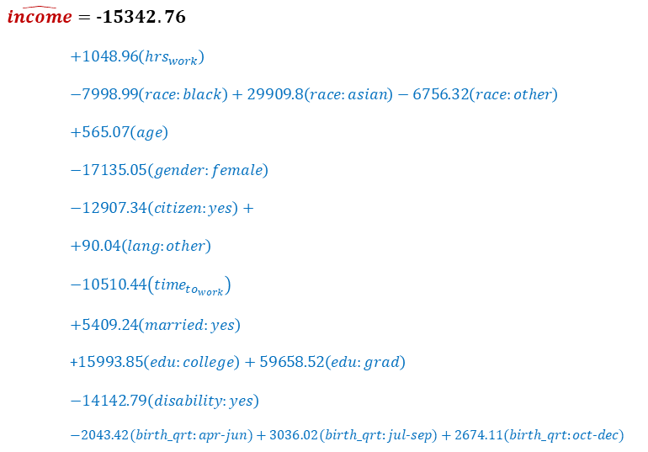
$$\hat{income}=−15342.76$$
$$+1048.96\left(hrs_{work}\right)$$
$$−7998.99\left(race:black\right)+29909.8\left(race:asian\right)−6756.32\left(race:other\right)$$
$$+565.07\left(age\right)$$
$$−17135.05\left(gender:female\right)$$
$$−12907.34\left(citizen:yes\right)+$$
$$+90.04\left(lang:other\right)$$
$$−10510.44\left(time_{to_{work}}\right)$$
$$+5409.24\left(married:yes\right)$$
+$15993.85\left(edu:college\right)+59658.52\left(edu:grad\right)$
$$−14142.79\left(disability:yes\right)$$
$$−2043.42(birth_qrt:apr−jun)+3036.02(birth_qrt:jul−sep)+2674.11(birth_qrt:oct−dec)$$

Slide 19
Activity: MLR interpretations
Intercept: Income for the following type of person is expected to be on average -$1534.76:
a white, ____, non-citizen, that speaks English at home, that is not married, has HS or lower education level, without disabilities, born in __________, who works 0 hours/week, that is 0 years old, that takes 0 hours to get to work.
Baseline observation
Estimate Std. Error t value Pr(>|t|)
(Intercept) hrs_work raceblack raceasian raceother
age genderfemale citizenyes time_to_work
langother marriedyes educollege edugrad disabilityyes
birth_qrtrapr thru jun birth_qrtrjul thru sep birth_qrtroct thru dec
-15342.76
1048.96
-7998.99
29909.80
-6756.32
565.07
-17135.05
-12907.34
90.04
-10510.44
5409.24
15993.85
59658.52
-14142.79
-2043.42
3036.02
2674.11
11716.57
149.25
6191.83
9154.92
7240.08
133.77
3705.35
8231.66
79.83
5447.45
3900.76
4098.99
5660.26
6639.40
4978.12
4853.19
5038.45
-1.31
7.03
-1.29
3.27
-0.93
4.22
-4.62
-1.57
1.13
-1.93
1.39
3.90
10.54
-2.13
-0.41
0.63
0.53
0.19
0.00
0.20
0.00
0.35
0.00
0.00
0.12
0.26
0.05
0.17
0.00
0.00
0.03
0.68
0.53
0.60

Slide 20
Activity: MLR interpretations
Intercept: Income for the following type of person is expected to be on average -$1534.76:
a white, male, non-citizen, that speaks English at home, that is not married, has HS or lower education level, without disabilities, born in January-March, who works 0 hours/week, that is 0 years old, that takes 0 hours to get to work.
baseline
Estimate Std. Error t value Pr(>|t|)
(Intercept) hrs_work raceblack raceasian raceother
age genderfemale citizenyes time_to_work
langother marriedyes educollege edugrad disabilityyes
birth_qrtrapr thru jun birth_qrtrjul thru sep birth_qrtroct thru dec
-15342.76
1048.96
-7998.99
29909.80
-6756.32
565.07
-17135.05
-12907.34
90.04
-10510.44
5409.24
15993.85
59658.52
-14142.79
-2043.42
3036.02
2674.11
11716.57
149.25
6191.83
9154.92
7240.08
133.77
3705.35
8231.66
79.83
5447.45
3900.76
4098.99
5660.26
6639.40
4978.12
4853.19
5038.45
-1.31
7.03
-1.29
3.27
-0.93
4.22
-4.62
-1.57
1.13
-1.93
1.39
3.90
10.54
-2.13
-0.41
0.63
0.53
0.19
0.00
0.20
0.00
0.35
0.00
0.00
0.12
0.26
0.05
0.17
0.00
0.00
0.03
0.68
0.53
0.60

Slide 21
Activity: MLR interpretations
Slope for Hours Worked: All else held constant, if we increase the weekly hours worked by one hour, we would expect yearly income to increase on average by $1048.96.
Estimate Std. Error t value Pr(>|t|)
(Intercept) hrs_work raceblack raceasian raceother
age genderfemale citizenyes time_to_work
langother marriedyes educollege edugrad disabilityyes
birth_qrtrapr thru jun birth_qrtrjul thru sep birth_qrtroct thru dec
-15342.76
1048.96
-7998.99
29909.80
-6756.32
565.07
-17135.05
-12907.34
90.04
-10510.44
5409.24
15993.85
59658.52
-14142.79
-2043.42
3036.02
2674.11
11716.57
149.25
6191.83
9154.92
7240.08
133.77
3705.35
8231.66
79.83
5447.45
3900.76
4098.99
5660.26
6639.40
4978.12
4853.19
5038.45
-1.31
7.03
-1.29
3.27
-0.93
4.22
-4.62
-1.57
1.13
-1.93
1.39
3.90
10.54
-2.13
-0.41
0.63
0.53
0.19
0.00
0.20
0.00
0.35
0.00
0.00
0.12
0.26
0.05
0.17
0.00
0.00
0.03
0.68
0.53
0.60

Slide 22
Activity: MLR interpretations
Slope for Gender: All else held constant, the predicted difference in monthly income for females and males is -$17,135.05.
All else held constant, the model predicts that females earn $17,135.05 less than people that are not female (“male in this example.”)
Estimate Std. Error t value Pr(>|t|)
(Intercept) hrs_work raceblack raceasian raceother
age genderfemale citizenyes time_to_work
langother marriedyes educollege edugrad disabilityyes
birth_qrtrapr thru jun birth_qrtrjul thru sep birth_qrtroct thru dec
-15342.76
1048.96
-7998.99
29909.80
-6756.32
565.07
-17135.05
-12907.34
90.04
-10510.44
5409.24
15993.85
59658.52
-14142.79
-2043.42
3036.02
2674.11
11716.57
149.25
6191.83
9154.92
7240.08
133.77
3705.35
8231.66
79.83
5447.45
3900.76
4098.99
5660.26
6639.40
4978.12
4853.19
5038.45
-1.31
7.03
-1.29
3.27
-0.93
4.22
-4.62
-1.57
1.13
-1.93
1.39
3.90
10.54
-2.13
-0.41
0.63
0.53
0.19
0.00
0.20
0.00
0.35
0.00
0.00
0.12
0.26
0.05
0.17
0.00
0.00
0.03
0.68
0.53
0.60

Slide 23
Outline
Housekeeping
Main ideas: Multiple Linear Regression (MLR)
Interpreting Slopes/Coefficients: In MLR everything is conditional on all other variables in the model
Setting up the MLR Equation: Categorical predictors and slopes for (almost) each level
Inference for MLR: model as a whole + individual slopes
Selecting Predictors for MLR:
Adjusted R² applies a penalty for additional variables
Avoid collinearity in MLR
Model selection criterion depends on goal: signiﬁcance vs. prediction
Additional Conditions for MLR: Conditions for MLR are (almost) the same as conditions for SLR
Summary

Slide 24
Outline
How many slopes would we need to model income with age and hours to get to work?

Slide 25


Outline
How many slopes would we need to model income with age and hours to get to work?
Response Variable:
Income
2 Explanatory Variables:
Age (numerical)
Hours to get to work (numerical)
2 slopes being estimated in the model: $b_{1},b_{2}$
$$\hat{income}=b_{0}+b_{1}age{+b}_{2}hrs_work$$

Slide 26
Outline
How many slopes would we need to model income with citizen status (citizen or not) and race (white/black/asian/other)?

Slide 27
Outline
How many slopes would we need to model income with citizen status (citizen or not) and race (white/black/asian/other)?
Response Variable:
Income
2 Explanatory Variables:
Citizen Status (categ. With 2 levels)
Race (categ. With 4 levels)
4 slopes being estimated in the model: $b_{1},b_{2},b_{3},b_{4}$
$$\hat{income}=b_{0}+b_{1}citizen:yes{+b}_{2}race:black{+b}_{3}race:asian{+b}_{4}race:other$$

Slide 28
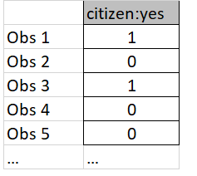
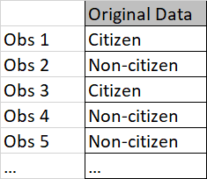
(2) Categorical predictors and slopes for (almost) each level
▶ Each categorical variable, with w levels, added to the model results in w − 1 slopes being estimated.
▶ It only takes w − 1 columns to code a categorical variable with w levels as 0/1s.
▶ Baseline: Level that’s left out (ie: non-citizen)
$$\hat{income}=b_{0}+b_{1}citizen:yes{+b}_{2}race:black{+b}_{3}race:asian{+b}_{4}race:other$$
Represented by

Slide 29
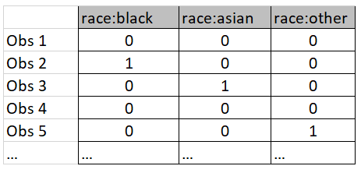
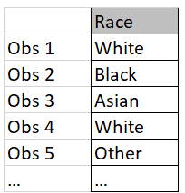
(2) Categorical predictors and slopes for (almost) each level
▶ Each categorical variable, with w levels, added to the model results in w − 1 slopes being estimated.
▶ It only takes w − 1 columns to code a categorical variable with w levels as 0/1s.
▶ Baseline: Level that’s left out (ie: white)
$$\hat{income}=b_{0}+b_{1}citizen:yes{+b}_{2}race:black{+b}_{3}race:asian{+b}_{4}race:other$$
Represented by

Slide 30
Clicker question
All else held constant, how do incomes of those born January thru March compare to those born April thru June?
Estimate Std. Error t value Pr(>|t|)
(Intercept) hrs_work raceblack raceasian raceother
age
genderfemale citizenyes time_to_work
langother
marriedyes educollege edugrad disabilityyes
birth_qrtrapr thru jun
birth_qrtrjul thru sep birth_qrtroct thru dec
-15342.76
1048.96
-7998.99
29909.80
-6756.32
565.07
-17135.05
-12907.34
90.04
-10510.44
5409.24
15993.85
59658.52
-14142.79
-2043.42
3036.02
2674.11
11716.57
149.25
6191.83
9154.92
7240.08
133.77
3705.35
8231.66
79.83
5447.45
3900.76
4098.99
5660.26
6639.40
4978.12
4853.19
5038.45
-1.31
7.03
-1.29
3.27
-0.93
4.22
-4.62
-1.57
1.13
-1.93
1.39
3.90
10.54
-2.13
-0.41
0.63
0.53
0.19
0.00
0.20
0.00
0.35
0.00
0.00
0.12
0.26
0.05
0.17
0.00
0.00
0.03
0.68
0.53
0.60
All else held constant, those born Jan thru Mar make, on average,
(a) $2,043.42
less
(b) $2,043.42
more
(c) $4978.12
less
(d) $4978.12
more
than those born Apr thru Jun.

Slide 31
Clicker question
All else held constant, how do incomes of those born January thru March compare to those born April thru June?
Estimate Std. Error t value Pr(>|t|)
(Intercept) hrs_work raceblack raceasian raceother
age
genderfemale citizenyes time_to_work
langother
marriedyes educollege edugrad disabilityyes
birth_qrtrapr thru jun
birth_qrtrjul thru sep birth_qrtroct thru dec
-15342.76
1048.96
-7998.99
29909.80
-6756.32
565.07
-17135.05
-12907.34
90.04
-10510.44
5409.24
15993.85
59658.52
-14142.79
-2043.42
3036.02
2674.11
11716.57
149.25
6191.83
9154.92
7240.08
133.77
3705.35
8231.66
79.83
5447.45
3900.76
4098.99
5660.26
6639.40
4978.12
4853.19
5038.45
-1.31
7.03
-1.29
3.27
-0.93
4.22
-4.62
-1.57
1.13
-1.93
1.39
3.90
10.54
-2.13
-0.41
0.63
0.53
0.19
0.00
0.20
0.00
0.35
0.00
0.00
0.12
0.26
0.05
0.17
0.00
0.00
0.03
0.68
0.53
0.60
baseline
All else held constant, those born Jan thru Mar make, on average,
(a) $2,043.42
less
(b) $2,043.42
more
(c) $4978.12
less
(d) $4978.12
more
than those born Apr thru Jun.

Slide 32
Outline
Housekeeping
Main ideas: Multiple Linear Regression (MLR)
Interpreting Slopes/Coefficients: In MLR everything is conditional on all other variables in the model
Setting up the MLR Equation: Categorical predictors and slopes for (almost) each level
Inference for MLR: model as a whole + individual slopes
Selecting Predictors for MLR:
Adjusted R² applies a penalty for additional variables
Avoid collinearity in MLR
Model selection criterion depends on goal: signiﬁcance vs. prediction
Additional Conditions for MLR: Conditions for MLR are (almost) the same as conditions for SLR
Summary

Slide 33
Outline
What is different about conducting inference with a simple linear regression model and a multiple linear regression model?

Slide 34
Outline
What is different about conducting inference with a simple linear regression model and a multiple linear regression model?
The inferences we conduct with a MLR must consider the presence of:
all of the variables and
this specific combination of variables.

Slide 35
Outline
How do we conduct inference for a intercept or individual coefficient in a regression model?

Slide 36
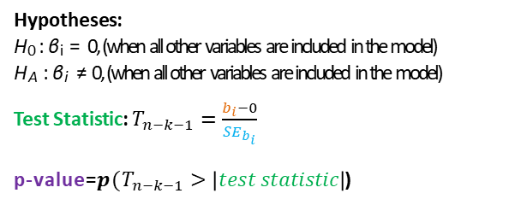
(3) Inference for MLR: model as a whole + individual slopes
Hypotheses:
H₀ : β_{i} = 0, (when all other variables are included in the model)
H_{A} : β_{i} ≠ 0, (when all other variables are included in the model)
Test Statistic: $T_{n−k−1}=\frac{b_{i}−0}{{SE}_{b_{i}}}$
p-value=$p(T_{n−k−1}>\left|test statistic\right|$)
*k=# of slopes being estimated

Slide 37
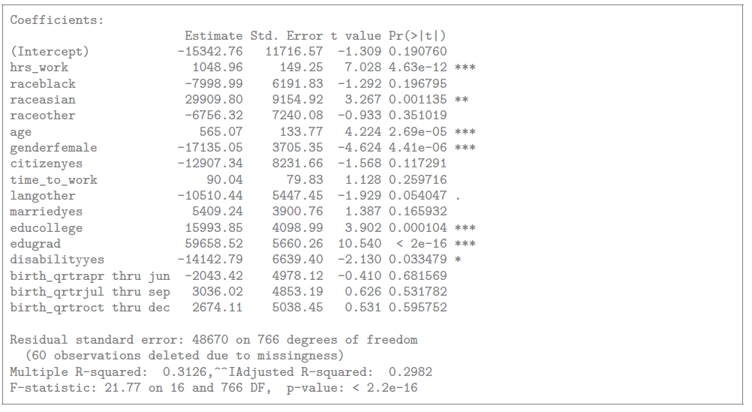
(3) Inference for MLR: model as a whole + individual slopes
Hypotheses:
H₀ : β_{i} = 0, (when all other variables are included in the model)
H_{A} : β_{i} ≠ 0, (when all other variables are included in the model)
Test Statistic: $T_{n−k−1}=\frac{b_{i}−0}{{SE}_{b_{i}}}$
p-value=$p(T_{n−k−1}>\left|test statistic\right|$)
*k=# of slopes being estimated
In R:
library(oilabs)
data(acs12)
mod=lm(income~ hrs_work+race+age+gender+
citizen+time_to_work+lang+
married+edu+disability
+birth_qrtr,data=acs12)
summary(mod)

Slide 38
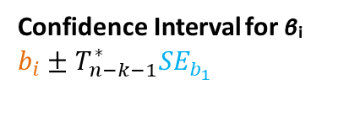
(3) Inference for MLR: model as a whole + individual slopes
Confidence Interval for β_{i}
$$b_{i}±T_{n−k−1}^{∗}{SE}_{b_{1}}$$
*k=# of slopes being estimated
In R:
library(oilabs)
data(acs12)
mod=lm(income~ hrs_work+race+age+gender+
citizen+time_to_work+lang+
married+edu+disability
+birth_qrtr,data=acs12)
summary(mod)

Slide 39
Clicker question
What is the degrees of freedom you would use to construct a confidence interval for the slope of the age variable? (Assume n=959).
10 Explanatory Variables
Hrs_work
Race
Age
Gender
Citizen
Lang
Married
Edu
Disability
birthqrtr
Estimate Std. Error t value Pr(>|t|)
(Intercept) hrs_work raceblack raceasian raceother
age
genderfemale citizenyes time_to_work
langother
marriedyes educollege edugrad disabilityyes
birth_qrtrapr thru jun
birth_qrtrjul thru sep birth_qrtroct thru dec
-15342.76
1048.96
-7998.99
29909.80
-6756.32
565.07
-17135.05
-12907.34
90.04
-10510.44
5409.24
15993.85
59658.52
-14142.79
-2043.42
3036.02
2674.11
11716.57
149.25
6191.83
9154.92
7240.08
133.77
3705.35
8231.66
79.83
5447.45
3900.76
4098.99
5660.26
6639.40
4978.12
4853.19
5038.45
-1.31
7.03
-1.29
3.27
-0.93
4.22
-4.62
-1.57
1.13
-1.93
1.39
3.90
10.54
-2.13
-0.41
0.63
0.53
0.19
0.00
0.20
0.00
0.35
0.00
0.00
0.12
0.26
0.05
0.17
0.00
0.00
0.03
0.68
0.53
0.60
16 slope
parameters
(a) df = 959 – 10 - 1
(b) df = 959 – 16 - 1

Slide 40
Clicker question
What is the degrees of freedom you would use to construct a confidence interval for the slope of the age variable? (Assume n=959).
10 Explanatory Variables
Hrs_work
Race
Age
Gender
Citizen
Lang
Married
Edu
Disability
birthqrtr
Estimate Std. Error t value Pr(>|t|)
(Intercept) hrs_work raceblack raceasian raceother
age
genderfemale citizenyes time_to_work
langother
marriedyes educollege edugrad disabilityyes
birth_qrtrapr thru jun
birth_qrtrjul thru sep birth_qrtroct thru dec
-15342.76
1048.96
-7998.99
29909.80
-6756.32
565.07
-17135.05
-12907.34
90.04
-10510.44
5409.24
15993.85
59658.52
-14142.79
-2043.42
3036.02
2674.11
11716.57
149.25
6191.83
9154.92
7240.08
133.77
3705.35
8231.66
79.83
5447.45
3900.76
4098.99
5660.26
6639.40
4978.12
4853.19
5038.45
-1.31
7.03
-1.29
3.27
-0.93
4.22
-4.62
-1.57
1.13
-1.93
1.39
3.90
10.54
-2.13
-0.41
0.63
0.53
0.19
0.00
0.20
0.00
0.35
0.00
0.00
0.12
0.26
0.05
0.17
0.00
0.00
0.03
0.68
0.53
0.60
16 slope
parameters
(a) df = 959 – 10 - 1
(b) df = 959 – 16 – 1 = n - k -1
*k = number of slopes in linear regression equation.

Slide 41
Outline
How do we conduct inference on the whole multiple linear regression model?

Slide 42
Outline
How do we conduct inference on the whole multiple linear regression model?
F-Test

Slide 43
(3) Inference for MLR: model as a whole + individual slopes
Hypotheses:
H₀ : β₁ = β₂ = · · · = β_{k} = 0
H_{A} : At least one of the β_{i} ≠ 0
F-statistic with df₁ = k, df₂ = n − k − 1
p-value

Slide 44
(3) Inference for MLR: model as a whole + individual slopes
Hypotheses:
H₀ : β₁ = β₂ = · · · = β_{k} = 0
H_{A} : At least one of the β_{i} ≠ 0
F-statistic with df₁ = k, df₂ = n − k − 1
p-value
In R:
library(oilabs)
data(acs12)
mod=lm(income~ hrs_work+race+age+gender+
citizen+time_to_work+lang+
married+edu+disability
+birth_qrtr,data=acs12)
summary(mod)

Slide 45
Outline
What does the F-Test for the whole linear regression model tell us?

Slide 46
Clicker question
True / False: The F test yielding a signiﬁcant result means the model ﬁts the data well.
True
False

Slide 47
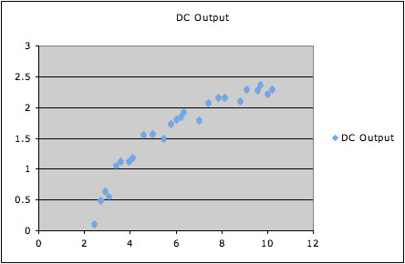
True / False: The F test yielding a signiﬁcant result means the model ﬁts the data well.
Clicker question
True
False
The F test yielding a signiﬁcant result doesn’t mean the model ﬁts the data well, it just means at least one of the βs is
non-zero. Whether or not the model ﬁt the data well is evaluated based on model diagnostics.
F-Test
p-value=7.5455E-12
Wind speed
https://web.ma.utexas.edu/users/mks/statmistakes/overallF.html

Slide 48
Clicker question
True / False: The F test not yielding a signiﬁcant result means individual variables included in the model are not good predictors of y.
True
False

Slide 49
True / False: The F test not yielding a signiﬁcant result means individual variables included in the model are not good predictors of y.
Clicker question
True
False
The F test not yielding a signiﬁcant result doesn’t mean individuals variables included in the model are not good predictors of y, it just means that the combination of these variables doesn’t yield a good model.

Slide 50
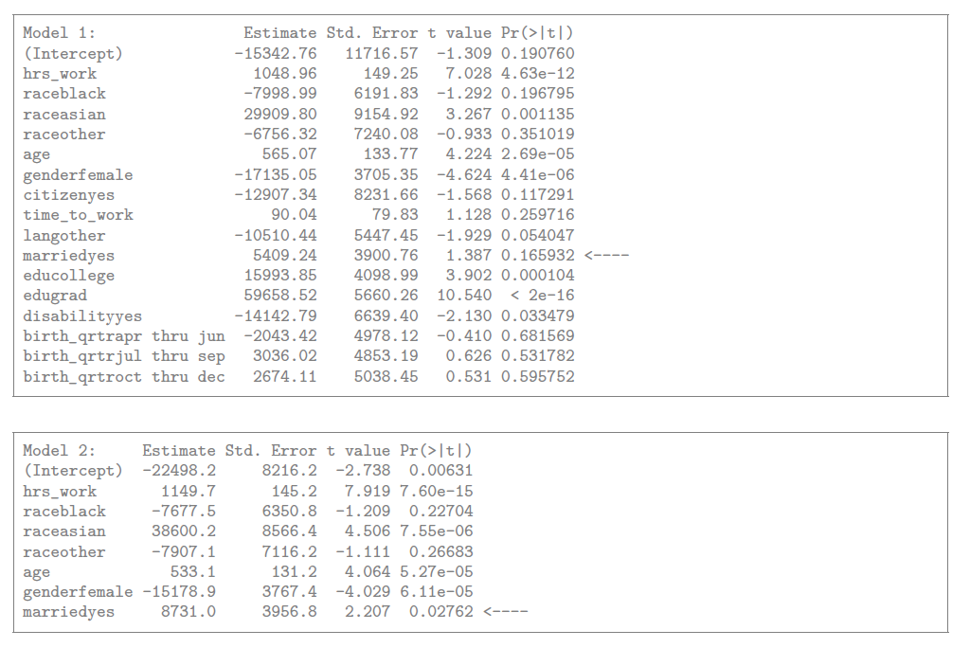
Signiﬁcance also depends on what else is in the model
A predictor may not be significant in one model…
… but significant in another.

Slide 51
Outline
Housekeeping
Main ideas: Multiple Linear Regression (MLR)
Interpreting Slopes/Coefficients: In MLR everything is conditional on all other variables in the model
Setting up the MLR Equation: Categorical predictors and slopes for (almost) each level
Inference for MLR: model as a whole + individual slopes
Selecting Predictors for MLR:
Adjusted R² applies a penalty for additional variables
Avoid collinearity in MLR
Model selection criterion depends on goal: signiﬁcance vs. prediction
Additional Conditions for MLR: Conditions for MLR are (almost) the same as conditions for SLR
Summary

Slide 52
Outline
Should we have as many variables as possible in our multiple linear regression model?

Slide 53
Outline
Should we have as many variables as possible in our multiple linear regression model?
Goal: Parsimonious Model – small amount of variables which has highest predictive power.

Slide 54
Outline
What metric helps us find a parsimonious model?

Slide 55
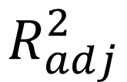
Outline
What metric helps us find a parsimonious model?
$$R_{adj}^{2}$$

Slide 56
(4) Adjusted R² applies a penalty for additional variables
▶ When any variable is added to the model R² increases.

Slide 57
(4) Adjusted R² applies a penalty for additional variables
▶ When any variable is added to the model R² increases.
▶ But if the added variable doesn’t really provide any new information, or is completely unrelated, adjusted R² does not increase.

Slide 58
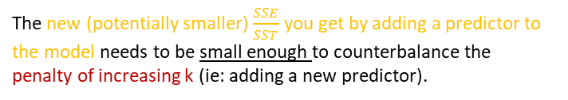
(4) Adjusted R² applies a penalty for additional variables
▶ When any variable is added to the model R² increases.
▶ But if the added variable doesn’t really provide any new information, or is completely unrelated, adjusted R² does not increase.
Adjusted R²
The higher k gets, the higher the “penalty.”
SS n − 1
( )
2
Error
R = 1 −
×
adj
SSTotal
n − k − 1
where n is the number of cases and k is the number of slopes estimated in the model.
The new (potentially smaller) $\frac{SSE}{SST}$ you get by adding a predictor to the model needs to be small enough to counterbalance the penalty of increasing k (ie: adding a new predictor).

Slide 59
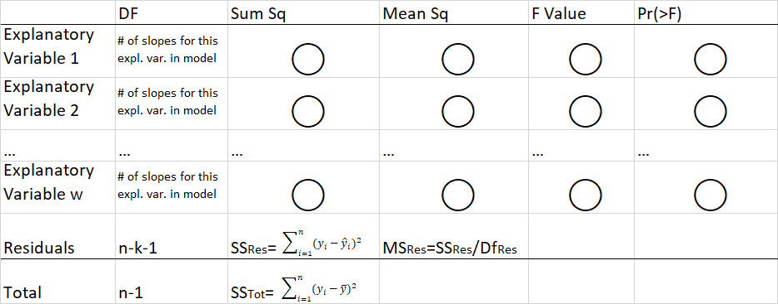


(4) Adjusted R² applies a penalty for additional variables
Multiple Linear Regression ANOVA
$$R_{adj}^{2}=1−\left(\frac{{SS}_{error}}{{SS}_{total}}×\frac{n−1}{n−k−1}\right)$$
*k=# of slopes in the model
$$R_{adj}^{2}=1−\left(\frac{{SS}_{resid}}{{SS}_{total}}×\frac{n−1}{n−k−1}\right)$$

Slide 60
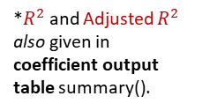
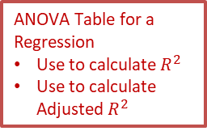
ANOVA Table for a Regression
Use to calculate $R^{2}$
Use to calculate Adjusted $R^{2}$
Analysis of Variance Table
Response: income
Df Sum Sq Mean Sq F value Pr(>F)
hrs_work race age gender citizen
time_to_work
lang married edu disability birth_qrtr Residuals Total
1 3.0633e+11 3.0633e+11 129.3025 < 2.2e-16 ***
3 7.1656e+10 2.3885e+10 10.0821 1.608e-06 ***
1 7.6008e+10 7.6008e+10 32.0836 2.090e-08 ***
1 4.8665e+10 4.8665e+10 20.5418 6.767e-06 ***
1 1.1135e+09 1.1135e+09 0.4700 0.49319
1 3.5371e+09 3.5371e+09 1.4930 0.22213
1 1.2815e+10 1.2815e+10 5.4094 0.02029 *
1 1.2190e+10 1.2190e+10 5.1453 0.02359 *
2 2.7867e+11 1.3933e+11 58.8131 < 2.2e-16 ***
1 1.0852e+10 1.0852e+10 4.5808 0.03265 *
*$R^{2}$ and Adjusted $R^{2}$ also given in coefficient output table summary().
3 3.3060e+09 1.1020e+09
766 1.8147e+12 2.3691e+09
782 2.6399e+12
0.4652 0.70667
(
1.8147e + 12
2.6399e + 12
783 − 1
783 − 16 − 1
)
2
R = 1−
×
≈ 1−0.7018 = 0.2982
adj

Slide 61
Clicker question
2
True / False: For a model with at least one predictor, R
always be smaller than R².
will
adj
True
False

Slide 62
Clicker question
2
True / False: For a model with at least one predictor, R
always be smaller than R².
will
adj
True
False
2
R².
Because k is positive, R will always be smaller than
adj
Always ≥ 1
SS n − 1
( )
2
Error
R = 1 −
×
adj
SSTotal
n − k − 1
SS
( )
2
Error
R = 1 −
SSTotal

Slide 63
Clicker question
2
True / False: For a model with at least one predictor, R
always be smaller than R².
will
adj
True
False
2
R².
Because k is positive, R will always be smaller than
adj
Always ≥ 1
SS n − 1
( )
2
Error
R = 1 −
×
Always larger than…
adj
SSTotal
n − k − 1
SS
( )
2
Error
R = 1 −
SSTotal

Slide 64
Clicker question
2
True / False: For a model with at least one predictor, R
always be smaller than R².
will
adj
True
False
2
R².
Because k is positive, R will always be smaller than
adj
Always ≥ 1
SS n − 1
( )
2
Error
R = 1 −
×
Always larger than…
adj
SSTotal
n − k − 1
Always smaller
than…
SS
( )
2
Error
R = 1 −
SSTotal

Slide 65
Clicker question
True / False: Adjusted R² tells us the percentage of variability in the response variable explained by the model.
True
False

Slide 66
True / False: Adjusted R² tells us the percentage of variability in the response variable explained by the model.
Clicker question
True
False
R² tells us the percentage of variability in the response variable explained by the model, adjusted R² is only useful for model selection.

Slide 67
Outline
Housekeeping
Main ideas: Multiple Linear Regression (MLR)
Interpreting Slopes/Coefficients: In MLR everything is conditional on all other variables in the model
Setting up the MLR Equation: Categorical predictors and slopes for (almost) each level
Inference for MLR: model as a whole + individual slopes
Selecting Predictors for MLR:
Adjusted R² applies a penalty for additional variables
Avoid collinearity in MLR
Model selection criterion depends on goal: signiﬁcance vs. prediction
Additional Conditions for MLR: Conditions for MLR are (almost) the same as conditions for SLR
Summary

Slide 68
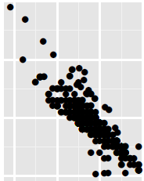
Outline
Why else should we be careful about choosing which explanatory variables to have in our model?
Explanatory Variable 2
Explanatory Variable 1

Slide 69
Outline
Why else should we be careful about choosing which explanatory variables to have in our model?
Watch out for two explanatory variables (or more) that are collinear!
Explanatory Variable 2
Explanatory Variable 1

Slide 70
(5) Avoid collinearity in MLR
▶ Two predictor variables are said to be collinear when they are correlated, and this collinearity (also called multicollinearity) complicates model estimation.
Remember: Predictors are also called explanatory or independent variables, so they should be independent of each other.

Slide 71
(5) Avoid collinearity in MLR
▶ Two predictor variables are said to be collinear when they are correlated, and this collinearity (also called multicollinearity) complicates model estimation.
Remember: Predictors are also called explanatory or independent variables, so they should be independent of each other.
▶ We don’t like adding predictors that are associated with each other to the model, because often times the addition of such variable brings nothing to the table. Instead, we prefer the simplest best model, i.e. parsimonious model.

Slide 72
(5) Avoid collinearity in MLR
▶ Two predictor variables are said to be collinear when they are correlated, and this collinearity (also called multicollinearity) complicates model estimation.
Remember: Predictors are also called explanatory or independent variables, so they should be independent of each other.
▶ We don’t like adding predictors that are associated with each other to the model, because often times the addition of such variable brings nothing to the table. Instead, we prefer the simplest best model, i.e. parsimonious model.
▶ In addition, addition of collinear variables can result in unreliable estimates of the slope parameters.

Slide 73
(5) Avoid collinearity in MLR
▶ Two predictor variables are said to be collinear when they are correlated, and this collinearity (also called multicollinearity) complicates model estimation.
Remember: Predictors are also called explanatory or independent variables, so they should be independent of each other.
▶ We don’t like adding predictors that are associated with each other to the model, because often times the addition of such variable brings nothing to the table. Instead, we prefer the simplest best model, i.e. parsimonious model.
▶ In addition, addition of collinear variables can result in unreliable estimates of the slope parameters.
▶ While it’s impossible to avoid collinearity from arising in observational data, experiments are usually designed to control for correlated predictors.

Slide 74
Outline
Housekeeping
Main ideas: Multiple Linear Regression (MLR)
Interpreting Slopes/Coefficients: In MLR everything is conditional on all other variables in the model
Setting up the MLR Equation: Categorical predictors and slopes for (almost) each level
Inference for MLR: model as a whole + individual slopes
Selecting Predictors for MLR:
Adjusted R² applies a penalty for additional variables
Avoid collinearity in MLR
Model selection criterion depends on goal: signiﬁcance vs. prediction
Additional Conditions for MLR: Conditions for MLR are (almost) the same as conditions for SLR
Summary

Slide 75


Outline
What algorithms can/should we use to help select what explanatory variables should be in the model?

Slide 76
Outline
What algorithms can/should we use to help select what explanatory variables should be in the model?
Depends on your goal for making a model!

Slide 77
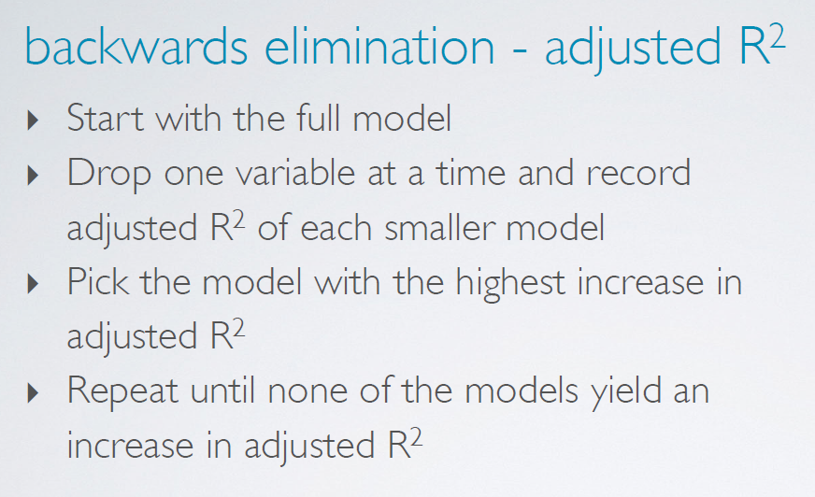
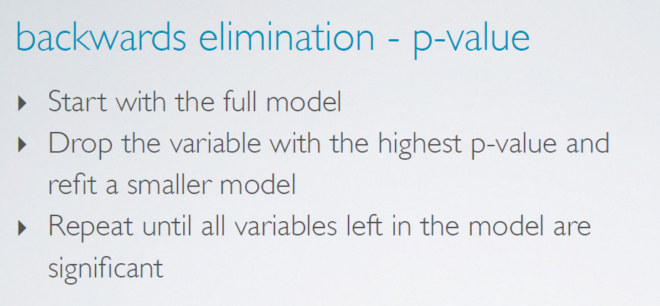
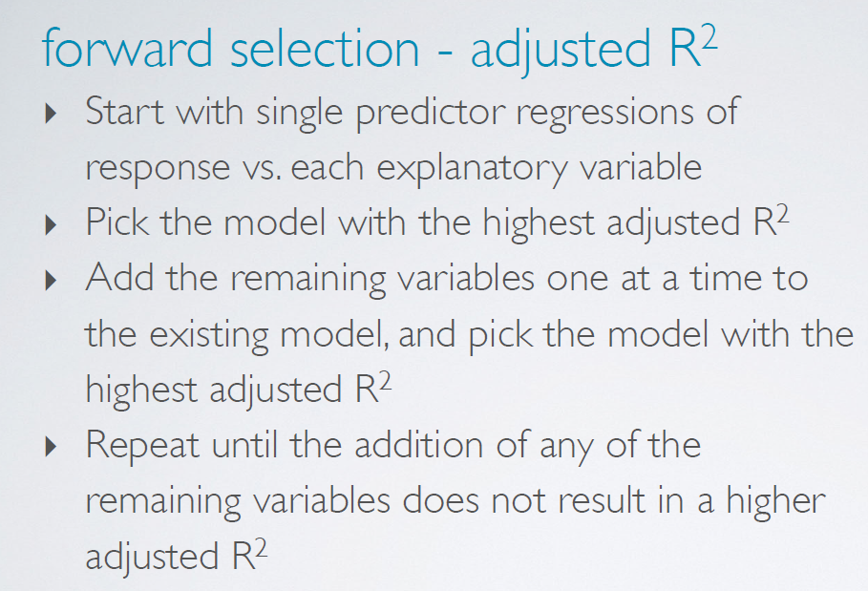
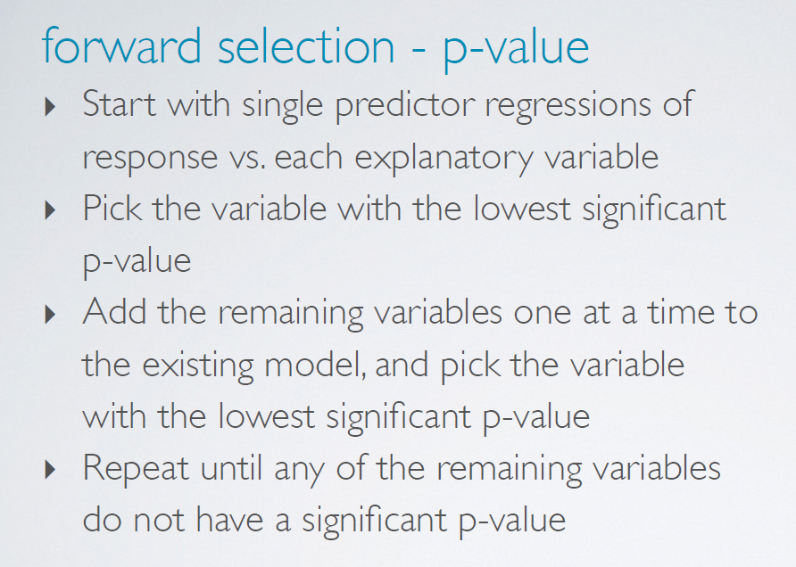
(6) Model selection criterion depends on goal: signiﬁcance vs.
prediction

Slide 78
(6) Model selection criterion depends on goal: signiﬁcance vs.
prediction
▶ If the goal is to ﬁnd the set of statistically significant predictors of y →use p-value selection.

Slide 79
(6) Model selection criterion depends on goal: signiﬁcance vs.
prediction
▶ If the goal is to ﬁnd the set of statistically significant predictors of y →use p-value selection.
▶ If the goal is to do better prediction of y → use adjusted
R² selection.

Slide 80
(6) Model selection criterion depends on goal: signiﬁcance vs.
prediction
▶ If the goal is to ﬁnd the set of statistically significant predictors of y →use p-value selection.
▶ If the goal is to do better prediction of y → use adjusted
R² selection.
▶ Either way, can use backward elimination or forward selection.

Slide 81
(6) Model selection criterion depends on goal: signiﬁcance vs.
prediction
▶ If the goal is to ﬁnd the set of statistically significant predictors of y →use p-value selection.
▶ If the goal is to do better prediction of y → use adjusted
R² selection.
▶ Either way, can use backward elimination or forward selection.
▶ Expert opinion and focus of research might also demand that a particular variable be included in the model.

Slide 82
Outline
Be careful about adding/deleting predictors that correspond to categorical explanatory variables with >2 levels….

Slide 83
Clicker question
Using the p-value approach, which variable would you remove from the model below first?
Estimate Std. Error t value Pr(>|t|)
(Intercept) hrs_work raceblack raceasian raceother
age
genderfemale citizenyes time_to_work
langother
marriedyes educollege edugrad disabilityyes
-14022.48
1045.85
-7636.32
29944.35
-7212.57
559.51
-17010.85
-13059.46
88.77
-10150.41
5400.41
16214.46
59572.20
-14201.11
11137.08
149.05
6177.50
9137.13
7212.25
133.27
3699.19
8219.99
79.73
5431.15
3896.12
4089.17
5631.33
6628.26
-1.26
7.02
-1.24
3.28
-1.00
4.20
-4.60
-1.59
1.11
-1.87
1.39
3.97
10.58
-2.14
0.21
0.00
0.22
0.00
0.32
0.00
0.00
0.11
0.27
0.06
0.17
0.00
0.00
0.03
married
race
race:other
race:black
time_to_work

Slide 84
Clicker question
Using the p-value approach, which variable would you remove from the model the model below first?
*In the p-value approach, the level with the SMALLEST p-value is chosen as representative for the categorical variable.
Estimate Std. Error t value Pr(>|t|)
(Intercept) hrs_work raceblack raceasian raceother
age
genderfemale citizenyes time_to_work
langother
marriedyes educollege edugrad disabilityyes
-14022.48
1045.85
-7636.32
29944.35
-7212.57
559.51
-17010.85
-13059.46
88.77
-10150.41
5400.41
16214.46
59572.20
-14201.11
11137.08
149.05
6177.50
9137.13
7212.25
133.27
3699.19
8219.99
79.73
5431.15
3896.12
4089.17
5631.33
6628.26
-1.26
7.02
-1.24
3.28
-1.00
4.20
-4.60
-1.59
1.11
-1.87
1.39
3.97
10.58
-2.14
0.21
0.00
0.22
0.00
0.32
0.00
0.00
0.11
0.27
0.06
0.17
0.00
0.00
0.03
married
race
race:other
race:black
time_to_work

Slide 85
Clicker question
Using the p-value approach, which variable would you remove from the model below first?
Estimate Std. Error t value Pr(>|t|)
(Intercept) hrs_work raceblack raceasian raceother
age
genderfemale citizenyes time_to_work
langother
marriedyes educollege edugrad disabilityyes
birth_qrtrapr thru jun
birth_qrtrjul thru sep birth_qrtroct thru dec
-15342.76
1048.96
-7998.99
29909.80
-6756.32
565.07
-17135.05
-12907.34
90.04
-10510.44
5409.24
15993.85
59658.52
-14142.79
-2043.42
3036.02
2674.11
11716.57
149.25
6191.83
9154.92
7240.08
133.77
3705.35
8231.66
79.83
5447.45
3900.76
4098.99
5660.26
6639.40
4978.12
4853.19
5038.45
-1.31
7.03
-1.29
3.27
-0.93
4.22
-4.62
-1.57
1.13
-1.93
1.39
3.90
10.54
-2.13
-0.41
0.63
0.53
0.19
0.00
0.20
0.00
0.35
0.00
0.00
0.12
0.26
0.05
0.17
0.00
0.00
0.03
0.68
0.53
0.60
race:other
race
time_to_work
birth_qrtr:apr thru jun
birth_qrtr

Slide 86
Clicker question
Using the p-value approach, which variable would you remove from the model below first?
Estimate Std. Error t value Pr(>|t|)
*Always remove ALL of the levels of a given categorical variable (for p-value method and Adjusted R^2 method)!
(Intercept) hrs_work raceblack raceasian raceother
age
genderfemale citizenyes time_to_work
langother
marriedyes educollege edugrad disabilityyes
birth_qrtrapr thru jun
birth_qrtrjul thru sep birth_qrtroct thru dec
-15342.76
1048.96
-7998.99
29909.80
-6756.32
565.07
-17135.05
-12907.34
90.04
-10510.44
5409.24
15993.85
59658.52
-14142.79
-2043.42
3036.02
2674.11
11716.57
149.25
6191.83
9154.92
7240.08
133.77
3705.35
8231.66
79.83
5447.45
3900.76
4098.99
5660.26
6639.40
4978.12
4853.19
5038.45
-1.31
7.03
-1.29
3.27
-0.93
4.22
-4.62
-1.57
1.13
-1.93
1.39
3.90
10.54
-2.13
-0.41
0.63
0.53
0.19
0.00
0.20
0.00
0.35
0.00
0.00
0.12
0.26
0.05
0.17
0.00
0.00
0.03
0.68
0.53
0.60
race:other
race
time_to_work
birth_qrtr:apr thru jun
birth_qrtr

Slide 87
Outline
Housekeeping
Main ideas: Multiple Linear Regression (MLR)
Interpreting Slopes/Coefficients: In MLR everything is conditional on all other variables in the model
Setting up the MLR Equation: Categorical predictors and slopes for (almost) each level
Inference for MLR: model as a whole + individual slopes
Selecting Predictors for MLR:
Adjusted R² applies a penalty for additional variables
Avoid collinearity in MLR
Model selection criterion depends on goal: signiﬁcance vs. prediction
Additional Conditions for MLR: Conditions for MLR are (almost) the same as conditions for SLR
Summary

Slide 88
(7) Conditions for MLR are (almost) the same as conditions for SLR
Important regardless of doing inference
▶ Linearity → randomly scattered residuals around 0 in the residuals plot

Slide 89
Important regardless of doing inference
(7) Conditions for MLR are (almost) the same as conditions for SLR
▶ Linearity → randomly scattered residuals around 0 in the residuals plot
Important for doing inference
▶ Nearly normally distributed residuals → histogram or normal probability plot of residuals
▶ Constant variability of residuals (homoscedasticity) → no fan shape in the residuals plot
▶ Independence of residuals (and hence observations) → depends on data collection method, often violated for time-series data

Slide 90
Important regardless of doing inference
(7) Conditions for MLR are (almost) the same as conditions for SLR
▶ Linearity → randomly scattered residuals around 0 in the residuals plot (or use scatter plot)
Important for doing inference
▶ Nearly normally distributed residuals → histogram or normal probability plot of residuals
▶ Constant variability of residuals (homoscedasticity) → no fan shape in the residuals plot
▶ Independence of residuals (and hence observations) → depends on data collection method, often violated for time-series data
▶ Also important to make sure that your explanatory variables are not collinear (make sure each pair of explanatory variables does not have high correlation… can check in scatter plot or with R)
*slightly different for MLR (see next slides)
*slightly different for MLR (see next slides)
*just for multiple linear regression

Slide 91
Which of the following is the appropriate plot for checking the homoscedasticity condition in MLR?
Clicker question
scatterplot of residuals vs. ˆy
scatterplot of residuals vs. x
histogram of residuals
normal probability plot of residuals
scatterplot of residuals vs. order of data collection

Slide 92
Which of the following is the appropriate plot for checking the homoscedasticity condition in MLR?
Clicker question
scatterplot of residuals vs. ˆy
scatterplot of residuals vs. x
histogram of residuals
normal probability plot of residuals
scatterplot of residuals vs. order of data collection
Plotting residuals against ˆy (predicted, or ﬁtted, values of y) allows us to evaluate the whole model as a whole as opposed to homoscedasticity with regards to just one of the explanatory variables in the model.

Slide 93
Important regardless of doing inference
(7) Conditions for MLR are (almost) the same as conditions for SLR
▶ Linearity → randomly scattered residuals around 0 in the residuals plot vs. fitted values plot (or use scatter plot)
Important for doing inference
▶ Nearly normally distributed residuals → histogram or normal probability plot of residuals
▶ Constant variability of residuals (homoscedasticity) → no fan shape in the residuals vs. fitted values plot
▶ Independence of residuals (and hence observations) → depends on data collection method, often violated for time-series data
▶ Also important to make sure that your explanatory variables are not collinear (make sure each pair of explanatory variables does not have high correlation… can check in scatter plot or with R)
*just for multiple linear regression

Slide 94
Summary of main ideas
Interpreting Slopes/Coefficients: In MLR everything is conditional on all other variables in the model
Setting up the MLR Equation: Categorical predictors and slopes for (almost) each level
Inference for MLR: model as a whole + individual slopes
Selecting Predictors for MLR:
Adjusted R² applies a penalty for additional variables
Avoid collinearity in MLR
Model selection criterion depends on goal: signiﬁcance vs. prediction
Additional Conditions for MLR: Conditions for MLR are (almost) the same as conditions for SLR

Slide 95
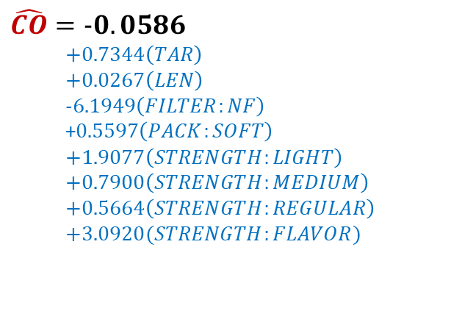
Final Regression Equation (after deleting some variables)
$$\hat{CO}=−0.0586$$
$$+0.7344\left(TAR\right)$$
$$+0.0267\left(LEN\right)$$
$$−6.1949\left(FILTER:NF\right)$$
+$0.5597\left(PACK:SOFT\right)$
$$+1.9077\left(STRENGTH:LIGHT\right)$$
$$+0.7900\left(STRENGTH:MEDIUM\right)$$
$$+0.5664\left(STRENGTH:REGULAR\right)$$
$$+3.0920(STRENGTH:FLAVOR)$$

Slide 96
Final Regression Equation (after deleting some variables)
Prediction Input
$$\hat{CO}=−0.0586$$
$$+0.7344\left(TAR\right)$$
$$+0.0267\left(LEN\right)$$
$$−6.1949\left(FILTER:NF\right)$$
+$0.5597\left(PACK:SOFT\right)$
$$+1.9077\left(STRENGTH:LIGHT\right)$$
$$+0.7900\left(STRENGTH:MEDIUM\right)$$
$$+0.5664\left(STRENGTH:REGULAR\right)$$
$$+3.0920(STRENGTH:FLAVOR)$$
12
80
0
0
1
0
0
0

Slide 97

Final Regression Equation (after deleting some variables)
$$\hat{CO}=−0.0586$$
$$+0.7344\left(12\right)$$
$$+0.0267\left(80\right)$$
$$−6.1949\left(0\right)$$
+$0.5597\left(0\right)$
$$+1.9077\left(1\right)$$
$$+0.7900\left(0\right)$$
$$+0.5664\left(0\right)$$
$$+3.0920(0)$$
=12.79 (predicted CO)

