Slide 1

Unit 7: Multiple linear regression
2. Model Selection, Diagnostics, Transformations & Case Study
Sta 101 – Spring 2019
Duke University, Department of Statistical Science
Dr. Ellison
Slides posted at https://www2.stat.duke.edu/courses/Spring19/sta101.001/

Slide 2
Outline
1. Housekeeping
2. Application Exercise 7.1
3. Transformations
4. Case Study

Slide 3
Coming up…
▶ Project Stage 2 Materials due 4/17 11:55pm (html file, RMD file, slides)
▶ Project Stage 2 Presentations 4/18
▶ Problem Set 7 and Performance Assessment 7 Sunday 4/21 11:55pm
--------------------------------------------------------------------------------
▶ Don’t forget to ask/answer 2 questions on Piazza before the final exam… part of your participation grade! Memes don’t count ☺
▶ TA office hours officially end after 4/24!
▶ 1-2 review sessions outside of class during reading period… scheduling poll coming soon!
Announcements

Slide 4
Outline
1. Housekeeping
2. Application Exercise 7.1
3. Transformations
4. Case Study

Slide 5
Outline
1. Housekeeping
2. Application Exercise 7.1
3. Transformations
4. Case Study

Slide 6
Outline
What can we try if our linear model does not meet all the conditions?
25000
●
●
20000
●
●
●
15000
●
●
●
price
● 
10000
●
●
●
●
●
●
●
●
●
5000
●
● 
●  
● 
●
●   
● 
● 
●
●
●
● 
●
●
1980
1990
year
2000

Slide 7
Truck prices
The scatterplot below shows the relationship between year and price of a random sample of 43 pickup trucks. Describe the relationship between these two variables.
25000
●
●
20000
●
●
●
15000
●
●
●
price
● 
10000
●
●
●
●
●
●
●
●
●
5000
●
● 
●  
● 
●
●   
● 
● 
●
●
●
● 
●
●
1980
1990
year
2000
From: http://faculty.chicagobooth.edu/robert.gramacy/teaching.html

Slide 8
Remove unusual observations
Let’s remove trucks older than 20 years, and only focus on trucks made in 1992 or later.

Slide 9
Remove unusual observations
Let’s remove trucks older than 20 years, and only focus on trucks made in 1992 or later.
Now what can you say about the relationship?
25000
●
●
20000
●
●
●
15000
●
●
●
price
●
●
10000
●
●
●
●
●
●
●
●
●
●
●
5000
●
● 
●  
●
●
●
●
●
●
● 
●
●
●
●
●
1996
2000
year
2004
2008

Slide 10
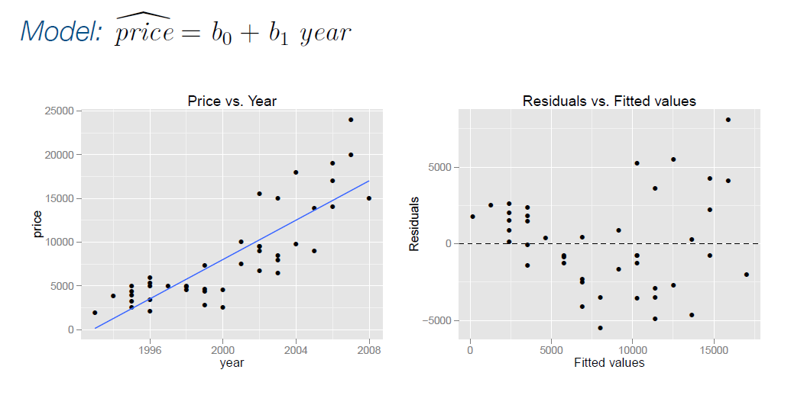
Truck prices - linear model?

Slide 11
Truck prices - linear model?
The linear model doesn’t appear to be a good ﬁt since the residuals have non-constant variance.

Slide 12
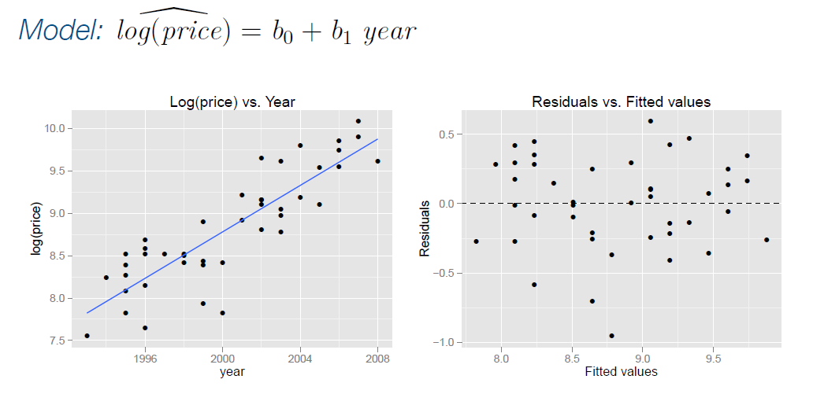
Truck prices - log transform of the response variable
*In this class and many other statistics classes, we refer to “log( )” as the natural log (ie: ln( ) or loge( ).)

Slide 13
Truck prices - log transform of the response variable
*In this class and many other statistics classes, we refer to “log( )” as the natural log (ie: ln( ) or loge( ).)
We applied a log transformation to the response variable. The relationship now seems linear, and the residuals no longer have non-constant variance.

Slide 14
Estimate Std. Error t value Pr(>|t|) (Intercept) -265.073 25.042 -10.585 0.000
year 0.137 0.013 10.937 0.000
Interpreting models with log transformation

Slide 15

Estimate Std. Error t value Pr(>|t|) (Intercept) -265.073 25.042 -10.585 0.000
year 0.137 0.013 10.937 0.000
Interpreting models with log transformation
Model: $\hat{\log\left(price\right)=}$ −265.073 + 0.137 year

Slide 16
Estimate Std. Error t value Pr(>|t|) (Intercept) -265.073 25.042 -10.585 0.000
year 0.137 0.013 10.937 0.000
Interpreting models with log transformation
▶ Less Useful Interpretation (using the standard way of interpreting regression slopes): “For each additional year the car is newer (for each year decrease in car’s age) we would expect the log price of the car to increase on average by 0.137 log dollars."
▶ which is not very useful...
Model: $\hat{\log\left(price\right)=}$ −265.073 + 0.137 year
?

Slide 17
Working with logs
▶ Subtraction and logs: log(a) − log(b) =
*In this class and many other statistics classes, we refer to “log( )” as the natural log (ie: ln( ) or loge( ).)

Slide 18
Working with logs
a
▶ Subtraction and logs: log(a) − log(b) = log( )
b
*In this class and many other statistics classes, we refer to “log( )” as the natural log (ie: ln( ) or loge( ).)

Slide 19
Working with logs
a
▶ Subtraction and logs: log(a) − log(b) = log( )
b
▶ Natural logarithm: e^{log(x)} =
*In this class and many other statistics classes, we refer to “log( )” as the natural log (ie: ln( ) or loge( ).)

Slide 20
Working with logs
a
▶ Subtraction and logs: log(a) − log(b) = log( )
b
▶ Natural logarithm: e^{log(x)} = x
*In this class and many other statistics classes, we refer to “log( )” as the natural log (ie: ln( ) or loge( ).)

Slide 21
Working with logs
a
▶ Subtraction and logs: log(a) − log(b) = log( )
b
▶ Natural logarithm: e^{log(x)} = x
▶ We can these identities to “undo” the log transformation for better interpretation.
*In this class and many other statistics classes, we refer to “log( )” as the natural log (ie: ln( ) or loge( ).)

Slide 22
Interpreting models with log transformation (cont.)
The Less Useful Interpretation “For each additional year the car is newer (for each year decrease in car’s age) we would expect the log price of the car to increase on average by 0.137 log dollars."
Putting this in mathematical equation form:
log(price at year x + 1) − log(price at year x) = 0.137

Slide 23
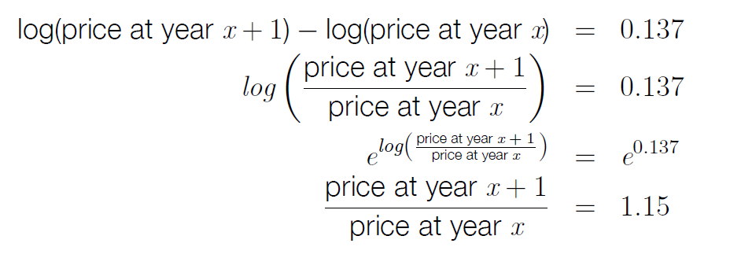
Interpreting models with log transformation (cont.)
Manipulating this equation (with log properties) to get a better interpretation of a slope:

Slide 24
Interpreting models with log transformation (cont.)
Manipulating this equation (with log properties) to get a better interpretation of a slope:
Logarithm properties

Slide 25
Interpreting models with log transformation (cont.)
Manipulating this equation (with log properties) to get a better interpretation of a slope:
Logarithm properties

Slide 26
Interpreting models with log transformation (cont.)
Manipulating this equation (with log properties) to get a better interpretation of a slope:
Logarithm properties

Slide 27
Interpreting models with log transformation (cont.)
Manipulating this equation (with log properties) to get a better interpretation of a slope:
How do we interpret this now?

Slide 28
Interpreting models with log transformation (cont.)
Manipulating this equation (with log properties) to get a better interpretation of a slope:
Correct Interpretation: “For each additional year the car is newer (for each year decrease in car’s age) we would expect the price of the car, on average, to increase by a factor of 1.15."

Slide 29
Interpreting models with log transformation (cont.)
Manipulating this equation (with log properties) to get a better interpretation of a slope:
Correct Interpretation: “For each additional year the car is newer (for each year decrease in car’s age) we would expect the price of the car, on average, to increase by 15%."

Slide 30
Interpreting models with log transformation (cont.)
Manipulating this equation (with log properties) to get a better interpretation of a slope:
INCORRECT Interpretation: For each additional year the car is newer (for each year decrease in car’s age) we would expect the price of the car, on average, to increase on average by 1.15 dollars.

Slide 31
Outline
What can we try if our linear model does not meet all the conditions?
25000
●
●
20000
●
●
●
15000
●
●
●
price
● 
10000
●
●
●
●
●
●
●
●
●
5000
●
● 
●  
● 
●
●   
● 
● 
●
●
●
● 
●
●
1980
1990
year
2000

Slide 32
▶ Non-constant variance is one of the most common model violations, however it is usually ﬁxable by transforming the response (y) variable
Recap: dealing with non-constant variance

Slide 33
▶ Non-constant variance is one of the most common model violations, however it is usually ﬁxable by transforming the response (y) variable
▶ The most common variance stabilizing transform is the log transformation: log(y), especially useful when the response variable is (extremely) right skewed.
Recap: dealing with non-constant variance

Slide 34
Recap: dealing with non-constant variance
▶ When using a log transformation on the response variable the interpretation of the slope changes:
Numerical Explanatory Variable x Interpretation:
e^{b1}<1
"For each unit increase in x, y is expected, on average, to decrease by a factor of e^{b1} .”
"For each unit increase in x, y is expected, on average, to decrease (1-e^{b1})%”.
e^{b1}>1
"For each unit increase in x, y is expected, on average, to increase by a factor of e^{b1} .”
"For each unit increase in x, y is expected, on average, to increase (e^{b1}-1)%”.

Slide 35
Recap: dealing with non-constant variance
▶ When using a log transformation on the response variable the interpretation of the slope changes:
Categorical Predictor Interpretation:
e^{b1}<1
“This predictor level is expected to have, on average, lower y than the reference level by a factor of e^{b1} ."
“This predictor level is expected to have, on average, a (1-e^{b1})% lower y than the reference level.
e^{b1}>1
“This predictor level is expected to have, on average, higher y than the reference level by a factor of e^{b1} ."
“This predictor level is expected to have, on average, a (e^{b1}-1)% higher y than the reference level.

Slide 36

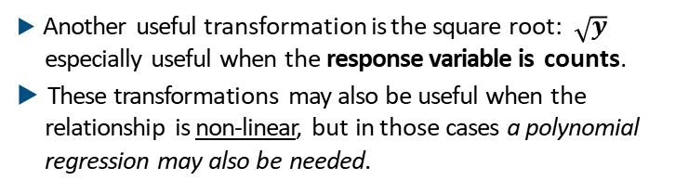
Recap: dealing with non-constant variance
▶ Another useful transformation is the square root: $\sqrt{y}$ especially useful when the response variable is counts.
▶ These transformations may also be useful when the relationship is non-linear, but in those cases a polynomial regression may also be needed.
$$\hat{y}=b_{0}+b_{1}x+b_{2}x^{2}$$

Slide 37
Outline
1. Housekeeping
2. Application Exercise 7.1
3. Transformations
4. Case Study

Slide 38
Data from the ACS
income: Yearly income (wages and salaries)
employment: Employment status, not in labor force, unemployed, or employed
hrs_work: Weekly hours worked
race: Race, White, Black, Asian, or other
age: Age
gender: gender, male or female
citizens: Whether respondent is a US citizen or not
time_to_work: Travel time to work
lang: Language spoken at home, English or other
married: Whether respondent is married or not
edu: Education level, hs or lower, college, or grad
disability: Whether respondent is disabled or not
birth_qrtr: Quarter in which respondent is born, jan thru mar, apr thru jun, jul thru sep, or oct thru dec

Slide 39
Load and subset data
acs_emp <- acs >
filter(employment == "employed", income > 0)

Slide 40
acs_emp > select(employment) > table()
Aside: categorical (factor) variables in R

Slide 41
acs_emp > select(employment) > table()
Aside: categorical (factor) variables in R
not in labor force | unemployed | employed
0 | 0 | 787

Slide 42
Aside: categorical (factor) variables in R
acs_emp > select(employment) > table()
not in labor force | unemployed | employed
0 | 0 | 787
acs_emp <- droplevels(acs_emp) # overwrite acs_emp
acs_emp > select(employment) > table()
*The inference() function may give you errors if your dataframe has had some of it’s original levels filtered completely out and you don’t run the droplevels() function.
employed
787

Slide 43
Full model
Suppose we only want to consider the following explanatory variables: hrs_work, race, age, gender, citizen.
m_full = lm(income ~ hrs_work + race + age + gender
+ citizen, data = acs_emp)

Slide 44
Suppose we only want to consider the following explanatory variables: hrs_work, race, age, gender, citizen.
Full model
m_full = lm(income ~ hrs_work + race + age + gender
+ citizen, data = acs_emp)
Estimate Std. Error t value Pr(>|t|) (Intercept) -17215.60 11399.81 -1.51 0.13
hrs_work | 1251.31 | 153.14 | 8.17 | 0.00
raceblack | -13202.39 | 6373.05 | -2.07 | 0.04
raceasian | 32699.34 | 8903.66 | 3.67 | 0.00
raceother | -12032.88 | 7556.78 | -1.59 | 0.11
age | 760.99 | 129.71 | 5.87 | 0.00
genderfemale | -17246.91 | 3887.17 | -4.44 | 0.00
citizenyes | -9537.20 | 8360.85 | -1.14 | 0.25

Slide 45
Diagnostics -- code
m_full = lm(income ~ hrs_work + race + age + gender
+ citizen, data = acs_emp)
# residuals vs. fitted
qplot(data = m_full, y = .resid, x = .fitted, geom = "point") + geom_hline(yintercept = 0, linetype = "dashed") + xlab("Fitted values") +
ylab("Residuals") +
ggtitle("Residuals vs. Fitted values")
# histogram of residuals
qplot(data = m_full, x = .resid, geom = "histogram") + xlab("Residuals") +
ggtitle("Histogram of residuals")
# normal prob plot of residuals
qplot(data = m_full, sample = .resid, stat = "qq") + ggtitle("Normal probability plot of residuals")
# order of residuals
qplot(data = m_full, y = .resid) + geom_hline(yintercept = 0, linetype = "dashed") + ylab("Residuals") +
xlab("Order of data collection") +
ggtitle("Residuals vs. Order of data collection")

Slide 46
Diagnostics
What do you think? (Response Variable = Income)
1
2
Residuals vs. Fitted values Histogram of residuals
●
●
3e+05
● 
● 
●
●

150
●

2e+05
●
●
●
●
Residuals
●
count
100
●

●   
1e+05
●  
●  
● 
●
       
● 
     
●
50
       
0e+00
●   ●      ●   
●   
●       
●       
● 
●   
     
●          
      
    ● 
−1e+05
●   
● 
0
●
0
50000
Fitted values
100000
150000
−1e+05 0e+00 1e+05 2e+05 3e+05 4e+05
Residuals
3
4
Normal probability plot of residuals
Residuals vs. Order of data collection
●
●
●
●
3e+05

3e+05
● 
●
●
●


●
●
●
●
●
●
●
●
●
2e+05
●
2e+05
●
●
Residuals
●
●
sample
●
●
●
●

●
●
●
●
●
●
1e+05
●
1e+05
●
●
●
●
●  
●
●
●
●
●
●
● 
● 
●
●
●
●
●
●
●
●
     
●   
● 
●
 
●

●
●

●     
● 
             
0e+00
●
0e+00
● 
●   
     
● 
●
  
● 
●             
● 
   
                 
●
●              
●
● 
 
●
●   
●  
       
● 
● 
        
  
●

●  
●
●
●  
●

●  
● 
−1e+05


−1e+05
●
● 
●    
● 
●
●
●
−2
0
theoretical
2
0
200 400
600
800
Order of data collection

Slide 47
Diagnostics
What do you think? (Response Variable = Income)
1
Residuals vs. Fitted values
●
●
3e+05
● 
● 
●
●

●

2e+05
●
●
●
●
Residuals
●
●

●   
1e+05
●  
●  
● 
●
       
● 
     
●
       
0e+00
●   ●      ●   
●   
●       
●       
● 
●   
     
●          
      
    ● 
−1e+05
●   
● 
●
0
50000
Fitted values
100000
150000
Linearity Condition: Scatter mostly above the line, then mostly below the line as fitted values increases → most likely not linear.
Constant Variance of Residuals Condition: Variance of residuals increases (not constant) as fitted values increases → constant variance of residual condition not met.

Slide 48
Diagnostics
What do you think? (Response Variable = Income)
2
Histogram of residuals
150
100
50
0
−1e+05 0e+00 1e+05 2e+05 3e+05 4e+05
Residuals
3
Normal probability plot of residuals
Normality of Residuals Condition: The distribution of the residuals is right skewed… condition not met.
3e+05

●

●
●
●
2e+05
●
●
sample
●
●
●
1e+05
●
●
●
●
●
●
0e+00
● 
●

● 
●
● 
−1e+05


●
−2
0
theoretical
2

Slide 49
Diagnostics
What do you think? (Response Variable = Income)
Independence of Residuals Condition:
No clear structure/pattern in residuals as order of data collection (“time”) increases, so this data has no time-series structure… so independence of residuals not violated via a time series relationship.
Should also check to see if data is collected via random sampling /assignment and meets the 10% rule, if not this would also violate independence.
4
Residuals vs. Order of data collection
●
●
3e+05
● 
●
●
●

●
●
●
●
●
●
●
Residuals
2e+05
●
●
●
1e+05
●
●

●
●
●
●
●
●
●  
●
●
●
●
●
● 
● 
●
●
●
●
●
●
●
●
     
●   
● 
 
●
●

●     
● 
             
0e+00
● 
●   
     
●
  
●             
● 
   
                 
●              
●
● 
 
●
●   
●  
       
● 
        
  
●

●  
●
●
●  
●

●  
● 
−1e+05
●
● 
●    
● 
●
●
0
200 400
600
800
Order of data collection

Slide 50
Diagnostics -- code
m_full_log = lm(log(income) ~ hrs_work + race + age + gender
+ citizen, data = acs_emp)
# residuals vs. fitted
qplot(data = m_full_log, y = .resid, x = .fitted, geom = "point") + geom_hline(yintercept = 0, linetype = "dashed") + xlab("Fitted values") +
ylab("Residuals") +
ggtitle("Residuals vs. Fitted values")
# histogram of residuals
qplot(data = m_full_log, x = .resid, geom = "histogram") + xlab("Residuals") +
ggtitle("Histogram of residuals")
# normal prob plot of residuals
qplot(data = m_full_log, sample = .resid, stat = "qq") + ggtitle("Normal probability plot of residuals")
# order of residuals
qplot(data = m_full_log, y = .resid) + geom_hline(yintercept = 0, linetype = "dashed") + ylab("Residuals") +
xlab("Order of data collection") +
ggtitle("Residuals vs. Order of data collection")

Slide 51
Log transformation
What do you think? (Response Variable = log(Income))
Residuals vs. Fitted values Histogram of residuals
● 
2
●
● 
 
●
●
● 
● 
●
●
90
● 
      

●
     
●
●    
●
●       
  
●
●
Residuals
●           
            
0
● 
●
●      ●  
●
count
            ●  
●
●          
60
●            
●
● 
●   
       

●         
●  
       
●         
●           
●     
● 
● 
●
●       
−2
●
●
●  
●
●
●
●
●
●
30
●
●
●
−4
●
●
●
0
8
10
Fitted values
12
−5.0
−2.5
0.0
Residuals
2.5
Normal probability plot of residuals
Residuals vs. Order of data collection
● 
●
●
2

●
● 
2
●  
●
●
●
●
●
●
●
●
  
●
●    
●
●

●  
●
●  
●
●  
●
●
●
●      
●
● 
●
●                
●
●       ● 

●
●     
●    ● 
●     
● 
Residuals
●           
●              ●    ●  
●                    
sample
0
● 
0
●     
●
●                 
● 
●                     
              ● 
●  
●           
●
●
●            ●    
●
● 
●
●               
●
●     
●
  
●
●
   
●
● 
●
●       
● 
●
●    
● 
●
●  
−2
●
−2
●     
●
●
● 
●
● 
●
●  
● 
●
●     
●
●
●
●
●
●
●
●


●
●
−4
●
−4
●
●
●
●
●
●
●
●
−2
0
theoretical
2
0
200 400
Order of data collection
600
800

Slide 52
Diagnostics
What do you think? (Response Variable = log(Income))
1
Residuals vs. Fitted values
● 
2
●
● 
 
●
●
● 
● 
●
●
● 
      

●
     
●
●    
●
●       
  
●
●
Residuals
●           
            
0
● 
●
●      ●  
●
            ●  
●
●          
●            
●
● 
●   
       

●         
●  
       
●         
●           
●     
● 
● 
●
●       
−2
●
●
●  
●
●
●
●
●
●
●
●
●
−4
●
●
●
8
10
Fitted values
12
Linearity Condition: Scatter distributed roughly evenly above/below the line as fitted values increase. → roughly linear.
Constant Variance of Residuals Condition: Variance of residuals roughly constant as fitted values increases → constant variance is met.

Slide 53
Diagnostics
What do you think? (Response Variable = log(Income))
2
Histogram of residuals
90
count
60
30
0
−5.0
−2.5
0.0
Residuals
2.5
Normality of Residuals Condition: The distribution of the residuals is roughly normal and centered at 0. Condition met.
Normal probability plot of residuals
● 
2

●
● 
●
●
●
●
●
●
sample
0
● 
● 
Residuals
●
●
● 
●
●
●
●
−2
●
●
●
●
●
●
●


●
−4
●
●
−2
0
theoretical
2

Slide 54
Diagnostics
What do you think? (Response Variable = log(Income))
Independence of Residuals Condition:
No clear structure/pattern in residuals as order of data collection (“time”) increases, so this data has no time-series structure… so independence of residuals not violated via a time series relationship.
Should also check to see if data is collected via random sampling /assignment and meets the 10% rule, if not this would also violate independence.
Residuals vs. Order of data collection
●
●
2
●  
●
●
●
●
●
●
  
●
●    
●
●

●  
●  
●
●  
●
●
●      
●
● 
●
●                
●       ● 

●     
●    ● 
●     
Residuals
●           
●              ●    ●  
●                    
0
●     
●                 
●                     
              ● 
●  
●           
●            ●    
●
● 
●               
●     
●
  
●
   
●
● 
●       
● 
●    
● 
●
●  
−2
●     
●
●
● 
● 
●
●  
● 
●     
●
●
●
●
●
●
●
−4
●
●
●
●
●
●
●
0
200 400
Order of data collection
600
800

Slide 55
Application exercise: 7.2 Interpreting models with a transformed
response
See course website for more details

Slide 56
